Slide 1
Engineering Standards
Capstone Design Spring 2019

Slide 2
What is an Engineering Standard?
A document that defines an agreed-upon way to doing something.
Product Design – ex. OSHA standards
Operation/Process – ex. ISO9000 Quality Management
Manufacturing – ex. RoHS1 (Restriction of Hazardous Substances)
Product Use – ex. ANSI Z136 Laser Safety Standards
Regulations (codes) specify mandatory standards to protect public safety and health
Enforced
Regulatory Agencies: EPA, FDA, OSHA, etc.
(www.ansi.org)

Slide 3
Why?
Protect human health and Safety
Protect environment
Ensure compatibility (interoperability / interchangeability)
Make our lives easier

Slide 4
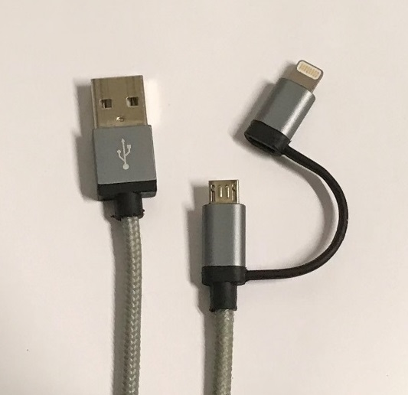
Standardization Everywhere!!
Capstone Design
Language: 日本語 English
Posters: MS Power Point, not Adobe Illustrator
Engineering Drawings: SoE template used in the CAD course
Safety: SoE Safety Guidelines
Cell Phone Chargers
Charger Side: USB Type A
Android: USB Micro B (Newer models may have Type C.)
Apple: Lightning
Incompatible Android ≠ iPhone
Lightning
A
Micro B

Slide 5
Application of Engineering Standards in Capstone Design
Requirements and Constraints
Engineering Communication (Standard Notations)
SoE Engineering drawing template
Coding style guide
Using standard notations in analyses, such as UML and BPMN
Using Known Solutions and Best Practices
Choosing an electric wire using AWG
Implement a standard protocol, such as HTTP
ASTM test methods
Cost Reduction by Using Standard Sizes of Materials and Components
Sheet metal – standard Gauge (thickness)
Software libraries

Slide 6
To Study Further
Engineering Standards in Our EDN
https://designlab.eng.rpi.edu/edn/projects/capstone-support-dev/wiki/Standards
Standards Education Database
https://www.standardslearn.org/trainingcourse.aspx
179 courses listed (as of January 2019)
ex. ASME, ASTM International, IEEE, etc.
Standards Activities Overview
https://www.ansi.org/standards_activities/overview/overview

Slide 7
Q&A

Slide 8
Type of Standards
Internal standards
Example: SoE engineering drawing template
DE fact standards
Example: MS Windows and Office Suite
Industry standards
Organizations: W3C (World Wide Web Consortium, OASIS (Organization for the Advancement of Structured Information Standards)
Accredited standards
Organizations: ANSI, ISO, etc.
Regulations
Organizations: EPA, FDA, etc.

Slide 9
Engineering Standards in Design
Requirements and
Compatibility (Interoperability and Interchangeability)
Test Methods and Reference Materials

