Slide 1
Introduction to using the Electronic Design Notebook for Capstone Design
Mark Anderson
Aren Paster
The Design Lab at Rensselaer
Rensselaer Polytechnic Institute
Based on a presentation given by
Junichi Kanai and Mark Anderson at the
ASEE St. Lawrence Section 2012 Conference March 24, 2012
Notes:
Revised 10/26/2022

Slide 2
Outline
What is the Electronic Design Notebook (EDN)?
Terminology and Definitions
Implementation – EDN in The Design Lab
Best Practices
Conclusions

Slide 3
What is the Electronic Design Notebook?
A project management, documentation, and bug-tracking tool
Includes a calendar and Gantt chart to aid visual representation of projects and their deadlines
Supports multiple projects
Provides integrated project management features, issue tracking, and support for multiple version control options
Web-based
Free and open source
Similar to tools used in industry
Adapted from http://en.wikipedia.org/wiki/Redmine, accessed 3/14/2012
Notes:
It was influenced by Trac, a software management / bug tracking tool.
The terminology is slightly software oriented but still applies to the various engineering disciplines

Slide 4
Why Capstone uses EDN
Engineering Functions
Record Keeping
Technical Discussions
Revision Control
Project / Task Management
IT Related
Available Technical Support
Backups
Secure
Academic Related
Visibility of Student Work
User Statistics
EDN Usage Supports Our Capstone Approach
Notes:
Open Source Software

Slide 5
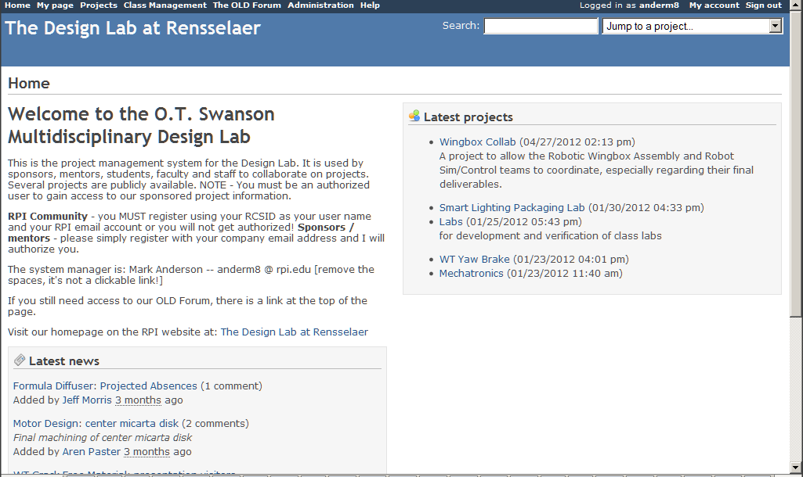
RPI Design Lab site
If it doesn’t say
“The Design Lab at Rensselaer”
then you are NOT ON OUR SITE!
Go to https://designlab.eng.rpi.edu

Slide 6
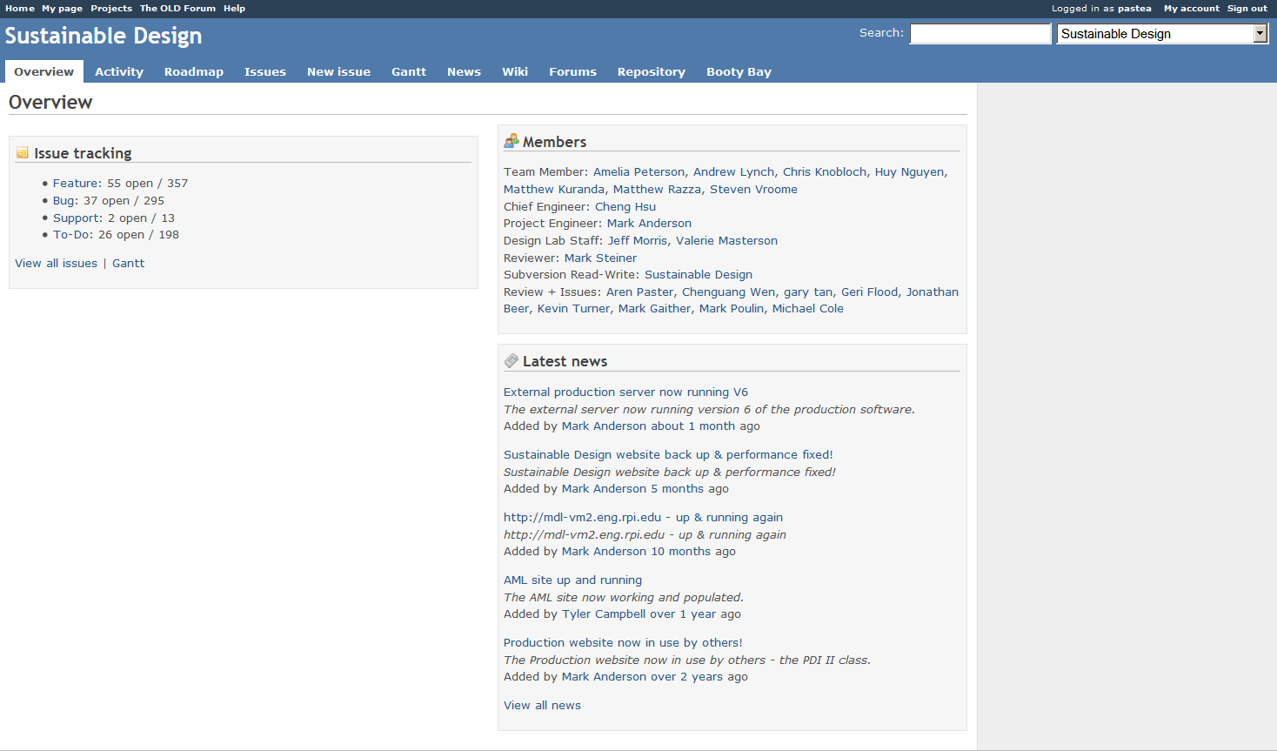
Sample Capstone Project Home Page

Slide 7
List of Electronic Design Notebook features
Overview – summary of issues, users and latest news
Activity – shows recent posts, changes made throughout the project (can specify based on what the user is looking to search for)
Roadmap – dynamically generated display of issues and their related “versions”
Issues – task tracking
Gantt – dynamically generated Gantt chart schedule based on issues and versions that have been created
Calendar – provides a view of the issues in a typical calendar mode
News – posting for general announcement (more pertinent for large groups)
Wiki – to collect shared knowledge, facts, data, etc…
Forums – for discussion of topics
Repository – for shared files with version control (a web display of the data that is integrated with an SVN client installed on users’ computers)
Booty Bay – shared resource management (i.e. loaning equipment, books)
Settings – allows user to adjust system settings for this particular project
Notes:
Redmine was initially developed to address software related projects and some of it’s terminology comes from that background.

Slide 8
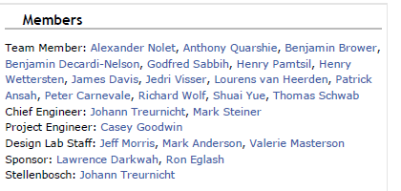
User Roles
These are Roles
Roles and Associated Project Members
Can Be Seen on the Overview Page
Each Role may have different privileges

Slide 9
Terminology
Standard Project Management Term | EDN Equivalent Term
Milestone | Version
Task | Issue
Electronic Design Notebook Terms
Tracker – used to filter Issues when displaying the Issues as a list or a Gantt chart
This is the “type” of issue.
Separates day to day “To-Do” items from “Gantt Chart” items
Category – used to filter Issues when displaying the Issues as a list or a Gantt chart
Can be used to group Issues
Can be used to separate the subsystems in your project

Slide 10
Project Management
Identify project tasks and create them as “Issues”
Assign task owner (“Assignee”) and due date
Not every task has to start today!
All tasks don’t end at the same time
On a regular basis, USE the “Issues” list to manage team activities
For multi-semester projects, review any open issues and re-plan them as needed. Do not simply close them!

Slide 11
Project Management
Effective use of Trackers – Used Across All Projects
To-Do – used for action items, various task assignments, things to be done
Features – once a baseline of functionality has been defined, NEW features or functions can be tagged with this Tracker
Bugs – these are used for any artifact that has been created but has errors. This includes software, fabricated parts, CAD models / drawings, documentation, etc.
Effective use of Categories – Unique to Your Project
Define categories that match your team’s Work Breakdown Structure (WBS) or Subsystems
Examples – Software, Hardware, Documentation, Maintenance, Project Management, Circuitry, Instrumentation, Assembly, Testing, Fabrication, etc.
Can also be used to represent major subsystems
Examples – Frame, Base, Packaging, Power Source, Controller, Optics, etc.
Do NOT create one called “To-Do”! There is already a tracker for that!
Do NOT create them based on people’s names
Use the Filters in the Issues listing to focus on the specific group of issues needed. From the above examples:
Open To-Do items for Packaging
Open Bugs in the CAD model
Open Features in the Software
Lets You Look At / Focus On
the Key Issues

Slide 12
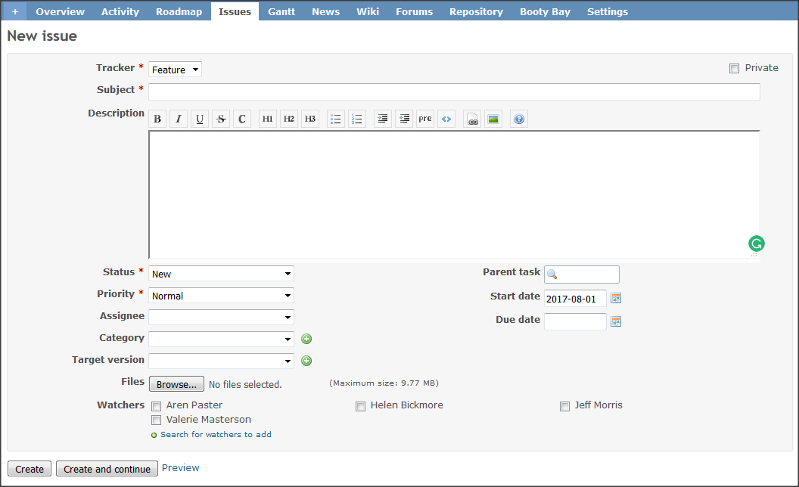
Defining “Issues” (Tasks)
Trackers: Feature / Bug / To Do
Allows
Filtering
Issues without Due Date will NOT be shown on Gantt Chart
Supports Issue (Task)
Hierarchy
Start Date
defaults to ‘today’
Automatically Keep Team Members Up to Date
Notes:
Be specific in describing the issue.
Be action oriented. Be clear what the results are or need to be.
Provide a due date and be sure to assign an owner as soon as possible.

Slide 13
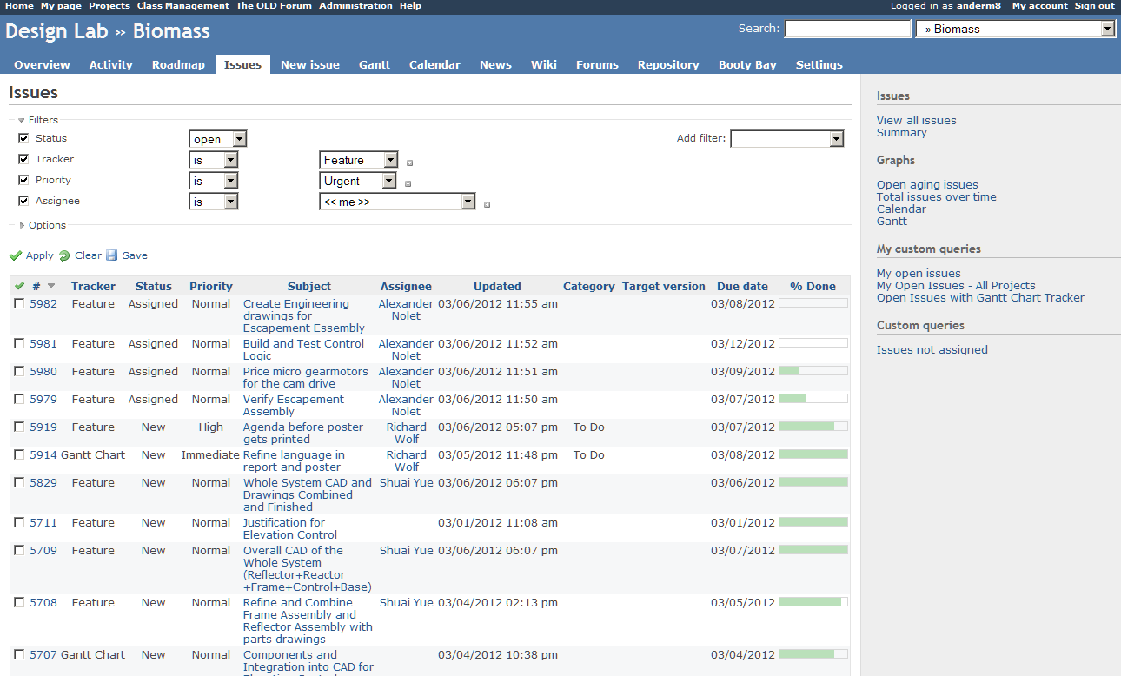
Using “Issues”
Filters can be defined to focus on specific issues
Issues With Varying
% Complete
Note – the above filter has not yet been applied!
Notes:
The filters selected in this screenshot have NOT yet been applied to the Issue list shown
Can sort by any column. Can create complex filters to focus on details – such as all urgent tasks, all tasks assigned to a team member, everything due at a certain version, etc.

Slide 14
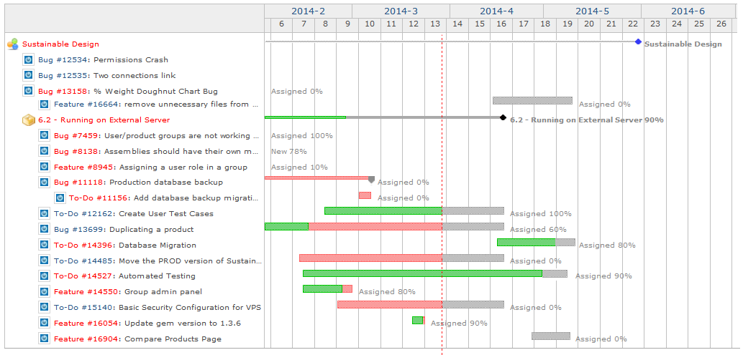
Task-Oriented Project Management Proactively Using Issues
Week numbers
Gantt Chart to View and Manage Project Status is
automatically
created from the Issues
Red line indicates ‘today’
On Time
Ahead
Late
New
Assigned
Closed
Working
Lifecycle of an Issue
Notes:
When any team member finds “something”, record it as a New Issue. When it’s reviewed, Assign if to an owner. When a second person determines it is complete, mark it Closed.

Slide 15
Implementing Your Gantt Chart in EDN
Pre-Plan on Paper or Whiteboard
Define Versions - Description / Date
Define Issues - Description / Dates / Owner
Tie Issues to Versions
Define Relationships between Issues (Precedes / Follows)
Implement in EDN
Define Versions
Define Issues
Update Based on Project Execution

Slide 16
Turn SOW Deliverables into Versions
Currently Defined Versions
After your Statement of Work is submitted…
Your team should create a Version (NOT an Issue!) for each of the Deliverables you listed on the SOW.
Define New Version

Slide 17
Creating Categories
Create Categories to help organize the issues. Usually teams create categories that match their Work Breakdown Structure such as:
Modules
Subsystems
Deliverables
Do NOT create a category called “To Do”. There is already a Tracker for that!

Slide 18
Creating Issues
Clearly define the issue
Reference corresponding forum posting for discussion and artifact collection with link
Be specific!
Be action oriented
Be clear on what the result of the issue is
Provide a Due Date (issues will not be visible on the Gantt Chart view without a due date!)
Assign an Owner, Category, and Version
Add additional team members as watchers
Create Parent / Child relationships to group issues together
Create Follows / Precedes relations to show the sequence of issues (can only be done after creation)

Slide 19
Managing EDN Issues
A new task (issue) is identified
A task is created and assigned to team member
New issue
A task (issue) is created (opened)
New
0%
Assigned
10%
Working
50%
Ready to Close
100%
Closed
The task is
assigned to you
You start working on the task
You finish the task
Your work is reviewed and approved by PE/CE
Note: When the task status is changed, EDN automatically updates “% Done.”

Slide 20
Exceptions to Standard Workflow
You create a new task and immediately start the work
You are assigned an existing task and immediately start the work
Your work is reviewed and
found to be incomplete by your teammate/PE/CE
New issue
New
0%
Assigned
10%
Working
50%
Ready to Close
100%
Closed

Slide 21
Issues and SCRUM
The following table maps the SCRUM workflow to the Issue workflow.
SCRUM | Backlog | In Progress | In Progress | Review | Done
Issue Status | New | Assigned | Working | Completed | Closed
Action | Define a feature (task) | Assign a task to a team member | Work on the task | Review/Inspect the output(s) | Close the issue

Slide 22
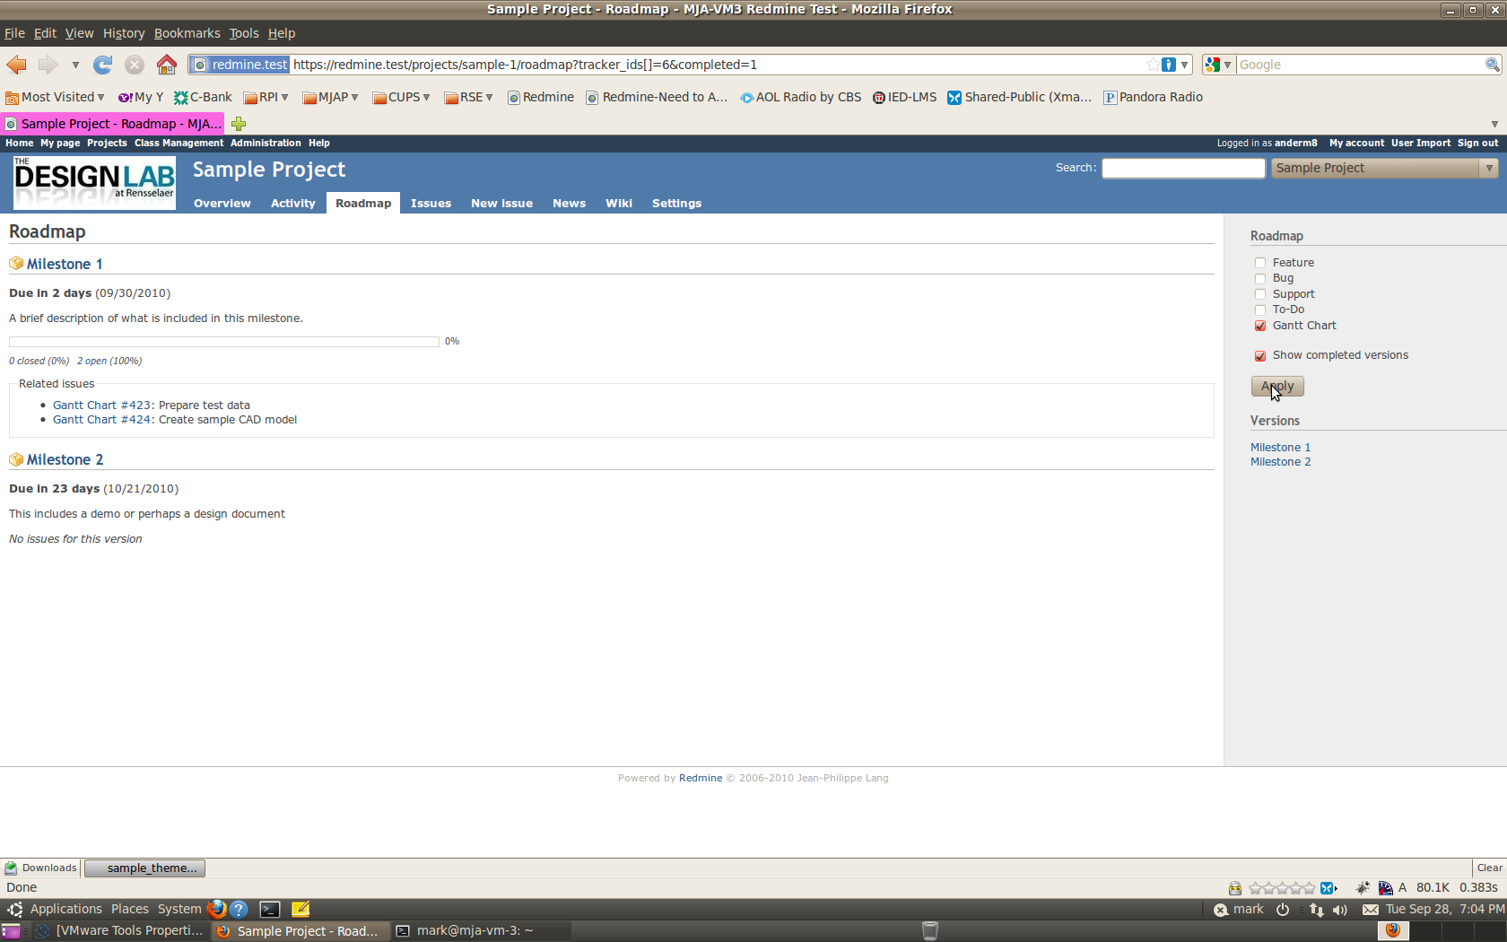
Showing Your Roadmap
List of milestones
There will be a list of the tasks needed to reach this milestone.
Completed tasks will have a line through them.
Nothing has been planned for this milestone yet

Slide 23
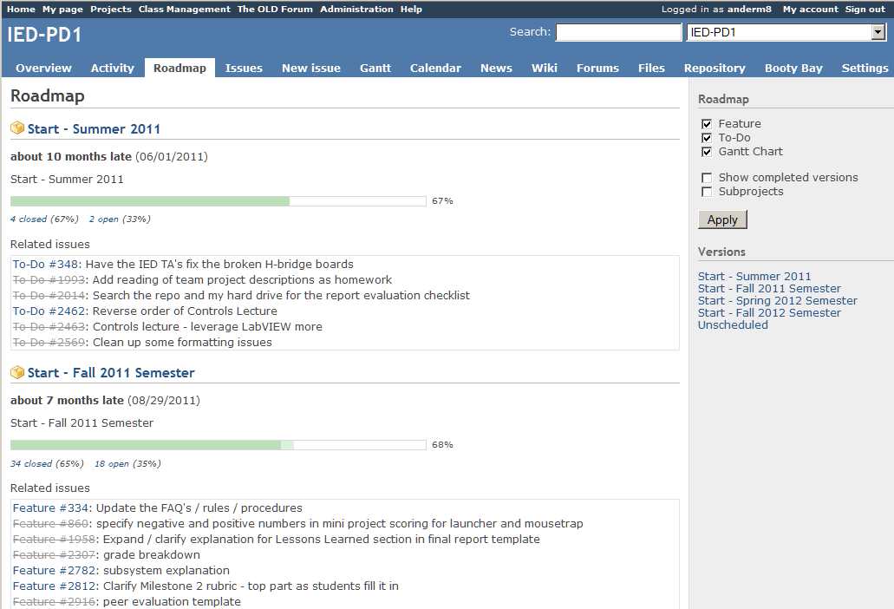
Using the Project Roadmap
Version
Overall Status of the Version
Done!
Can Jump to Any Version
Issues = Tasks
Versions = Milestones
Notes:
Quick way to see what’s coming up!

Slide 24
Project Management Best Practice
On a Regular Basis:
Review open items
Ensure all items are assigned to an owner
There should be an owner
Verify assigned owner is the proper one
Is there a due date?
Is Status correct?
Address problems associated with completing issues
Use Gantt chart view – it’s the industry standard
Try the Calendar view and see if you like it!

Slide 25
Wikis
Can be used to collaboratively compile information
Should be organized by ‘function’ rather than by ‘team member’
The Capstone Support Wiki has course-wide reference material
Sample of a ‘typical’ project wiki page:
https://designlab.eng.rpi.edu/redmine/projects/capstone-support-dev/wiki/Typical_Home_Page

Slide 26
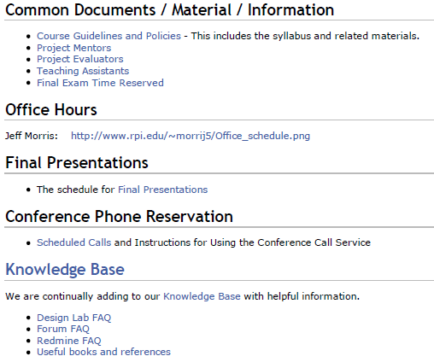
Capstone Support Wiki
Two Primary Usages
Creation of Collaborative Documentation
Shared
Knowledge Base

Slide 27
Creating a New Wiki Page
Go to an Existing Page
Edit
For a new page called “New Page” enter the following (those are square brackets):
[[New Page]]
That creates a link to the new page.
Save the page
Click on the link you just created
It will take you to the new page in edit mode
Enter your material
Preview to verify layout/format is acceptable
Save the new page
Done!

Slide 28
Discussion “Forums”
Each Semester Has a Common Set of Forums
Background Info
PE/CE Feedback
Project Management
Design
Statement of Work
Midterm
Final Deliverables
The Forums Serve as an Electronic Design Notebook
Notes:
A place to collaborate on the mid term deliverables and to post and discuss updated versions.
A thread for posting a design artifact and providing feedback (design reviews) as replies.

Slide 29
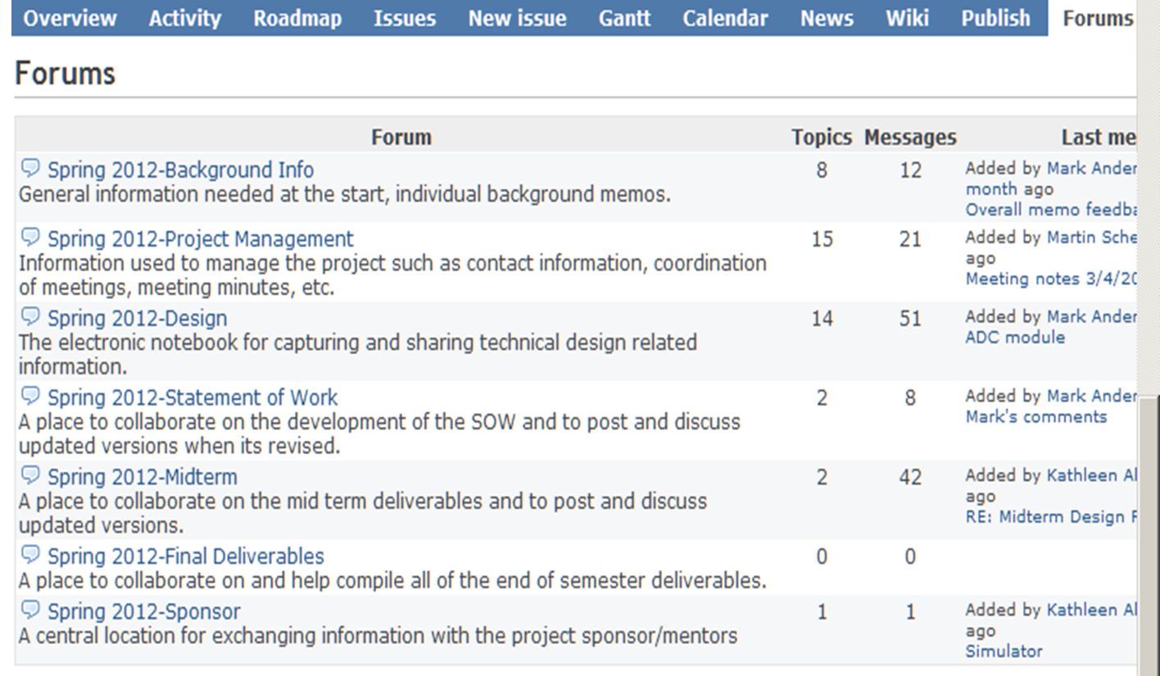
Discussion Forums
Measures of Activity
Student Postings are Evaluated for Technical Quality
Notes:
Topics / Messages / Last Message give an indication of activity

Slide 30
Version Control / Subversion
Version Control is Used for:
Software Source Code – All Languages
Microsoft Office / OpenOffice / Latex Documents
Mechanical & Electrical CAD Models
Data
Key Features:
Files stored by Subversion in repositories can be restored if accidentally deleted!
Impossible to overwrite another users files
Can be used to restore project work to your PC after a re-imaging
Can handle large files
Revision control, also known as version control or source control, is the management of changes to files, documents, and programs.
Adapted from http://en.wikipedia.org/wiki/Revision_control, accessed 3/14/2012

Slide 31
Version Control / Subversion
“Tags” are made with / by your PE at the end of the semester as part of the technology transfer of your project. Do NOT work in that folder!
Figure 1 - Sample Subversion Folder Structure
Sample Folder Structure Suitable for Most Projects

Slide 32
What Goes Where?
The Electronic Design Notebook has multiple places where information is stored:
Forums
Issues
Wiki
Repository
See the Capstone Support Wiki for guidance: https://designlab.eng.rpi.edu/redmine/projects/capstone-support-dev/wiki/EDN_FAQ
There is a search box in the upper right corner - use it to find things in your project or the Capstone Support Wiki!

Slide 33
Best Practices
For forums / issues / wiki – post text directly into the system instead of posting a Word or PDF attachment. Attachments are not searched!
Do not ‘double post’ – do not attach a document AND paste the contents of that document into the post. Do one or the other!
Post information to the EDN instead of sharing via email. Team members, instructors, sponsor/mentors, and people from next semester’s group can not see those emails! And you run the risk of violating your agreement to protect intellectual property.

Slide 34
Inventory Management
Books and Equipment
can be signed out
Supports both Resource Books (Book Shelf) and Lab Materials (Device Room)
Shows who currently has the book / equipment
Pseudo Users “A cabinet 2” and “storage.jec2027” for Storage Locations OR
Actual person’s name

Slide 35
Monitoring Student Progress
Last Login Date
Participating Students Will Login Every 1-2 Day
Activity by User
Timing of Posts
Relevance / Content / Quality of Posts
New Material vs. Knowledge Synthesis
Participating students will have frequent postings of significant technical content
Student Postings are Evaluated for Technical Quality
Notes:
Student contributions and participation in this course are evaluated based on the artifacts they produce. This includes physical items, such as devices, and intellectual items which can be seen in everything you post as well as during team meetings / presentations / reviews.

Slide 36
User Statistics
ID | Forum | Wiki | Repository | Issues
 |  |  |  | Total | Created | Updates
Student 1 | 11 | 1 | 11 | 11 | 4 | 7
Student 2 | 1 | 1 | 5 | 1 | 1 | 0
Student 3 | 13 | 1 | 18 | 36 | 8 | 28
Student 4 | 20 | 26 | 42 | 31 | 8 | 23
Student 5 | 9 | 5 | 9 | 30 | 10 | 20
We Have Observed a Positive Correlation Between
Posting Quality & Frequency and Team Success
Notes:
Simple statistics show who’s active but cannot determine quality from this simple analysis.

Slide 37
Participation
The EDN is configured to ‘push’ information to you via email. Alternatively, you can chose to diligently visit the site and ‘pull’ the information. (Email preferences available at ‘My Account’ link.)
You each MUST BE AWARE of team progress, status, and problems throughout the semester.
It is every team member’s responsibility to actively participate in the project throughout the semester. This is integrated into the Individual Contribution Factor (ICF), as defined in the course syllabus.

Slide 38
Conclusions
Collaboration tools play an essential role in The Design Lab’s Capstone Program
Students are evaluated based on making a variety of significant technical contributions and a successful project outcome
Collaborative experiences prepare our students for both academic & industry careers
Productively using the Electronic Design Notebook can increase a team’s level of success

