Slide 1
Capstone Drafting Guidelines Example Visual examples of requirements from https://afsws.rpi.edu/AFS/dept/eng/cax/cad/ENG_DWG_Guidelines.pdf

Slide 2
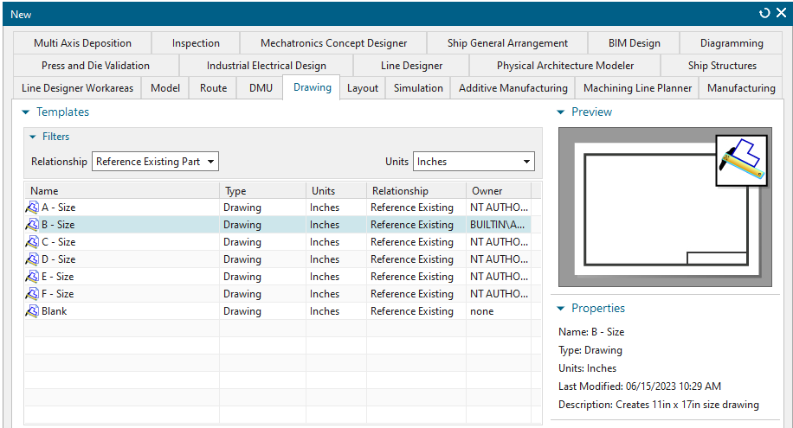
A.1
A.4
A.5
A.2
A.6
A.3

Slide 3
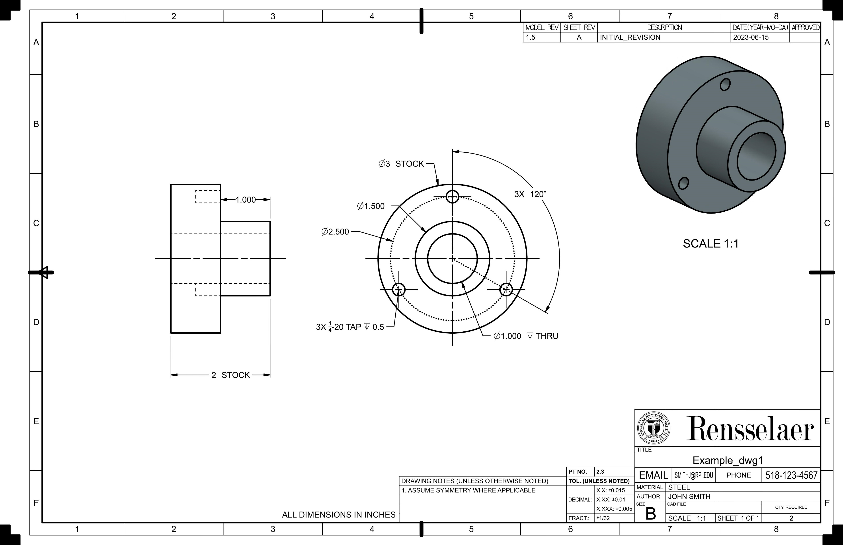
B.8
D.3
D.3
B.2

Slide 4
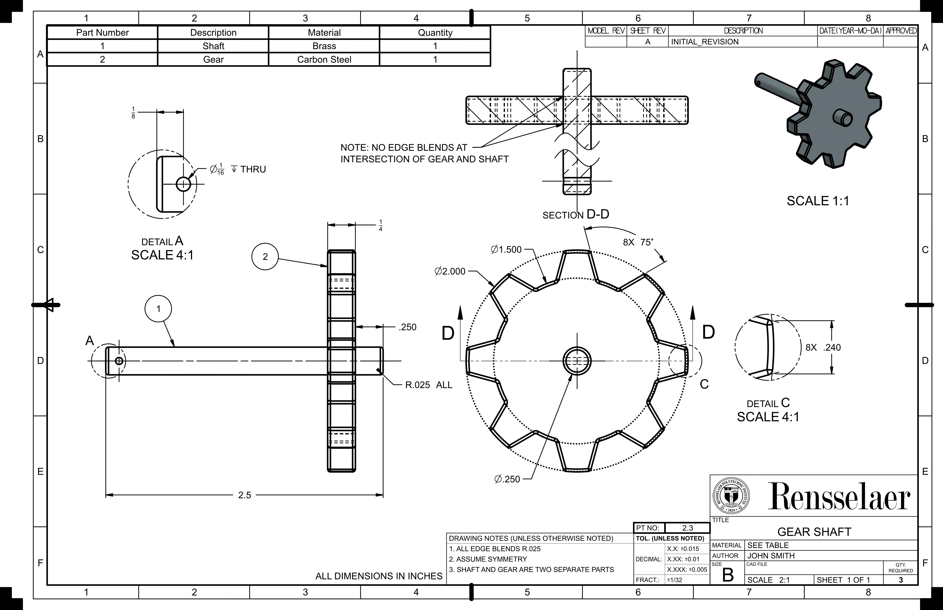
D.8
D.7
C.4
C.7
C.2
C.3
D.2
D.5

Slide 5
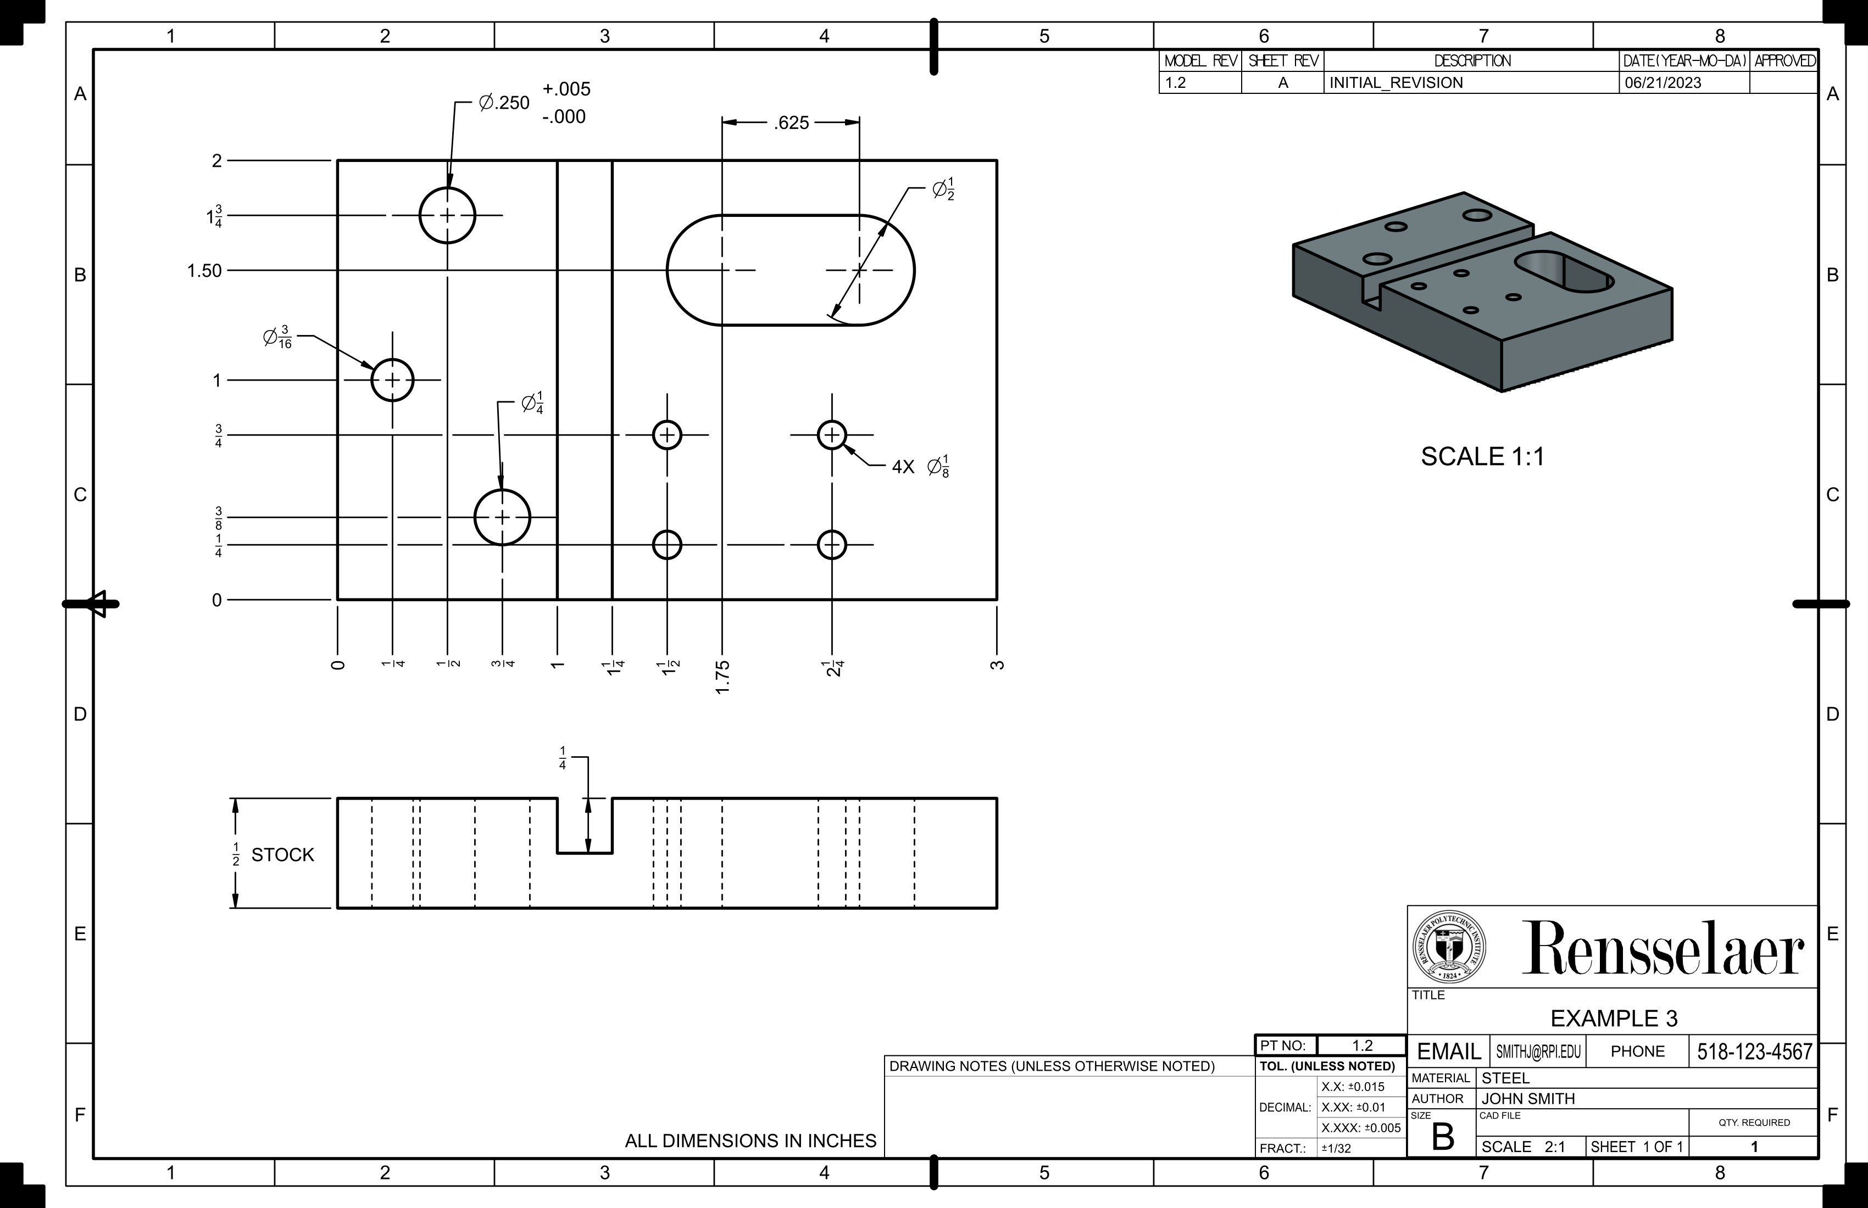
B.4
C.6

