Slide 1
MS Word Time Saver Tips (DRAFT)
Prof. Junichi Kanai April, 2010

Slide 2
Outline
Abbreviations and Shortcuts
Citation and Bibliography
Equations
Captions and Cross References
(Image Manipulation)
(Master Document & Subdocuments)
Before Saving a File

Slide 3
Abbreviations and Shortcuts
Font Style & Effects
Greek Letters and Math Symbols
Abbreviations with & w/o Formatting
AutoText Gallery

Slide 4
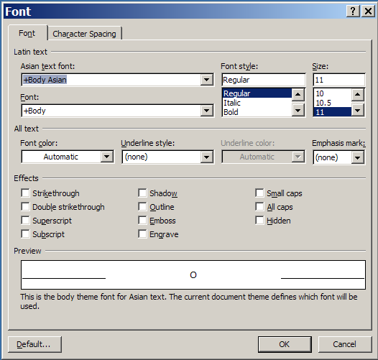
Font Style & Effects
Avoid m^2 or m**2; Use m²
Word ’03 & later: Type, Select, Right-Click, Font…

Slide 5
Font Style & Effects (cont’d)
MS Word ‘07 & Later

Slide 6
Font Style & Effects (cont’d)
MS Word ‘03 and Later – Keyboard Shortcuts
Bold: Ctrl+b
Italic: Ctrl+I
Underlined: Ctrl+u
Superscirpt: Ctrl++
Subscript: Ctrl+=

Slide 7
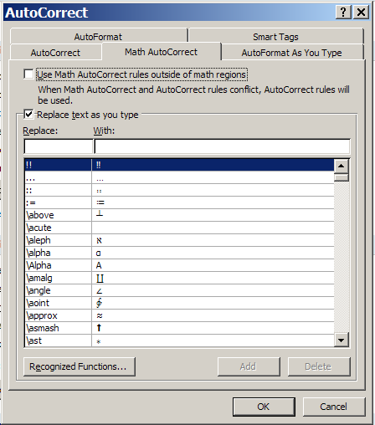
Greek Letter and Math Symbols
Word Options, Proofing, AutoCorrect Options…,

Slide 8
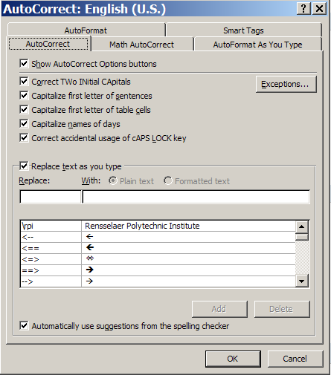
Abbreviations w/o Formatting
Word Options, Proofing, AutoCorrect Options…
Example: \rpi → Rensselaer Polytechnic Institute

Slide 9
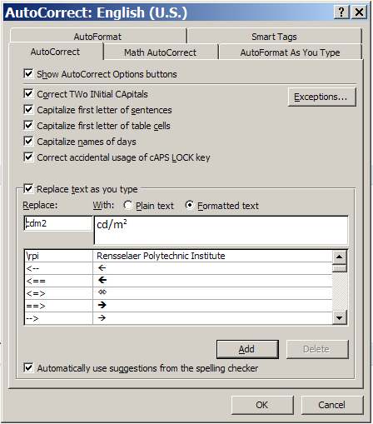
Abbreviations with Formatting
Type, Format, , Word Options, Proofing, AutoCorrect Options…
Make sure to select Formatted text
Example: cd/m2 → cd/m²
Note: Include a blank space that is not a superscript (subscript)

Slide 10
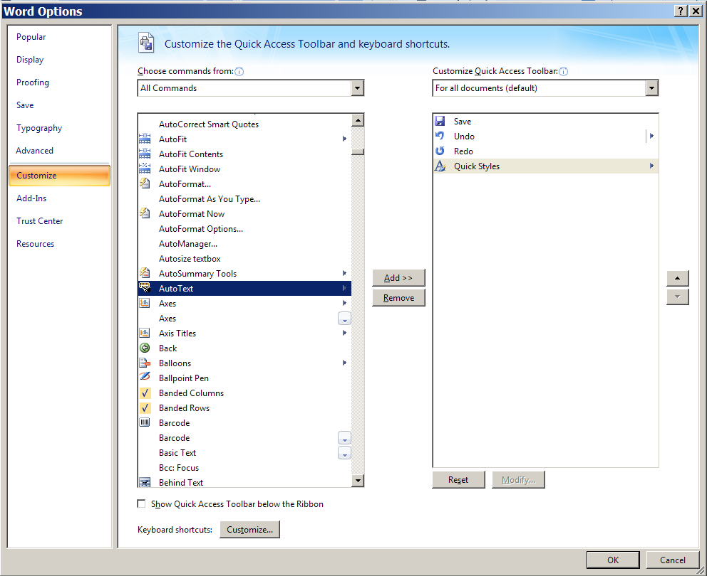
AutoText Gallery – Activation
, Word Options, Customize
Source: http://office.microsoft.com/en-us/word/HA102552091033.aspx

Slide 11
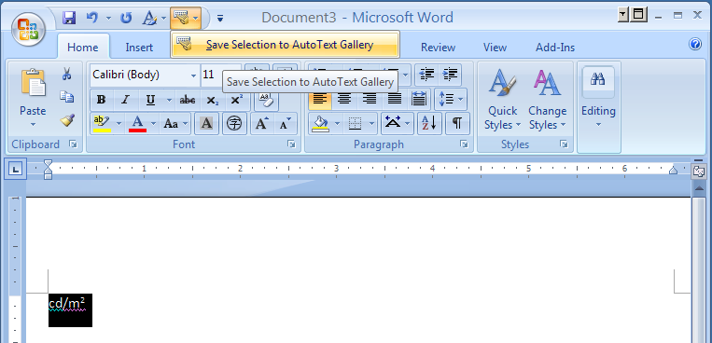
AutoText Gallery – Storing Texts (1)
Type, Format, Select, , Save

Slide 12
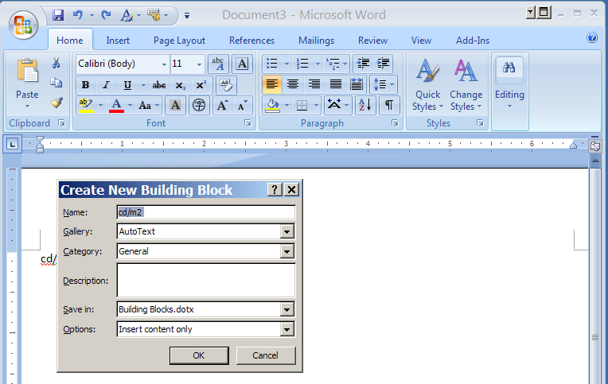
AutoText Gallery – Storing Texts (2)

Slide 13
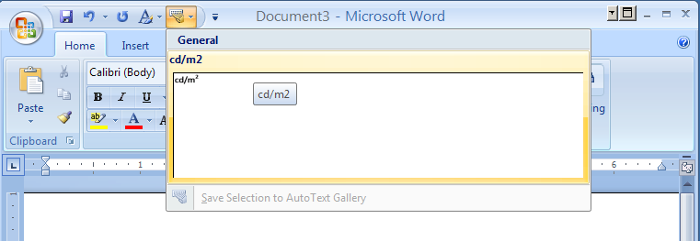
AutoText Gallery – Adding Texts

Slide 14
Citation and Bibliography
Citation & Bibliography Ribbon
Additional Bibliography Styles
Reusing Sources
Insert Bibliography

Slide 15
Citation & Bibliography Ribbon
References, Citations & Bibliography
Bibliography Styles
APA (American Psychology Association), Chicago, MLA (Modern Language Association), Turabian
GB7714, GOST, ISO690, SIST02

Slide 16
Additional Bibliography Styles
BibWord (http://bibword.codeplex.com/)
Readymade Styles
Association for Computing Machinery (ACM)
American Chemical Society (ACS) American
Medical Association (AMA)
Council of Science Editors (CSE)
IEEE → [1] and [Author]
Lecture Notes in Computer Science (LNCS)
Nature
BibWord Extender
External tool
Support the Name+Year format

Slide 17
Adding a New Source (1)
Citation & Bibliography, Insert Citation, Add New Source …

Slide 18
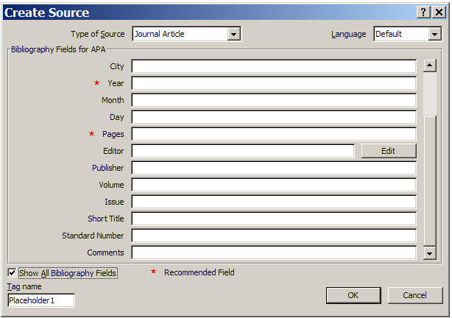
Adding a New Source (2)

Slide 19
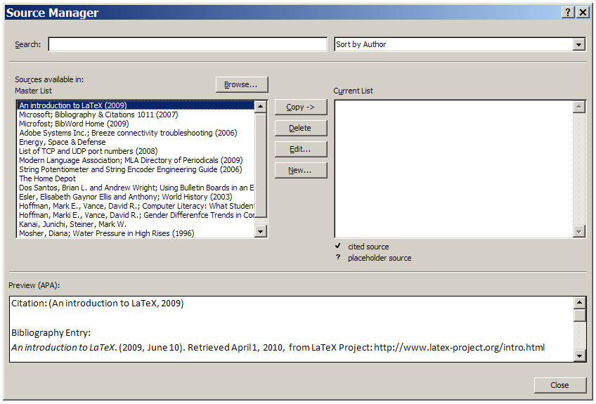
Reusing Sources
Citation & Bibliography, Manage Sources

Slide 20
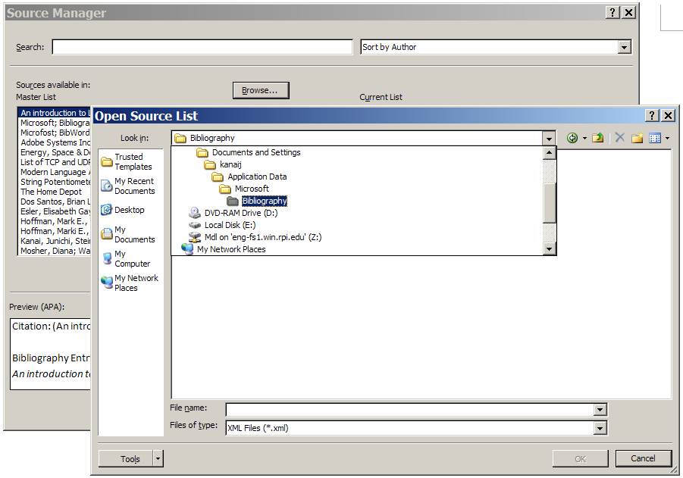
Database File
Document Settings\YourAccount\Application Data\Microsoft\Bibliography\Sources.xml

Slide 21
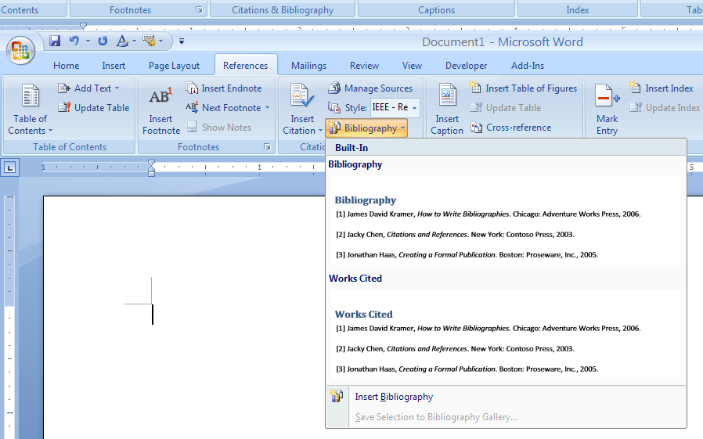
Insert Bibliography
Citation & Bibliography, Bibliography

Slide 22
Equations
UI-Based Approach
Linear Format

Slide 23
UI-Based Approach
Insert, Symbols, Equation

Slide 24
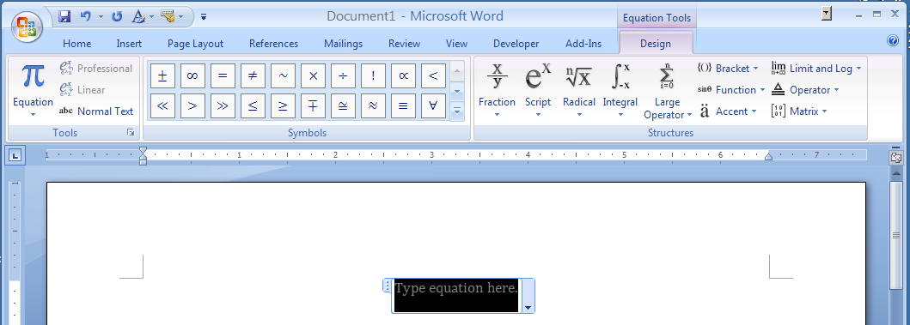
Linear Format
TeX like notation (example: x^2 for x²⁾
http://blogs.msdn.com/microsoft_office_word/archive/2006/10/04/Equations-in-Word-2007.aspx

Slide 25
Headings, Captions & Cross-Reference
Section Titles
Table of Contents
Captions
List of Figures/Tables
Equation Numbers
Cross-Reference

Slide 26
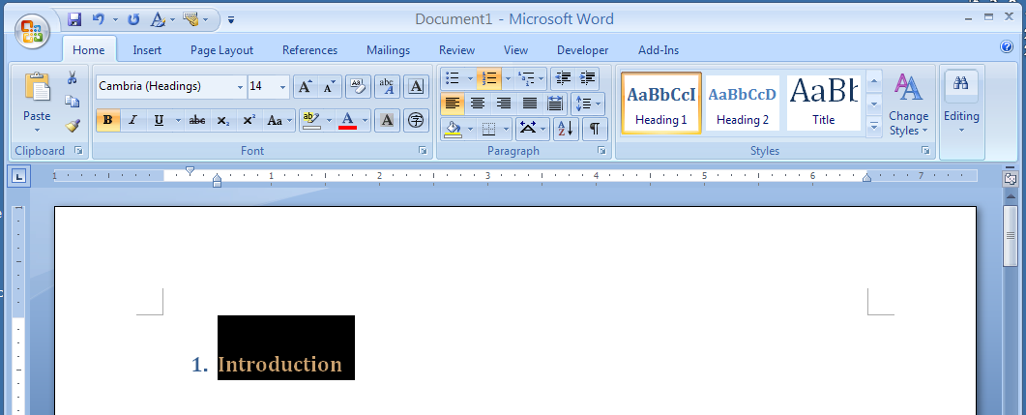
Section Titles
Apply a Heading Style

Slide 27
Table of Contents (1)
References, Table of Contents

Slide 28
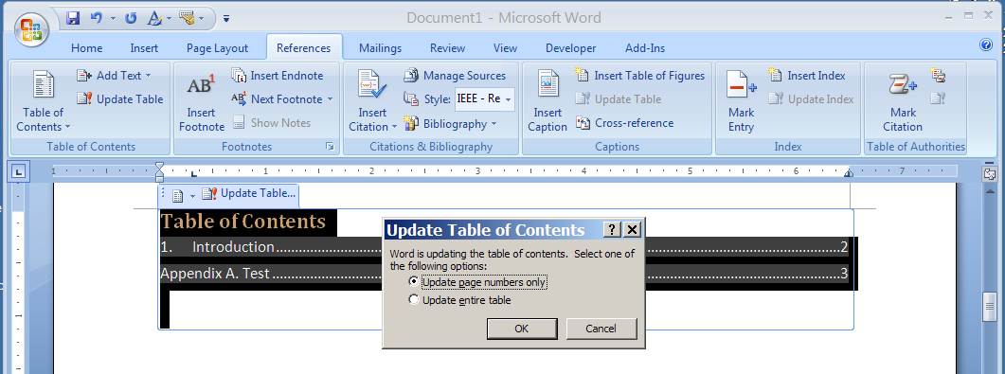
Table of Contents (2)

Slide 29
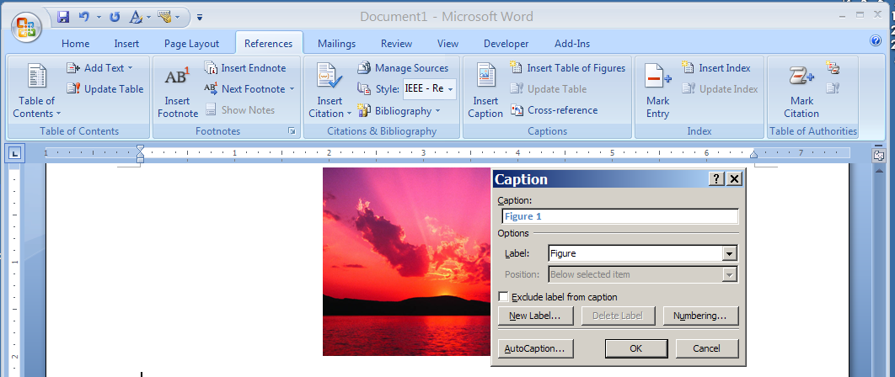
Captions
Figure Caption – Below
Table Caption - Above

Slide 30
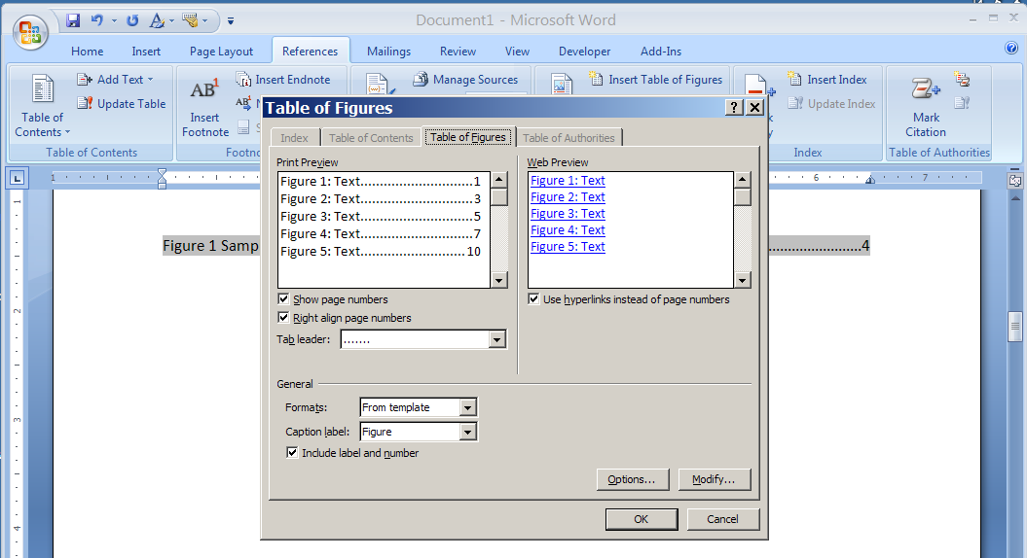
List of Figures/Tables

Slide 31
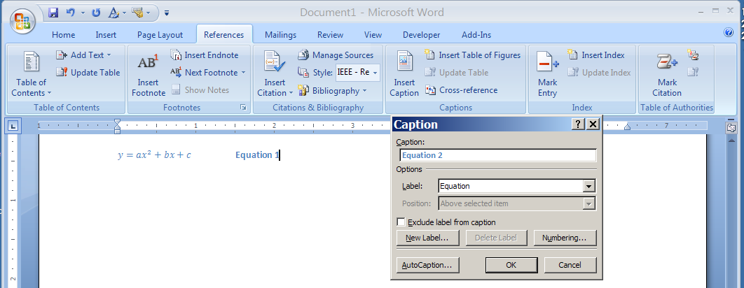
Equation Number (1)

Slide 32
Equation Number (2)
Tab Equation Tab Caption
Tab1 – Center @ 3.25”
Tab2 – Right @ 6.25”
Create & apply your own equation style
Create your own keyboard macro

Slide 33
Cross-Reference
Numbered items can be automatically updated
Dynamic Links useful in PDF documents
Page numbers are useful in printed documents

Slide 34
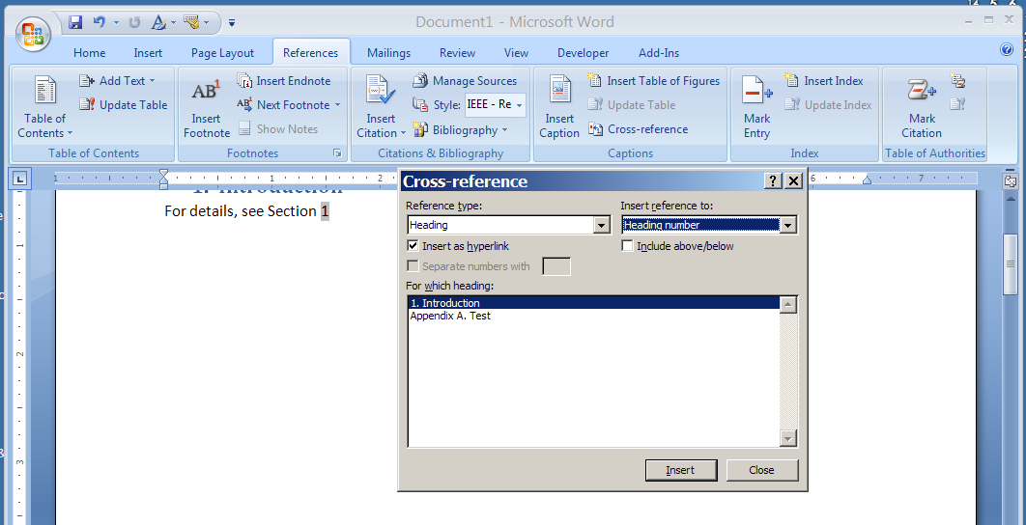
Cross-Reference Sections
Numbered section titles

Slide 35
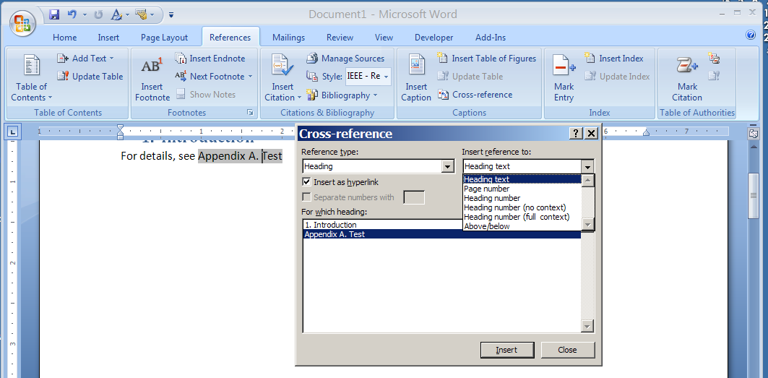
Cross-Reference Appendixes

Slide 36
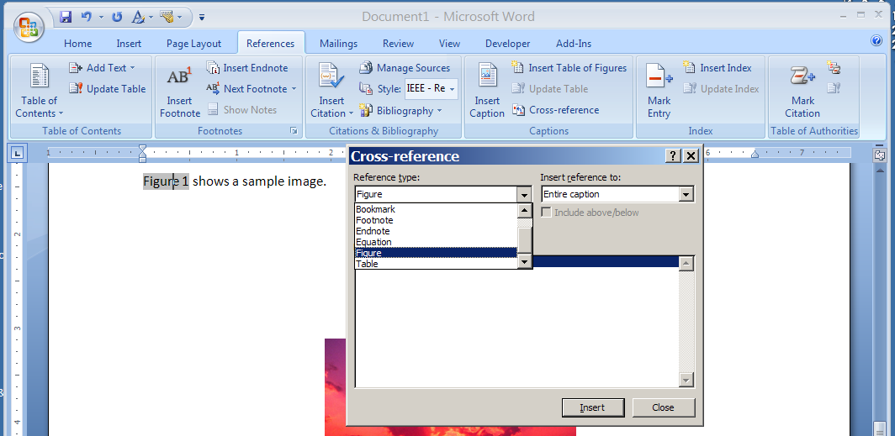
Cross-Reference Fig/Table/Equ (1)
Select a Reference Type first

Slide 37
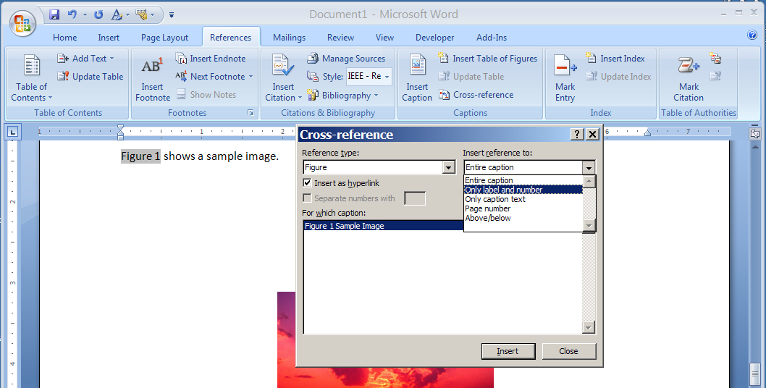
Cross-Reference Fig/Table/Equ (2)
Select how a caption to be shown

Slide 38
Before Saving a File
Make sure to update automatically generated items
Select the entire document (Ctrl-A), F9

