Slide 1
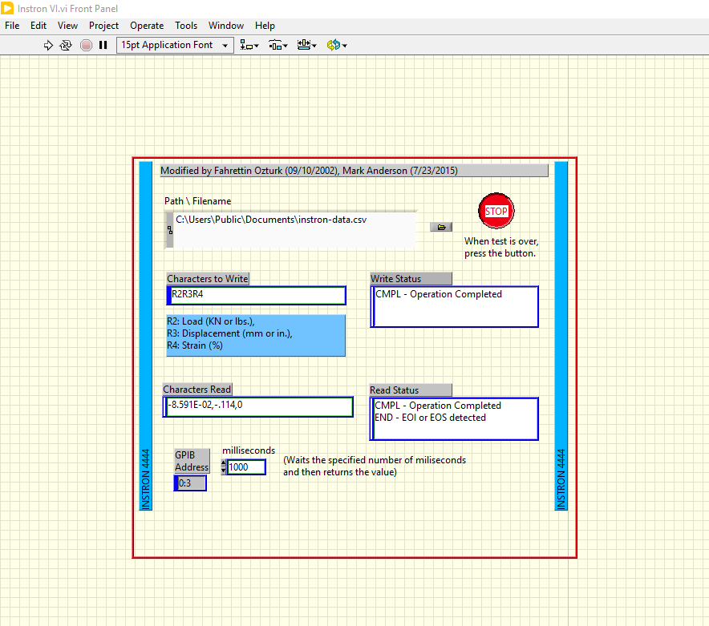
STOP
Recording data
START
Recording data
Time between data points

