Slide 1
Example Capstone Drawing Package
This PowerPoint is excerpted from a drawing package produced by a Capstone Design team.
It has been annotated with
Explanation/notes on what is present
Mistakes which should have been corrected

Slide 2
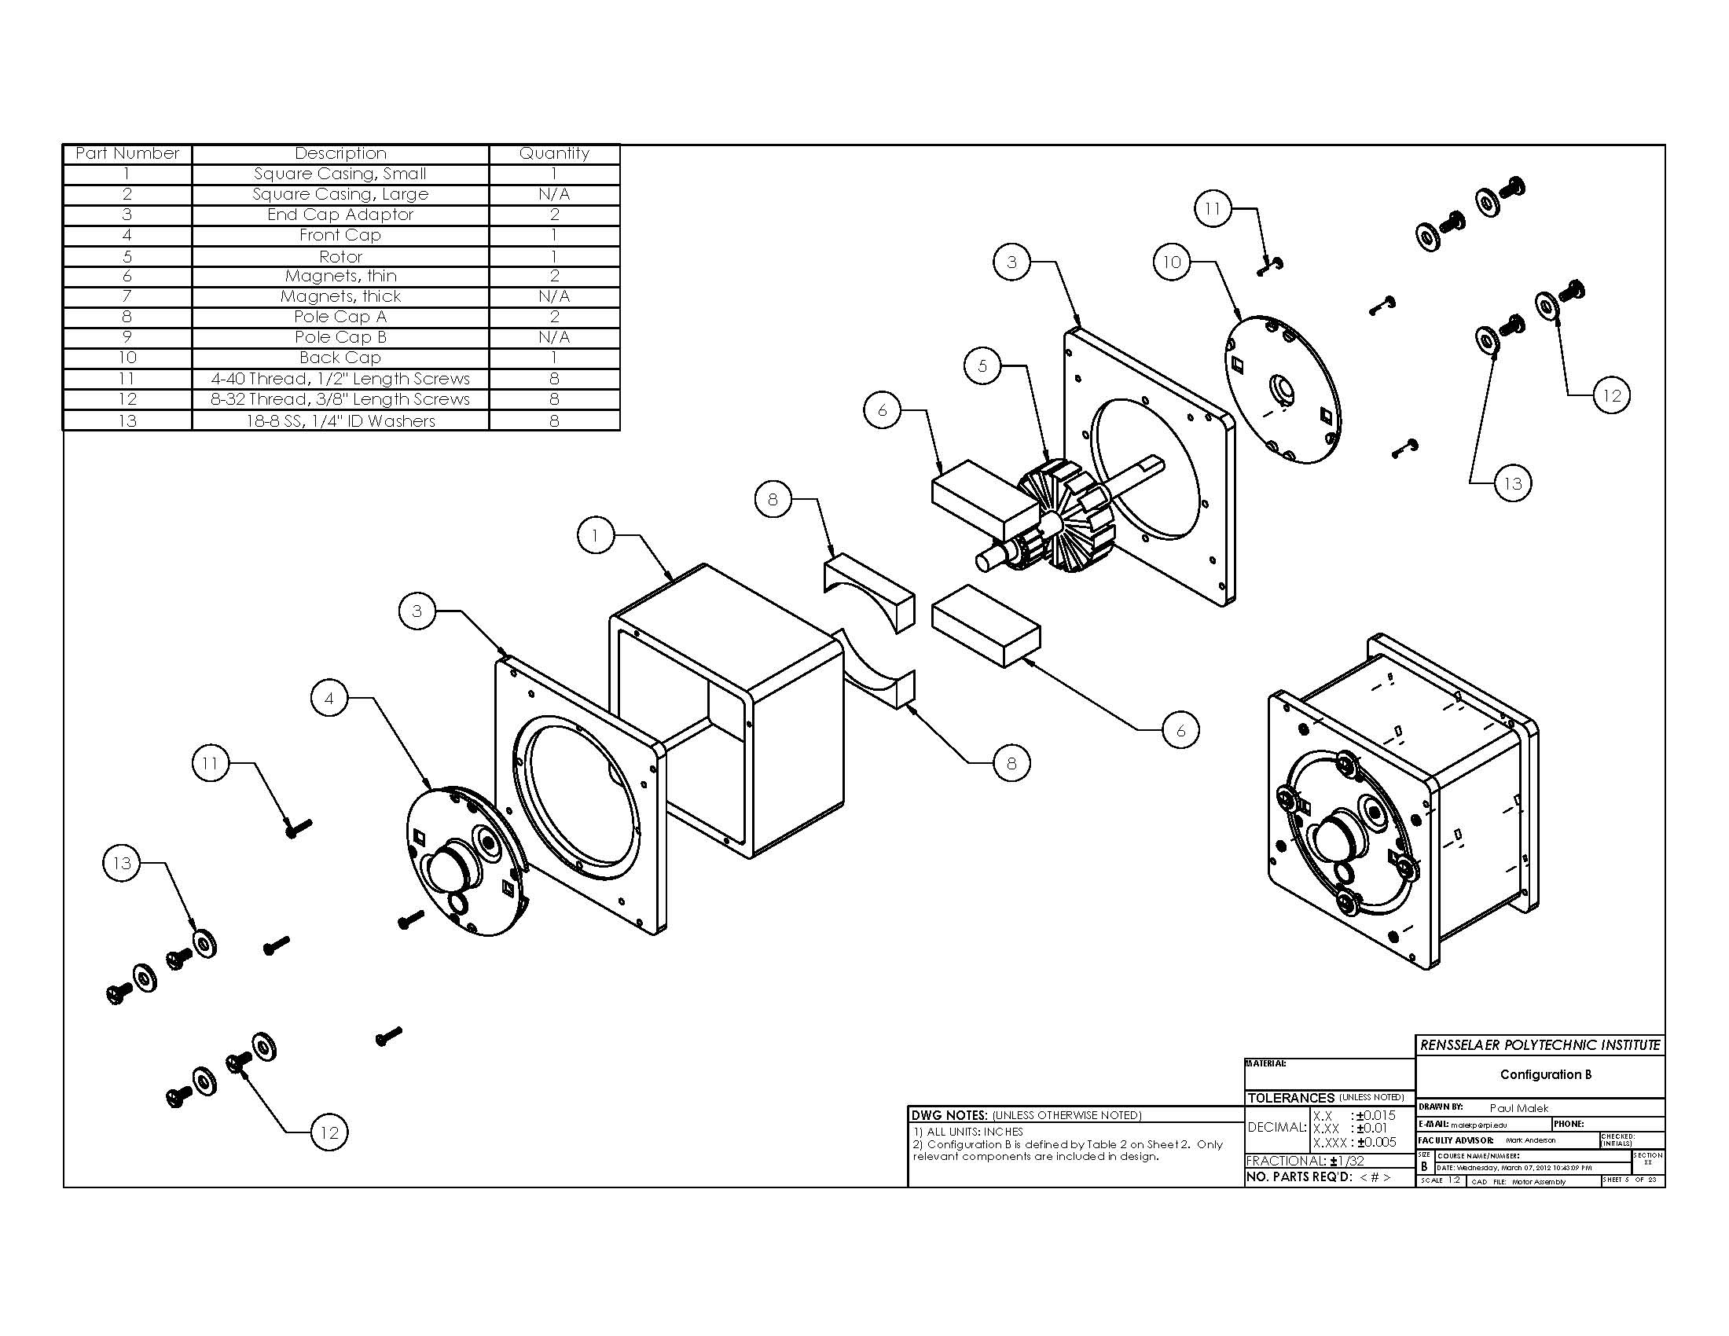
Bill of Materials
Include columns for
manufacturer and part #
for purchased parts
What is material?
What style head on screw?
x 2
Unnecessary to label each instance of part
x 2
Item Numbers
x 2
x 8
x 8
Exploded Assembly View
Isometric View
Bill of Materials
Quantity
x 8
Title Block
with meaningful part name

Slide 3
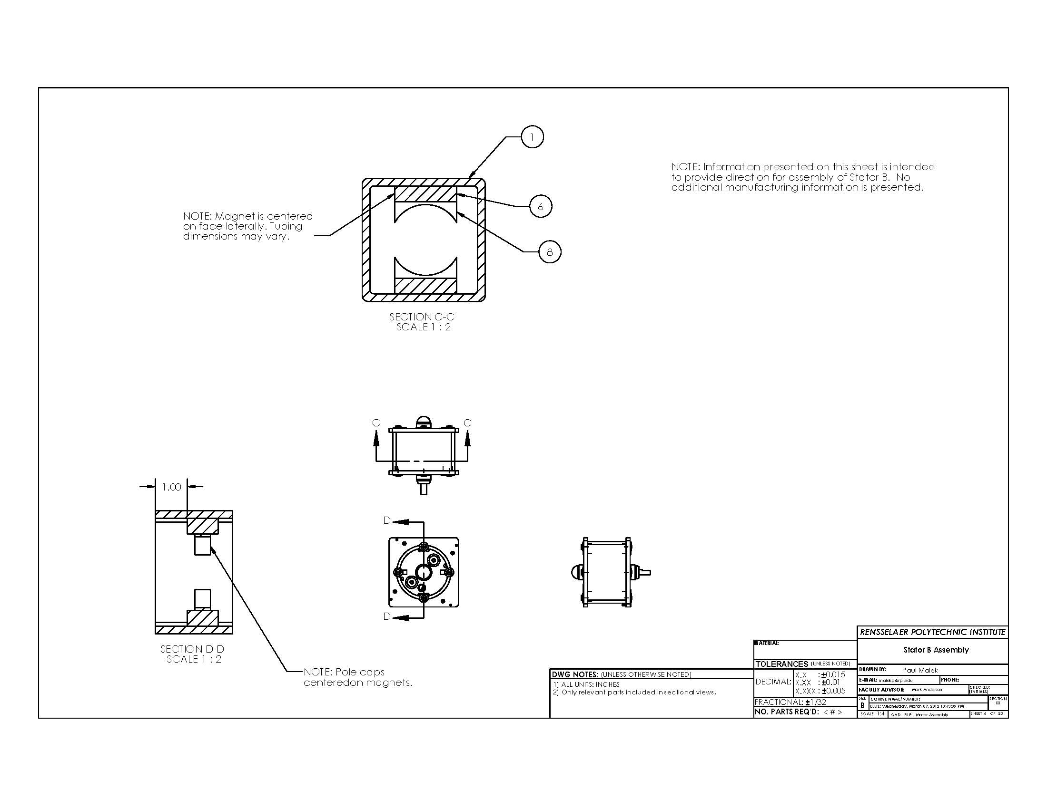
Cross Section View
x 2
Orthographically projected sectional views must be same scale and aligned with their parent view. If they need to be larger, your sheet scale needs to increase.
x 2
Section Labels should be consecutive (this package is missing some pages)
Centerline is correct way to convey information in these notes
Standard Orthographic views - Front, Right, Top
Plus Cross section for display of offset dimension
Hidden lines should be shown in orthographic views.
Sheet scale too small

Slide 4
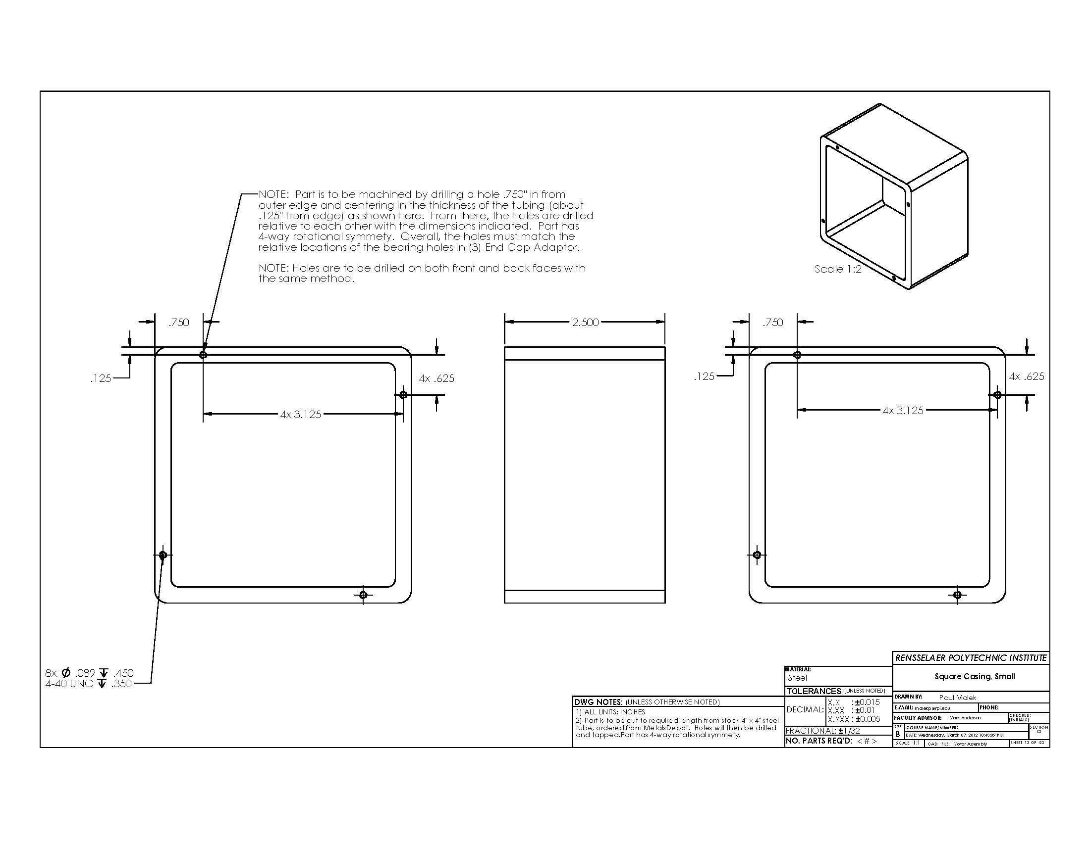
Stock material is shown with reference dimensions. Machinist not expected to produce this size, but shown dim helps to verify material is correct size
Per tolerance block, 3 decimal places means ±0.005” and would require milling both sides. 2-1/2” can be produced with tape measure and band saw. Time is money, so dimension and tolerance to produce required accuracy
If intent is to drill on center, simply draw centerline
4” REF
1
1/4” REF
Item # from BOM
4” REF
Hidden lines can be shown to improve clarity of blind holes
Hole callout with thread size, depth, number of holes
Inappropriate note. Provide reference dimensions for stock material on drawing views. Unless required, no need to list vendor on print.

Slide 5
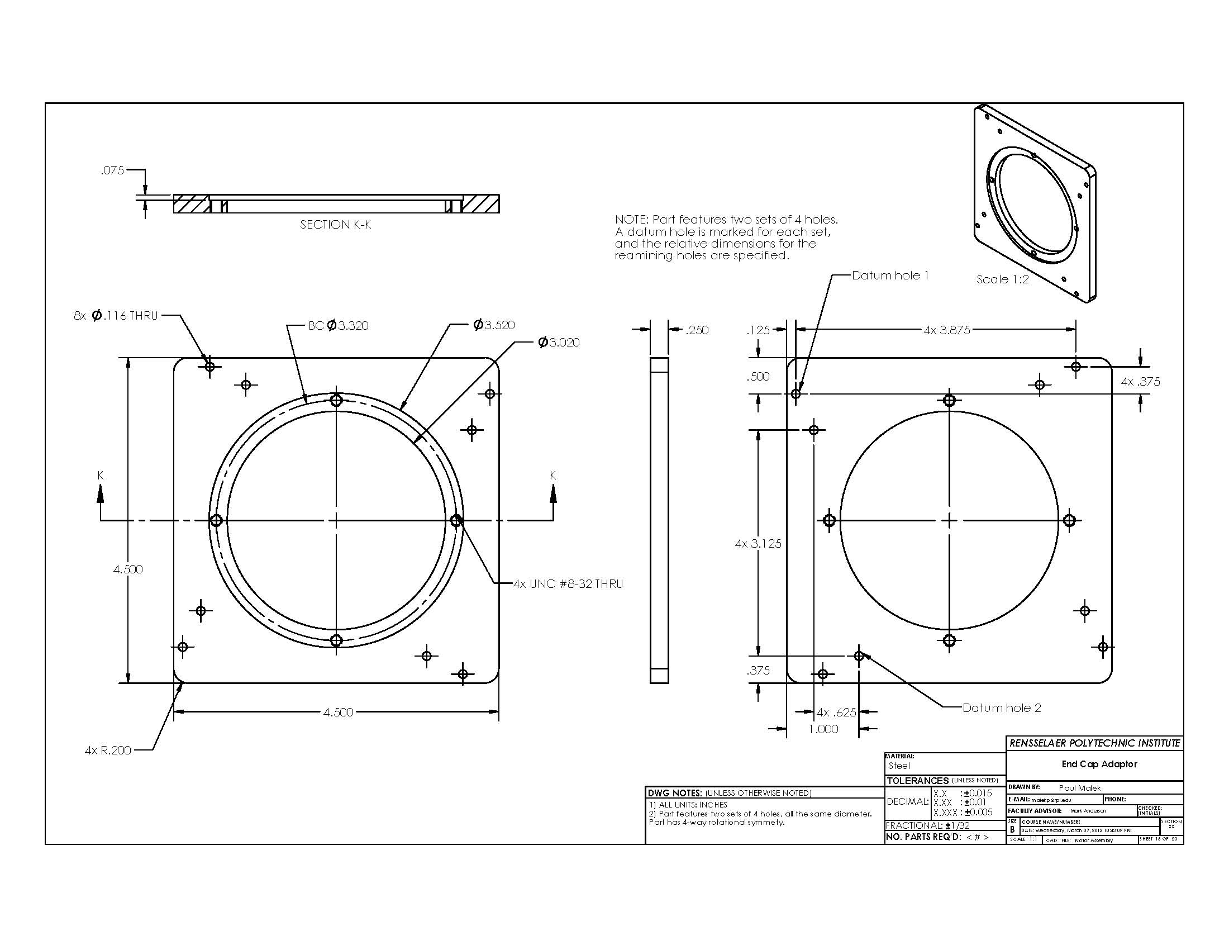
Incorrect hatch style for steel
Axonometric view
Standard Orthographic views - Front, Right, Top
Plus Back view to detail holes within step
Is 3 decimal place round profile required, or would “break all corners” suffice for this application?
3
Hidden lines should be shown in orthographic views.

Slide 6
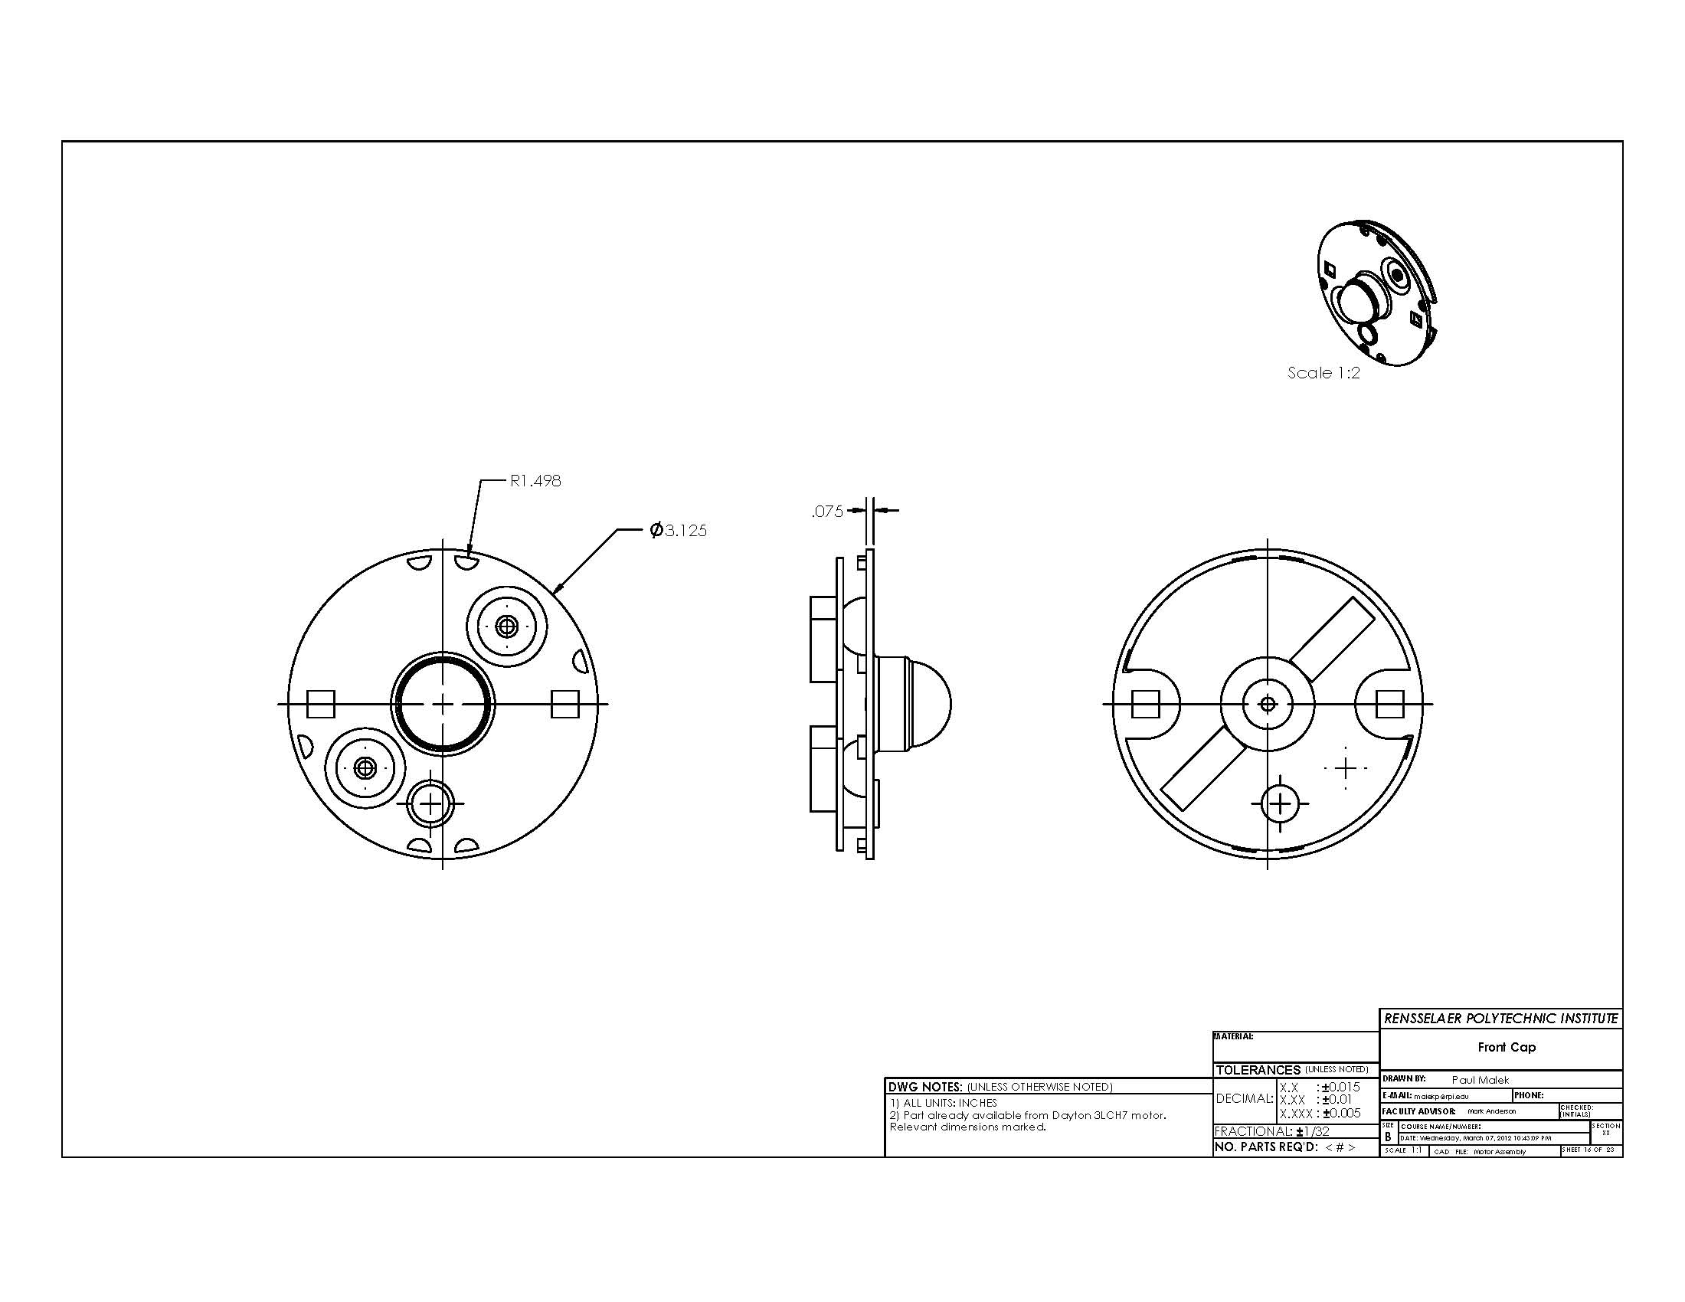
Dimensions are not to be machined, simply reference for assembler to verify part. Using parentheses around the dimensions is also sufficient, e.g. (R1.498).
Hidden lines should be shown in orthographic views.
REF
REF
REF
Include manufacturer, part #, vendor
for purchased parts
4

Slide 7
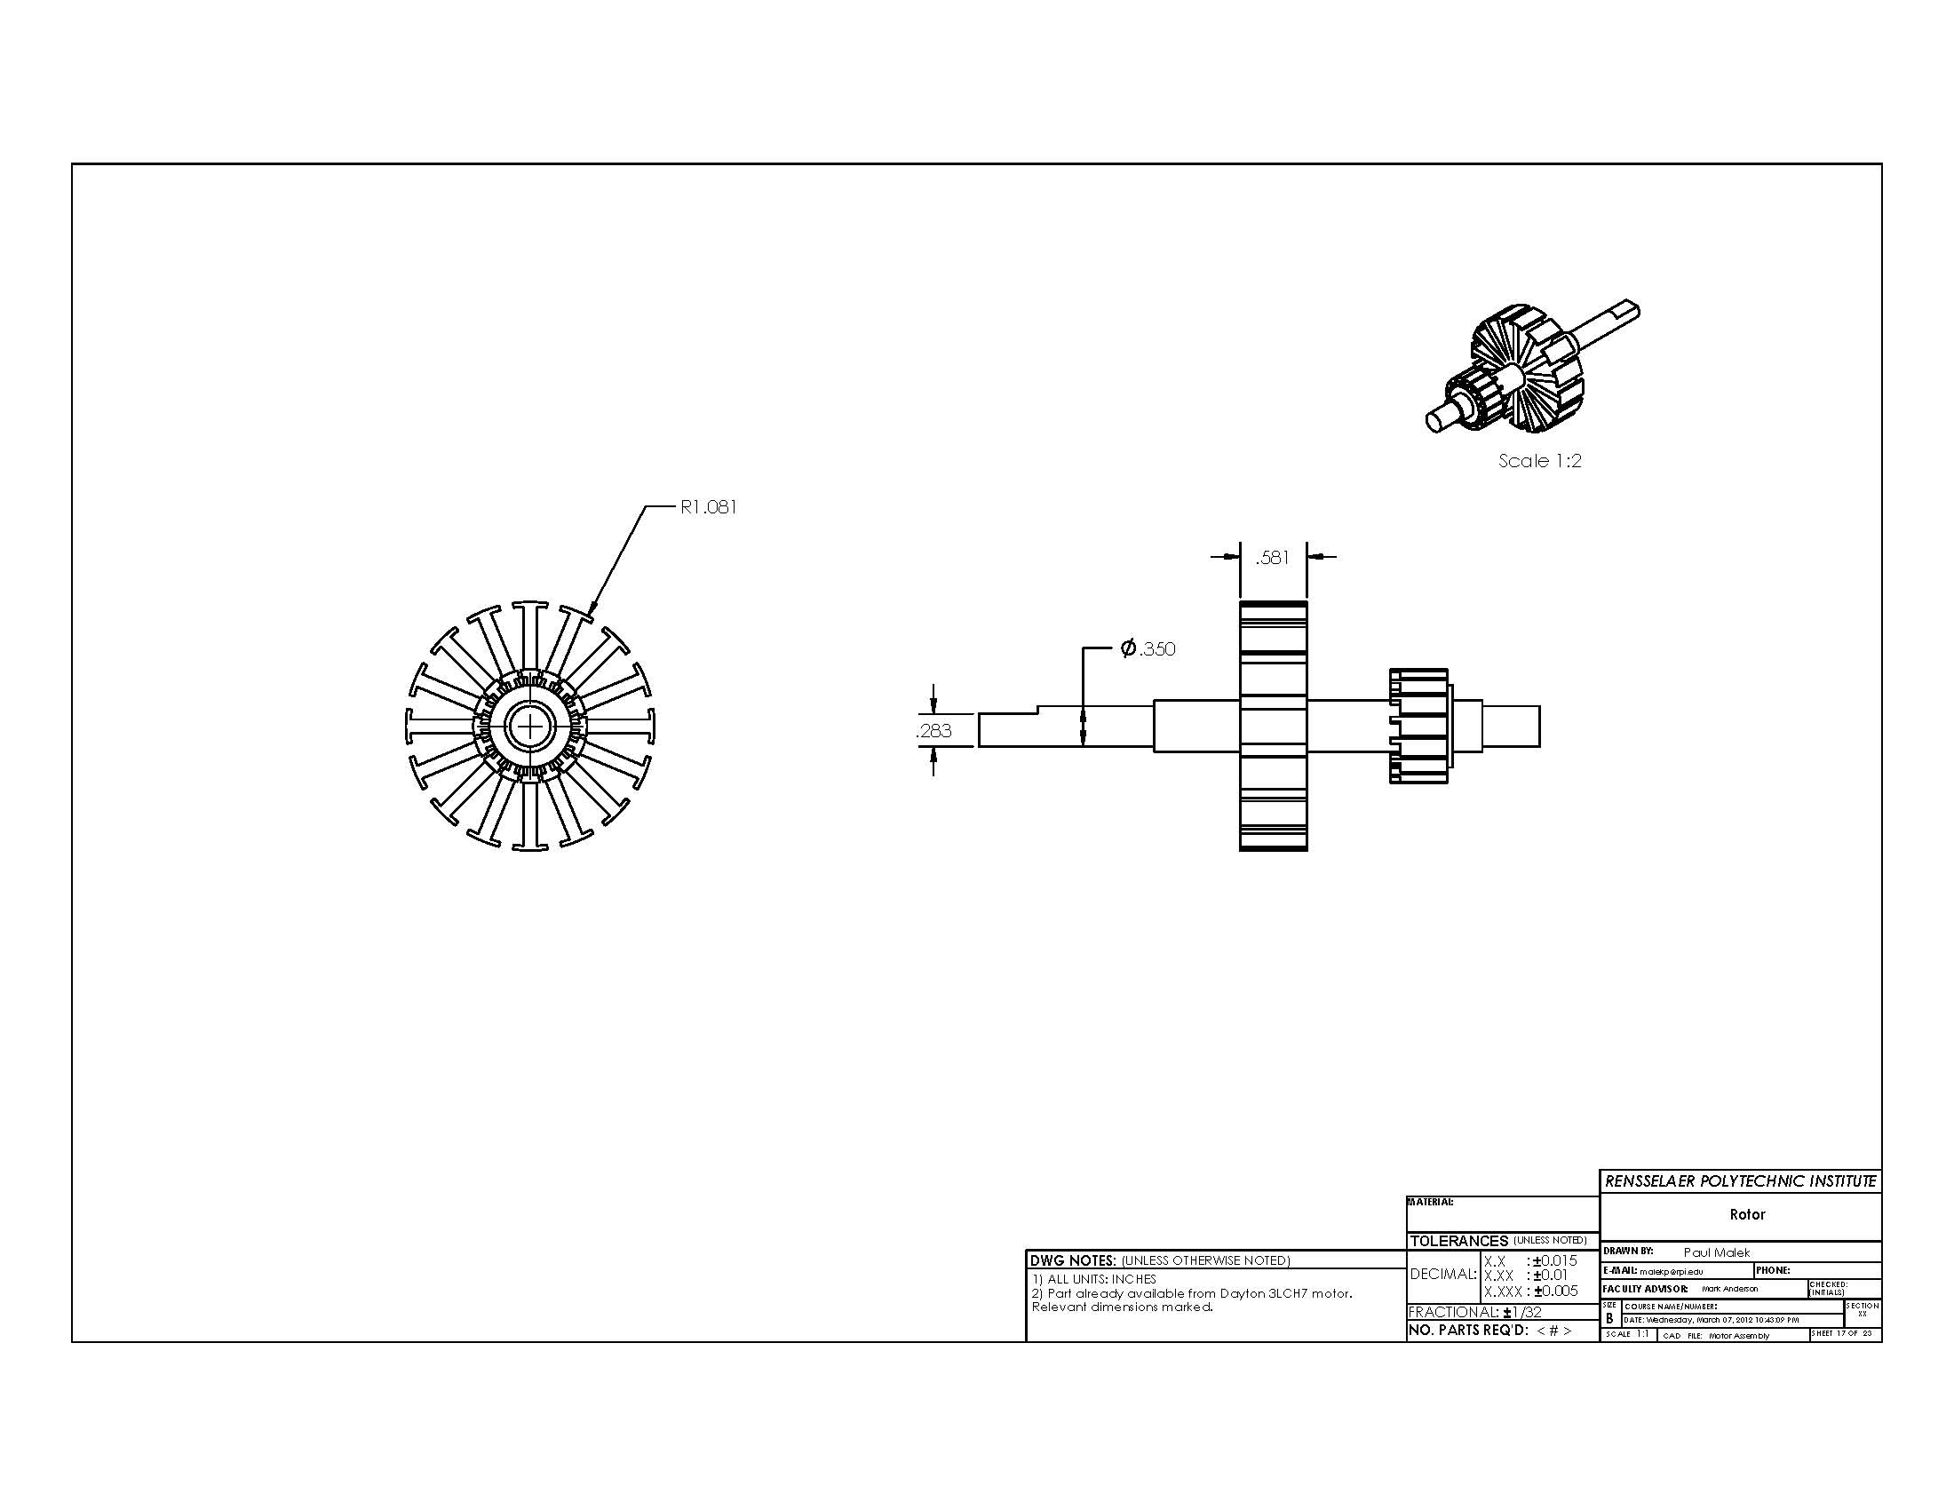
5
Sheet scale too small

Slide 8
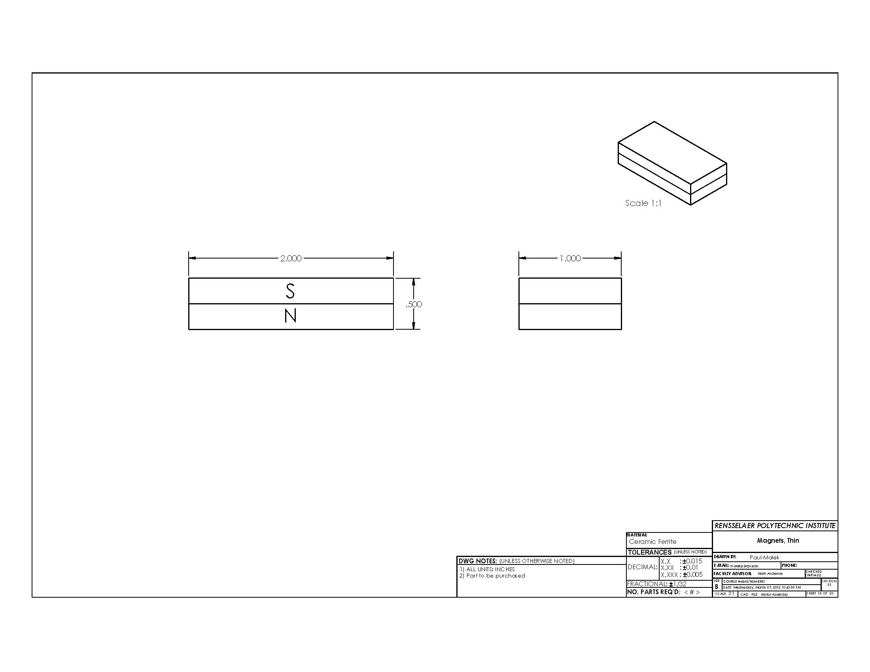
Is high tolerance necessary? May not be possible on purchased part. Or at greatly increased price.
Required magnetic strength should be specified
6
Sheet scale too small

Slide 9
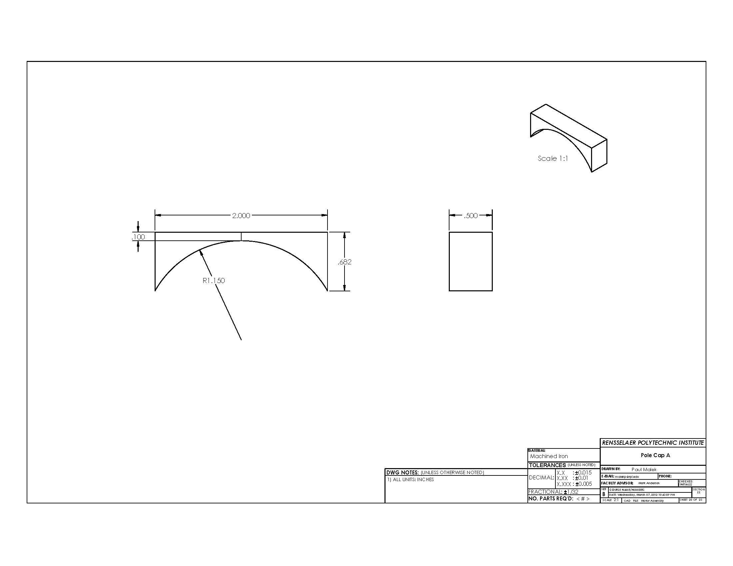
Artifact line segment can confuse reader
Difficult to machine part based on this dimension. Simpler to dimension vertical location of arc centerpoint.
Hidden lines should be shown in orthographic views.
8
Sheet scale too small

Slide 10
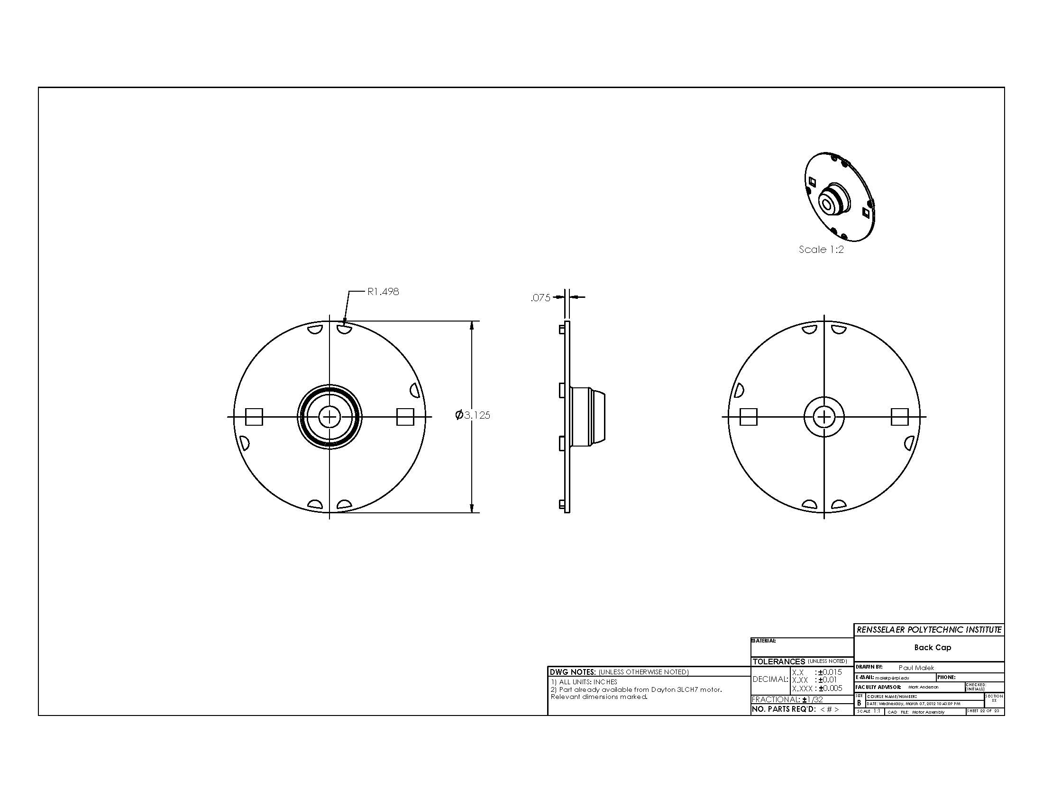
View is reversed from standard projections, protrusion should face to right based on other Front and Back views
10
Sheet scale too small

Slide 11
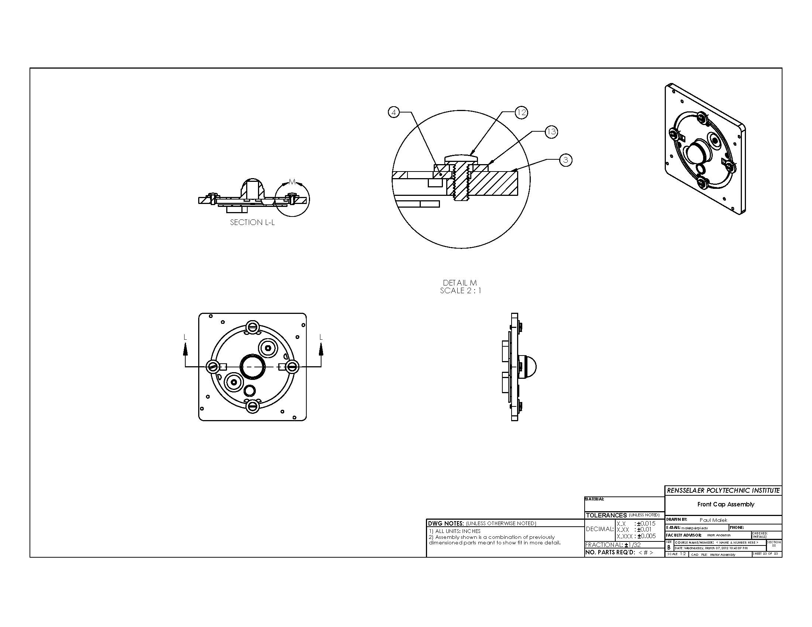
x 4
x 4
If bolt torque is important to assembly or function, call out here
Sheet scale too small

Slide 12
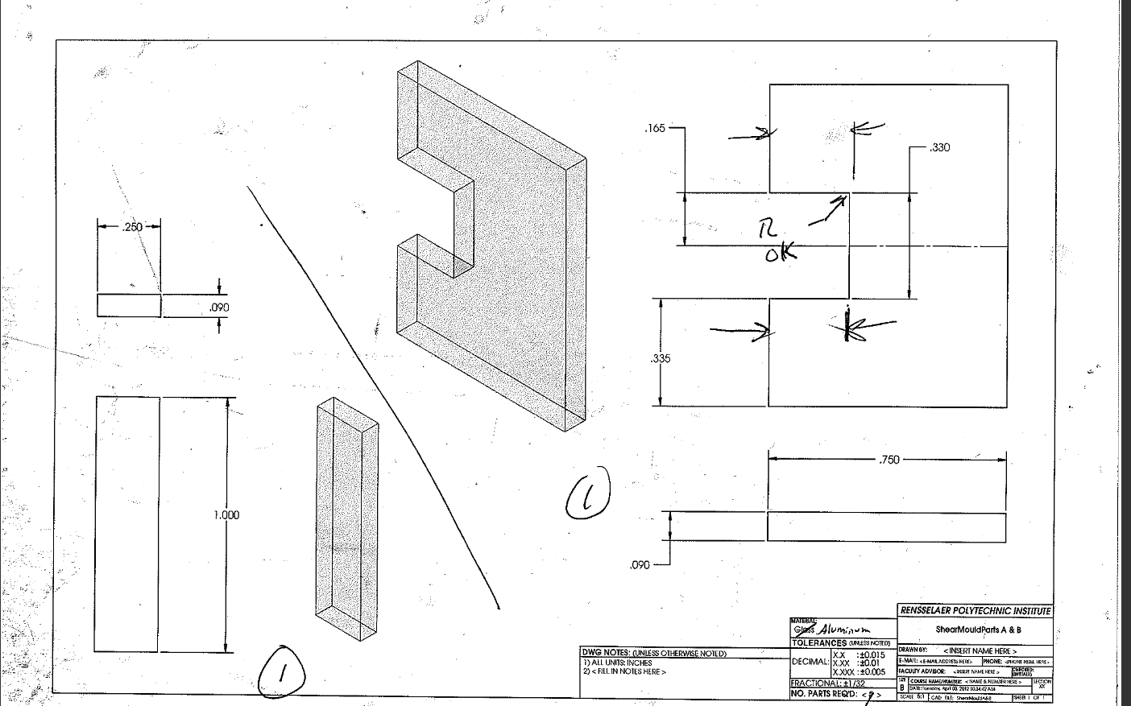
Standard view layout and alignment not followed here
Use two sheets for two separate parts
Hidden lines missing in orthographic view
Author Info MISSING

Slide 13
Standard view layout and alignment not followed. Upper right should be axonometric view.

Slide 14
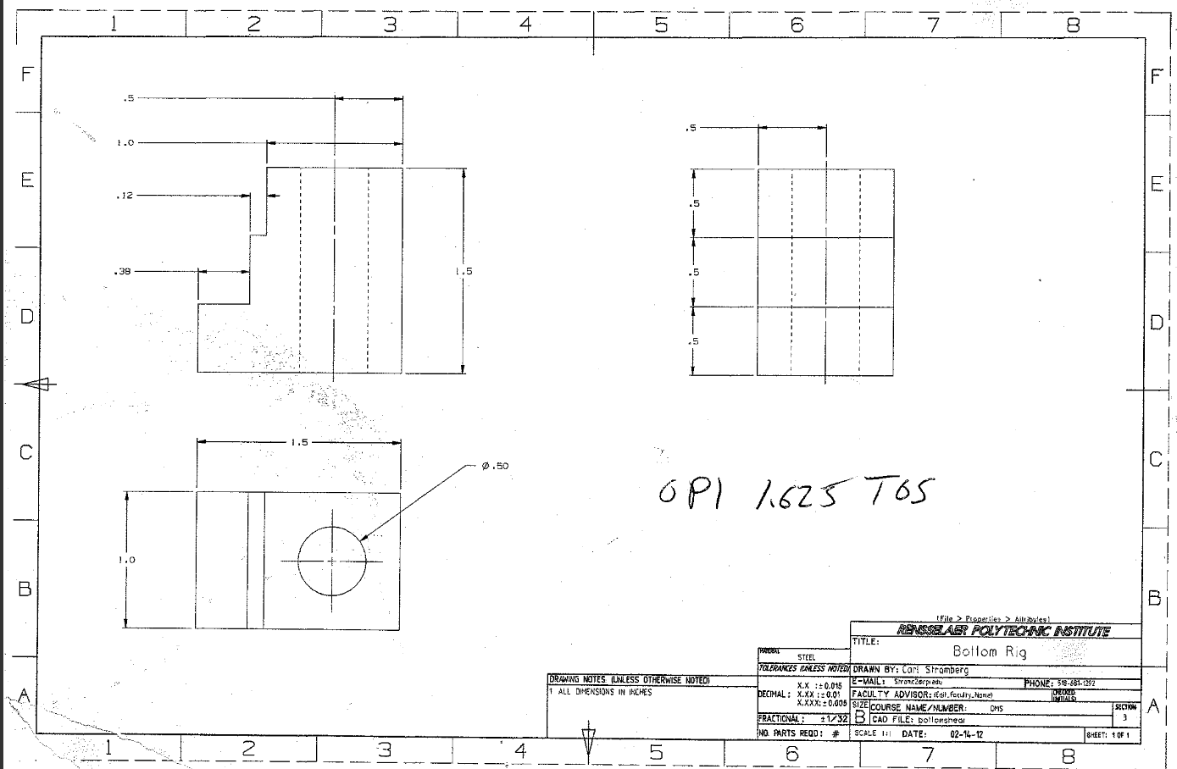
Stacked Dimensions not appropriate. Use baseline dimensioning instead.
Standard view layout and alignment not followed. Upper right should be axonometric view.

Slide 15
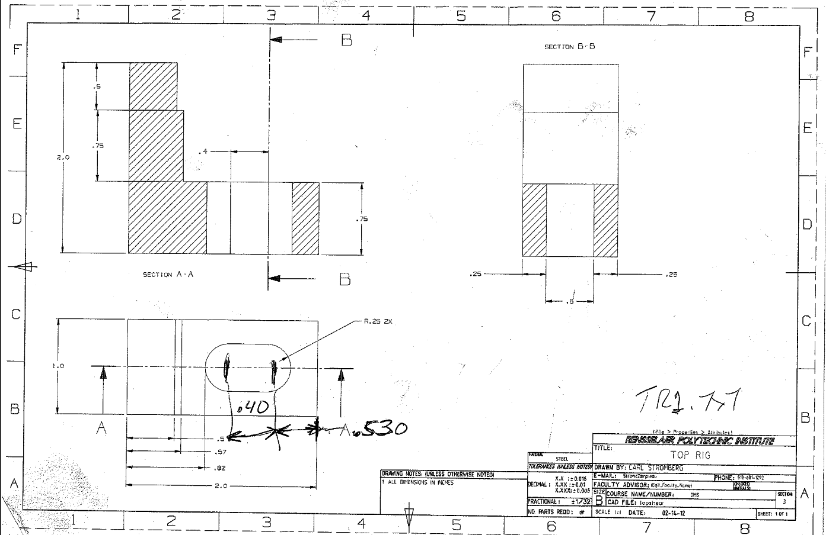
Not the correct hatch pattern for Steel
Standard view layout and alignment not followed. Upper right should be axonometric view.
Stacked Dimensions not appropriate. Use baseline dimensioning instead.
Centerlines & Center marks necessary to convey important dimensions and relationships (e.g. symmetry)
Baseline dimensioning used

