Slide 1


Slide 2
Applications of Controls, Sensors & Basic Electric Circuits and LabView
Mark Anderson – The Design Lab at Rensselaer
Jeff Braunstein - ECSE

Slide 3
Agenda
Controls / Sensors / Circuits Overview – 50 minutes
LabVIEW Overview – 35 minutes
Most of Today’s Concepts & Material Will Serve as Reference Material for Your Team Projects. Download it Later for Easy Access!

Slide 4
Learning Objectives
Identify the basic control strategies
Recognize and apply simple electric / electronic circuits for controls
Select typical input sensors
Select typical output devices
Select an appropriate motor type
Be aware of the additional resources in LMS
Understand the basic use of LabVIEW
Notes:
So – Why are we sharing this material? We hope to bring everyone up to a common understanding of the fundamentals of control.

Slide 5
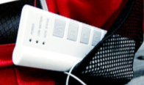
What is Your Major?
A – Mechanical / Aero / Nuclear
B – Electrical & Computer Systems
C – Civil / Environmental
D – Industrial & Systems, Materials
E – Bio / Biomed
Note – If your Major is Journalism, You Might Be On the Wrong Campus!
An iClicker Moment!
Notes:
Just a quick iClicker Survey

Slide 6
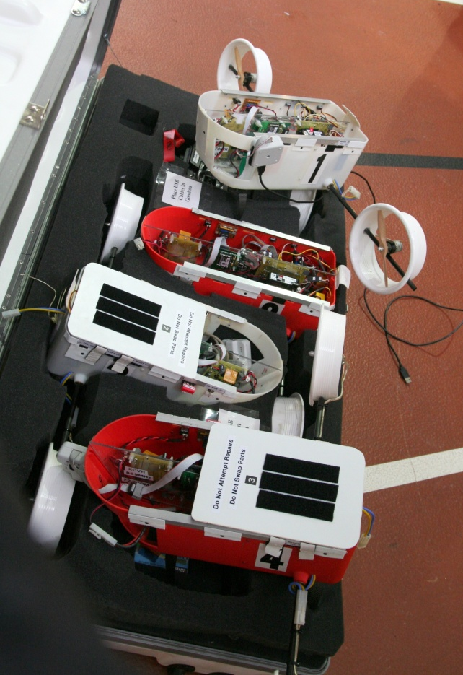
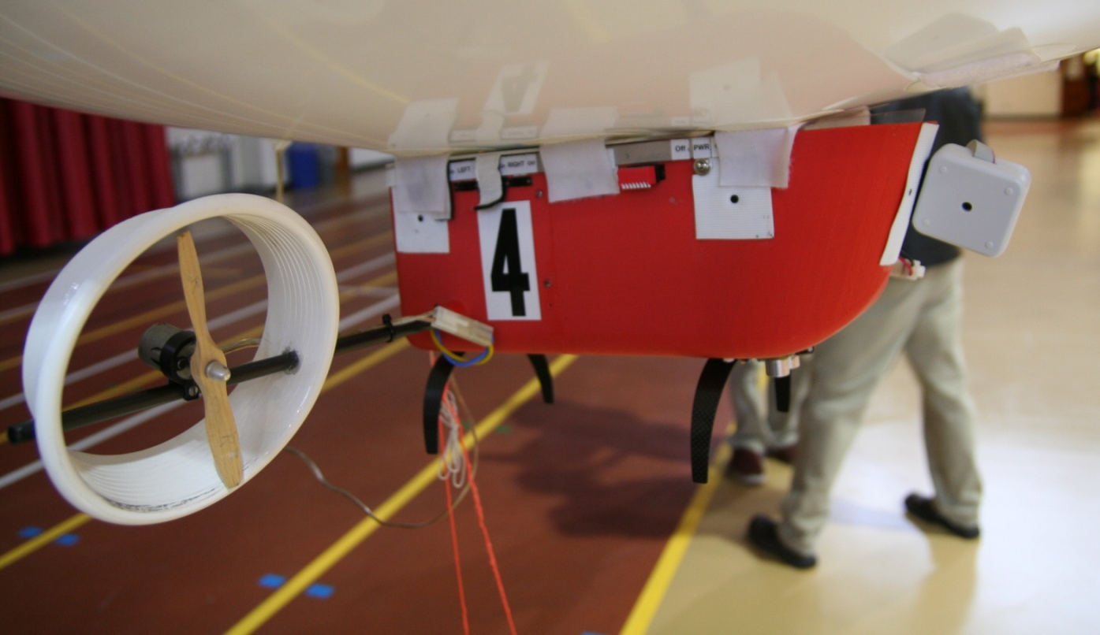
An Example Control System
Blimps – Altitude and direction controlled using range and compass sensors
Notes:
Shout out WHAT things are controlled?
Shout out HOW they are controlled?
Shout out WHY those are controlled?
Who / What / When / Where / Why / How / How Much

Slide 7
Controls Concepts
Discrete (on/off switch, binary)
Continuous (analog; speed: rpm 0-1000; temperature)
  Device State (memory) e.g. light switch; electronic flip-flop
  on/off (position of a light switch, set/reset latch, electronic flip flop)
  empty/filling/full/emptying, etc. (washing machine, toilet)
Hysteresis (dead zone/dead time)
  Schmitt trigger
  Thermostat/heater system
Discrete control of continuous variable (thermostat)
Closed loop control
Open loop control
Notes:
Discrete vs. Continuous
Hysteresis – Thermostat example –
helps keep the system from continuously adjusting
Not always desirable!
Open / Closed on next slide

Slide 8
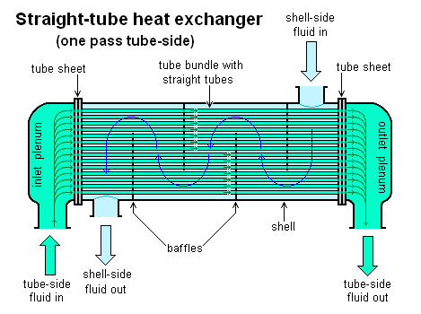
Control Systems
Take 3 minutes and identify some control systems that do not have electrical components.
http://en.wikipedia.org/wiki/Heat_exchanger
Notes:
I asked about your majors and tried to come up with an example that each of you may recognize.
One way of grouping these is by the type of “hardware” used to perform the control functions.

Slide 9
Types of Controls & Systems
(Loosely Organized by Controlling Hardware)
Mechanical
Fluid (Pneumatic / Hydraulic)
Aeronautic
Nuclear
Biomedical
Electrical / Electronic
Computer
Hybrid (All or Most of the Above!)
Notes:
I asked about your majors and tried to come up with an example that each of you may recognize.
One way of grouping these is by the type of “hardware” used to perform the control functions.

Slide 10

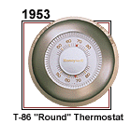
Mechanical
Drinking Bird
“Round” Thermostat
http://en.wikipedia.org/wiki/Drinking_bird
http://www.youtube.com/watch?v=Yk71GY02diY
http://www.honeywell.com/sites/honeywell/ourhistory.htm,
Viewed 9/15/2009
These examples do not include a
microprocessor / microcontroller!
Notes:
The thermostat is a great example of KISS. Do we all know what KISS is?
What does the drinking bird do? Its an oscillator!

Slide 11
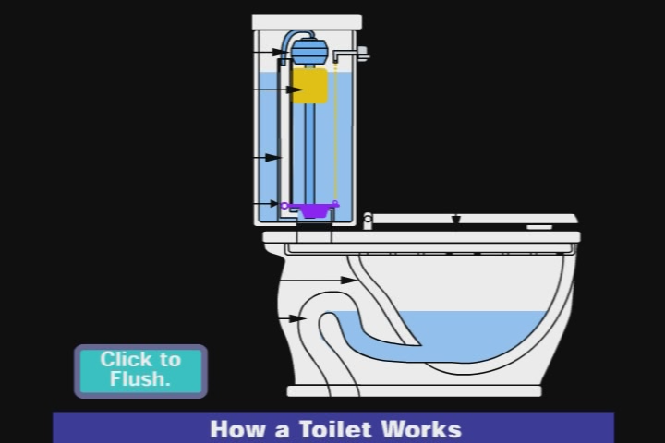
Fluid
The Toilet
Notes:
For most of us, this should be a common item.
How many have actually “looked under the hood”?
How does it work?

Slide 12
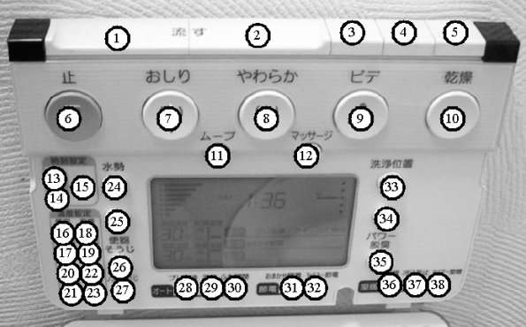
Wireless Toilet Control Panel
Source: http://upload.wikimedia.org/wikipedia/commons/2/25/Wireless_toilet_control_panel_w._open_lid_Numbered_Buttons.jpg, Viewed 9/15/2009
Notes:
In this case we can imagine that the output device is mechanical, the input device is possibly hydraulic and the controller is a combination of electronics and microcontrollers.

Slide 13
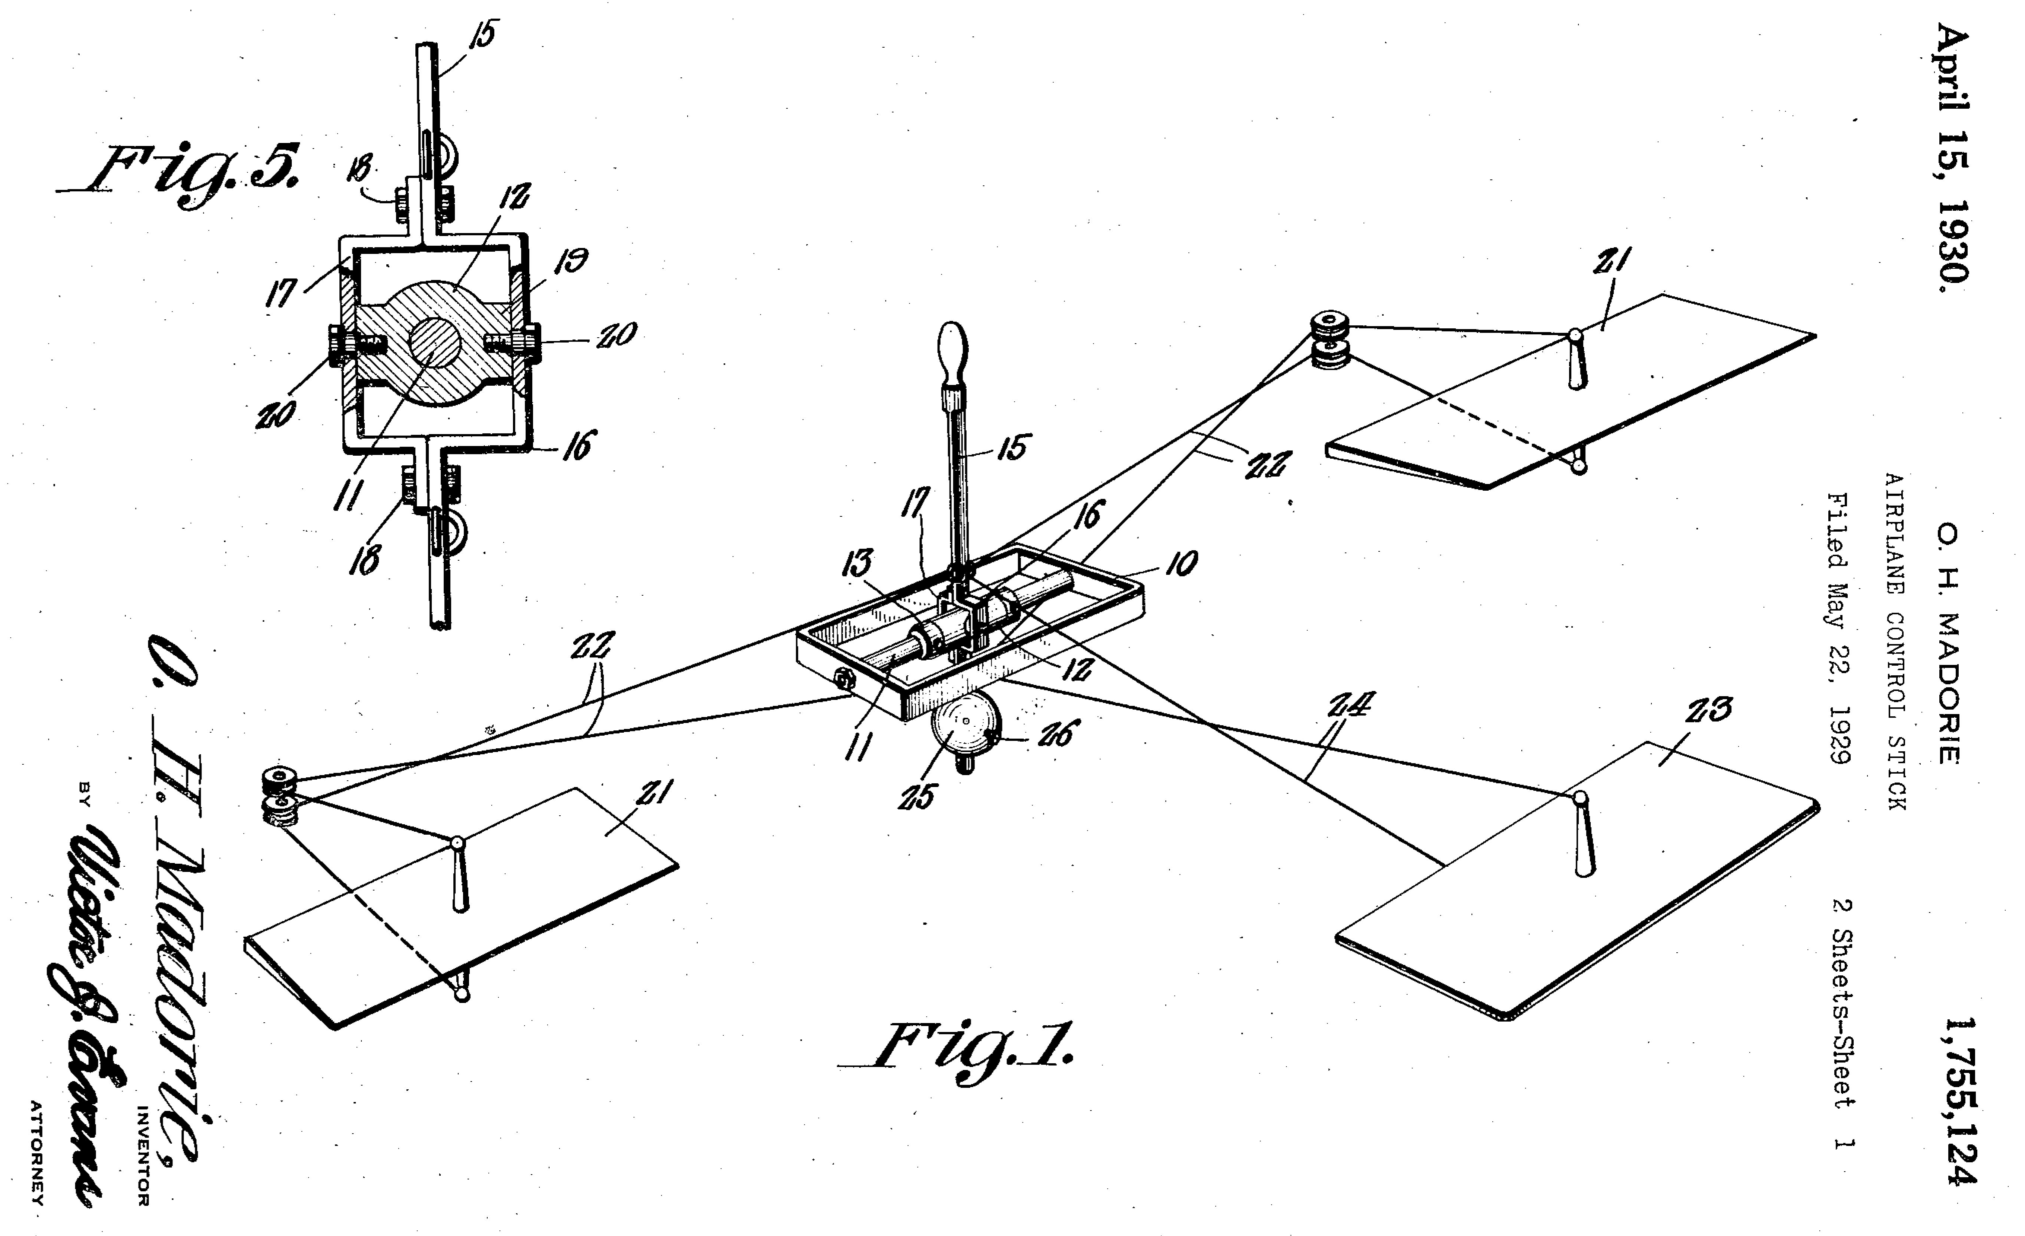
Aeronautical
Biplanes used a control stick for pilot
Feedback to pilot from force on the stick
http://www.freepatentsonline.com/1755124.html, viewed 9/15/2009
Notes:
Haptic technology is the branch of controls where part of the user interface includes touch.
For all you gamers, its important to understand “prior art”!
This is also used in developing things like surgical instruments and is required for developing robots that can pick up eggs without crushing them.

Slide 14
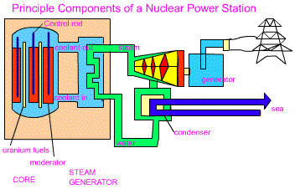
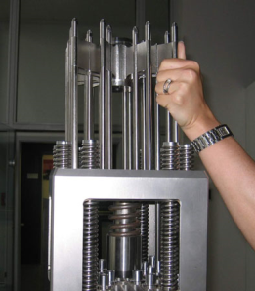
Nuclear
Reactors use control rods to modulate the speed of the fission process
http://library.thinkquest.org/27954/reactor.htm,
Viewed 9/15/2009
http://en.wikipedia.org/wiki/File:Controlrods.jpg,
Viewed 9/15/2009
Note – production systems do NOT employ human actuators!
Notes:
The position of the control rods can be changed.
When they are deeply inserted, fission is minimized. When removed, maximum fission occurs.

Slide 15
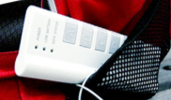
Biomedical
An iClicker Moment!
If You Stand up and
Turn around 3 times
Do You Feel dizzy?
What is your body’s balance feedback device?
A – brain
B – muscles
C – inner ear
D - cornea
Why? How?

Slide 16
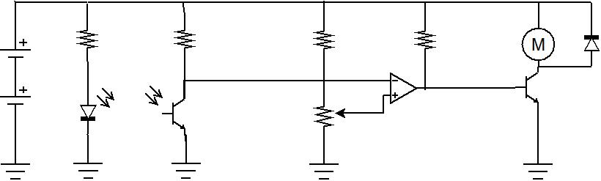
Electronic
Op-amps / Comparators
Basic Line Follower Circuit
Notes:
Is this Open or Closed loop control? And why? If there is feedback, where does it come from / how does it happen?
This circuit is duplicated for the other wheel motor.

Slide 17
Which of the following can be measured electronically?
Acceleration
Temperature
Mechanical Strain
Carbonic Monoxide Levels
None of the above
An iClicker Moment!

Slide 18
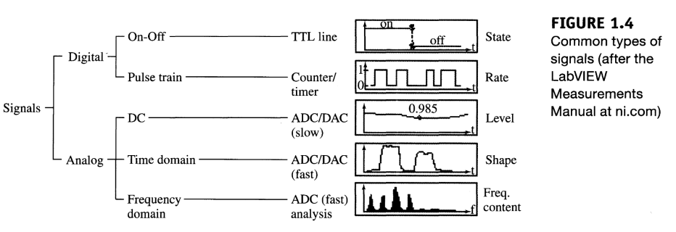
Signal Types
Introduction to Data Acquisition with LabVIEW, King, 2009)
Signal Type Determines the Type of Input / Output Electronics Needed
Microcontrollers or Electronic Circuits can Convert Between The Signal Types
Notes:
Signals come in many types!
Making a list of all your signals, the name of each, what its used for, and the electrical characteristics will help plan your I/O requirements.
Although this is very helpful for circuit based solutions, its critical for microcontroller & computer based solutions.

Slide 19
Basic Line Follower Circuit
Revisited
One Copy For Each Wheel
The Comparator Function Can Be Combined with Different Inputs / Outputs
For Other Applications
Notes:
LED provides the signal to be monitored
Phototransistor detects the presence of light
A voltage divider provides a reference voltage.
The op amp / comparator then compares the phototransistor output voltage to the reference
When the phototransistor output is LESS than the reference, the comparator output goes high.
This energizes the output power transistor.
Which allows current to flow through the motor! The diode is there to protect the power transistor from reverse voltage spikes that could destroy it.

Slide 20
Basic Line Follower Circuit
Revisited
Each of these Sections is a
Subsystem of this Control System.
Notes:
LED provides the signal to be monitored
Phototransistor detects the presence of light
A voltage divider provides a reference voltage.
The op amp / comparator then compares the phototransistor output voltage to the reference
When the phototransistor output is LESS than the reference, the comparator output goes high.
This energizes the output power transistor.
Which allows current to flow through the motor! The diode is there to protect the power transistor from reverse voltage spikes that could destroy it.

Slide 21
Which of the following devices have you used today?
A - Antenna
B - MOSFET
C - Amplifier
D - None of the above
E - All of the above
An iClicker Moment!

Slide 22
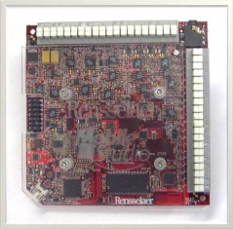
Computer
Microcontrollers
  PSoC 4 / PSoC 5
  LITEC 8051 Board
  Arduino / ATMega
  Raspberry Pi
Hardware Input / Output Interface
  Mobile Studio IO Board
  Agilent – Discovery Board
  LabJack U12 (works with LabVIEW)
Software
  LabVIEW
  C / C++
http://en.wikipedia.org/wiki/File:RED2-final-640x480.jpg, Viewed 9/15/2009
See LMS
And MANY More Possibilities!
Notes:
Everyone has a “favorite” microcontroller / microprocessor / IO device
PSoC 4 is new to the list!
But the real selection should be made based on the engineering criteria perhaps weighted by your experience.

Slide 23
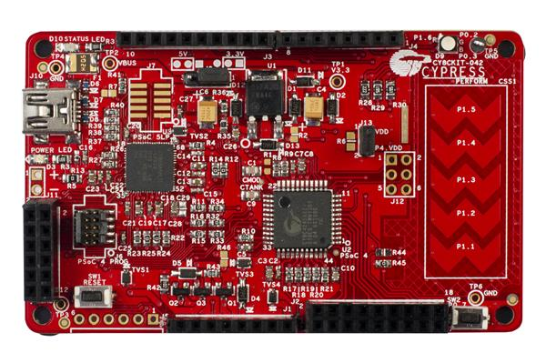
Microcontrollers – PSoC
Developed by Cypress
Available in Multiple Models (1,3,4,5) Each with a Variety of Features
Used in Industrial / Commercial Applications
  Touchpad Controller on Laptops
  Game Boy Micro
  Fire Detectors
  Alarm Clocks
PSoC 4 Pioneer Kit

Slide 24
Microcontrollers – PSoC
Analog Functions
  On-board Amplifiers, i.e. op-amps **
  Analog to Digital Converters (ADC)
  Digital to Analog Converters (DAC) **
  Filters **
  Comparators **
Digital Functions - Implemented in Hardware
  Timers **
  Counters **
  PWMs **
  SPI
  UARTs
Communication Interfaces
  I2C, SPI
  USB
A Limited Number of PSoC 4 Pioneer Kits Will Be Available to Borrow From the IED Shop!
** NOT available on most Arduinos

Slide 25
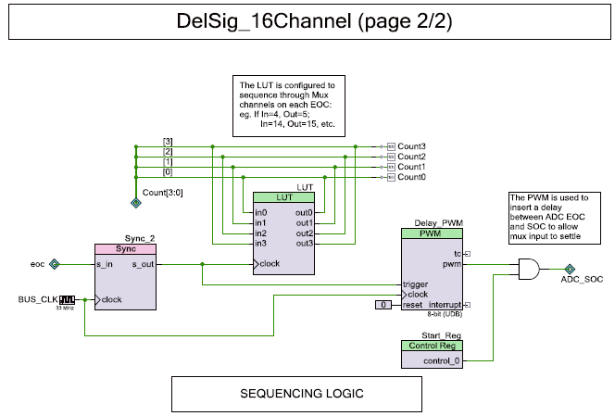
PSoC Programming
LCD_Start();
ADC_Start();
Delay_PWM_Start();
for(;;)
{
LCD_ClearDisplay();
LCD_PrintString("Channel: ");
LCD_PrintNumber(curChan);
LCD_Position(1u, 0u);
LCD_PrintNumber(result[curChan]);
/* If SW2 is pressed */
if(!ChannelSelect_Read())
{
/* Increment to next channel for display */
curChan++;
}
}
Uses Both “Schematic” and C

Slide 26
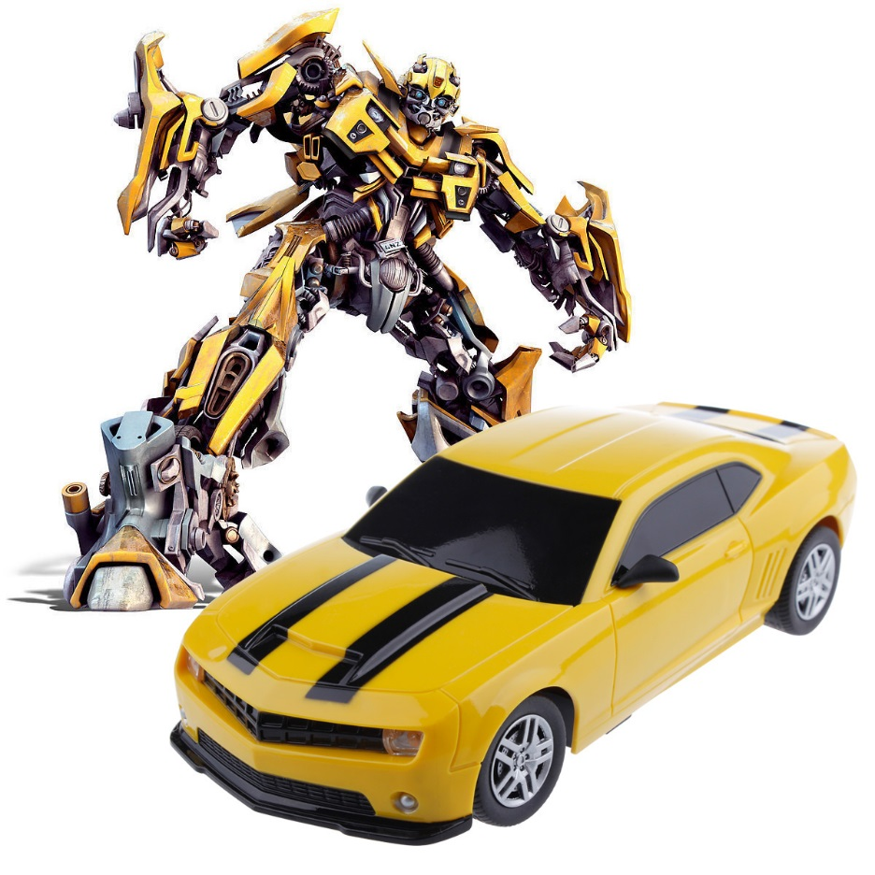
How many control systems are in a modern car?
A – One(s)
B – Ten(s)
C – Hundred(s)
D – Thousand(s)
http://www.embedded.com/electronics-blogs/significant-bits/4024611/Motoring-with-microprocessors
http://www.aliexpress.com/item/2013-New-GIFT-Child-Electric-toy-RC-Car-Bumblebee-Remote-Control-Charge-Car-toys-High-Speed/1346815394.html
An iClicker Moment!
Notes:
Just a quick iClicker Survey

Slide 27
Controls: Common Examples
Common System | Hardware Category | Control Category | Sensor | Actuator | What is controlled
Household lights | Electrical | Open loop | NONE | Light bulb | Light level
Heater with Thermostat | Electro-mechanical | Closed loop | Bimetallic Thermostat | Heating Element and Fan | Temperature
Toilet Tank fill system | Mechanical & Hydraulic | Closed loop | Float | Valve | Liquid level
Intelligent Battery Charger | Electronic | Closed loop | Voltage detector circuit | Current output transistor | Charge Current
Cruise Control (traditional) | Pneumatic ( & Electro-mechanical for activation) | Closed loop | Vacuum bellows | Vacuum bellows | Throttle position (thus vehicle speed)
Notes:
In summary
A complete system can be viewed as a combination of the various elements.
Note – this is ALSO a Concept Combination Chart! You can, to some degree, mix and match the columns!

Slide 28
Open vs. Closed Loops
Motor Controller Block Diagram
Input
Device
Controller
Control Signal
Command Signal
Motor
Adding Feedback Creates a Closed Loop
Feedback Signal
Position, Speed
Notes:
With an open loop system we can have an input device that turns it on or off or sets a desired speed.
But how do we know the motor actually started or reached the desired speed?
We need to add feedback!
With feedback we can know its speed and possibly its position as well.

Slide 29
Open vs. Closed Loops
What is different about these two circuits?
Notes:
With an open loop system we can have an input device that turns it on or off or sets a desired speed.
But how do we know the motor actually started or reached the desired speed?
We need to add feedback!
With feedback we can know its speed and possibly its position as well.

Slide 30
What Device(s) to Use?
Physical | Use This Sensor | Use This Actuator
Light (visible or Infrared) | Photocell / Phototransistor | LED / Lamp
Temperature | Thermistor / Bimetallic Strip / Thermocouple / IC’s | Resistive Wire (Nichrome)
Contact | On/Off Switch
Water Level | Float / Conductivity
Sound | Microphone | Speaker
Force | Strain Gage / Load Cell / Piezoelectric Transducer | Motor / Solenoid / Pump (fluid flow / pressure)
Position / Distance | Potentiometer / Optical Encoder / Ultrasonic | Motor / Solenoid
Motion | Accelerometer / Gyro | Motor / Solenoid / Pump
Use A Power Transistor or Relay To
Control High Voltage / High Current Devices
Notes:
First you need to figure out what physical principle you need to observe & measure.
The Line Followers tracked visible or IR light.
Your PC probably uses temperature sensing IC’s to monitor the CPU / motherboard temperature.
The Roomba “bounces” off the walls by detecting contact.
A sump pump in your house detects the water level
Etc.
Can you think of applications with these other items?

Slide 31
Motor Types
AC – Good for Open Loop
DC – Good for Open Loop
Stepper – Great for Positioning
Servo – Implies Built-in Feedback Sensor Useful for Close Loop Control
Feedback Can Be Added to 1 – 3 to Create a Closed Loop System
Adding a Built-In Gearbox to 1 & 2 Makes it a Gearmotor
Notes:
Motor Selection can be a difficult challenge unless you understand the various types of motor.
These are the types you might typically find & use in an IED project.

Slide 32
Motor Characteristics
Voltage * Current = Power
Speed Range
Motor Body Size
Shaft Dimensions
Torque
You Can Potentially Save Time, Cost, and Effort if You Can Adjust Your Proof of Concept Design to Apply the “Standard IED Motor”
Notes:
Selecting a motor does not start the motor specs. It starts with your design requirements!
What voltage / current range can you power?
How fast does the shaft need to turn vs. how fast does the item being turned really need to go?
How much space is available to fit the motor into?
If you have gears / pulleys / etc. – what size is the motor shaft?
How much power is needed and at what speeds? Remember the mousetrap cars – some models “stalled” at the start but ran fine once they got moving.
From those you seek to find a matching motor.
If your project seems to need a different or larger motor you may be able to work with your instructor to simplify your design.

Slide 33
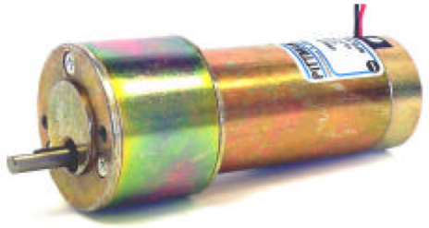
The “Standard IED Motor”
Key Fact !
Available in the Shop
Specs on LMS
Go to LMS, Find & Download the Data Sheet
See LMS
Notes:
You can obtain these in the shop.

Slide 34
What is the Maximum Voltage for the standard IED motor?
5 volts DC
9 volts DC
12 volts DC
24 volts DC
120 volts AC
Hint – You Will Find This On the Data Sheet!

Slide 35
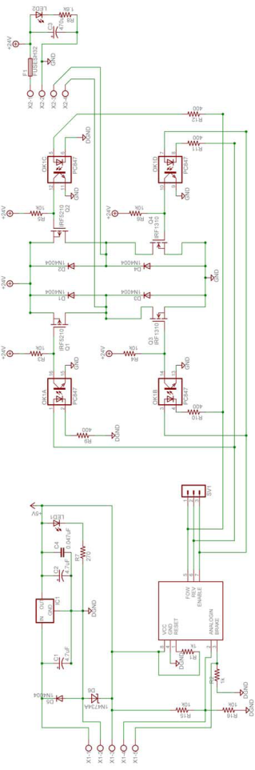
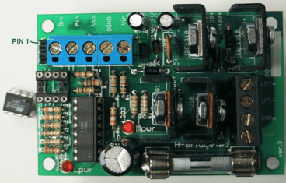
Controlling a Motor Using the
H-Bridge
Can Control
  Speed
  Direction
See LMS
Notes:
Remind them – its available for sign-out.
The schematic shows a power regulator, a control chip and a power amplifier section. By using it as a function block you don’t need to worry about its internal details, only how its applied.

Slide 36
Controls: Working Example
Common System | Hardware Category | Control Category | Sensor | Actuator | What is controlled
Temperature Monitoring & Control | Electronic / Micro-controller | Closed loop | Temp Sensor Type - TBD | Output transistor driving: Heating Unit Fan | Temp 32 – 212°F
LMS -> Technical Resources -> Manufacturing Resources
Select one Parts Source and Search There to Identify two different types of temperature sensor
  how do they interface?
  cost?
  temperature range?
Sketch a Block Diagram of the Closed Loop System
3 minutes

Slide 37
Controls: Working Example
Power
Transistor
Analog
Signal
TEMP
SENSOR
MICROCONTROLLER
HEATER
Feedback
Placing the Temperature Sensor Near the Heater Provides the
Feedback Needed for Closed Loop control

Slide 38
What is ‘PID’ when talking about a PID controller?
A – Pride, Integrity, Determination
B – Π Ι Δ
C – Pie, Ingestion, Drowsiness
D – Proportional, Integral, Derivative
An iClicker Moment!

Slide 39

PID – Applications
Take a few minutes, think of some examples where Proportional, Derivative and Integral Control is needed.
An iClicker Moment!
https://itunes.apple.com/us/app/the-little-engine-that-could/id409139980?mt=8

Slide 40
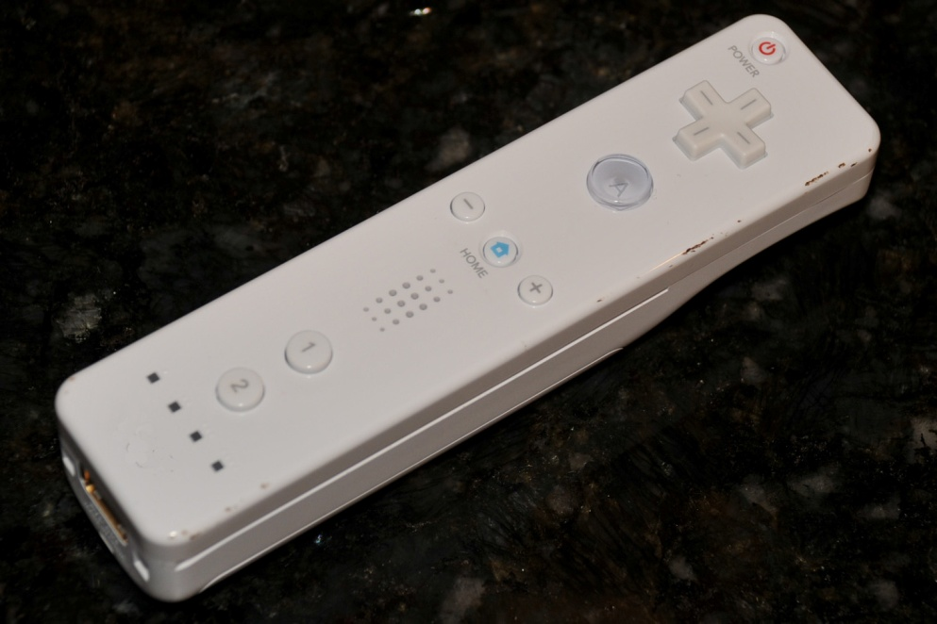
What is this?
TV remote
PS3 remote
Wii mote
I don’t know
An iClicker Moment!

Slide 41
PC Compatible Input / Output
Input
  Wireless Connection (Bluetooth)
  Contact (12 Switches)
  Motion Sensing (Accelerometer)
    3-axis
    +/-3g, 100Hz update rate
  Position (Infrared Camera Tracker)
Output
  Tactile feedback (vibration motor)
  Auditory feedback (speaker)
  Visual feedback (4 LEDs)

Slide 42
For More Information
Overview - How the Wiimote Work
  http://www.youtube.com/watch?v=ETAKfSkec6A
Technical & Linux
  http://www.wiili.com
Technical - Wiimote at WiiBrew
  http://www.wiibrew.org/wiki/Wiimote
Last Accessed – 10/8/09
Notes:
Skip over in lecture

Slide 43
Wiimote under MS Windows
Install WiimoteLib.dll
    Open Source (Microsoft Public License)
    http://www.codeplex.com/WiimoteLib
Write a Program
  C# or VB.NET
    http://blogs.msdn.com/coding4fun/archive/2007/03/14/1879033.aspx
  LabVIEW (8.6 or Later)(only this needed for demo!)
    http://decibel.ni.com/content/docs/DOC-1353
    (download currently includes the WiimoteLib)
Last Accessed – 10/8/09
Notes:
Skip over in lecture

Slide 44
Wii Remote Applications/Ideas
J.C. Lee, “Hacking the Nintendo Wii Remote”, IEEE PERVASIVE Computing, July-September 2008, pp. 39-45
  Finger and object tracking
  Interactive whiteboards & tablet displays
  Head tracking for desktop VR displays
  Spatial augmented reality
  3D motion tracking
  Tracking objects with ID
  IR glyphs
  Laser tag
  Gesture recognition

Slide 45
Sample LabVIEW Applications
    WiimoteManaged(wml17).zip available at http://decibel.ni.com/content/docs/DOC-1353
      Acquisition + IR (Event).vi
      Roll Pitch 3dGraph (Event).vi
      Simple Flash LEDs
Last accessed on 10/12/09
Notes:
Skip over in lecture

Slide 46
Bluetooth Pairing
Managed Library for Nintendo’s Wiimote
  Getting Connected section
  http://blogs.msdn.com/coding4fun/archive/2007/03/14/1879033.aspx
Last Accessed: 10/12/09
Notes:
Skip over in lecture

Slide 47
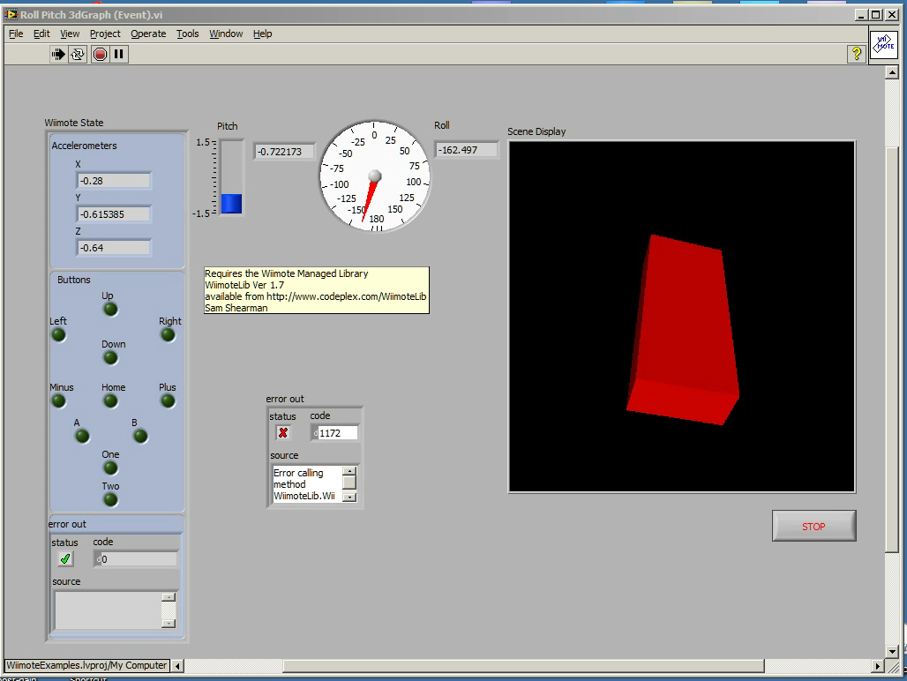
A Little Demo!
Roll Pitch 3dGraph (Event).vi

Slide 48
Senior Design Capstone Project
Problem
  Develop a method for quantifying human static balance
Concept
  Accelerometer as a sensor
Feasibility Study
  Wii remote as a sensor sub-system
Led to the Creation of a Product / Company!
http://www.balancengineering.com/corporate/strategic-partners

Slide 49
WiiMote Summary
Key Ingredients
Take one WiiMote
Add one Lenovo Laptop
Use their built-in Bluetooth Communications
Sprinkle them with a little LabVIEW programming
YIELDS – One Fully Integrated Control System with Accelerometer Inputs and Graphic Output!
Notes:
Take it away Junichi

Slide 50
Transfer Functions
Insert Scary Math Here…
OR
Let’s see a working example…

Slide 51
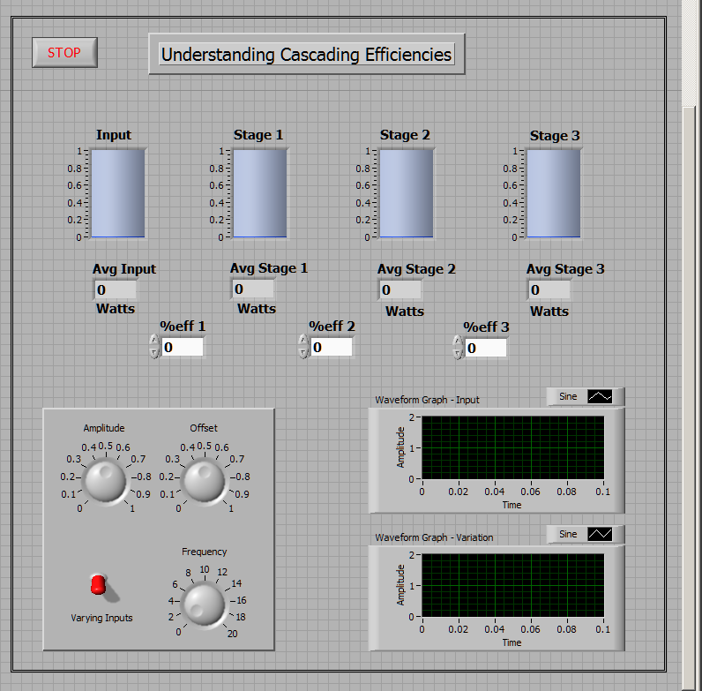
LabVIEW for Demonstrating Cascading Efficiencies
- Front Panel

Slide 52
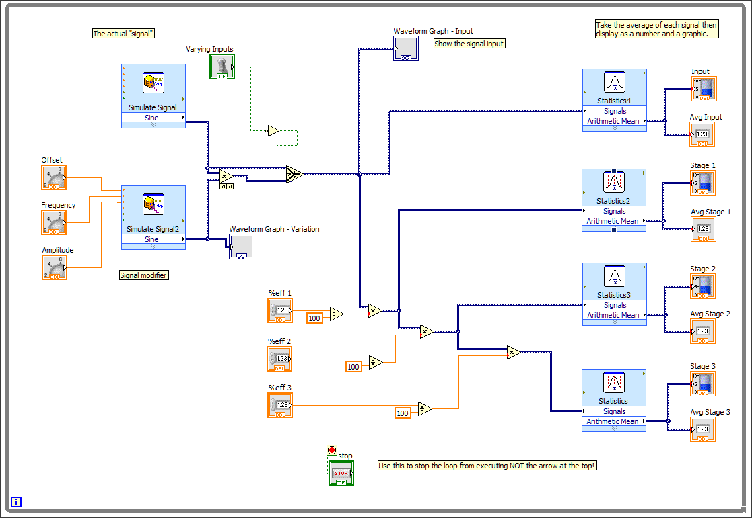
Block Diagram

Slide 53
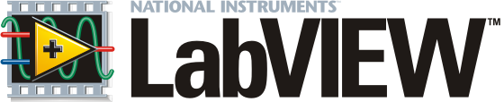
Introduction to LabVIEW

Slide 54
Learning Objectives
To realize that any engineer can do programming
To recognize LabVIEW’s major functionality
To discover how to start learning LabVIEW
To identify how LabVIEW may be used for Your Team Projects

Slide 55
iClicker –
First Robotics Competition (FRC)
I participated in the FRC and used LabVIEW
I participated in the FRC but did not use LabVIEW
I did not participate in the FRC
An iClicker Moment!

Slide 56
iClicker –
What programming system do you prefer?
Matlab
C/C++
Java
Python
Something else
An iClicker Moment!

Slide 57
What is LabVIEW?
LabVIEW (short for Laboratory Virtual Instrumentation Engineering Workbench) is a system design platform and development environment for a visual programming language from National Instruments.
used for data acquisition, instrument control, and industrial automation by Bose, GE, General Dynamics, etc.
source - Wikipedia
LabVIEW is a Product of National Instruments

Slide 58
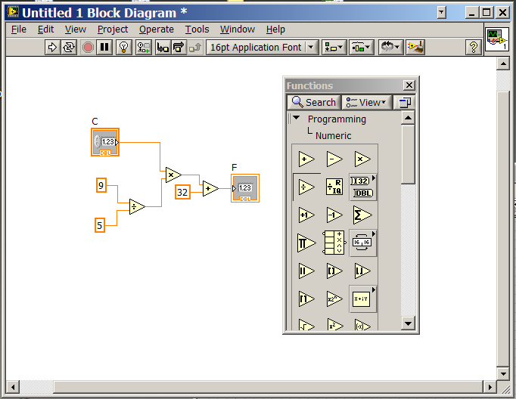
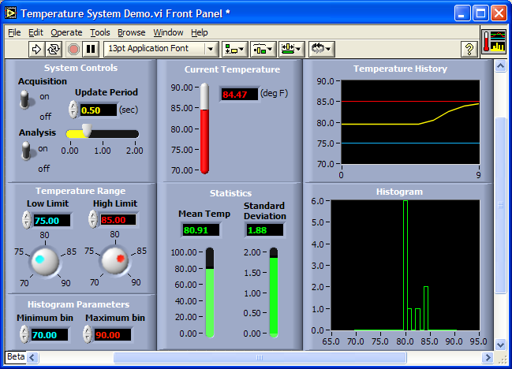
Background
Graphical Programming Environment

Slide 59
Background (cont’d)
Platform and development environment for a visual programming language
Graphical approach also allows “non-programmers” to build programs simply by dragging and dropping virtual representations of lab equipment with which they are already familiar
Commonly used for data acquisition, instrument control, and industrial automation

Slide 60


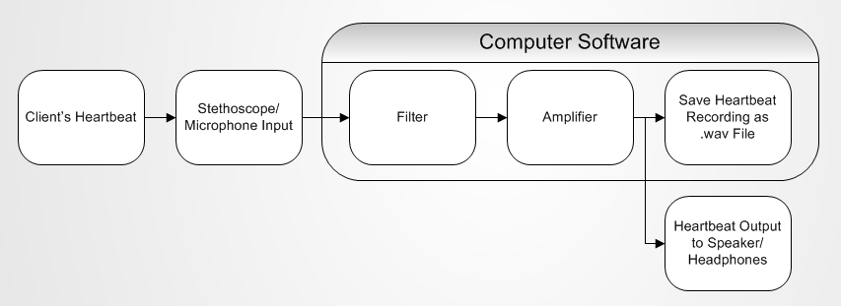
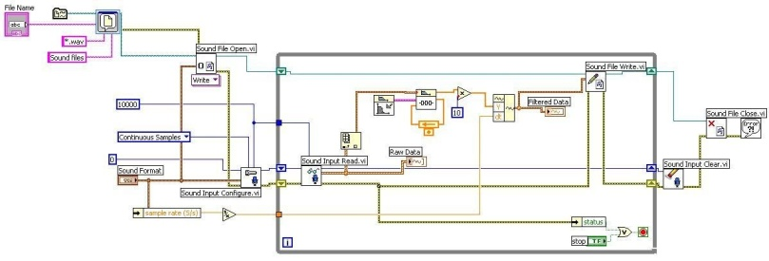
Programming for Engineers
Identify Problem
Break Down and Evaluate Problem
Resolve Problem
I need improvement
Signal Process Break Down
Block Diagram
Software-Based Solution
Notes:
Evaluation – Solve a problem using hardware or software

Slide 61
Intro Video –
Your First LabVIEW Program
On YouTube
http://youtu.be/ZHNlKyYzrPE
The Complete Set of Videos
http://www.ni.com/academic/students/learn-labview/

Slide 62
Intermediate Video – CompactRIO
Video showing more LabVIEW features and the use of a CompactRIO can be found at:
http://www.youtube.com/watch?v=PubUdY5x3ps
“CompactRIO is a reconfigurable embedded control and acquisition system. The CompactRIO system’s rugged hardware architecture includes I/O modules, a reconfigurable FPGA chassis, and an embedded controller.”
– National Instruments website: http://www.ni.com/compactrio/whatis/ viewed 7/15/2013

Slide 63
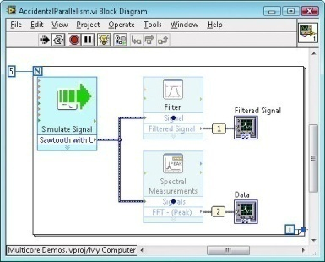
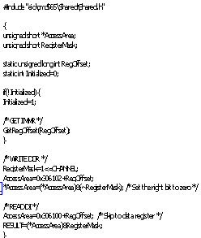
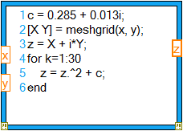
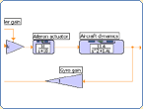
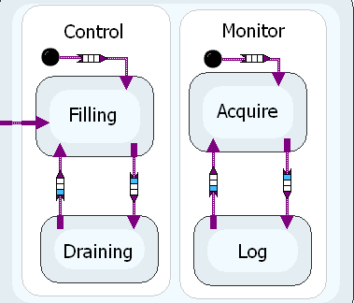

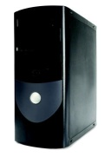
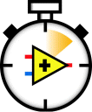
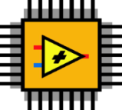

High-Level Design Models
Data Flow
C Code
Textual Math
Simulation
Statechart
Desktop
Real-Time
FPGA
Microprocessors
Multiple Execution Platforms
Notes:
Design involves a variety of approaches and techniques optimized for different types of developers and applications.
LabVIEW is an open platform that offers a variety of computational models aligned with these needs. You can mix and match these various computational models in one VI. We’ve discussed graphical dataflow and textual MathScript. Other alternatives include C-code (Formula Node, DLLs, LV Microprocessor SDK), dynamic system simulation (with the Control Design & Simulation Module), and state charts (with the Statechart Module). In addition, and not represented on this slide, there are a number of options for invoking third party software from LabVIEW.

Slide 64
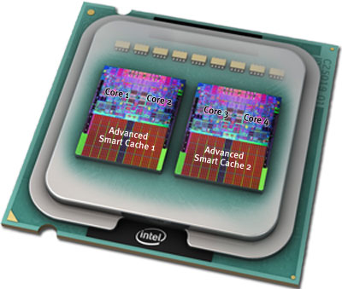
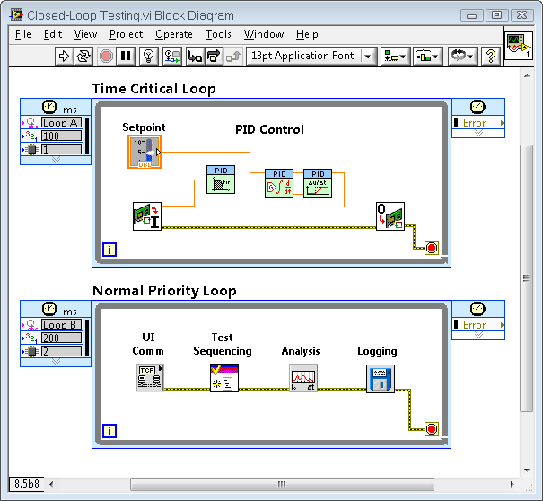
Design, Prototyping & Deployment with NI LabVIEW
Powerful programming language
  Built-in multithreading & multicore capability
  Ease of integrating graphical & textual programming
  Natively compiled for multiple hardware targets
Tight hardware integration w/ broad range of I/O
Instant & customizable user interface
Extensive libraries for math, optimization, signal processing, control design, image processing, …

Slide 65
Quiz Time!

Slide 66
After-Class Exercise
– Acquire Audio Signal
Customer Requirements
  Capture Sound
  Filter the waveform
  Display the filtered waveforms
Approach
  Take sound from the laptop’s microphone (Acquire Sound)
  Pass it through a filter (Filter)
  Display as a graph (Waveform Graph)

Slide 67
After-Class Exercise
- How To Create the Exercise
Visit LMS, go to:
  Lectures, Week 6 – Controls
Download the Word document –
“Acquire Audio Exercise”
Launch LabVIEW
Follow the instructions!
Take 15 Minutes @ home

Slide 68
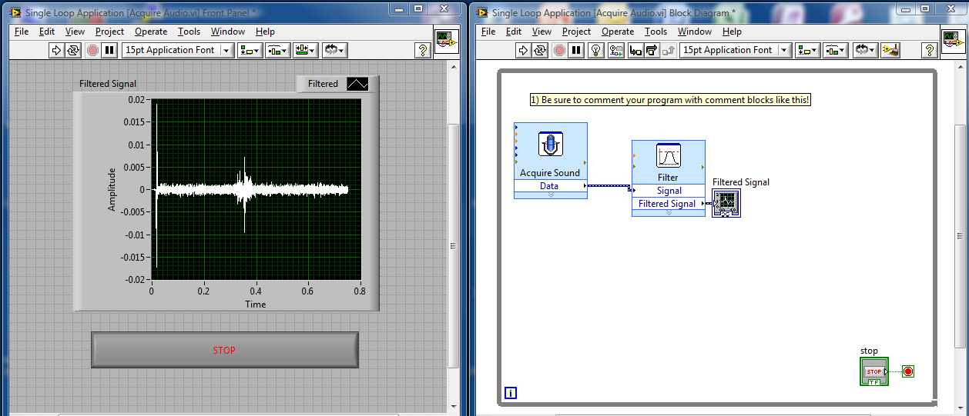
Final Program
Use Control-T to show both the Front Panel and the Block Diagram

Slide 69
Top 5 Reasons to Learn LabVIEW
Natural transition from problem description to problem solving
Bang for your buck: Learn one software and program multiple hardware platforms
Applications in just about every industry you can think of
Large and diverse user community: focus on your invention, not re-inventing the wheel
It’s a Marketable Job Skill !
You already have a license !
  Mac OS and Linux versions also available (White DVD)
  Can Download at Help Desk or From Campus Server
Notes:
http://narnia.cs.ttu.edu/drupal/node/34 – Installing LabVIEW to Ubuntu

Slide 70
How do I learn more?
Tutorial and Sample Codes Available from Splash Screen of LabVIEW
NI.com - On-line Tutorial / Training Modules
  Academic Self-Paced Learning Modules
  NI Developer Zone
YouTube
  Computer Based Training LabVIEW Basic I and II
    Yellow DVD 2 of 2 available at the VCC Help Desk

Slide 71
What can I do with it?

Slide 72
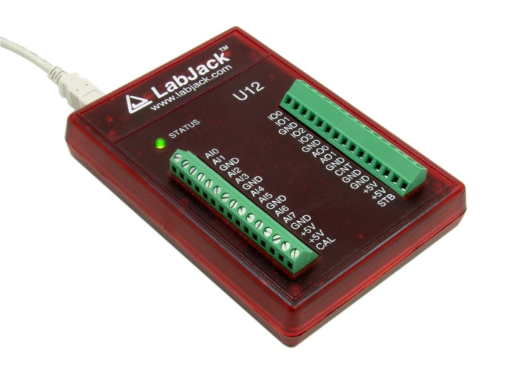
Using LabVIEW for IED
Use the LabJack to Interface to your Project
Design a VI (Virtual Instrument) to Monitor and/or Control your Project
Implement The VI
View Data on Screens and/or Log to a File
LabJack U12
Does NOT Require a Microprocessor!
Notes:
LabVIEW can be used as a testing subsystem!

Slide 73
LabVIEW Ideas for
IED Team Projects
Data Collection & Display
Data Logging
Data Analysis
Simple Open or Closed Loop Control
Vision Control – identify colors / size
The LabJack U12 is available for sign-out in the IED Shop. Provides Digital and Analog Inputs and Outputs.

Slide 74
LabVIEW Usage @ Rensselaer
– Coursework
Data Collection & Analysis for the US Olympic Skeleton Team – Sr. Capstone Design Project
Monitoring & Analysis of Human Balance – Sr. Capstone Design Project
Data Acquisition for a Motor Test System – Sr. Capstone Design Project
Remote Controlled Color Sensing Vehicle – IED Project

Slide 75
LabVIEW Usage @ Rensselaer
– Teams
Data Collection & Analysis on the Impact Attenuator (bumper) for the Formula SAE & Formula Hybrid teams

Slide 76
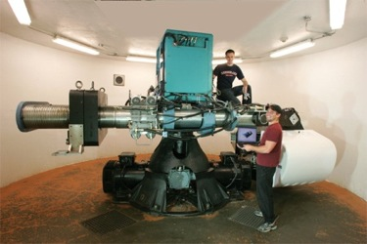
LabVIEW Usage @ Rensselaer
– Campus Facilities
Data Collection & Analysis for Wind Tunnel – JEC & Watervliet
Automation Equipment – CATS / CII
Controlling the Centrifuge – JEC
Picture from the Center for Earthquake Engineering Simulation (CEES) website:
nees.rpi.edu

Slide 77
Piano Staircase Video
http://waterloolabs.blogspot.com/2010/07/mydaq-piano-staircase-video-live.html

Slide 78
LV for tieing ties
http://www.youtube.com/watch?v=c0atClPSTx8

Slide 79
LabVIEW User Group
Typically meet once a semester
  Presentation by an NI engineer
  Sharing experience
Organize Certified LabVIEW Associate Developer (CLAD) exam – Free!!
Contacts:
  Junichi Kanai (kanaij@rpi.edu)
  Mark Anderson (anderm8@rpi.edu)
  Casey Goodwin (goodwc3@rpi.edu)

Slide 80
