Slide 1
Sample WBS by Task Types
System Development
Project Management
Planning, Tracking & Risk Management
Safety Control
Hardware
Training
Development Environment
Changes & Configuration Management
Reports & Meetings
Development
Research & Learning
System (Architecture) Design
Detailed Design
Implementation
Tests
Selection & Purchasing
Installation
Consumables (Spare Parts)
Creating Manuals
User Training
Admin Training
This chart created in Office 2007 PowerPoint using the Insert > SmartArt feature. Once created, the chart can be reformatted as needed.

Slide 2
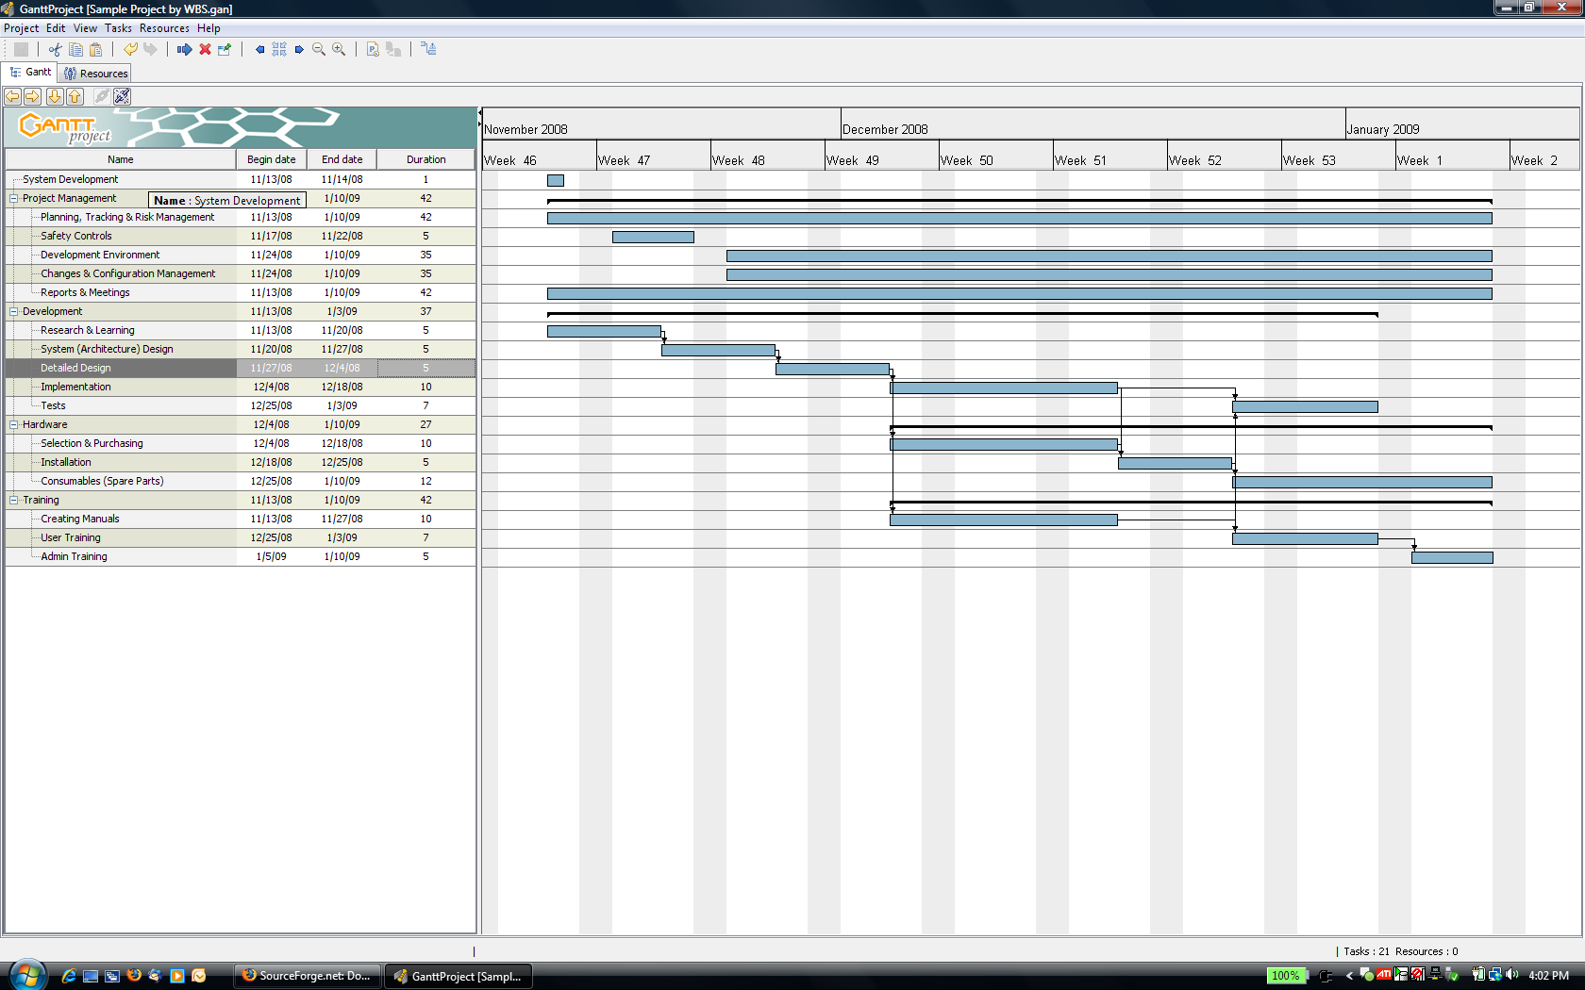
Gantt Chart / Project Plan for
Sample WBS by Task Types
Gantt Project allows you to model the links/relationships between tasks

