Slide 1
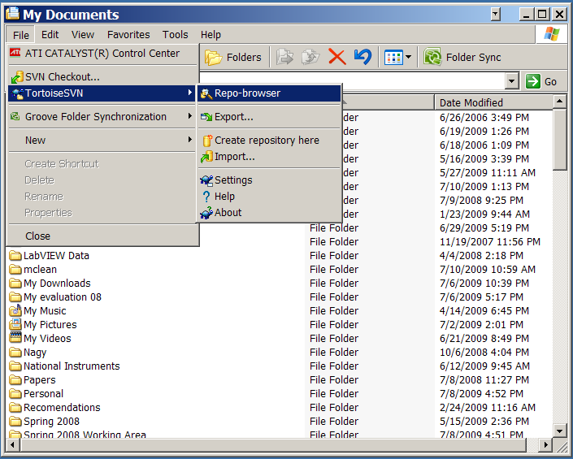
Start TortiseSVN

Slide 2
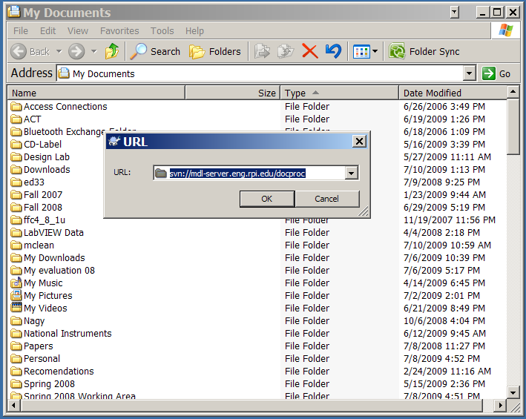
Choose a Repository

Slide 3
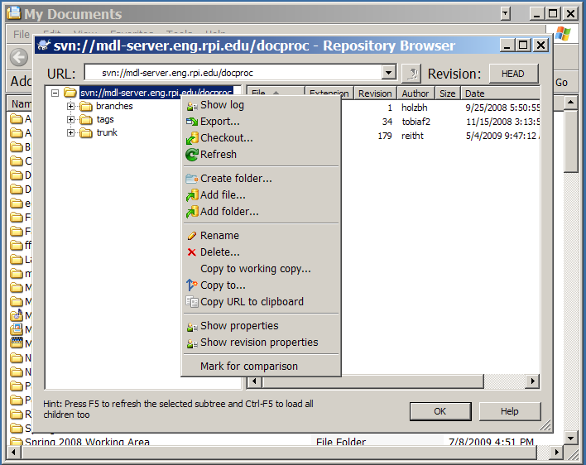
Show a Log

Slide 4
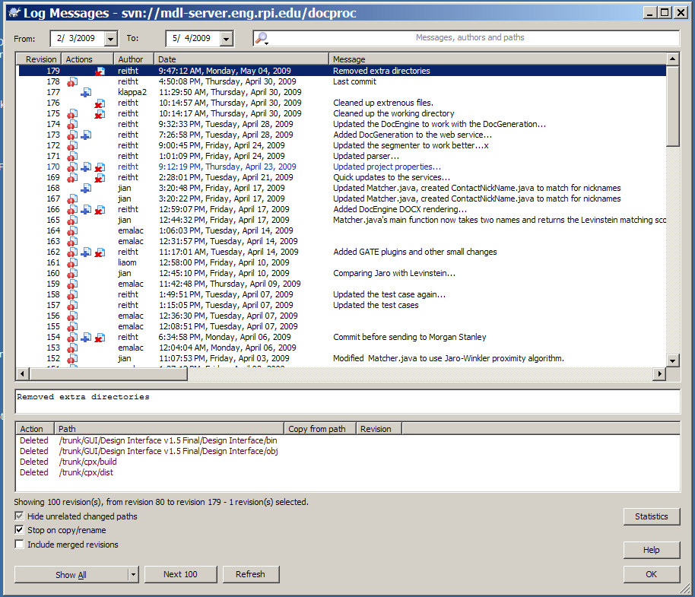
Refining a Report
Reporting Period
Selecting a student

Slide 5
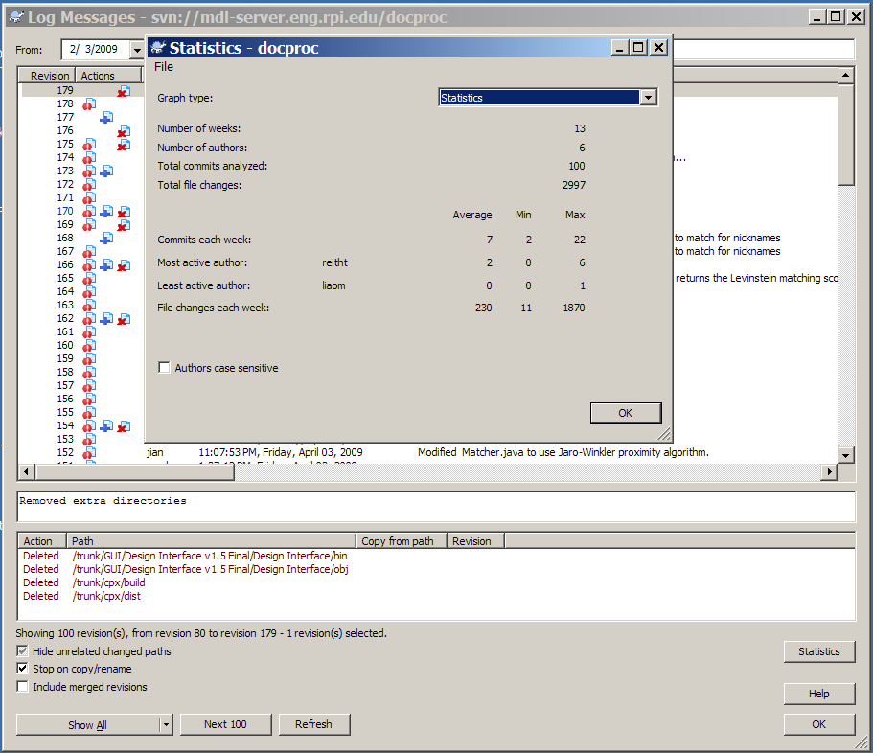
Summary Statistics

