Slide 1
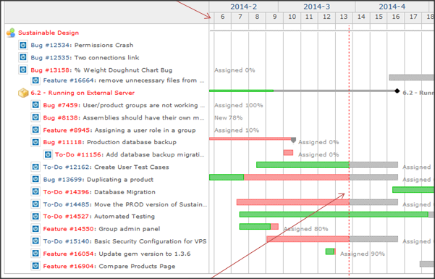
EDN and the Repository
TL;DR

Slide 2
Wiki
Team contact info
Instructions for equipment/software
Standard Operating Procedures (SOP)
Table of Contents to project
Quick links to extra useful stuff
Forums
Repository
Project Wiki
Capstone Support Wiki

Slide 3
Forum
Post ALL work done here
Sketches, documents, PPT, meeting minutes
CAD and Code should go in Repository
Links to externally available information
Include summary and page number of interest
Use version # in filenames
Link to issue where progress is tracked
Drafts encouraged. DO NOT WAIT until complete to post work
Reply with DISCUSSION of work done
Change subject to address content of reply

Slide 4
Repository
Post CAD & Software Code here
Create forum thread to collect discussion on this work
Do NOT add version # or date to file name
Subversion automatically tracks
Comment should explain what changed and why
Everything else should go in Forums

Slide 5
Issues
Track all work for project completion
Short duration (NEVER more than 2 weeks)
Measurable outcome
DO NOT document dialog of progress on Issue
Create a Forum thread to collect deliverables and discussion
Add link to forum thread in Issue
Update status as progress is made
Assigned : team member chosen to complete task
Working : Post link to artifacts (document, spreadsheet, etc..)
Complete : Ask teammate to verify work, check artifact, and mark complete

Slide 6
General Guidelines
Every post is date stamped and name recorded
No need to include student name in file names
Plain text is searchable, attachments are not
Minutes and notes more useful as plain text posts

Slide 7
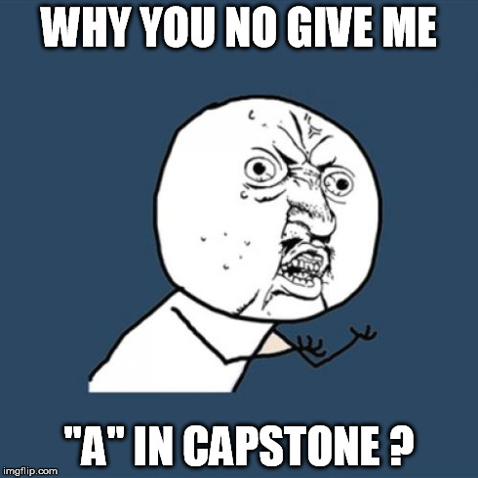
ID #6 Project Documentation
“A” students post useful, technical items multiple times per week which advance project completion
“D/F” students document poorly, if at all, via the Electronic Design Notebook

Slide 8
References
Electronic Design Notebook FAQ
https://designlab.eng.rpi.edu/edn/projects/capstone-support-dev/wiki/EDN_FAQ
Electronic Design Notebook Quick Start Guide
https://designlab.eng.rpi.edu/edn/projects/capstone-support-dev/wiki/EDN_FAQ#Quick-Start-Guide-Using-the-Electronic-Design-Notebook-for-Capstone-Designpptx
Subversion FAQ
https://designlab.eng.rpi.edu/edn/projects/capstone-support-dev/wiki/Subversion
Gantt Chart & Project Management
https://designlab.eng.rpi.edu/edn/projects/capstone-support-dev/wiki/Gantt_Charts

