Slide 1
Using ShareX to Record Videos
Download & Documentation at: https://getsharex.com/

Slide 2
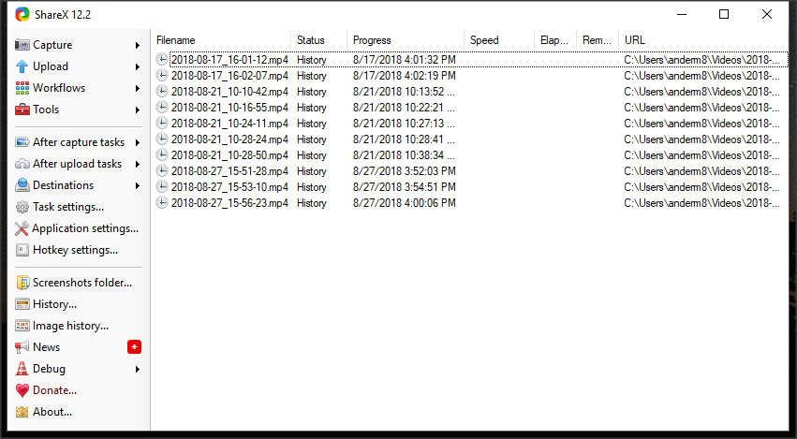
ShareX Starting Screen
Choose This

Slide 3
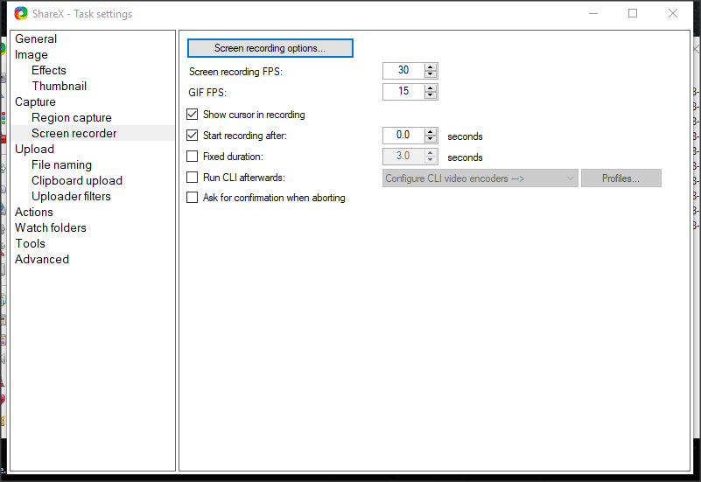
Screen Recording Options
Choose This
Make sure your settings match.

Slide 4
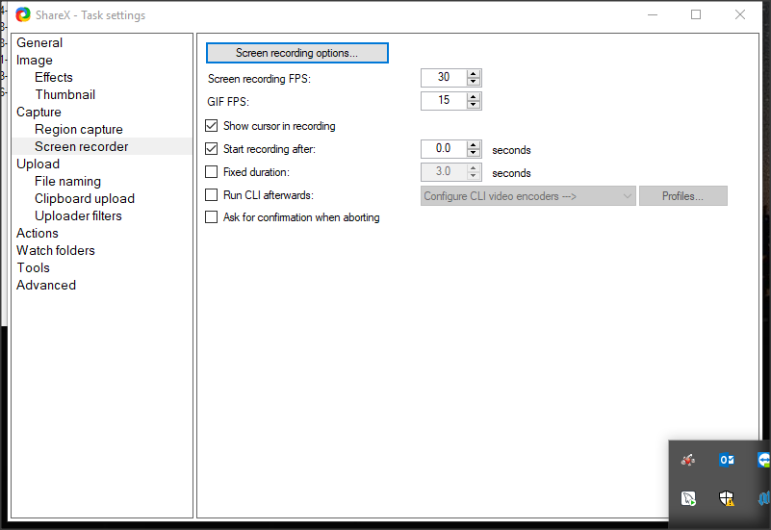
Task Settings
Choose This

Slide 5
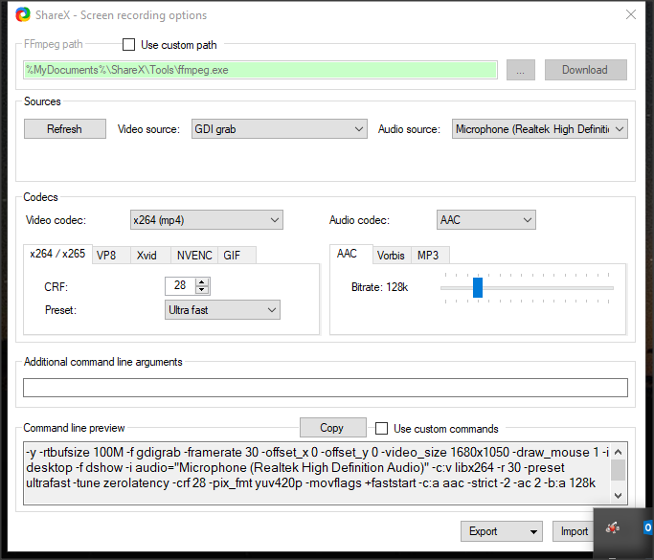
Screen Recording Options - Using a Microphone
Make sure your settings match.

Slide 6
ShareX Starting Screen
Choose This

Slide 7
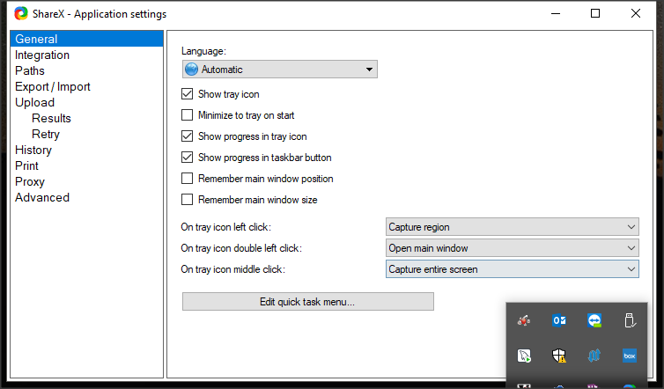
Application Settings
Use this to see where your captures go

Slide 8
To Capture Video
Simply press the Shift – Print Screen keys to start recording!

