Slide 1
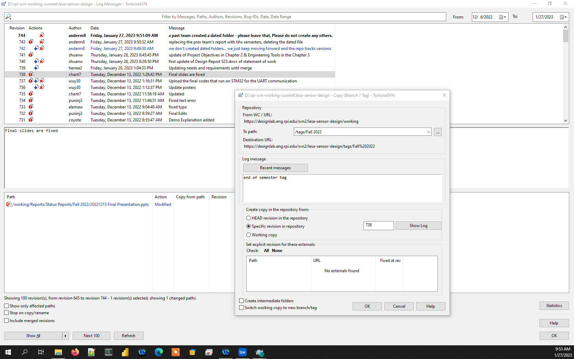
From Tortise SVN, select “Show Log”
Identify the revision number to be tagged by looking for the date change at end of semester.
Right click on that revision’s number.
Select “Create Branch/tag from revision” to get the popup screen shown on the right.
Change the destination to /tags/semester-info
Click OK

