Slide 1
Engineering Communication and Documentation
Fall 2020
THIS IS A DRAFT / WORK IN PROGRESS !
Improvements Welcome!

Slide 2
Outline
WHY
WHAT
WHEN
HOW
Expectations

Slide 3
WHY
Reminder (memo to yourself)
Collaboration
  On-going design reviews
  Fix problems sooner, cheaper, and better
  Delegation and Outsourcing
Risk Management
  Hard disk / computer problems
  Absence

Slide 4
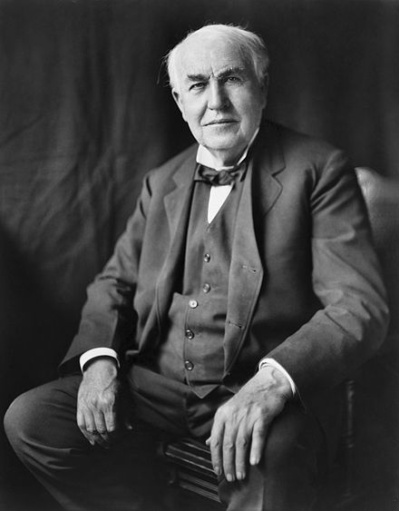
WHAT
Everything!!
  Your design process and solution
  Rejected ideas
  Solutions that did not work
I have not failed. I've just found 10,000 ways that won't work.
(Thomas Edison)
Source: https://en.wikipedia.org/wiki/Thomas_Edison

Slide 5
Show all your work
Design Process
  How and Why engineering decisions are made
Results
Assumptions

Slide 6
WHEN
Homework Assignment
  Finalized work
  Only once
Engineering Design
  As soon as possible
  After each update
…
Rough Idea
Review & Feed- back
Preliminary Design
Review & Feed- back
Final Design
Engineering design is an iterative process.

Slide 7

HOW
Forum
  Asynchronous threaded discussions
  Write once
  Update information using Reply
  Easy to document progress (evolution) and technical discussions
Boards

Slide 8
EDN Content Areas / Typical Uses
Wiki
  Editable
  Show up to date information
  Table of Contents
  How To
Issues (Tasks)
  Project Management - Tasks, assignments, and status
Repository and Version Control System
  Attend a training session

Slide 9
Attach Files
Can be Attached to Forum Posts or Wiki Pages:
Photos
  Whiteboard
  Prototyping process
Images
  Graphs
Digitized Paper
  Sketch
  Calculation
Things That Will Probably Be Updated Should go to the Repository Instead

Slide 10
Common EDN Link Information
Link Type | Link Syntax
Repository Revision number 34 | r34
Wiki Page | [[Wiki page]]
Issue number 12 | #12
Attachment to a wiki page * | attachment:attachment_name
Repository Folder ** | export:”working/Engineering Analysis/”
Repository File ** | export:”working/Engineering Analysis/Needs and Requirements.xlsx”
Forum Message ID 1234 | message#1234
Syntax must be exactly as shown, no spaces before the “special” characters
* Attachment names may NOT have spaces. Use underscore as shown
** The double quotes are required because there is a space in the file path

Slide 11
Expectations
Fair
Your teammates can report your progress and accomplishments to you sponsor, CE, and PE using EDN only
Good
Your teammates can add value / update work on tasks assigned to you using the information on the EDN
Better
Your teammates can complete tasks assigned to you using the information on the EDN

Slide 12
Different Approach
Ideas
Talk
Thoughts
Forum
Discus ideas
Iterate on ideas
Issues
Plan out milestones
Assign tasks to owner
Mention work location in the repository
Discuss the work found in the repository
Plan out actions to achieve milestones
Monitor/track progress
Mention work location in the repository
Mention discussion location in forums
Repository
Store original work
Store updates to work
Keeps track of file versions
Safe backup location for work files

Slide 13
Different Graphic Approach
Ideas
Talk
Thoughts
Forum
Discus ideas
Iterate on ideas
Issues
Plan out milestones
Assign tasks to owner
Mention work location in the repository
Discuss the work found in the repository
Plan out actions to achieve milestones
Monitor/track progress
Mention work location in the repository
Mention discussion location in forums
Repository
Store original work
Store updates to work
Keeps track of file versions
Safe backup location for work files
Ideas are documented in the forums, with the work is tracked as issues and the work itself can be found in the repository.

