Slide 1
The Design Process
-- 5 Minute Overview --
Mark Anderson
Sr. Project Engineer

Slide 2
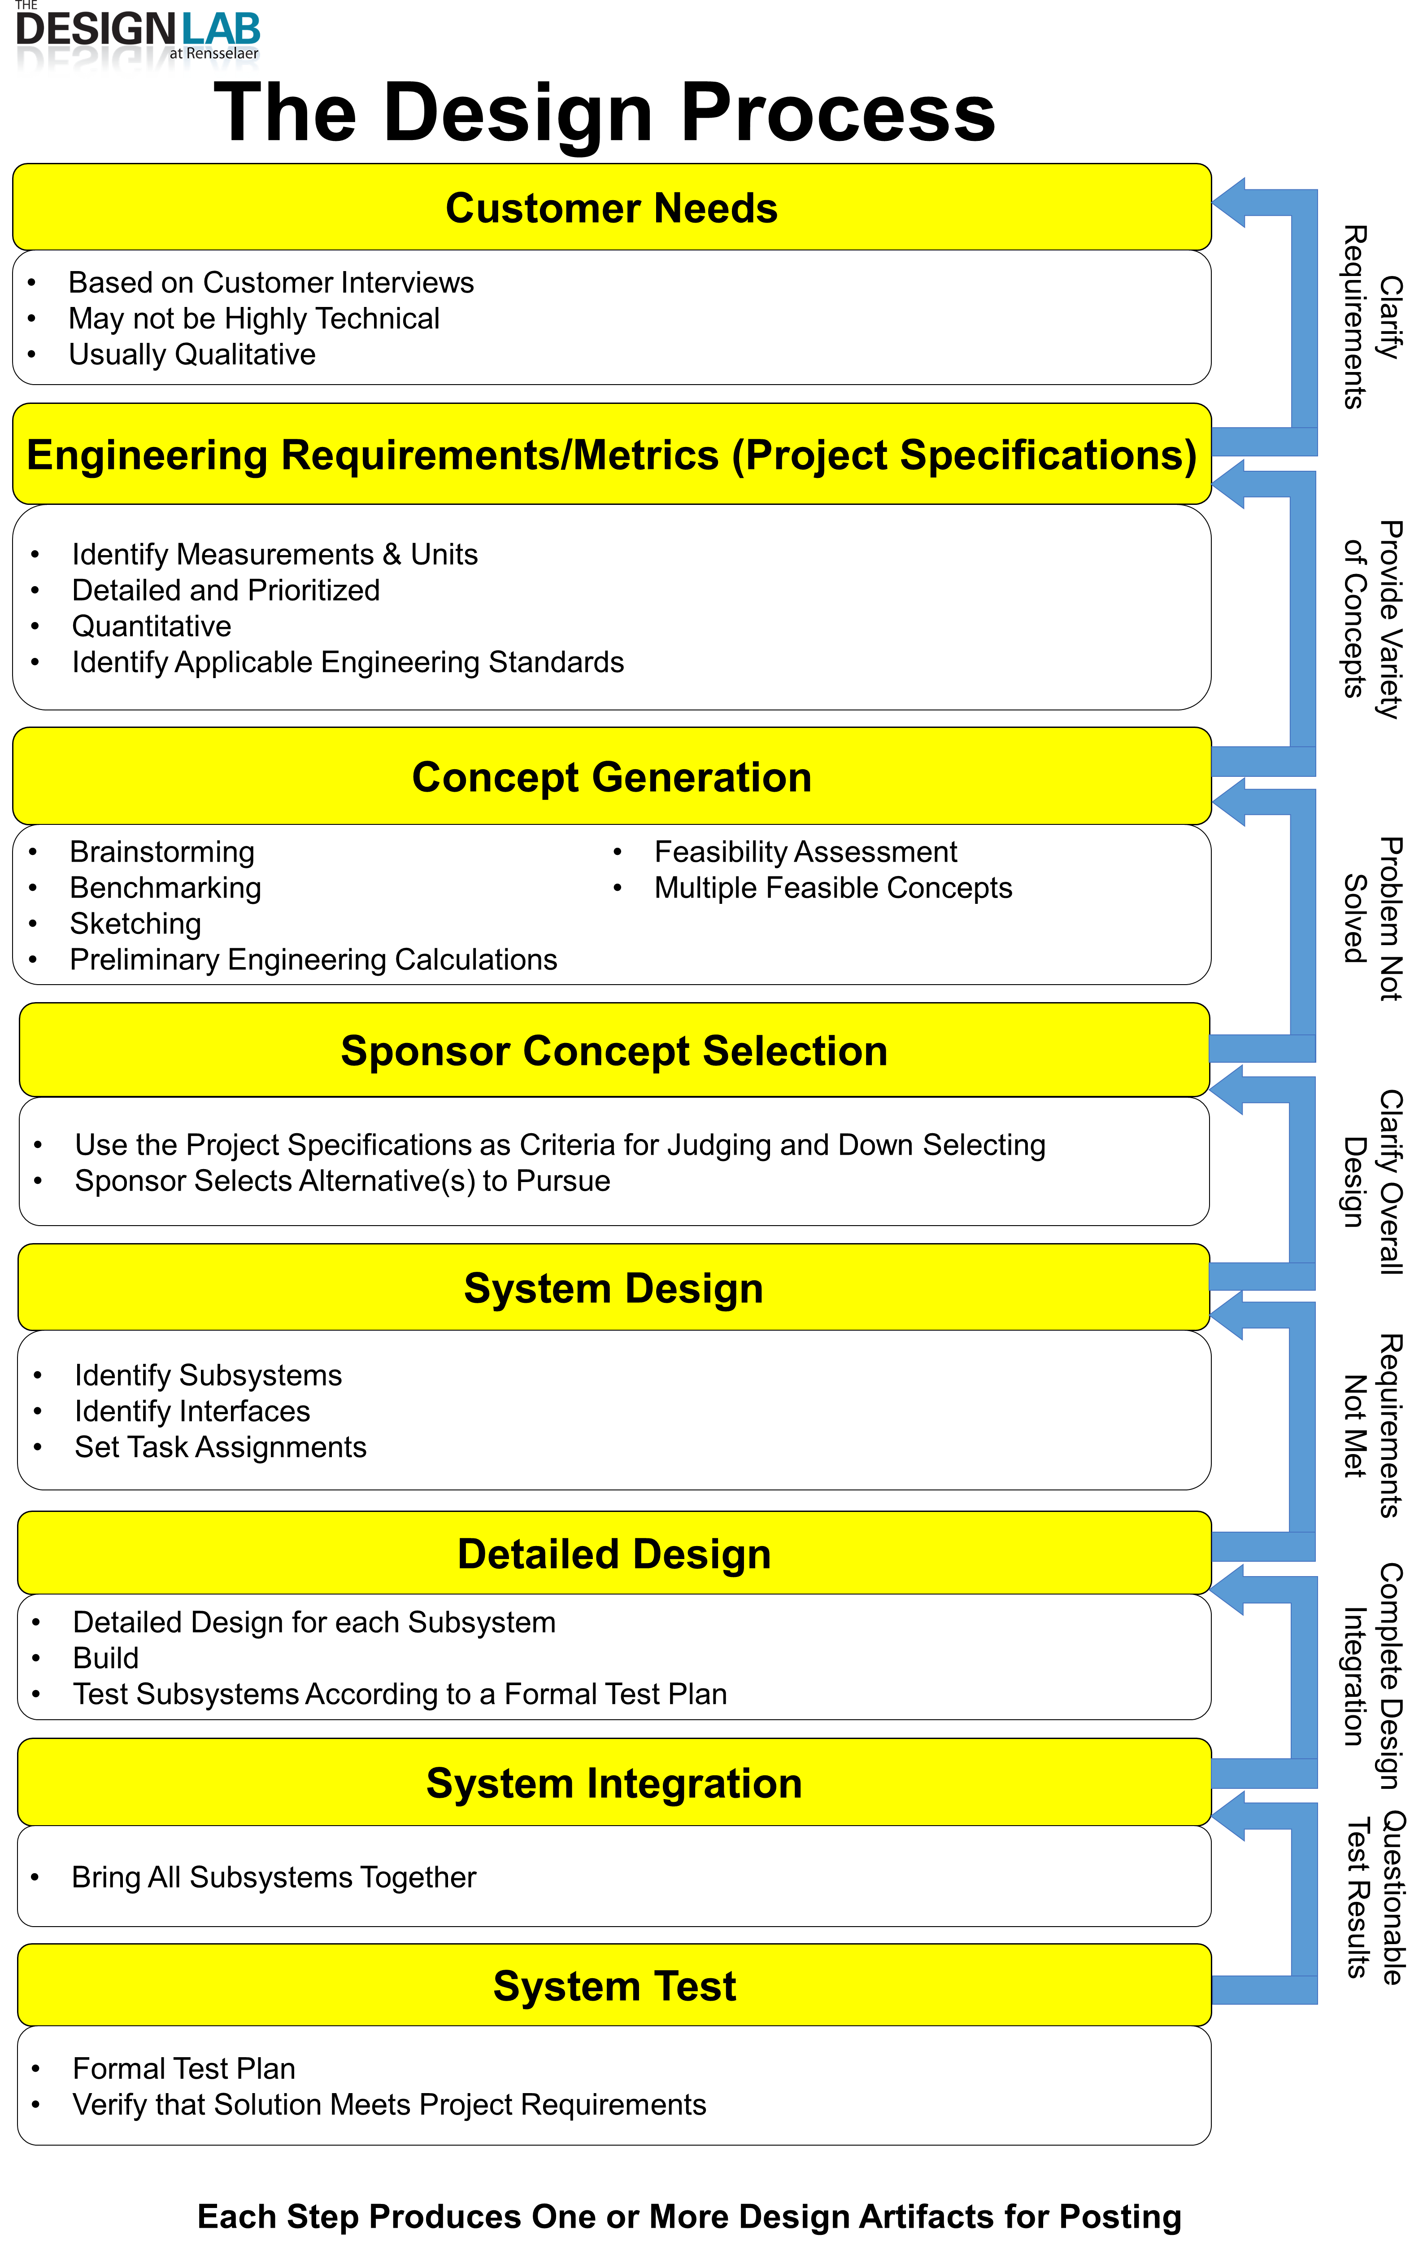
The Design Process
This Presentation is:
An overview to those not yet familiar with the design process
Or
A refresher for those who have already been exposed to it
Formally Taught in IED
Used Throughout Capstone
Experienced in Every Day Life!

Slide 3
Customer Needs
Based on Customer Interviews
May not be Highly Technical
Usually Qualitative
Key Output(s)
Prioritized List of Needs

Slide 4
Engineering Requirements / Metrics
(Project Specifications)
Identify Measurements & Units
Detailed and Prioritized
Quantitative
Identify Applicable Engineering Standards
Key Output(s)
Updated Prioritized List of Needs Now With Associated
Measurable Requirements

Slide 5
Concept Generation
Brainstorming
Benchmarking
Sketching
Preliminary Engineering Calculations
Feasibility Assessment
Multiple Feasible Concepts
Key Output(s)
Set of Concepts for Evaluation
Crude Documentation for Each Concept

Slide 6
System Design
Identify Subsystems
Identify Interfaces
Set Task Assignments
Key Output(s)
System Block Diagram(s)
Interface Definitions
Team Roles & Responsibilities Assigned
Initial Project Planning – Milestones (Versions) / Tasks (Issues)

Slide 7
Detailed Design
Detailed Design for each Subsystem
Build
Test Subsystems According to a Formal Test Plan
Key Output(s)
Design Documents (Will be Domain Dependent)
Test Plan (Document) – Unit Testing
Build / Implement Each Subsystem
Test & Document Each Subsystem According to Test Plan

Slide 8
System Integration
Bring All Subsystems Together
Key Output(s)
Design and/Fabrication Changes Based on Integration Challenges

Slide 9
Integration Testing
Formal Test Plan (Document)
Verify that Solution Meets Project Requirements
Key Output(s)
Documentation Showing that the System Meets Requirements

