Slide 1
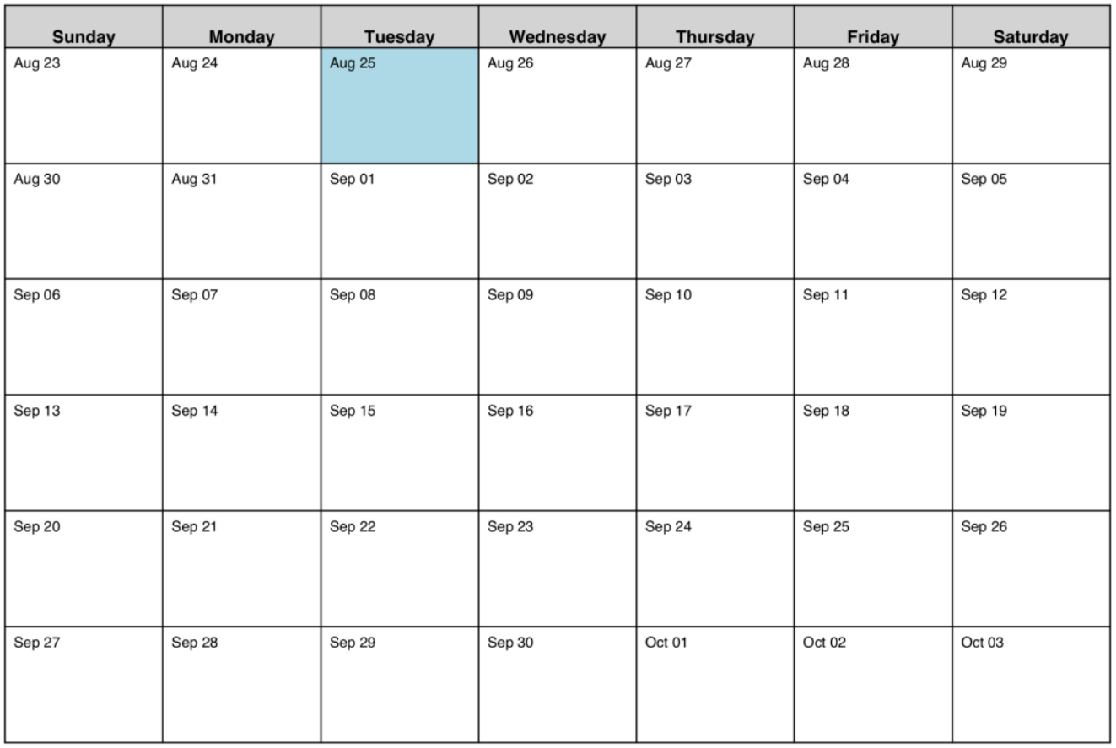
Capstone On-Site Meeting Schedule ex: 9/14 is Day 5 for sections 1+2
AUGUST 2026
SEPTEMBER
Section 1+2 – orange
Section 3+4 – blue
OCTOBER
1 1
2 2 3 3
4 4 5
Labor Day
5 6 6 7
7 8 8 9
9 10 10
Notes:
Fall 2025

Slide 2
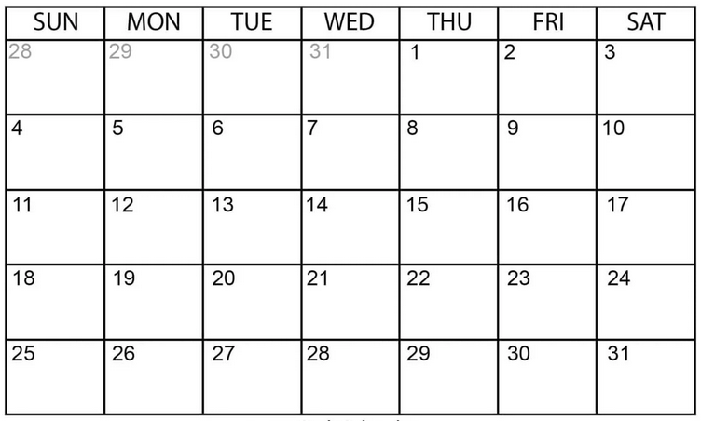
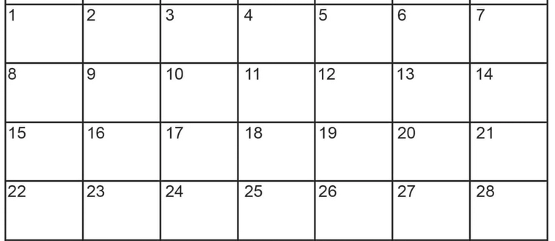
Capstone On-Site Meeting Schedule ex: 1/26 is Day 4 for sections 1+2
JANUARY 2026
Section 1+2 – orange
Section 3+4 – blue
FEBRUARY 2026
1
1
2
2
3
3
4
MLK
4
5
5
6
6
7
7
8
8
9
9
10
10
11
11
President’s Day

