Slide 1
Engineering Communication and Documentation
Fall 2019

Slide 2
Outline
WHY
WHAT
WHEN
HOW
Expectations

Slide 3
WHY
Reminder (memo to yourself)
Collaboration
On-going design reviews Fix problems sooner, cheaper, and better
Delegation and Outsourcing
Risk Management
Hard disk / computer problems
Absence

Slide 4
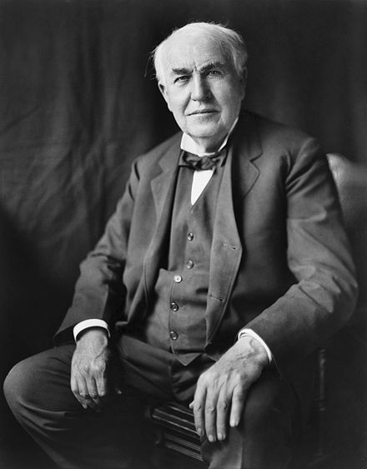
WHAT
Everything!!
Your design process and solution
Rejected ideas
Solutions that did not work
I have not failed. I've just found 10,000 ways that won't work.
(Thomas Edison)
Source: https://en.wikipedia.org/wiki/Thomas_Edison

Slide 5
Show all your work
Design Process
How and Why engineering decisions are made
Results
Assumptions

Slide 6
WHEN
Homework Assignment
Finalized work
Engineering Design
As soon as possible
…
Rough Idea
Review & Feed- back
Preliminary Design
Review & Feed- back
Final Design
Engineering design is an iterative process.

Slide 7
HOW
Forum
Asynchronous threaded discussions
Write once
Update information using Reply
Easy to document progress (evolution) and technical discussions
Boards

Slide 8
Wiki
Editable
Show up to date information
Table of Contents
How To
Issues (Tasks)
Project Management - Tasks, assignments, and status
Repository and Version Control System
Attend a training session

Slide 9
Attach Files
Photos
Whiteboard
Prototyping process
Images
Graphs
Digitized Paper
Sketch
Calculation

Slide 10
Link Information
Wiki Page - [[Wiki page]]
Issue #12 - #12
Repository Revision #34 – r34
Forum Message ID 1234 – message#1234
For more information, see https://designlab.eng.rpi.edu/edn/help/en/wiki_syntax_detailed_textile.html

Slide 11
Expectations
Fair Your teammates can report your progress and accomplishments to you sponsor, CE, and PE using EDN only
Good Your teammates can complete tasks assigned to you EDN only

