Slide 1

Creating & Using
Webex Teams and
Using Webex Meetings
By
The Design Lab at Rensselaer
Team
Take me to the Tips!
Note – this document will be updated as new info is available.

Slide 2
Webex Meetings and Teams
CISCO Webex Products
Meetings
Teams
Teams
Spaces
Team 1
Team 2
General
General
Subsystem 1
Subsystem 2
Space 1
Space 2
Space 3
Personal Room
Scheduled Meeting
Started from a Space
Meeting 1
Meeting 2
Meeting 3
Meeting A
Meeting B
Meeting C
Their product structure can be confusing!
Everyone with an RCSID one!
Meeting ends when owner leaves.
Start/stop at specific times.
End when last person leaves meeting
Essentially “chat rooms” that retain all conversations.
Teams get a General space by default but can then add more Spaces accessible only by that team.

Slide 3
Webex Teams
Similar to Chat rooms or Slack
Links / integrates with Webex Meetings (you need both!)
Primarily supports the configuration of a set of teams
  Each Team can have one or more spaces.
  Team members with moderator status can create new spaces shared within that team
It is possible to have Spaces without the Space belonging to a team
Used by Capstone and IED
While both Teams and Meetings can be started from a browser, downloading and installing the app is preferred.
  Teams will continue to run so that you get notifications

Slide 4
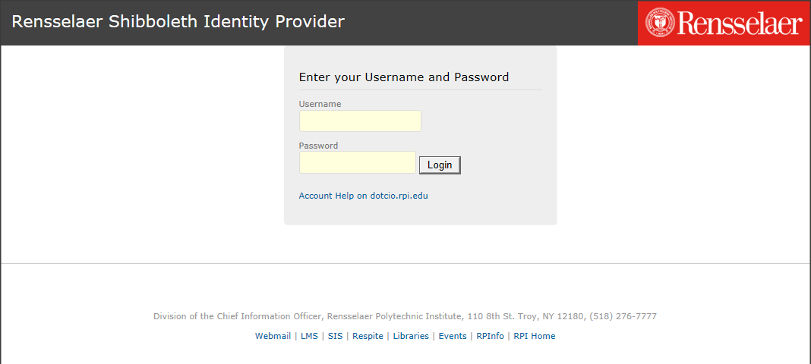
Getting Started
Visit: https://www.webex.com/downloads.html/
Download & install BOTH Webex Teams and Meetings
  Note that your PC may ask permission to modify your PC to install the software
Launch Webex Teams
Login using your RPI email account. This will take you to the RPI Shibboleth Identity Provider shown below.
There, enter your RCSID / password
The PE has already created Teams. Each Team automatically gets a space called “General”.
The PE has already added the students and CE to each Team.
Webex Meetings will launch as needed OR you can launch it and leave it running.

Slide 5
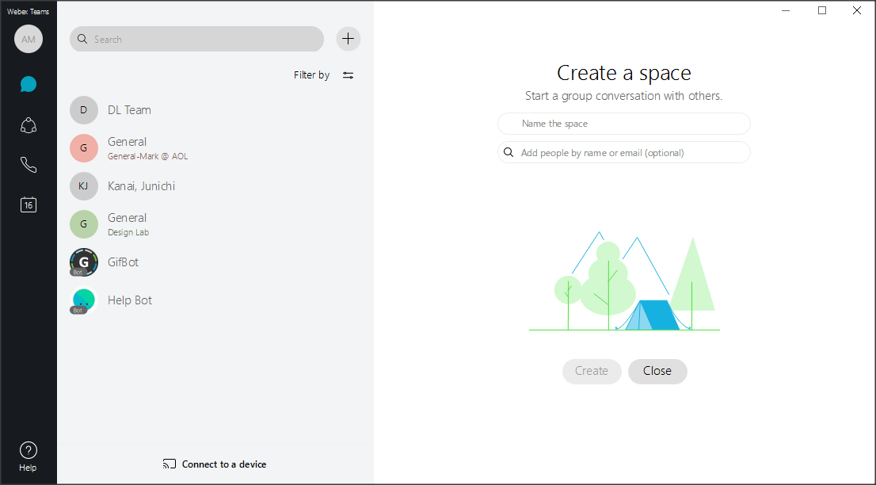
Creating Additional Spaces Within a Team
Click Here to Add a New Space
After adding,
Team names will appear here
You can create multiple teams, e.g. the entire team +
multiple subgroups.
Name the Space
Everyone in the Team should already be able to access the additional spaces.

Slide 6
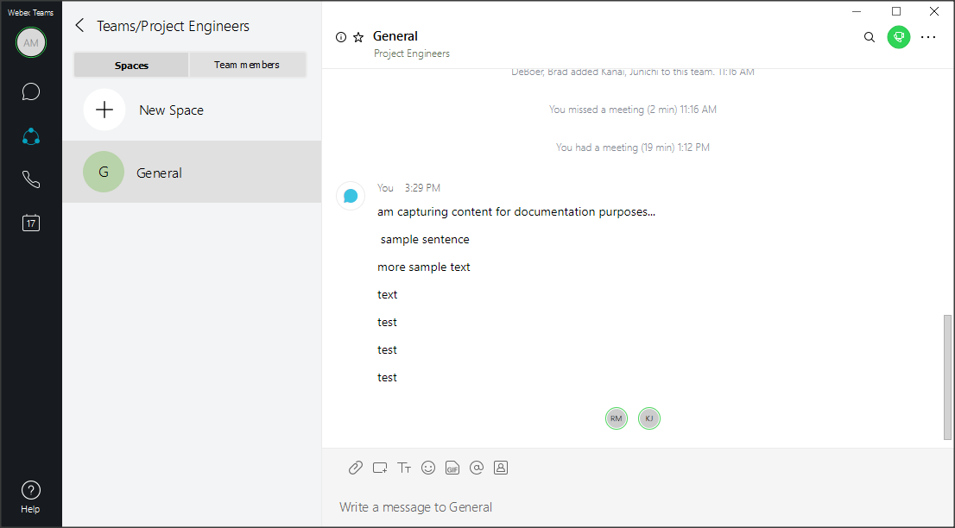
Starting a Meeting from a Space
Click Here to Access Several Other Features, e.g. to Schedule a Meeting for this Space
Click Here to Start or Join a Meeting for this Space
Click Here to Start a Meeting Using your Personal Room.
Useful for side conversations.
You can get a little fancy with messages in the Space!

Slide 7
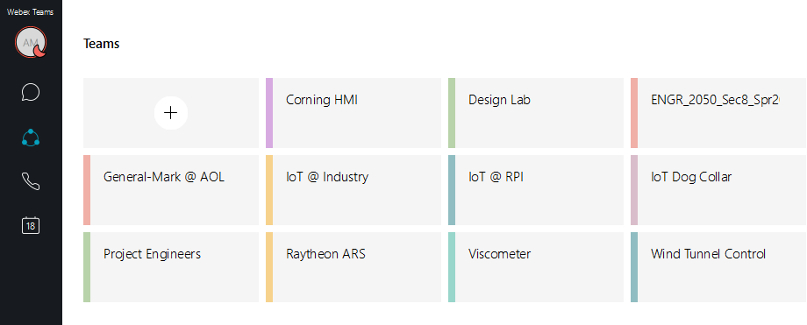
Webex Teams – List of Teams / Settings
Click Here to get to Settings
In Settings, ceplace your initials with a thumbnail photo of yourself

Slide 8
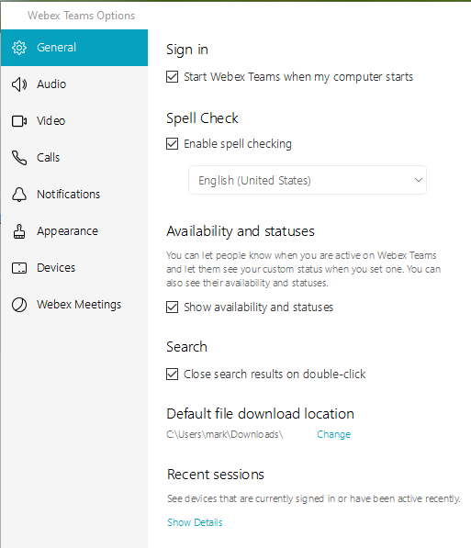
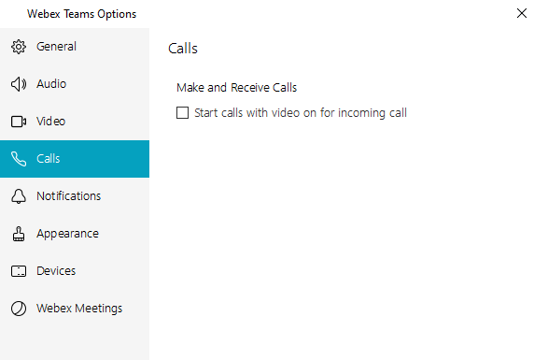
Teams - Preferences / Settings
Recommend turning this off to save bandwidth

Slide 9
Teams Space Usage Tips
Remember that it is a group chat. All messages in a space go to everyone in that space and can be seen both now and later.
From the Space, you can start a Meeting. The members of the space are notified of the meeting and can come and go from that meeting.
Remember that the “system of record” remains the EDN.
  ALL engineering content needs to be posted on the EDN.
  All files need to be posted to the forums or repository as usual.
Notifications will come in while Teams is running. To exit Teams, use the icon in the system tray (Windows).

Slide 10
Webex Meetings
Supports
  Voice only calls
  Voice & camera video calls
  Either of the above with screen sharing which can also be annotated
  The above plus a whiteboard
Explanation of people’s icons –
https://help.webex.com/en-us/wghlt5/Webex-Teams-See-People-s-Availability

Slide 11
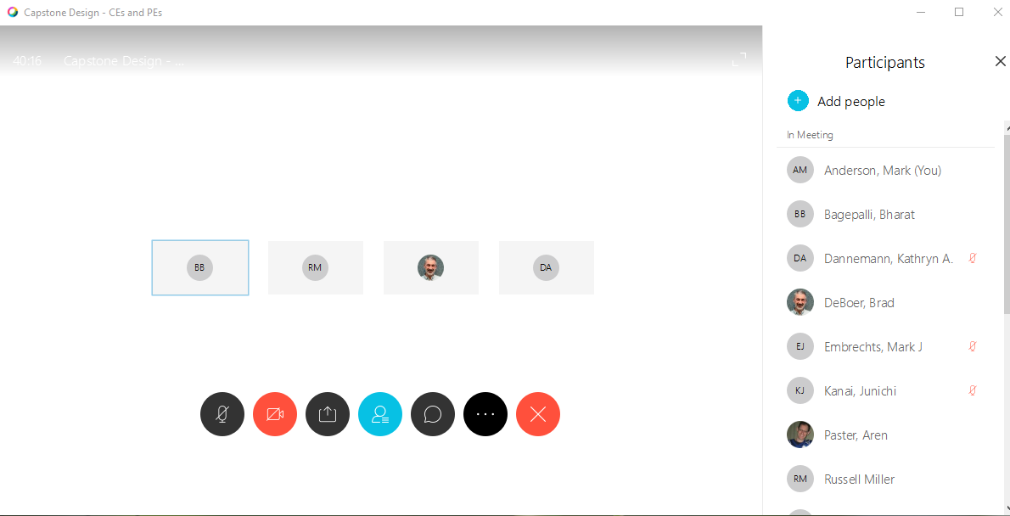
Webex Meeting
Click Here to See the Participant List
Click Here to See the text Chat window
If you join from a web browser, you may not see this Chat icon
Click Here to Share either Your Screen (recommended) or a single app, e.g. PowerPoint

Slide 12
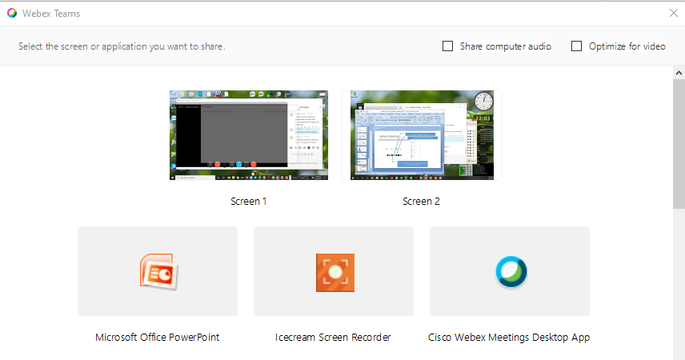
Sharing Content – Screen or App
Note that I have 2 monitors! Can share either one
OR I can choose to share a single app

Slide 13
Webex Teams and Meetings Tips

Slide 14
Webex Meeting Tips – Not in Any Order
Mute your Mic if not speaking to reduce noise and bandwidth
The host can mute anyone to avoid feedback via the Participants window
Mute Video if not needed to save bandwidth
When presenting, can use the round icons at the bottom of the screen or in the Sharing menu at the top of the screen
When sharing content, you can share either your entire screen OR just a single app, e.g. PowerPoint. In case you need to change apps, it’s easier to share your whole screen
If there are audio issues, mute your mic and speaker and call into the meeting instead
For groups larger than 8, suggest using the Chat window to gather feedback, questions, etc. to minimize sound problems (noise / feedback)
For personal rooms, the meeting starts when the host arrives and ends when the host leaves.
For meetings created from a space, the meeting ends when the last person leaves. Others can come and go while the meeting is open.
For scheduled meetings, the meeting starts after the scheduled time once the host joins. It does not automatically close at the scheduled end time.

Slide 15
Webex Meeting Tips - Continued
Take a roll call at the start of a meeting to verify everyone's audio and/or video
Meetings started from a space also allow you to call in. When you click the Join button, you can choose Audio to be either computer or phone.
If you have two monitors available (laptop + an external monitor/TV) you can move the Team Space to the second screen and use the other monitor for the meeting.
If your audio is poor, try leaving and rejoining the meeting. If still a problem you can leave and rejoin, selecting “phone” for audio.
Only 1 person can share content at a time. If a second person starts to share, the first person's sharing is ended.
To start or join a meeting, use the green icon in the upper right of the Team Space window.
To access the settings for Teams, click on the round icon at the top left with your photo or initials. Choose settings and make whatever changes are desired. We suggest that you turn off the video when answering calls option to reduce bandwidth.
If you plug in a webcam after the meeting starts, you may need to exit the meeting and rejoin to activate the camera.

Slide 16
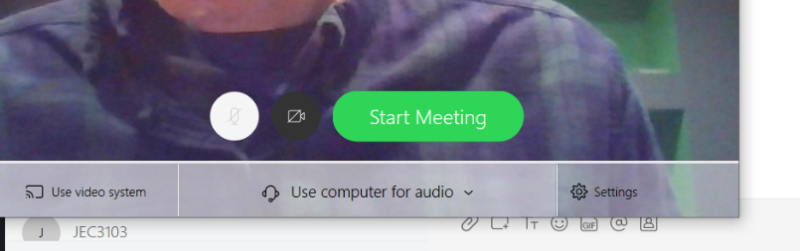
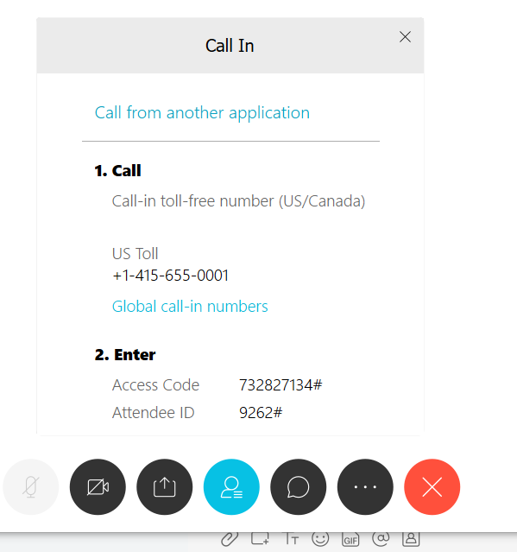
Poor Internet Tips
It is possible to call in (with a phone) to meetings or team spaces if bandwidth/connection are limited
Step #1
Change to “Call In” before clicking ‘Start Meeting’
Step #2
Number provided before you join meeting space
Step #3
Dial number. Enter access code.
Say “Hello” to meeting.
If no content is shared, no need to maintain the internet based connection.

