Slide 1
Welcome to Capstone Design
Introduction and Expectations
First Class

Slide 2
Revision History
Version | Date | Name | Reason for Changes
0.80 | 7/1/20-8/29/20 | A. Paster | Initial document. Days 1 through 4 are 87% complete. Future days less accurate. Document will be updated as the semester progresses.
0.90 | 8/29/20 | A. Paster | Added urls of key documents and info in Capstone Support Wiki and Repository.
1.0 | 8/30/20 | A. Paster | Link for syllabus questions updated (p. 13) Table formatting (p. 15) Official release of document
1.1 | 8/31/20 | B. DeBoer | Specified entry and exit doors for MDL (p. 4) Corrected Shop Room No., added notes requiring PE permission to use shop and requirement for online safety training prior to using shop (p. 6)
1.2 | 8/31/20 | A. Paster | Table formatting (p. 2) Small time shifts for group wrap-up (p. 19) Out-of-class meeting added (p. 21) Removed some ‘behind the scenes’ notes (p. secret)
1.3 | 9/1/20 | A. Paster | Retitled activity on Day 1 Agenda (p. 7) Corrected whenisgood.NET url (p. 21) New EDN & Documentation content (p. 30-35, 48-50) Added Design Process content (p. 39-41)
1.4 | 9/2/20 | A. Paster | Revisions to Day 2 formatting IED reference (p.40) Fixed ‘location’ footer throughout User Stories (p. 43)
1.5 | 9/3/20 | A. Paster J. Kanai | Added section time callouts throughout Day 3 Updated footer location throughout Day 4 Purchasing (p. 36)
1.6 | 9/3/20 | A. Paster | Fixed time error on Day 3 agenda (p. 39) User Story content (p. 42)
1.7 | 9/4/20 | B. DeBoer | Added note about prior semesters’ presentations to Out of Class Tasks for Day 2

Slide 3
Revision History - continued
Version | Date | Name | Reason for Changes
1.8 | 9/4/20 | M. Anderson | Added another page for revisions. Added hyperlinks to the class agenda for faster jumping. Note that these link to the slide # - so adding slides before that agenda will throw off the link. Since class 2 is done, the link to class 3 should remain valid
1.9 | 9/8/20 | B. DeBoer | Changed “Day Two” to “Day Three” for Design Process slide (presently slide 43)
2.0 | 9/8/20 | A. Paster | Updated term in Day 4 Agenda Added hyperlinks to class 7-9 Added list of ALL class topics for Day 3 & 4 (p. 41)
2.1 | 9/9/20 | B. DeBoer | Moved EDN & Engineering Tools and Methods from Day 4 to Day 5. Replaced with 55 minutes of Project Work on Day 4
2.2 | 9/11/20 | M. Anderson | Added non-critical animation to the needs & requirements slide

Slide 4
Link to Agendas
Class 1
Class 2
Class 3
Class 4
Class 5
Class 6
Class 7
Class 8
Class 9

Slide 5
Logistics
All students (in person & remote) should attend class meetings using Webex Teams
  Project Space (ex: GSK Toothpaste Flow)
  Project Engineer Space (ex: Paster-F20-sec1)
This PPT is available on Electronic Design Notebook and will guide the first 10 classes
  https://designlab.eng.rpi.edu/edn/projects/capstone-support-dev/repository/changes/Fall%202020%20Playbook.pptx
Daily Class Agendas
  https://designlab.eng.rpi.edu/edn/projects/capstone-support-dev/wiki/Capstone_Class_Agendas

Slide 6
Covid-19 related challenges
Projects were chosen and scoped to still be possible even in the event RPI semester goes full remote
Off campus and out of country students should strive to stay as synchronous as possible with team meetings and project progress
All course material is available online (EDN)
  https://designlab.eng.rpi.edu/edn/projects/capstone-support-dev/wiki
Nearly all interactions will take place online
  In Class Activities – Webex Team Spaces
    Project Space
    PE Space
  Class time - Webex Project Space or Sub-team Spaces
  Sponsor meetings – Webex meetings
  PE/CE Office hours – Webex private rooms
Classroom
  One-way entry/exit
    Enter @ JEC3332 door (SoE Hub side), exit @ JEC 3232 door
  No use of physical whiteboards. Webex teams has whiteboard functionality
  Chairs stay on X’s at 6 foot separation
  4 additional tables available for smaller 2 person meetings

Slide 7
Class meeting logistics
Bring laptop, charger, headphones/earbuds to in-person classes
Wear a mask at all times
Teams may wish to record their meetings for any members who are 'absent' or have connection issues.
  ALWAYS encouraged to take meeting minutes and post to EDN for future reference

Slide 8
Class “location”
Hybrid schedule to reduce campus density
  Your team will meet remote one day and in classroom one day each week
  Approx. 30% of students chose to be all remote
Capstone shop (JEC 2332) will be open 9am-4pm for hands-on work
  Due to COVID, students must request permission to use shop from PE to ensure staffing – walk-ins are not allowed
  Students MUST complete online safety training prior to using shop (PE will send info)
Bounce between Project Space and PE Space
  Agenda and this PPT will continuously remind you of proper location
Notes:
PE should remind each team which day they are remote vs in class

Slide 9
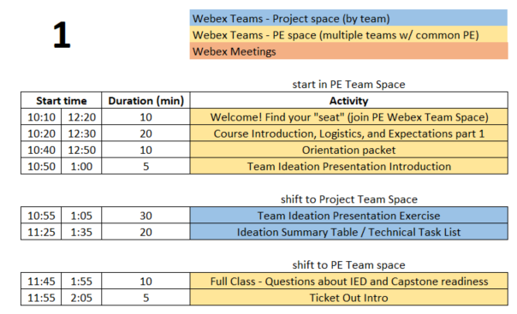
Day 1 Agenda

Slide 10
RPI Design Lab
Our Mission is to Develop High Performing Engineers by Mentoring Students in Professional and Engineering Design Practices Through Project Based Learning.
NO textbook, NO lecture
It is a Team EXPERIENCE
Guided/assisted by Project Engineer (PE)
Graded/assisted by Chief Engineer (CE)

Slide 11








Design Lab Team
Associate Director
Admin Specialist
Manufacturing Manager
Shop Technician
Director
Kathryn Dannemann
Junichi Kanai
Valerie Masterson
Sam Chiappone
Scott Yerbury
Project Engineers
Mark Anderson
Brad DeBoer
Aren Paster

Slide 12
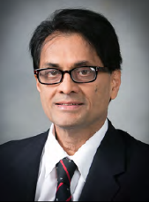
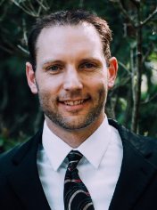
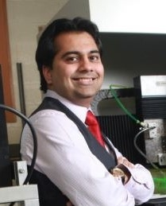

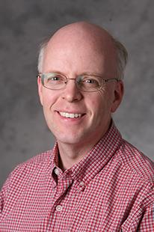
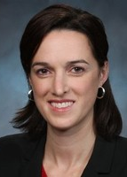
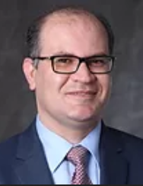
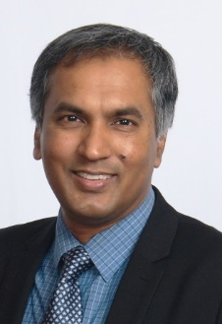

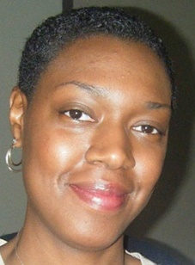
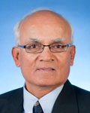

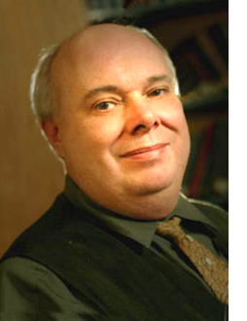

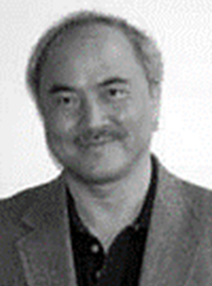



Faculty – Chief Engineers
MANE
Bharat Bagepalli
Josh Hurst
Sandipan Mishra
Matt Oehlschlaeger
Dan Walczyk
Sarah Felix
ECSE
Ali Tajer
Partha Dutta
Junichi Kanai
Shayla Sawyer
Manoj Shah
Kyle Wilt
ISE
MSE
Mark Embrechts
Bill Foley
Cheng Hsu
Kathryn
Dannemann
Daniel Lewis
Rahmi Ozisik

Slide 13
Participation Expectations
Arrive to Class On Time / Stay until class ends
  We encourage use of video
Be present in Class and Team Meetings
  Listen, Engage, Participate
  Not distracted on your Phone or other tasks
3 Credit Hour course mandates:
  4 Hours per week IN class
  5 Hours per week OUT of class
Read communication from Design Lab staff and team mates
  Emails
  Webex chat
  EDN posts

Slide 14

Capstone is TEAM work not GROUP work
Team Work
  collaborative effort
  peer review
  Student managed
Group Work
  divide and conquer
  low interaction with team
  Supervisor managed

Slide 15
Grading
Syllabus
  https://designlab.eng.rpi.edu/edn/attachments/download/109925/Common%20Course%20Syllabus.pdf
Tasks and Due Dates
  https://designlab.eng.rpi.edu/edn/projects/capstone-support-dev/wiki/Tasks_and_Due_Dates
Pose any questions to kanaij@rpi.edu
  Answers will be posted to EDN
  https://designlab.eng.rpi.edu/edn/projects/capstone-support-dev/wiki/Syllabus_or_Grading_questions

Slide 16
Behavior Expectations
Q: “How will you interact with your boss and peers in 6 months?”
Let’s start doing this NOW in Capstone Design
  Be Accountable.
    To your teammates, to Chief/Project Engineer, and to project sponsor.
  Be Professional.
  Make your work VISIBLE.
    Post/share as you go. No need to hide from team until its perfect or completely finished.
    Use Electronic Design Notebook (EDN)
Notes:
This slide is animated. Shows only the question – PE should ask students and get some responses

Slide 17
Capstone Orientation Packet
Director’s Introduction letter | Read Later
Instructions for electronic signatures in Adobe | Read Later | Reference for last steps
Project Description | Should have already read | Reference now
Recognition Waiver and Release | Read later | Sign PDF or print and scan | Email to mastev@rpi.edu
Sponsorship Agreement
More information
  https://designlab.eng.rpi.edu/edn/projects/capstone-support-dev/wiki/Confidentiality_Requirements

Slide 18

Collaboration Logistics
Each team has a Box folder pre-loaded with files
  https://rpi.app.box.com/
  Login using RPI credentials
EVERYONE open “20 min Poster - Webex enabled.pptx” file in PowerPoint Online
  This will allow simultaneous group editing
  (warning/notice) Online version lacks MANY features

Slide 19
35 min - Team Ideation Presentation
Time boxed exercise. It will feel rushed, things won't feel complete. THAT'S OK.
You'll want more time. You can't have it. Team must move on.
For EACH section of presentation slides:
2 min
  Individual silent thought on content
  Type thoughts into text editor (Word, Notepad, etc...)
2 min
  Copy answers into shared Team PPT on Box
  Quick discussion of similar, unique, or new answers
Move on to next section of Ideation PPT as a team
PE will send chat messages to PE Space to help remind team to move on to each section of presentation

Slide 20
20 min - Team Ideation Presentation Summary
What unique skills does each person bring to the team?
What skills do members share in common?
What specific team or organizational strength will each person contribute?
What team or organizational weakness or areas for growth does each person have?
How can team make best use of each individual’s skills and talents?
Does every team member have a TECHNICAL action item to complete by next class?
  Note: This is something that should happen by end of every class.

Slide 21
10 min - Team Questions
What part of your IED experience do you NOT want to repeat? - 4 min
  Personality conflicts
  Time management (ran out of time)
  Unequal division of labor
  Communication breakdown
How ready is your team to move forward on project?
1 (low) - 10 (high) scale
1 min - Pick individual answer
Move to PROJECT SPACE, discuss as a team, and come to consensus. - 5 min
Return to PE SPACE for full class debrief. - 5 min

Slide 22
5 min – Ticket Out
Design Lab wants your 'immediate' feedback on the course and your experience.
These 'surveys' after many classes will help us help you.
Collected anonymously using Google Forms.
  If you ever want an individual response from PE/CE/Director, be sure to INCLUDE your name.
You can also always use email or Webex to reach out to PE/CE with any questions.

Slide 23
Out of Class Tasks (what you might call homework, complete BEFORE Class 2)
Complete Class 1 Ticket Out
  https://forms.gle/jDFyUZtew9cb45n7A
Register for EDN – https://designlab.eng.rpi.edu/edn/
  Registration button in upper right hand corner
  Login must be your RCSID (RPI email before the @ symbol)
  Email must be your RPI email
  Bookmark this site. You will use it A LOT for this course.
Choose a one hour out-of-class team meeting time
  www.WhenIsGood.net works well
  NOT RECOMMENDED to use this time every week for the full team. That’s what class time is for. Instead use this time for occasional needed planning meetings, or for smaller sub groups to meet about project.
Post evidence of progress on your project task assignment to team's Box folder as Word file. Filename should be RCSID-topic. Ex: pastea-FreeBodyDiagram.docx
  Web link of research AND summary of why it's important or useful
  Calculations
  Sketch of concept idea
NOTE – These tasks are posted on EDN along with all class agendas
https://designlab.eng.rpi.edu/edn/projects/capstone-support-dev/wiki/Capstone_Class_Agendas

Slide 24
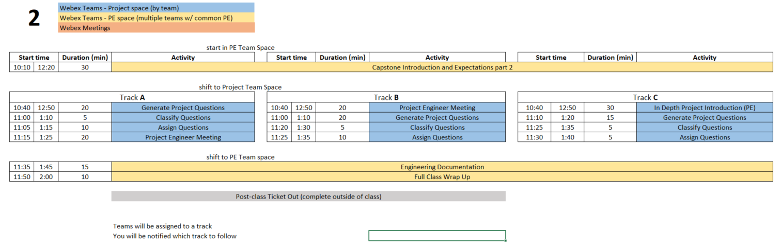
Class 2 Agenda

Slide 25
30 min - Capstone Introduction and Expectations part 2

Slide 26
Capstone Design – Why we do it
What is a "real world experience"?
What is difference between IED and Capstone Design?
Why is Capstone a required course?
What is goal of this course?
What is a successful outcome for
  Project Sponsor?
  Student?
  RPI?
What is the Engineering Design Process?
Notes:
Group discussion of all questions

Slide 27
Design Course Progression
General Coursework
Intro Engineering Design
Capstone Design
On-going Feedback from Instructor
Instructor Ownership (content)
Student Ownership (project)
Stakeholder is Student Team
Student Ownership (project)
Stakeholder is Company/Organization
Instructor time: prepared lecture and skill instruction
Student project time: research and experimentation
Graded activities: presentation of results, HW/quiz/test
Project work reviewed/graded continuously rather than formally submitted

Slide 28
Typical Course Content
Instructor Guided Content
Lecture & Lab
Quiz/Test
Structured Activities
Student/team performance feedback
Submit only finished work
Team Guided Content
Meetings (in & out of class)
Design / Build / Test (Engineering Design Process)
Presentations
Peer to peer feedback & review
Iterative design & documentation
Capstone instructor-guided activities will be primarily in first 5 weeks of semester

Slide 29


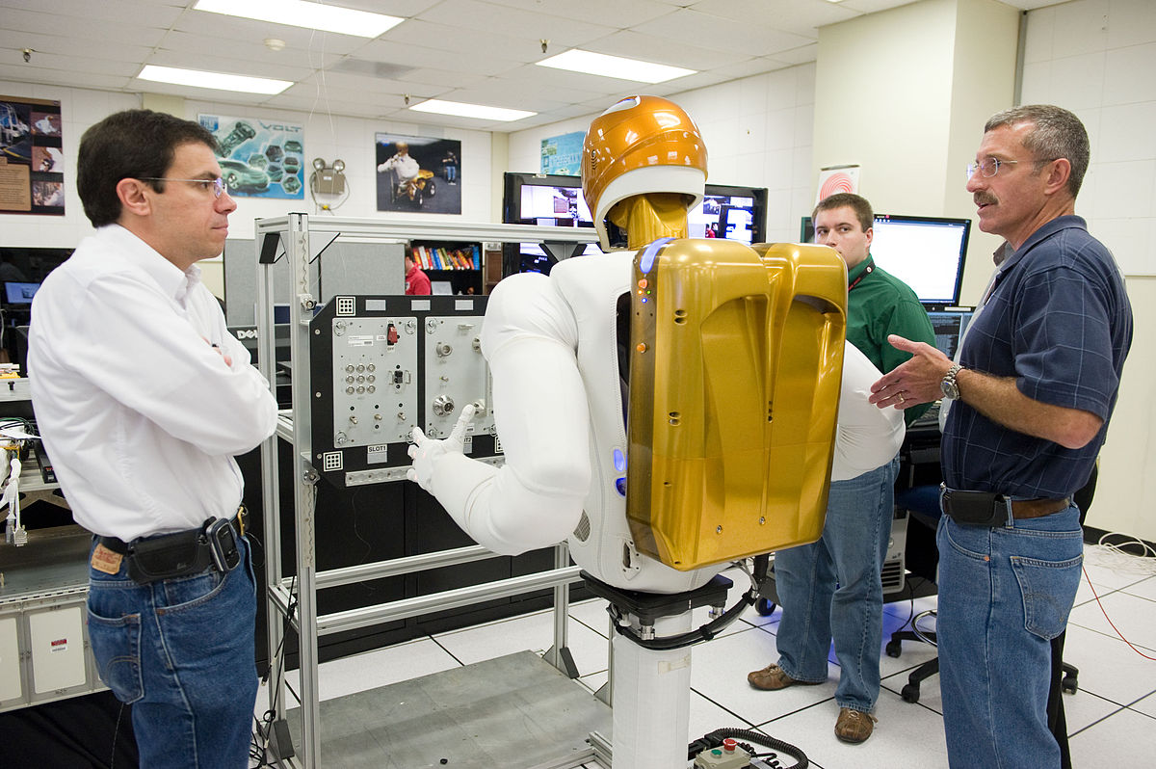
Capstone Design – How We Do It
Solve Open Ended Project by
Applying what you've already learned in 15+ years of courses
  Including re-learning whatever you've forgotten
AND self-learning new skills as needed
Begin the shift from
Engineering Student
Engineer

Slide 30
Roles and Responsibilities of Team
YOU (students) are OWNER of this project process
Sponsor (company) is OWNER of the project output
Design Lab Instructors are coaches, not teachers
  Offer guidance and help
    Point you to proper book, equation, or process, but students will do the math/analysis to justify their suggested solution
  Project Engineer (PE) – day to day operations
  Chief Engineer (CE) – grading/evaluation

Slide 31
15 or 20 min - Generate Project Questions
These questions can be about any aspect of the project, but by the end of the class include questions targeted to:
  Customer Needs
  Project Specifications / Technical Requirements
Same inclusive discussion format as first class
  2 min. silent question generation
  Then begin copying into Project Questions.xlsx spreadsheet in Box.
  Combine duplicates/similar questions
  Add more to list as you think of them during discussion

Slide 32
Split between
a) 20 min Project Engineer Meeting
      Project Engineer meets with each team to discuss project, review question & categories, and confirm/correct. When not meeting with your PE, team members generate/discuss questions.
b) 15 min Classify and Assign Questions
      Classify all questions generated into one of three categories
        Things team members can research/answer themselves
        Things PE will answer
        Things to ask sponsor during kick-off meeting
      Team assigns owner to all questions in category A
      Add question classification and ownership to Box spreadsheet
Notes:
Point students to other PE/CE/profs as appropriate who are resources for Category A

Slide 33
15 min – Engineering Documentation
Topics
  What is Documentation?
  Why bother?
  How is it done in Capstone?

Slide 34
What is Documentation?
Engineering Documentation?
Living record of your work
  Evolution of your product/design is traceable
  Your work (experiment) is reproducible
  Your work can be understood by others

Slide 35
Why Document?
Extension of your memory
  Who, What, When, Where, Why, How
  So that others can collaborate and continue the work
  Facilitates teamwork
  So that others can review/understand your work
Legal ramifications
  Contractual/legal defense
  Patent application
Efficiently and Effectively move the project forwards

Slide 36
Capstone Course Policies
Electronic Design Notebook - REQUIRED for all collaboration
GroupMe – team logistics
When Is Good – meeting scheduling
Not Permitted
  Slack or Discord for chatting
  Google Drive for file storage
  Google Suite for document creation
  Other cloud based tools for any use (schematics, mind maps, drawings, analysis, etc…)
Webex Teams is good for chat and live meetings, but project documentation MUST be transferred to EDN Forum or Repository.
  Simple/easy solution is to never put it on Webex to begin with.

Slide 37
What Tool Will You Use?
Electronic Design Notebook (EDN)
  Integrated Project Management
  Threaded Communication by topic, rather than a single unorganized stream
  IP protection
  Grading - accountability and visibility
  Secure access to team and sponsor
  Backed up daily !
  The EDN software may not be the PERFECT choice, but nothing is.
  It meets the Design Lab's needs better than the alternatives*.
  * https://designlab.eng.rpi.edu/edn/projects/capstone-support-dev/wiki/Why_Electronic_Design_Notebook_is_the_ONLY_choice

Slide 38
What Should I Document?
Everything
  Research, web links, notes
  Interviews and observations
  Ideas, concepts, sketches, charts, diagrams
  Calculations
  Purchases - components models, vendors, cost
  Analyses – technical and non-technical
  Experiments, debugging, tests
  Hypothesis, procedures, equipment used, steps taken, data, results
  Future work/ideas

Slide 39
10 min – Full class Wrap up
Information should be complete before documented?
  True or False
It is necessary to document negative results?
  True or False
Teammates share responsibility with PE/CE to offer technical feedback on EDN posts?
  True or False

Slide 40
Out of Class Tasks (what you might call homework, complete BEFORE Class 3)
Complete Class 2 Ticket Out
  https://forms.gle/EpXvm4hr6xPCtv8T7
Enter contact info to EDN Wiki
Find answer(s) to assigned question(s) & post to Box folder
Watch Customer Needs video (9 min)
  https://mediasite.mms.rpi.edu/Mediasite5/Channel/anderm8winrpiedu-engr-2050/watch/87d950eccc2942038b1d06530e9217841d
Watch Requirements video (11 min)
  https://mediasite.mms.rpi.edu/Mediasite5/Channel/anderm8winrpiedu-engr-2050/watch/96dceab44ae7447d812f5a216afa97cf1d
Identify one Customer Need for your project and translate it into an Engineering Requirement
For ongoing projects, review prior semesters’ final presentations IAW PE instructions for class discussion in Class 3/4

Slide 41
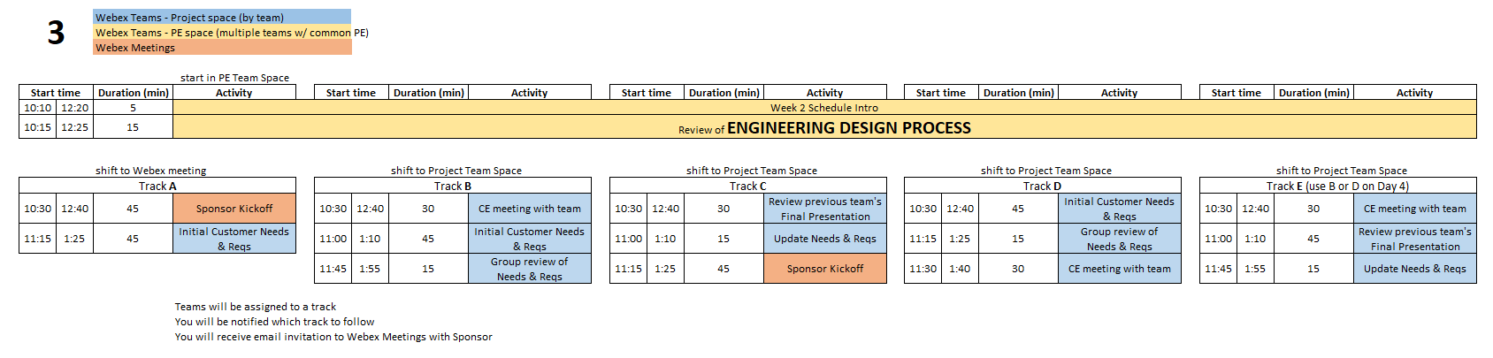
Day 3 Agenda
Over the course of Days 3 & 4 – All teams will complete the following:
Sponsor Kickoff Meeting
CE meeting with team
Customer Needs & Requirements - development and review
Review previous Final Presentation – ongoing projects only

Slide 42
15 min - Engineering Design Process
We will use the Engineering Design Process
Quick refresher of what that means and how your team can apply it to your Capstone project

Slide 43

Engineering Design Process
Today is Day Three of class
Let’s look at steps ONE & TWO
Customer Needs
Engineering Requirements
This Design Process and terminology is taught in IED at RPI

Slide 44
10 mins - Customer Needs & Engineering Requirements Example
Discuss a Vehicle
  What are Customer Needs?
  Translate those to Engineering Requirements
With Needs and Reqs in mind - an informed customer could go to a dealership and talk about “product specifications” and choose the ‘right’ car for themselves

Slide 45
User Stories
Alternative method to Needs/Reqs to document how users/customers will interact with a system, website, program
User Story (who, what, and why of system use)
  As a [type of user], I want to [perform some task] so that I can [achieve some goal].
Acceptance Criteria (how to judge success)
  Given that [some context], when [some action is carried out], then [a set of observable outcomes should occur].

Slide 46

30 min - CE Meeting with Team
(Class 3 or 4)
Chief Engineer led discussion of:
  Course
    Course grading
    Student expectations
  CE background and experience
  Project impressions

Slide 47
45 min - Customer Needs & Engineering Requirements Generation
Needs and Requirements workbook.xlsx spreadsheet is in team Box folder
Fill out based on team’s current (uninformed impression) of project
  This is first pass. Don’t worry that answers are not complete or verified by sponsor.

Slide 48
45 min - Sponsor Kick-Off Meeting
Meeting Agenda
  Team introductions to sponsor (name, major, relevant experience/skills)
  Sponsor introduction to team
  Sponsor describes project "in their words“
    History, ultimate and semester goals, deliverables, etc…
  Open Q&A

Slide 49
30 min - Prior Presentation
(if applicable)
Team should review (outside of class) the final PPT presentation given by previous semester team
  Forums->Final Deliverables
  Repository->Reports->Final Reports
Quickly walk PE/CE through slide deck and discuss what you feel previous team would say about:
  Goals
  Accomplishments / Successes
  Challenges
  Next steps
PE/CE will help to clear up confusion and answer any questions current team may have

Slide 50
Out of Class Tasks (what you might call homework, complete BEFORE Class 4)
Update Needs/Reqs matrix based on feedback (in Box folder)
Choose sponsor liaison
  This person will be the focal point for emails to/from your sponsor. They are not the team's "spokesperson" at meetings, conference calls, in class, etc.
Watch Intro to EDN video (5/min)
  https://designlab.eng.rpi.edu/edn/projects/capstone-support-dev/repository/raw/training/Intro%20to%20the%20EDN.mp4
Read Project Documentation page
  https://designlab.eng.rpi.edu/edn/projects/capstone-support-dev/wiki/Project_Documentation
Complete the Online Safety Training in Percipio by end of 3rd week
  https://www.percipio.com
  Rensselaer Manufacturing and Prototyping Laboratories-Safety Orientation

Slide 51
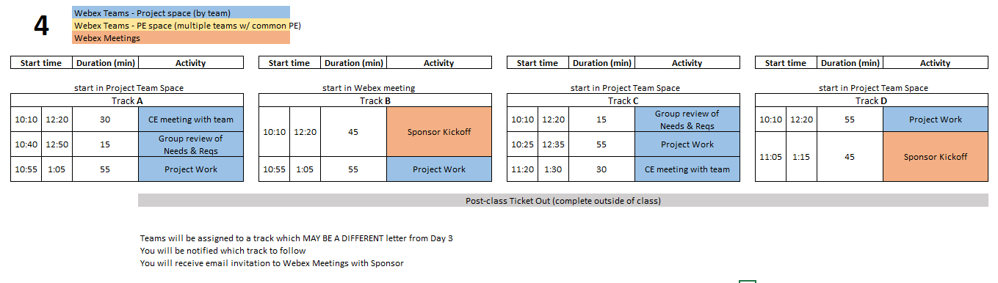
Class 4 Agenda

Slide 52
55 Min - Project Work
Refine Needs and Requirements Spreadsheet
  Needs
    Ensure all known Customer Needs are documented
  Requirements:
    Associate with appropriate Customer Need(s)
    Identify Measurements and Units (quantitative)
    Ensure that Requirements are detailed and prioritized
    Identify Applicable Engineering Standards
Refine/Develop Follow-Up Questions for Sponsor
  If Team has already had Sponsor Meeting, what new questions have been identified as a result?
    Clearly document and send to Sponsor, copy PE
Background Research/Benchmarking
  Discuss/document work done to date
  Identify/document additional benchmarking needs

Slide 53
30 min - CE Meeting with Team
(Class 3 or 4)
Chief Engineer led discussion of:
  Course
    Course grading
    Student expectations
  CE background and experience
  Project impressions

Slide 54
Out of Class Task / Action Items:
Complete Class 4 Ticket Out
  https://forms.gle/J6EBfnh2hjTJbPse8
Complete the Online Safety Training in Percipio by end of 3rd week
  https://www.percipio.com
  Rensselaer Manufacturing and Prototyping Laboratories-Safety Orientation

Slide 55
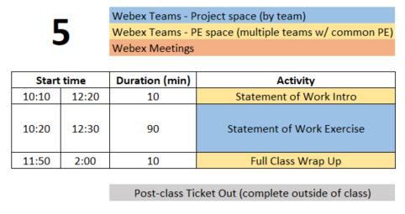
Class 5 Agenda

Slide 56
35 min - Documentation & EDN Usage
Where to post your work
How to create post (which buttons/links on EDN)

Slide 57

Where to put information?
Poster Summary, Task Assignments
Forums Tab
Technical Work
Work through examples of actual files in Box

Slide 58

How to post
Forums
New Message
Live demonstration of shifting actual files from Box to Project Forums

Slide 59
20 min - Engineering Tools and Methods
  What techniques, software, calculations will be used to address the problems in front of team? Ex:
  Mechanical aspects – Free Body diagram, torque measurement
  Software – flow chart of system control loop, storyboard of user input
  Process – conduct customer interviews of toddler caregivers, create Standard Operating Procedure for system startup and calibration

Slide 60
Statement of Work Exercise
10 min – Break into 3 groups
  Long Term Objectives (1-5+ years, from Customer Perspective)
  Current Semester Objectives (3 months!)
  Deliverables (Be S.M.A.R.T.!)
10 min - Team review – Long Term and Current Semester Objectives
15 min - Team review – Deliverables
55 min
  PE/CE review of Deliverables
  Team development of Dates and Engineering Tools and Methods
Create threads in Statement of Work Forum for notes on each section

Slide 61
Out of Class Task / Action Items:
Complete Class 5 Ticket Out
  https://forms.gle/WcGzPoJYMSpJrepQ8
Wordsmith and polish SoW
Post Statement of Work to EDN - SoW Forum prior to class 6

Slide 62
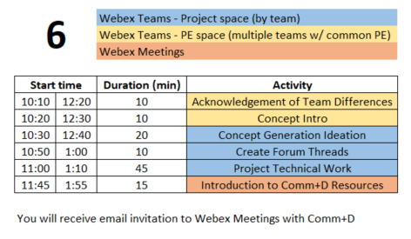
Class 6 Agenda

Slide 64
Out of Class Task / Action Items:
Continue technical work
Post progress to Design Forum threads
Add deliverables from Statement of Work into EDN as milestones (versions)
Brainstorm 6 individual tasks which need to be accomplished to reach project goals

Slide 65
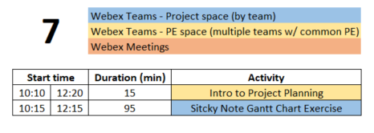
Class 7 Agenda

Slide 66
Out of Class Task / Action Items:
Create draft of Status Report topics
  Template - https://designlab.eng.rpi.edu/edn/projects/capstone-support-dev/wiki/Templates_and_Forms
Create agenda for 30 mins of Class 8
Add tasks identified in Gantt Chart exercise into EDN as Issues
Attend Comm+D workshop on PPT/posters(Weds 2/12) ??

Slide 67
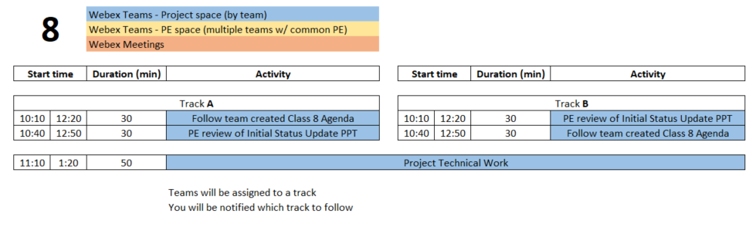
Class 8 Agenda

Slide 68
Out of Class Task / Action Items:
Address any feedback on status update PPT
Sponsor liaison should email PPT to sponsor 24 hours prior to call
Continue technical work
Post progress to Design Forum thread(s)
Student Team should now be creating individual project tasks

Slide 69
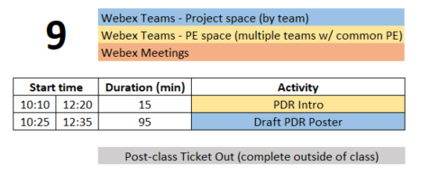
Class 9 Agenda

Slide 70
Out of Class Task / Action Items:
Class 9 Ticket Out
  https://forms.gle/fahNCHu9zFo7Qeze6
Upload poster draft to EDN - PDR Forum
Continue technical work
Post progress to Design Forum thread(s)
Student Team should now be creating class agendas and individual project tasks

