Slide 1
Welcome to Capstone Design
Introduction and Expectations
First Class

Slide 2
Revision History
Version | Date | Name | Reason for Changes
1.0 | 5/17/21 | Paster | Copy created from S21 Playbook Revision history cleared
1.1 | 5/18/21 | Paster | “disposable mask” clarified p9 Orientation Packet p19
1.2 | 6/8/21 | Paster | EDN usage p67
1.3 | 6/21/21 | Anderson | COVID page. Mentioned flipped on slide 12. Added comment about where to discussed flipped, fixed some grammar / increased font size-formatting on a couple slides
1.4 | 6/28/21 | Paster | Added Design Process image after agenda slides Font change p44
1.5 | 7/2/21 | Paster | Updated all web links to F21 Ticket Outs
1.6 | 7/8/21 | Paster | Added External & Internal concept search slides from IED textbook p 79+80 Improved task description on daily Design Process poster callback
1.7 | 7/13/21 | Paster | Removed mention of Risk Analysis Memo Added content and reference to Benchmarking Memo Updated dates for PDR and Memo submission s/’Midterm forum’/‘PDR forum’ Updated most Agenda slides to add CE time and fix formatting Added Class 3 Ticket Out
1.8 | 7/15/21 | Paster | Benchmarking Memo introduced – p84 Related Out Of Class tasks & link to rubric added

Slide 3
Revision History - continued
Version | Date | Name | Reason for Changes

Slide 4
Revision History - continued
Version | Date | Name | Reason for Changes

Slide 5
Link to Agendas
Class 1
Class 2
Class 3
Class 4
Class 5
Class 6
Class 7
Class 8
Class 9
Pro Tip – Current Out of Class Tasks are listed ONE page before next class’s agenda

Slide 6
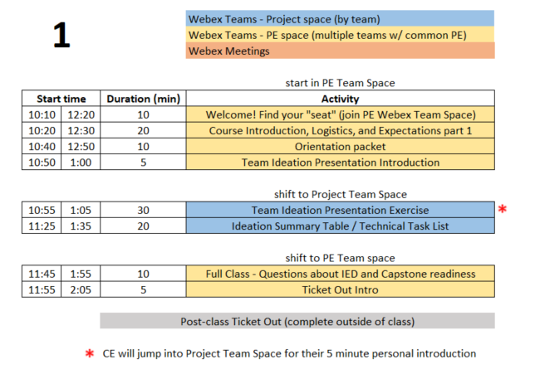
Day 1 Agenda

Slide 7
Logistics
All students (in person & remote) should attend class meetings using Webex Teams
  Project Space (ex: GSK Toothpaste Flow)
  Project Engineer Space (ex: S21-sec1-Paster)
This PPT is available on Electronic Design Notebook (EDN) and will guide the first 9 classes
  https://designlab.eng.rpi.edu/edn/projects/capstone-support-dev/repository/raw/playbook/2021%20Spring%20Playbook.pptx
  You are STRONGLY ENCOURAGED to download newest version of Playbook prior to EACH class meeting.
Daily Class Agendas
  https://designlab.eng.rpi.edu/edn/projects/capstone-support-dev/wiki/Capstone_Class_Agendas

Slide 8
Covid-19 related challenges
Projects were chosen and scoped to still be possible with some or all students being remote
Off campus and out of country students should strive to stay as synchronous as possible with team meetings and project progress
All course material is available online (EDN)
  https://designlab.eng.rpi.edu/edn/projects/capstone-support-dev/wiki
If any team member is remote, then all interactions will take place via Webex. If a team is entirely local, then some interactions will be via Webex.
  In Class Activities – Webex Team Spaces
    Project Space
    PE Space
  Class time - Webex Project Space or Sub-team Spaces
  Sponsor meetings – Webex meetings
  PE/CE Office hours – Webex private rooms
Classroom
  One-way entry/exit
    Enter @ JEC3332 door (SoE Hub side), exit @ JEC 3232 door
  No use of physical whiteboards. Webex teams has whiteboard functionality
  Chairs stay on X’s at 6 foot separation
  4 additional tables available for smaller 2 person meetings

Slide 9
Class meeting logistics
Bring laptop, charger, headphones/earbuds (for best Webex audio) to in-person classes
Wear a disposable mask at all times
Teams may wish to use Webex to record their meetings for any members who are 'absent' or have connection issues.
  ALWAYS encouraged to take meeting minutes and post to EDN for future reference

Slide 10
Webex/Meeting Tips
Be productive for meetings.
  Have a written agenda, posted into the EDN Project Management folder
  Keep meeting minutes for ALL team Webex sessions and post to the Project Management forum on EDN
Webex chat will not be archived, so it's important to document results & discussion in the Forums and the Repository as appropriate
Although Webex can be great for socialization, we would like to encourage productive meetings to reduce Webex burnout

Slide 11
Class “location”
TBD
Hybrid schedule to reduce campus density
  Your team will meet remote one day and in classroom one day each week
  Approx. 30% of students chose to be all remote
Capstone shop (JEC 2332) will be open 9am-4pm for hands-on work
  Due to COVID, students must request permission to use shop from PE to ensure staffing – walk-ins are not allowed
  Students MUST complete online safety training prior to using shop (PE will send info)
Bounce between Project Space and PE Space
  Agenda and this PPT will continuously remind you of proper location in slide footer
Notes:
PE should remind each team which day they are remote vs in class

Slide 12
RPI Design Lab
Our Mission is to Develop High Performing Engineers by Mentoring Students in Professional and Engineering Design Practices Through Project Based Learning.
NO textbook, NO lecture
It is a Team EXPERIENCE
It is a mostly “flipped” class experience
Guided/assisted by Project Engineer (PE)
Graded/assisted by Chief Engineer (CE)

Slide 13

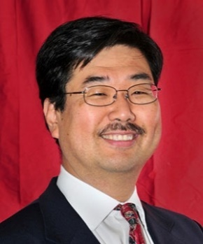
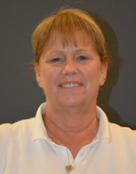

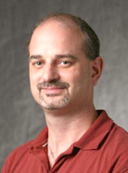

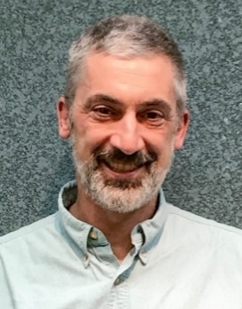
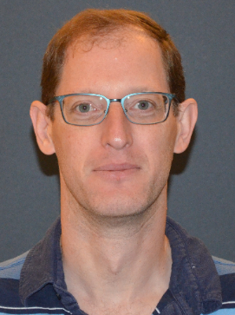
Design Lab Team
Associate Director
Admin Specialist
Manufacturing Manager
Shop Technician
Director
Kathryn Dannemann
Junichi Kanai
Valerie Masterson
Sam Chiappone
Scott Yerbury
Project Engineers
Mark Anderson
Brad DeBoer
Aren Paster

Slide 14
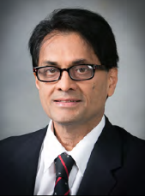

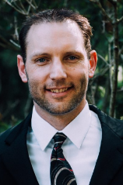
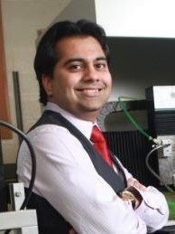
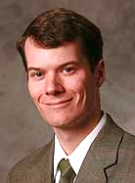
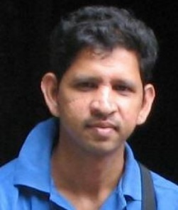

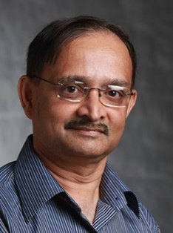
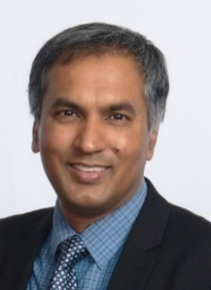
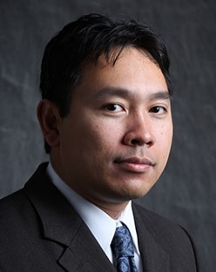
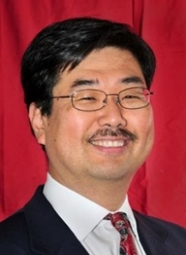



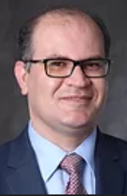





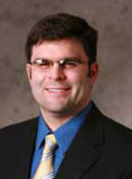
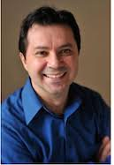
Faculty – Chief Engineers
MANE
Bharat Bagepall
Sarah Felix
Josh Hurst
Sandipan Mishra
Matt Oehlschlaeger
Karthik
Panneerselvam
Dan Walczyk
ECSE
Ishwara B. Bhat
Partha Dutta
Agung Julius
Junichi Kanai
Dylan Rees
Shayla Sawyer
Manoj Shah
Ali Tajer
Kyle Wilt
ISE
MSE
Mark Embrechts
Al Wallace
Kathryn
Dannemann
Dave
Duquette
Daniel Lewis
Rahmi Ozisik

Slide 15
Participation Expectations
Arrive to Class On Time / Stay until class ends
  We encourage use of cameras when on Webex
Be present in Class and Team Meetings
  Listen, Engage, Participate
  Not distracted on your Phone or other tasks
3 Credit Hour course mandates:
  4 Hours per week IN class
  5 Hours per week OUT of class
Read communication from Design Lab staff and teammates
  Emails
  Webex chat
  EDN posts

Slide 16
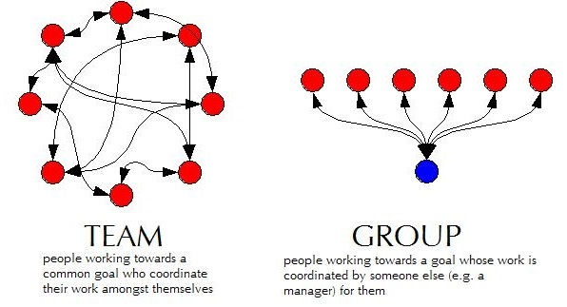
Capstone is TEAM work not GROUP work
Team Work
  collaborative effort
  peer review
  Student managed
Group Work
  divide and conquer
  low interaction with team
  Supervisor managed

Slide 17
Grading
Syllabus
  https://designlab.eng.rpi.edu/edn/attachments/download/109925/Common%20Course%20Syllabus.pdf
Tasks and Due Dates
  https://designlab.eng.rpi.edu/edn/projects/capstone-support-dev/wiki/Tasks_and_Due_Dates
Pose any questions to kanaij@rpi.edu
  Answers will be posted to EDN
  https://designlab.eng.rpi.edu/edn/projects/capstone-support-dev/wiki/Syllabus_or_Grading_questions

Slide 18
Behavior Expectations
Q: “How will you interact with your boss and peers in 6 months?”
Let’s start doing this NOW in Capstone Design
  Be Accountable.
    To your teammates, to Chief/Project Engineer, and to project sponsor.
  Be Professional.
  Make your work VISIBLE.
    Post/share as you go. No need to hide from team until its perfect or completely finished.
    Use Electronic Design Notebook (EDN)
Notes:
This slide is animated. Shows only the question – PE should ask students and get some responses

Slide 19
Accountability Step #1
You all received via email the Capstone Orientation Packet:
Director’s Introduction letter
Project Description - Will guide work today
Instructions for electronic signatures in Adobe
Recognition Waiver and Release - SIGN & return by end of day
Sponsorship Agreement - SIGN & return by end of day
Now we’re done talking about it.
More information
  https://designlab.eng.rpi.edu/edn/projects/capstone-support-dev/wiki/Confidentiality_Requirements

Slide 20
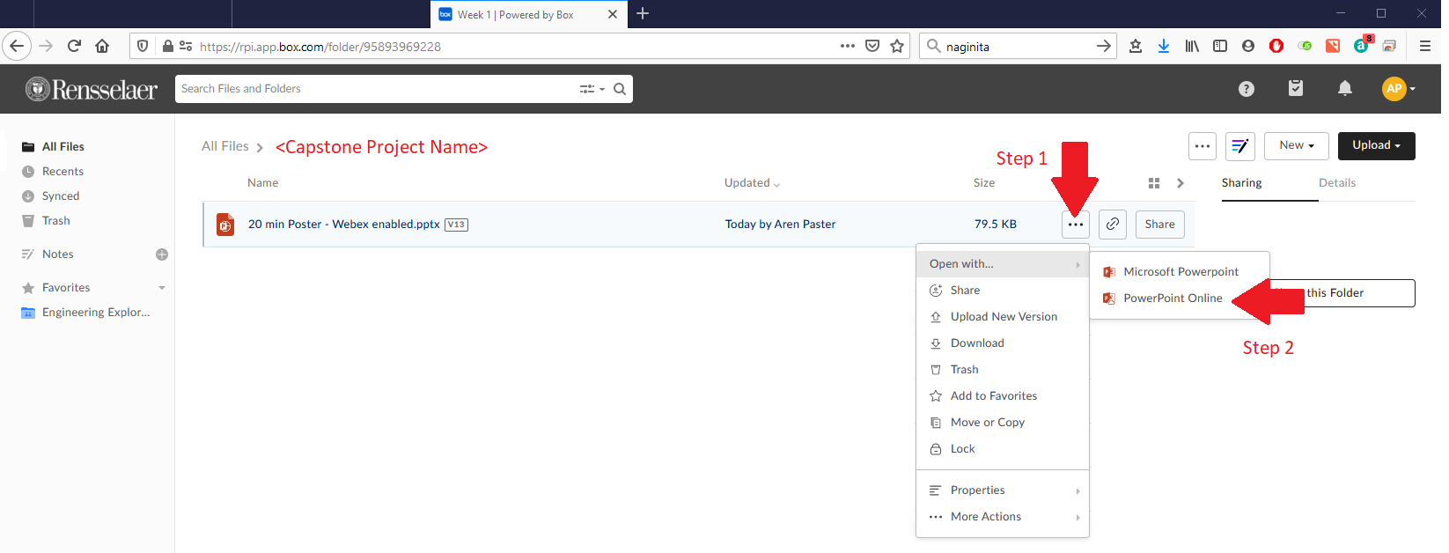
Collaboration Logistics
Each team has a Box folder pre-loaded with files
  https://rpi.app.box.com/
  Login using RPI credentials
EVERYONE open “20 min Poster - Webex enabled.pptx” file in PowerPoint Online
  This will allow simultaneous group editing
  (warning/notice) Online Office version lacks MANY features of standalone program

Slide 21
30 min - Team Ideation Presentation
Time boxed exercise. It will feel rushed, things won't feel complete. THAT'S OK.
You'll want more time. You can't have it. Team must move on.
For EACH section of presentation slides:
2 min
  Individual silent thought on content
  Type thoughts into text editor (Word, Notepad, etc...)
2 min
  Copy answers into shared Team PPT on Box
  Quick discussion of similar, unique, or new answers
Move on to next section of Ideation PPT as a team
PE will send chat messages to PE Space to help remind team to move on to each section of presentation

Slide 22
20 min - Team Ideation Presentation Summary
What unique skills does each person bring to the team?
What skills do members share in common?
What specific team or organizational strength will each person contribute?
What team or organizational weakness or areas for growth does each person have?
How can team make best use of each individual’s skills and talents?
Does every team member have a TECHNICAL action item to complete by next class?
  Note: This is something that should happen by end of EVERY class.

Slide 23
5 min - Team Meeting
Choose a 30-60 min time for team to meet before next class
  www.WhenIsGood.net works well
  NOT RECOMMENDED to use this time every week for the full team. That’s what class time is for. Instead use this time for occasional needed planning meetings, or for smaller sub groups to meet about project.
MUST REACH DECISION TODAY! You have a group assignment to complete before next class.

Slide 24
10 min – Questions about IED and Capstone Readiness
What part of your IED experience do you NOT want to repeat? - 4 min
  Personality conflicts
  Time management (ran out of time)
  Unequal division of labor
  Communication breakdown
How ready is your team to move forward on project?
1 (low) - 10 (high) scale
1 min - Pick individual answer
Move to PROJECT SPACE, discuss as a team, and come to consensus - 5 min
Return to PE SPACE for full class debrief - 5 min

Slide 25
5 min – Ticket Out
Design Lab wants your 'immediate' feedback on the course and your experience.
These 'surveys' after many classes will help us help you.
Collected anonymously using Google Forms.
  If you ever want an individual response from PE/CE/Director, be sure to INCLUDE your name.
Please Complete Ticket Out Today or Tomorrow
You can also always use email or Webex to reach out to PE/CE with any questions.

Slide 26
Out of Class Tasks (what you might call homework, complete BEFORE Class 2)
Complete Class 1 Ticket Out
  https://forms.gle/kT3iYxnPDvwJjSVu7
Register for EDN – https://designlab.eng.rpi.edu/edn/
  Registration button in upper right hand corner
  Login must be your RCS ID (RPI email before the @ symbol)
  Email must be your RPI email
  Bookmark this site. You will use it A LOT for this course.
Use out of class team meeting to start team building
Student Team Introductions
    Major, hometown
    Interests, clubs/sports, experience related to project topic
    Co-op, internship, summer job
    Pet, favorite ice cream flavor
Post evidence of progress on your project task assignment to team's Box folder as Word file. Filename should be RCSID-topic. Ex: pastea-FreeBodyDiagram.docx
  Web link of research AND summary of why it's important or useful
  Calculations
  Sketch of concept idea
NOTE – These tasks are posted on EDN along with all class agendas
https://designlab.eng.rpi.edu/edn/projets/capstone-support-dev/wik/Capstone_Class_Agendas

Slide 27
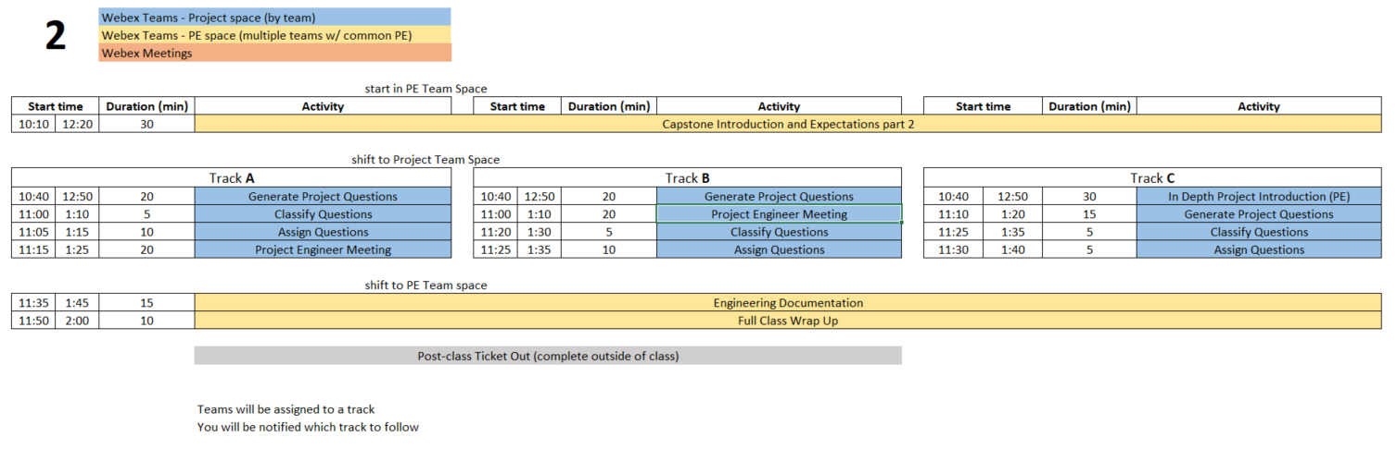
Class 2 Agenda
  You are STRONGLY ENCOURAGED to download newest version of Playbook prior to EACH class meeting.
Repository instructions - https://designlab.eng.rpi.edu/edn/projects/capstone-support-dev/wiki/Subversion
Notes:
PE notes – Track C is for projects with lots of history or content wholly unfamiliar to students.
Track A vs B is just a coin flip for scheduling.

Slide 28
30 min - Capstone Introduction and Expectations part 2

Slide 29
Capstone Design – Why we do it
What is a "real world experience"?
What is difference between IED and Capstone Design?
Why is Capstone a required course?
What is goal of this course?
What is a successful outcome for
  Project Sponsor?
  Student?
  RPI?
What is the Engineering Design Process?
Notes:
Group discussion of all questions

Slide 30
Design Course Progression
General Coursework
Intro Engineering Design
Capstone Design
On-going Feedback from Instructor
Instructor Ownership (content)
Student Ownership (project)
Stakeholder is Student Team
Student Ownership (project)
Stakeholder is Company/Organization
Instructor time: prepared lecture and skill instruction
Student project time: research and experimentation
Graded activities: presentation of results, HW/quiz/test
Project work reviewed/graded continuously rather than formally submitted

Slide 31
Typical Course Content
Instructor Guided Content
Lecture & Lab
Quiz/Test
Structured Activities
Student/team performance feedback
Submit only finished work
Team Guided Content
Meetings (in & out of class)
Design / Build / Test (Engineering Design Process)
Presentations
Peer to peer feedback & review
Iterative design & documentation
Capstone instructor-guided activities will be primarily in first 5 weeks of semester

Slide 32


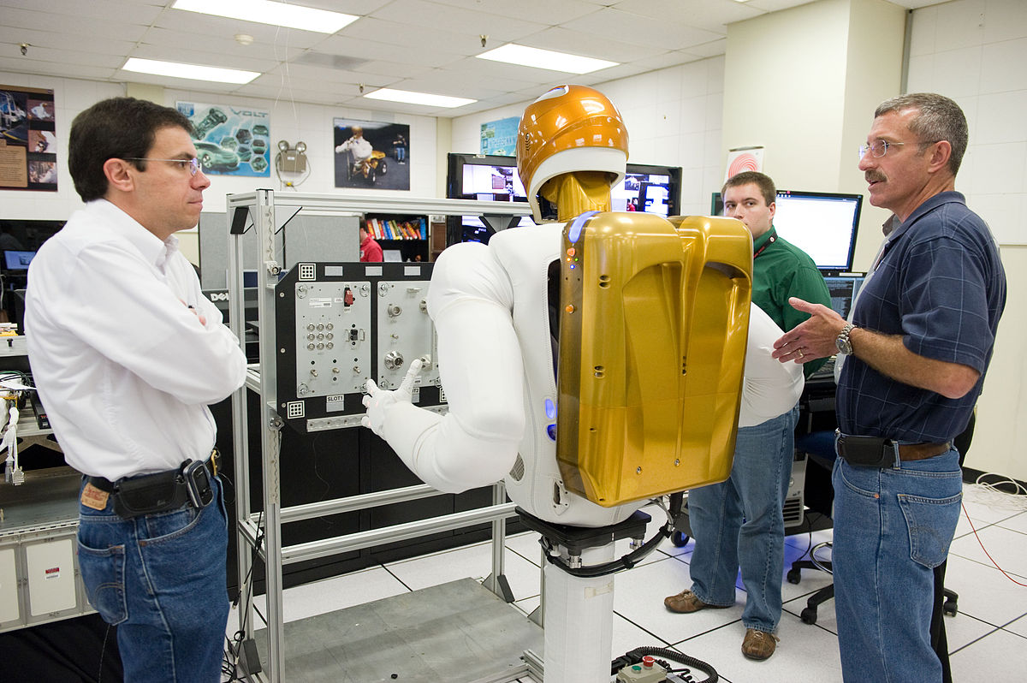
Capstone Design – How We Do It
Solve Open Ended Project by
Applying what you've already learned in 15+ years of courses
  Including re-learning whatever you've forgotten
AND self-learning new skills as needed
Begin the shift from
Engineering Student
Engineer

Slide 33
Roles and Responsibilities of Team
YOU (students) are OWNER of this project process
Sponsor (company) is OWNER of the project output
Design Lab Instructors are coaches & mentors, not teachers
  Offer guidance and help
    Point you to proper book, equation, or process, but students will do the math/analysis to justify their suggested solution
  Project Engineer (PE) – day to day operations
  Chief Engineer (CE) – grading/evaluation

Slide 34
Follow Track A/B/C as instructed by PE
Track A | Track B | Track C
Generate Project Questions | Generate Project Questions | In Depth Project Introduction (PE)
Classify Questions | Project Engineer Meeting | Generate Project Questions
Assign Questions | Classify Questions | Classify Questions
Project Engineer Meeting | Assign Questions | Assign Questions
Instructions for each activity are on the next few slides
ALL activities in TEAM Space

Slide 35
15 or 20 min - Generate Project Questions
These questions can be about any aspect of the project, but by the end of the class include questions targeted to:
  Customer Needs
  Project Specifications / Technical Requirements
Same inclusive discussion format as first class
  2 min. silent question generation
  Then begin copying into Project Questions.xlsx spreadsheet in Box.
  Combine duplicates/similar questions
  Add more to list as you think of them during discussion

Slide 36
15 min Classify and Assign Questions
  Classify all questions generated into one of three categories
    Things team members can research/answer themselves
    Things PE will answer
    Things to ask sponsor during kick-off meeting
  Team assigns owner to all questions in category A
  Add question classification and ownership to Box spreadsheet

Slide 37
20 min Project Engineer Meeting
  Project Engineer meets with each team:
    to check on team status / welfare
    to discuss project, review question & categories, and confirm/correct. When not meeting with your PE, team members generate/discuss questions.

Slide 38
Go back to PE space for
Engineering Documentation discussion

Slide 39
15 min – Engineering Documentation
Topics
  What is Documentation?
  Why bother?
  How is it done in Capstone?
PE note:
  Let group answer 1st two questions
  Then run through next few slide to see if anything was not suggested
  Then discuss 3rd question

Slide 40
What is Documentation?
Engineering Documentation?
Living record of your work
  Evolution of your product/design is traceable
  Your work (experiment) is reproducible
  Your work can be understood by others and why you did it that way

Slide 41
Why Document?
Extension of your memory
  Who, What, When, Where, Why, How
  So that others can collaborate and continue the work
  Facilitates teamwork
  So that others can review/understand your work
Legal ramifications
  Contractual/legal defense
  Patent application
Efficiently and Effectively move the project forwards

Slide 42
Capstone Course Policies - Tools
Electronic Design Notebook - REQUIRED for all collaboration
Webex – Team Chat
When Is Good – meeting scheduling
Box – Initial Collaborative work (week 1 - 4)
Not Permitted
  Slack, GroupMe or Discord for chatting
  Google Drive for file storage
  Google Suite for document creation
  Other cloud based tools for any use (schematics, mind maps, drawings, analysis, etc…) e.g. diagrams.net, etc.
Webex Teams is good for chat and live meetings, but project documentation MUST be transferred to EDN Forum or Repository.
  Simple/easy solution is to never put it on Webex to begin with.

Slide 43
What Tool Will You Use?
Electronic Design Notebook (EDN)
  Integrated Project Management
  Threaded Communication by topic, rather than a single unorganized stream
  IP protection
  Grading - accountability and visibility
  Secure access to team and sponsor
  Backed up daily !
  The EDN software may not be the PERFECT choice, but nothing is.
  It meets the Design Lab's needs better than the alternatives*.
  * https://designlab.eng.rpi.edu/edn/projects/capstone-support-dev/wiki/Why_Electronic_Design_Notebook_is_the_ONLY_choice

Slide 44
What Should I Document?
Everything
  Research, web links, notes
  Interviews and observations
  Ideas, concepts, sketches, charts, diagrams
  Calculations
  Purchases - components models, vendors, cost
  Analyses – technical and non-technical
  Experiments, debugging, tests
  Hypothesis, procedures, equipment used, steps taken, data, results
  Future work/ideas

Slide 45
10 min – Full class Wrap up
Information should be complete before documented?
  True or False
It is necessary to document negative results?
  True or False
Teammates share responsibility with PE/CE to offer technical feedback on EDN posts?
  True or False

Slide 46
Out of Class Tasks (what you might call homework, complete BEFORE Class 3)
Complete Class 2 Ticket Out
  https://forms.gle/3pGX1JgYy5nYnnep8
Post personal contact info (name, major, RPI email, phone #) to one thread in the EDN Background Info Forum (start new thread titled “Team Contact Info”, then reply for subsequent entries)
Find answer(s) to assigned question(s) & post to new thread titled “Class 2 Questions and Answers” in EDN Background Info Forum
Watch Customer Needs video (9 min)
  https://mediasite.mms.rpi.edu/Mediasite5/Channel/anderm8winrpiedu-engr-2050/watch/87d950eccc2942038b1d06530e9217841d
Watch Requirements video (11 min)
  https://mediasite.mms.rpi.edu/Mediasite5/Channel/anderm8winrpiedu-engr-2050/watch/96dceab44ae7447d812f5a216afa97cf1d
Identify one Customer Need for your project and translate it into an Engineering Requirement. Post to new thread in EDN Design Forum titled “Initial Needs and Requirements”
For ongoing projects, review prior semesters’ final presentations in accordance with PE instructions for class discussion in Class 3/4

Slide 47
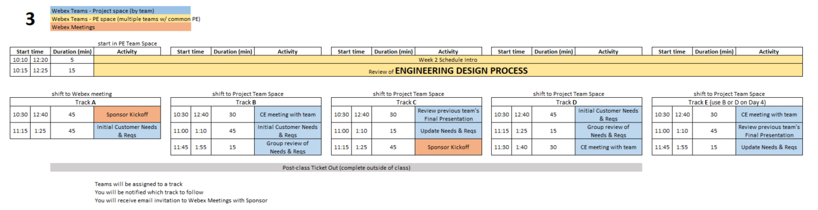
Day 3 Agenda
Over the course of Days 3 & 4 – All teams will complete the following:
Sponsor Kickoff Meeting
CE meeting with team
Customer Needs & Requirements - development and review
Review previous Final Presentation – ongoing projects only
  You are STRONGLY ENCOURAGED to download newest version of Playbook prior to EACH class meeting.
Repository instructions - https://designlab.eng.rpi.edu/edn/projects/capstone-support-dev/wiki/Subversion
Notes:
PE Notes
Continuing projects should follow Track C or E
New projects can follow A, B, or D
Track A or C on Day 3 should follow track A or C on Day 4
Track B, D, or E on Day 3 should follow track B or D on Day 4

Slide 48
15 min - Engineering Design Process
We will use the Engineering Design Process
This is INTENTIONALLY a quick refresher of the Design Process as covered in IED.
This may help you understand what it means and how your team can apply it to your Capstone project
If you remember it well – please help your team mates!

Slide 49
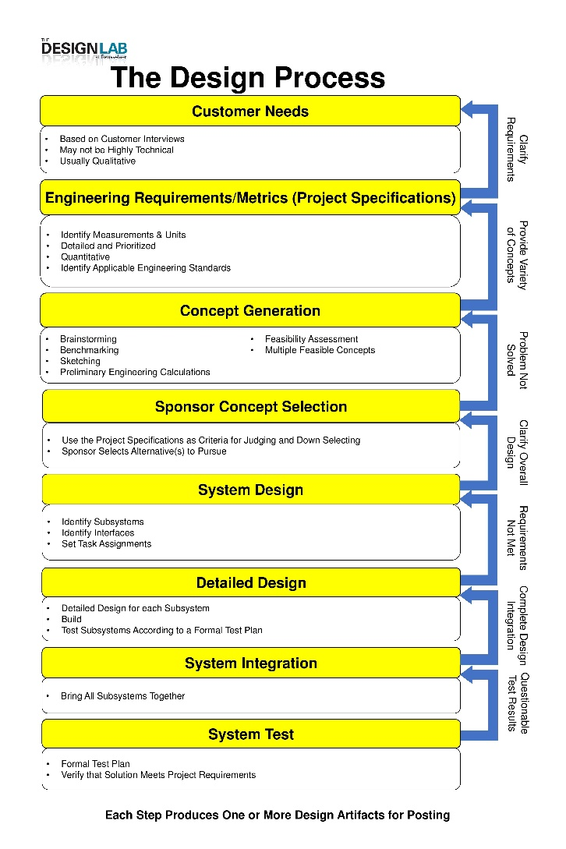
Engineering Design Process
Today is Day Three of class
Let’s look at steps ONE & TWO
Team will create/review/improve project’s list of:
Customer Needs
Engineering Requirements
This Design Process and terminology is taught in IED at RPI

Slide 50
10 mins - Customer Needs & Engineering Requirements Example
Discuss a Vehicle
  What are Customer Needs?
  Translate those to Engineering Requirements
With Needs and Reqs in mind - an informed customer could go to a dealership and talk about “product specifications” and choose the ‘right’ car for themselves

Slide 51
User Stories
Alternative method to Needs/Reqs to document how users/customers will interact with a system, website, program
User Story (who, what, and why of system use)
  As a [type of user], I want to [perform some task] so that I can [achieve some goal].
Acceptance Criteria (how to judge success)
  Given that [some context], when [some action is carried out], then [a set of observable outcomes should occur].

Slide 52
All teams are in a different place
Project Age
  New project
  Continuing project
Goal
  New product/process
  Improvement of existing product/process
  Investigation of new technology
  System integration
Product Life cycle
  Research and Development
  Feature Growth
  Repair & Maintenance
Team
  Multidisciplinary vs single discipline
  Remote vs on-campus
That’s OK and expected.
The Engineering Design Process still applies.

Slide 53

30 min - CE Meeting with Team
(Class 3 or 4)
Chief Engineer led discussion of:
  Course
    Course grading
    Student expectations
  CE background and experience
  Project impressions

Slide 54
45 min - Customer Needs & Engineering Requirements Generation
Needs and Requirements workbook.xlsx spreadsheet is in team Box folder
Fill out based on team’s current (uninformed impression) of project
  This is first pass. Don’t worry that answers are not complete or verified by sponsor.

Slide 55
45 min - Sponsor Kick-Off Meeting
Meeting Agenda
  Team introductions to sponsor (name, major, relevant experience/skills)
  Sponsor introduction to team
  Sponsor describes project "in their words“
    History, ultimate and semester goals, deliverables, etc…
  Open Q&A

Slide 56
30 min - Prior Presentation
(if applicable)
Team should review (outside of class) the final PPT presentation given by previous semester team
  Forums->Final Deliverables
  Repository->Reports->Final Reports
Quickly walk PE/CE through slide deck and discuss what you feel previous team would say about:
  Goals
  Accomplishments / Successes
  Challenges
  Next steps
PE/CE will help to clear up confusion and answer any questions current team may have

Slide 57
Out of Class Tasks (what you might call homework, complete BEFORE Class 4)
Update Needs/Reqs Workbook based on feedback (in Box folder)
Post class notes taken during PPT review to Project Management Forum
Choose sponsor liaison
  This person will be the focal point for emails to/from your sponsor. They are not the team's "spokesperson" at meetings, conference calls, in class, etc.
Watch Intro to EDN video (5 min)
  https://designlab.eng.rpi.edu/edn/projects/capstone-support-dev/repository/raw/training/Intro%20to%20the%20EDN.mp4
Read Project Documentation page
  https://designlab.eng.rpi.edu/edn/projects/capstone-support-dev/wiki/Project_Documentation
Complete Class 3 Ticket Out
  https://forms.gle/QcsmZ5qAhS9L9Sdr5
Complete the Online Safety Training in Percipio by end of 3rd week
  https://www.percipio.com
  Rensselaer Manufacturing and Prototyping Laboratories-Safety Orientation
  NOT required for
    Fully remote students
    Local students without campus access

Slide 58
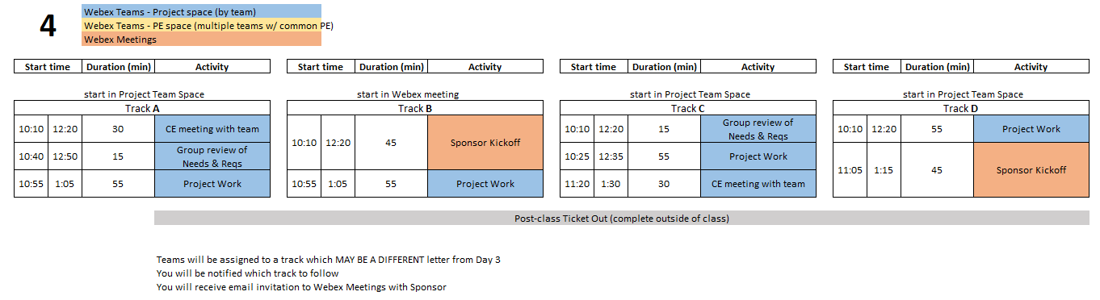
Class 4 Agenda
  You are STRONGLY ENCOURAGED to download newest version of Playbook prior to EACH class meeting.
Repository instructions - https://designlab.eng.rpi.edu/edn/projects/capstone-support-dev/wiki/Subversion
Notes:
PE Notes
Track A or C on Day 3 should follow track A or C on Day 4
Track B, D, or E on Day 3 should follow track B or D on Day 4

Slide 59
Engineering Design Process
Today is Day Four of class
Team should be working towards student agreement, and PE/CE/sponsor review/approval of steps ONE & TWO
Customer Needs
Engineering Requirements
This Design Process and terminology is taught in IED at RPI

Slide 60
55 Min - Project Work
Refine Needs and Requirements Spreadsheet
  Needs
    Ensure all known Customer Needs are documented
  Requirements:
    Associate with appropriate Customer Need(s)
    Identify Measurements and Units (quantitative)
    Ensure that Requirements are detailed and prioritized
    Identify Applicable Engineering Standards
Refine/Develop Follow-Up Questions for Sponsor
  If Team has already had Sponsor Meeting, what new questions have been identified as a result?
    Clearly document and send to Sponsor, copy PE
Background Research/Benchmarking
  Discuss/document work done to date
  Identify/document additional benchmarking needs

Slide 61
30 min - CE Meeting with Team
(Class 3 or 4)
Chief Engineer led discussion of:
  Course
    Course grading
    Student expectations
  CE background and experience
  Project impressions

Slide 62
Out of Class Task / Action Items:
Complete Class 4 Ticket Out
  https://forms.gle/9oFPZF4a2r3uZv1v7
Update Needs/Reqs Workbook - post to EDN Design forum
Complete the Online Safety Training in Percipio by end of 3rd week
  https://www.percipio.com
  Rensselaer Manufacturing and Prototyping Laboratories-Safety Orientation
  NOT required for
    Fully remote students
    Local students without campus access

Slide 63
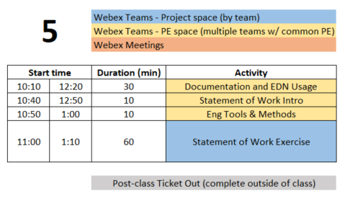
Class 5 Agenda
  You are STRONGLY ENCOURAGED to download newest version of Playbook prior to EACH class meeting.
Repository instructions - https://designlab.eng.rpi.edu/edn/projects/capstone-support-dev/wiki/Subversion

Slide 64
Engineering Design Process
Today is Day Five of class
Team will develop Statement of Work (SoW).
This puts into clear words & pictures what the FINAL output will look like, and the tools required to get there.
This Design Process and terminology is taught in IED at RPI

Slide 65

TA Introduction – Jim Olson
Capstone Role Spring 2021
Experience
Student Support
  Presentation Preparation
  Ideation
  Project Planning
  Requisition Preparation
  Fabrication Planning
Faculty / Staff Support
  Upon request from PE / CE
Publications
  An Economic Cost Assessment on HALEU Fuels for Small Modular Reactors, Science and Technology of Nuclear Installations, 2020
Patents
  US 8,286,430 (GE)
  US 8,926,273 (GE)
Adjunct Professor
  Capstone Spring 2019
RPI Visiting Research Scholar 2016-2018
Private Consultant, NYS OVS 2018-Present
  Assistive Technology Development for TBI
WebEx Contact: Olson, James Edward Email: olsonj5@rpi.edu

Slide 66
30 min - Documentation & EDN Usage
You should have already watched EDN video and read Documentation Wiki page
  Intro to EDN video (5 min)
    https://designlab.eng.rpi.edu/edn/projects/capstone-support-dev/repository/raw/training/Intro%20to%20the%20EDN.mp4
  Project Documentation page
    https://designlab.eng.rpi.edu/edn/projects/capstone-support-dev/wiki/Project_Documentation
Where to post your work
How to create post (which buttons/links on EDN)
Notes:
Need to add some show not tell to these slides
How do you currently organize information:
On your desk
-on your PC
In text messages
In emails
Within an organization, e.g. fraternity / sorority, sports teams, clubs, etc.

Slide 67
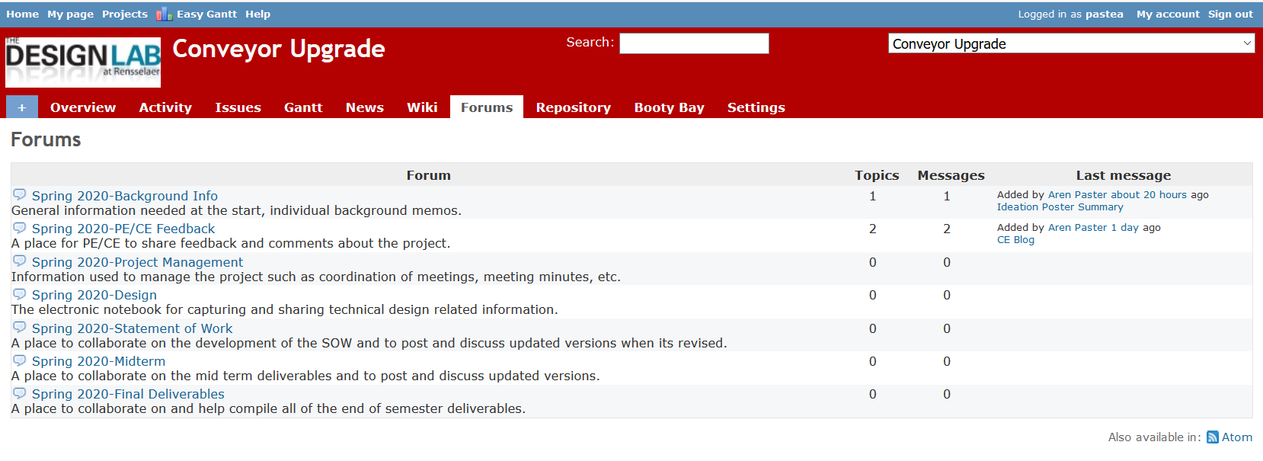
Where to put information?
Task Assignments
Forums Tab
Technical Work
Statement of Work
Work through quick examples using EDN

Slide 68
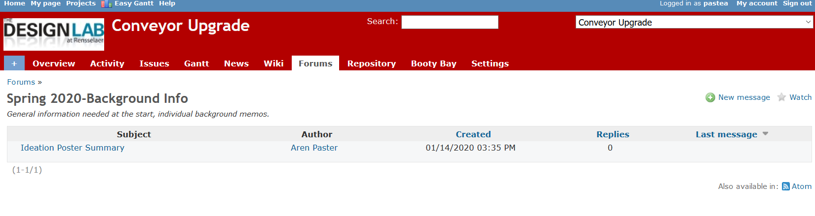
How to post
Forums
New Message
Live demonstration of making a forum post

Slide 69
EDN Usage
Using the EDN effectively will contribute greatly to you and your team’s success in this course. Both for getting work accomplished and for documenting that work!
  Issues to track and direct effort
  Forums to document and discuss the output of that effort
  Visibility for instructors to assign credit
Post or it didn’t happen!

Slide 70
10 min - Engineering Tools and Methods
  What techniques, software, calculations will be used to address the problems in front of team? Ex:
  Mechanical aspects – Free Body diagram, torque measurement
  Software – flow chart of system control loop, storyboard of user input
  Process – conduct customer interviews of toddler caregivers, create Standard Operating Procedure for system startup and calibration

Slide 71
Phases of the Design Report
Phase 1
Statement of Work
Phase 2
Preliminary Design Report
Phase 3
Final Report
Week 4
Midterm
End of Semester
In ALL cases, the file name and location remains the same:
“working/Reports/Design Report and Poster/Design Report.docx”

Slide 72
Design Report.docx - Table of Contents
Green – Create
Yellow – Update
File name
DOES NOT change

Slide 73
Design Report Section Progress
Create (green)
  first pass at generating this content
Required Update (yellow)
  revise and update based on work done to date
  incorporate feedback from PE/CE/sponsor
Optional Update
  any existing material can be revised with new information
  incorporate feedback
At all stages, the file name and location in Repository remains the same:
“working/Reports/Design Report and Poster/Design Report.docx”

Slide 74
10 min - Statement of Work Introduction
60 min - Statement of Work Exercise
Design Report Template – SoW is phase 1 of this document
https://designlab.eng.rpi.edu/edn/projects/capstone-support-dev/repository/changes/template%20documents/Design%20Report.docx
10 min – Break into 3 groups (meet in subteam spaces A/B/C)
  A - Long Term Objectives (1-5+ years, from Customer Perspective)
  B - Current Semester Objectives (3 months!)
  C - Deliverables (Be S.M.A.R.T.!)
Shift back to Team Space
10 min - Team review – Long Term and Current Semester Objectives
15 min - Team review – Deliverables
20 min
  PE/CE review of Deliverables
  Team development of Dates for Deliverables and Engineering Tools and Methods
Create threads in Statement of Work Forum for notes on each section

Slide 75
Out of Class Task / Action Items:
Complete Class 5 Ticket Out
  https://forms.gle/Af4Bfe47Q9u5SBsh7
Wordsmith and polish Statement of Work
Post Statement of Work (Phase 1 of Design Report.docx) to EDN Repository prior to class 6 in the folder:
  working/Reports/Design Report + Poster
Complete the Online Safety Training in Percipio by end of 3rd week
  https://www.percipio.com
  Rensselaer Manufacturing and Prototyping Laboratories-Safety Orientation
  NOT required for
    Fully remote students
    Local students without campus access

Slide 76
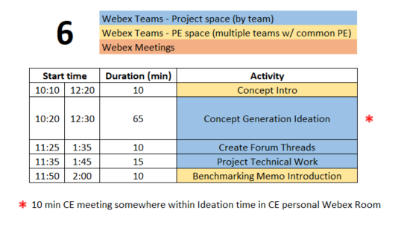
Class 6 Agenda
  You are STRONGLY ENCOURAGED to download newest version of Playbook prior to EACH class meeting.
Repository instructions - https://designlab.eng.rpi.edu/edn/projects/capstone-support-dev/wiki/Subversion

Slide 77
Engineering Design Process
Today is Day Six of class
Team will generate AND document concepts to address and meet the Needs & Requirements of the project.
This Design Process and terminology is taught in IED at RPI

Slide 78
10 min – What’s a Concept?
Returning to vehicle example discussed last class:
What were the needs? The requirements?
What concepts address the needs/reqs identified?
Where do concepts come from?
External
  Literature / Internet search to identify how others have addressed related topics. This is part of “benchmarking”
Internal
  Ideas from within the team
Effective Concept Generation Requires
both Internal AND External Sources

Slide 79
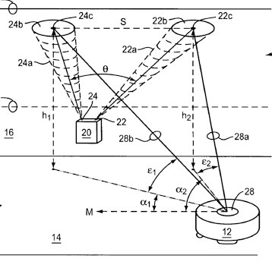
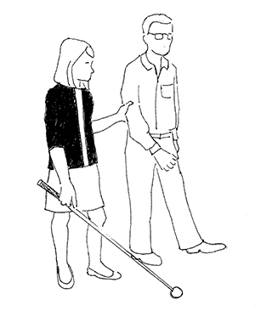

External Search:
Finding Existing and Related Solutions
Patents
Market
Users
Search
Licensing
Benchmarking
Competition
Lead users
Extreme users
Product Design and Development
Chapter 7
Karl T. Ulrich, Steven D. Eppinger, Maria C. Yang
7th Edition, McGraw-Hill, 2020.
Notes:
iRobot celestial guidance system
Samsung famously copied Apple’s patented innovations
GorillaPod developed by students in a design class at Stanford

Slide 80
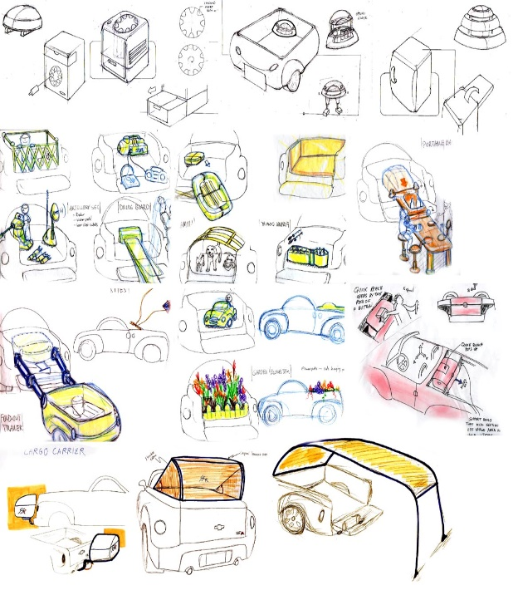


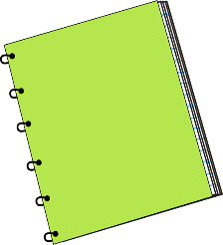
Internal Search:
Brainstorming to Explore the Solution Space
Stimulation
Connection
Transformation
Related stimuli
Unrelated stimuli
Build on ideas
Gallery method
Refinement
SCAMPER method
persona
FIELD
NOTES
Product Design and Development
Chapter 7
Karl T. Ulrich, Steven D. Eppinger, Maria C. Yang
7th Edition, McGraw-Hill, 2020.

Slide 81
65 Min - Concept Generation
Similar inclusive plan as previous exercises using Box document
5 min – Individually silently generate any concept to solve/address project needs/reqs
10 min – Add concepts to Concept Generation Spreadsheet.xlsx in Box
15 min – Organize list by topic
  Eliminate duplicates
  Add extra ideas you think of right now or are inspired by others ideas
35 min – Group discussion
  Explain further to improve group understanding – if necessary
  Look for missing/unaddressed needs –think of concepts to address them
  Look for lone concepts – think of alternative ideas

Slide 82
10 min – Create Forum Threads
Concept topics ARE the key discussions and work areas for the team
Create Design Forum threads for each topic
  Use these thread to post explanation, sketches, calculations, etc…
  Reply to team mates posts to move idea forwards and advance project

Slide 83
15 min – Project Work
Go to Team Space
Work on project
Someone should take notes of meeting discussion
Post to Forums –> Project Mgmt
  NOT as Word document, simply as plain text in Forum post.

Slide 84
Benchmarking Memo
What is current state of the art? How is problem currently solved?
What will team members NEED to know to move forwards?
What has already been accomplished by prior team?
Team creates topic list
  Literature search
  User interviews
  Identifying / installing / practicing software or techniques which will be required for the project
  Install existing project software
  Verify work done by past Capstone team
  Conduct testing or system operation described by prior team
PE/CE approve list
Capstone Support Wiki has description, template, and rubric

Slide 85
Out of Class Task / Action Items:
Continue technical work
Post progress to Design Forum threads
Upload Needs and Requirements Worksheet to Repository
  Ongoing project – Merge new work into existing documentation
Team generates Benchmarking Memo topic list
  Post to Background Info forum
Brainstorm 6 individual tasks which need to be accomplished to reach project goals, post to a thread in the Project Mgt. Forum
Complete the Online Safety Training in Percipio by end of 3rd week RIGHT NOW
  https://www.percipio.com
  Rensselaer Manufacturing and Prototyping Laboratories-Safety Orientation
  NOT required for
    Fully remote students
    Local students without campus access

Slide 86
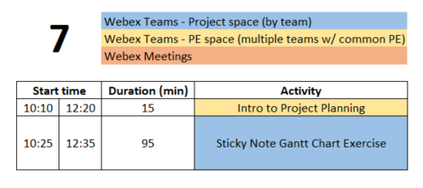
Class 7 Agenda
  You are STRONGLY ENCOURAGED to download newest version of Playbook prior to EACH class meeting.
Repository instructions - https://designlab.eng.rpi.edu/edn/projects/capstone-support-dev/wiki/Subversion

Slide 87
Engineering Design Process
This Design Process and terminology is taught in IED at RPI
Today is Day Seven of class
Team will develop list of the tasks necessary to complete the project, and schedule them over the remainder of the semester.

Slide 88
10 min - Project Planning
To improve odds of success having a plan ALWAYS helps.
Let’s talk about building a house.
How is ‘plan’ communicated?
What are the milestones?
How is timing/scheduling/order important?

Slide 89
95 min - ‘Post It Note’ Project Planning Exercise
10 min – (individually silently) generate list of TEN tasks which team must accomplish to meet deliverables
  Out of Class Task was to post 6 to EDN, so start with those. Then create 4 more.
(PE has/will preload with Deliverables from SoW)
10 min – enter tasks in the Gantt Chart PPT.pptx in Box
Create 1 text box for each task
Choose a personalized fill color for your entries
Position tasks appropriately along week by week calendar
60 min – Group organization of tasks
Add missing tasks, remove duplicates
Organize by subsystem or milestone
15 min – Re-assign ownership (by color) to ensure everyone has work throughout semester

Slide 90
Out of Class Task / Action Items:
Create draft of Status Update PPT topics
  Template - https://designlab.eng.rpi.edu/edn/projects/capstone-support-dev/wiki/Templates_and_Forms
Create agenda for 60 mins of Class 8
EDN Gantt Chart Creation
  Create Versions for each deliverable
  Add your personal tasks identified in Gantt Chart exercise as Issues
Complete the Online Safety Training in Percipio by end of 3rd week RIGHT NOW !!
  https://www.percipio.com
  Rensselaer Manufacturing and Prototyping Laboratories-Safety Orientation
  NOT required for
    Fully remote students
    Local students without campus access
Benchmarking Memo due on 9/23 (9/28)
  Memo Template: https://designlab.eng.rpi.edu/edn/projects/capstone-support-dev/repository/changes/template%20documents/BM_Memo-Topic-RCSid.docx
  Memo Rubric: https://designlab.eng.rpi.edu/edn/projects/capstone-support-dev/repository/changes/Rubrics/BM%20Memo%20Rubric.docx
  Submit your memo in the Background Info forum
    Include your RCSID and topic in filename!

Slide 91
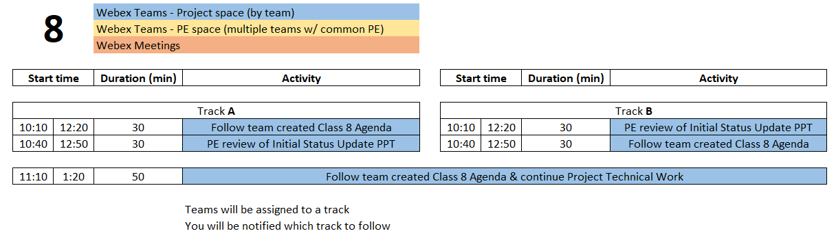
Class 8 Agenda
  You are STRONGLY ENCOURAGED to download newest version of Playbook prior to EACH class meeting.
Repository instructions - https://designlab.eng.rpi.edu/edn/projects/capstone-support-dev/wiki/Subversion

Slide 92
Engineering Design Process
Today is Day Eight of class
Team is developing concepts and beginning to down select.
Creating poster to communicate overall project and progress made.
This Design Process and terminology is taught in IED at RPI

Slide 93
Out of Class Task / Action Items:
Address any feedback on Status Update PPT
Sponsor liaison should email PPT to sponsor 24 hours prior to call
Continue technical work
Post progress to Design Forum thread(s)
Student Team should now be creating individual project tasks
Prep for upcoming PDR - There will be THREE groups presenting
Identify who will be presenting in each of the three groups
Identify TWO team members for EACH session who will “host” the team’s upcoming PDR in their personal Webex space. One as “primary” and one as an alternate. Please post this information to a thread in the PDR Forum.

Slide 94
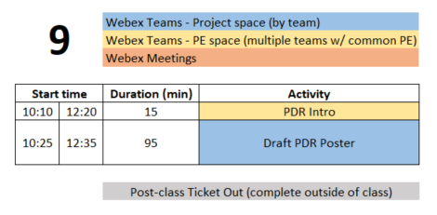
Class 9 Agenda
  You are STRONGLY ENCOURAGED to download newest version of Playbook prior to EACH class meeting.
Repository instructions - https://designlab.eng.rpi.edu/edn/projects/capstone-support-dev/wiki/Subversion

Slide 95
Engineering Design Process
This Design Process and terminology is taught in IED at RPI
Today is Day Nine of class
Team is creating poster to communicate
Overall project (Needs & Requirements)
Progress made (Concepts, System Architecture)
Future steps (Test Plan)

Slide 96
15 min – Preliminary Design Review Introduction
Opportunity to share information and receive feedback
  Tradeshows
  Conference
  Investor pitch
Tell a cohesive story to introduce project
  Audience is educated (profs and RPI students), but may know NOTHING about your topic
  2-3 mins to establish big picture background and history
You WILL be interrupted with questions
Use the poster as a guide
Logistics
  Presentations via Webex NOT in-person
  Students not presenting should join as audience for OTHER projects

Slide 97
95 min – Poster Creation
Open Poster.pptx in Box in PPT Online
10 mins – Divide into 3 groups, shift to sub-Spaces on Webex Teams, and work on initial slides. Content can be pulled from Statement of Work.
  Purpose
  Past Work and/or Project History
  Semester Objectives/Requirements
40 mins – As a full team discuss Technical Approach, Results and Accomplishments to Date
30 mins – Move on to Next Steps and Plan
15 mins – Begin assembly of content onto single slide (pg 8)

Slide 98
Out of Class Task / Action Items:
Class 9 Ticket Out
  https://forms.gle/pPHLdBH1PmDVAoTw9
Upload poster draft to EDN
  File in the Repository – working/Reports/Report + Poster/Poster.pptx
  Discuss in PDR Forum
Continue technical work
Post progress to Design Forum thread(s)
Student Team should now be creating agendas for each class meeting and individual project tasks
Make an appointment with James Olson (olsonj5@rpi.edu), TA, and get feedback on your PDR poster. Update the poster as needed.

Slide 99
Preliminary Design Review (10/7 Th or 10/8 Fri)
Presentation Schedule
Sections 1&3 | Sections 2&4 | Activity | Presenter A Primary Host | Presenter B Backup Host | Presenter C
10:10 | 12:20 | Beginning of class
10:15 | 12:25 | Start the 1st sub-team's design review | Name & Email | Name & Email | Name & Email
10:35 | 12:45 | Start of Q&A
10:40 | 12:50 | Time for reviewers to document evaluation
10:50 | 13:00 | Start the 2nd sub-team's design review | Name & Email | Name & Email | Name & Email
11:10 | 13:20 | Start of Q&A
11:15 | 13:25 | Time for reviewers to document evaluation
11:25 | 13:35 | Start the 3rd sub-team's design review | Name & Email | Name & Email | Name & Email
11:45 | 13:55 | Start of Q&A
11:50 | 14:00 | Time for reviewers to document evaluation

