Slide 1

The Statement of Work
The Design Lab at Rensselaer

Slide 2
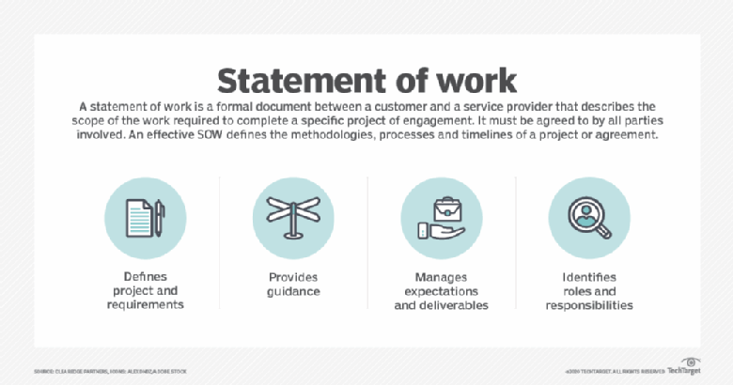
The Statement of Work - SoW
What Is It?
Written Shared Understanding of the Project
Why Do We Use One for Capstone?
Used to Define Projects and Help Manage Scope
Commonly Used in Industry
When Is It Created for a Capstone Project?
Approximately Week 4
https://searchitchannel.techtarget.com/definition/statement-of-work-SOW

Slide 3
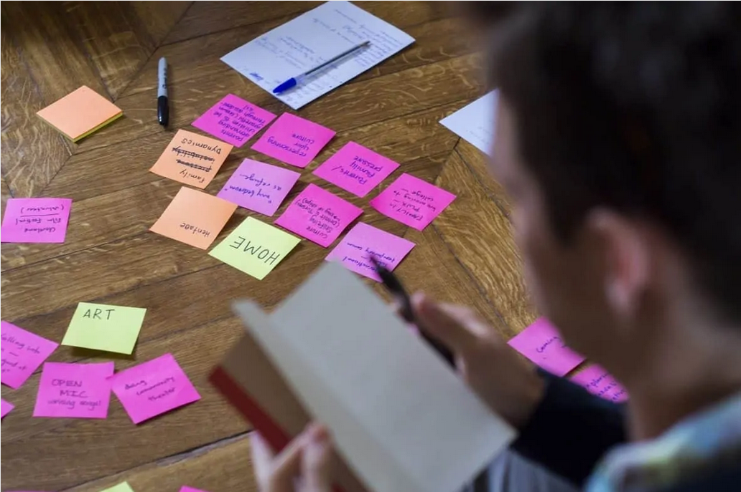
The Process
Download and Review the Design Report Template
Note Sections Required for SoW
Consider How Those Sections Relate To Your Project
For Each Section – As You Work
Remove any sample text / instructions
Fill in the appropriate information
Some Sections May Require More Discussion Than Others
This is Preliminary and WILL Be Revised During the Project
All Team Members Proofread the Entire Document
https://merlinone.com/mistakes-generating-statement-of-work/

Slide 4
These Design Report Sections = SoW
The Statement of Work is simply a Subset of the Design Report
You Will Add The Other Sections Later In the Semester

Slide 5
Where / How ?
Section | General Guidance / Information Source
Executive Summary | Write this Last!
List of Figures and Tables | Automatically Created by Using Word Captions
Revision History | Loosely Keep Track of Changes
Glossary | Start this ASAP & Keep Adding
1. Introduction | New Writing
2. Project Objectives & Semester Objectives | Leverage The Initial Project Description
3. Engineering Tools and Methods | From Your Earlier Working Session
References | Start this ASAP & Keep Adding! Do NOT do this last!
Appendix A: Initial Deliverables and Dates | From Your Earlier Working Session
The file name and location in your Repository always remains the same:
“working/Reports/Design Report and Poster/Design Report.docx”

Slide 6
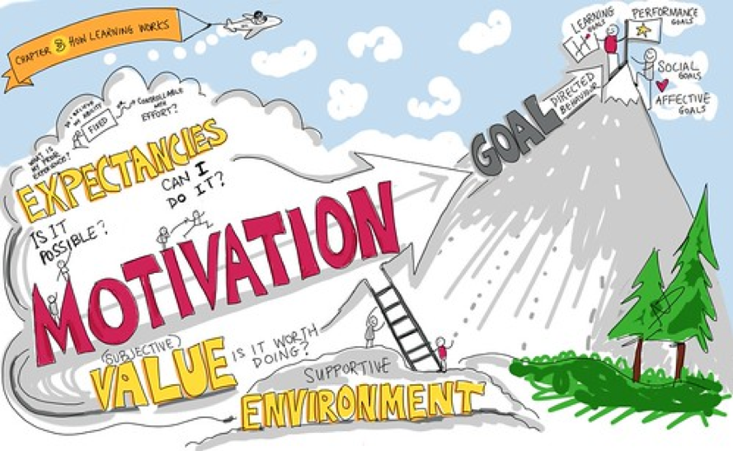
Helpful Hints - Background and Motivation
Included in Section 2 - Project Objectives & Semester Objectives
May come from: Industry / Academia, Your sponsor, Previous capstone teams
Start with your project description
Change for new information (if any) from your sponsor meeting(s), PE, CE
This Photo by Unknown Author is licensed under CC BY

Slide 7

Helpful Hints - Long Term Objectives and Customer Payoff
Included in Section 2 - Project Objectives & Semester Objectives
aka “The Big Picture”
Timeframe: 2-5 Years after this semester
What will your customer do with your results?
Assume your work may need to be combined with other developments at RPI or Sponsor
How will your results facilitate better products, higher profits, contributions to society, etc.?
This Photo by Unknown Author is licensed under CC BY-SA-NC

Slide 8
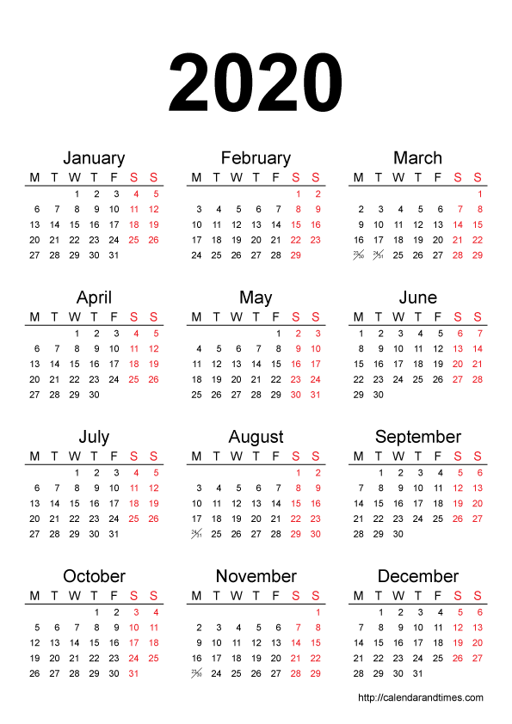
Helpful Hints - Current Semester Objectives
Included in Section 2 - Project Objectives & Semester Objectives
aka “The Little Picture”
If yours is an on-going project, summarize the project history first so that it is easy for the readers to understand why you chose the semester objectives.
Do NOT simply repeat the generic design process.
Capture the valuable results that you will produce and deliver to your customer in this one-semester course.
Include specific commitments by your team
What will delight your sponsor?
Be project specific, not generic.
20xx
This Photo by Unknown Author is licensed under CC BY-NC

Slide 9
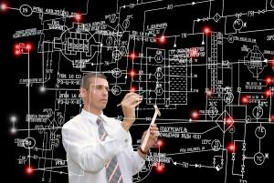
Helpful Hints - Engineering Tools and Methods
Section 3 of the Design Report
Provide specific information on the technical aspects of work.
Convince the reader that the team has the technical know-how required to execute the project.
Do not include project management approach details unless they specifically relate to how the team will deliver their work. Check with your PE.
https://www.engineering.com/story/5-skills-hiring-managers-look-for-in-engineering-grads
See Example On Next Slide

Slide 10
Helpful Hints - Engineering Tools and Methods
Examples
Project Area | Tools and Methods
Software | Iteratively releasing code for sponsor feedback Flow chart of system control loop Storyboard of user input Pseudocode for embedded software
Mechanical | Free Body diagram - relationship of force vectors Torque measurements on the shaft to determine maximum system loading Finite element analysis (FEA) for maximum deflection under expected load
Process | Conduct customer interviews of toddler caregivers Create Standard Operating Procedure for system startup and calibration Discrete Time Simulation using ARENA for material flows for factory layout

Slide 11

Helpful Hints – Initial Deliverables and Dates
Found in Appendix A
Do not list course items, e.g. Preliminary Design Document, sponsor visits, etc.
Include completion of specific intermediate project accomplishments
Analysis, experiments, design drawings or fabrication of parts
Confirm deliverables are tangible items.
Be S.M.A.R.T.
Be specific to your project, rather than generic.
Deliverables are the outputs of the tasks, not the tasks themselves. E.g.
  Task - Research competitors' products.
  Deliverable - A report on competing products.
Deliverables should relate to your Current Semester Objectives
This Photo by Unknown Author is licensed under CC BY-NC

Slide 12
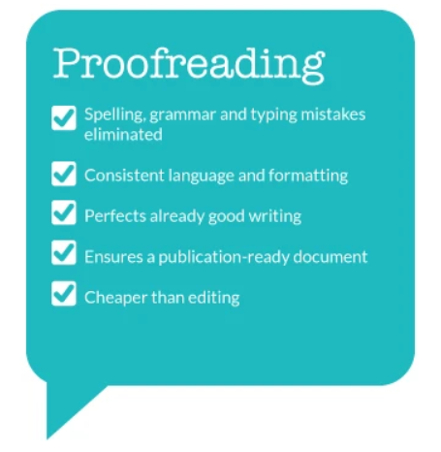

Things to Keep In Mind
Stay S.M.A.R.T.
Proofread
Do not rename the file! Keep “Design Report.docx”
Avoid flowery prose. Be concise and technically focused. Be sure all terms are clear or defined.
Incorporate feedback from PE/CE/sponsor
Use Our Checklists as a Self-Evaluation Rubric
Look at the Rubric - https://designlab.eng.rpi.edu/svn2/capstone-support-dev/Rubrics
https://experteditor.com.au/proofreading-services/
https://grad.tamu.edu/Blog/Blog/April-2018/The-Powerful-Tool-Checklist

Slide 13
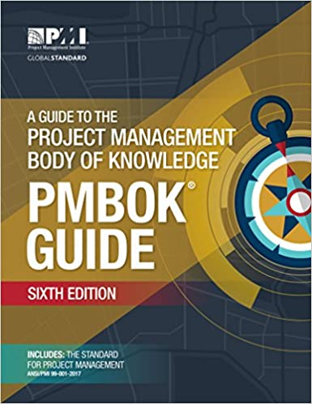
Additional Resources
The Project Management Institute, https://www.pmi.org/
  Training Materials
  Certifications
  Publisher of “The Project Management Book of Knowledge”
Ulrich & Eppinger / Ulrich, Eppinger and Yang
  Product Design and Development – Project Management chapter in the IED Textbook
Capstone Support Wiki
  https://designlab.eng.rpi.edu/edn/projects/capstone-support-dev/wiki/Statement_of_Work
  https://designlab.eng.rpi.edu/edn/projects/capstone-support-dev/wiki/Gantt_Charts__Project_Management

