Slide 1
Welcome to Capstone Design
Playbook for Class 1 to 9
Scaffolded Sessions

Slide 2
Revision History
Version | Date | Name | Reason for Changes
1.0 | 5/17/21 | Paster | Copy created from S21 Playbook Revision history cleared
1.1 | 5/18/21 | Paster | “disposable mask” clarified p9 Orientation Packet p19
1.2 | 6/8/21 | Paster | EDN usage p67
1.3 | 6/21/21 | Anderson | COVID page. Mentioned flipped on slide 12. Added comment about where to discussed flipped, fixed some grammar / increased font size-formatting on a couple slides
1.4 | 6/28/21 | Paster | Added Design Process image after agenda slides Font change p44
1.5 | 7/2/21 | Paster | Updated all web links to F21 Ticket Outs
1.6 | 7/8/21 | Paster | Added External & Internal concept search slides from IED textbook p 79+80 Improved task description on daily Design Process poster callback
1.7 | 7/13/21 | Paster | Removed mention of Risk Analysis Memo Added content and reference to Benchmarking Memo Updated dates for PDR and Memo submission s/’Midterm forum’/‘PDR forum’ Updated most Agenda slides to add CE time and fix formatting Added Class 3 Ticket Out
1.8 | 7/15/21 | Paster | Benchmarking Memo introduced – p84 Related Out Of Class tasks & link to rubric added
1.9 | 7/23/21 | Paster | Added CE Time to Day 6 – p81 Added ‘Re-read project description’ as task after Day 1
2.0 | 7/26/21 | Paster | Semester removed from filename to make document ‘evergreen’ Updated link to Capstone Playbook on agenda slides Added TBD link to EDN posting video - p46

Slide 3
Revision History - continued
Version | Date | Name | Reason for Changes
2.1 | 7/29/21 | Anderson & Paster | Updated EDN posting video class 2 tasks – p46 Standardized formatting on RCSID throughout document
2.2 | 8/2/21 | Paster | Updated ALL agenda slides to reflect scaffolding changes
2.3 | 8/10/21 | Paster | “Meet with PE/CE” branding Swapped content for Q&A slides – Engineering Design Process, Statement of Work, Concept Generation, Project Planning, PDR Activity description slides duplicated for classes 3&4 Updated activity times and order to match Flipped content changes
2.4 | 8/16/21 | Paster | Updated all Out of Class Task slides Removed ‘All Teams in a Different Place’ slide Class 10 agenda added - p106 Adjusted PDR times to match return to 10:00 &12:00 class start - p105
2.5 | 8/25/21 | Paster | Updated links to Out of Class tasks on day 4 – p66

Slide 4
Revision History - continued
Version | Date | Name | Reason for Changes

Slide 5
Link to Agendas
Class 1
Class 2
Class 3
Class 4
Class 5
Class 6
Class 7
Class 8
Class 9
Pro Tip – Current Out of Class Tasks are listed ONE page before next class’s agenda

Slide 6
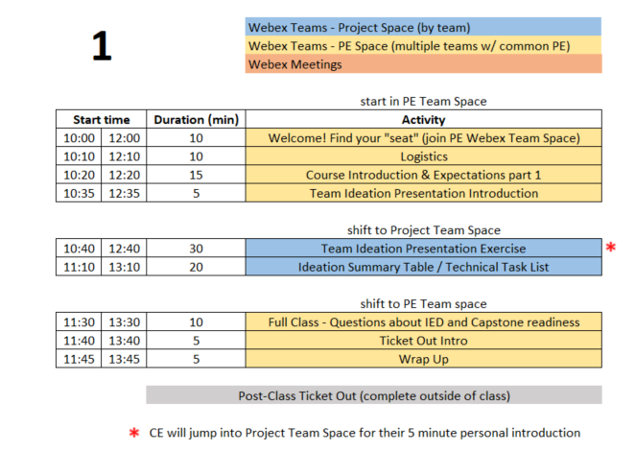
Day 1 Agenda

Slide 7
10 min - Logistics
All students (in person & remote) should attend class meetings using Webex Teams
  Project Space (ex: GSK Toothpaste Flow)
  Project Engineer Space (ex: F21-sec1-Paster)
This PPT is available on Electronic Design Notebook (EDN) and will guide the first 9 classes
  https://designlab.eng.rpi.edu/edn/projects/capstone-support-dev/repository/changes/playbook/Capstone%20Playbook.pptx
  You are STRONGLY ENCOURAGED to download newest version of Playbook prior to EACH class meeting.
Daily Class Agendas
  https://designlab.eng.rpi.edu/edn/projects/capstone-support-dev/wiki/Capstone_Class_Agendas

Slide 8
Covid-19 related challenges
Projects were chosen and scoped to still be possible with some or all students being remote
Off campus and out of country students should strive to stay as synchronous as possible with team meetings and project progress
All course material is available online (EDN)
  https://designlab.eng.rpi.edu/edn/projects/capstone-support-dev/wiki
If any team member is remote, then ALL interactions will take place via Webex. If a team is entirely local, then some interactions will be via Webex.
  In Class Activities – Webex Team Spaces
    Project Space
    PE Space
  Class time - Webex Project Space or Sub-team Spaces
  Sponsor meetings – Webex meetings
  PE/CE Office hours – Webex private rooms
Classroom
  One-way entry/exit
    Enter @ JEC3332 door (SoE Hub or West side), Exit @ JEC 3232 door (15th St or East side)
  No use of physical whiteboards. Webex teams has whiteboard functionality
  Chairs stay on X’s at 6 foot separation
  4 additional tables available for smaller 2 person meetings

Slide 9
Class meeting logistics
Bring laptop, charger, headphones/earbuds (for best Webex audio) to in-person classes
Wear a disposable mask at all times
Teams may wish to use Webex to record their meetings for any members who are 'absent' or have connection issues.
  ALWAYS encouraged to take meeting minutes and post to EDN for future reference

Slide 10
Webex/Meeting Tips
Be productive for meetings.
  Have a written agenda, posted into the EDN Project Management folder
  Keep meeting minutes for ALL team Webex sessions and post to the Project Management forum on EDN
Webex chat will not be archived, so it's important to document results & discussion in the Forums and the Repository as appropriate
Although Webex can be great for socialization, we would like to encourage productive meetings to reduce Webex burnout

Slide 11
Class “location”
TBD
Hybrid schedule to reduce campus density
  Your team will meet remote one day and in classroom one day each week
  Approx. 30% of students chose to be all remote
Capstone shop (JEC 2332) will be open 9am-4pm for hands-on work
  Due to COVID, students must request permission to use shop from PE to ensure staffing – walk-ins are not allowed
  Students MUST complete online safety training prior to using shop (PE will send info)
Bounce between Project Space and PE Space
  Agenda and this PPT will continuously remind you of proper location in slide footer
Notes:
PE should remind each team which day they are remote vs in class

Slide 12
RPI Design Lab
Our Mission is to Develop High Performing Engineers by Mentoring Students in Professional and Engineering Design Practices Through Project Based Learning.
NO textbook, NO lecture
It is a Team EXPERIENCE
It is a mostly “flipped” class experience
Guided/assisted by Project Engineer (PE)
Graded/assisted by Chief Engineer (CE)

Slide 13








Design Lab Team
Associate Director
Admin Specialist
Manufacturing Manager
Shop Technician
Director
Kathryn Dannemann
Junichi Kanai
Valerie Masterson
Sam Chiappone
Scott Yerbury
Project Engineers
Mark Anderson
Brad DeBoer
Aren Paster

Slide 14
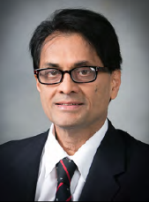

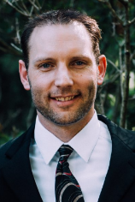
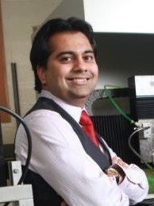



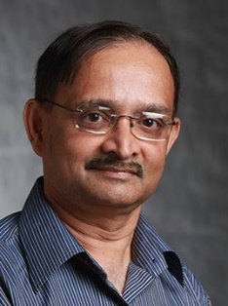

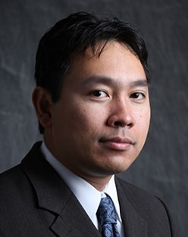

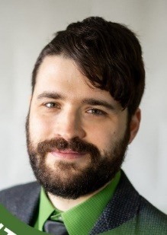


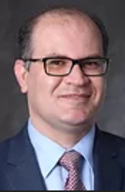





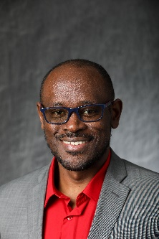


Faculty – Chief Engineers
MANE
Bharat Bagepall
Sarah Felix
Josh Hurst
Sandipan Mishra
Matt Oehlschlaeger
Karthik
Panneerselvam
Dan Walczyk
ECSE
Ishwara B. Bhat
Partha Dutta
Agung Julius
Junichi Kanai
Dylan Rees
Shayla Sawyer
Manoj Shah
Ali Tajer
Kyle Wilt
ISE
MSE
Mark Embrechts
Al Wallace
Kathryn
Dannemann
Dave
Duquette
Edwin Fohtung
Daniel Lewis
Rahmi Ozisik

Slide 15
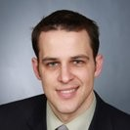
TA Introduction – Jim Olson
Capstone Role Fall 2021
Experience
Student Support
  Presentation Preparation
  Ideation
  Project Planning
  Requisition Preparation
  Fabrication Planning
Faculty / Staff Support
  Upon request from PE / CE
Publications
  An Economic Cost Assessment on HALEU Fuels for Small Modular Reactors, Science and Technology of Nuclear Installations, 2020
Patents
  US 8,286,430 (GE)
  US 8,926,273 (GE)
Adjunct Professor
  Capstone Spring 2019
RPI Visiting Research Scholar 2016-2018
Private Consultant, NYS OVS 2018-Present
  Assistive Technology Development for TBI
WebEx Contact: Olson, James Edward Email: olsonj5@rpi.edu

Slide 16
Participation Expectations
Arrive to Class On Time / Stay until class ends
  We encourage use of cameras when on Webex
Be present in Class and Team Meetings
  Listen, Engage, Participate
  Not distracted on your Phone or other tasks
3 Credit Hour course mandates:
  4 Hours per week IN class
  5 Hours per week OUT of class
Read communication from Design Lab staff and teammates
  Emails
  Webex chat
  EDN posts

Slide 17

Capstone is TEAM work not GROUP work
Team Work
  collaborative effort
  peer review
  Student managed
Group Work
  divide and conquer
  low interaction with team
  Supervisor managed

Slide 18
Grading
Syllabus
  https://designlab.eng.rpi.edu/edn/attachments/download/109925/Common%20Course%20Syllabus.pdf
Tasks and Due Dates
  https://designlab.eng.rpi.edu/edn/projects/capstone-support-dev/wiki/Tasks_and_Due_Dates
Pose any questions to kanaij@rpi.edu
  Answers will be posted to EDN
  https://designlab.eng.rpi.edu/edn/projects/capstone-support-dev/wiki/Syllabus_or_Grading_questions

Slide 19
Behavior Expectations
Q: “How will you interact with your boss and peers in 6 months?”
Let’s start doing this NOW in Capstone Design
  Be Accountable.
    To your teammates, to Chief/Project Engineer, and to project sponsor.
  Be Professional.
  Make your work VISIBLE.
    Post/share as you go. No need to hide from team until its perfect or completely finished.
    Use Electronic Design Notebook (EDN)
Notes:
This slide is animated. Shows only the question – PE should ask students and get some responses

Slide 20
Accountability Step #1
You all received via email the Capstone Orientation Packet:
Director’s Introduction letter
Project Description - Will guide work today
Instructions for electronic signatures in Adobe
Recognition Waiver and Release - SIGN & return by end of day
Sponsorship Agreement - SIGN & return by end of day
Now we’re done talking about it.
More information
  https://designlab.eng.rpi.edu/edn/projects/capstone-support-dev/wiki/Confidentiality_Requirements

Slide 21

Collaboration Logistics
Each team has a Box folder pre-loaded with files
  https://rpi.app.box.com/
  Login using RPI credentials
EVERYONE open “20 min Poster - Webex enabled.pptx” file in PowerPoint Online
  This will allow simultaneous group editing
  (warning/notice) Online Office version lacks MANY features of standalone program

Slide 22
30 min - Team Ideation Exercise
Time boxed exercise. It will feel rushed, things won't feel complete. THAT'S OK.
You'll want more time. You can't have it. Team must move on.
For EACH section of presentation slides:
2 min
  Individual silent thought on content
  Type thoughts into text editor (Word, Notepad, etc...)
2 min
  Copy answers into shared Team PPT on Box
  Quick discussion of similar, unique, or new answers
Move on to next section of Ideation PPT as a team
PE will send chat messages to PE Space to help remind team to move on to each section of presentation

Slide 23
20 min - Team Ideation Summary
What unique skills does each person bring to the team?
What skills do members share in common?
What specific team or organizational strength will each person contribute?
What team or organizational weakness or areas for growth does each person have?
How can team make best use of each individual’s skills and talents?
Does every team member have a TECHNICAL action item to complete by next class?
  Note: This is something that should happen by end of EVERY class.

Slide 24
5 min - Team Meeting
Choose a 30-60 min time for team to meet before next class
  www.WhenIsGood.net works well
  NOT RECOMMENDED to use this time every week for the full team. That’s what class time is for. Instead use this time for occasional needed planning meetings, or for smaller sub groups to meet about project.
MUST REACH DECISION TODAY! You have a group task to complete before next class.

Slide 25
10 min – Questions about IED and Capstone Readiness
What part of your IED experience do you NOT want to repeat? - 4 min
  Personality conflicts
  Time management (ran out of time)
  Unequal division of labor
  Communication breakdown
How ready is your team to move forward on project?
1 (low) - 10 (high) scale
1 min - Pick individual answer
Move to PROJECT SPACE, discuss as a team, and come to consensus - 5 min
Return to PE SPACE for full class debrief - 5 min

Slide 26
5 min – Ticket Out
Design Lab wants your 'immediate' feedback on the course and your experience.
These 'surveys' after many classes will help us help you.
Collected anonymously using Google Forms.
  If you ever want an individual response from PE/CE/Director, be sure to INCLUDE your name.
Please Complete Ticket Out Today or Tomorrow
You can also always use email or Webex to reach out to PE/CE with any questions.

Slide 27
Out of Class Tasks (what you might call homework, complete BEFORE Class 2)
Complete Class 1 Ticket Out
  https://forms.gle/kT3iYxnPDvwJjSVu7
Register for EDN – https://designlab.eng.rpi.edu/edn/
  Registration button in upper right hand corner
  Login must be your RCSID (RPI email before the @ symbol)
  Email must be your RPI email
  Bookmark this site. You will use it A LOT for this course.
Use out of class team meeting to start team building
Student Team Introductions
    Major, hometown
    Interests, clubs/sports, experience related to project topic
    Co-op, internship, summer job
    Pet, favorite ice cream flavor
Re-read the Project Description with Class 1 Ideation Exercise in mind
Post evidence of progress on your project task assignment to team's Box folder as Word file. Filename should be RCSID-topic. Ex: pastea-FreeBodyDiagram.docx
  Web link of research AND summary of why it's important or useful
  Calculations
  Sketch of concept idea
Watch/Read Intro & Expectations video (?? Min)
  link
NOTE – These tasks are posted on EDN along with all class agendas
https://designlab.eng.rpi.edu/edn/projets/capstone-support-dev/wik/Capstone_Class_Agendas

Slide 28
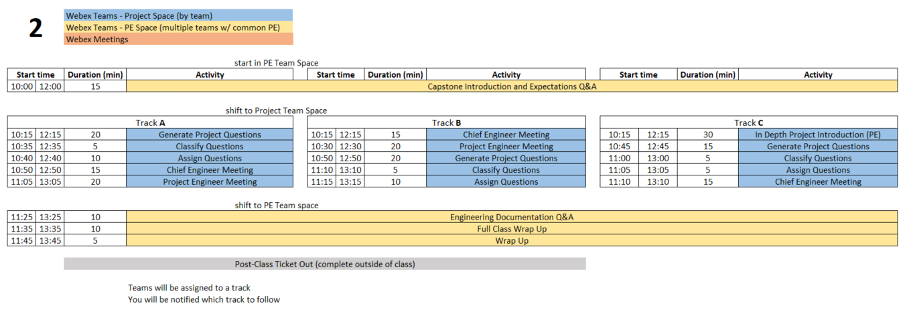
Class 2 Agenda
  You are STRONGLY ENCOURAGED to download newest version of Playbook prior to EACH class meeting.
Repository instructions - https://designlab.eng.rpi.edu/edn/projects/capstone-support-dev/wiki/Subversion
Playbook - https://designlab.eng.rpi.edu/edn/projects/capstone-support-dev/wiki/Capstone_Playbook
Notes:
PE notes – Track C is for projects with lots of history or content wholly unfamiliar to students.
Track A vs B is just a coin flip for scheduling.

Slide 29
15 min - Capstone Expectations Q&A
Out of Class Task was to watch 1 videos…
QUESTIONS about content?
What is difference between IED and Capstone?
Who ‘owns’ your project – student team, PE, CE, sponsor?
What is role of students in Capstone?
What is role of PE?
What is role of CE?
Notes:
Day 2

Slide 30
30 min - Capstone Introduction and Expectations part 2

Slide 31
Capstone Design – Why we do it
What is a "real world experience"?
What is difference between IED and Capstone Design?
Why is Capstone a required course?
What is goal of this course?
What is a successful outcome for
  Project Sponsor?
  Student?
  RPI?
What is the Engineering Design Process?
Notes:
Group discussion of all questions

Slide 32
Design Course Progression
General Coursework
Intro Engineering Design
Capstone Design
On-going Feedback from Instructor
Instructor Ownership (content)
Student Ownership (project)
Stakeholder is Student Team
Student Ownership (project)
Stakeholder is Company/Organization
Instructor time: prepared lecture and skill instruction
Student project time: research and experimentation
Graded activities: presentation of results, HW/quiz/test
Project work reviewed/graded continuously rather than formally submitted

Slide 33
Typical Course Content
Instructor Guided Content
Lecture & Lab
Quiz/Test
Structured Activities
Student/team performance feedback
Submit only finished work
Team Guided Content
Meetings (in & out of class)
Design / Build / Test (Engineering Design Process)
Presentations
Peer to peer feedback & review
Iterative design & documentation
Capstone instructor-guided activities will be primarily in first 5 weeks of semester

Slide 34


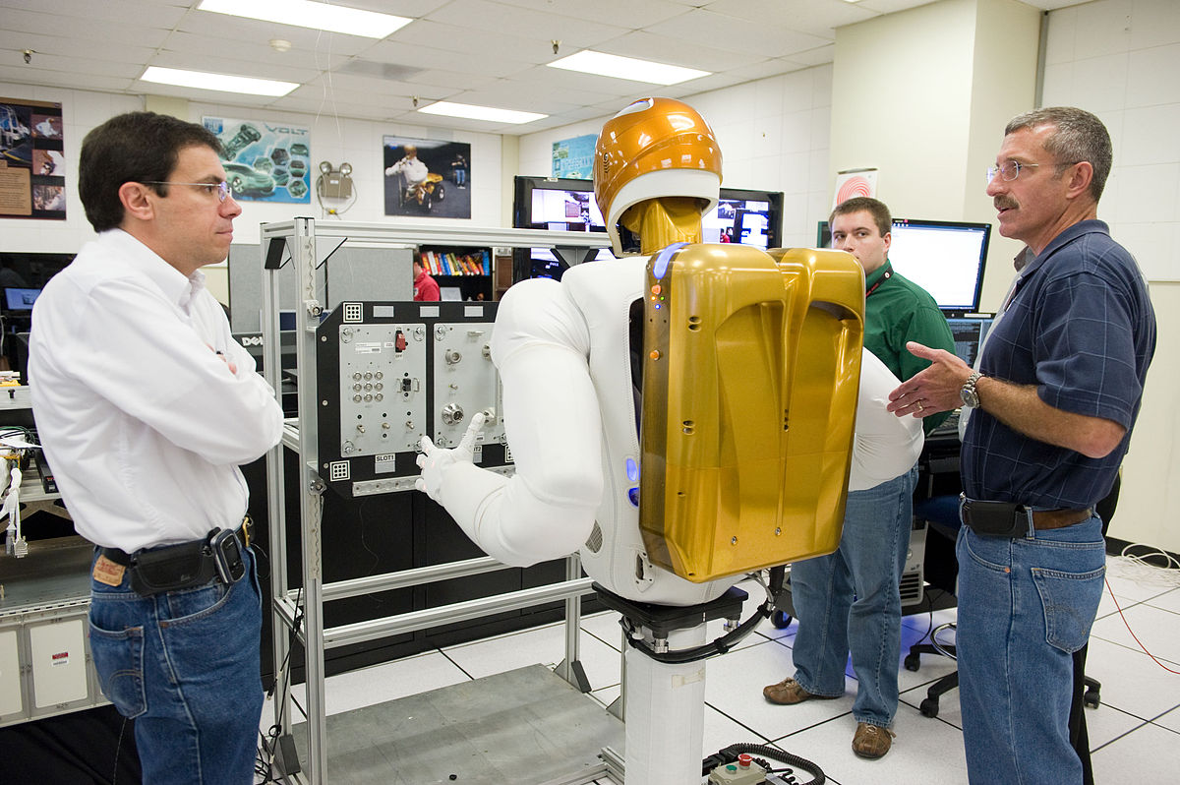
Capstone Design – How We Do It
Solve Open Ended Project by
Applying what you've already learned in 15+ years of courses
  Including re-learning whatever you've forgotten
AND self-learning new skills as needed
Begin the shift from
Engineering Student
Engineer

Slide 35
Roles and Responsibilities of Team
YOU (students) are OWNER of this project process
Sponsor (company) is OWNER of the project output
Design Lab Instructors are coaches & mentors, not teachers
  Offer guidance and help
    Point you to proper book, equation, or process, but students will do the math/analysis to justify their suggested solution
  Project Engineer (PE) – day to day operations
  Chief Engineer (CE) – grading/evaluation

Slide 36
Follow Track A/B/C as instructed by PE
Track A | Track B | Track C
Generate Project Questions | Generate Project Questions | In Depth Project Introduction (PE)
Classify Questions | Meet with Chief Engineer | Generate Project Questions
Assign Questions | Meet with Project Engineer | Classify Questions
Meet with Chief Engineer | Classify Questions | Assign Questions
Meet with Project Engineer | Assign Questions | Meet with Chief Engineer
Instructions for each activity are on the next few slides
ALL activities in TEAM Space

Slide 37
15 or 20 min - Generate Project Questions
These questions can be about any aspect of the project, but by the end of the class include questions targeted to:
  Customer Needs
  Project Specifications / Technical Requirements
Same inclusive discussion format as first class
  2 min. silent question generation
  Then begin copying into Project Questions.xlsx spreadsheet in Box.
  Combine duplicates/similar questions
  Add more to list as you think of them during discussion

Slide 38
15 min - Classify and Assign Questions
  Classify all questions generated into one of three categories
    Things team members can research/answer themselves
    Things PE will answer
    Things to ask sponsor during kick-off meeting
  Team assigns owner to all questions in category A
  Add question classification and ownership to Box spreadsheet

Slide 39
15/20 min - Meet with Project Engineer
  Project Engineer meets with each team:
    Check on team status / welfare
    Student introductions
    Discuss project background and goals
    Review project question & categories
      Confirm & update
    When not meeting with your PE or CE, team members generate/discuss questions.

Slide 40
15 min - Meet with Chief Engineer
  Chief Engineer meets with each team:
    Check on team status / welfare
    Student introductions
    Discuss project impressions
    Review project question & categories
      Confirm & update
    CE’s background/experience
    When not meeting with your PE or CE, team members generate/discuss questions.

Slide 41
Go back to PE space for
Engineering Documentation discussion

Slide 42
10 min - Engineering Documentation Q&A
Out of Class Task was to watch 1 videos…
QUESTIONS about content?
What is Documentation?
Why should you Document work?
What system will Capstone use?
Specifically what should students/team document?
Notes:
Day 2

Slide 43
15 min – Engineering Documentation
Topics
  What is Documentation?
  Why bother?
  How is it done in Capstone?
PE note:
  Let group answer 1st two questions
  Then run through next few slide to see if anything was not suggested
  Then discuss 3rd question

Slide 44
What is Documentation?
Engineering Documentation?
Living record of your work
  Evolution of your product/design is traceable
  Your work (experiment) is reproducible
  Your work can be understood by others and why you did it that way

Slide 45
Why Document?
Extension of your memory
  Who, What, When, Where, Why, How
  So that others can collaborate and continue the work
  Facilitates teamwork
  So that others can review/understand your work
Legal ramifications
  Contractual/legal defense
  Patent application
Efficiently and Effectively move the project forwards

Slide 46
Capstone Course Policies - Tools
Electronic Design Notebook - REQUIRED for all collaboration
Webex – Team Chat
When Is Good – meeting scheduling
Box – Initial Collaborative work (week 1 - 4)
Not Permitted
  Slack, GroupMe or Discord for chatting
  Google Drive for file storage
  Google Suite for document creation
  Other cloud based tools for any use (schematics, mind maps, drawings, analysis, etc…) e.g. diagrams.net, etc.
Webex Teams is good for chat and live meetings, but project documentation MUST be transferred to EDN Forum or Repository.
  Simple/easy solution is to never put it on Webex to begin with.

Slide 47
What Tool Will You Use?
Electronic Design Notebook (EDN)
  Integrated Project Management
  Threaded Communication by topic, rather than a single unorganized stream
  IP protection
  Grading - accountability and visibility
  Secure access to team and sponsor
  Backed up daily !
  The EDN software may not be the PERFECT choice, but nothing is.
  It meets the Design Lab's needs better than the alternatives*.
  * https://designlab.eng.rpi.edu/edn/projects/capstone-support-dev/wiki/Why_Electronic_Design_Notebook_is_the_ONLY_choice

Slide 48
What Should I Document?
Everything
  Research, web links, notes
  Interviews and observations
  Ideas, concepts, sketches, charts, diagrams
  Calculations
  Purchases - components models, vendors, cost
  Analyses – technical and non-technical
  Experiments, debugging, tests
  Hypothesis, procedures, equipment used, steps taken, data, results
  Future work/ideas

Slide 49
10 min – Documentation Wrap up
Information should be complete before documented?
  True or False
It is necessary to document negative results?
  True or False
Teammates share responsibility with PE/CE to offer technical feedback on EDN posts?
  True or False

Slide 50
Out of Class Tasks (what you might call homework, complete BEFORE Class 3)
Complete Class 2 Ticket Out
  https://forms.gle/3pGX1JgYy5nYnnep8
Watch EDN Guidance for Out of Class Tasks - Initial Postings Video (7.5 min)
  https://designlab.eng.rpi.edu/edn/projects/capstone-support-dev/repository/changes/training/EDN%20Guidance%20for%20Out%20of%20Class%20Tasks%20-%20Initial%20Postings.mp4
  Post personal contact info (name, major, RPI email, phone #) to one thread in the EDN Background Info Forum (start new thread titled “Team Contact Info”, then reply for subsequent entries)
  Find answer(s) to assigned question(s) & post to new thread titled “Class 2 Questions and Answers” in EDN Background Info Forum
Read The Engineering Design Process Refresher.pptx in preparation for class 3 discussion
  https://designlab.eng.rpi.edu/edn/projects/capstone-support-dev/repository/raw/training/The%20Engineering%20Design%20Process%20Refresher.pptx
Watch Customer Needs video (9 min)
  https://mediasite.mms.rpi.edu/Mediasite5/Channel/anderm8winrpiedu-engr-2050/watch/87d950eccc2942038b1d06530e9217841d
Watch Requirements video (11 min)
  https://mediasite.mms.rpi.edu/Mediasite5/Channel/anderm8winrpiedu-engr-2050/watch/96dceab44ae7447d812f5a216afa97cf1d
Identify one Customer Need for your project and translate it into an Engineering Requirement. Post to new thread in EDN Design Forum titled “Initial Needs and Requirements”
For ongoing projects, review prior semesters’ final presentations in accordance with PE instructions for class discussion in Class 3 or 4
  PPT should be in last semester's Final Deliverables Forum on EDN

Slide 51
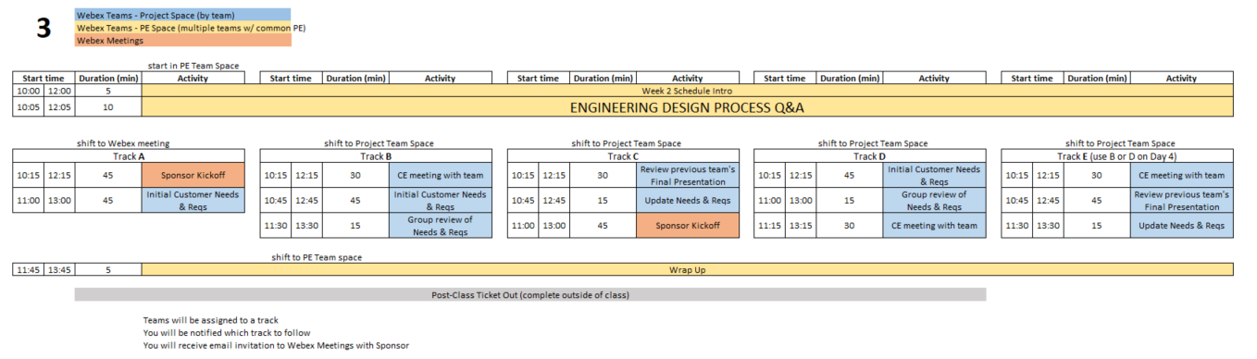
Day 3 Agenda
Over the course of Days 3 & 4 - All teams will complete the following:
Sponsor Kickoff Meeting
CE meeting with team
Customer Needs & Requirements - development and review
Review previous Final Presentation - ongoing projects only
  You are STRONGLY ENCOURAGED to download newest version of Playbook prior to EACH class meeting.
Repository instructions - https://designlab.eng.rpi.edu/edn/projects/capstone-support-dev/wiki/Subversion
Playbook - https://designlab.eng.rpi.edu/edn/projects/capstone-support-dev/wiki/Capstone_Playbook
Notes:
PE Notes
Continuing projects should follow Track C or E
New projects can follow A, B, or D
Track A or C on Day 3 should follow track A or C on Day 4
Track B, D, or E on Day 3 should follow track B or D on Day 4

Slide 52
10 min - Engineering Design Process Q&A
Out of Class Task was to watch 3 videos…
QUESTIONS about content?
What are the steps in Engineering Design Process?
What is a Customer Need?
What is an Engineering Requirement?
What is the difference between a Need and a Requirement?
What is a User Story?
What is an Acceptance Criteria?
What is the difference between a User Story and an Acceptance Criteria?
Notes:
Day 3

Slide 53

Engineering Design Process
Today is Day Three of class
Let’s look at steps ONE & TWO
Team will create/review/improve project’s list of:
Customer Needs
Engineering Requirements
This Design Process and terminology is taught in IED at RPI

Slide 54

30 min – Meet with CE
(Class 3 or 4)
Chief Engineer led discussion of:
  Course
    Course grading
    Student expectations
  CE background and experience
  Project impressions

Slide 55
45 min - Customer Needs & Engineering Requirements Generation
Needs and Requirements workbook.xlsx spreadsheet is in team Box folder
Fill out based on team’s current (uninformed impression) of project
  This is first pass. Don’t worry that answers are not complete or verified by sponsor.

Slide 56
15 min – Group Review of
Needs & Requirements
Read notes in template document for tips
Remove/combine duplicates
Unsure of a proper metric?
  Quick Google search to put in an educated guess
  Use ‘Confidence’ column to mark low and plan to research/update after class
Fill in holes/gaps after looking at categories
  https://designlab.eng.rpi.edu/edn/projects/capstone-support-dev/wiki/Requirements_Management
  Safety, Reliability, Maintainability, etc…

Slide 57
45 min - Sponsor Kick-Off Meeting
Meeting Agenda
  Team introductions to sponsor (name, major, relevant experience/skills)
  Sponsor introduction to team
  Sponsor describes project "in their words“
    History, ultimate and semester goals, deliverables, etc…
  Open Q&A

Slide 58
30/45 min - Prior Presentation
(if applicable)
Team should review (outside of class) the final PPT presentation given by previous semester team
  Forums->Final Deliverables
  Repository->Reports->Final Reports
Quickly walk PE/CE through slide deck and discuss what you feel previous team would say about:
  Goals
  Accomplishments / Successes
  Challenges
  Next steps
PE/CE will help to clear up confusion and answer any questions current team may have

Slide 59
Out of Class Tasks (what you might call homework, complete BEFORE Class 4)
Complete Class 3 Ticket Out
  https://forms.gle/QcsmZ5qAhS9L9Sdr5
Update Needs/Reqs Workbook based on feedback (in Box folder)
Choose sponsor liaison
  This person will be the focal point for emails to/from your sponsor. They are not the team's "spokesperson" at meetings, conference calls, in class, etc.
Watch Intro to EDN video (5 min) in preparation of Class 4 review
  https://designlab.eng.rpi.edu/edn/projects/capstone-support-dev/repository/raw/training/Intro%20to%20the%20EDN.mp4
Read Project Documentation Wiki page in preparation of Class 4 review
  https://designlab.eng.rpi.edu/edn/projects/capstone-support-dev/wiki/Project_Documentation
Read Meeting Minutes Wiki Page
  https://designlab.eng.rpi.edu/edn/projects/capstone-support-dev/wiki/Meeting_Minutes
  Post notes taken during PPT review to Project Management Forum
Follow Subversion instructions to download and install client, then checkout a copy of your project’s repository. Visit your PE’s office hours for assistance.
  https://designlab.eng.rpi.edu/edn/projects/capstone-support-dev/wiki/Subversion_Clients#section-2
Complete the Online Safety Training in Percipio by end of 3rd week
  https://www.percipio.com
  Rensselaer Manufacturing and Prototyping Laboratories-Safety Orientation
  NOT required for
    Fully remote students
    Local students without campus access

Slide 60
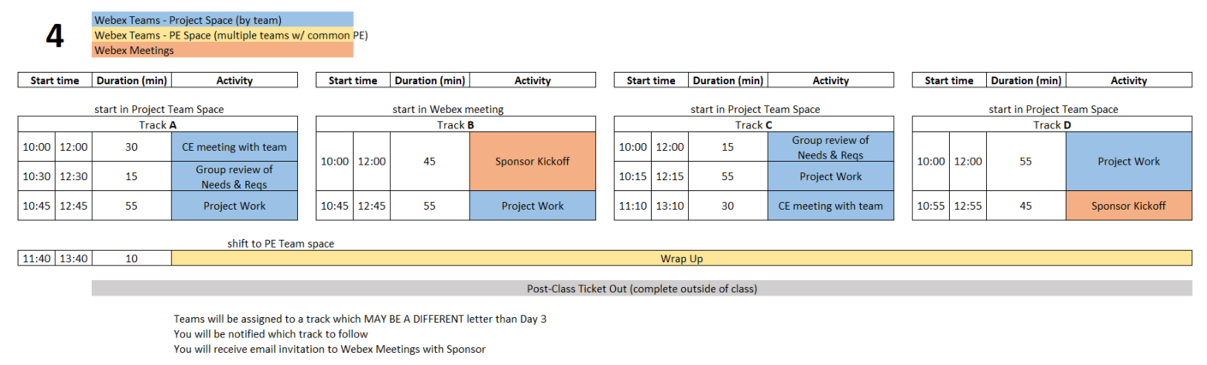
Class 4 Agenda
  You are STRONGLY ENCOURAGED to download newest version of Playbook prior to EACH class meeting.
Repository instructions - https://designlab.eng.rpi.edu/edn/projects/capstone-support-dev/wiki/Subversion
Playbook - https://designlab.eng.rpi.edu/edn/projects/capstone-support-dev/wiki/Capstone_Playbook
Notes:
PE Notes
Track A or C on Day 3 should follow track A or C on Day 4
Track B, D, or E on Day 3 should follow track B or D on Day 4

Slide 61
Engineering Design Process
Today is Day Four of class
Team should be working towards student agreement, and PE/CE/sponsor review/approval of steps ONE & TWO
Customer Needs
Engineering Requirements
This Design Process and terminology is taught in IED at RPI

Slide 62
15 min – Group Review of
Needs & Requirements
Read notes in template document for tips
Remove/combine duplicates
Unsure of a proper metric?
  Quick Google search to put in an educated guess
  Use ‘Confidence’ column to mark low and plan to research/update after class
Fill in holes/gaps after looking at categories
  https://designlab.eng.rpi.edu/edn/projects/capstone-support-dev/wiki/Requirements_Management
  Safety, Reliability, Maintainability, etc…

Slide 63
45 min - Sponsor Kick-Off Meeting
Meeting Agenda
  Team introductions to sponsor (name, major, relevant experience/skills)
  Sponsor introduction to team
  Sponsor describes project "in their words“
    History, ultimate and semester goals, deliverables, etc…
  Open Q&A

Slide 64
55 Min - Project Work
Refine Needs and Requirements Spreadsheet
  Needs
    Ensure all known Customer Needs are documented
  Requirements:
    Associate with appropriate Customer Need(s)
    Identify Measurements and Units (quantitative)
    Ensure that Requirements are detailed and prioritized
    Identify Applicable Engineering Standards
Refine/Develop Follow-Up Questions for Sponsor
  If Team has already had Sponsor Meeting, what new questions have been identified as a result?
    Clearly document and send to Sponsor, copy PE
Background Research/Benchmarking
  Discuss/document work done to date
  Identify/document additional benchmarking needs

Slide 65
30 min – Meet with CE
(Class 3 or 4)
Chief Engineer led discussion of:
  Course
    Course grading
    Student expectations
  CE background and experience
  Project impressions

Slide 66
Out of Class Task / Action Items:
Complete Class 4 Ticket Out
  https://forms.gle/9oFPZF4a2r3uZv1v7
Update Needs/Reqs Workbook - post to EDN Design forum
Watch Statement of Work video (10 min) in preparation for creating draft in class
  https://designlab.eng.rpi.edu/edn/projects/capstone-support-dev/repository/raw/training/Statement%20of%20Work.mp4
Read Project Documentation Wiki page in preparation for class review
  https://designlab.eng.rpi.edu/edn/projects/capstone-support-dev/wiki/Project_Documentation
Complete the Online Safety Training in Percipio by end of 3rd week
  https://www.percipio.com
  Rensselaer Manufacturing and Prototyping Laboratories-Safety Orientation
  NOT required for
    Fully remote students
    Local students without campus access

Slide 67
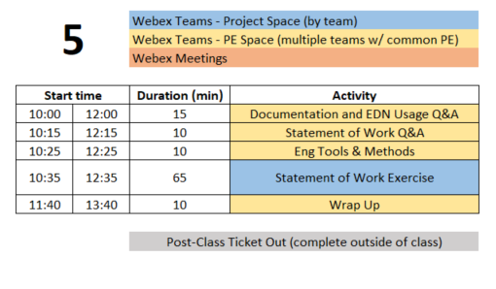
Class 5 Agenda
  You are STRONGLY ENCOURAGED to download newest version of Playbook prior to EACH class meeting.
Repository instructions - https://designlab.eng.rpi.edu/edn/projects/capstone-support-dev/wiki/Subversion
Playbook - https://designlab.eng.rpi.edu/edn/projects/capstone-support-dev/wiki/Capstone_Playbook

Slide 68
Engineering Design Process
Today is Day Five of class
Team will develop Statement of Work (SoW).
This puts into clear words & pictures what the FINAL output will look like, and the tools required to get there.
This Design Process and terminology is taught in IED at RPI

Slide 69
TA Introduction – Jim Olson
Capstone Role Fall 2021
Experience
Student Support
  Presentation Preparation
  Ideation
  Project Planning
  Requisition Preparation
  Fabrication Planning
Faculty / Staff Support
  Upon request from PE / CE
Publications
  An Economic Cost Assessment on HALEU Fuels for Small Modular Reactors, Science and Technology of Nuclear Installations, 2020
Patents
  US 8,286,430 (GE)
  US 8,926,273 (GE)
Adjunct Professor
  Capstone Spring 2019
RPI Visiting Research Scholar 2016-2018
Private Consultant, NYS OVS 2018-Present
  Assistive Technology Development for TBI
WebEx Contact: Olson, James Edward Email: olsonj5@rpi.edu

Slide 70
30 min - Documentation & EDN Usage
You should have already watched EDN video and read Documentation Wiki page
  Intro to EDN video (5 min)
    https://designlab.eng.rpi.edu/edn/projects/capstone-support-dev/repository/raw/training/Intro%20to%20the%20EDN.mp4
  Project Documentation page
    https://designlab.eng.rpi.edu/edn/projects/capstone-support-dev/wiki/Project_Documentation
Where to post your work
How to create post (which buttons/links on EDN)
Notes:
Need to add some show not tell to these slides
How do you currently organize information:
On your desk
-on your PC
In text messages
In emails
Within an organization, e.g. fraternity / sorority, sports teams, clubs, etc.

Slide 71

Where to put information?
Task Assignments
Forums Tab
Technical Work
Statement of Work
Work through quick examples using EDN

Slide 72

How to post
Forums
New Message
Live demonstration of making a forum post

Slide 73
EDN Usage
Using the EDN effectively will contribute greatly to you and your team’s success in this course. Both for getting work accomplished and for documenting that work!
  Issues to track and direct effort
  Forums to document and discuss the output of that effort
  Visibility for instructors to assign credit
Post or it didn’t happen!

Slide 74
Phases of the Design Report
Phase 1
Statement of Work
Phase 2
Preliminary Design Report
Phase 3
Final Report
Week 4
Midterm
End of Semester
In ALL cases, the file name and location remains the same:
“working/Reports/Design Report and Poster/Design Report.docx”

Slide 75
Design Report.docx - Table of Contents
Green – Create
Yellow – Update
File name
DOES NOT change

Slide 76
Design Report Section Progress
Create (green)
  first pass at generating this content
Required Update (yellow)
  revise and update based on work done to date
  incorporate feedback from PE/CE/sponsor
Optional Update
  any existing material can be revised with new information
  incorporate feedback
At all stages, the file name and location in Repository remains the same:
“working/Reports/Design Report and Poster/Design Report.docx”

Slide 77
10 min - Statement of Work Q&A
Out of Class Task was to watch 1 video…
QUESTIONS about content?
What is a Statement of Work?
What is difference between the Project Objectives and Semester Objectives?
What are Engineering Tools and Methods?
What is difference between a task and a deliverable?
Where is the SoW document template located?
Notes:
Day 5

Slide 78
10 min - Engineering Tools and Methods
  What techniques, software, calculations will be used to address the problems in front of team? Ex:
  Mechanical aspects – Free Body diagram, torque measurement
  Software – flow chart of system control loop, storyboard of user input
  Process – conduct customer interviews of toddler caregivers, create Standard Operating Procedure for system startup and calibration

Slide 79
65 min - Statement of Work Exercise
Design Report Template – SoW is phase 1 of this document
https://designlab.eng.rpi.edu/edn/projects/capstone-support-dev/repository/changes/template%20documents/Design%20Report.docx
10 min – Break into 3 groups (meet in subteam spaces A/B/C)
  A - Long Term Objectives (1-5+ years, from Customer Perspective)
  B - Current Semester Objectives (3 months!)
  C - Deliverables (Be S.M.A.R.T.!)
Shift back to Team Space
10 min - Team review – Long Term and Current Semester Objectives
15 min - Team review – Deliverables
20 min
  PE/CE review of Deliverables
  Team development of Dates for Deliverables and Engineering Tools and Methods
Create threads in Statement of Work Forum for notes on each section

Slide 80
Out of Class Task / Action Items:
Complete Class 5 Ticket Out
  https://forms.gle/Af4Bfe47Q9u5SBsh7
Wordsmith and polish Statement of Work
Post Statement of Work (Phase 1 of Design Report.docx) to EDN Repository prior to class 6
  Location - working/Reports/Design Report + Poster
Upload Needs & Requirements spreadsheet to Repository
Watch Concept Generation video (9 min) in preparation for Concept Generation class exercise
  https://mediasite.mms.rpi.edu/Mediasite5/Channel/anderm8winrpiedu-engr-2050/watch/d78db44fd9f7424b9d8f4c72857f84371d
Attend SVN Training or watch video
  https://designlab.eng.rpi.edu/edn/projects/capstone-support-dev/repository/raw/training/Getting%20Started%20with%20Subversion-For%20Windows%20Users.mp4
Complete the Online Safety Training in Percipio by end of 3rd week
  https://www.percipio.com
  Rensselaer Manufacturing and Prototyping Laboratories-Safety Orientation
  NOT required for
    Fully remote students
    Local students without campus access

Slide 81
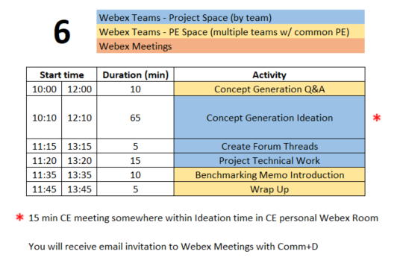
Class 6 Agenda
  You are STRONGLY ENCOURAGED to download newest version of Playbook prior to EACH class meeting.
Repository instructions - https://designlab.eng.rpi.edu/edn/projects/capstone-support-dev/wiki/Subversion

Slide 82
Engineering Design Process
Today is Day Six of class
Team will generate AND document concepts to address and meet the Needs & Requirements of the project.
This Design Process and terminology is taught in IED at RPI

Slide 83
10 min - Concept Generation Q&A
Out of Class Task was to watch 1 video…
QUESTIONS about content?
Where do concept ideas come from?
  Example of Internal Search?
  Example of External Search?
Notes:
Day 6

Slide 84
15 min – CE Time
Meeting will be in CE’s Webex Personal Room
This will take place at some point during Concept Generation exercise depending on CE’s schedule

Slide 85
65 Min - Concept Generation
Similar inclusive plan as previous exercises using Box document
5 min – Individually silently generate any concept to solve/address project needs/reqs
10 min – Everyone add concepts to Concept Generation Spreadsheet.xlsx in Box
15 min – Organize list by topic
  Eliminate duplicates
  Add extra ideas you think of right now or are inspired by others ideas
35 min – Group discussion
  Explain further to improve group understanding – if necessary
  Look for missing/unaddressed needs –think of concepts to address them
  Look for lone concepts – think of alternative ideas
Notes:
Note
CE will jump in to talk for 15 mins of this time block

Slide 86
5 min – Create Forum Threads
Concept topics ARE the key discussions and work areas for the team
Create Design Forum threads for each topic
  Use these thread to post explanation, sketches, calculations, etc…
  Reply to team mates posts to move idea forwards and advance project

Slide 87
15 min – Project Work
Go to Team Space
Work on project
Someone should take notes of meeting discussion
    NOT as Word document, simply as plain text in Forum post.
  Minute instructions and template https://designlab.eng.rpi.edu/edn/projects/capstone-support-dev/wiki/Meeting_Minutes
Post AT END of class to Forums –> Project Mgmt
  Others can reply to post with any corrections or additional information

Slide 88
10 min - Benchmarking Memo
What is current state of the art? How is problem currently solved?
What will team members NEED to know to move forwards?
What has already been accomplished by prior team?
Team creates topic list
  Literature search
  User interviews
  Identifying / installing / practicing software or techniques which will be required for the project
  Install existing project software
  Verify work done by past Capstone team
  Conduct testing or system operation described by prior team
PE/CE approve list
Capstone Support Wiki has instructions, template, and rubric
https://designlab.eng.rpi.edu/edn/projects/capstone-support-dev/wiki/Benchmarking_Memo

Slide 89
Out of Class Task / Action Items:
Continue technical work
  Post progress to Design Forum threads
Brainstorm 6 individual tasks which need to be accomplished to reach project goals, post to a thread in the Project Mgt. Forum
Team brainstorms Benchmarking Memo topic list
  https://designlab.eng.rpi.edu/edn/projects/capstone-support-dev/wiki/Benchmarking_Memo
  Post to Background Info forum
Watch videos in preparation for Project Planning activity
  Intro to Project Mgmt (7 min)
    https://www.youtube.com/watch?v=QwuwzBBThPY
  Deliverables & Activities (3 min)
    https://www.youtube.com/watch?v=L6WYJh1Ygoc
Complete the Online Safety Training in Percipio by end of 3rd week RIGHT NOW
  https://www.percipio.com
  Rensselaer Manufacturing and Prototyping Laboratories-Safety Orientation
  NOT required for
    Fully remote students
    Local students without campus access

Slide 90
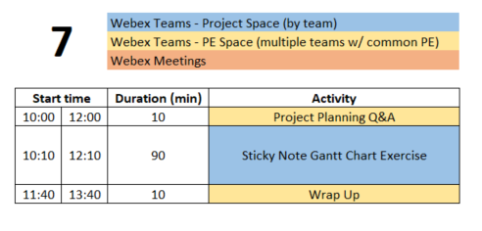
Class 7 Agenda
  You are STRONGLY ENCOURAGED to download newest version of Playbook prior to EACH class meeting.
Repository instructions - https://designlab.eng.rpi.edu/edn/projects/capstone-support-dev/wiki/Subversion

Slide 91
Engineering Design Process
This Design Process and terminology is taught in IED at RPI
Today is Day Seven of class
Team will develop list of the tasks necessary to complete the project, and schedule them over the remainder of the semester.

Slide 92
10 min - Project Planning Q&A
Out of Class Task was to watch 2 videos…
QUESTIONS about content?
What is a milestone?
What is the difference between parallel tasks and serial tasks?
What is critical path of a plan?
Notes:
Day 7

Slide 93
90 min - ‘Post It Note’ Project Planning Exercise
10 min – (individually silently) generate list of TEN tasks which team must accomplish to meet deliverables
  Out of Class Task was to post 6 to EDN, so start with those. Then create 4 more.
(PE has/will preload with Deliverables from SoW)
10 min – enter tasks in the Gantt Chart PPT.pptx in Box
Create 1 text box for each task
Choose a personalized fill color for your entries
Position tasks appropriately along week by week calendar
60 min – Group organization of tasks
Add missing tasks, remove duplicates
Organize by subsystem or milestone
10 min – Re-assign ownership (by color) to ensure everyone has work throughout semester

Slide 94
Out of Class Task / Action Items:
Create draft of Status Update PPT topics
  Template - https://designlab.eng.rpi.edu/edn/projects/capstone-support-dev/wiki/Templates_and_Forms
Create agenda for 60 mins of Class 8
Add tasks identified on sticky notes into EDN as Issues
Add deliverables from Statement of Work to EDN Gantt Chart as Versions
  watch video with instructions (4 min) - https://designlab.eng.rpi.edu/edn/projects/capstone-support-dev/repository/raw/training/Creating%20Versions%20from%20your%20Statement%20of%20Work.mp4
Read Risks Associated with Project Plans Wiki page and revise team plan in EDN Gantt chart as necessary
  https://designlab.eng.rpi.edu/edn/projects/capstone-support-dev/wiki/Risks_Associated_with_Project_Plans
Benchmarking Memo due on 9/23 (9/28)
  Memo Template: https://designlab.eng.rpi.edu/edn/projects/capstone-support-dev/repository/changes/template%20documents/BM_Memo-Topic-RCSid.docx
  Memo Rubric: https://designlab.eng.rpi.edu/edn/projects/capstone-support-dev/repository/changes/Rubrics/BM%20Memo%20Rubric.docx
  Submit your memo in the Background Info forum
    Include your RCSID and topic in filename!
Complete the Online Safety Training in Percipio by end of 3rd week RIGHT NOW !!
  https://www.percipio.com
  Rensselaer Manufacturing and Prototyping Laboratories-Safety Orientation
  NOT required for
    Fully remote students
    Local students without campus access

Slide 95
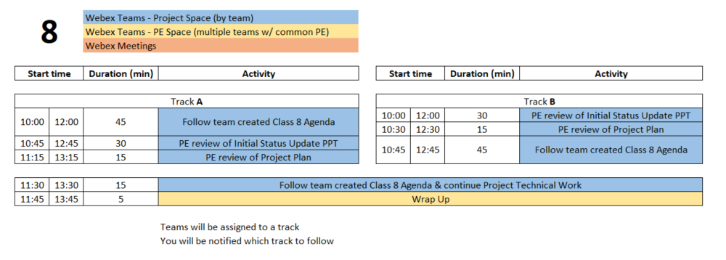
Class 8 Agenda
  You are STRONGLY ENCOURAGED to download newest version of Playbook prior to EACH class meeting.
Repository instructions - https://designlab.eng.rpi.edu/edn/projects/capstone-support-dev/wiki/Subversion

Slide 96
Engineering Design Process
Today is Day Eight of class
Team is developing concepts and beginning to down select.
Creating poster to communicate overall project and progress made.
This Design Process and terminology is taught in IED at RPI

Slide 97
60 min – Follow Team Agenda
Designate team member to take and post minutes

Slide 98
15 min – PE Review Project Plan
Many short individual tasks? Few large group tasks?
Adequate time for:
  Manufacturing?
  Purchasing?
  Testing?
  Iterative development? Second round of any tasks?
Equal division of labor across all students?
Ability to do some work in parallel rather than series?
  Design test plan BEFORE mfg is complete
  Create dummy data NOW to test software performance or analysis approach

Slide 99
30 min – PE Review of Status Update PPT
Number slides
Figure labels
Team members names, PE/CE names, sponsor name, company logo
Agenda
  Does it match actual contents of PPT?
Contents appropriate? (match rubric)
  Background & Customer Needs
  Technology Assessment
  Engineering Requirements
  Concept Generation

Slide 100
Out of Class Task / Action Items:
Address any feedback received on Status Update PPT
Sponsor liaison should email PPT to sponsor 24 hours prior to call
Read Preliminary Design Review and Poster Wiki page in preparation for creating a first draft of the poster during Class 9
  https://designlab.eng.rpi.edu/edn/projects/capstone-support-dev/wiki/Preliminary_Design_Review_and_Poster
Continue technical work
Post progress to Design Forum thread(s)
Student Team should now be creating individual project tasks
Prep for upcoming PDR - There will be THREE groups presenting
Identify who will be presenting in each of the three groups
Identify TWO team members for EACH session who will “host” the team’s upcoming PDR in their personal Webex space. One as “primary” and one as an alternate. Please post this information to a thread in the PDR Forum.

Slide 101
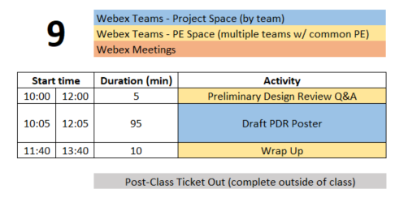
Class 9 Agenda
  You are STRONGLY ENCOURAGED to download newest version of Playbook prior to EACH class meeting.
Repository instructions - https://designlab.eng.rpi.edu/edn/projects/capstone-support-dev/wiki/Subversion

Slide 102
Engineering Design Process
This Design Process and terminology is taught in IED at RPI
Today is Day Nine of class
Team is creating poster to communicate
Overall project (Needs & Requirements)
Progress made (Concepts, System Architecture)
Future steps (Design, Integration, & Test Plan)

Slide 103
5 min - PDR Q&A
Out of Class Task was to watch review 1 Wiki page…
QUESTIONS about content?
What does PDR stand for?
Who is audience for PDR?
Approx. how many PPT slides should team prepare?
Notes:
Day 9

Slide 104
95 min – Poster Creation
Open Poster.pptx in Box in PPT Online
10 mins – Divide into 3 groups, shift to sub-Spaces on Webex Teams, and work on initial slides. Content can be pulled from Statement of Work.
  Purpose
  Past Work and/or Project History
  Semester Objectives/Requirements
40 mins – As a full team discuss Technical Approach, Results and Accomplishments to Date
30 mins – Move on to Next Steps and Plan
15 mins – Begin assembly of content onto single slide (pg 8)

Slide 105
Out of Class Task / Action Items:
Class 9 Ticket Out
  https://forms.gle/pPHLdBH1PmDVAoTw9
Upload poster draft to EDN
  File in the Repository – working/Reports/Report + Poster/Poster.pptx
  Discussion in PDR Forum
Continue technical work
Post progress to Design Forum thread(s)
Student Team should now be creating agendas for each class meeting and individual project tasks
Make an appointment with James Olson (olsonj5@rpi.edu), TA, and get feedback on your PDR poster. Update the poster as needed.

Slide 106
Preliminary Design Review (10/7 Th or 10/8 Fri)
Presentation Schedule
Sections 1&3 | Sections 2&4 | Activity | Presenter A Primary Host | Presenter B Backup Host | Presenter C
10:00 | 12:00 | Beginning of class
10:05 | 12:05 | Start the 1st sub-team's design review | Name & Email | Name & Email | Name & Email
10:25 | 12:25 | Start of Q&A
10:30 | 12:30 | Time for reviewers to document evaluation
10:40 | 12:40 | Start the 2nd sub-team's design review | Name & Email | Name & Email | Name & Email
11:00 | 13:00 | Start of Q&A
11:05 | 13:05 | Time for reviewers to document evaluation
11:15 | 13:15 | Start the 3rd sub-team's design review | Name & Email | Name & Email | Name & Email
11:35 | 13:35 | Start of Q&A
11:40 | 13:40 | Time for reviewers to document evaluation

Slide 107
Class 10 and Beyond Agenda
Scaffolded class activities have ended.
Primary purpose of the remaining class meetings is team review and assessment of work already completed, especially with your PE and/or CE.
It is NOT productive to use class time for completing individual work.
These 4 hours of class time may be the only available time for FULL team to meet. So it is recommended to use for group discussions.
Pro Forma Agenda posted on Capstone Support
  https://designlab.eng.rpi.edu/edn/projects/capstone-support-dev/wiki/Class_10_and_beyond

