Slide 1
Getting Started with Subversion

Slide 2
What You Will Learn
Why Version Control and What is Subversion
Install / Setup TortoiseSVN on Windows
Checkout your repository
Make commits
Keep updated
Add / Delete / Move files around

Slide 3
Why Version Control and What is Subversion
When Multiple Files are Involved, Version Control Becomes Important
Avoid over-writing each other’s files
Backup of all work
Changes can be made by multiple users
Changes can be tracked to each user
Previous versions are saved and recoverable
Design Lab teams use Subversion (SVN) for collaboration and version control for:
Word documents
PowerPoint presentations
Mechanical CAD files, e.g. SolidWorks / NX
Electronics CAD files, e.g. Eagle, KiCAD, OrCAD
Simulations
Software, e.g. Arduino, C/C++, LabVIEW, Python, etc.
And more!

Slide 4
The Workflow for Version Control
A Working Copy
is on every user’s PC
The Repository (Repo)
lives on a server,
aka “the cloud”
This is where teams will be working throughout the semester.

Slide 5
Install the Subversion Client
Windows
  TortoiseSVN - https://tortoisesvn.net/
MacOS
  svnx - https://subversion.assembla.com/svn/svnx/html/Downloads.html
Linux
  Follow your distribution’s instructions
Visit the appropriate site, download the software and install per their instructions.

Slide 6
Setup Subversion Client – MacOS Only
With the svnx Client Software Installed:
Create a new Working Copy Folder – Can be anywhere on your Mac
Link to the Repository for your Project
  Click on Repository thing
  Add
  Enter the URL for your Repository
    If the path to your wiki is:
    Then the repository URL is: “https://designlab.eng.rpi.edu/svn2/sample-ied-fall-2014.
Now Checkout your team’s Repository
  Click on the Checkout button in the Repository Browser window

Slide 7
Setup Subversion Client – PC Only
To get started, you must first Checkout your team’s Repository
This is a One-Time task
Using TortoiseSVN:
  Create a new folder to be your Working copy
  Right click on it
  Select Checkout from the TortoiseSVN menu
  Enter the URL for your team’s Repository
    If the path to your wiki is:
    Then the repository URL is: “https://designlab.eng.rpi.edu/svn2/sample-ied-fall-2014.
Using svnx:

Slide 8
Make Commits
As part of your project you’ll modify existing files or create new ones.
To share these with the team, you must Commit them.

Slide 9
Keep updated

Slide 10
Add / Delete / Move Files Around

Slide 11
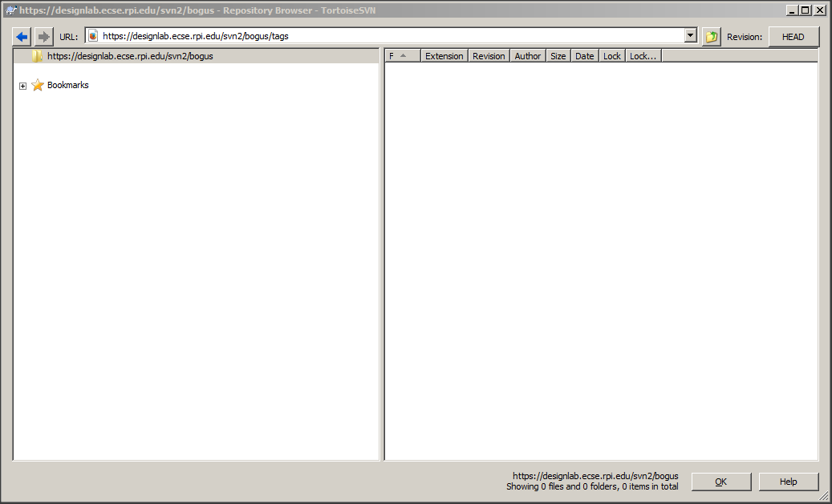
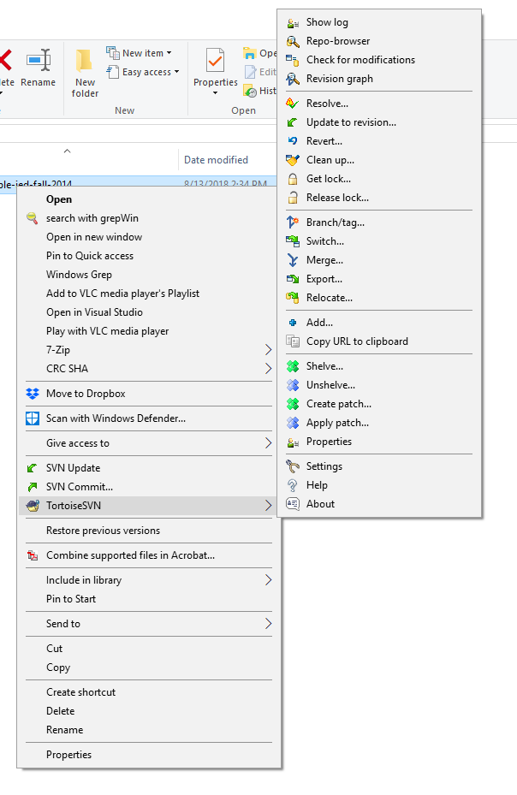
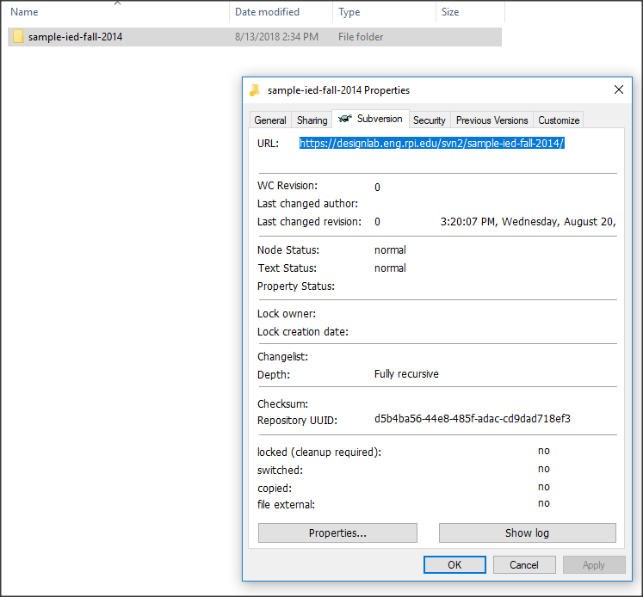
  You should have to enter your EDN username and password. Check on the “remember this password” box so that you don’t have to keep re-entering it.
  A window should appear (Figure 3 - TortoiseSVN Repository Browser Window) with two main panes: on the left is the folder hierarchy and on the right side are the files and sub folders of the currently selected folder from the left. Congratulations, SVN is working! This does NOT require VPN access to campus.
  If this does not happen and/or you get an error, check with a team mate. If you both cannot access the repository, contact your Project Engineer.
Figure 3 - TortoiseSVN Repository Browser Window
Back in Windows Explorer, create your own “working” folder somewhere on your hard drive. The folder can be called whatever you want. All of your files for Capstone will end up in this folder.
Right click on your new folder, and select “SVN Checkout”, just above the TortoiseSVN option. See Figure 4 - Tortoise Right Click Menu for reference
Figure 4 - Tortoise Right Click Menu
In the “URL of Repository” line, enter in the location of the working folder on your repository. For instance “https://designlab.eng.rpi.edu/svn2/[repository name]/working”. For the sample project shown earlier this URL would be: https://designlab.eng.rpi.edu/svn2/sample-ied-fall-2014/working.
The checkout directory should be the path of your own working folder.
Checkout Depth: Fully recursive
Revision: Head
Click OK. If prompted, enter your EDN username and password. The server will take some time to download the history and files of the server to date. Click OK.
Your “working” folder might have a check-mark graphic on it now. If not, don’t worry. Double-click the folder. Inside you will see all the other folders and files that were within the Repo’s working folder, available for you to edit.
DO NOT CREATE A REPOSITORY ON YOUR PC! There is only 1 and it’s on the server!!
Using Your Repository
In Windows’ Explorer, right click on a folder associated with your SVN server; you will see a few options.
SVN Update – This will update your computer with all the revisions that have been made to the server since the last time you updated. You should do an update before you start working on shared files – in case someone else has already modified them.
SVN Commit – This brings up options to commit any folder or files you have selected up to the server. You should provide a short comment for every commit so that it’s clear what the purpose is for each commit. If you are updating a batch of different files, it might be wise to update them individually or in chunks such that the revisions are easier to separate, and you can write a short, relevant note about each one. Be sure to only commit “good” versions of your files. Your team mates will be using them in their work! If you commit a file with known errors and a team mate updates that to their PC, they will have problems in their work.
TortoiseSVN Options – Most of these, with the exception of Repo-Browser, Show Log, and Clean-Up, are irrelevant to your needs. Read the Tortoise documentation online if you are really curious.
Graphic Status Indicators
On Windows 8 and earlier, Tortoise marks files and folders with a graphic status indicator. Unfortunately, these apparently stopped working as of Windows 10 due to issues within Windows. On Windows 10, a right click, Properties will show a Subversion tab with useful information (Figure 4).
Figure 5 - Right Clicking to see the Subversion tab on a folder's Properties
In Windows 7 explorer, the primary graphic indicators are:
Check mark – Your folder and file set match those on the server.
Exclamation point – Something about your folder and file set is different than the server. Commit what you have changed, then Update which will download whatever is new. It is ok if you accidentally do the update first as Subversion will NOT overwrite the files you changed! Simply do a “Commit” followed by another “Update”.
Other Platforms
Because Subversion is a mature and widely used package, support is available for all of the platforms we use in Capstone. Since we are running a standard Subversion server, any compatible SVN client can be used. Many platforms include a command line client.
Linux
On Ubuntu you may download and install RabbitVCS which is essentially a Linux implementation of Tortoise and works the same way.
Mac
Neither Tortoise nor RabbitVCS is currently available for Mac however there are other free SVN clients. Mac users have been successfully working with svnx although there are occasional issues. A number of Mac users simply use the command line “svn” interface instead.
Using Subversion at the Command Line
If you are accustomed to using Subversion at the command line, then you may continue to do that – you do NOT have to use a GUI. Note that when using the command line you need to first change to the proper directory! The key commands are:
Checkout: svn co https://designlab.eng.rpi.edu/svn2/ied-sample-fall-/working
Update: svn up
List: svn list
Add: svn add filename (must follow with a commit)
Delete: svn delete filename (must follow with a commit)
Commit: svn commit –m “log message, why are you committing this”
Help: svn help
Things to Avoid
The Capstone Support wiki page for Subversion contains all of the current guidelines but we include a few here to help you avoid some of the common errors.
Do not use file or folder names that include version information. Subversion will be responsible for all version info – so you do not have to be! A given memo might be called “Memo on Topic X” but should not be called:
  “Memo on Topic X – version 1”
  “Memo on Topic X - Tuesday”
  “Memo on Topic X 0 2014-08-26”
  “Memo on Topic X – Mark’s Updates”
  Etc.
Always include all documents in their “source” format not just a PDF of the output. For example, DO include a PDF of a SolidWorks / NX CAD models but ALSO be sure to include the actual CAD files. DO include a PDF of something that you processed using a Finite Element Analysis package but ALSO include the raw data and program command files. Your own or the following team may want to reuse your information and/or edit it!
Software folders should include all source code and “make” files or instructions on how to rebuild the program. For microcontroller types of programming be sure to include full instructions on how to obtain / load their development environment.
Every folder should include a README file that explains what is in that folder and what software tools are required to access/use it. Don’t just list the files!
Typically, you only need the working folder contents – not the branches or tags folders. For some projects you might not need all of the working folder – LOOK before you check out the entire folder!
Do not create a repository on your own PC. The repository lives on the server. You will checkout a copy of the repository into a working copy that lives on your PC/Mac.
Revision History
The original author was Capstone student Ian Keyworth, Class 2010, MECL. All subsequent revisions can be tracked in the capstone Support repository.

Slide 12
For More Information
Search Google for Subversion
  Videos
    https://www.youtube.com/watch?v=fPUdXvjY_G4 – Good demonstration except that you can skip the “set up” since that has already been done for all our repositories
  Manual
    http://svnbook.red-bean.com/ - Red-Bean, a very helpful manual on Subversion
    https://subversion.apache.org/docs/ - Apache is now the software maintainer / developer for Subversion. Note that it points to the Red-Bean book above!
  Downloads – you need a client, NOT the server side!
    https://tortoisesvn.net/downloads.html - Windows only
    https://subversion.assembla.com/svn/svnx/html/Downloads.html - MaOS only
    Linux – see your distribution’s instructions

Slide 13
A Note About Git
Currently, Git is commonly used by Software developers. Previously, they primarily used Subversion.
For Capstone, we have found Subversion to be preferable.
  Most Capstone students have never used any version control tool before
  Subversion requires slightly fewer steps to upload a file to an existing remote repository
  Subversion eliminates the risk that users will forget to perform the final “push” step required by Git.
  Subversion is more efficient when handling binary files such as CAD models.
  It seems that those who learn to use Subversion are able to quickly transition to Git.
  Git offers a number of features not available in Subversion but which are not typically needed for our multidisciplinary Capstone program.
The course goal is to show and teach the importance of Version Control across all disciplines – not a specific tool.

