Slide 1
Welcome to
Capstone Design
Playbook for Class 1 to 9
Scaffolded Sessions

Slide 2
Revision History
Version | Date | Name | Reason for Changes
1.0 | 6.2.22 | Paster | Copy created from S22 Playbook Revision history cleared
1.1 | 6.2.22 | Paster | Ticket Out links updated
1.2 | 7.8.22 | Paster | Out of Class pages reformatted and sorted by category
1.3 | 7.11.22 | Paster | Out of Class task slides - Deleted old version, improved agreement between Wiki and Playbook
1.4 | 8.4.22 | Paster, Anderson | Welcome slide added, contact info posted to Wiki, reformatted Report schedule table p66

Slide 3
Revision History - continued
Version | Date | Name | Reason for Changes

Slide 4
Revision History - continued
Version | Date | Name | Reason for Changes

Slide 5
Link to Agendas
Class 1
Class 2
Class 3
Class 4
Class 5
Class 6
Class 7
Class 8
Class 9
#Pro Tip – Current Out of Class Tasks are listed ONE page before next class’s agenda
Reworked Classes 1 and 2

Slide 6

Multidisciplinary Capstone Design
ISYE 4270 – Industrial Engineers
ECSE 4900 – Electrical & Computer Systems Engineers
MANE 4260 – Mechanical Engineers
MTLE 4920 – Materials Engineers

Slide 7
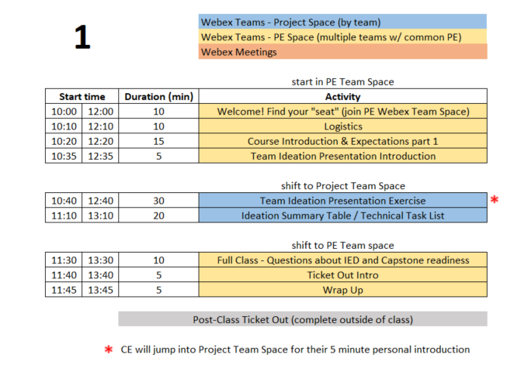
Class 1 Agenda

Slide 8
10 min - Logistics
All students should attend class meetings using Webex Teams
  Project Space (ex: GSK Toothpaste Flow)
  Project Engineer Space (ex: F21-sec1-Paster)
This PPT is available on Electronic Design Notebook (EDN) and will guide the first 9 classes
  Playbook - https://designlab.eng.rpi.edu/edn/projects/capstone-support-dev/wiki - Playbook.pptx
  You are STRONGLY ENCOURAGED to download newest version of Playbook prior to EACH class meeting.
Daily Class Agendas
  https://designlab.eng.rpi.edu/edn/projects/capstone-support-dev/wiki/Capstone_Class_Agendas

Slide 9
Covid-19 related challenges
Off campus and out of country students should strive to stay as synchronous as possible with team meetings and project progress
All course material is available online Electronic Design Notebook (EDN)
  https://designlab.eng.rpi.edu/edn/projects/capstone-support-dev/wiki
If any team member is remote, then ALL interactions will take place via Webex. If a team is entirely local, then some interactions will be via Webex.
  In Class Activities – Webex Team Spaces
    Project Space
    PE Space
  Class time - Webex Project Space or Sub-team Spaces
  Sponsor meetings – Webex meetings
  PE/CE Office hours – Webex private rooms
Classroom
  One-way entry/exit
    Enter @ JEC3332 door (SoE Hub or West side), Exit @ JEC 3232 door (15th St or East side)
  Webex teams has whiteboard functionality
  Chairs stay on X’s at 6 foot separation
  4 additional tables available for smaller 2 person meetings

Slide 10
Class meeting logistics
Bring laptop, charger, headphones/earbuds (for best Webex audio) to in-person classes
Wear a disposable mask at all times
Teams may wish to use Webex to record their meetings for any members who are 'absent' or have connection issues.
  If you record, save to the cloud so your team can access the recording.
  ALWAYS encouraged to take meeting minutes and post to Electronic Design Notebook (EDN) for future reference

Slide 11
Webex/Meeting Tips
Be productive for meetings.
  Have a written agenda, posted into the EDN Project Management folder
  Keep meeting minutes for ALL team Webex sessions and post to the Project Management forum on EDN
Webex chat will not be archived, so it's important to document results & discussion in the Forums and the Repository as appropriate
Although Webex can be great for socialization, we would like to encourage productive meetings to reduce Webex burnout

Slide 12
Class “location”
TBD
First 2 weeks remote only. All meetings on Webex.
IF NEEDED - Hybrid schedule to reduce campus density
  Your team will meet remote one day and in classroom one day each week
  Approx. 30% of students chose to be all remote
Capstone shop (JEC 2332) will be open 9am-4pm for hands-on work only when classes resume in-person
  Due to COVID, students must request permission to use shop from PE to ensure staffing – walk-ins are not allowed
  Students MUST complete online safety training prior to using shop
Bounce between Project Space and PE Space
  Agenda and this PPT will continuously remind you of proper location in slide footer (with bonus red arrow to highlight shifts in location)
Notes:
PE should remind each team which day they are remote vs in class

Slide 13
RPI Design Lab
Our Mission is to Develop High Performing Engineers by Mentoring Students in Professional and Engineering Design Practices Through Project Based Learning.
NO textbook, NO lecture
It is a Team EXPERIENCE
It is a mostly “flipped” class experience
Guided/assisted by Project Engineer (PE)
Graded/assisted by Chief Engineer (CE)

Slide 14

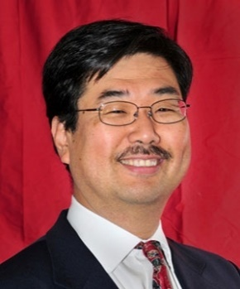
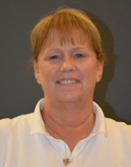

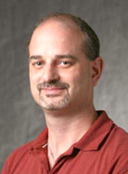

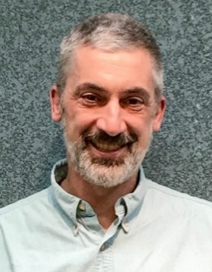
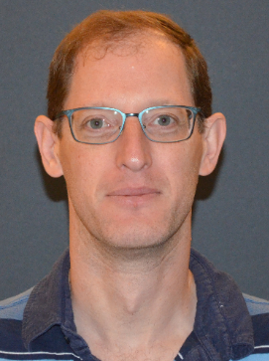

Design Lab Team
Associate Director
Admin Specialist
Manufacturing Manager
Shop Technician
Director
Kathryn Dannemann
Junichi Kanai
Valerie Masterson
Sam Chiappone
Scott Yerbury
Project Engineers
Mark Anderson
Brad DeBoer
Aren Paster
Mark Vermilyea

Slide 15
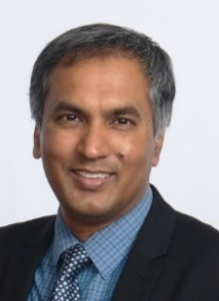
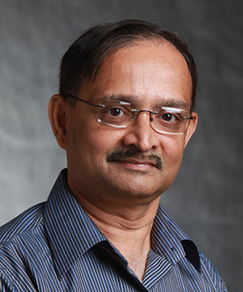
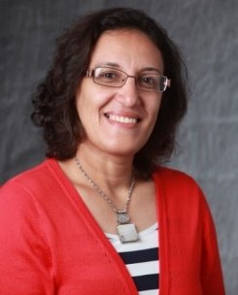
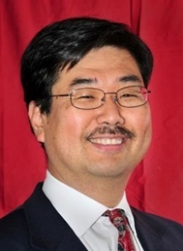
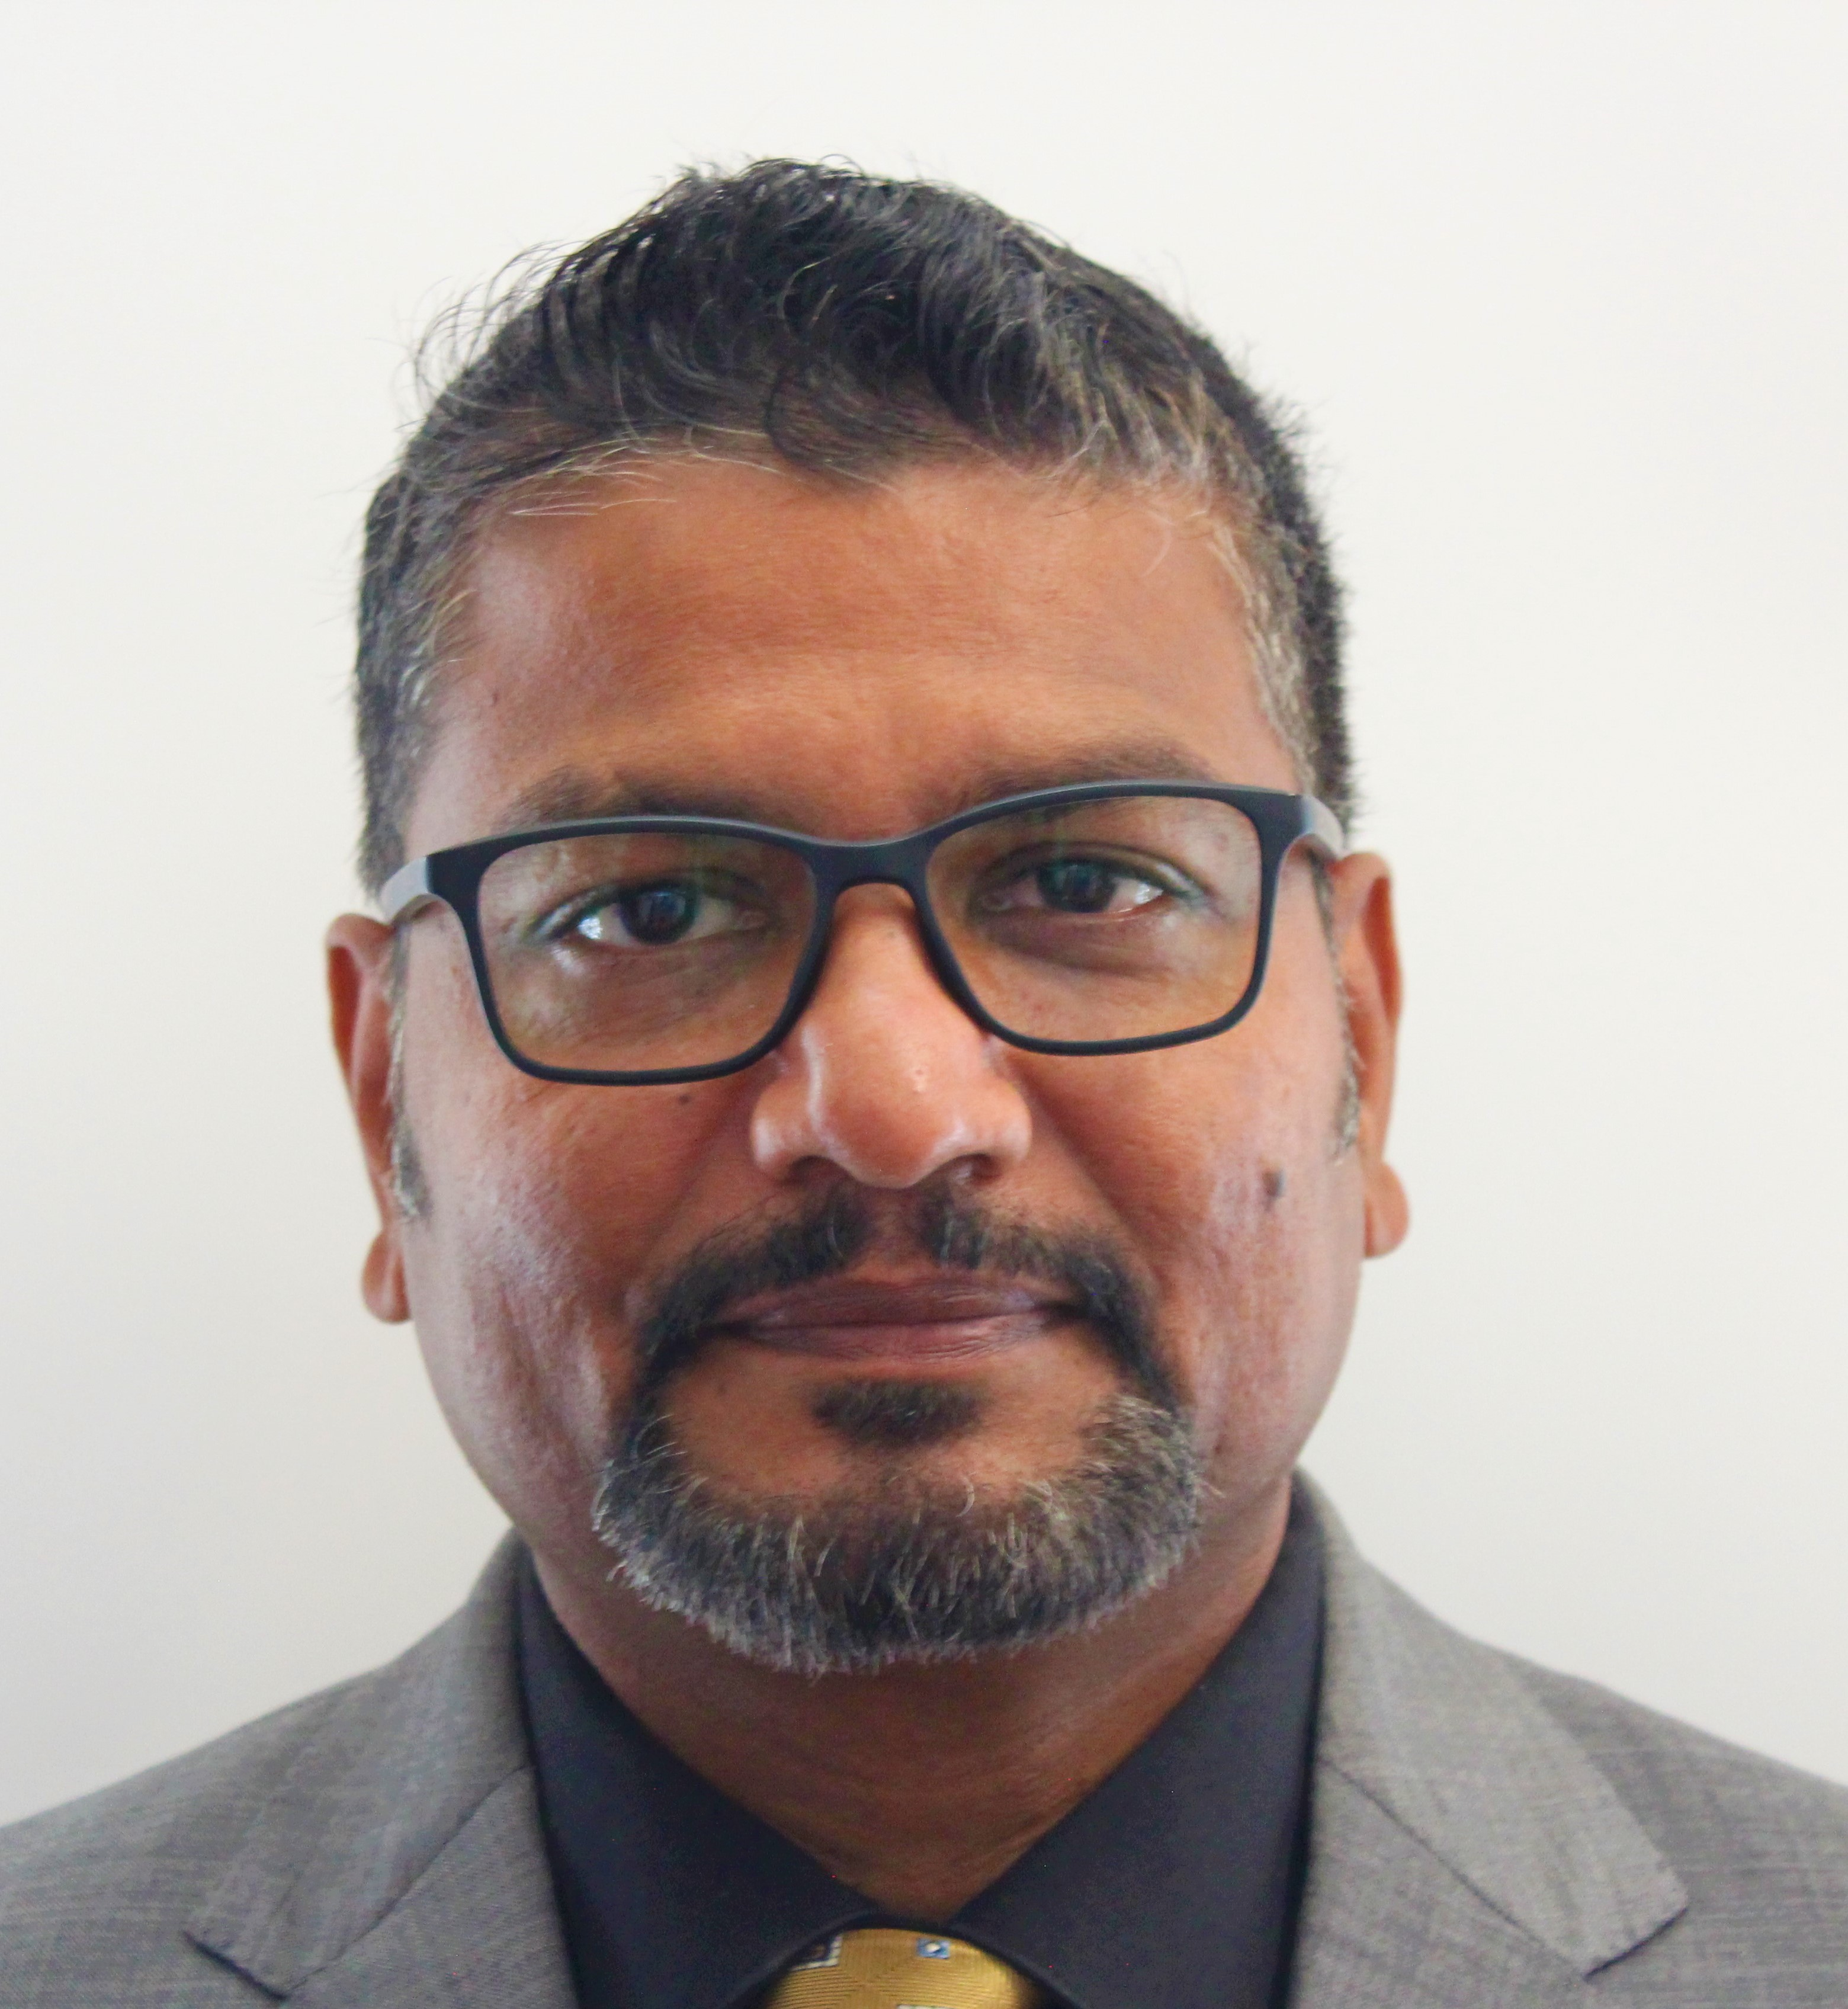
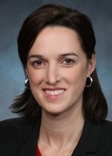
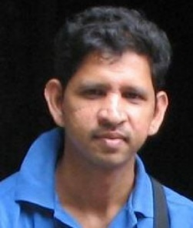
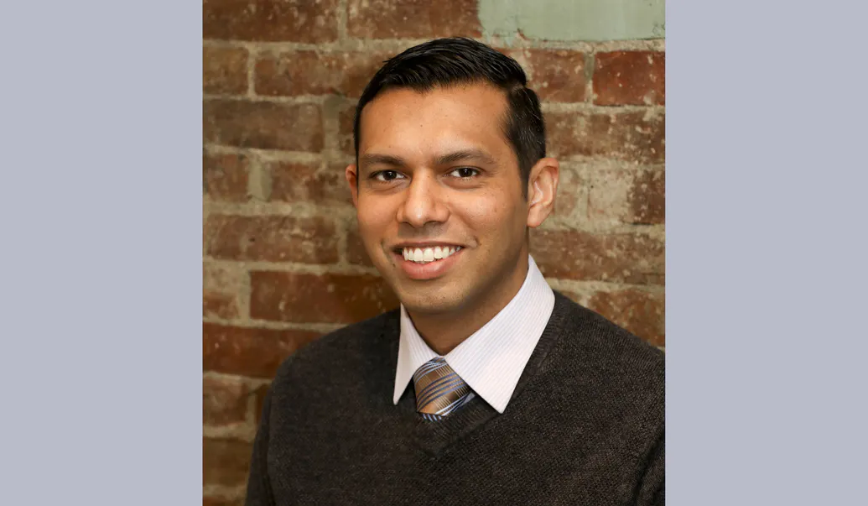



Faculty – Chief Engineers
ECSE
Partha Dutta
Ishwara Bhat
Mona Hella
Junichi Kanai
Prabahakar Neti
MANE
Sarah Felix
Karthik
Panneerselvam
Indika
Perera
MSE
IME
Kathryn
Dannemann
David
Duquette
Nima
Ahmadi

Slide 16
Participation Expectations
Arrive to Class On Time / Stay until class ends
  We encourage use of cameras when on Webex
Be present in Class and Team Meetings
  Listen, Engage, Participate
  Not distracted on your Phone or other tasks
3 Credit Hour course mandates:
  4 Hours per week IN class
  5 Hours per week OUT of class
Read communication from Design Lab staff and teammates
  Emails
  Webex chat
  EDN posts
Respond in timely manner

Slide 17
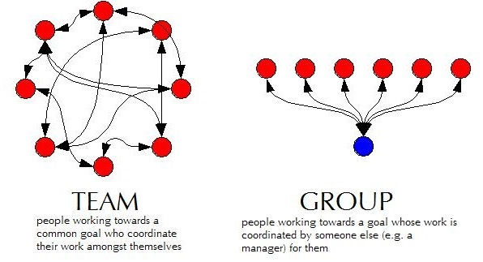
Capstone is TEAM work not GROUP work
Team Work
  collaborative effort
  peer review
  Student managed
Group Work
  divide and conquer
  low interaction with team
  Supervisor managed

Slide 18
Grading
Syllabus
  https://designlab.eng.rpi.edu/edn/projects/capstone-support-dev/repository/112/raw/Course%20Documents/Common%20Course%20Syllabus.pdf
Tasks and Due Dates
  https://designlab.eng.rpi.edu/edn/projects/capstone-support-dev/wiki/Tasks_and_Due_Dates
Pose any questions to kanaij@rpi.edu
  Answers will be posted to Electronic Design Notebook (EDN)
  https://designlab.eng.rpi.edu/edn/projects/capstone-support-dev/wiki/Syllabus_or_Grading_questions

Slide 19
Behavior Expectations
Q: “What expectations will your boss and peers have after graduation?”
Let’s start doing this NOW in Capstone Design
  Be Accountable.
    To your teammates, to Chief/Project Engineer, and to project sponsor.
  Be Professional.
  Make your work VISIBLE.
    Post/share as you go. No need to hide from team until its perfect or completely finished.
    Use Electronic Design Notebook (EDN)
Notes:
This slide is animated. Shows only the question – PE should ask students and get some responses

Slide 20
Communications Expectations
Written capstone communications are permitted ONLY on:
  The EDN
    Native EDN posts, MS Office files, CAD, etc.
  Webex
  RPI Box
Use of any other cloud-based service, such as Google Drive, GroupMe, Discord, Slack, etc. is FORBIDDEN
Scheduling services such as WhenIsGood are acceptable for setting up meetings but must not contain any technical information

Slide 21
Accountability Step #1
You all received via email the Capstone Orientation Packet:
Director’s Introduction letter
Project Description - Will guide your work today
Instructions for electronic signatures in Adobe
Recognition Waiver and Release - SIGN & return by end of day
Sponsorship Agreement - SIGN & return by end of day
Now we’re done talking about it.
More information
  https://designlab.eng.rpi.edu/edn/projects/capstone-support-dev/wiki/Confidentiality_Requirements

Slide 22
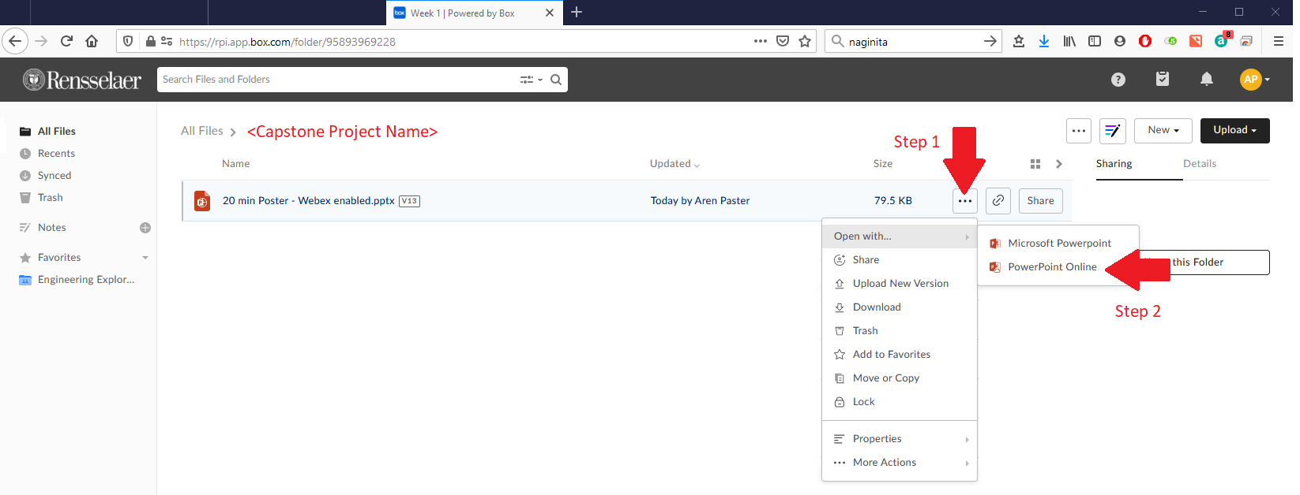
Collaboration Logistics
Each team has a Box folder pre-loaded with files
  https://rpi.app.box.com/
  Login using RPI credentials
EVERYONE open “20 min Poster - Webex enabled.pptx” file in PowerPoint Online
  This will allow simultaneous group editing
  (warning/notice) Online Office version lacks MANY features of standalone program

Slide 23
30 min - Team Ideation Exercise
Time boxed exercise. It will feel rushed, things won't feel complete. THAT'S OK.
You'll want more time. You can't have it. Team must move on.
For EACH section of presentation slides:
2 min
  Individual silent thought on content
  Type thoughts into text editor (Word, Notepad, etc...)
2 min
  Copy answers into shared Team PPT on Box
  Quick discussion of similar, unique, or new answers
Move on to next section of Ideation PPT as a team
PE will send chat messages to PE Space to help remind team to move on to each section of presentation

Slide 24
20 min - Team Ideation Summary
What unique skills does each person bring to the team?
What skills do members share in common?
What specific team or organizational strength will each person contribute?
What team or organizational weakness or areas for growth does each person have?
How can team make best use of each individual’s skills and talents?
Does every team member have a TECHNICAL action item to complete by next class?
  Note: This is something that should happen by end of EVERY class.

Slide 25
5 min – Initial Team Meeting
Choose a 30-60 min time for team to meet before next class
  www.WhenIsGood.net works well
  This is only for your first team meeting and may or may not be the same for the remainder of the semester.
MUST REACH DECISION TODAY! You have a group task to complete before next class.

Slide 26
10 min – Questions about IED and
Capstone Readiness
What part of your IED experience do you NOT want to repeat? - 4 min
  Personality conflicts
  Time management (ran out of time)
  Unequal division of labor
  Communication breakdown
How ready is your team to move forward on project?
1 (low) - 10 (high) scale
1 min - Pick individual answer
Move to PROJECT SPACE, discuss as a team, and come to consensus - 5 min
Return to PE SPACE for full class debrief - 5 min

Slide 27
5 min – Ticket Out
Design Lab wants your 'immediate' feedback on the course and your experience.
These 'surveys' after many classes will help us help you.
Collected anonymously using Google Forms.
  If you ever want an individual response from PE/CE/Director, be sure to INCLUDE your name.
Please Complete Ticket Out Today or Tomorrow
You can also always use email or Webex to reach out to PE/CE with any questions.

Slide 28
Capstone Activities topics
Project Technical Work
  Contribute directly to project progress and deliverables
  ALL project documentation & planning – notes, reports, analysis, Gantt chart
  Background research, design, prototyping, testing
P
Team Development / Design Process Refresher
  Forming, Storming, Norming, Performing
  Sequence of design artifacts – Needs & Reqs, Concepts, Decision Matrix
T/D
Administrative Tasks
  Onboarding - Legal paperwork, Safety training
  Course / Academic logistics
  Tickets Out & Feedback
A

Slide 29
Out of Class Tasks
(what you might call homework, to be completed BEFORE Class 2)
Project Technical Work
Re-read the Project Description with Class 1 Ideation Exercise in mind
Post evidence of progress on your project task assignment to team's Box folder as Word file. Filename should be RCSID-topic. Ex: pastea-FreeBodyDiagram.docx
  Web link of research AND summary of why it's important or useful
  Calculations
  Sketch of concept idea
P
Team Development / Design Process Refresher
Hold Team Meeting for Introductions
    Major, hometown
    Interests, clubs/sports, experience related to project topic
    Co-op, internship, summer job
    Pet, favorite ice cream flavor
T/D
Administrative Tasks
Complete Class 1 Ticket Out - https://forms.gle/VAiL3GTZs3R9QoQv7
Register for EDN – https://designlab.eng.rpi.edu/edn/
  Registration button in upper right hand corner
  Login must be your RCSID (RPI email before the @ symbol)
  Email must be your RPI email
  Bookmark this site. You will use it A LOT for this course.
Watch Capstone Introduction & Expectations – Part 2 video (7 Min)
  https://designlab.eng.rpi.edu/edn/projects/capstone-support-dev/repository/112/raw/training/Capstone%20Introduction%20and%20Expectations%20Part%202.mp4
A

Slide 30
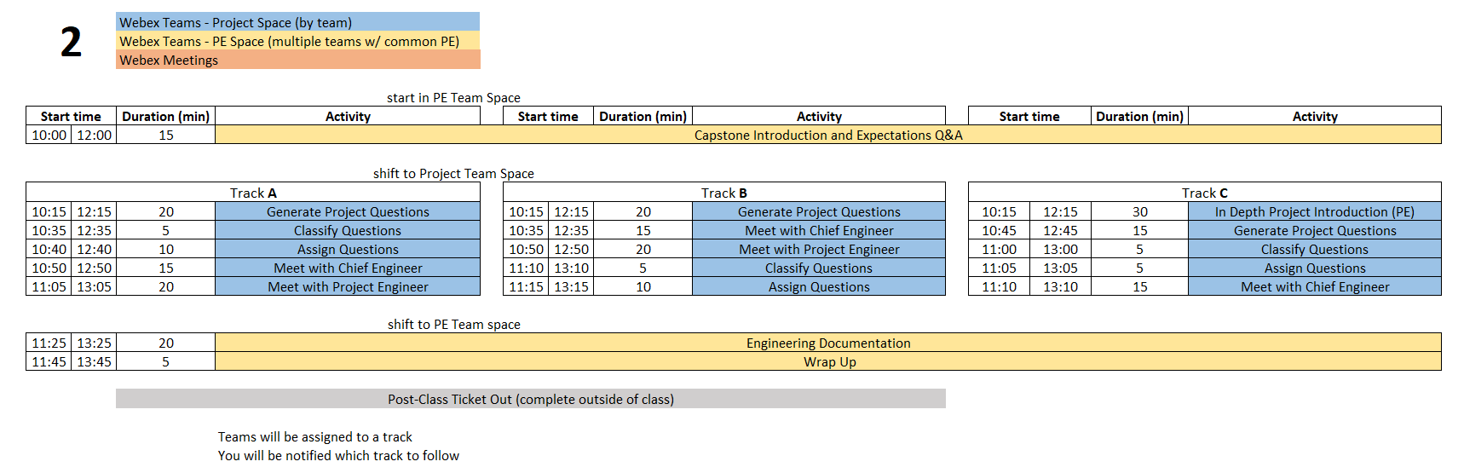
Class 2 Agenda
P
Project Technical Work
Team Development /
Design Process Refresher
Administrative Tasks
TD
A
  You are STRONGLY ENCOURAGED to download newest version of Playbook prior to EACH class meeting.
Repository instructions - https://designlab.eng.rpi.edu/edn/projects/capstone-support-dev/wiki/Subversion
Playbook - https://designlab.eng.rpi.edu/edn/projects/capstone-support-dev/wiki - Playbook.pptx
Notes:
PE notes – Track C is for projects with lots of history or content wholly unfamiliar to students.
Track A vs B is just a coin flip for scheduling.

Slide 31
15 min - Capstone Expectations Q&A
Out of Class Task was to watch 1 video
QUESTIONS about content?
What is difference between IED and Capstone?
Who ‘owns’ your project – student team, PE, CE, sponsor?
What is role of students in Capstone?
What is role of PE?
What is role of CE?
Notes:
Day 2

Slide 32
Follow Track A/B/C as instructed by PE
Track A | Track B | Track C
Generate Project Questions | Generate Project Questions | In Depth Project Introduction (PE)
Classify Questions | Meet with Chief Engineer | Generate Project Questions
Assign Questions | Meet with Project Engineer | Classify Questions
Meet with Chief Engineer | Classify Questions | Assign Questions
Meet with Project Engineer | Assign Questions | Meet with Chief Engineer
Instructions for each activity are on the next few slides
ALL activities in TEAM Space

Slide 33
15 or 20 min - Generate Project Questions
These questions can be about any aspect of the project, but by the end of the class include questions targeted to:
  Customer Needs
  Project Specifications / Technical Requirements
Same inclusive discussion format as first class
  2 min. silent question generation
  Then begin copying into Project Questions.xlsx spreadsheet in Box.
  Combine duplicates/similar questions
  Add more to list as you think of them during discussion

Slide 34
15 min - Classify and Assign Questions
  Classify all questions generated into one of three categories
    Things team members can research/answer themselves
    Things PE will answer
    Things to ask sponsor during kick-off meeting
  Team assigns owner to all questions in category A
  Add question classification and ownership to Box spreadsheet

Slide 35
15/20 min - Meet with Project Engineer
  Project Engineer meets with each team:
    Check on team status / welfare
    Student introductions
    Discuss project background and goals
    Review project question & categories
      Confirm & update
    When not meeting with your PE or CE, team members generate/discuss questions.

Slide 36
15 min - Meet with Chief Engineer
  Chief Engineer meets with each team:
    Check on team status / welfare
    Student introductions
    Discuss project impressions
    Review project question & categories
      Confirm & update
    CE’s background/experience
    When not meeting with your PE or CE, team members generate/discuss questions.

Slide 37
Go back to PE space for
Engineering Documentation discussion

Slide 38
20 min – Engineering Documentation
Topics
  What is Documentation?
  Why bother?
  How is it done in Capstone?
PE note:
  Let group answer 1st two questions
  Then run through next few slide to see if anything was not suggested
  Then discuss 3rd question

Slide 39
What is Documentation?
Engineering Documentation?
Living record of your work
  Evolution of your product/design is traceable
  Your work (experiment) is reproducible
  Your work can be understood by others and why you did it that way

Slide 40
Why Document?
Extension of your memory
  Who, What, When, Where, Why, How
  So that others can collaborate and continue the work
  Facilitates teamwork
  So that others can review/understand your work
Legal ramifications
  Contractual/legal defense
  Patent application
Efficiently and Effectively move the project forwards

Slide 41
Capstone Course Policies - Tools
Electronic Design Notebook - REQUIRED for all collaboration
Webex – Team Chat
When Is Good – meeting scheduling
Box – Initial Collaborative work (week 1 - 4)
Not Permitted
  Slack, GroupMe or Discord for chatting
  Google Drive for file storage
  Google Suite for document creation
  Other cloud-based tools for any use (schematics, mind maps, drawings, analysis, etc…) e.g., diagrams.net, etc.
Webex Teams is good for chat and live meetings, but project documentation MUST be transferred to Electronic Design Notebook (EDN) Forum or Repository.
  Simple/easy solution is to never put it on Webex to begin with.

Slide 42
What Tool Will You Use?
Electronic Design Notebook (EDN)
  Integrated Project Management
  Threaded Communication by topic, rather than a single unorganized stream
  IP protection
  Grading - accountability and visibility
  Secure access to team and sponsor
  Backed up daily !
  The EDN software may not be the PERFECT choice, but nothing is.
  It meets the Design Lab's needs better than the alternatives*.
  * https://designlab.eng.rpi.edu/edn/projects/capstone-support-dev/wiki/Why_Electronic_Design_Notebook_is_the_ONLY_choice

Slide 43
What Should I Document?
Everything
  Research, web links, notes
  Interviews and observations
  Ideas, concepts, sketches, charts, diagrams
  Calculations
  Purchases - components models, vendors, cost
  Analyses – technical and non-technical
  Experiments, debugging, tests
  Hypothesis, procedures, equipment used, steps taken, data, results
  Future work/ideas

Slide 44
Documentation Wrap up
Information should be complete before documented?
  True or False
It is necessary to document negative results?
  True or False
Teammates share responsibility with PE/CE to offer technical feedback on EDN posts?
  True or False

Slide 45
Out of Class Tasks
(what you might call homework, to be completed BEFORE Class 3)
Project Technical Work
Find answer(s) to assigned question(s) & post to new thread titled “Class 2 Questions and Answers” in EDN Background Info Forum
Identify one Customer Need for your project and translate it into an Engineering Requirement. Post to new thread in EDN Design Forum titled “Initial Needs and Requirements”
For ongoing projects, review prior semesters’ final presentations in accordance with PE instructions for class discussion in Class 3 or 4
  PPT should be in last semester's Final Deliverables Forum on EDN
  First student - create new thread in EDN Background Info titled "Questions about project"
  Rest of team - respond to thread with questions you have about project
P
Team Development / Design Process Refresher
Read The Engineering Design Process Refresher.pptx in preparation for class 3 discussion
  https://designlab.eng.rpi.edu/edn/projects/capstone-support-dev/repository/112/raw/training/The%20Engineering%20Design%20Process%20Refresher.pptx
Watch Customer Needs video (9 min)
  https://mediasite.mms.rpi.edu/Mediasite5/Channel/anderm8winrpiedu-engr-2050/watch/87d950eccc2942038b1d06530e9217841d
Watch Engineering Requirements video (11 min)
  https://mediasite.mms.rpi.edu/Mediasite5/Channel/anderm8winrpiedu-engr-2050/watch/96dceab44ae7447d812f5a216afa97cf1d
T/D
Administrative Tasks
Complete Class 2 Ticket Out - https://forms.gle/YweXodSa96dVjdQZ8
Watch EDN Guidance for Out of Class Tasks - Initial Postings Video (7.5 min)
  https://designlab.eng.rpi.edu/edn/projects/capstone-support-dev/repository/112/raw/training/EDN%20Guidance%20for%20Out%20of%20Class%20Tasks%20-%20Initial%20Postings.mp4
Post personal contact info (name, major, RPI email, phone #) to the Wiki. First member creates the page, other members simply edits the page to add their info.
A

Slide 46
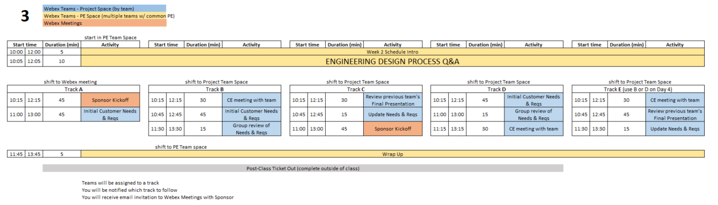
Class 3 Agenda
Over the course of Days 3 & 4 - All teams will complete the following:
Sponsor Kickoff Meeting
CE meeting with team
Customer Needs & Requirements - development and review
Review previous Final Presentation - ongoing projects only
  You are STRONGLY ENCOURAGED to download newest version of Playbook prior to EACH class meeting.
Repository instructions - https://designlab.eng.rpi.edu/edn/projects/capstone-support-dev/wiki/Subversion
Playbook - https://designlab.eng.rpi.edu/edn/projects/capstone-support-dev/wiki - Playbook.pptx
Notes:
PE Notes
Continuing projects should follow Track C or E
New projects can follow A, B, or D
Track A or C on Day 3 should follow track A or C on Day 4
Track B, D, or E on Day 3 should follow track B or D on Day 4

Slide 47
10 min - Engineering Design Process Q&A
Out of Class Task was to watch 3 videos…
QUESTIONS about content?
What are the steps in Engineering Design Process?
What is a Customer Need?
What is an Engineering Requirement?
What is the difference between a Need and a Requirement?
What is a User Story?
What is an Acceptance Criteria?
What is the difference between a User Story and an Acceptance Criteria?
Notes:
Day 3

Slide 48
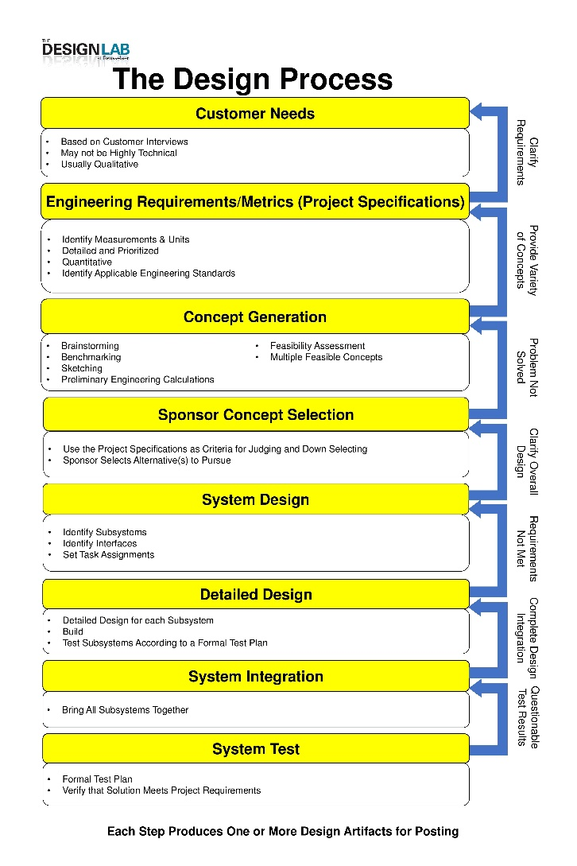
Engineering Design Process
Today is Day Three of class
Let’s look at steps ONE & TWO
Team will create/review/improve project’s list of:
Customer Needs
Engineering Requirements
This Design Process and terminology is taught in IED at RPI

Slide 49

30 min – Meet with CE
(Class 3 or 4)
Chief Engineer led discussion of:
  Course grading
  Student expectations
  CE background and experience
  Project impressions

Slide 50
45 min - Customer Needs & Engineering Requirements Generation
Needs and Requirements workbook.xlsx spreadsheet is in team Box folder
Fill out based on team’s current (uninformed impression) of project
  This is first pass. Don’t worry that answers are not complete or verified by sponsor.

Slide 51
15 min – Group Review of
Needs & Requirements
Read notes in template document for tips
Remove/combine duplicates
Unsure of a proper metric?
  Quick Google search to put in an educated guess
  Use ‘Confidence’ column to mark low and plan to research/update after class
Fill in holes/gaps after looking at categories
  https://designlab.eng.rpi.edu/edn/projects/capstone-support-dev/wiki/Requirements_Management
  Safety, Reliability, Maintainability, etc…

Slide 52
45 min - Sponsor Kick-Off Meeting
Meeting Agenda
  Team introductions to sponsor (name, major, relevant experience/skills)
  Sponsor introduction to team
  Sponsor describes project "in their words“
    History, ultimate and semester goals, deliverables, etc…
  Open Q&A

Slide 53
30/45 min - Prior Presentation
(if applicable)
Team should review (outside of class) the final PPT presentation given by previous semester team
  Forums->Final Deliverables
  Repository->Reports->Final Reports
PE/CE will quickly walk-through slide deck and discuss:
  Goals
  Accomplishments / Successes
  Challenges
  Next steps
PE/CE will help to clear up confusion and answer any questions current team may have

Slide 54
Out of Class Tasks
(what you might call homework, to be completed BEFORE Class 4)
Project Technical Work
Update Needs/Reqs Workbook based on feedback and post to EDN Design Forum.
P
Team Development / Design Process Refresher
Administrative Tasks
Complete Class 3 Ticket Out - https://forms.gle/wvAGzscgNjTHmAxZ7
Choose sponsor liaison
  This person will be the focal point for emails to/from your sponsor. They are not the team's "spokesperson" at meetings, conference calls, in class, etc.
Watch Intro to EDN video (5 min) in preparation of Class 4 review
  https://designlab.eng.rpi.edu/edn/projects/capstone-support-dev/repository/112/raw/training/Intro%20to%20the%20EDN.mp4
Read Project Documentation Wiki page in preparation of Class 4 review
  https://designlab.eng.rpi.edu/edn/projects/capstone-support-dev/wiki/Project_Documentation
Read Meeting Minutes Wiki Page
  https://designlab.eng.rpi.edu/edn/projects/capstone-support-dev/wiki/Meeting_Minutes
  Post notes taken during PPT review to Project Management Forum
Follow Subversion instructions to download and install client, then checkout a copy of your project’s repository. Visit your PE’s office hours for assistance.
  https://designlab.eng.rpi.edu/edn/projects/capstone-support-dev/wiki/Subversion_Clients#section-2
Complete the Online Safety Training in Percipio by end of 3rd week
  https://www.percipio.com
  Rensselaer Manufacturing and Prototyping Laboratories-Safety Orientation
  Instructions https://designlab.eng.rpi.edu/edn/attachments/download/114354/RMPL%20Safety%20Module%20Completion%20Instructions-Percipio%20.pdf
T/D
A

Slide 55
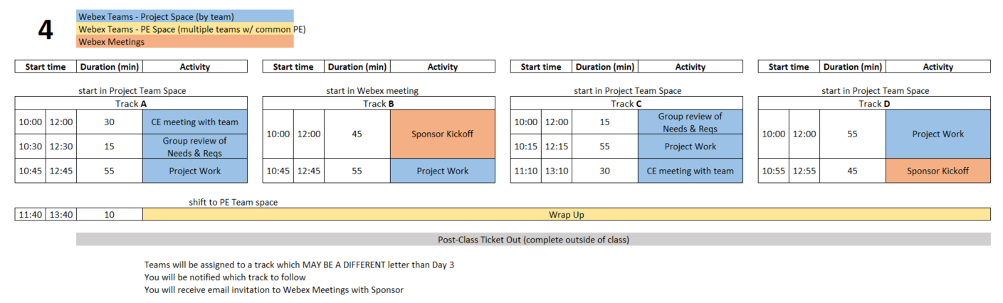
Class 4 Agenda
  You are STRONGLY ENCOURAGED to download newest version of Playbook prior to EACH class meeting.
Repository instructions - https://designlab.eng.rpi.edu/edn/projects/capstone-support-dev/wiki/Subversion
Playbook - https://designlab.eng.rpi.edu/edn/projects/capstone-support-dev/wiki - Playbook.pptx
Notes:
PE Notes
Track A or C on Day 3 should follow track A or C on Day 4
Track B, D, or E on Day 3 should follow track B or D on Day 4

Slide 56
Engineering Design Process
Today is Day Four of class
Team should be working towards student agreement, and PE/CE/sponsor review/approval of steps ONE & TWO
Customer Needs
Engineering Requirements
This Design Process and terminology is taught in IED at RPI

Slide 57
15 min – Group Review of
Needs & Requirements
Read notes in template document for tips
Remove/combine duplicates
Unsure of a proper metric?
  Quick Google search to put in an educated guess
  Use ‘Confidence’ column to mark low and plan to research/update after class
Fill in holes/gaps after looking at categories
  https://designlab.eng.rpi.edu/edn/projects/capstone-support-dev/wiki/Requirements_Management
  Safety, Reliability, Maintainability, etc…

Slide 58
45 min - Sponsor Kick-Off Meeting
Meeting Agenda
  Team introductions to sponsor (name, major, relevant experience/skills)
  Sponsor introduction to team
  Sponsor describes project "in their words“
    History, ultimate and semester goals, deliverables, etc…
  Open Q&A

Slide 59
55 min - Project Work
Refine Needs and Requirements Spreadsheet
  Needs
    Ensure all known Customer Needs are documented
  Requirements:
    Associate with appropriate Customer Need(s)
    Identify Measurements and Units (quantitative)
    Ensure that Requirements are detailed and prioritized
    Identify Applicable Engineering Standards
Refine/Develop Follow-Up Questions for Sponsor
  If Team has already had Sponsor Meeting, what new questions have been identified as a result?
    Clearly document and email to Sponsor, copy your PE
Background Research/Benchmarking
  Discuss/document work done to date
  Identify/document additional benchmarking needs

Slide 60
30 min – Meet with CE
(Class 3 or 4)
Chief Engineer led discussion of:
  Course grading
  Student expectations
  CE background and experience
  Project impressions

Slide 61
Out of Class Tasks
(to be completed BEFORE Class 5)
Project Technical Work
Update Needs/Reqs Workbook - post to Engineering Analysis folder in the repository
P
Team Development / Design Process Refresher
Watch Statement of Work video (10 min) in preparation for creating draft in class 5
  https://designlab.eng.rpi.edu/edn/projects/capstone-support-dev/repository/112/raw/training/Statement%20of%20Work.mp4
T/D
Administrative Tasks
Complete Class 4 Ticket Out - https://forms.gle/sXn3zGefqdyHnqg77
Read Project Documentation Wiki page in preparation for class review
  https://designlab.eng.rpi.edu/edn/projects/capstone-support-dev/wiki/Project_Documentation
Complete the Online Safety Training in Percipio by end of 3rd week
  https://www.percipio.com
  Rensselaer Manufacturing and Prototyping Laboratories-Safety Orientation
A

Slide 62
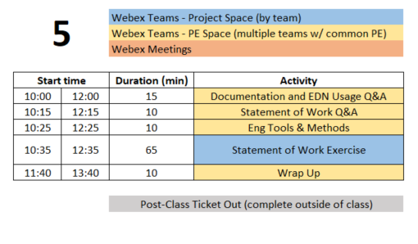
Class 5 Agenda
  You are STRONGLY ENCOURAGED to download newest version of Playbook prior to EACH class meeting.
Repository instructions - https://designlab.eng.rpi.edu/edn/projects/capstone-support-dev/wiki/Subversion
Playbook - https://designlab.eng.rpi.edu/edn/projects/capstone-support-dev/wiki - Playbook.pptx

Slide 63
Engineering Design Process
Today is Day Five of class
Team will develop Statement of Work (SoW).
This puts into clear words & pictures what the FINAL output will look like, and the tools required to get there.
This Design Process and terminology is taught in IED at RPI

Slide 64
15 min – Documentation & EDN Usage Q&A
You should have already watched EDN video and read Documentation Wiki page
  Intro to EDN video (5 min)
    https://designlab.eng.rpi.edu/edn/projects/capstone-support-dev/repository/112/raw/training/Intro%20to%20the%20EDN.mp4
  Project Documentation page
    https://designlab.eng.rpi.edu/edn/projects/capstone-support-dev/wiki/Project_Documentation
QUESTIONS about content?
Why do we document?
What do we document?
How will you document?
How often / when will you document?
Must we wait for things to be complete / final to document?
Where does it go?
Notes:
Day 5

Slide 65
Phases of the Design Report
Phase 1
Statement of Work
Phase 2
Preliminary Design Report
Phase 3
Final Report
Week 4
Midterm
End of Semester
In ALL cases, the file name and location remains the same:
“working/Reports/Design Report and Poster/Design Report.docx”

Slide 66
Design Report.docx - Table of Contents
Revision Fall 2021
Green – Create
Yellow – Update
File name
DOES NOT change

Slide 67
Design Report Section Progress
Create (green)
  first pass at generating this content
Required Update (yellow)
  revise and update based on work done to date
  incorporate feedback from PE/CE/sponsor
Optional Update
  any existing material can be revised with new information
  incorporate feedback
At all stages, the file name and location in Repository remains the same:
“working/Reports/Design Report and Poster/Design Report.docx”

Slide 68
10 min - Statement of Work Q&A
Out of Class Task was to watch 1 video…
QUESTIONS about content?
What is a Statement of Work?
What is difference between the Project Objectives and Semester Objectives?
What are Engineering Tools and Methods?
What is difference between a task and a deliverable?
Where is the SoW document template located?
Notes:
Day 5

Slide 69
10 min - Engineering Tools and Methods
  What techniques, software, calculations will be used to address the problems in front of team? Ex:
  Mechanical aspects – Free Body diagram, torque measurement
  Software – flow chart of system control loop, storyboard of user input
  Process – conduct customer interviews of toddler caregivers, create Standard Operating Procedure for system startup and calibration

Slide 70
65 min - Statement of Work Exercise
Design Report Template – SoW is phase 1 of this document
https://designlab.eng.rpi.edu/edn/projects/capstone-support-dev/wiki/Templates_and_Forms - Design Report.docx
10 min – Break into 3 groups (meet in subteam spaces A/B/C)
  A - Long Term Objectives (1-5+ years, from Customer Perspective)
  B - Current Semester Objectives (3 months!)
  C - Deliverables (Be S.M.A.R.T.!)
Shift back to Team Space
10 min - Team review – Long Term and Current Semester Objectives
15 min - Team review – Deliverables
20 min
  PE/CE review of Deliverables
  Team development of Dates for Deliverables and Engineering Tools and Methods
Create threads in Statement of Work Forum for notes on each section

Slide 71
Out of Class Tasks
(to be completed BEFORE Class 6)
Project Technical Work
Wordsmith and polish Statement of Work
Upload Statement of Work (Phase 1 of Design Report.docx) to Repository prior to class 6
  Location - working/Reports/Design Report + Poster
Upload Needs & Requirements spreadsheet to Repository
  Location - working/Engineering Analysis
P
Team Development / Design Process Refresher
Watch Concept Generation video (9 min) in preparation for Concept Generation class exercise
  https://mediasite.mms.rpi.edu/Mediasite5/Channel/anderm8winrpiedu-engr-2050/watch/d78db44fd9f7424b9d8f4c72857f84371d
T/D
Administrative Tasks
Complete Class 5 Ticket Out - https://forms.gle/15vkmdmQLpqfMnhw5
Attend SVN Training or watch video
  https://designlab.eng.rpi.edu/edn/projects/capstone-support-dev/repository/112/raw/training/Getting%20Started%20with%20Subversion-For%20Windows%20Users.mp4
Complete the Online Safety Training in Percipio by end of 3rd week
  https://www.percipio.com
  Rensselaer Manufacturing and Prototyping Laboratories-Safety Orientation
A

Slide 72
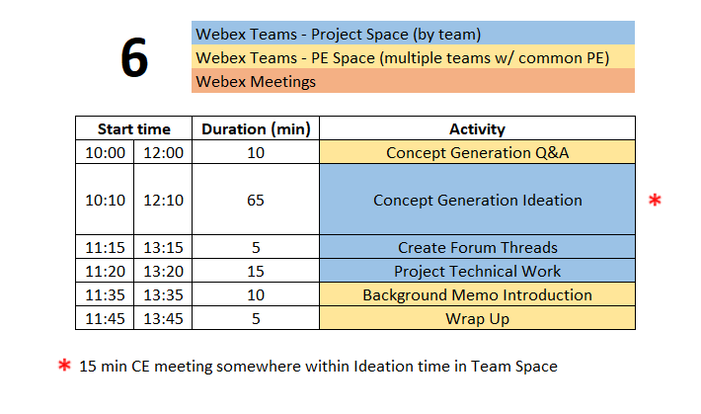
Class 6 Agenda
  You are STRONGLY ENCOURAGED to download newest version of Playbook prior to EACH class meeting.
Repository instructions - https://designlab.eng.rpi.edu/edn/projects/capstone-support-dev/wiki/Subversion
Playbook - https://designlab.eng.rpi.edu/edn/projects/capstone-support-dev/wiki - Playbook.pptx

Slide 73
Engineering Design Process
Today is Day Six of class
Team will generate AND document concepts to address and meet the Needs & Requirements of the project.
This Design Process and terminology is taught in IED at RPI

Slide 74
10 min - Concept Generation Q&A
Out of Class Task was to watch 1 video…
QUESTIONS about content?
Where do concept ideas come from?
  Example of Internal Search?
  Example of External Search?
Notes:
Day 6

Slide 75
15 min – CE Time
Meeting will be in CE’s Webex Personal Room
This will take place at some point during Concept Generation exercise depending on CE’s schedule

Slide 76
65 Min - Concept Generation
Similar inclusive plan as previous exercises using Box document
5 min – Individually silently generate any concept to solve/address project needs/reqs
10 min – Everyone add concepts to Concept Generation Spreadsheet.xlsx in Box
15 min – Organize list by topic
  Eliminate duplicates
  Add extra ideas you think of right now or are inspired by others ideas
35 min – Group discussion
  Explain further to improve group understanding – if necessary
  Look for missing/unaddressed needs –think of concepts to address them
  Look for lone concepts – think of alternative ideas
Notes:
Note
CE will jump in to talk for 15 mins of this time block

Slide 77
5 min – Create Forum Threads
Concept topics ARE the key discussions and work areas for the team
Create Design Forum threads for each topic
  Use these thread to post explanation, sketches, calculations, etc…
  Reply to team mates posts to move idea forwards and advance project

Slide 78
15 min – Project Work
Go to Team Space
Work on project
Someone should take notes of meeting discussion
    NOT as Word document, simply as plain text in Forum post.
  Minute instructions and template https://designlab.eng.rpi.edu/edn/projects/capstone-support-dev/wiki/Meeting_Minutes
Post AT END of class to Forums –> Project Mgmt
  Others can reply to post with any corrections or additional information

Slide 79
10 min - Background Memo
What is current state of the art? How is problem currently solved?
What will team members NEED to know to move forwards?
What has already been accomplished by prior team?
Team creates topic list
  Literature search
  User interviews
  Identifying / installing / practicing software or techniques which will be required for the project
  Install existing project software
  Verify work done by past Capstone team
  Conduct testing or system operation described by prior team
PE/CE approve list
Capstone Support Wiki has instructions, template, and rubric
https://designlab.eng.rpi.edu/edn/projects/capstone-support-dev/wiki/Background_Memo

Slide 80
Out of Class Tasks
(to be completed BEFORE Class 7)
Project Technical Work
Continue technical work
  Post progress to Design Forum threads
Brainstorm 6 individual tasks which need to be accomplished to reach project goals
  (first person to post) Create a SINGLE thread in the Project Mgt. Forum called “Tasks”
  (everyone else) Reply to post with your 6 task ideas
Team brainstorms Background Memo topic list
  https://designlab.eng.rpi.edu/edn/projects/capstone-support-dev/wiki/Background_Memo
  Post to Background Info forum – “Memo topics”
P
Team Development / Design Process Refresher
Watch videos in preparation for Project Planning activity
  Intro to Project Mgmt (7 min)
    https://www.youtube.com/watch?v=QwuwzBBThPY
  Deliverables & Activities (3 min)
    https://www.youtube.com/watch?v=L6WYJh1Ygoc
T/D
Administrative Tasks
Complete the Online Safety Training in Percipio by end of 3rd week TODAY!
  https://www.percipio.com
  Rensselaer Manufacturing and Prototyping Laboratories-Safety Orientation
A

Slide 81
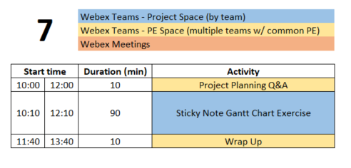
Class 7 Agenda
  You are STRONGLY ENCOURAGED to download newest version of Playbook prior to EACH class meeting.
Repository instructions - https://designlab.eng.rpi.edu/edn/projects/capstone-support-dev/wiki/Subversion
Playbook - https://designlab.eng.rpi.edu/edn/projects/capstone-support-dev/wiki - Playbook.pptx

Slide 82
Engineering Design Process
This Design Process and terminology is taught in IED at RPI
Today is Day Seven of class
Team will develop list of the tasks necessary to complete the project, and schedule them over the remainder of the semester.

Slide 83
10 min - Project Planning Q&A
Out of Class Task was to watch 2 videos…
QUESTIONS about content?
What is a milestone?
What is the difference between parallel tasks and serial tasks?
What is critical path of a plan?
Notes:
Day 7

Slide 84
Defining Meaningful Tasks aka “SMART”
One idea per Post-it. Be concise!
Defined to be No More than 1 week long. Break big things into smaller pieces.
Everyone Needs at Least 1 Task / Week for the Entire Semester
What will YOU contribute to the project? Focus on YOUR potential contributions to the project. (We know these may not yet be defined!)
Focus on the technical work required.
Leave out project management / overhead tasks, e.g., report writing, slide making, etc.
DO include documentation needed for technology transfer, e.g. user manual
Be Technical! Be SMART!

Slide 85
Defining Meaningful Tasks aka “SMART”
Yes, it gets harder to define tasks near the end of the semester. So instead, work backwards from the end!
There may be gaps in time – you will need to fill those in today
Do not just copy a task 3 times because it spans 3 weeks. Instead, you must break it down into 3 well defined smaller tasks.
Don’t allocate slack time at the end of the semester. Gantt charts do not include tasks called “Just in Case”. Instead estimate the length of tasks to factor in some risk. Not everything works the first time and many thing turn out to be more difficult than first thought.
Group things by functional subsystem rather than by name. this helps reveal possible planning gaps.
Remember your deliverables! Do you have the tasks needed to produce each of them, including things like demos?
Be Technical! Be SMART!

Slide 86
90 min - ‘Post It Note’ Project Planning Exercise
10 min – (individually silently) each student generate list of TEN tasks which must be completed to accomplish the deliverables
Previous Out of Class Task was to post 6 personal tasks to EDN, so start with those. Now create at least 4 more each.
10 min – enter tasks in the Gantt Chart PPT.pptx in Box or placed on Whiteboard
Create 1 text box / post-it for each task
On PPT, choose a personalized fill color for your entries
Position tasks appropriately along week-by-week calendar
  This can be done before or after getting all items shared.
60 min – Group organization of tasks
Add missing tasks, remove duplicates
Organize by subsystem or milestone
10 min – Re-assign ownership (by color) to ensure everyone has work throughout semester
Notes:
Nice to have – preload the Gantt Chart PPT with the SOW deliverables to speed up the mapping of tasks to milestones.

Slide 87
Out of Class Tasks
(to be completed BEFORE Class 8)
Project Technical Work
Add deliverables from Statement of Work to EDN Gantt Chart as Versions
  Watch video with instructions (4 min) - https://designlab.eng.rpi.edu/edn/projects/capstone-support-dev/repository/112/raw/training/Creating%20Versions%20from%20your%20Statement%20of%20Work.mp4
  Prefix with current semester name/year, e.g. “F22-” to avoid duplication of common deliverable names across semesters.
Add tasks identified on sticky notes into EDN as Issues and associate them with the appropriate version and assignee (owner)
Background Memo due on 2/7 (2/4)
  Memo Template: https://designlab.eng.rpi.edu/edn/projects/capstone-support-dev/repository/112/raw/template%20documents/BM_Memo-Topic-RCSid.docx
  Memo Rubric: https://designlab.eng.rpi.edu/edn/projects/capstone-support-dev/repository/112/raw/Rubrics/Background%20Memo%20Rubric.docx
  Submit your memo in the Background Info forum
    Include your RCSID and topic in filename!
P
Team Development / Design Process Refresher
Read Risks Associated with Project Plans Wiki page and revise team plan in EDN Gantt chart as necessary
  https://designlab.eng.rpi.edu/edn/projects/capstone-support-dev/wiki/Risks_Associated_with_Project_Plans
T/D
Administrative Tasks
Create draft of Status Update PPT topics
  Template - https://designlab.eng.rpi.edu/edn/projects/capstone-support-dev/wiki/Templates_and_Forms
Create agenda for 60 mins of class 8
Complete the Online Safety Training in Percipio by end of 3rd week TODAY !!
  https://www.percipio.com
  Rensselaer Manufacturing and Prototyping Laboratories-Safety Orientation
A

Slide 88
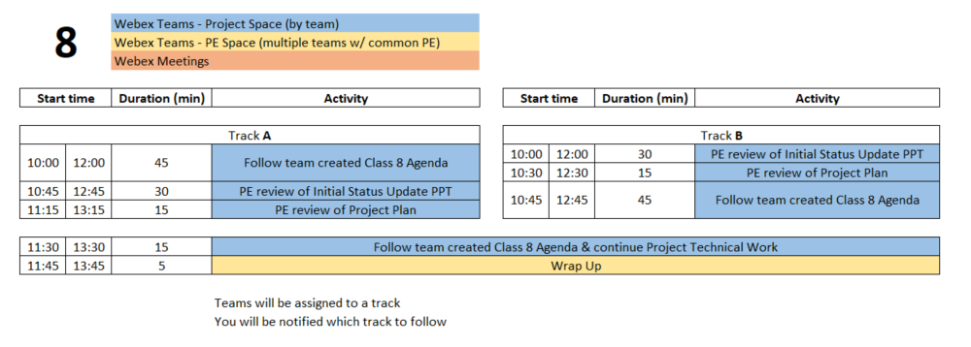
Class 8 Agenda
  You are STRONGLY ENCOURAGED to download newest version of Playbook prior to EACH class meeting.
Repository instructions - https://designlab.eng.rpi.edu/edn/projects/capstone-support-dev/wiki/Subversion
Playbook - https://designlab.eng.rpi.edu/edn/projects/capstone-support-dev/wiki - Playbook.pptx

Slide 89
Engineering Design Process
Today is Day Eight of class
Team is developing concepts and beginning to down select.
Creating poster to communicate overall project and progress made.
This Design Process and terminology is taught in IED at RPI

Slide 90
60 min – Follow Team Agenda
Designate team member to take and post minutes to EDN
  This task should be done for EVERY meeting. Rotate responsibility.

Slide 91
15 min – PE Review Project Plan
Many short individual tasks? Few large group tasks?
Adequate time for:
  Manufacturing?
  Purchasing?
  Testing?
  Iterative development? Second round of any tasks?
Equal division of labor across all students?
Ability to do some work in parallel rather than series?
  Design test plan BEFORE mfg is complete
  Create dummy data NOW to test software performance or analysis approach

Slide 92
30 min – PE Review of Status Update PPT
Number slides
Figure labels
Team members names, PE/CE names, sponsor name, company logo
Agenda
  Does it match actual contents of PPT?
Contents appropriate? (match rubric & PDR content)
  Background & Customer Needs
  Technology Assessment
  Engineering Requirements
  Concept Generation

Slide 93
Out of Class Tasks
(to be completed BEFORE Class 9)
Project Technical Work
Read Preliminary Design Review and Poster Wiki page in preparation for creating a first draft of the poster during Class 9
  https://designlab.eng.rpi.edu/edn/projects/capstone-support-dev/wiki/Preliminary_Design_Review_and_Poster
Continue technical work
Post progress to Design Forum thread(s)
Student Team should now be creating individual project tasks
P
T/D
Team Development / Design Process Refresher
Administrative Tasks
Address any feedback received on Status Update PPT
Sponsor liaison should email PPT to sponsor 24 hours prior to call
Prep for upcoming PDR - There will be THREE groups presenting SAME content from SAME poster
  Identify who will be presenting in each of the three groups
A

Slide 94
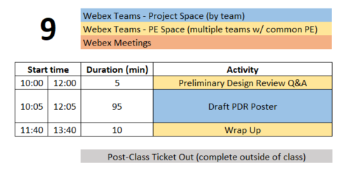
Class 9 Agenda
  You are STRONGLY ENCOURAGED to download newest version of Playbook prior to EACH class meeting.
Repository instructions - https://designlab.eng.rpi.edu/edn/projects/capstone-support-dev/wiki/Subversion
Playbook - https://designlab.eng.rpi.edu/edn/projects/capstone-support-dev/wiki - Playbook.pptx

Slide 95
Engineering Design Process
This Design Process and terminology is taught in IED at RPI
Today is Day Nine of class
Team is creating poster to communicate
Overall project (Needs & Requirements)
Progress made (Concepts, System Architecture)
Future steps (Design, Integration, & Test Plan)

Slide 96
5 min - PDR Q&A
Out of Class Task was to watch review 1 Wiki page…
QUESTIONS about content?
What does PDR stand for?
Who is audience for PDR?
Approx. how many PPT slides should team prepare?
Covid Tip – It’s hard to hear speakers through a mask. Be sure to SPEAK LOUDLY during presentation.
Notes:
Day 9

Slide 97
95 min – Poster Creation
Open Poster.pptx in Box in PPT Online
10 mins – Divide into 3 groups, shift to sub-Spaces on Webex Teams, and work on initial slides. Content can be pulled from Statement of Work.
  Purpose
  Past Work and/or Project History
  Semester Objectives/Requirements
40 mins – As a full team discuss Technical Approach, Results and Accomplishments to Date
30 mins – Move on to Next Steps and Plan
15 mins – Begin assembly of content onto single slide (pg 8)

Slide 98
Out of Class Tasks
(to be completed BEFORE Class 10)
Project Technical Work
Continue technical work
Post progress to Design Forum thread(s)
Upload poster draft created in class to EDN
  File in the Repository – working/Reports/Report + Poster/Poster.pptx
  Discussion in Forum – PDR thread
P
T/D
Team Development / Design Process Refresher
Administrative Tasks
Class 9 Ticket Out - https://forms.gle/7JvfgSsWBVWRfvob9
Student Team should now be creating agendas for each class meeting and individual project tasks
A

Slide 99
Preliminary Design Review (10/7 Th or 10/8 Fri)
Presentation Schedule
Sections 1&3 | Sections 2&4 | Activity | Presenter A Primary Host | Presenter B Backup Host | Presenter C
10:00 | 12:00 | Beginning of class
10:05 | 12:05 | Start the 1st sub-team's design review | Name & Email | Name & Email | Name & Email
10:25 | 12:25 | Start of Q&A
10:30 | 12:30 | Time for reviewers to document evaluation
10:40 | 12:40 | Start the 2nd sub-team's design review | Name & Email | Name & Email | Name & Email
11:00 | 13:00 | Start of Q&A
11:05 | 13:05 | Time for reviewers to document evaluation
11:15 | 13:15 | Start the 3rd sub-team's design review | Name & Email | Name & Email | Name & Email
11:35 | 13:35 | Start of Q&A
11:40 | 13:40 | Time for reviewers to document evaluation
IF VIRTUAL

Slide 100
Class 10 and Beyond Agenda
Scaffolded class activities have ended!
Primary purpose of the remaining class meetings is team review and assessment of work already completed, especially with your PE and/or CE.
It is NOT productive to use class time for completing individual work.
These 4 hours of class time may be the only available time for FULL team to meet. So it is recommended to use for group discussions.
Pro Forma Agenda posted on Capstone Support
  https://designlab.eng.rpi.edu/edn/projects/capstone-support-dev/wiki/Class_10_and_beyond
Use EDN and Repository (rather than Box) to document all work moving forwards

