Slide 1
Getting Started with Subversion
For Windows Users

Slide 2
What You Will Learn
Why Version Control and What is Subversion
Install / Setup TortoiseSVN on Windows
Checkout Your Repository
Add Files
Delete / Move Files
Make Commits
Keep Updated
For More Information

Slide 3
Why Version Control and What is Subversion
When Multiple Files and People are Involved, Version Control Becomes Important
Avoid over-writing each other’s files
Backup of all work
Changes can be made by multiple users
Changes can be tracked to each user
Previous versions are saved and recoverable
Design Lab teams use Subversion (SVN) for collaboration and version control for:
Word documents
PowerPoint presentations
Mechanical CAD files, e.g. SolidWorks / NX
Electronics CAD files, e.g. Eagle, KiCAD, OrCAD
Simulations
Software, e.g. Arduino, C/C++, LabVIEW, Python, etc.
And more!
Subversion uses a
Client / Server Architecture
With Subversion, YOU Can Recover Any Version of Any File for Your Project!

Slide 4
The Workflow for Version Control
A Working Copy
is on every user’s PC
We use a client to do this.
The Repository (Repo)
lives on a server,
aka “the cloud”
This is where teams will be working throughout the semester.
Subversion runs on the Server
TortoiseSVN is the Client on Your PC

Slide 5
Install the Subversion Client
Visit TortoiseSVN - https://tortoisesvn.net/
Download the 64 bit client unless you have a fairly old PC
Double click to install
Done!
TortoiseSVN is Integrated into Windows Explorer as Right Click Menu Options
It is NOT a Standalone Program Like Word, PowerPoint or Excel

Slide 6
Setup TortoiseSVN
To get started, you must first Checkout your team’s Repository
  This is a One-Time task
Create a new folder to be your Working copy
Right click on it
Select Checkout from the TortoiseSVN menu
Enter the URL for your team’s Repository
  If the path to your wiki is:
  Then the repository URL is: https://designlab.eng.rpi.edu/svn2/sample-ied-fall-2014
  The Checkout Directory should be the working copy folder you just created
Accept the defaults and click OK

Slide 7
Add a File or Folder to Subversion
Within your Working copy, simply create any new files or folders as needed.
Add new folders within the folders your project started with
Then, within the folder, or by selecting specific items, use the right click menu to access the TortoiseSVN Add function.
The files are now known to Subversion but currently exist only on your computer
The Files Are Now Known To Subversion But Currently Exist Only On Your Computer

Slide 8
Move Files or Folders Around
Sometimes a file or folder is put in the wrong place. It is very easy to fix this and keep your repository current.
Select the items that are in the wrong place
While right-clicking on one of them, simply drag them to the new location within your working copy.
Typically, chose the SVN Move Versioned Item(s) Here
Then Select OK

Slide 9
Delete Folders or Files
Sometimes a file or folder is no longer needed. Be careful what you delete! Although with Subversion and TortoiseSVN you can always recover accidental deletions, it can cause confusion to your team if you unexpectedly delete things!
Select the items that are in the wrong place
While right-clicking on one of them, chose the SVN Delete option

Slide 10
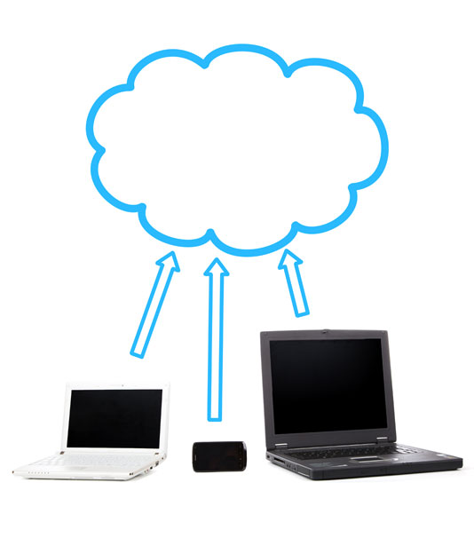
Make Commits
As part of your project you’ll modify existing files or create new ones.
To share these with the team, you must Commit them.
To commit individual files and/or folders
Select the Items to be Committed
Use the right click menu to access TortoiseSVN Commit function.
Provide a Meaningful Comment for the Log
To Commit an Entire Folder.
Click Anywhere Within the folder where your work is:
Use the right click menu to access TortoiseSVN Commit function.
Provide a Meaningful Comment for the Log
Repository
Commit
Changes
Team Member’s PCs
The Files Will Be Uploaded to the Subversion Repository For Sharing

Slide 11
Keep Updated
It Is Critical To Ensure That You Have The Latest Work From The Rest Of Your Team Before You Start Working!
Go To The Top Level Folder Of Your Working Copy
Use The Right Click Menu And Select SVN Update
Repeat At The Start Of Every Work Session!
Your Working Copy will Be Brought up to Date With All of the Team’s Latest Work

Slide 12
For More Information
Search Google for Subversion
  Videos
    https://www.youtube.com/watch?v=fPUdXvjY_G4 – Good demonstration. Skip the “set up” since that has already been done for all our repositories
  Manual
    http://svnbook.red-bean.com/ - Red-Bean, a very helpful manual on Subversion
    https://subversion.apache.org/docs/ - Apache is now the software maintainer / developer for the Subversion server. Note that it points to the Red-Bean book above!
  Downloads – you need a client, NOT the server side!
    https://tortoisesvn.net/downloads.html - Windows only

Slide 13
A Note About Git
Currently, Git is commonly used by Software developers. Previously, they primarily used Subversion.
For Capstone, we have found Subversion to be preferable.
  Most Capstone students have never used any version control tool before
  Subversion requires slightly fewer steps to upload a file to an existing remote repository
  Subversion eliminates the risk that users will forget to perform the final “push” step required by Git.
  Subversion is more efficient when handling binary files such as CAD models.
  It seems that those who learn to use Subversion are able to quickly transition to Git.
  Git offers a number of features not available in Subversion but which are not typically needed for our multidisciplinary Capstone program.
The course goal is to show and teach the importance of Version Control across all disciplines – not a specific tool.

