Slide 1
Welcome to
Capstone Design
Playbook for Class 1 to 9
Scaffolded Sessions

Slide 2
Revision History
Version | Date | Name | Reason for Changes
1.0 | 6.2.22 | Paster | Copy created from S22 Playbook Revision history cleared
1.1 | 6.2.22 | Paster | Ticket Out links updated
1.2 | 7.8.22 | Paster | Out of Class pages reformatted and sorted by category
1.3 | 7.11.22 | Paster | Out of Class task slides - Deleted old version, improved agreement between Wiki and Playbook
1.4 | 8.4.22 | Paster, Anderson | Welcome slide added, contact info posted to Wiki, reformatted Report schedule table p66
1.5 | 8.15.22 | Paster | Daily Agendas updated with activity topic categorization Day 1 & 2 reworked
1.6 | 8.16.22 | Kanai | Slide 8 10 min - Logistics: Deleted the Webex instructions Slide 9 COVID-19 Related Challenges - Modified to follow the latest RPI's guidelines. Slide 16 Participation Expectations - Added DIE statements; added documentation needs.
1.7 | 8.18.22 | Paster | Day 1 & 2 Content shifted to match new schedule Proofread and group agreement to flow
1.8 | 8.22.22 | Paster | Removed ALL mention of Webex spaces and Box Agenda slides updated IED question removed Team readiness question moved to Ticket Out #2
1.9 | 8.22.22 | DeBoer | Added Icebreaker and Team Standards Agreement content
1.10 | 8.24.22 | Paster | Fixed class 4 Ticket Out link
1.11 | 8.26.22 | DeBoer | Deleted first slide (List of Playbook to-do’s before start of classes)
1.12 | 8.27.22 | Kanai | Updated the CEs’ photos

Slide 3
Revision History - continued
Version | Date | Name | Reason for Changes
1.13 | 08/29/22 | DeBoer | Updated Class 1 Out of Class Tasks
1.14 | 8/30/22 | Paster | Updated choices for Day 1 Ice Breaker

Slide 4
Revision History - continued
Version | Date | Name | Reason for Changes

Slide 5
Link to Agendas
Class 1
Class 2
Class 3
Class 4
Class 5
Class 6
Class 7
Class 8
Class 9
#Pro Tip – Current Out of Class Tasks are listed ONE page before next class’s agenda

Slide 6

Multidisciplinary Capstone Design
ISYE 4270 Industrial Engineers
ECSE 4900 Electrical & Computer Systems Engineers
MANE 4260 Mechanical Engineers
MTLE 4920 Materials Engineers

Slide 7
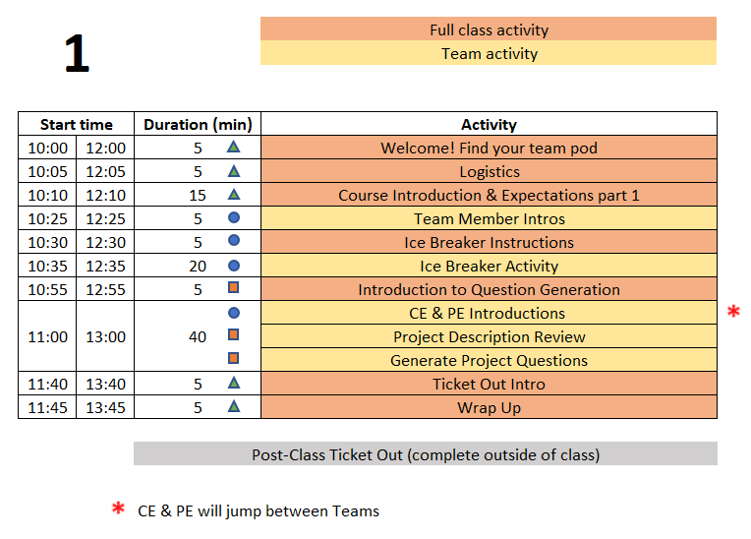
Class 1 Agenda
P
Project Technical Work
Team Development /
Design Process Refresher
Administrative Tasks
TD
A

Slide 8
5 min - Logistics
This PPT is available on Electronic Design Notebook (EDN) and will guide the first 9 classes
  Playbook - https://designlab.eng.rpi.edu/edn/projects/capstone-support-dev/wiki - Playbook.pptx
  You are STRONGLY ENCOURAGED to download newest version of Playbook prior to EACH class meeting.
Daily Class Agendas
  https://designlab.eng.rpi.edu/edn/projects/capstone-support-dev/wiki/Capstone_Class_Agendas

Slide 9
COVID-19 Related Challenges
We follow RPI’s COVID-19 guidelines.
  https://covid19.rpi.edu/
All course material is available online Electronic Design Notebook (EDN)
  https://designlab.eng.rpi.edu/edn/projects/capstone-support-dev/wiki

Slide 10
Course logistics
Bring laptop, charger, headphones/earbuds (for best Webex audio) to in-person classes
Teams may wish to use Webex to record their meetings for any members who are 'absent' or have connection issues.
  If you record, save to the cloud so your team can access the recording.
  ALWAYS encouraged to take meeting minutes and post to Electronic Design Notebook (EDN) for future reference

Slide 11
Class “location”
Capstone Classrooms are JEC 3232/3332
Capstone Shop (JEC 2332) will be open 9am-4pm for hands-on work only when classes resume in-person. (Glass area behind IED shop)
Conference Room (JEC 3321) for online meetings and a speaker phone. Ask you PE to reserve it.
Conference Table back of JEC3232 for a speaker phone. Ask you PE to reserve it.

Slide 12
RPI Design Lab
Our Mission is to Develop High Performing Engineers by Mentoring Students in Professional and Engineering Design Practices Through Project Based Learning.
NO textbook, NO lecture
It is a Team EXPERIENCE
It is a mostly “flipped” class experience
Guided/assisted by Project Engineer (PE)
Graded/assisted by Chief Engineer (CE)

Slide 13
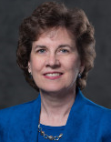
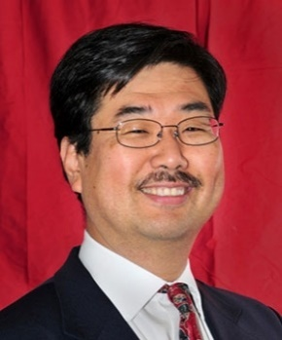
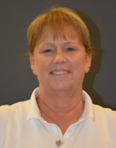

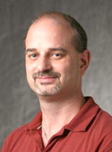
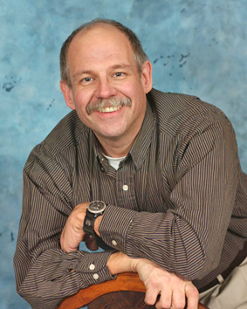
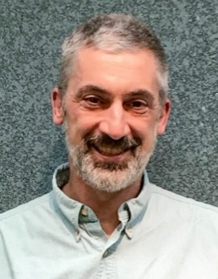
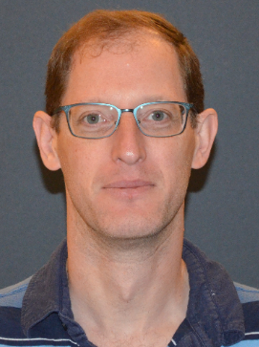
Design Lab Team
Associate Director
Admin Specialist
Manufacturing Manager
Shop Technician
Director
Kathryn Dannemann
Junichi Kanai
Valerie Masterson
Sam Chiappone
Scott Yerbury
Project Engineers
Mark Anderson
Brad DeBoer
Aren Paster

Slide 14
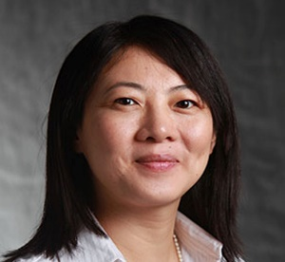
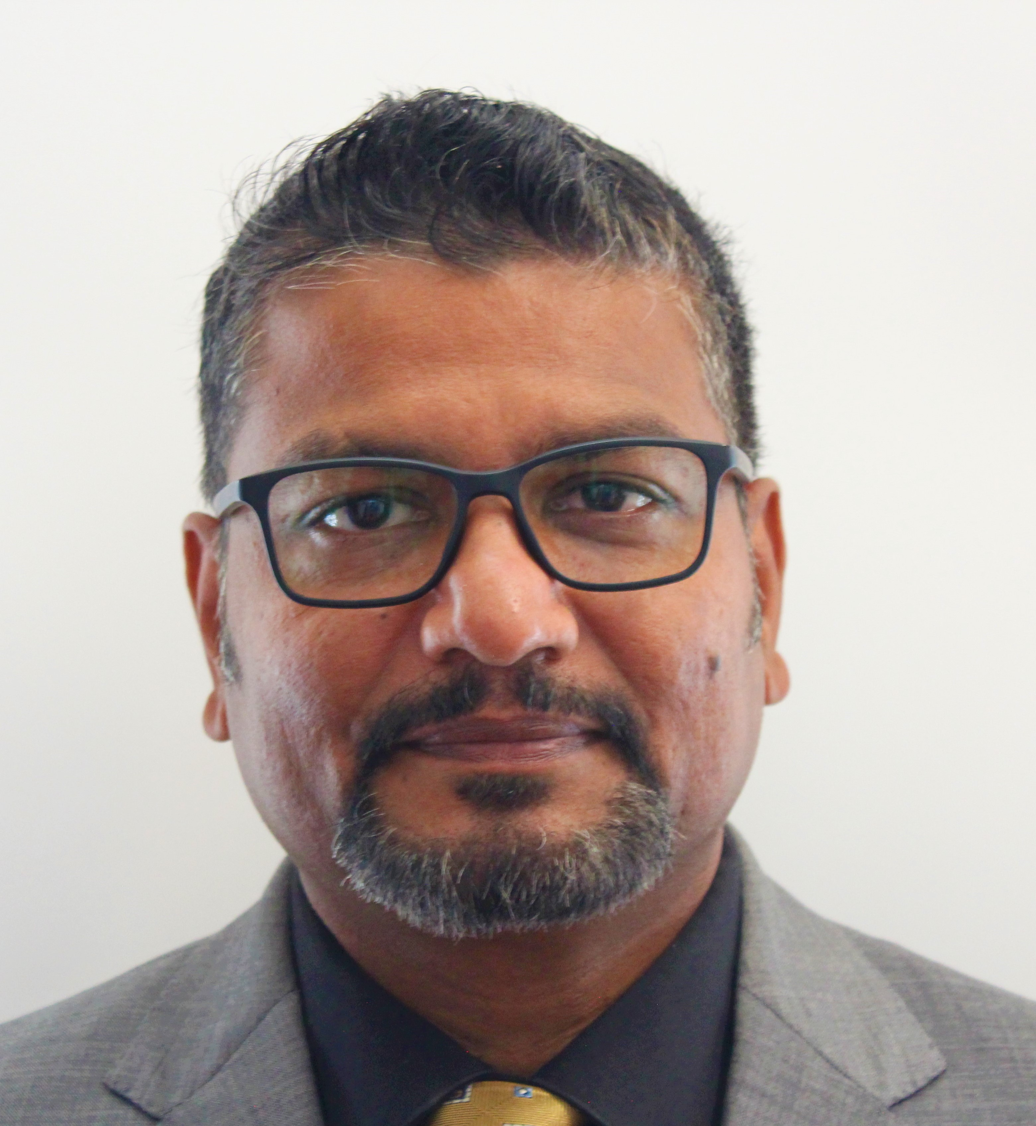
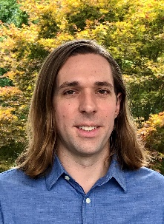
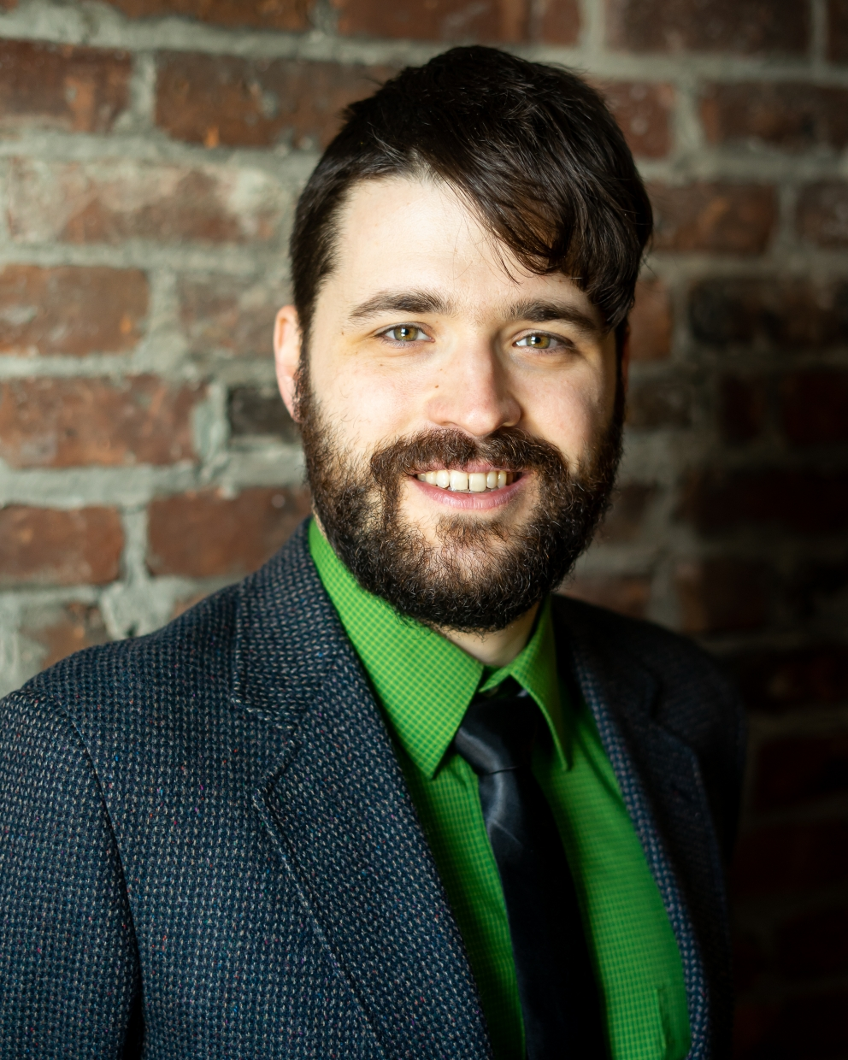
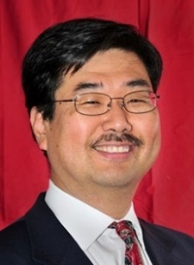
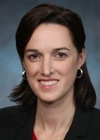
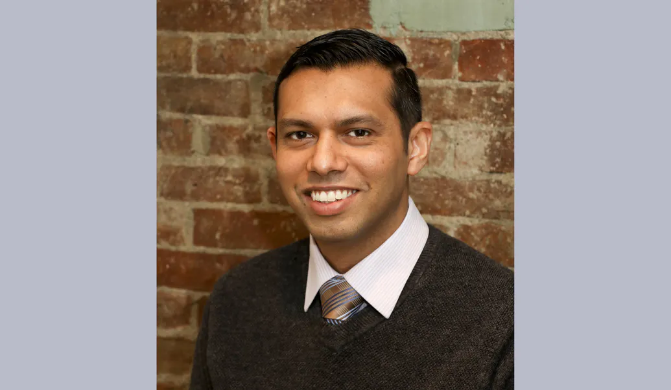
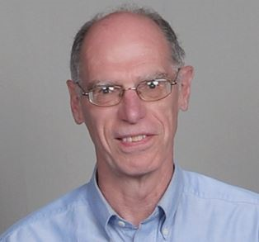
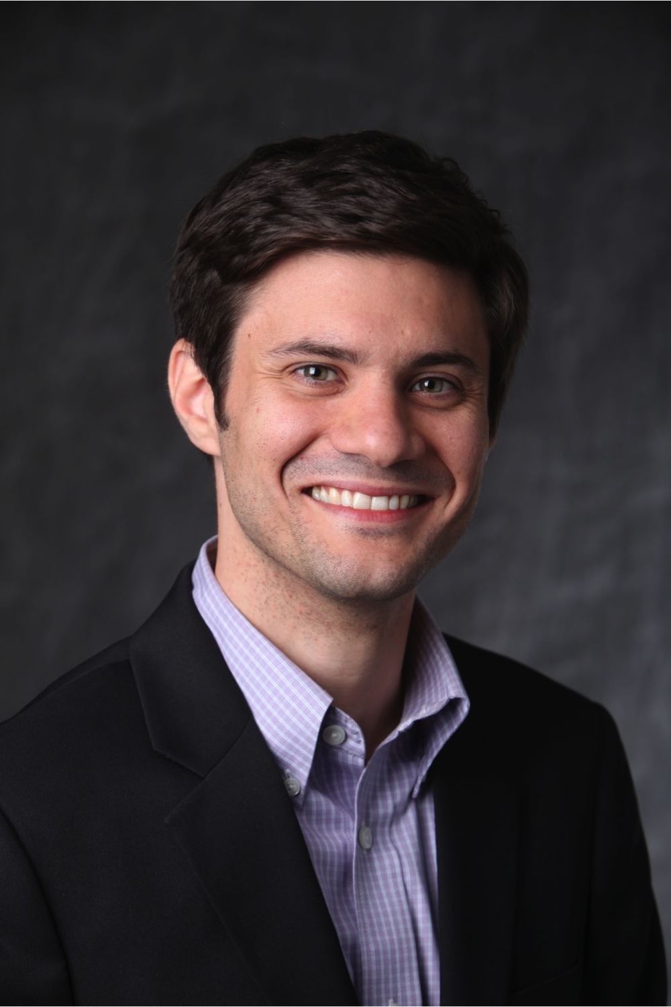

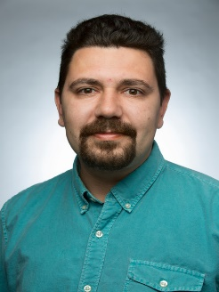
Faculty – Chief Engineers
ECSE
Rena Huang
Prabahakar Neti
Alex Patterson
Dylan Rees
Junichi Kanai
MANE
Sarah Felix
Indika Perera
Fred Willett
MSE
IME
Edmund Palermo
Chaitanya Ullal
Rostyslav (Rosty) Korolov

Slide 15
Participation Expectations
Work with students of diverse backgrounds, skills, and perspective
Create an inclusive and equitable team environment
Arrive to Class On Time / Stay until class ends
  We encourage use of cameras when on Webex
Be present in Class and Team Meetings
  Listen, Engage, Participate
  Not distracted on your Phone or other tasks
3 Credit Hour course mandates:
  4 Hours per week IN class
  5 Hours per week OUT of class
Document all of your work (Communication Intensive Course)
Read communication from Design Lab staff and teammates
  Emails
  Webex chat
  EDN posts
Respond in timely manner

Slide 16
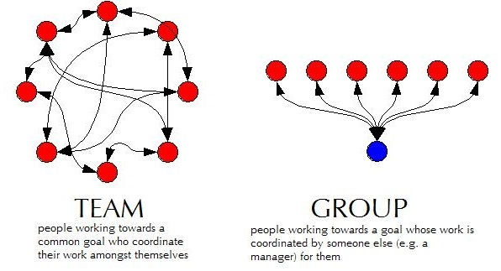
Capstone is TEAM work not GROUP work
Team Work
  collaborative effort
  peer review
  Student managed
Group Work
  divide and conquer
  low interaction with team
  Supervisor managed

Slide 17
Grading
Syllabus
  https://designlab.eng.rpi.edu/edn/projects/capstone-support-dev/repository/112/raw/Course%20Documents/Common%20Course%20Syllabus.pdf
Tasks and Due Dates
  https://designlab.eng.rpi.edu/edn/projects/capstone-support-dev/wiki/Tasks_and_Due_Dates
Pose any questions to kanaij@rpi.edu
  Answers will be posted to Electronic Design Notebook (EDN)
  https://designlab.eng.rpi.edu/edn/projects/capstone-support-dev/wiki/Syllabus_or_Grading_questions

Slide 18
Behavior Expectations
Q: “What expectations will your boss and peers have after graduation?”
Let’s start doing this NOW in Capstone Design
  Be Accountable.
    To your teammates, to Chief/Project Engineer, and to project sponsor.
  Be Professional.
  Make your work VISIBLE.
    Post/share as you go. No need to hide from team until its perfect or completely finished.
    Use Electronic Design Notebook (EDN)
Notes:
This slide is animated. Shows only the question – PE should ask students and get some responses

Slide 19
Communications Expectations
Written capstone communications are permitted ONLY on:
  The EDN
    Native EDN posts, MS Office files, CAD, etc.
  Webex
Use of any other cloud-based service, such as Google Drive/Docs/Sheets/Slides, GroupMe, Discord, Slack, Draw.io, etc. is FORBIDDEN
Although supported by campus, RPI Box and RPI Onedrive are also FORBIDDEN
Scheduling services such as WhenIsGood are acceptable for setting up meetings but must not contain any technical information

Slide 20
Accountability Step #1
You all received via email the Capstone Orientation Packet:
Director’s Introduction letter
Project Description - Will guide your work today
Instructions for electronic signatures in Adobe
Recognition Waiver and Release - SIGN & return by end of day
Sponsorship Agreement - SIGN & return by end of day
Now we’re done talking about it.
More information
  https://designlab.eng.rpi.edu/edn/projects/capstone-support-dev/wiki/Confidentiality_Requirements

Slide 21
5 min - Team Member Intro
Introduce your Name and Major
You will introduce other characteristics during the following Ice Breaker Activity

Slide 22
25 mins - Ice Breaker Activity
Desired Outcomes – Why are we doing this?
  Prepare students for collaborative team performance by helping create a relaxed environment where students share ideas and participate more fully in class
  Build rapport among students
Notes:
Introduce yourself and discuss desired outcomes – 1 minute

Slide 23
Ice Breaker – Community Agreements
Community Agreements help teams (communities) create a culture that is inclusive, respectful, and open
  Make Space to Take Space (Talking Stick)
  Stories Stay, Lessons Leave
  Embrace Ambiguity
  ___________ (Team generated, write on whiteboard)
  ___________ (Team generated, write on whiteboard)
Notes:
Example Community Agreements –
Be Curious, Open, and Respectful - call in not out/throw sunshine not shade
No one knows everything - together we know a lot
We can’t be articulate all the time - give the benefit of the doubt and ask questions
We take care of ourselves - stretch, eat, drink, use restroom, rest, etc.
Confidentiality - don’t speak for others without explicit permission, don’t share something communicated in a private or safe space.
One mic - one voice at a time
Take Space/Make Space - if you are usually quiet challenge yourself to take more space, and if you usually talk a lot be mindful to leave room for quieter voices
Avoid Jargon, Acronyms, and Industry language - use inclusive language that is accessible for people with varying inside knowledge
Be aware of time - enough let’s move on (ELMO) means if what you wanted to say has already been said, don’t say it
Speak from your own experience - Use I statements rather than generalizations
Challenge assumptions
Be conscious of intent vs. impact - no matter intention you’re responsible for your impact
Avoid using isms

Slide 24



Ice Breaker – Activity and Report Out
Notes:
Wave activity – three waves, two minutes each plus report out. Divide according to:
Pets – Dogs / Cats / Other (none, birds, reptiles)
Exercise preference – Cardio / Strength / Couch Potato
Favorite vacation (past or future) – Beach / City / Mountains
Share out question – after each wave, ask team to explain how team was sorted, and share something funny, interesting, or new that was revealed

Slide 25
40 min
Chief Engineer (CE) & Project Engineer (PE) Introductions
  Both individuals will stop by to meet with the team
Project Description Review
  If you have not read the document yet, NOW is your chance
Generate Project Questions

Slide 26
10 min - Meet with Project Engineer
  Project Engineer meets with each team:
    Check on team status / welfare
    Student introductions
    Discuss project background and goals
    When not meeting with your PE or CE, team members generate/discuss questions.

Slide 27
15 min - Meet with Chief Engineer
  Chief Engineer meets with each team:
    Check on team status / welfare
    Student introductions
    Discuss project impressions
    CE’s background/experience
    When not meeting with your PE or CE, team members generate/discuss questions.

Slide 28
15 min - Generate Project Questions
These questions can be about any aspect of the project, but by the end of the class MUST include questions targeted to:
  Customer Needs
  Project Specifications / Technical Requirements
Note - Needs and Requirements were taught in IED
Refer to the Project Description as needed
Write individual questions on separate Post It notes - ONE question per Post It.
Combine duplicate/similar ideas
Discuss, collaborate, and add to the list of questions
Take photo of board BEFORE end of class to preserve the list for Class 2 activity
  Post to Webex project space

Slide 29
5 min – Ticket Out
Design Lab wants your 'immediate' feedback on the course and your experience.
These 'surveys' after many classes will help us help you.
Collected anonymously using Google Forms.
  If you ever want an individual response from PE/CE/Director, be sure to INCLUDE your name.
Please Complete Ticket Out Today or Tomorrow
You can also always use email or Webex to reach out to PE/CE with any questions.

Slide 30
Out of Class Tasks
(what you might call homework, to be completed BEFORE Class 2)
Project Technical Work
Re-read the Project Description with Class 1 Question Generation exercise in mind
Post list of questions to team’s Webex General space
P
Team Development / Design Process Refresher
Hold Team Meeting for Introductions
    Major, hometown
    Interests, clubs/sports, experience related to project topic
    Co-op, internship, summer job
    Pet, favorite ice cream flavor
T/D
Administrative Tasks
Complete Class 1 Ticket Out - https://forms.gle/VAiL3GTZs3R9QoQv7
Register for EDN – https://designlab.eng.rpi.edu/edn/
  Registration button in upper right hand corner
  Login must be your RCSID (RPI email before the @ symbol)
  Email must be your RPI email
  Bookmark this site. You will use it A LOT for this course.
Watch Capstone Introduction & Expectations – Part 2 video (7 Min)
  https://designlab.eng.rpi.edu/edn/projects/capstone-support-dev/repository/112/raw/training/Capstone%20Introduction%20and%20Expectations%20Part%202.mp4
A

Slide 31
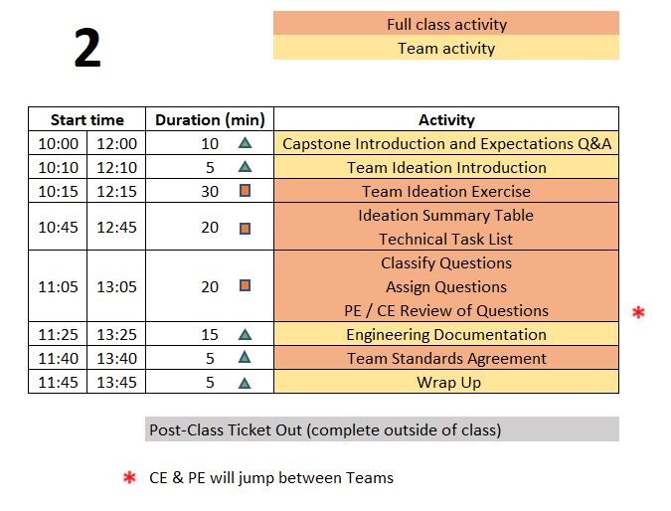
Class 2 Agenda
P
Project Technical Work
Team Development /
Design Process Refresher
Administrative Tasks
TD
A
  You are STRONGLY ENCOURAGED to download newest version of Playbook prior to EACH class meeting.
Repository instructions - https://designlab.eng.rpi.edu/edn/projects/capstone-support-dev/wiki/Subversion
Playbook - https://designlab.eng.rpi.edu/edn/projects/capstone-support-dev/wiki - Playbook.pptx

Slide 32
10 min - Capstone Expectations Q&A
Out of Class Task was to watch 1 video (Capstone Introduction & Expectations – Part 2)
QUESTIONS about content?
What is difference between IED and Capstone?
Who ‘owns’ your project – student team, PE, CE, sponsor?
What is role of students in Capstone?
What is role of PE?
What is role of CE?
Notes:
Day 2

Slide 33
Capstone Activity Categories
Project Technical Work
  Contribute directly to project progress and deliverables
  ALL project documentation & planning – notes, reports, analysis, Gantt chart
  Background research, design, prototyping, testing
P
Team Development / Design Process Refresher
  Forming, Storming, Norming, Performing
  Sequence of design artifacts – Needs & Requirements, Concepts, Decision Matrix
T/D
Administrative Tasks
  Onboarding - Legal paperwork, Safety training
  Course / Academic logistics
  Tickets Out & Feedback
A

Slide 34
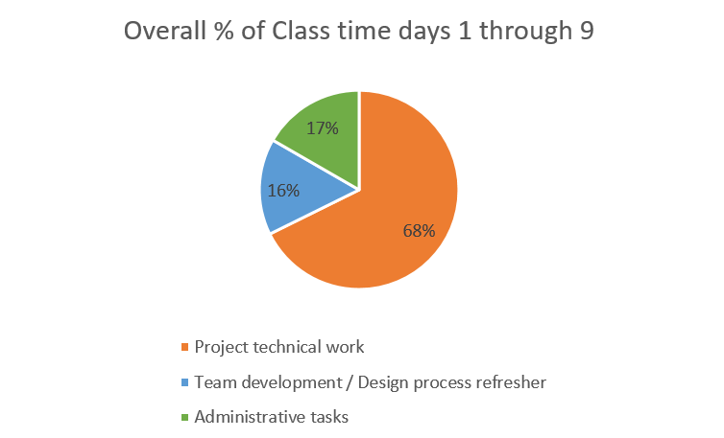

Slide 35
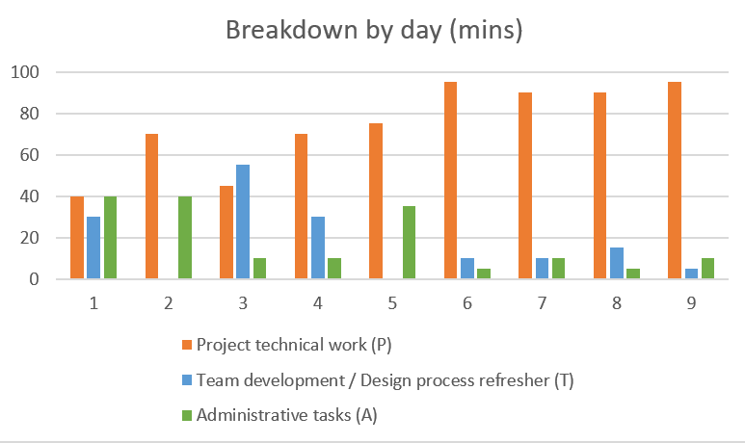

Slide 36
30 min - Team Ideation Exercise
Goal: This exercise accelerates the Forming stage of the team development process by establishing common understanding of the project and the team members’ background and skills
Time boxed exercise. It will feel rushed, things won't feel complete. THAT'S OK.
You'll want more time. You can't have it. Team must move on.
For EACH section of poster:
2 min
  Individual silent thought on content
  Write thoughts on Post It Notes
2 min
  Place Post Its onto poster sheet
  Quick discussion of similar, unique, or new answers
Move on to next section of Ideation Poster as a team

Slide 37
20 min - Team Ideation Summary
What unique skills does each person bring to the team?
What skills do members share in common?
What specific team or organizational strength will each person contribute?
What team or organizational weakness or areas for growth does each person have?
How can team make best use of each individual’s skills and talents?
Does every team member have a TECHNICAL action item to complete by next class?
  Note: This is something that should happen by end of EVERY class.

Slide 38
20 min - Classify and Assign Questions
  Classify all questions generated into one of three categories
    Things team members can research/answer themselves
    Things PE will answer
    Things to ask sponsor during kick-off meeting
  Team assigns owner to all questions in category A
  Add question classifications and ownership to Word document
  Chief Engineer & Project Engineer review of questions & classification
  Post document to EDN Forum by end of class – Project Mgmt thread

Slide 39
15 min – Engineering Documentation
Topics
  What is Documentation?
  Why bother?
  How is it done in Capstone?
PE note:
  Let group answer 1st two questions
  Then run through next few slide to see if anything was not suggested
  Then discuss 3rd question

Slide 40
What is Documentation?
Engineering Documentation?
Living record of your work
  Evolution of your product/design is traceable
  Your work (experiment) is reproducible
  Your work can be understood by others and why you did it that way

Slide 41
Why Document?
Extension of your memory
  Who, What, When, Where, Why, How
  So that others can collaborate and continue the work
  Facilitates teamwork
  So that others can review/understand your work
Legal ramifications
  Contractual/legal defense
  Patent application
Efficiently and Effectively move the project forwards

Slide 42
Capstone Course Policies - Tools
Electronic Design Notebook - REQUIRED for all collaboration
Webex – Team Chat
When Is Good – meeting scheduling
Not Permitted
  Slack, GroupMe or Discord for chatting
  Google Drive for file storage
  Google Docs/Sheets/Slides for document creation
  Other cloud-based tools for any use (schematics, mind maps, drawings, analysis, etc…) e.g., diagrams.net, etc.
  RPI Box and RPI Onedrive
Webex Teams is good for chat and live meetings, but project documentation MUST be transferred to Electronic Design Notebook (EDN) Forum or Repository.
  Simple/easy solution is to never put it on Webex to begin with.

Slide 43
What Tool Will You Use?
Electronic Design Notebook (EDN)
  Integrated Project Management
  Threaded Communication by topic, rather than a single unorganized stream
  IP protection
  Grading - accountability and visibility
  Secure access to team and sponsor
  Backed up daily !
  The EDN software may not be the PERFECT choice, but nothing is.
  It meets the Design Lab's needs better than the alternatives*.
  * https://designlab.eng.rpi.edu/edn/projects/capstone-support-dev/wiki/Why_Electronic_Design_Notebook_is_the_ONLY_choice

Slide 44
What Should I Document?
Everything
  Research, web links, notes
  Interviews and observations
  Ideas, concepts, sketches, charts, diagrams
  Calculations
  Purchases - components models, vendors, cost
  Analyses – technical and non-technical
  Experiments, debugging, tests
  Hypothesis, procedures, equipment used, steps taken, data, results
  Future work/ideas

Slide 45
Documentation Wrap up
Information should be complete before documented?
  True or False
It is necessary to document negative results?
  True or False
Teammates share responsibility with PE/CE to offer technical feedback on EDN posts?
  True or False

Slide 46
5 min - Team Standards Agreement Intro
According to concepts in organizational behavior, there are five stages of team development (Tuckman’s Model, 1964): forming, storming, norming, performing and adjourning
In high performing teams a Team Standards Agreement is often generated to establish procedures and roles in order to move the team more quickly into the performing stage
A Team Standards Agreement will be generated outside of class time by each team in five steps over the next five weeks
  The Team Standards Agreement shall be posted to your team’s EDN Wiki page in accordance with the instructions in the following document: https://designlab.eng.rpi.edu/edn/projects/capstone-support-dev/repository/112/raw/Course%20Documents/Team%20Standards%20Agreement.docx

Slide 47
Capstone Activity categories
Project Technical Work
  Contribute directly to project progress and deliverables
  ALL project documentation & planning – notes, reports, analysis, Gantt chart
  Background research, design, prototyping, testing
P
Team Development / Design Process Refresher
  Forming, Storming, Norming, Performing
  Sequence of design artifacts – Needs & Reqs, Concepts, Decision Matrix
T/D
Administrative Tasks
  Onboarding - Legal paperwork, Safety training
  Course / Academic logistics
  Tickets Out & Feedback
A

Slide 48
Out of Class Tasks
(what you might call homework, to be completed BEFORE Class 3)
Project Technical Work
Find answer(s) to assigned question(s) & post to new thread titled “Class 2 Questions and Answers” in EDN Background Info Forum
Identify one Customer Need for your project and translate it into an Engineering Requirement. Post to new thread in EDN Design Forum titled “Initial Needs and Requirements”
For ongoing projects, review prior semesters’ final presentations in accordance with PE instructions for class discussion in Class 3 or 4
  PPT should be in last semester's Final Deliverables Forum on EDN
  First student - create new thread in EDN Background Info titled "Questions about project"
  Rest of team - respond to thread with questions you have about project
P
Team Development / Design Process Refresher
Read The Engineering Design Process Refresher.pptx in preparation for class 3 discussion
  https://designlab.eng.rpi.edu/edn/projects/capstone-support-dev/repository/112/raw/training/The%20Engineering%20Design%20Process%20Refresher.pptx
Watch Customer Needs video (9 min)
  https://mediasite.mms.rpi.edu/Mediasite5/Channel/anderm8winrpiedu-engr-2050/watch/87d950eccc2942038b1d06530e9217841d
Watch Engineering Requirements video (11 min)
  https://mediasite.mms.rpi.edu/Mediasite5/Channel/anderm8winrpiedu-engr-2050/watch/96dceab44ae7447d812f5a216afa97cf1d
Team Standards Agreement part 1 due by class 4
T/D
Administrative Tasks
Complete Class 2 Ticket Out - https://forms.gle/YweXodSa96dVjdQZ8
Watch EDN Guidance for Out of Class Tasks - Initial Postings Video (7.5 min)
  https://designlab.eng.rpi.edu/edn/projects/capstone-support-dev/repository/112/raw/training/EDN%20Guidance%20for%20Out%20of%20Class%20Tasks%20-%20Initial%20Postings.mp4
Post personal contact info (name, major, RPI email, phone #) to the Wiki. First member creates the page, other members simply edits the page to add their info.
A

Slide 49
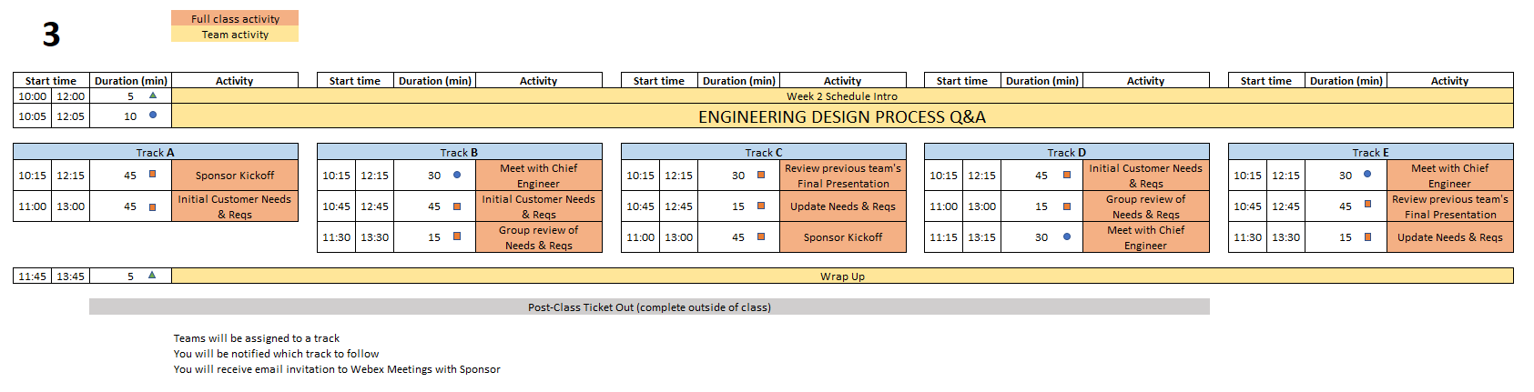
Class 3 Agenda
Over the course of Days 3 & 4 - All teams will complete the following:
Sponsor Kickoff Meeting
CE meeting with team
Customer Needs & Requirements - development and review
Review previous Final Presentation - ongoing projects only
  You are STRONGLY ENCOURAGED to download newest version of Playbook prior to EACH class meeting.
Repository instructions - https://designlab.eng.rpi.edu/edn/projects/capstone-support-dev/wiki/Subversion
Playbook - https://designlab.eng.rpi.edu/edn/projects/capstone-support-dev/wiki - Playbook.pptx
Notes:
PE Notes
Continuing projects should follow Track C or E
New projects can follow A, B, or D
Track A or C on Day 3 should follow track A or C on Day 4
Track B, D, or E on Day 3 should follow track B or D on Day 4

Slide 50
10 min - Engineering Design Process Q&A
Out of Class Task was to watch 3 videos…
QUESTIONS about content?
What are the steps in Engineering Design Process?
What is a Customer Need?
What is an Engineering Requirement?
What is the difference between a Need and a Requirement?
What is a User Story?
What is an Acceptance Criteria?
What is the difference between a User Story and an Acceptance Criteria?
Notes:
Day 3

Slide 51
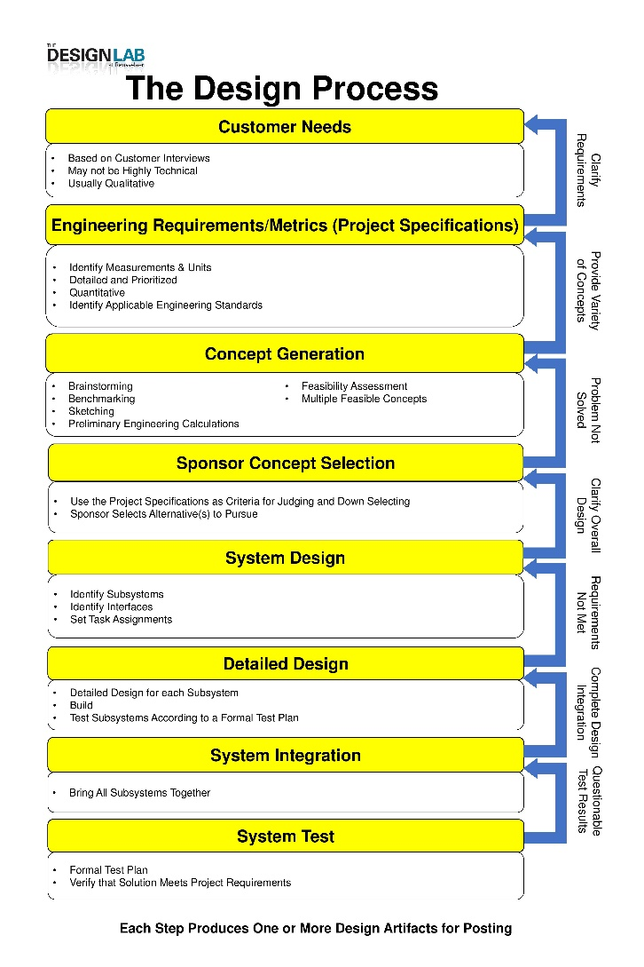
Engineering Design Process
Today is Day Three of class
Let’s look at steps ONE & TWO
Team will create/review/improve project’s list of:
Customer Needs
Engineering Requirements
This Design Process and terminology is taught in IED at RPI

Slide 52

30 min – Meet with CE
(Class 3 or 4)
Chief Engineer led discussion of:
  Course grading
  Student expectations
  CE background and experience
  Project impressions
  Team Standards Agreement

Slide 53
45 min - Customer Needs & Engineering Requirements Generation
Needs and Requirements workbook.xlsx spreadsheet is located at:
  [new project] Capstone Support Template Documents page https://designlab.eng.rpi.edu/edn/projects/capstone-support-dev/repository/112/entry/template%20documents/Needs%20and%20Requirements%20workbook.xlsx
  [continuing project] Team’s Repository
Fill out based on team’s current (uninformed impression) of project
  This is first pass. Don’t worry that answers are not complete or verified by sponsor.

Slide 54
15 min – Group Review of
Needs & Requirements
Read notes in template document for tips
Remove/combine duplicates
Unsure of a proper metric?
  Quick Google search to put in an educated guess
  Use ‘Confidence’ column to mark low and plan to research/update after class
Fill in holes/gaps after looking at categories
  https://designlab.eng.rpi.edu/edn/projects/capstone-support-dev/wiki/Requirements_Management
  Safety, Reliability, Maintainability, etc…

Slide 55
45 min - Sponsor Kick-Off Meeting
Meeting Agenda
  Team introductions to sponsor (name, major, relevant experience/skills)
  Sponsor introduction to team
  Sponsor describes project "in their words“
    History, ultimate and semester goals, deliverables, etc…
  Open Q&A

Slide 56
30/45 min - Prior Presentation
(if applicable)
Team should review (outside of class) the final PPT presentation given by previous semester team
  Forums->Final Deliverables
  Repository->Reports->Final Reports
PE/CE will quickly walk-through slide deck and discuss:
  Goals
  Accomplishments / Successes
  Challenges
  Next steps
PE/CE will help to clear up confusion and answer any questions current team may have

Slide 57
Out of Class Tasks
(what you might call homework, to be completed BEFORE Class 4)
P
Project Technical Work
Update Needs/Reqs Workbook based on feedback and post to EDN Design Forum.
Team Development / Design Process Refresher
Team Standards Agreement part 1
T/D
Administrative Tasks
Complete Class 3 Ticket Out - https://forms.gle/wvAGzscgNjTHmAxZ7
Choose sponsor liaison
  This person will be the focal point for emails to/from your sponsor. They are not the team's "spokesperson" at meetings, conference calls, in class, etc.
Watch Intro to EDN video (5 min) in preparation of Class 4 review
  https://designlab.eng.rpi.edu/edn/projects/capstone-support-dev/repository/112/raw/training/Intro%20to%20the%20EDN.mp4
Read Project Documentation Wiki page in preparation of Class 4 review
  https://designlab.eng.rpi.edu/edn/projects/capstone-support-dev/wiki/Project_Documentation
Read Meeting Minutes Wiki Page
  https://designlab.eng.rpi.edu/edn/projects/capstone-support-dev/wiki/Meeting_Minutes
  Post notes taken during PPT review to Project Management Forum
Follow Subversion instructions to download and install client, then checkout a copy of your project’s repository. Visit your PE’s office hours for assistance.
  https://designlab.eng.rpi.edu/edn/projects/capstone-support-dev/wiki/Subversion_Clients#section-2
Complete the Online Safety Training in Percipio by end of 3rd week
  https://www.percipio.com
  Rensselaer Manufacturing and Prototyping Laboratories-Safety Orientation
  Instructions https://designlab.eng.rpi.edu/edn/attachments/download/114354/RMPL%20Safety%20Module%20Completion%20Instructions-Percipio%20.pdf
A

Slide 58
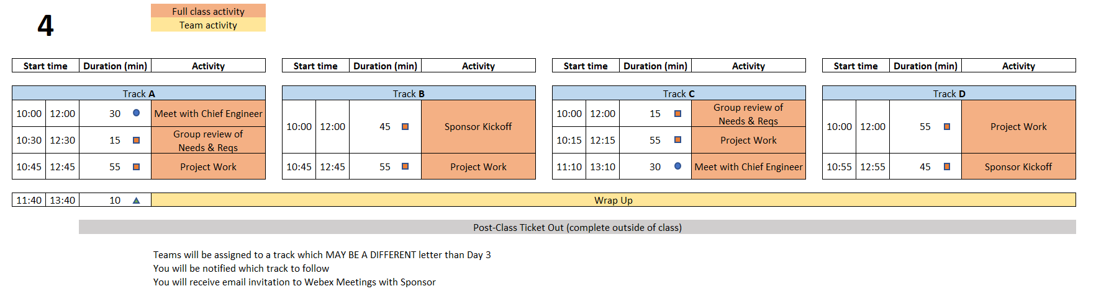
Class 4 Agenda
  You are STRONGLY ENCOURAGED to download newest version of Playbook prior to EACH class meeting.
Repository instructions - https://designlab.eng.rpi.edu/edn/projects/capstone-support-dev/wiki/Subversion
Playbook - https://designlab.eng.rpi.edu/edn/projects/capstone-support-dev/wiki - Playbook.pptx
Notes:
PE Notes
Track A or C on Day 3 should follow track A or C on Day 4
Track B, D, or E on Day 3 should follow track B or D on Day 4

Slide 59
Engineering Design Process
Today is Day Four of class
Team should be working towards student agreement, and PE/CE/sponsor review/approval of steps ONE & TWO
Customer Needs
Engineering Requirements
This Design Process and terminology is taught in IED at RPI
Notes:
Day 4

Slide 60
15 min – Group Review of
Needs & Requirements
Read notes in template document for tips
Remove/combine duplicates
Unsure of a proper metric?
  Quick Google search to put in an educated guess
  Use ‘Confidence’ column to mark low and plan to research/update after class
Fill in holes/gaps after looking at categories
  https://designlab.eng.rpi.edu/edn/projects/capstone-support-dev/wiki/Requirements_Management
  Safety, Reliability, Maintainability, etc…

Slide 61
45 min - Sponsor Kick-Off Meeting
Meeting Agenda
  Team introductions to sponsor (name, major, relevant experience/skills)
  Sponsor introduction to team
  Sponsor describes project "in their words“
    History, ultimate and semester goals, deliverables, etc…
  Open Q&A

Slide 62
55 min - Project Work
Refine Needs and Requirements Spreadsheet
  Needs
    Ensure all known Customer Needs are documented
  Requirements:
    Associate with appropriate Customer Need(s)
    Identify Measurements and Units (quantitative)
    Ensure that Requirements are detailed and prioritized
    Identify Applicable Engineering Standards
Refine/Develop Follow-Up Questions for Sponsor
  If Team has already had Sponsor Meeting, what new questions have been identified as a result?
    Clearly document and email to Sponsor, copy your PE
Background Research/Benchmarking
  Discuss/document work done to date
  Identify/document additional benchmarking needs

Slide 63
30 min – Meet with CE
(Class 3 or 4)
Chief Engineer led discussion of:
  Course grading
  Student expectations
  CE background and experience
  Project impressions
  Team Standards Agreement

Slide 64
Out of Class Tasks
(to be completed BEFORE Class 5)
Project Technical Work
Update Needs/Reqs Workbook - post to Engineering Analysis folder in the repository
P
Team Development / Design Process Refresher
Watch Statement of Work video (10 min) in preparation for creating draft in class 5
  https://designlab.eng.rpi.edu/edn/projects/capstone-support-dev/repository/112/raw/training/Statement%20of%20Work.mp4
Team Standards Agreement part 2 due by class 6
T/D
Administrative Tasks
Complete Class 4 Ticket Out - https://forms.gle/zwE4Le9jfExECtE98
Read Project Documentation Wiki page in preparation for class review
  https://designlab.eng.rpi.edu/edn/projects/capstone-support-dev/wiki/Project_Documentation
Complete the Online Safety Training in Percipio by end of 3rd week
  https://www.percipio.com
  Rensselaer Manufacturing and Prototyping Laboratories-Safety Orientation
A

Slide 65
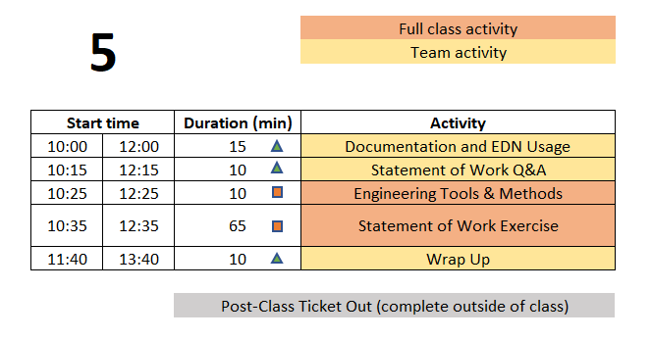
Class 5 Agenda
  You are STRONGLY ENCOURAGED to download newest version of Playbook prior to EACH class meeting.
Repository instructions - https://designlab.eng.rpi.edu/edn/projects/capstone-support-dev/wiki/Subversion
Playbook - https://designlab.eng.rpi.edu/edn/projects/capstone-support-dev/wiki - Playbook.pptx

Slide 66
Engineering Design Process
Today is Day Five of class
Team will develop Statement of Work (SoW).
This puts into clear words & pictures what the FINAL output will look like, and the tools required to get there.
This Design Process and terminology is taught in IED at RPI
Notes:
Day 5

Slide 67
15 min – Documentation & EDN Usage Q&A
You should have already watched EDN video and read Documentation Wiki page
  Intro to EDN video (5 min)
    https://designlab.eng.rpi.edu/edn/projects/capstone-support-dev/repository/112/raw/training/Intro%20to%20the%20EDN.mp4
  Project Documentation page
    https://designlab.eng.rpi.edu/edn/projects/capstone-support-dev/wiki/Project_Documentation
QUESTIONS about content?
Why do we document?
What do we document?
How will you document?
How often / when will you document?
Must we wait for things to be complete / final to document?
Where does it go?
Notes:
Day 5

Slide 68
Phases of the Design Report
Phase 1
Statement of Work
Phase 2
Preliminary Design Report
Phase 3
Final Report
Week 4
Midterm
End of Semester
In ALL cases, the file name and location remains the same:
“working/Reports/Design Report and Poster/Design Report.docx”

Slide 69
Design Report.docx - Table of Contents
Revision Fall 2021
Green – Create
Yellow – Update
File name
DOES NOT change

Slide 70
Design Report Section Progress
Create (green)
  first pass at generating this content
Required Update (yellow)
  revise and update based on work done to date
  incorporate feedback from PE/CE/sponsor
Optional Update
  any existing material can be revised with new information
  incorporate feedback
At all stages, the file name and location in Repository remains the same:
“working/Reports/Design Report and Poster/Design Report.docx”

Slide 71
10 min - Statement of Work Q&A
Out of Class Task was to watch 1 video…
QUESTIONS about content?
What is a Statement of Work?
What is difference between the Project Objectives and Semester Objectives?
What are Engineering Tools and Methods?
What is difference between a task and a deliverable?
Where is the SoW document template located?

Slide 72
10 min - Engineering Tools and Methods
  What techniques, software, calculations will be used to address the problems in front of team? Ex:
  Mechanical aspects – Free Body diagram, torque measurement
  Software – flow chart of system control loop, storyboard of user input
  Process – conduct customer interviews of toddler caregivers, create Standard Operating Procedure for system startup and calibration

Slide 73
65 min - Statement of Work Exercise
Design Report Template – SoW is phase 1 of this document
https://designlab.eng.rpi.edu/edn/projects/capstone-support-dev/wiki/Templates_and_Forms - Design Report.docx
10 min – Break into 3 groups
  A - Long Term Objectives (1-5+ years, from Customer Perspective)
  B - Current Semester Objectives (3 months!)
  C - Deliverables (Be S.M.A.R.T.!)
10 min - Team review – Long Term and Current Semester Objectives
15 min - Team review – Deliverables
20 min
  PE/CE review of Deliverables
  Team development of Dates for Deliverables and Engineering Tools and Methods
Create threads in Statement of Work Forum for notes on each section

Slide 74
Webex/Meeting Tips
Be productive for meetings
  Have a written agenda, posted into the EDN Project Management folder
  Keep meeting minutes for ALL team Webex sessions and post to the Project Management forum on EDN
Webex chat will not be archived, so it's important to document results & discussion in the Forums and the Repository as appropriate
Although Webex can be great for socialization, we would like to encourage productive meetings to reduce Webex burnout

Slide 75
Out of Class Tasks
(to be completed BEFORE Class 6)
Project Technical Work
Wordsmith and polish Statement of Work
Upload Statement of Work (Phase 1 of Design Report.docx) to Repository prior to class 6
  Location - working/Reports/Design Report + Poster
Upload Needs & Requirements spreadsheet to Repository
  Location - working/Engineering Analysis
P
T/D
Team Development / Design Process Refresher
Watch Concept Generation video (9 min) in preparation for Concept Generation class exercise
  https://mediasite.mms.rpi.edu/Mediasite5/Channel/anderm8winrpiedu-engr-2050/watch/d78db44fd9f7424b9d8f4c72857f84371d
Team Standards Agreement part 2
Administrative Tasks
Complete Class 5 Ticket Out - https://forms.gle/15vkmdmQLpqfMnhw5
Attend SVN Training or watch video
  https://designlab.eng.rpi.edu/edn/projects/capstone-support-dev/repository/112/raw/training/Getting%20Started%20with%20Subversion-For%20Windows%20Users.mp4
Complete the Online Safety Training in Percipio by end of 3rd week
  https://www.percipio.com
  Rensselaer Manufacturing and Prototyping Laboratories-Safety Orientation
A

Slide 76
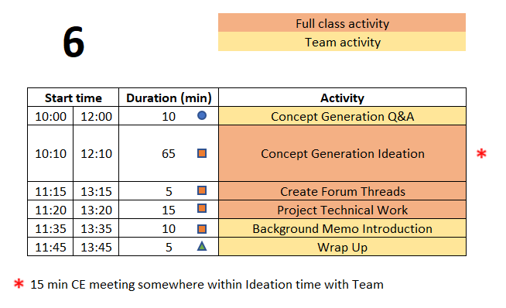
Class 6 Agenda
  You are STRONGLY ENCOURAGED to download newest version of Playbook prior to EACH class meeting.
Repository instructions - https://designlab.eng.rpi.edu/edn/projects/capstone-support-dev/wiki/Subversion
Playbook - https://designlab.eng.rpi.edu/edn/projects/capstone-support-dev/wiki - Playbook.pptx

Slide 77
Engineering Design Process
Today is Day Six of class
Team will generate AND document concepts to address and meet the Needs & Requirements of the project.
This Design Process and terminology is taught in IED at RPI
Notes:
Day 6

Slide 78
10 min - Concept Generation Q&A
Out of Class Task was to watch 1 video…
QUESTIONS about content?
Where do concept ideas come from?
  Example of Internal Search?
  Example of External Search?
Notes:
Day 6

Slide 79
15 min – CE Time
Meeting will be at team table
This will take place at some point during Concept Generation exercise depending on CE’s schedule

Slide 80
65 Min - Concept Generation
Similar inclusive plan as previous exercises
5 min – Individually silently generate any concept to solve/address project needs/reqs
  write separately on Post It Notes
15 min – Place concepts on whiteboard
  Organize list by topic
  Eliminate duplicates
  Add extra ideas you think of right now or are inspired by others ideas
30 min – Group discussion
  Explain further to improve group understanding – if necessary
  Look for missing/unaddressed needs –think of concepts to address them
  Look for lone concepts – think of alternative ideas
Note: 15 min - CE will jump in to talk for 15 mins of this time block

Slide 81
5 min – Create Forum Threads
Concept topics ARE the key discussions and work areas for the team
Create Design Forum threads for each topic
  Use these thread to post explanation, sketches, calculations, etc…
  Reply to team mates posts to move idea forwards and advance project

Slide 82
15 min – Project Work
Work on project
Someone should take notes of meeting discussion
    NOT as Word document, simply as plain text in Forum post.
  Minute instructions and template https://designlab.eng.rpi.edu/edn/projects/capstone-support-dev/wiki/Meeting_Minutes
Post AT END of class to Forums –> Project Mgmt
  Others can reply to post with any corrections or additional information

Slide 83
10 min - Background Memo
What is current state of the art? How is problem currently solved?
What will team members NEED to know to move forwards?
What has already been accomplished by prior team?
Team creates topic list
  Literature search
  User interviews
  Identifying / installing / practicing software or techniques which will be required for the project
  Install existing project software
  Verify work done by past Capstone team
  Conduct testing or system operation described by prior team
PE/CE approve list
Capstone Support Wiki has instructions, template, and rubric
https://designlab.eng.rpi.edu/edn/projects/capstone-support-dev/wiki/Background_Memo

Slide 84
Out of Class Tasks
(to be completed BEFORE Class 7)
Project Technical Work
Continue technical work
  Post progress to Design Forum threads
Brainstorm 6 individual tasks which need to be accomplished to reach project goals
  (first person to post) Create a SINGLE thread in the Project Mgt. Forum called “Tasks”
  (everyone else) Reply to post with your 6 task ideas
Team brainstorms Background Memo topic list
  https://designlab.eng.rpi.edu/edn/projects/capstone-support-dev/wiki/Background_Memo
  Post to Background Info forum – “Memo topics”
P
T/D
Team Development / Design Process Refresher
Watch videos in preparation for Project Planning activity
  Intro to Project Mgmt (7 min)
    https://www.youtube.com/watch?v=QwuwzBBThPY
  Deliverables & Activities (3 min)
    https://www.youtube.com/watch?v=L6WYJh1Ygoc
  Team Standards Agreement part 3 due by class 8
Administrative Tasks
Complete the Online Safety Training in Percipio by end of 3rd week TODAY!
  https://www.percipio.com
  Rensselaer Manufacturing and Prototyping Laboratories-Safety Orientation
A

Slide 85
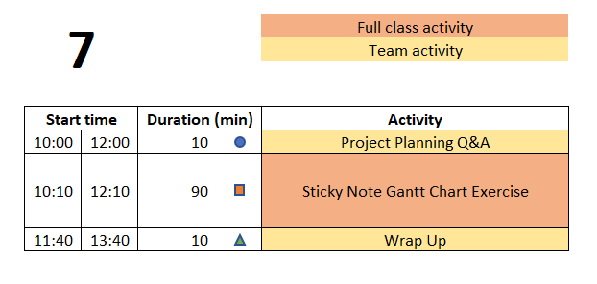
Class 7 Agenda
  You are STRONGLY ENCOURAGED to download newest version of Playbook prior to EACH class meeting.
Repository instructions - https://designlab.eng.rpi.edu/edn/projects/capstone-support-dev/wiki/Subversion
Playbook - https://designlab.eng.rpi.edu/edn/projects/capstone-support-dev/wiki - Playbook.pptx

Slide 86
Engineering Design Process
This Design Process and terminology is taught in IED at RPI
Today is Day Seven of class
Team will develop list of the tasks necessary to complete the project, and schedule them over the remainder of the semester.
Notes:
Day 7

Slide 87
10 min - Project Planning Q&A
Out of Class Task was to watch 2 videos…
QUESTIONS about content?
What is a milestone?
What is the difference between parallel tasks and serial tasks?
What is critical path of a plan?
Notes:
Day 7

Slide 88
Defining Meaningful Tasks aka “SMART”
One idea per Post-it. Be concise!
Defined to be No More than 1 week long. Break big things into smaller pieces.
Everyone Needs at Least 1 Task / Week for the Entire Semester
What will YOU contribute to the project? Focus on YOUR potential contributions to the project. (We know these may not yet be defined!)
Focus on the technical work required.
Leave out project management / overhead tasks, e.g., report writing, slide making, etc.
DO include documentation needed for technology transfer, e.g. user manual
Be Technical! Be SMART!

Slide 89
Defining Meaningful Tasks aka “SMART”
Yes, it gets harder to define tasks near the end of the semester. So instead, work backwards from the end!
There may be gaps in time – you will need to fill those in today
Do not just copy a task 3 times because it spans 3 weeks. Instead, you must break it down into 3 well defined smaller tasks.
Don’t allocate slack time at the end of the semester. Gantt charts do not include tasks called “Just in Case”. Instead estimate the length of tasks to factor in some risk. Not everything works the first time and many thing turn out to be more difficult than first thought.
Group things by functional subsystem rather than by name. this helps reveal possible planning gaps.
Remember your deliverables! Do you have the tasks needed to produce each of them, including things like demos?
Be Technical! Be SMART!

Slide 90
90 min - ‘Post It Note’ Project Planning Exercise
10 min – (individually silently) each student generate list of TEN tasks which must be completed to accomplish the deliverables
Previous Out of Class Task was to post 6 personal tasks to EDN, so start with those. Now create at least 4 more each.
10 min – Organize tasks on Whiteboard
Create 1 post-it for each task
Add you initials to post-it in case there are questions about content
Position tasks appropriately along week-by-week calendar
  This can be done before or after getting all items shared.
60 min – Group organization of tasks
Add missing tasks, remove duplicates
Organize by subsystem or milestone
10 min – Re-assign ownership (by color/initial) to ensure everyone has work throughout semester

Slide 91
Out of Class Tasks
(to be completed BEFORE Class 8)
Project Technical Work
Add deliverables from Statement of Work to EDN Gantt Chart as Versions
  Watch video with instructions (4 min) - https://designlab.eng.rpi.edu/edn/projects/capstone-support-dev/repository/112/raw/training/Creating%20Versions%20from%20your%20Statement%20of%20Work.mp4
  Prefix with current semester name/year, e.g. “F22-” to avoid duplication of common deliverable names across semesters.
Add tasks identified on sticky notes into EDN as Issues and associate them with the appropriate version and assignee (owner)
Background Memo due on 2/7 (2/4)
  Memo Template: https://designlab.eng.rpi.edu/edn/projects/capstone-support-dev/repository/112/raw/template%20documents/BM_Memo-Topic-RCSid.docx
  Memo Rubric: https://designlab.eng.rpi.edu/edn/projects/capstone-support-dev/repository/112/raw/Rubrics/Background%20Memo%20Rubric.docx
  Submit your memo in the Background Info forum
    Include your RCSID and topic in filename!
P
T/D
Team Development / Design Process Refresher
Read Risks Associated with Project Plans Wiki page and revise team plan in EDN Gantt chart as necessary
  https://designlab.eng.rpi.edu/edn/projects/capstone-support-dev/wiki/Risks_Associated_with_Project_Plans
Team Standards Agreement part 3
Administrative Tasks
Create draft of Status Update PPT topics
  Template - https://designlab.eng.rpi.edu/edn/projects/capstone-support-dev/wiki/Templates_and_Forms
Create agenda for 60 mins of class 8
Complete the Online Safety Training in Percipio by end of 3rd week TODAY !!
  https://www.percipio.com
  Rensselaer Manufacturing and Prototyping Laboratories-Safety Orientation
A

Slide 92
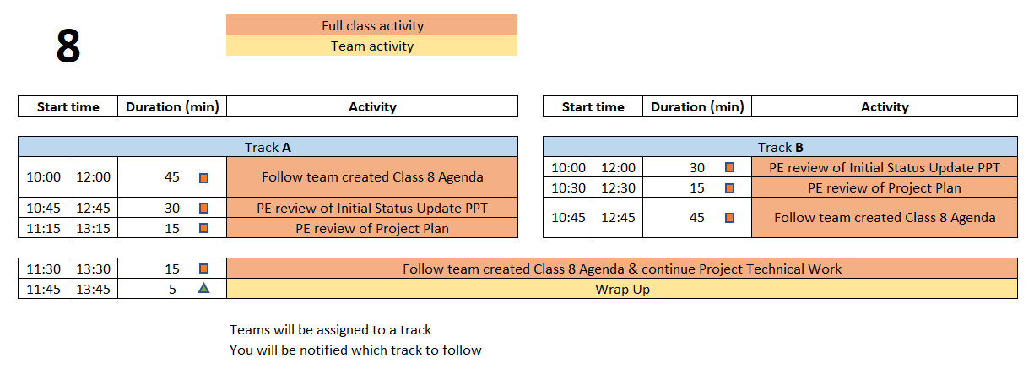
Class 8 Agenda
  You are STRONGLY ENCOURAGED to download newest version of Playbook prior to EACH class meeting.
Repository instructions - https://designlab.eng.rpi.edu/edn/projects/capstone-support-dev/wiki/Subversion
Playbook - https://designlab.eng.rpi.edu/edn/projects/capstone-support-dev/wiki - Playbook.pptx

Slide 93
Engineering Design Process
Today is Day Eight of class
Team is developing concepts and beginning to down select.
Creating poster to communicate overall project and progress made.
This Design Process and terminology is taught in IED at RPI
Notes:
Day 8

Slide 94
60 min – Follow Team created Agenda
Designate team member to take and post minutes to EDN
  This task should be done for EVERY meeting. Rotate responsibility.
Notes:
Day 8

Slide 95
15 min – PE Review Project Plan
Many short individual tasks? Few large group tasks?
Adequate time for:
  Manufacturing?
  Purchasing?
  Testing?
  Iterative development? Second round of any tasks?
Equal division of labor across all students?
Ability to do some work in parallel rather than series?
  Design test plan BEFORE fabrication is complete
  Create dummy data NOW to test software performance or analysis approach

Slide 96
30 min – PE Review of Status Update PPT
Number slides
Figure labels
Team members names, PE/CE names, sponsor name, company logo
Agenda
  Does it match actual contents of PPT?
Contents appropriate? (match rubric & PDR content)
  Background & Customer Needs
  Technology Assessment
  Engineering Requirements
  Concept Generation

Slide 97
Out of Class Tasks
(to be completed BEFORE Class 9)
Project Technical Work
Read Preliminary Design Review and Poster Wiki page in preparation for creating a first draft of the poster during Class 9
  https://designlab.eng.rpi.edu/edn/projects/capstone-support-dev/wiki/Preliminary_Design_Review_and_Poster
Continue technical work
Post progress to Design Forum thread(s)
Student Team should now be creating individual project tasks
P
T/D
Team Development / Design Process Refresher
Team Standards Agreement part 4 due by class 10
Administrative Tasks
Address any feedback received on Status Update PPT
Sponsor liaison should email PPT to sponsor 24 hours prior to call
Prep for upcoming PDR - There will be THREE groups presenting SAME content from SAME poster
  Identify who will be presenting in each of the three groups
A

Slide 98
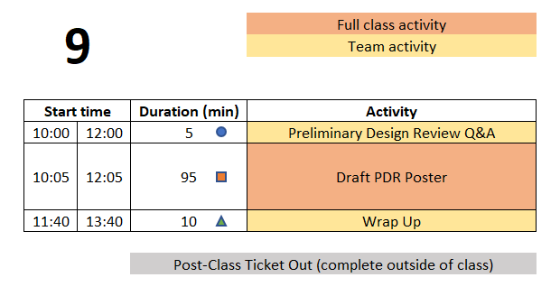
Class 9 Agenda
  You are STRONGLY ENCOURAGED to download newest version of Playbook prior to EACH class meeting.
Repository instructions - https://designlab.eng.rpi.edu/edn/projects/capstone-support-dev/wiki/Subversion
Playbook - https://designlab.eng.rpi.edu/edn/projects/capstone-support-dev/wiki - Playbook.pptx

Slide 99
Engineering Design Process
This Design Process and terminology is taught in IED at RPI
Today is Day Nine of class
Team is creating poster to communicate
Overall project (Needs & Requirements)
Progress made (Concepts, System Architecture)
Future steps (Design, Integration, & Test Plan)
Notes:
Day 9

Slide 100
5 min - PDR Q&A
Out of Class Task was to watch review 1 Wiki page…
QUESTIONS about content?
What does PDR stand for?
Who is audience for PDR?
Approx. how many PPT slides should team prepare?
Covid Tip – It’s hard to hear speakers through a mask. Be sure to SPEAK LOUDLY during presentation.
Notes:
Day 9

Slide 101
95 min – Poster Creation
Open Poster.pptx on Repository
  https://designlab.eng.rpi.edu/edn/projects/capstone-support-dev/repository/112/entry/template%20documents/Poster.pptx
10 mins – Divide into 3 groups, and work on initial slides. Content can be pulled from Statement of Work.
  Purpose
  Past Work and/or Project History
  Semester Objectives/Requirements
40 mins – As a full team discuss Technical Approach, Results and Accomplishments to Date
30 mins – Move on to Next Steps and Plan
15 mins – Begin assembly of content onto single slide (pg 8)

Slide 102
Out of Class Tasks
(to be completed BEFORE Class 10)
Project Technical Work
Continue technical work
Post progress to Design Forum thread(s)
Upload poster draft created in class to EDN
  File in the Repository – working/Reports/Report + Poster/Poster.pptx
  Discussion in Forum – PDR thread
P
T/D
Team Development / Design Process Refresher
Administrative Tasks
Class 9 Ticket Out - https://forms.gle/7JvfgSsWBVWRfvob9
Student Team should now be creating agendas for each class meeting and individual project tasks
A

Slide 103
Preliminary Design Review (10/7 Th or 10/8 Fri)
Presentation Schedule
Sections 1&3 | Sections 2&4 | Activity | Presenter A Primary Host | Presenter B Backup Host | Presenter C
10:00 | 12:00 | Beginning of class
10:05 | 12:05 | Start the 1st sub-team's design review | Name & Email | Name & Email | Name & Email
10:25 | 12:25 | Start of Q&A
10:30 | 12:30 | Time for reviewers to document evaluation
10:40 | 12:40 | Start the 2nd sub-team's design review | Name & Email | Name & Email | Name & Email
11:00 | 13:00 | Start of Q&A
11:05 | 13:05 | Time for reviewers to document evaluation
11:15 | 13:15 | Start the 3rd sub-team's design review | Name & Email | Name & Email | Name & Email
11:35 | 13:35 | Start of Q&A
11:40 | 13:40 | Time for reviewers to document evaluation
IF VIRTUAL

Slide 104
Class 10 and Beyond Agenda
Scaffolded class activities have ended!
Primary purpose of the remaining class meetings is team review and assessment of work already completed, especially with your PE and/or CE.
It is NOT productive to use class time for completing individual work.
These 4 hours of class time may be the only available time for FULL team to meet. So it is recommended to use for group discussions.
Pro Forma Agenda posted on Capstone Support
  https://designlab.eng.rpi.edu/edn/projects/capstone-support-dev/wiki/Class_10_and_beyond
Use EDN and Repository to document all work moving forwards

