Slide 1
Welcome to
Capstone Design
Playbook for Class 1 to 8
Scaffolded Sessions

Slide 2
Link to Agendas
Class 1
Class 2
Class 3
Class 4
Class 5
Class 6
Class 7
Class 8
#Pro Tip – Current Action Items are listed ONE page before next class’s agenda

Slide 3

Multidisciplinary Capstone Design
ISYE 4270 Industrial Engineers
ECSE 4900 Electrical & Computer Systems Engineers
MANE 4260 Mechanical Engineers
MTLE 4920 Materials Engineers

Slide 4
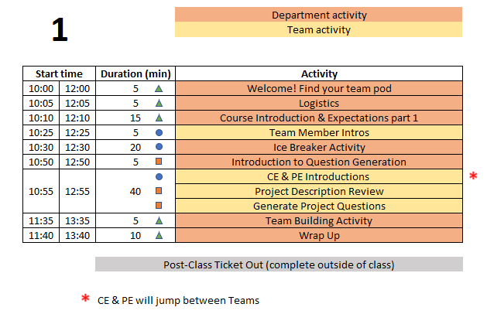
Class 1 Agenda
P
Project Technical Work
Team Development /
Design Process Refresher
Administrative Tasks
TD
A

Slide 5
5 min - Logistics
This PowerPoint is available on Electronic Design Notebook (EDN) and will guide the first 8 meetings
  Playbook - https://designlab.eng.rpi.edu/edn/projects/capstone-support-dev/wiki/Capstone_Playbook
  You are STRONGLY ENCOURAGED to download newest version of Playbook prior to EACH class meeting to get the latest info.
Daily Meeting Agendas
  https://designlab.eng.rpi.edu/edn/projects/capstone-support-dev/wiki/Capstone_Daily_Agendas

Slide 6
Design Lab Mission
Develop High Performing Engineers by Mentoring Students in Professional and Engineering Design Practices Through Project Based Learning.

Slide 7
Capstone Design transition
NO textbook, NO lecture
It is a Team EXPERIENCE
It is a mostly “flipped” experience
Guided/assisted by Project Engineer (PE)
Graded/assisted by Chief Engineer (CE)

Slide 8
Capstone Design:
Practice Engineering in Safe Environment
Initial Cover letter and Resume
New Employee Packet from
your Project Engineer
Company Support Staff
Project Engineers and Chief Engineers
Students in a Course ➔
Consulting Engineering Team
Solving a Client Problem

Slide 9

Design Lab
Engineering Team
New hire

Slide 10
New Employee On-Boarding
Day 1 Agenda
Class 1 Agenda
P
Project Technical Work
Team Development /
Design Process Refresher
Administrative Tasks
TD
A

Slide 11
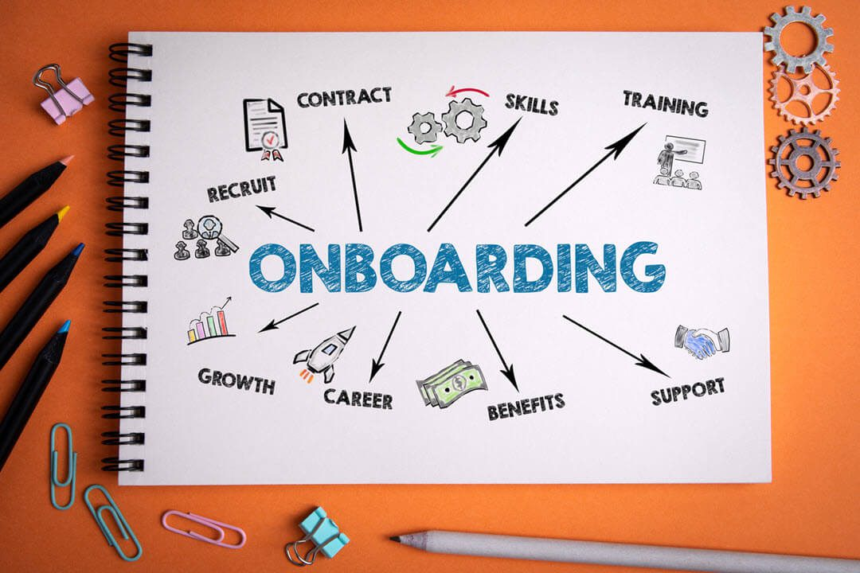
15 Min – Company Introductions and Expectations

Slide 12
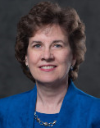
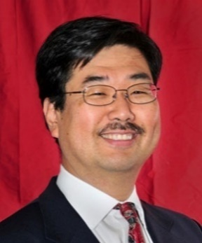
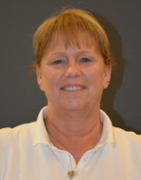

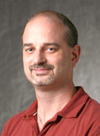
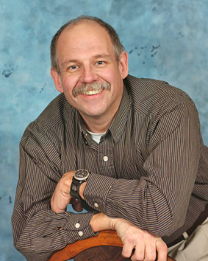
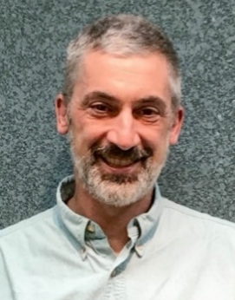
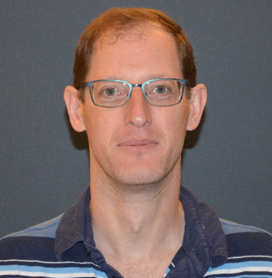
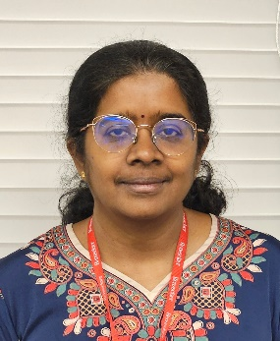
Design Lab Team
Technical Director
Associate Director
Purchasing Agent
Manufacturing Director
Sr. Manufacturing Technician
Kathryn Dannemann
Junichi Kanai
Valerie Masterson
Sam Chiappone
Scott Yerbury
Senior Project Engineers
Mark Anderson
Brad DeBoer
Aren Paster
Kannathal Natarajan

Slide 13
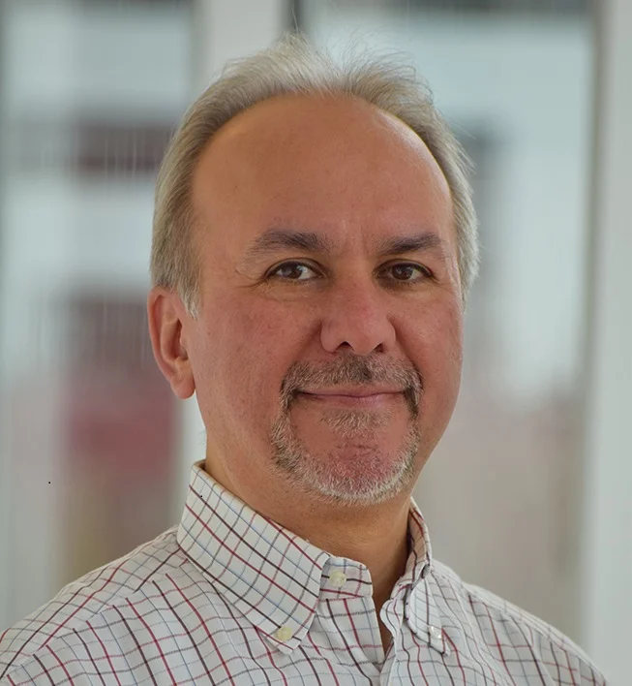
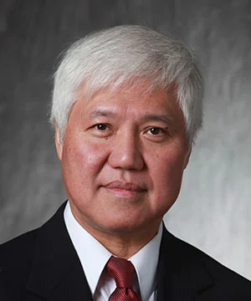
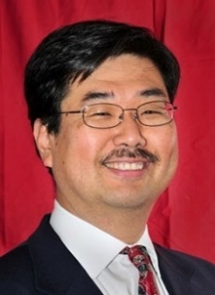
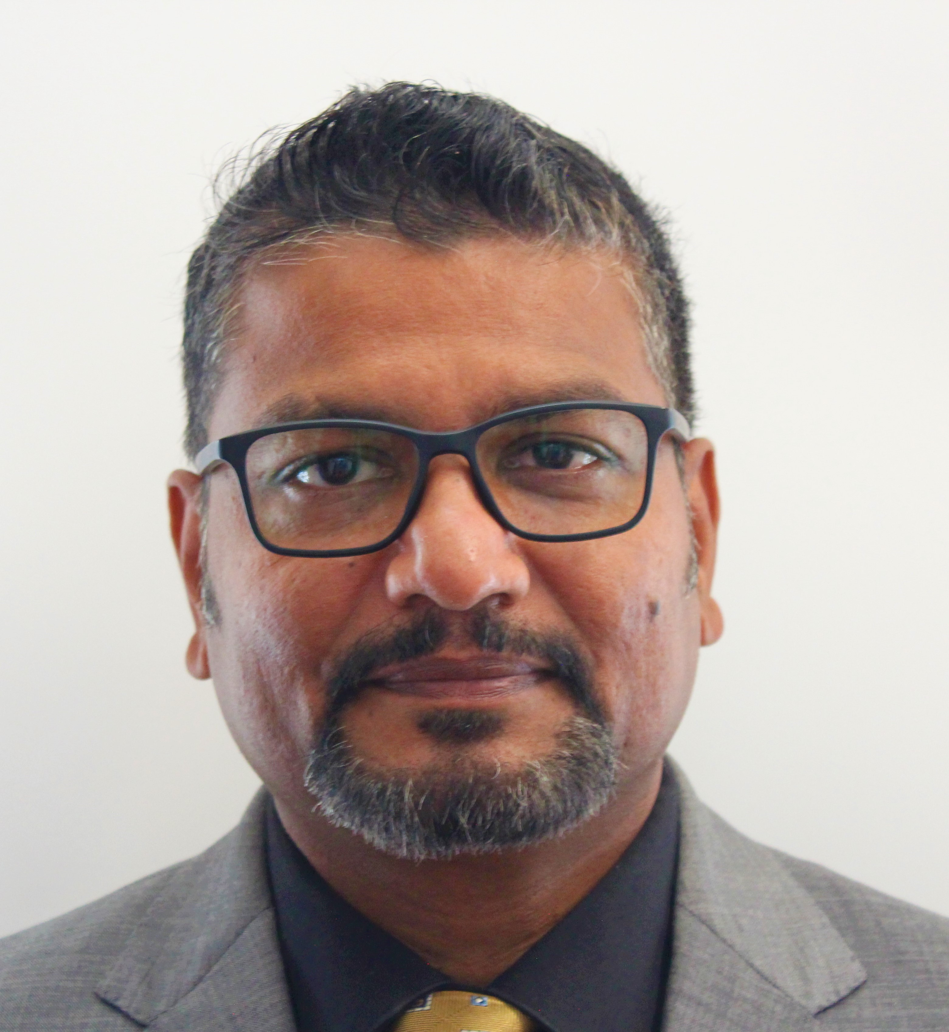
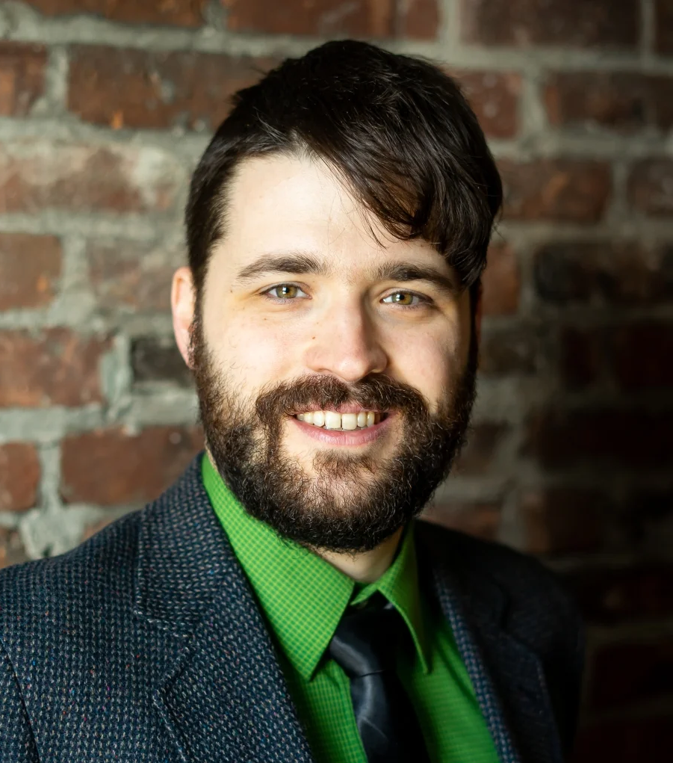
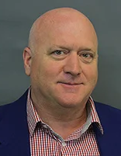
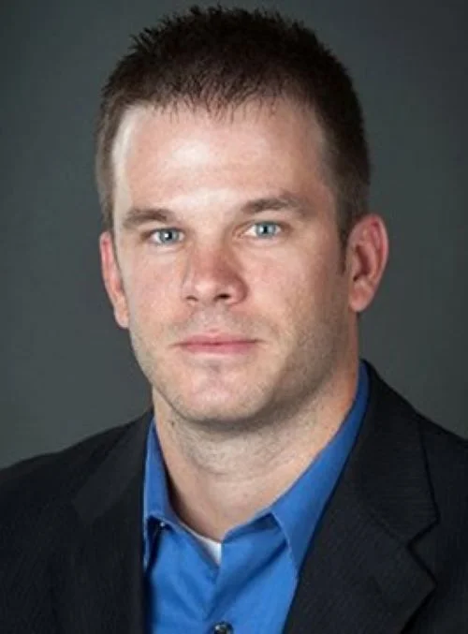
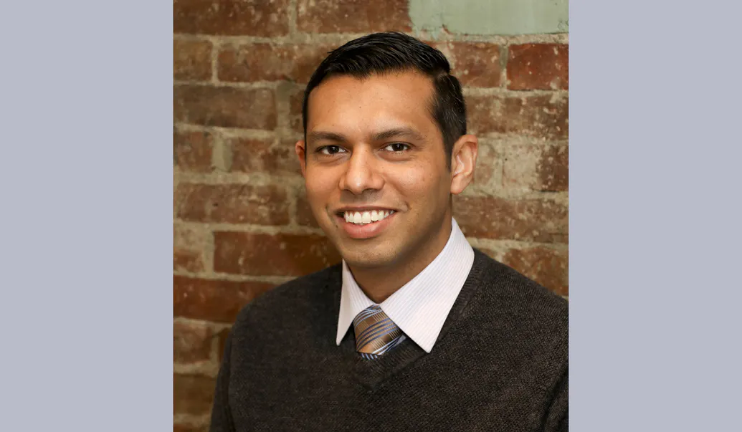
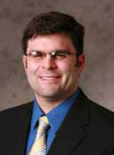
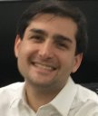
Faculty – Chief Engineers
ECSE
Muhsin Celik
Paul Chow
Junichi Kanai
Prabahakar Neti
Dylan Rees
MANE
Clint Ballinger
Casey Hoffman
Indika Perera
MSE
IME
Kathryn Dannemann
Dan Lewis
Nima Ahmadi

Slide 14

Design Lab - Core Values
At the Design Lab we believe in:
Working with people of diverse backgrounds, skills, and perspective
Creating an inclusive and equitable team environment
Professionalism and Respect

Slide 15



Participation Expectations
Arrive to meetings on time.
Stay until meeting ends.
Be present in all meetings.
Listen, Engage, Participate.
Focus on the Project.
Minimize Distractions
(phone, other tasks)

Slide 16
Work Expectations
Your new position involves:
  4 Hours per week of on-site work
  5 Hours per week of off-site work
    Individual technical work & team meetings
Document all of progress and results
Read communication from Design Lab staff and teammates
  Emails
  Webex chat
  EDN posts
Please respond in a timely manner!

Slide 17
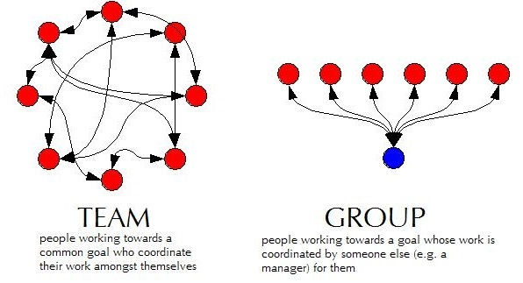
Capstone is More TEAM work than GROUP work
Team Work
  Collaborative effort
  Interactive -peer review
  Team member managed
Group Work
  Divide and conquer
  Low interaction with team
  Supervisor managed

Slide 18
Work Expectations
Q: “What expectations do your boss and peers have at work?”
Let’s start doing this NOW in the Design Lab.
  Be Accountable.
    To your teammates, to Chief/Project Engineer, and to project Client.
  Be Professional.
  Make your work VISIBLE.
    Post/share as you go. Please do not “hide” it from team until its perfect or completely finished.
    Use Electronic Design Notebook (EDN)
Notes:
This slide is animated. Shows only the question – PE should ask students and get some responses

Slide 19
Company Communications & Documentation Policies
Written capstone communications are permitted using ONLY company standard tools:
  The EDN
    Native EDN posts, MS Office files, CAD, etc.
  Webex
Use of any other cloud-based service, such as Google Drive/Docs/Sheets/Slides, GroupMe, Discord, Slack, Draw.io, etc. is FORBIDDEN
Although supported by campus, RPI Box and RPI Onedrive are also FORBIDDEN
Scheduling services such as WhenIsGood & When2Meet are acceptable for setting up meetings but must not contain any technical information
This Helps Protect Against Unauthorized Access And
Provides Equal Access To All Team Members

Slide 20
Accountability Step #1
You all received the New Employee Packet via email:
Director’s Introduction letter
Project Description - Will guide your work today
Instructions for electronic
signatures in Adobe
Recognition Waiver and Release - SIGN & return by end of day
Sponsorship Agreement - SIGN & return by end of day
MANDATORY for all employees to SIGN & return by end of day
More information on Sponsorship Agreement and Confidentiality
  https://designlab.eng.rpi.edu/edn/projects/capstone-support-dev/wiki/Confidentiality_Requirements

Slide 21
5 min - Team Member Intro
Introduce your Name, Major, and Hometown
You will share other information during the following Ice Breaker Activity

Slide 22
20 mins - Ice Breaker
Desired Outcomes
  Prepare everyone for collaborative engineering team performance by helping create a relaxed environment where everyone can share ideas and participate more fully
  Build rapport among the engineering team members
Notes:
Introduce yourself and discuss desired outcomes – 1 minute

Slide 23
Ice Breaker – Community Agreements
Community Agreements help teams (communities) create a culture that is inclusive, respectful, and open
  Make Space to Take Space (Talking Stick)
  Stories Stay, Lessons Leave
  Embrace Ambiguity
  ___________ (Team generated, write on whiteboard)
  ___________ (Team generated, write on whiteboard)
Notes:
Example Community Agreements –
Be Curious, Open, and Respectful - call in not out/throw sunshine not shade
No one knows everything - together we know a lot
We can’t be articulate all the time - give the benefit of the doubt and ask questions
We take care of ourselves - stretch, eat, drink, use restroom, rest, etc.
Confidentiality - don’t speak for others without explicit permission, don’t share something communicated in a private or safe space.
One mic - one voice at a time
Take Space/Make Space - if you are usually quiet challenge yourself to take more space, and if you usually talk a lot be mindful to leave room for quieter voices
Avoid Jargon, Acronyms, and Industry language - use inclusive language that is accessible for people with varying inside knowledge
Be aware of time - enough let’s move on (ELMO) means if what you wanted to say has already been said, don’t say it
Speak from your own experience - Use I statements rather than generalizations
Challenge assumptions
Be conscious of intent vs. impact - no matter intention you’re responsible for your impact
Avoid using isms

Slide 24
Wave Ice Breaker – Activity and Report Out
  Time to stand up and move!
  For each wave, teams will be given a prompt with three potential answers and have two minutes to sort themselves into three groups based on individuals’ answers to prompt
    Example prompt – Favorite “chill” music genre: jazz/classical/folk
  After dividing, teams will be asked to “report out”
    How did you sort yourselves?
    What is something interesting/funny/new that was revealed
  Any Questions?

Slide 25

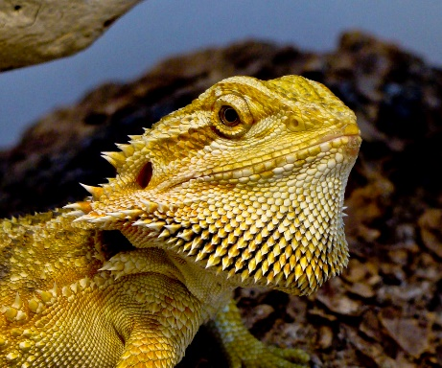
Ice Breaker Wave One – Pets!
What is your pet preference?
  Dogs
  Cats
  Other (birds, reptiles, all of the above, none)

Slide 26

Ice Breaker Wave Two – Exercise!
What is your preferred means of exercise?
  Cardio (Running, Cycling, Swimming, etc.)
  Strength (Weights, Plyometrics, etc.)
  Couch Potato

Slide 27

Ice Breaker Wave Three – Vacation!
What is your preferred vacation environment?
  Mountains
  City
  Beach

Slide 28
40 min – Staff Introduction & Project Launch
Chief Engineer (CE) & Project Engineer (PE) Introductions
  Both individuals will stop by to meet with the team
Project Description Review
  If you have not read the document yet, NOW is your chance. You need that information to do the next step effectively!
Generate Project Questions

Slide 29
5 min - Meet with Project Engineer
  Project Engineer meets with each team:
    Explain the PE Role
    Check on team status / welfare
    Team member introductions
    When not meeting with your PE or CE, team members generate/discuss questions.

Slide 30
5 min - Meet with Chief Engineer
  Chief Engineer meets with each team:
    Explain the CE role
    Check on team status / welfare
    Team member introductions
    Discuss project impressions
    CE’s background/experience
    When not meeting with your PE or CE, team members generate/discuss questions.

Slide 31
10 min – Review Project Description
    Re-Read Project Description
    PE is available to answer any fundamental project questions the Team may have
      - Write these questions on the Whiteboard

Slide 32
20 min - Generate Project Questions
These questions can be about any aspect of the project, but by the end of today MUST include questions targeted to functionality and goals
Refer to the Project Description as needed
Write individual questions on separate Post-It notes - ONE question per Post-It.
Combine duplicate / similar ideas
Discuss, collaborate, and add to the list of questions
Take photo of board BEFORE end of meeting to preserve the list for Day 2 activity.
Post photo to Webex project space

Slide 33
Question Prompts
Potential topic areas for generating questions:
  Functionality
  Performance
  Quality
  Usability
  Accessibility
  Reliability
  Durability
  Availability
  Manufacturability
  Maintainability
  Environmental Impact
  Interfaces

Slide 34
5 min – Team-Building Retreat
During the second week, there will be an off-site, peer-led, Team-Building Retreat
Retreat Goals:
  Build positive foundations of teamwork and communication.
  Foster motivation and accountability within teams.
  Enhance leadership, working together, and getting to know each other.
  Understand the importance of eye contact and active listening.

Slide 35
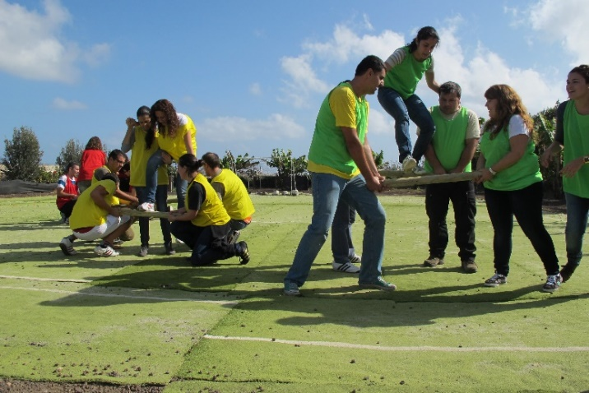
Team-Building Retreat
Location – Meet in Design Lab
Schedule - Three options:
  Wednesday 09/06 6:30-8PM
  Saturday 09/09 1:30-3PM
  Sunday 09/10 4:30-6PM
Attendance is expected (and incentivized with a little treat)
  Goal is to have entire or majority of team at one session
  If entire team can’t make same session, individuals will work with other teams during the event
Notes:
Pic: http://www.entrepreneur-resources.net/theres-no-i-in-team-let-your-company-identity-grow-naturally

Slide 36
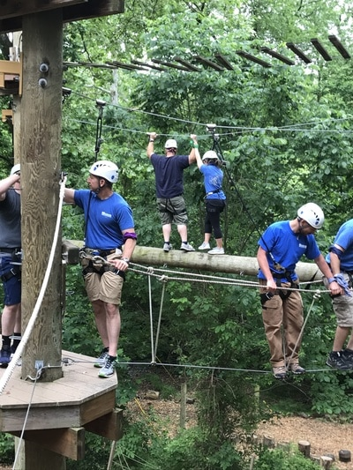
Team-Building Retreat
Action Required!
  Determine which session works best for team
  Each individual must register by Close of Business (COB) on Tuesday, 09/05/23 at: https://docs.google.com/spreadsheets/d/1YyuAUceBjjqBNjeVwXmJcqnEKxf7gu66obY1jszcvQQ/edit#gid=0
Notes:
Pic: http://www.msimarinesolutions.com/uploads/3/2/3/0/32309061/img-2216.jpg

Slide 37
10 min – Wrap-up
Employee Survey
  The Design Lab wants your 'immediate' feedback on your experience.
  These 'surveys' after many meetings will help us to help you.
  Collected anonymously using Google Forms.
    If you ever want an individual response from PE/CE/Director, be sure to INCLUDE your name.
  Please Complete Employee Survey Today or Tomorrow
  You can also always use email or Webex to reach out to PE/CE with any questions.

Slide 38
Action Items / Meeting Prep
(previously called homework, to be completed BEFORE Meeting 2)
Project Technical Work
Re-read the Project Description with Meeting 1 Question Generation exercise in mind
Post list of project questions for team’s Webex General space
Each team member add TWO additional project questions to team’s Webex General space for further discussion in Day 2
P
Team Development / Design Process Refresher
Identify time and register for Team Building Retreat at https://docs.google.com/spreadsheets/d/1YyuAUceBjjqBNjeVwXmJcqnEKxf7gu66obY1jszcvQQ/edit#gid=0
T/D
Administrative Tasks
Complete Day 1 Employee Survey - https://forms.gle/HoU1JufnPfDkbtW6
Register for EDN – https://designlab.eng.rpi.edu/edn/
  Registration button in upper right hand corner
  Login must be your RCSID (RPI email before the @ symbol)
  Email must be your RPI email
  Bookmark this site. You will use it A LOT for this course.
Watch Capstone Introduction & Expectations – Part 2 video (7 Min)
  https://designlab.eng.rpi.edu/edn/projects/capstone-support-dev/repository/112/raw/training/Capstone%20Introduction%20and%20Expectations%20Part%202.mp4
A

Slide 39
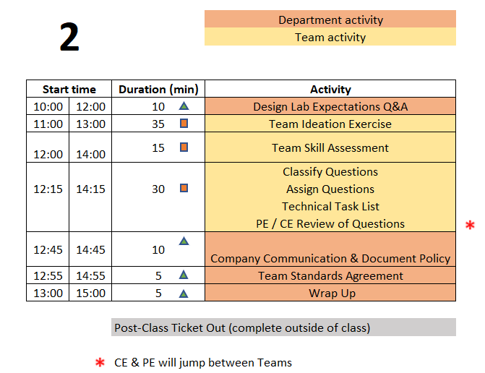
Day 2 Agenda
Project Technical Work
Team Development /
Design Process Refresher
Administrative Tasks
P
TD
A
  You are STRONGLY ENCOURAGED to download newest version of Playbook prior to EACH meeting.
Playbook - https://designlab.eng.rpi.edu/edn/projects/capstone-support-dev/wiki/Capstone_Playbook

Slide 40
10 min – Design Lab Expectations Q&A
Action Item was to watch 1 video (Capstone Introduction & Expectations – Part 2)
Ask me 1 or 2 QUESTIONS about content!
What is difference between IED and Capstone?
Who ‘owns’ your project – team, PE, CE, Client?
What is role of team members in Capstone?
What is role of PE?
What is role of CE?
Notes:
Day 2
IED vs CD
IED – Becoming an Engineer
CD – Be an Engineer
Owner – Students
Role of Students – Solve an open-ended complex problem by applying good engineering practices
Role of PE – Assist students by day to day operations
Role of CE - Evaluation

Slide 41
Action Item / Meeting Prep Categories
Project Technical Work
  Contribute directly to project progress and deliverables
  ALL project documentation & planning – notes, reports, analysis, Gantt chart
  Background research, design, prototyping, testing
P
Team Development / Design Process Refresher
  Forming, Storming, Norming, Performing
  Sequence of design artifacts – Needs & Requirements, Concepts, Decision Matrix
T/D
Administrative Tasks
  Onboarding - Legal paperwork, Safety training
  Design Lab Logistics
  Employee Surveys
A

Slide 42
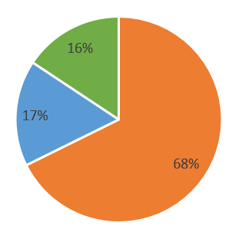
Project Works Starts on Day 1!

Slide 43
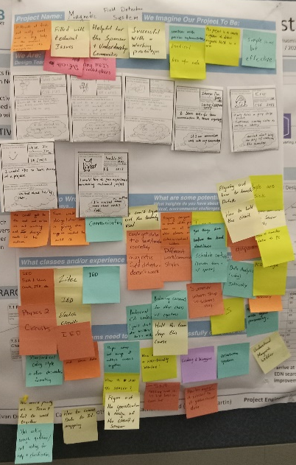
35 min - Team Ideation Exercise
Goal
Accelerate the Forming stage of the engineering team development process by establishing:
- common understanding of the project
- the team members’ background and skills
Time boxed exercise: It will feel rushed, things won't feel complete. THAT'S OK.
You'll want more time. You can't have it.
Team must move on – the company has deadlines to meet!
Process
For EACH section of Ideation poster:
2 min
  Individual silent thought on content
  Write thoughts on Post-It Notes
2 min
  Place Post-Its onto poster sheet
  Quick discussion of similar, unique, or new answers
Move on to next section of Ideation Poster as a team

Slide 44
Team Ideation Poster Creation Activities
We Are (5 min + 1 min)
Write your project name at top.
We Imagine Our Project to Be (2 min + 2 min)
What Can Go Wrong? (2 min + 2 min)
What are some potential challenges (2 min + 2 min)
What classes and/or experience can you call on to help with this project? (2 min + 2 min)
What technical problems need to be solved to successfully complete this project? (2 min + 2 min)
Notes:
Hand out “We Are” cards just before that step
Potential Challenges include societal, financial, environmental, technical, ethical, etc.

Slide 45
15 min - Team Skill Assessment
Please Create a Word Document Based on your Team Poster
Shared by 2+ Team Members
Unique Skills
________________
________________
_______________
_______________
Skill Gaps
_______________
_______________
Post the MS Word document in team’s general
Webex space by end of today’s meeting!

Slide 46
30 min - Classify and Assign Questions
  Classify all project questions generated during Day 1 meeting and Action Items into one of three categories
    Things team members can research/answer themselves
    Things PE will answer
    Things to ask Client during kick-off meeting
  Team assigns owner to all questions in category A
  Add question classifications and ownership to Word document
  Chief Engineer & Project Engineer review questions & classification
  Post document to EDN Forum by end of meeting – Project Mgmt thread
Does every team member have a TECHNICAL action item to complete by next meeting?
  Note: Team should assign action items at end of EVERY meeting.

Slide 47
10 mins – Company Communication & Documentation Policies
Electronic Design Notebook - REQUIRED for all collaboration
Webex – Team Chat
WhenIsGood or When2Meet – meeting scheduling
Not Permitted
  Slack, GroupMe, or Discord
  Google Drive
  Google Docs/Sheets/Slides
  Other cloud-based tools for any use (schematics, mind maps, drawings, analysis, etc…) e.g., diagrams.net, etc.
  RPI Box, RPI Onedrive, RPI Sharepoint
  Texting, Instagram, WhatsApp, etc. for ANY project technical content
Webex is good for chat and live meetings, but project documentation should start on and stay in the Electronic Design Notebook (EDN) Forum or Repository.
  Simple/easy solution is to never put it on Webex (or elsewhere) to begin with.

Slide 48
Electronic Design Notebook (EDN)
  Integrated Project Management
  Threaded Communication by topic, rather than a single unorganized stream
  IP protection
  Performance Evaluation - accountability and visibility
  Secure access to team and Client
  Backed up daily !
  The EDN software was chosen as it currently meets the Design Lab’s needs better than the alternatives*.
  * https://designlab.eng.rpi.edu/edn/projects/capstone-support-dev/wiki/Why_Electronic_Design_Notebook_is_the_ONLY_choice

Slide 49

What Should I Document?
Everything
  Research, web links, ALL NOTES *
  Interviews and observations
  Ideas, concepts, sketches, charts, diagrams
  Calculations
  Purchases - components models, vendors, cost
  Analyses – technical and non-technical
  Experiments, debugging, tests
  Hypothesis, procedures, equipment used, steps taken, data, results
  Future work/ideas
Thou shalt document ALL
thy work
* On-site / off-site – ALL meetings & individual work
Although everyone should take notes, there should be a designated note taker for each meeting.

Slide 50
5 min - Team Standards Agreement Intro
According to concepts in organizational behavior, there are five stages of team development (Tuckman’s Model, 1964): forming, storming, norming, performing and adjourning
In high performing teams a Team Standards Agreement is often generated to establish procedures and roles in order to move the team more quickly into the performing stage
A Team Standards Agreement will be generated off-site by each team before Day 6
  The Team Standards Agreement shall be posted to your team’s EDN Wiki page in accordance with the instructions in the following document: https://designlab.eng.rpi.edu/edn/projects/capstone-support-dev/wiki/Team_Standards_Agreement
Completed Agreement should be posted to Wiki by START of Day 6

Slide 51
Design Lab Work Categories
Project Technical Work
  Contribute directly to project progress and deliverables
  ALL project documentation & planning – notes, reports, analysis, Gantt chart
  Background research, design, prototyping, testing
P
Team Development / Design Process Refresher
  Forming, Storming, Norming, Performing
  Sequence of design artifacts – Needs & Reqs, Concepts, Decision Matrix
T/D
Administrative Tasks
  Onboarding - Legal paperwork, Safety training
  Course / Academic logistics
  Employee Survey & Feedback
A

Slide 52
Action Items / Meeting Prep
(previously called homework, to be completed BEFORE Day 3)
Project Technical Work
Find answer(s) to assigned question(s) & post to new thread titled “Day 2 Questions and Answers” in EDN Background Info Forum
Identify one Customer Need for your project and translate it into an Engineering Requirement. Post to new thread in EDN Design Forum titled “Initial Needs and Requirements”. Leverage the Team Ideation Poster! First member creates the thread, other members reply to add their thoughts.
For ongoing projects, review prior semesters’ final presentations in accordance with PE instructions for discussion during Meeting 3 or 4
  PPT should be in last semester’s Repository or Final Deliverables Forum on EDN
  First team member - create new thread in EDN Background Info titled "Questions about project"
  Rest of team - respond to thread with questions you have about project
P
Team Development / Design Process Refresher
Read The Engineering Design Process Refresher.pptx in preparation for meeting 3 discussion
  https://designlab.eng.rpi.edu/edn/projects/capstone-support-dev/repository/112/raw/training/The%20Engineering%20Design%20Process%20Refresher.pptx
Watch Customer Needs video (9 min)
  https://mediasite.mms.rpi.edu/mediasite/Play/87d950eccc2942038b1d06530e9217841d
Watch Engineering Requirements video (11 min)
  https://mediasite.mms.rpi.edu/mediasite/Play/96dceab44ae7447d812f5a216afa97cf1d
Team Standards Agreement due by Day 6
Identify time and register for Team Building Retreat at https://docs.google.com/spreadsheets/d/1YyuAUceBjjqBNjeVwXmJcqnEKxf7gu66obY1jszcvQQ/edit#gid=0
T/D
Administrative Tasks
Complete Day 2 Employee Survey - https://forms.gle/yvkvFuR9rSaEhrB8
Watch EDN Guidance for Action Items - Initial Postings Video (7.5 min)
  https://designlab.eng.rpi.edu/edn/projects/capstone-support-dev/repository/112/raw/training/EDN%20Guidance%20for%20Out%20of%20Class%20Tasks%20-%20Initial%20Postings.mp4
Post personal contact info (name, major, RPI email, phone #) to a Project Management Forum thread in accordance with the Initial Postings Video. First member creates the thread, other members reply to add their info.
A

Slide 53
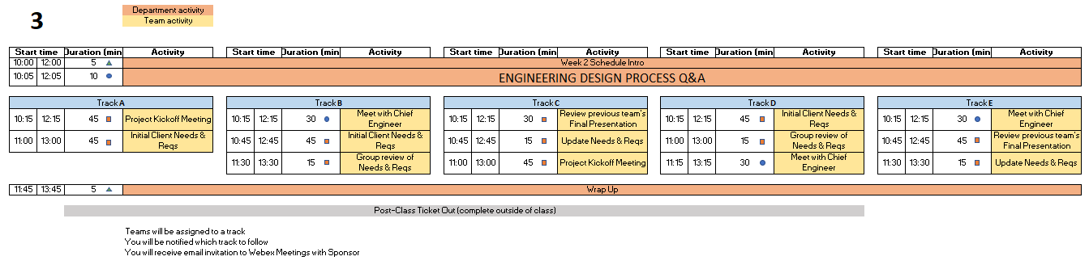
Day 3 Agenda
Over the course of Days 3 & 4 - All teams will complete the following:
Project Kickoff Meeting
CE meeting with team
Customer Needs & Requirements - development and review
Review previous Final Presentation - ongoing projects only
  You are STRONGLY ENCOURAGED to download newest version of Playbook prior to EACH on-site meeting.
Repository instructions - https://designlab.eng.rpi.edu/edn/projects/capstone-support-dev/wiki/Subversion
Playbook - https://designlab.eng.rpi.edu/edn/projects/capstone-support-dev/wiki/Capstone_Playbook
Notes:
PE Notes
Continuing projects should follow Track C or E
New projects can follow A, B, or D
Track A or C on Day 3 should follow track A or C on Day 4
Track B, D, or E on Day 3 should follow track B or D on Day 4

Slide 54
10 min - Engineering Design Process Q&A
Action Item was to watch 3 videos…
Ask me 2-3 QUESTIONS about the videos!
What are the steps in Engineering Design Process?
What is a Customer Need?
What is an Engineering Requirement?
What is the difference between a Need and a Requirement?
What is a User Story?
What is an Acceptance Criteria?
What is the difference between a User Story and an Acceptance Criteria?
Notes:
Day 3

Slide 55
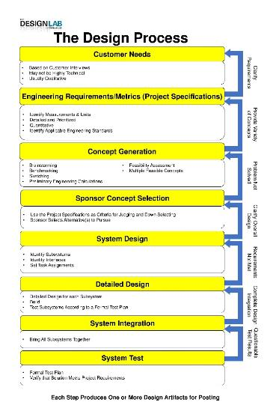
Engineering Design Process
Today is Day Three
Let’s look at steps ONE & TWO
Team will create/review/improve project’s list of:
Customer Needs
Engineering Requirements
This Design Process and terminology is taught in IED at RPI

Slide 56

30 min – Meet with CE
(Day 3 or 4)
Chief Engineer led discussion of:
  Performance Evaluations – aka Course grading
  Team member expectations
  CE background and experience
  Project impressions
  Team Standards Agreement

Slide 57
45 min - Customer Needs & Engineering Requirements Generation
Needs and Requirements workbook.xlsx spreadsheet is located at:
  [new project] Capstone Support Template Documents page https://designlab.eng.rpi.edu/edn/projects/capstone-support-dev/repository/112/entry/template%20documents/Needs%20and%20Requirements%20workbook.xlsx
  [continuing project] Team’s Repository, Engineering Analysis folder
Fill out based on team’s current (uninformed impression) of project
  This is first pass. Don’t worry that answers are not complete or verified by Client. You’ll be updating this often!
The Upcoming Exercise Will Help You Generate Ideas!

Slide 58
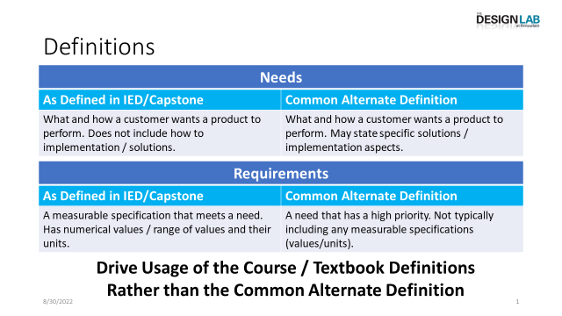
We Use These Definitions for
IED & the Design Lab
Note – Key IED Course Materials in Capstone Support wiki.

Slide 59
Generating Ideas for Your Needs
The Engineering Team will Play “Spin for Needs” using this link:
https://wheeldecide.com/?c1=Functionality&c2=Performance&c3=Quality&c4=Usability&c5=Accessibility&c6=Reliability&c7=Durability&c8=Availability&c9=Manufacturability&c10=Maintainability&c11=Environmental%20Impact&c12=Wild%20Card&c13=Interfaces
(be sure to copy the entire link to your browser!)
Start with the Needs you Previously Captured as part of your Meeting Prep!
Spin the Wheel
Use the Topic
Write One Related Need on a Post-It
Repeat!

Slide 60
15 min – Group Review of
Needs & Requirements
Read notes in template document for tips
Remove/combine duplicates
Add Requirements based on the Needs
Unsure of a proper metric?
  Quick Google search to put in an educated guess
Fill in holes/gaps after looking at categories
  https://designlab.eng.rpi.edu/edn/projects/capstone-support-dev/wiki/Requirements_Management
  Safety, Reliability, Maintainability, etc…
Take photo of whiteboard and post to Design Forum

Slide 61
45 min - Project Kick-Off Meeting
Meeting Agenda
  Team introductions to Client (name, major, relevant experience/skills)
  Client introduction to team
  Client describes project "in their words“
    History, ultimate and semester goals, deliverables, etc…
  Open Q&A
Document meeting minutes to Project Mgmt Forum on EDN

Slide 62
30/45 min - Prior Presentation
(if applicable)
Team should review (outside of on-site meeting) the final PPT presentation given by previous engineering team
  Forums->Final Deliverables
  Repository->Reports->Final Reports
PE/CE will quickly walk-through slide deck and discuss:
  Goals
  Accomplishments / Successes
  Challenges
  Next steps
PE/CE will help to clear up confusion and answer any questions current engineering team may have

Slide 63
Action Items / Meeting Prep
(what you might call homework, to be completed BEFORE Day 4)
P
Project Technical Work
Update Needs/Reqs Workbook based on feedback and post to EDN Design Forum
T/D
Team Development / Design Process Refresher
Post Team Standards Agreement to Wiki before Day 6
Administrative Tasks
Complete Day 3 Employee Survey - https://forms.gle/DnZCi1MzGQZTLAn8
Choose Client liaison
  This person will be the focal point for emails to/from your Client. They are not the team's "spokesperson" at meetings, conference calls, on/off site meetings, etc.
Watch Intro to EDN video (5 min) in preparation of Day 4 review
  https://designlab.eng.rpi.edu/edn/projects/capstone-support-dev/repository/112/raw/training/Intro%20to%20the%20EDN.mp4
Read Project Documentation page in preparation for Day 4 review
  https://designlab.eng.rpi.edu/edn/projects/capstone-support-dev/wiki/Project_Documentation
Read Meeting Minutes Wiki Page
  https://designlab.eng.rpi.edu/edn/projects/capstone-support-dev/wiki/Meeting_Minutes
  Post notes taken during PPT review to Project Management Forum
Follow Subversion instructions to download and install client, then checkout a copy of ONLY your project’s working folder from the Repository. Visit your PE’s office hours for assistance.
  https://designlab.eng.rpi.edu/edn/projects/capstone-support-dev/wiki/Subversion_Clients#section-2
Complete the Online Safety Training in Percipio by end of 3rd week
  https://rpi.percipio.com/
  Rensselaer Manufacturing and Prototyping Laboratories - Safety Orientation
  Instructions https://designlab.eng.rpi.edu/edn/attachments/download/114354/RMPL%20Safety%20Module%20Completion%20Instructions-Percipio%20.pdf
A

Slide 64
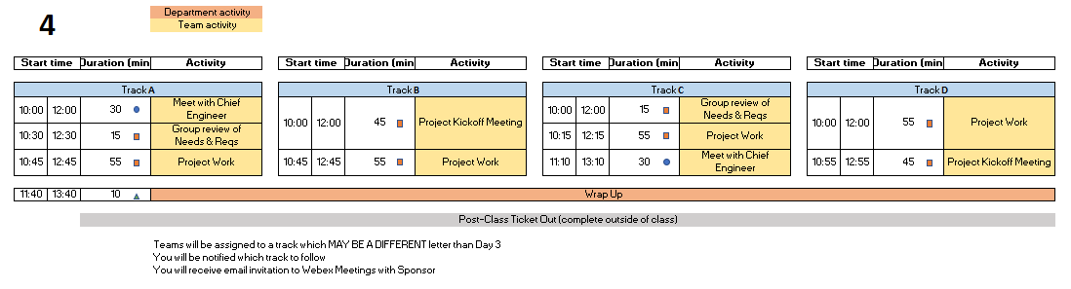
Day 4 Agenda
  You are STRONGLY ENCOURAGED to download newest version of Playbook prior to EACH on-site meeting.
Repository instructions - https://designlab.eng.rpi.edu/edn/projects/capstone-support-dev/wiki/Subversion
Playbook - https://designlab.eng.rpi.edu/edn/projects/capstone-support-dev/wiki/Capstone_Playbook
Notes:
PE Notes
Track A or C on Day 3 should follow track A or C on Day 4
Track B, D, or E on Day 3 should follow track B or D on Day 4

Slide 65
Engineering Design Process
Today is Day Four
Team should be working towards agreement, and PE/CE/Client review/approval of steps ONE & TWO
Customer Needs
Engineering Requirements
This Design Process and terminology is taught in IED at RPI
Notes:
Day 4

Slide 66
15 min – Group Review of
Needs & Requirements
Read notes in template document for tips
Remove/combine duplicates
Unsure of a proper metric?
  Quick Google search to put in an educated guess
Fill in holes/gaps after looking at categories
  https://designlab.eng.rpi.edu/edn/projects/capstone-support-dev/wiki/Requirements_Management

Slide 67
45 min - Project Kick-Off Meeting
Meeting Agenda
  Team introductions to Client (name, major, relevant experience/skills)
  Client introduction to team
  Client describes project "in their words“
    History, ultimate and semester goals, deliverables, etc…
  Open Q&A

Slide 68

55 min - Project Work
Refine Needs and Requirements Spreadsheet
  Needs
    Ensure all known Customer Needs are documented
  Requirements:
    Associate with appropriate Customer Need(s)
    Identify Measurements and Units (quantitative)
    Ensure that Requirements are detailed and prioritized
    Identify Applicable Engineering Standards
Refine/Develop Follow-Up Questions for Client
  If Team has already had Kick-Off Meeting, what new questions have been identified as a result?
    Clearly document, review with PE then email to Client, copy your PE & CE
Background Research/Benchmarking
  Discuss/document work done to date
  Identify/document additional benchmarking needs

Slide 69
30 min – Meet with CE
(Day 3 or 4)
Chief Engineer led discussion of:
  Performance Evaluations – aka Course grading
  Team member expectations
  CE background and experience
  Project impressions
  Team Standards Agreement

Slide 70
Action Items / Meeting Prep
(to be completed BEFORE Day 5)
Project Technical Work
Read the Project Statement & Objectives Wiki page in preparation for Day 5 review
  https://designlab.eng.rpi.edu/edn/projects/capstone-support-dev/wiki/Project_Statement_and_Objectives
Read the Engineering Tools and Methods Wiki page in preparation for Day 5 review
  https://designlab.eng.rpi.edu/edn/projects/capstone-support-dev/wiki/Engineering_Tools_and_Methods_Worksheet
Update Needs & Requirements Workbook based on feedback and post to EDN Design Forum
P
T/D
Team Development / Design Process Refresher
Post Team Standards Agreement to Wiki before Day 6
Administrative Tasks
Complete Day 4 Employee Survey - https://forms.gle/JcjmKadJw7cZz3i6
Read Project Documentation Wiki page in preparation for Day 5 review
  https://designlab.eng.rpi.edu/edn/projects/capstone-support-dev/wiki/Project_Documentation
Follow Subversion instructions to download and install client, then checkout a copy of the folder titled working from your project’s repository. Visit your PE’s office hours for assistance.
  https://designlab.eng.rpi.edu/edn/projects/capstone-support-dev/wiki/Subversion
Complete the Online Safety Training in Percipio by end of 3rd week
  https://rpi.percipio.com/
  Rensselaer Manufacturing and Prototyping Laboratories - Safety Orientation
  Instructions https://designlab.eng.rpi.edu/edn/attachments/download/114354/RMPL%20Safety%20Module%20Completion%20Instructions-Percipio%20.pdf
A

Slide 71
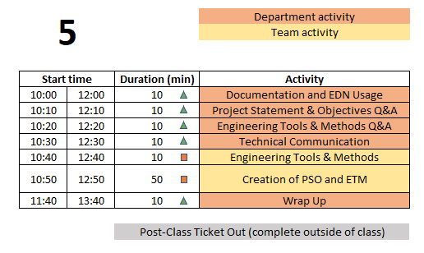
Day 5 Agenda
  You are STRONGLY ENCOURAGED to download newest version of Playbook prior to EACH on-site meeting.
Repository instructions - https://designlab.eng.rpi.edu/edn/projects/capstone-support-dev/wiki/Subversion
Playbook - https://designlab.eng.rpi.edu/edn/projects/capstone-support-dev/wiki/Capstone_Playbook

Slide 72
Engineering Design Process
Today is Day Five
Team will develop the Project Statement & Objectives and identify Tools and Methods
This Design Process and terminology is taught in IED at RPI
Notes:
Day 5

Slide 73
10 min – Documentation & EDN Usage Q&A
You should have already watched EDN video and read Documentation Wiki page
  Intro to EDN video (5 min)
    https://designlab.eng.rpi.edu/edn/projects/capstone-support-dev/repository/112/raw/training/Intro%20to%20the%20EDN.mp4
  Project Documentation page
    https://designlab.eng.rpi.edu/edn/projects/capstone-support-dev/wiki/Project_Documentation
Ask me 1-2 QUESTIONS about the content!
Why do we document?
What do we document?
How will you document?
How often / when will you document?
Must we wait for things to be complete / final to document?
Where does it go?
Notes:
Day 5

Slide 74
What is Engineering Documentation?
Living record of your work so that:
  Evolution of your product/design is traceable
  Your work (experiment) is reproducible
    Sketches, ideas, discussions
    Test setup, results, failures & successes
  Your work can be understood by others and why you did it that way
  Feedback & help can be offered
  Easy to incorporate into client meeting presentations and the final design report

Slide 75

Why Document?
Extension of your memory
  Who, What, When, Where, Why, How
  So that others can collaborate and continue the work
  Facilitates teamwork
  So that others can review/understand your work
Legal ramifications
  Contractual/legal defense
  Patent application
Efficiently and Effectively move the project forwards
Everyone (now and future) can understand the Who, What, When, Where, Why, and How of the team’s work

Slide 76
Corporate Communication & Documentation
Policies Reminder
Electronic Design Notebook - REQUIRED for all project work & effort
Webex (only) - Team Chat
WhenIsGood or When2Meet - meeting scheduling
Not Permitted
  Slack, GroupMe, or Discord
  Google Drive
  Google Docs/Sheets/Slides
  Other cloud-based tools for any use (schematics, mind maps, drawings, analysis, etc…) e.g., diagrams.net, etc.
  RPI Box, RPI Onedrive, RPI Sharepoint
Webex Teams is good for chat and live meetings, but project documentation should start on and stay in the Electronic Design Notebook (EDN) Forum or Repository.
  Simple/easy solution is to never put it on Webex (or elsewhere) to begin with.

Slide 77
Documentation Wrap up
True or False
Information should be complete before documented?
It is necessary to document negative results?
Teammates share responsibility with PE/CE to offer technical feedback on EDN posts?

Slide 78
10 min - Project Statement & Objectives Q&A
Action Item was to read the wiki page…
Ask me 1-2 QUESTIONS about the content!
What is a Project Statement & Objectives (PSO)?
What is difference between the Long Term and Short Term Goals?
What is difference between an objective and a deliverable?
Where is the PSO document template located?

Slide 79
10 min - Engineering Tools and Methods Q&A
Action Item was to read their wiki pages…
Ask me 1-2 QUESTIONS about the content!
What are Engineering Tools and Methods?
Give an example of a Mechanical Engineering Tool or Method
Give an example of an Electrical Engineering Tool or Method
Give an example of a Computer Systems Engineering Tool or Method
Give an example of an Industrial Engineering Tool or Method
Give an example of a Material Engineering Tool or Method

Slide 80
10 mins - Technical Communications
Helpful Hints for Career Success at
Design Lab
And Beyond!

Slide 81
3 Keys to Success*
Ability to Speak
Ability to Write
Quality of Your Ideas
*Prof. Patrick Winston, MIT – Director of AI Lab 1972-1997
https://www.youtube.com/watch?v=ukYi50Gfc5M

Slide 82
Tech Memos and Reports
Differ from a Term Paper or Essay
- News Article vs. Feature Story
- Factual vs. Opinion
Provide Technical Information and Results
- What?
- Why?
- How?
Reader must be able to re-produce the results

Slide 83
Start with an Outline
What is the Key Message?
Who is the Audience?
Can an Uninformed Reader Understand?
Avoid Information Overload (...Data Dump)
Utilize Illustrations to convey the message
“A picture is worth 1000 words!”
- Figures, Plots
- Schematics, Diagrams
- Tables, Lists
- Equations
Self-Explanatory Figure Captions and Table Names
Can the reader understand the diagram/table without reading the entire text?

Slide 84
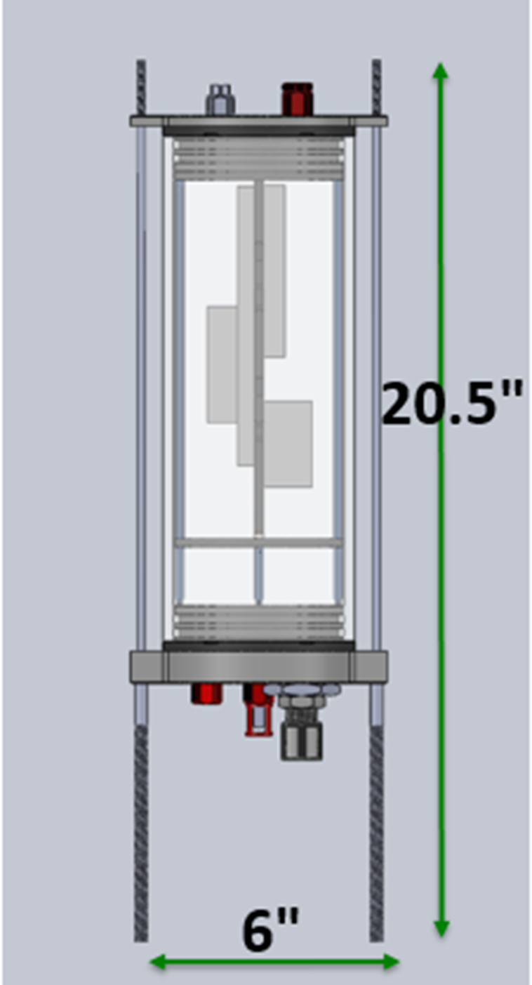
Writing Style
Clear and Concise
Short Sentences
Use Formatting for Clarity
4.0 Design Concept
4.1 Mechanical System
4.1.1 Engine
4.1.2 Powertrain
4.2 Electrical System
4.2.1 Sensors
4.2.2 Controls
Use a Scale in Figures to show Dimensions
Figure 1 – Water
Column Sensor

Slide 85
Provide Supporting Information
To Support Your Hypothesis
- Data
- Experimental Results
- Published Information
OR To Present an Alternate Perspective
- Findings from the Literature
References and Citations
Always Provide Attribution!
PLAGIARISM:
Use of Others’ Data/Figures/Text Without Attribution is Unethical and Not Acceptable

Slide 86
References
Include Numbered Reference List
Use Word’s Built-in Utility
All Figures and Tables must be referenced in the appropriate places in the text.
Is it a Legitimate/Reliable Reference?
- Peer Reviewed Journal Articles
- Technical Reports
- Textbook/Handbook
- Industry Website
For Web references, ensure all Reference Links are functional

Slide 87
50 min – Creation of Project Statement and Objectives & Engineering Tools and Methods
  Templates for both documents are on the Capstone Support Wiki
    https://designlab.eng.rpi.edu/edn/projects/capstone-support-dev/wiki/Templates_and_Forms
  Instructions
    https://designlab.eng.rpi.edu/edn/projects/capstone-support-dev/wiki/Project_Statement_and_Objectives
    https://designlab.eng.rpi.edu/edn/projects/capstone-support-dev/wiki/Engineering_Tools_and_Methods_Worksheet
  Your CE & PE are available to answer any questions and review your work
  Finish & save in ‘working\Reports\Final Report + Poster‘ folder in the Repository as Prep for next Meeting
  Files in the Repo can be revised as needed. These are drafts and your documents may later change as the engineering team learns more!

Slide 88
Long Term vs. Short Term
FYI
Long Term
1 – 5+ years in future
Assume there may be multiple projects / semesters / teams working AFTER yours
Assume a successful output from each team
What can the Client do / achieve 1-5+ years from now because your work was successful?
Short Term
By the end of this semester
Things your Client wants you to achieve early this semester, by mid-semester, and at the end of the semester
Assumes your success
What can your Client do with your work immediately after the semester ends?

Slide 89
Action Items / Meeting Prep
(to be completed BEFORE Day 6)
Project Technical Work
Wordsmith and polish Project Statement & Objectives
    Upload to Repository - working/Reports/Design Report + Poster
Finalize Engineering Tools & Methods Worksheet
    Upload to Repository - working/Reports/Design Report + Poster
Update Needs & Requirements spreadsheet to Repository
  Shift file to Repository - working/Engineering Analysis
P
Team Development / Design Process Refresher
Watch Concept Generation video (9 min) in preparation for Concept Generation on-site exercise
  https://mediasite.mms.rpi.edu/mediasite/Play/d78db44fd9f7424b9d8f4c72857f84371d
Post Team Standards Agreement to Wiki BEFORE day 6
T/D
Administrative Tasks
Complete Day 5 Employee Survey - https://forms.gle/cQM67DEXopv8FD59
Watch SVN Training video
  https://designlab.eng.rpi.edu/edn/projects/capstone-support-dev/repository/112/raw/training/Getting%20Started%20with%20Subversion-For%20Windows%20Users.mp4
Complete the Online Safety Training in Percipio by end of 3rd week
  https://rpi.percipio.com/
  Rensselaer Manufacturing and Prototyping Laboratories - Safety Orientation
  Instructions https://designlab.eng.rpi.edu/edn/attachments/download/114354/RMPL%20Safety%20Module%20Completion%20Instructions-Percipio%20.pdf
A

Slide 90
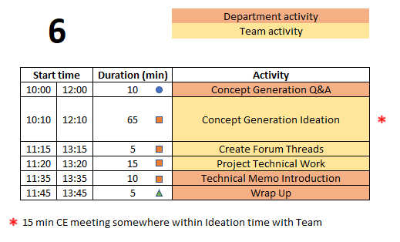
Day 6 Agenda
  You are STRONGLY ENCOURAGED to download newest version of Playbook prior to EACH on-site meeting.
Repository instructions - https://designlab.eng.rpi.edu/edn/projects/capstone-support-dev/wiki/Subversion
Playbook - https://designlab.eng.rpi.edu/edn/projects/capstone-support-dev/wiki/Capstone_Playbook

Slide 91
Engineering Design Process
Today is Day Six
Team will generate AND document concepts to address and meet the Needs & Requirements of the project.
This Design Process and terminology is taught in IED at RPI
Notes:
Day 6

Slide 92
10 min - Concept Generation Q&A
Action Item was to watch 1 video…
Ask me 1-2 QUESTIONS about the content!
Where do concept ideas come from?
  Example of Internal Search?
  Example of External Search?
Notes:
Day 6

Slide 93
15 min – CE Time
Meeting will be at team table
This will take place at some point during Concept Generation exercise depending on CE’s schedule

Slide 94

65 Min - Concept Generation
Similar inclusive plan as previous exercises
5 min – Individually silently generate any concept to solve/address customer needs/reqs
  write separately on Post-It Notes
15 min – Place concepts on whiteboard
  Organize list by topic
  Eliminate duplicates
  Add extra ideas you think of right now or are inspired by others ideas
30 min – Group discussion
  Explain further to improve group understanding – if necessary
  Look for missing/unaddressed needs –think of concepts to address them
  Look for lone concepts – think of alternative ideas
Note - CE will jump in to talk for 15 mins of this time block

Slide 95
5 min – Create Forum Threads
Concept topics ARE the key discussions and work areas for the team
Create Design Forum threads for each topic
  Use these thread to post explanation, sketches, calculations, etc…
  Reply to teammate’s posts to move idea forwards and advance project
  Includes links to material as appropriate but it is helpful to explain what can be found at the link

Slide 96
15 min – Project Work
Work on project
Someone should take notes of meeting discussion
    NOT as Word document, simply as plain text in Forum post.
  Meeting Minutes instructions and template https://designlab.eng.rpi.edu/edn/projects/capstone-support-dev/wiki/Meeting_Minutes
Post your meeting minutes AT END of the meeting to Forums –> Project Mgmt
  Others can reply to post with any corrections or additional information

Slide 97
10 min - Technical Memo
Team Creates (Together or Independently) A List of Topics, e.g.:
What is current state of the art? How is problem currently solved?
  Literature search on topic X and how that helps the project
  User interviews to gather additional needs and requirements
What will team members NEED to know to move forwards?
  Identifying / installing / practicing software or techniques which will be required for the project and documenting any challenges or issues
What has already been accomplished by prior team?
  Install existing project software and identify issues and opportunities for improvement
  Verify work done by past Design Lab team(s) and identify issues and opportunities for improvement
  Conduct testing or system operation described by prior team and identify issues and opportunities for improvement
Capstone Support Wiki has instructions, template, and rubric
https://designlab.eng.rpi.edu/edn/projects/capstone-support-dev/wiki/Technical_Memo

Slide 98
10 min - Technical Memo
If there is time during on-site meeting, team brainstorms list of topics and one person posts to Background Forum ASAP to allow collaboration
Outside of meeting, everyone review and reply with either their pick of one of those topics OR replies with a new proposed topic as their memo topic
ALL topics should directly apply to your project. It should provide useful information that will help the team better understand:
  The needs & requirement
  Possible solution concepts
  Potential technologies, tools and methods from your Problem Statement and Objectives
Your proposed topic should be SMART. This will make your writing easier and more beneficial to the team
Keep your writing focused. The memo is only 4 pages long!
PE/CE must approve your individual topic proposals

Slide 99
Action Items / Meeting Prep
(to be completed BEFORE Day 7)
Project Technical Work
Continue technical work
  Post progress to Design Forum threads of EDN
Post list of proposed topics for Technical Memos in Background Info forum
  Thread called “Memo topics” – notify PE/CE when posted for approval
Each team member brainstorm at least 6 individual tasks which will need to be accomplished to reach the semester objectives
  Post to a SINGLE thread in the Project Mgt. Forum called “Tasks” (first person creates thread, others reply). There should be at least 6 tasks per team member by Day 7
P
Team Development / Design Process Refresher
Watch videos in preparation for Project Planning activity on Day 7
  Intro to Project Mgmt (7 min)
    https://www.youtube.com/watch?v=QwuwzBBThPY
  Deliverables & Activities (3 min)
    https://www.youtube.com/watch?v=L6WYJh1Ygoc
T/D
Administrative Tasks
Complete the Online Safety Training in Percipio TODAY!
  https://rpi.percipio.com/
  Rensselaer Manufacturing and Prototyping Laboratories - Safety Orientation
  Instructions https://designlab.eng.rpi.edu/edn/attachments/download/114354/RMPL%20Safety%20Module%20Completion%20Instructions-Percipio%20.pdf
A

Slide 100
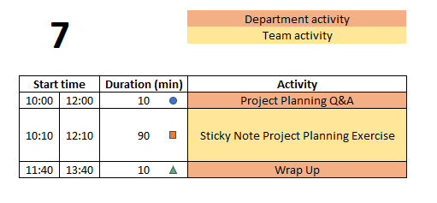
Day 7 Agenda
  You are STRONGLY ENCOURAGED to download newest version of Playbook prior to EACH on-site meeting.
Repository instructions - https://designlab.eng.rpi.edu/edn/projects/capstone-support-dev/wiki/Subversion
Playbook - https://designlab.eng.rpi.edu/edn/projects/capstone-support-dev/wiki/Capstone_Playbook

Slide 101
Engineering Design Process
This Design Process and terminology is taught in IED at RPI
Today is Day Seven
Team will develop list of the tasks necessary to complete the project, and schedule them over the remainder of your work assignment.
Notes:
Day 7

Slide 102
10 min - Project Planning Q&A
Action Item was to watch 2 videos…
Ask me 1-2 QUESTIONS about the content!
What is a milestone?
What is the difference between parallel tasks and serial tasks?
What is critical path of a plan?
Notes:
Day 7

Slide 103
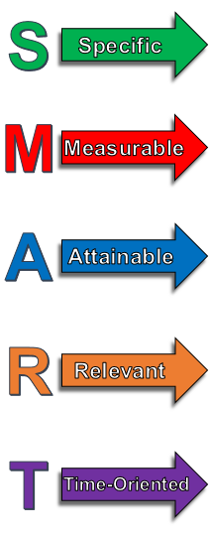
Defining Meaningful Tasks
90 min - ‘Post-It Note’ Project Planning
One idea per Post-It. Be concise!
Defined to be No More than 1 week long.
Break big things into smaller pieces.
Everyone Needs at Least 1 Task / Week for the
Entire Semester
What will YOU contribute to the project?
Focus on YOUR potential contributions to the project.
(We know these may not yet be defined!)
Focus on the technical work required
For now, leave out project management / overhead tasks,
e.g., report writing, slide making, etc.
DO include documentation needed for technology transfer,
e.g., user manual
Be Technical! Be SMART!

Slide 104
Defining Meaningful Tasks aka “SMART”
Project Planning Tips
Yes, it gets harder to define tasks near the end of the semester. So instead, work backwards from the end!
There may be gaps in time – you will need to fill those in today
Do not just copy a task 3 times because it spans 3 weeks. Instead, you must break it down into 3 well defined smaller tasks.
Don’t allocate slack time at the end of the semester. Project plans do not include tasks called “Just in Case”. Instead estimate the length of tasks to factor in some risk. Not everything works the first time and many thing turn out to be more difficult than first thought.
Group things by functional subsystem rather than by name. This helps reveal possible planning gaps.
Remember your deliverables! Do you have the tasks needed to produce each of them, including things like demos?
Be Technical! Be SMART!

Slide 105
20 min - ‘Post-It Note’ Project Planning
10 min – Deliverables
Write each Deliverable from Project Statement and Objectives on a Post-It and
place on the board/calendar at approximate due date.
Draw a box around the note so that it stands out.
10 min – Tasks
(Individually silently) Each team member generate list of TEN tasks which must
be completed to accomplish the deliverables.
Off-site Action Item was to post 6 individual tasks to EDN, so start with those.
Now create at least 4 more each.
Create 1 Post-It for each task
Add your initials to post-it in case there are questions about content

Slide 106
‘Post-It Note’ Project Planning Exercise
10 min – Organize tasks on Whiteboard
Position tasks appropriately along week-by-week calendar
  This can be done before or after getting all items shared.
50 min – Group organization of tasks
Add missing tasks, remove duplicates
Organize by subsystem or milestone
10 min – Re-assign ownership (by color/initial)
Ensure everyone has work throughout semester
Each Team Member Should Leave meeting with their assigned Post-It’s.
Each Team Member then Enters Their Own Tasks as EDN Issues!

Slide 107

10 Min - Reflecting on your New Project Plan
Take a few minutes to pause and reflect on the Project Plan the Engineering Team just created.
Use the prompts on this Wiki page to guide the discussion.
  https://designlab.eng.rpi.edu/edn/projects/capstone-support-dev/wiki/Reflecting_on_your_New_Project_Plan
Focus on Process and Results

Slide 108
Action Items/ Meeting Prep
(to be completed BEFORE Day 8)
Project Technical Work
Add deliverables from Project Statement & Objectives to EDN Gantt Chart as Versions
  Watch video with instructions (4 min) - https://designlab.eng.rpi.edu/edn/projects/capstone-support-dev/repository/112/raw/training/Creating%20Versions%20from%20your%20Statement%20of%20Work.mp4
  Prefix with current semester name/year, e.g. “F23-” to avoid duplication of common deliverable names across semesters.
Add tasks identified on sticky notes into EDN as Issues and associate them with the appropriate version and assignee (owner)
Technical Memo due on 9/21 (9/26)
  Memo Information: https://designlab.eng.rpi.edu/edn/projects/capstone-support-dev/wiki/Technical_Memo
  Submit your memo by Uploading to the Background Information folder in team’s Repository
    Include your RCSID and topic in filename!
P
T/D
Team Development / Design Process Refresher
Read Risks Associated with Project Plans Wiki page and revise team plan in EDN Gantt chart as necessary
  https://designlab.eng.rpi.edu/edn/projects/capstone-support-dev/wiki/Risks_Associated_with_Project_Plans
Administrative Tasks
Create draft of Client Meeting #1 PPT and upload to the Repo BY START OF Day 8
  Template - https://designlab.eng.rpi.edu/edn/projects/capstone-support-dev/wiki/Templates_and_Forms
  Repository location – working/Reports/Client Meetings
Create agenda for 45 mins of Day 8, NOT just work on your Client Meeting slides!
Complete the Online Safety Training in Percipio by end of 3rd week TODAY !!
  https://rpi.percipio.com/
  Rensselaer Manufacturing and Prototyping Laboratories - Safety Orientation
A

Slide 109
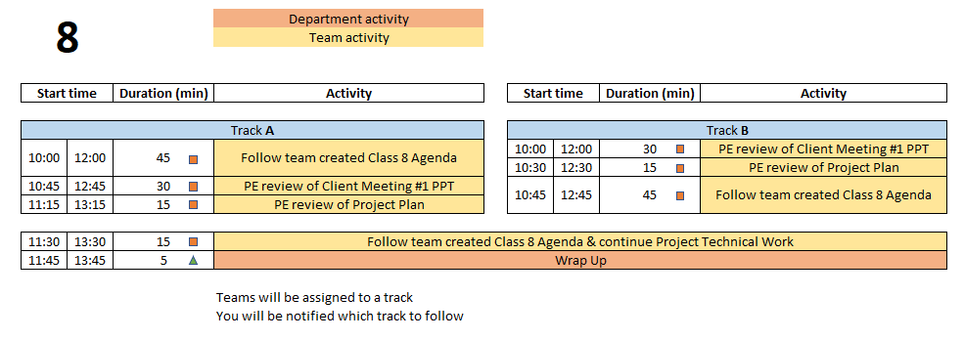
Day 8 Agenda
  You are STRONGLY ENCOURAGED to download newest version of Playbook prior to EACH on-site meeting.
Repository instructions - https://designlab.eng.rpi.edu/edn/projects/capstone-support-dev/wiki/Subversion
Playbook - https://designlab.eng.rpi.edu/edn/projects/capstone-support-dev/wiki/Capstone_Playbook

Slide 110
Engineering Design Process
Today is Day Eight
Team is developing concepts and beginning to down select.
This Design Process and terminology is taught in IED at RPI
Notes:
Day 8

Slide 111
60 min – Follow Team created Agenda
Designate team member to take and post minutes to EDN
  This should be done for EVERY on-site and off-site meeting.
  Rotate responsibility. To be equitable, ALL team members should have a turn!
Notes:
Day 8

Slide 112
15 min – PE Review Project Plan
Many short individual tasks? Few large group tasks?
Adequate time for:
  Manufacturing?
  Purchasing?
  Testing?
  Iterative development? Second round of any tasks?
Equal division of labor across all team members?
Ability to do some work in parallel rather than series?
  Design test plan BEFORE fabrication is complete
  Create dummy data NOW to test software performance or analysis approach

Slide 113
30 min – PE Review of Client Meeting PPT
Checklist
Are slides numbered?
Are figures labeled?
Have Team members names, PE/CE names, Client name, company logo been updated from blank template?
Does agenda match actual contents of PPT?
Do the contents match the rubric and Project Statement & Objectives content?
  Background & Customer Needs
  Technology Assessment
  Engineering Requirements
  Concept Generation

Slide 114
Action Items / Meeting Prep
(to be completed BEFORE Day 9)
Project Technical Work
Continue technical work
Post progress to Design Forum thread(s)
Team should now be creating and updating your individual project tasks
P
T/D
Team Development / Design Process Refresher
Administrative Tasks
Address any feedback received on Client Meeting PPT
Client liaison should email PPT to Client no later than 24 hours prior to call. This person will be the focal point for emails to/from your Client. They are not the team's "spokesperson" at meetings, conference calls, etc.
Prep for upcoming client meeting, e.g., identify speakers for each slide, prepare your notes, etc.
A

Slide 115
Day 9 and Beyond Agenda
Employee Orientation activities have ended!
Primary purpose of the remaining on-site meetings is team review and assessment of work already completed, especially with your PE and/or CE.
These 4 hours per week of on-site meeting time may be the only available time for FULL Engineering team to meet. So it is recommended to use for group discussions, group work, planning, updating Needs and Requirements, making decisions, etc. IF all that is complete / up to date, use the time for individual work.
Pro Forma Agenda posted on Capstone Support
  https://designlab.eng.rpi.edu/edn/projects/capstone-support-dev/wiki/Pro_Forma_Meeting_Agenda
Use EDN and Repository to document all work moving forwards

Slide 116


CONGRATULATIONS you are now ON BOARD
USS Design Lab

Slide 117
All Employee Meetings

Slide 118
5 min – BDR Q&A
BDR Introduction
Action Item was to watch review 1 Wiki page…
Ask me 1-2 QUESTIONS about the content!
What does BDR stand for?
Who is audience for BDR?
Approx. how many PPT slides should team prepare?
Notes:
Day 9

Slide 119
Engineering Design Process
POSTER introduction
This Design Process and terminology is taught in IED at RPI
Team is creating a poster to communicate
Overall project (Needs & Requirements)
Progress made (Concepts, System Architecture)
Future steps (Design, Integration, & Test Plan)
Notes:
Day 9

Slide 120
95 min – Poster Creation
Download and Open Poster.pptx from Repository
  https://designlab.eng.rpi.edu/edn/projects/capstone-support-dev/repository/112/entry/template%20documents/Poster.pptx
10 mins – Divide into 3 groups, and work on initial slides. Content can be pulled from Project Statement & Objectives.
  Purpose
  Past Work and/or Project History
  Semester Objectives/Requirements
40 mins – As a full team discuss Technical Approach, Results and Accomplishments to Date
30 mins – Move on to Next Steps and Plan
15 mins – Begin assembly of content onto single slide (pg 8)

Slide 121
Revision History
Version | Date | Name | Reason for Changes
1.0 | 7.20.23 | Paster | Copy created from S23 Playbook Revision history cleared Revision history moved to END of PPT
1.2 | 8.4.23 | AP/JK/MA/BD | Slight time shifts for class 1+2 Wraparound narrative language and explanation slides
1.3 | 8.8.23 | MA | Adjusting
1.4 | 8.11.23 | AP | out of class task -> action item Sponsor -> client PDR -> Board of Directors Review Statement of Work -> Project Statement & Objectives
1.5 | 8.14.23 | MA | Better / more positive wording for Class 11 slide. Changed “student” to “team member” for narrative. Minor tweaks for look. Added D&D graphic to the framing slide. Keep that?
1.6 | 8.16.23 | MA | Team meetings yields many updates for narrative and improved wording.
1.7 | 8.17.23 | AP | Updated some links and terminology Swept and replaced instances of ‘class’
1.8 | 8.17.23 | AP,KN,MA,BD | Removed Orientation Day 9+10 Added All hands meeting slides
1.9 | 8.18.23 | AP | ALL references to ‘Webex Space location’ removed Deleted hidden slides Page numbers standardized
1.10 | 8.21.23 | BD | Added Team-Building Retreat
1.11 | 8.22.23 | AP | Ticket Out -> Employee Survey URLs checked throughout
1.12 | 8.23.23 | AP | Incorporated suggestions from KD Review and update of Action Items to match on-site meeting content
1.13 | 8.24.23 | AP | Agreement of Action Items between Playbook slides and Capstone Support Wiki

Slide 122
Revision History - continued
Version | Date | Name | Reason for Changes
1.14 | 8.24.23 | MA | Broken links to Mediasite fixed
1.15 | 8.25.23 | KD via AP | Changes to slides 8,13,14,17,43,103,105,106

Slide 123
Revision History - continued
Version | Date | Name | Reason for Changes

