Slide 1
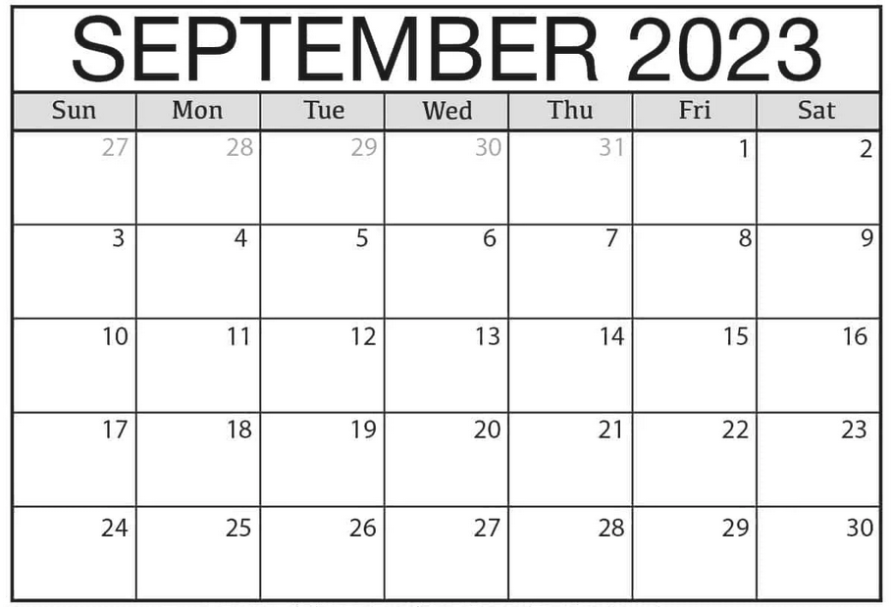
Capstone Onboarding Schedule ex: 9/14 is Day 6 for sections 1+2
1 1 2 2
3 4 3
Section 1+2 – red
Section 3+4 - blue
5 4 6 5
7 6 8 7
9 8 9

