Slide 1
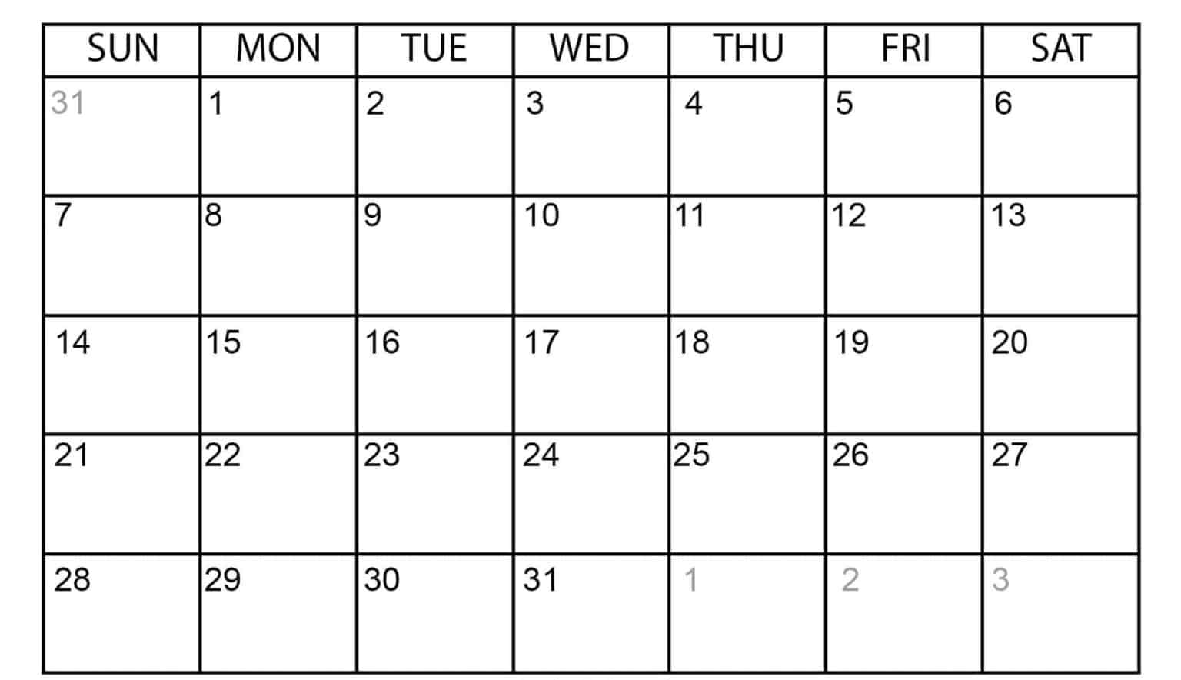
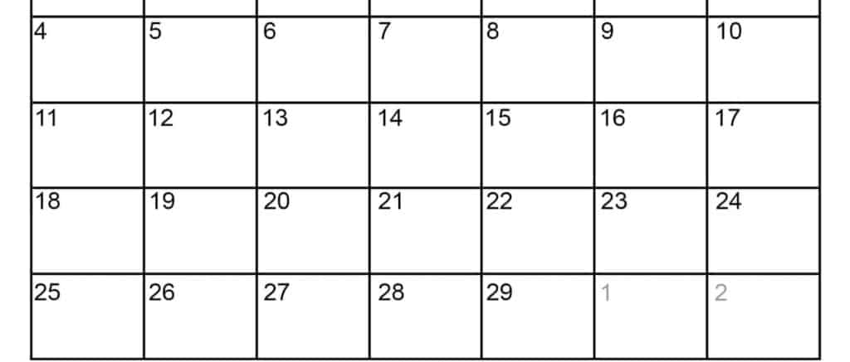
JANUARY 2024
Section 1+2 – orange
Section 3+4 – blue
FEBUARY 2024
1
1
2
1
2
2
3
3
4
MLK
4
5
5
6
6
7
7
8
8
9
9
President
Day
BDR
BDR

