Slide 1
Creating Stronger Posters
A Before and After Look at Some Examples
Mid-Term Posters
By
The Design Lab Staff

Slide 2
Teaching approach
For each poster, show “before”
Ask students to write down (on whiteboard if available) their comments on how to make the poster stronger. This might include listing anything they did not understand, anything that was not clear, missing information or things they wish the poster communicated. Comments should be on both text and images. Too much / too little, etc.
Have the team create their own additional checklist to be used for their posters & post that to their wiki (preferred because they can edit it later) or a forum.
Goal Is To Provide Detailed Feedback To Show How Typical Posters Can Be Improved

Slide 3
Teaching Approach – Initial Ideas
For each poster now show an “after” version updated by the PE’s based on starting with the team’s poster.
Show on the after, what changed then voice over explain why
Alternative, use this interactively. Show before / morph then ask students “guess what changed”, then have them explain why those changes were made
Dropped - Making the revisions / edits will be too time consuming!!!

Slide 4
Notes
Some of the poster formats may have been altered slightly during importing. In general, we are not addressing formatting issues.
All teams should be referencing the “Creating Strong PowerPoint Presentations” page on the Capstone Support Wiki. Those suggestions also apply to posters!
All teams should also refer to and use the definition for “S.M.A.R.T”
The font sizes used in this presentation are known to be too small for projecting! It must be viewed on individual laptops instead.

Slide 5
Notes - Continued
It is acknowledged that this material currently focuses on improvements and does NOT indicate things done well.
This NEEDS to be ADDED!

Slide 6
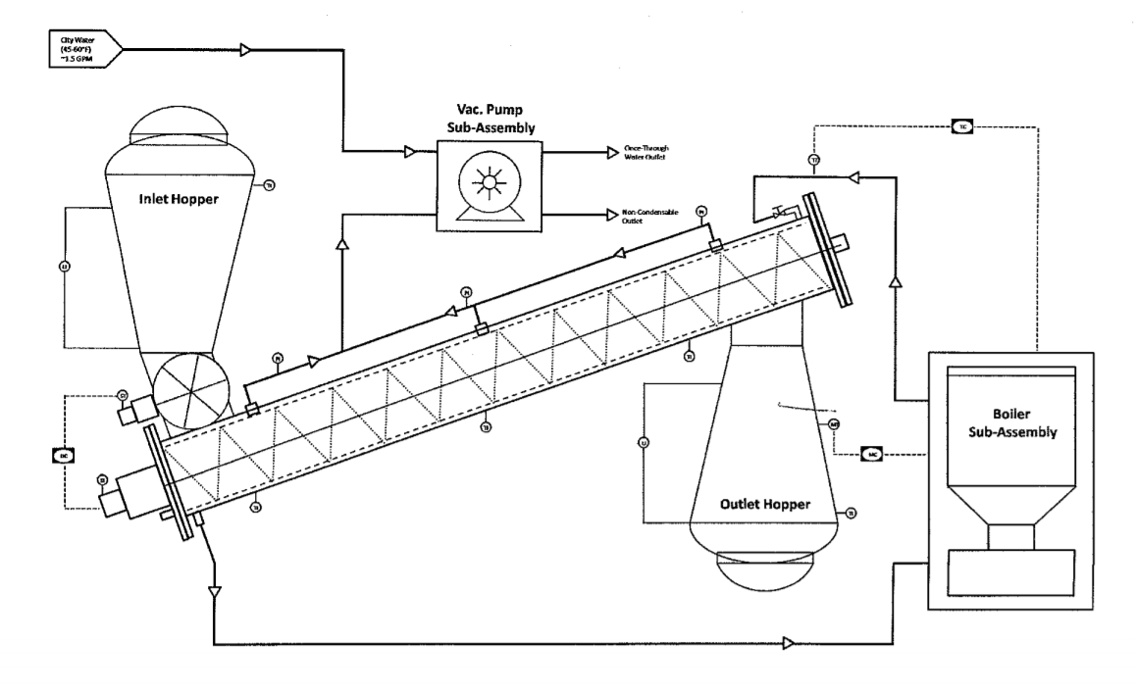
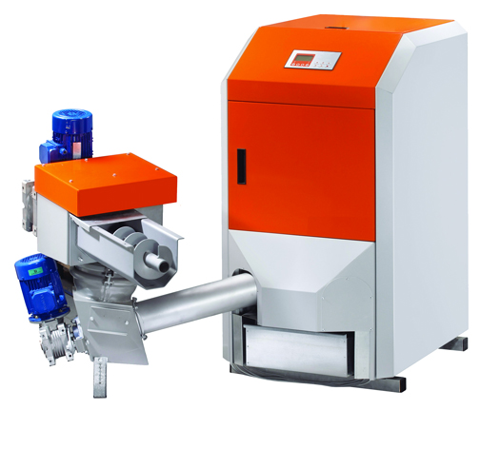
Woodchip Fuel Dryer
Purpose
Semester Objectives
Work to Date
Adapt an existing woodchip fuel dryer design built by Evoworld to handle commercial output loads. The updated model should be transportable with improved efficiency.
Convert to continuous operation
Eliminate bunching
Increase throughput
Create automatic control system
Cost analysis
Initial thermal calculations
Airlock requirements/ quotes
Required screw parameters (ton/hr)
Convection simulation models
Initial control system design
Logic flowchart for system
Preliminary circuit diagram
Past Work
Proof of concept prototype
Vacuum-assisted
Batch process = 1 ton/day
1.25 hours to complete
Manual controls
Next Steps
Finalize mechanical & electrical/control design
Develop packaging concept
Calculate power requirements
Produce bill of materials
Complete cost analysis
System Diagram of Prototype
Technical Approach
Electrical
Automated control system
Power system
Mechanical
Analyze vacuum vs convection drying
Eliminate bunching
Create continuous process
Engineering Requirements
25 ton/day capacity
<=25% moisture content
Evoworld Woodchip Boiler
Notes:
Purpose-
Past Work-
Semester Objectives-
Technical Approach-
Work to Date-
Next Steps-

Slide 7
Opportunities for Improvement
Overall the poster would greatly benefit from using SMART. As a result it does not communicate very much without a person to narrate. This is NOT the goal for posters!
Past Work
What about a proof of concept?
What is/about vacuum assisted? What does this mean?
Manual controls of what?
Objectives
Bunching of what?
Automatic control of what?
Diagram
Needs dimensions to provide a sense of scale. Needs many more annotations to explain the key components to people who do not know about such drying systems (aka "everyone"!)
Work to Date
Most of these might be better shown by pointing to things in the system diagram. USE figures to help tell the story
What thermal calculations? Of what/where within the system? Any calculations would be initial, so that does not clarify anything.
What airlock? What are its requirements?
Screw parameters - calculated, discovered, provided by sponsor? Unclear what the accomplishment is
Where in this does convection occur?
What does the control system design look like? Show that with a block diagram at least
Same forth logic flowchart - might need to be a simplified version
Showing the circuit is probably not as important as showing the higher level design. The circuit is the most likely to change at midterm.
Tech Approach
Electrical - these are just subsystems. They are NOT a tech approach. The tech approach would tell us HOW the team plans to design these.
Mechanical - why? Is that a decision the team needs to make? That's not clear anywhere else What has the team done so far towards migrating to a continuous process? Nothing seems to be shown.
Engineering Requirements – as stated, this is not an approach. This should be part of the objectives since it's what the team is trying to achieve.
Next Steps
The first bullet essentially says: "finish the project" and as such is not informative. Designs of what? Be more specific!

Slide 8
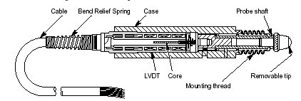
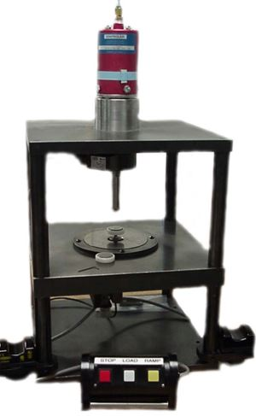
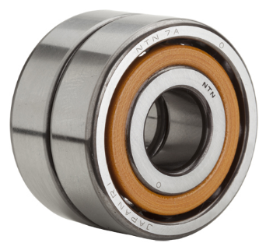
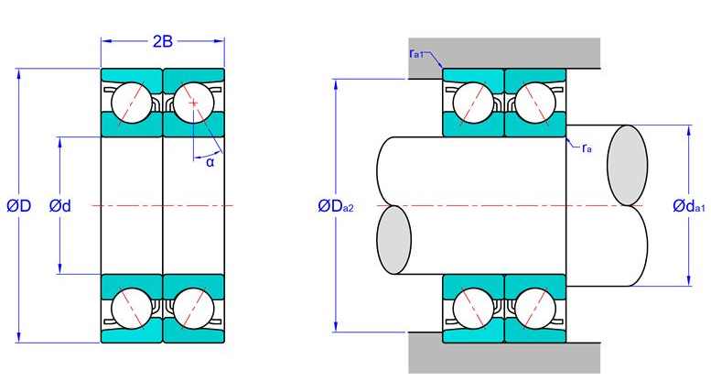
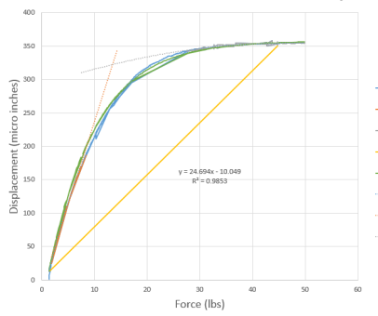
Bearing Preload Gauge
Project Introduction & Purpose
Technical Approach & Results to Date
Bearing Preload Gauge: Measures load vs. displacement on ball bearing pairs to match duplexed pairs of bearings
Duplex Bearing: Used to increase shaft location accuracy, load capacity, and bearing assembly stiffness, and to decrease radial and axial play
Customer currently experiences reliability issues with gauge.
Causes: Analog output, manual knee point determination, sensor incompatibility, etc.
Finish research of linear displacement sensor
Completed initial setup of current gauge system
Knee point calculations based on curve fitting techniques (exponential, polynomial regression, and interpolative curve fitting, etc.)
(Left) External view of bearing stack
(Right) Internal view of bearing stack
Semester Objectives
Current Bearing Preload Gauge
New linear displacement sensor: research & implementation
Create CAD model for each part on the gauge
Compile full user manual to assist operators with using the new gauge
Compile full gauge manual for maintenance or repair
Create computer algorithm that finds the knee point
Next Steps
Sensors Selection and Wiring
Creating Computer Program and Documentation
Testing and Final Adjustments
Preliminary CAD model for preload gauge
Knee Point Demonstration

Slide 9
Opportunities for Improvement
Intro
Not clear if the left photo is a "duplexed pair of bearings" - not sure what those are. Perhaps that term is not common/standard? It "looks" like two bearings side by side. Maybe that's what duplexed means. Similar issues with the right hand fixture. That looks like there are two different shaft sizes though adding to the confusion.
Does the machine measure a pair OR does it measure individual bearings and they then pair ones that have matching displacement values?
Past History missing - Need to explain that they manually have to 'guess' at the knee.
Objectives - what's a knee point. Although there is a graph with that title, no "knee" is clearly shown on the poster.
Approach / Results
It seems but is not clear that your approach is to identify an alternate gauge - but the poster does not say that.
What setup? Not clear on poster that the team HAS the equipment in house!
The Knee result and graph is not clear. Annotations pointing to specific things on the graph are needed to walk the viewer through an understanding of what happens.
Its unclear if the team is successful so far and has a high probability of final success.
Annotate / label all parts in the AD drawing. What, if anything is significant about them?
The figures should show where/how forces are applied and measured.
Next Steps as stated appears to be "do the project".

Slide 10
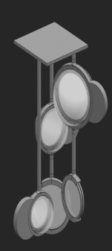
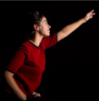
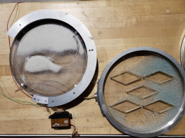
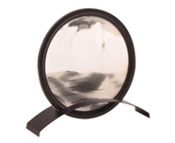
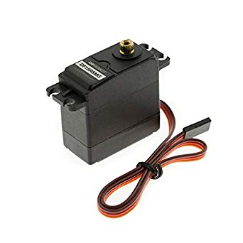
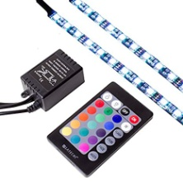
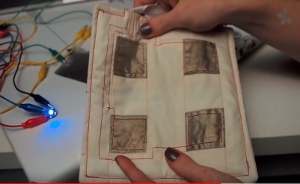
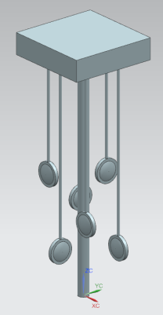
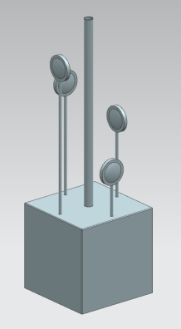
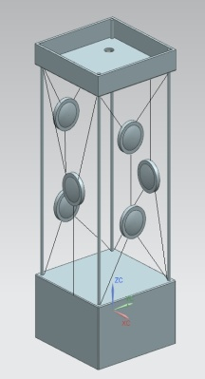
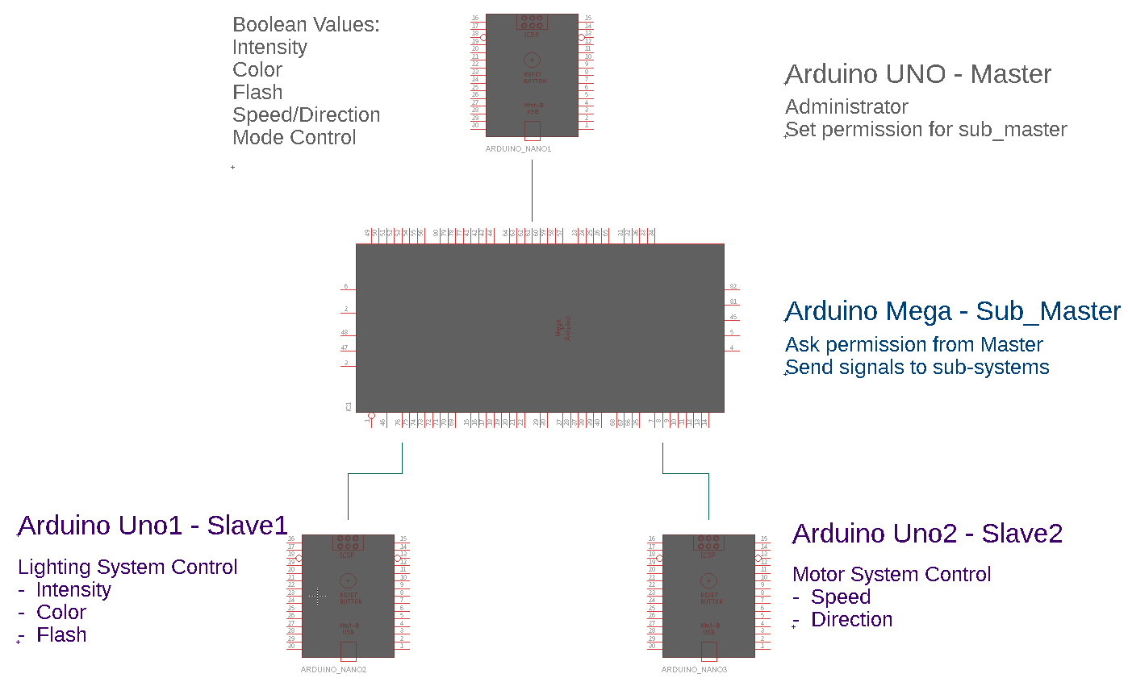
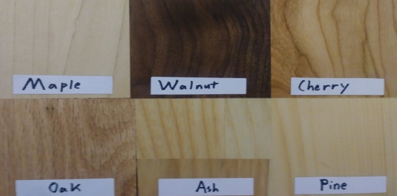
ARC Sensory Feature
Project Objective
Sand Feature Evolution
Develop a Sensory Feature for Developmentally Disabled Users
Safe, interactive, automated, and easy to use.
Preliminary frame design was completed (Fall 2018)
Specs given to previous team:
Fit within 2.5’x2.5’ column
Fall 2018 Disc Fabrication
Sand disc selection from external vendor complete.
UI Evolution
Frame Design Evolution
Specs
A’
B
C
User Interface Logic Flow
Materials Selection
Remaining Work
Fabrication of conductive fabric controller
Implement wiring systems for UI subsystems
Create “manufacturing-ready” CAD models for final design
Must fit within 2.5’x2.5’ column
Six individual sand disks for 360$°$ use
Zero safety hazards
Two motorized disks
User-controlled LED strips (color, intensity, effect)

Slide 11
Opportunities for Improvement
Overall
Great that there are lots of pictures but in this case, they do not always speak for themselves.
Font size to be readable
Objective, very high level, not clear what the team must do for this semester. It looks more like long term objectives. As a result it does not help set the stage for the rest of the poster. What problem(s) is the team attempting to address?
Missing Tech Approach Section
Please follow the provided template!
This section could have clarified that the team is following 3 things - UI, frame, sand feature - if that is actually true. Since it's not clear on the poster, this is only a guess.
Sand Feature
Label the 3 images. WHAT are they? In the first image are those disks sand features? Annotate to communicate that.
Is all of that Fall 2018? If so, then put that in the title, leaving more space for important info. What IS important about all that? Need words for this.
Dimensions?
UI
What is all this? Why does it matter? How does it relate to the sand feature or the other thing with disks? Need words.
What is the purpose / significance of the fabric?
Frame Design
Does this go with sand features or the UI thing?
Dimensions?
Base could have been rendered to show wood grain.
Specs - for what? Looks like for the Frame but it's separated from that block. Isn't the 2.5'x2.5' size already stated in the Sand Feature block? And why is that Frame image even there?
Two of the 6 are motorized or are there two more that must be motorized. What does motorized mean, i.e. what motion is motorized? Why?
Materials Selection
Materials for what? Show this via annotations on the appropriate figure(s)! The wood samples not as important as their image size within the poster suggests. Why is that really a big deal? Only the choices are shown but no explanation. Why does it really matter? If it's cost then show them in a ranked table with $/ft2
User Interface Logic Flow
That is NOT a logic flow chart, it's a block diagram.
Explain / annotate data flows
WHY does it look like that? No justifications are provided. In fact, it appears to be the most complicated way to do this - why not a single Arduino / microprocessor? Why use Arduino vs. other microprocessors?
Font too small to read, lines to faint to see clearly. Avoid more dull gray coloring for the poster.
Remaining Work
What conductive fabric? What objective does it meet?
What does the controller "control"? Why?
Not clear what the subsystems of the UI subsystem are.
What needs to be fabricated? No clear list shown / indicated. What things purchasable vs. needing to be fabricated?

Slide 12
Notes:
Instron Grips – I requested the Missing PPTX but since we’re not editing, can live with this for now. Team should post it anyway!!!

Slide 13
Opportunities for Improvement
Purpose text can be smaller to make room for more important info.
Past Work - Mentioning the square nut means you should annotate that in the left side photo. Same for the shear pin.
Figure 1 & CAD - need annotations to point out all of the "interesting" items.
Objectives - How do these compare to existing gripper? A table of data would be better.
Results
Clamping force < desired - so now what?
Rotation / Shear torque / stress analysis - you had no listed spec on that but should have
Approach
Leave off all dates
Fab - mentions drafting but no actual fab!
User manual - missing from objectives
Missing - how you will actually meet your specs

Slide 14
Robots for Physically Challenged – need PPTX

Slide 15
Opportunities for Improvement
Where is the ECSE content? There is much circuitry and control in this project but there’s nothing on the poster
Annotations
Dimensions

