Slide 1
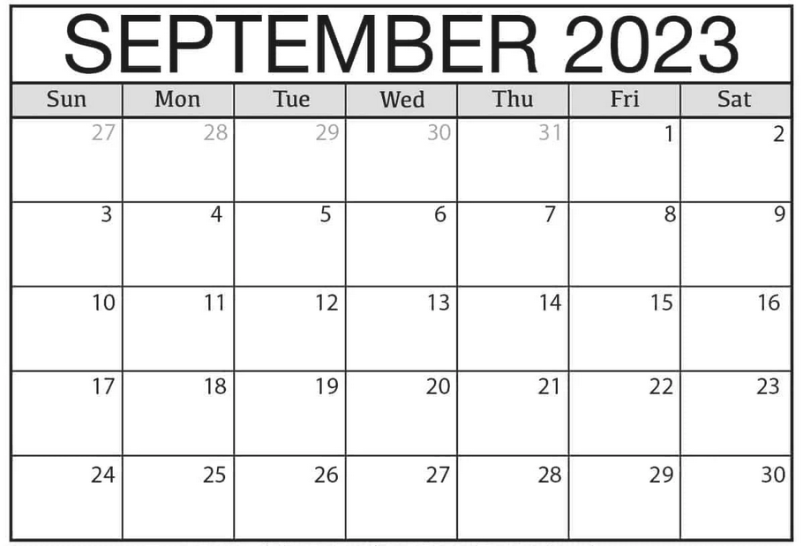
Capstone Onboarding Schedule ex: 9/14 is Day 6 for sections 1+2
1 1 2 2
3 4 3
Section 1+2 – red
Section 3+4 - blue
5 4 6 5
7 6 8 7
9 8 9

Slide 2
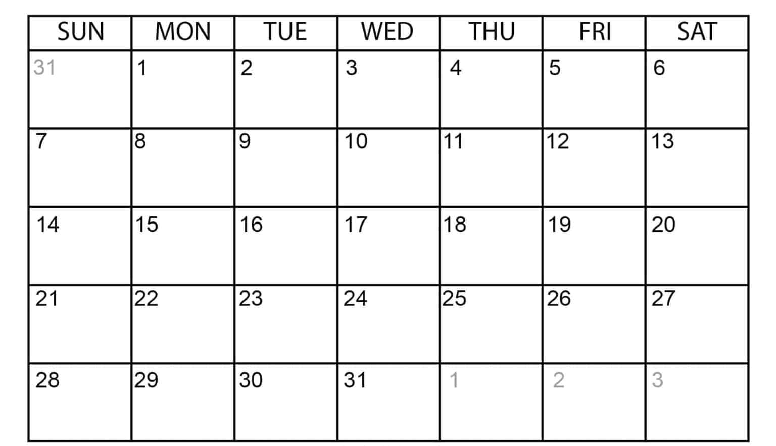
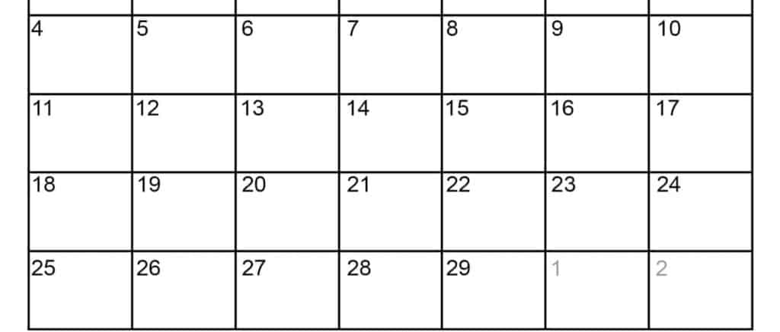
JANUARY 2024
Section 1+2 – orange
Section 3+4 – blue
FEBUARY 2024
1
1
2
1
2
2
3
3
4
MLK
4
5
5
6
6
7
7
8
8
9
9
President
Day
BDR
BDR

