Slide 1
Capstone Introduction and Expectations
Part 2
Notes:
Speak Slowly
This short video represents the second of two parts in our discussion introducing the Capstone Design course and our expectations for students

Slide 2
Capstone Design – Why we do it
Provide a "real world experience“
What exactly is that vs. “traditional” classes?
What are some differences between IED and Capstone Design?
Why is Capstone a required course?
What is a successful outcome for
Project Sponsor?
Student?
RPI?
Notes:
First we will talk about why we do Capstone Design
A hallmark of Capstone Design is to provide as close to a real world experience as we can while you are still undergraduate students. So, what exactly is a real-world experience vs. traditional lecture- or lab-based courses? Here are some key differences:
Most classes have singular focus, such as Dynamics or Intro to Circuit Design, and in the real world the problems you will be tasked with solving will almost certainly require skillsets you’ve acquired across multiple classes
Closed vs. open-ended problems – most problems in traditional classes are “closed” problems that have one, or perhaps a couple, tightly defined solutions that you are seeking to find. Open-ended problems on the other hand can have many potential solutions, and it is up to the teams to determine which of those solutions to pursue
Team work vs. group work (as covered in our earlier discussion) – most students once graduating will work in teams, and we wish to duplicate that as much as possible. As a reminder, we are looking for:
Student as opposed to supervisor management of projects
Collaboration vs the divide and conquer method
Peer vs. supervisor/instructor review
Next, we will talk about differences between IED and Capstone. While IED prepares students for Capstone, there are some key differences
Assigned project vs. project choice in IED = IED students do two projects, a mini project drawn from 3-4 options presented by instructors, and a team project developed by the team. While the organizations you work for once graduating will define to an extent the types of work you do, the specific projects will most likely be assigned to you, esp. as entry-level engineers. We reflect that practice here in Capstone
PROJECT SPONSOR – IED students are only responsible to team and instructors, while in Capstone we are trying to achieve a successful outcome for someone else, whether that is an outside organization, a campus research center, or faculty member. In short, your results matter beyond your grade.
Why is capstone required?
To give you a venue to demonstrate all that you’ve learned across classes at RPI (and before), jobs and internships, clubs and sports, and any other life experiences that you can draw from
We want to give you real world experience while you are still students, so you can receive feedback and grow before moving on to whatever is next
Successful Outcomes
Sponsor – successful completion or advancement of project, interaction with students for things like recruitment, and access to RPI faculty and staff
Student – that you learn something that helps you in your career
RPI – maintain or raise standing with sponsors, obtain future projects, and ideally having students return with projects as sponsors

Slide 3
Design Course Progression
General Coursework
Intro Engineering Design
Capstone Design
On-going Feedback from Instructor
Instructor Ownership (content)
Student Ownership (project)
Stakeholder is Student Team
Student Ownership (project)
Stakeholder is Company/Organization
Instructor time: prepared lecture and skill instruction
Student project time: research and experimentation
Graded activities: presentation of results, HW/quiz/test
Project work reviewed/graded continuously rather than formally submitted
Notes:
Next we’ll talk about the progression from general coursework through IED to Capstone
As you can see from the charts, instructor content, for example lectures, decreases as we move through the progression
At the same time, content ownership moves from the instructors to the student teams
Stakeholders progress from students in general coursework to student teams in IED to project sponsors in Capstone
IED and Capstone students receive ongoing, continuous feedback from instructors, more in capstone than IED
It is vital that students recognize this!
Finally, in capstone, project work is reviewed/graded continuously rather than only through formal, discrete submissions

Slide 4
Design Course Progression
Typical Course Content
Instructor Guided Content
Lecture & Lab
Quiz/Test
Structured Activities
Student/team performance feedback
Submit only finished work
Team Guided Content
Meetings (in & out of class)
Design / Build / Test (Engineering Design Process)
Presentations
Peer to peer feedback & review
Iterative design & documentation
Capstone instructor-guided activities will be primarily in first 5 weeks of semester
Notes:
This slide goes into greater detail regarding typical instructor-guided vs. team-guided course content, and gives examples of each
As you can see, Instructor-guided content includes things like (see slide)
Of these, only structured activities and student/team performance feedback occur in Capstone, whereas all of the listed team-guided content is required for successful projects.
Note that the instructor-guided content in Capstone is highly front-loaded with the vast majority occurring in the first 4-5 weeks

Slide 5
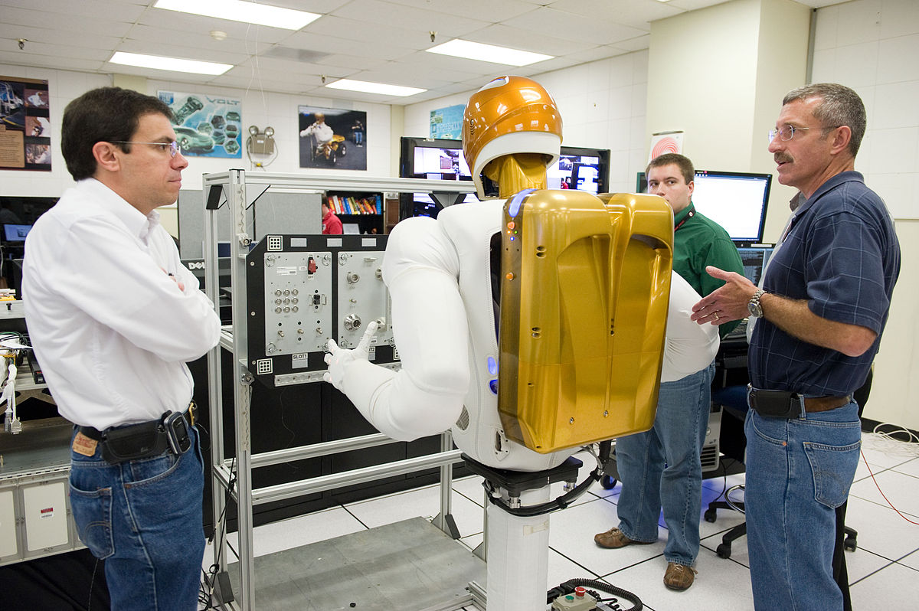
Capstone Design – How We Do It
Work as a Team to Solve an Open Ended Project by:
Applying what you've already learned in 15+ years of schooling, jobs, internships, and other life experiences
Includes re-learning whatever you've forgotten
AND self-learning new skills as needed
Begin the shift from
Engineering Student
Engineer
Notes:
No shame in re-learning things – you’ve learned a lot and inevitably, have forgotten some of that
In the same vein, it’s important to embrace the self-learning new skills – there is little chance that you posses currently all of the skills that you need to be successful for the duration of your career

Slide 6
Engineering Design Process
Capstone Design – How We Do It
This Design Process and terminology is taught in IED at RPI
Notes:
To solve our open ended project, we will employ the Engineering Design Process
This same process and terminology was taught in IED.
The EDP presents a framework for developing, analyzing, designing, and evaluating solutions to problems
We will go over the EDP in greater depth in the future

Slide 7
Team Member Roles and Responsibilities
YOU (students) are OWNERS of this project process
Sponsor (company) is OWNER of the project output
Design Lab Instructors are coaches & mentors, not teachers
Offer guidance and help
Point you to proper book, equation, or process, but students will do the math/analysis to justify their suggested solution
Project Engineer (PE) – day to day operations
Chief Engineer (CE) – grading/evaluation
Notes:
Some projects may have a single instructor who will serve as both Project and Chief Engineer
This concludes our discussion regarding Introducing Capstone and Expectations for the class. Thank you for watching.

