Slide 1
Welcome to
Capstone Design
Playbook for Day 1 through 10
In-Class Meetings
WARNING
This whole document is a work in process and in massive flux

Slide 2
Link to Agendas
Class 1
Class 2
Class 3
Class 4
Class 5
Class 6
Class 7
Class 8
Class 9
Class 10
#Pro Tip – Current Action Items are listed ONE page before next class’s agenda

Slide 3

Multidisciplinary Capstone Design
ECSE 4900 Electrical & Computer Systems Engineers
ISYE 4270 Industrial Engineers
MANE 4260 Mechanical Engineers
MTLE 4920 Materials Engineers

Slide 4
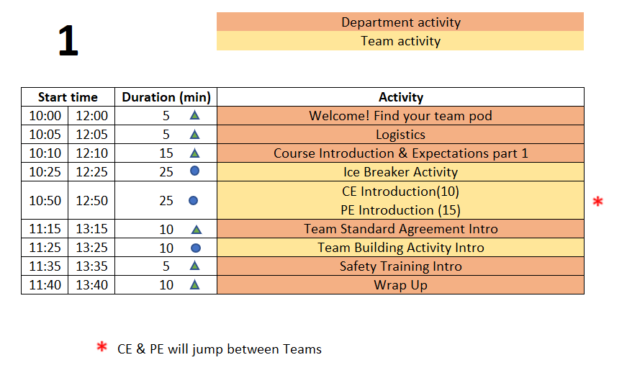
Class 1 Agenda
TD
Team Development /
Design Process Refresher
Administrative Tasks
Project Work
A
P

Slide 5
5 min - Logistics
The Daily Meeting Agendas are on the Capstone Support Wiki - see link from your PE’s intro email

Slide 6
Design Lab Mission
Develop High Performing Engineers by Mentoring Students in Professional and Engineering Design Practices Through Project Based Learning.

Slide 7
Capstone Design Transition
NO textbook, NO lecture
It is a Team EXPERIENCE
It is a mostly “flipped” experience
Guided/assisted by Project Engineer (PE)
Graded/assisted by Chief Engineer (CE)

Slide 8
Capstone Design:
Practice Engineering in Safe Environment
Initial Cover letter and Resume
New Employee Packet from
your Project Engineer
Design Lab Support Staff
Project Engineers and Chief Engineers
Students in a Course ➔
Consulting Engineering Team
Solving a Client Problem

Slide 9

Design Lab
Engineering Team
New hire

Slide 10
New Employee On-Boarding
Day 1 Agenda
Class 1 Agenda
TD
Team Development /
Design Process Refresher
Administrative Tasks
Project Work
A
P

Slide 11




Welcome to Your Project Team!
Student Team Members
Project Engineer (PE)
Purchasing
Fabrication Support
Chief Engineer (CE)
Client

Slide 12
Student Expectations
What are YOUR expectations for your Capstone experience?
  Workload
  Teammates
  Project
  Grading
Activity from Kanna??
Notes:
Capture these for our notes

Slide 13

Design Lab - Core Values
Embrace diverse backgrounds, skills, and perspective
Create an inclusive and equitable team environment
Act with Professionalism and Respect

Slide 14



Participation Expectations
Arrive to meetings on time.
Stay until meeting ends.
Be present in all meetings.
Listen, Engage, Participate.
Focus on the Project.
Minimize Distractions
(phone, other tasks)

Slide 15
Work Expectations
Your new position involves:
  4 Hours per week of on-site work
  5 Hours per week of off-site work
    Individual technical work & team meetings
Document all progress and results
Read communication from Design Lab staff and teammates
  Emails
  Webex chat
  EDN posts
Please respond in a timely manner!

Slide 16
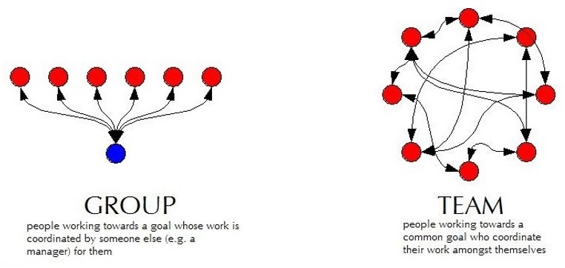
Capstone is More TEAM work than GROUP work
Group Work
  Divide and conquer
  Low interaction with team
  Supervisor managed
Team Work
  Collaborative effort
  Interactive -peer review
  Team member managed

Slide 17
Work Expectations
Q: “What expectations do your boss and peers have at work?”
Let’s start doing this NOW in the Design Lab.
  Be Accountable.
    To your teammates, to your Chief/Project Engineer, and to the project Client.
  Be Professional.
  Make your work VISIBLE.
    Post/share as you go. Please do not “hide” it from team until its perfect or completely finished.
    Use Electronic Design Notebook (EDN)
Notes:
This slide is animated. Shows only the question – PE should ask students and get some responses

Slide 18
Design Lab Communications & Documentation Policies
Written capstone communications are permitted using ONLY Design Lab tools:
  The EDN
    Native EDN posts
    MS Office files, CAD, etc.
    Repository via Subversion
  Webex
Use of any other cloud-based service, such as Google Drive/Docs/Sheets/Slides, GroupMe, Discord, Slack, Draw.io, etc. is FORBIDDEN
Although supported by campus, RPI Box and RPI Onedrive are also FORBIDDEN
Scheduling services such as WhenIsGood & When2Meet are acceptable for setting up meetings but must not contain any technical information
This Helps Protect Against Unauthorized Access And
Provides Equal Access To All Team Members

Slide 19
Accountability Step #1
You all received the New Employee Packet via email:
Project Description - Will guide your work today
Instructions for electronic
signatures in Adobe
Recognition Waiver and Release - SIGN & return by end of day
Sponsorship Agreement - SIGN & return by end of day
MANDATORY for all employees to SIGN & return by end of day
More information on Sponsorship Agreement and Confidentiality
  https://designlab.eng.rpi.edu/edn/projects/capstone-support-dev/wiki/Confidentiality_Requirements

Slide 20
25 mins - Ice Breaker
Desired Outcomes
  Prepare everyone for collaborative engineering team performance by helping create a relaxed environment where everyone can share ideas and participate more fully
  Build rapport among the engineering team members

Slide 21
The Process…
Break into pairs within your team – if your team has an odd number of members, one group should include three members
Answer the prompt for the first question using Slido – 1 minute
Pair off and Share Responses with your partner & discuss – 2 minutes
Go around the team and each person introduces their partner – name & skill – 5 minutes total
Review the full word cloud & discuss – 2 minutes
Repeat for second question
Repeat for third question

Slide 22
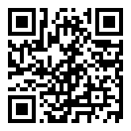
Ice Breaker
JEC 3232 side
SCAN this code
OR
  Open slido.com on your smart phone or laptop
  Join as a participant with
  #3748323

Slide 23


What is something that you are good at doing?
ⓘ Start presenting to display the poll results on this slide.

Slide 24
What is something that you are good at doing? - school related
ⓘ Start presenting to display the poll results on this slide.

Slide 25

How did you get good at the thing you are good at doing?
ⓘ Start presenting to display the poll results on this slide.

Slide 26
?? min – Syllabus Overview
Brief description of course deliverables and high level schedule of activities
  Old Excel horizontal layout graphic from Sarah Felix?
Slide(s) from Kanna

Slide 27
25 min – Staff Introductions & Project Launch
Chief Engineer (CE) & Project Engineer (PE) Introductions
  Both individuals will stop by to meet with the team
Project Description Review
  If you have not read the document yet, NOW is your chance. You need that information to do the next step effectively!
Begin documenting Questions you have about the project

Slide 28
15 min - Meet with Project Engineer
  Project Engineer meets with each team:
    Explain the PE Role
    Check on team status / welfare
    Team member introductions
    Discuss project impressions
    PE’s background/experience
    When not meeting with your PE or CE, team members generate/discuss questions about project.

Slide 29
10 min - Meet with Chief Engineer
  Chief Engineer meets with each team:
    Explain the CE role
    Check on team status / welfare
    Team member introductions
    Discuss project impressions
    CE’s background/experience
    When not meeting with your PE or CE, team members generate/discuss questions about project.

Slide 30

Engineering Design Process Progression
Days 1-5
You are here!
Days 3-5
Day 5+6
Day 7
Days 8-10 – Project Planning
This Design Process and terminology was learned previously in IED

Slide 31
20 min - Generate Project Questions
This exercise is intended to help you build on what you learned in IED
  IED project was created by team, and therefore easier to identify Needs, as the team was the client
  In capstone you are working for an external client and must practice understanding customer needs by interviewing client and asking questions
  Based on the Project Description and your engineering knowledge, what questions can you ask the client to better understand and document their needs?
Dropped
Shift info to Wiki
Notes:
Begin discussion here about building on what was learned in IED as opposed to IED refresher
Yogi Berra – If you don’t know where you are going, you’ll end up somewhere else

Slide 32
20 min - Generate Project Questions
Dropped
Shift info to Wiki
These questions can be about any aspect of the project, but by the end of today MUST include questions targeted to functionality and goals
Refer to the Project Description as needed
Write individual questions on separate Post-It notes - ONE question per Post-It.
Combine duplicate / similar ideas
Discuss, collaborate, and add to the list of questions
Take photo of board BEFORE end of meeting to preserve the list for Day 2 activity.
Post photo to Webex project space

Slide 33
Question Prompts
Dropped
Shift info to Wiki
Potential topic areas for generating questions:
  Functionality
  Performance
  Quality
  Usability
  Accessibility
  Reliability
  Durability
  Availability
  Manufacturability
  Maintainability
  Environmental Impact
  Interfaces

Slide 34
10 min - Team Standards Agreement Intro
According to concepts in organizational behavior, there are five stages of team development (Tuckman’s Model, 1964): forming, storming, norming, performing and adjourning
In high performing teams a Team Standards Agreement is often generated to establish procedures and roles to move the team more quickly into the performing stage
A Team Standards Agreement will be generated off-site by each team before Day 6
  The Team Standards Agreement shall be posted to your team’s EDN Wiki page in accordance with the instructions in the following document: https://designlab.eng.rpi.edu/edn/projects/capstone-support-dev/wiki/Team_Standards_Agreement
Completed Agreement should be posted to Wiki by START of Day 6

Slide 35
10 min – Team-Building Retreat
During the second week, there will be an off-site, peer-led, Team-Building Retreat
Retreat Goals:
  Build positive foundations of teamwork and communication.
  Foster motivation and accountability within teams.
  Enhance leadership, working together, and getting to know each other.
  Understand the importance of eye contact and active listening.

Slide 36

Team-Building Retreat
Location – Meet in the JEC 3222
Schedule - Three options:
  Wednesday 01/17 6:00-8PM
  Saturday 01/20 10:00AM-NOON
  Sunday 01/21 10:00AM-NOON
Attendance is expected (and incentivized with a little treat)
  Goal is to have entire or majority of team at one session
  If entire team can’t make same session, individuals will work with other teams during the event
Update dates & times
Notes:
Pic: http://www.entrepreneur-resources.net/theres-no-i-in-team-let-your-company-identity-grow-naturally

Slide 37

Team-Building Retreat
Action Required!
  Determine which session works best for team
  Each individual must register by Close of Business (COB) on Tuesday, 01/16/24 at: Capstone S24 LEAP Training Sign Up - Google Sheet
Update dates & times & link
Notes:
Pic: http://www.msimarinesolutions.com/uploads/3/2/3/0/32309061/img-2216.jpg

Slide 38
5 min – Safety Training Intro
Same material used for IED and other RPI courses
Certification ONLY good for one year, must be valid through END of this semester
Available on Percipio
Notes:
No different from industry

Slide 39
10 min – Wrap-up
Each day of the on-site meetings will end with a wrap-up and discussion of next steps
Team Engineers (YOU) are expected to complete Action Items/Meeting Prep work between on-site meetings to be prepared and make efficient use of meeting time.
Notes:
No different from industry

Slide 40
Wrap-up
Good example of benefits to students, e.g., what’s in it for them!
On Day 2, teams will utilize the work started today and continued off-site.
  Questions will be categorized then answered by team members, PE, or client.
    Establishing a strong list of questions aids in having a productive Project Kickoff meeting.
    Helping team members to begin answering questions about their project.
  Prepare for Project Kickoff meetings with clients to take place during Day 3 or 4 (project-dependent).

Slide 41
Action Items / Meeting Prep
(previously called homework, to be completed BEFORE Meeting 2)
Team Development / Design Process Refresher
Identify time and register for Team Building Retreat at
  Capstone S24 LEAP Training Sign Up - Google Sheet
Watch Wiki video (3 min)
  Add personal info (name, preferred pronouns, major, RPI email, phone #) to team’s Wiki on EDN.
Meet as team to generate project questions in preparation for Client Meeting #1.
T/D
UPDATE link
Administrative Tasks
Register for EDN – https://designlab.eng.rpi.edu/edn/
  Registration button in upper right-hand corner
  Login must be your RCSID (RPI email before the @ symbol)
  Email must be your RPI email
  Bookmark this site. You will use it A LOT for this course.
Watch Capstone Introduction & Expectations – Part 2 video (7 Min)
  https://designlab.eng.rpi.edu/edn/projects/capstone-support-dev/repository/112/raw/training/Capstone%20Introduction%20and%20Expectations%20Part%202.mp4
  EDN -> Tasks & Due Dates -> Day 1 Assignments
A
Turn url into embedded link
Project Technical Work
The Project Description sets the project’s initial direction. Read it carefully!
We invite you to bring project questions to next class.
P

Slide 42
Action Items / Meeting Prep
(previously called homework, to be completed BEFORE Meeting 2)
https://designlab.eng.rpi.edu/edn/capstone-support/wiki/class1-assignments
to be completed BEFORE Meeting 2
Note – link is in the PE email you received before classes! And will be echoed in your team’s Webex for convenience!
Notes:
Open the link, show it’s contents, done! Do NOT read it to them!!!

Slide 43
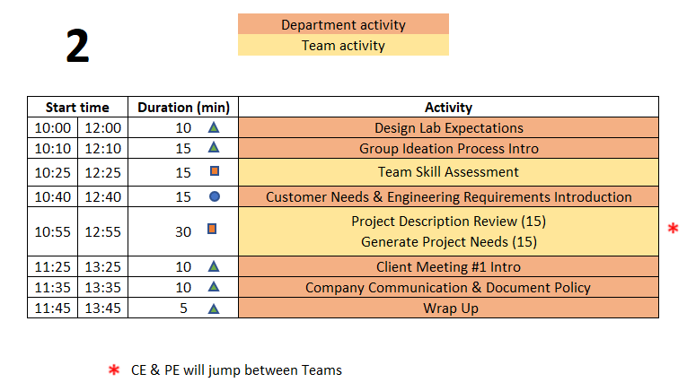
Day 2 Agenda
TD
Team Development /
Design Process Refresher
Administrative Tasks
Project Work
A
P
  You are STRONGLY ENCOURAGED to download newest version of Playbook prior to EACH meeting.
Playbook - https://designlab.eng.rpi.edu/edn/projects/capstone-support-dev/wiki/Capstone_Playbook

Slide 44
Engineering Design Process Progression
Days 1-5
You are here!
Days 3-5
Day 5+6
Day 7
Days 8-10 – Project Planning
This Design Process and terminology was learned previously in IED

Slide 45
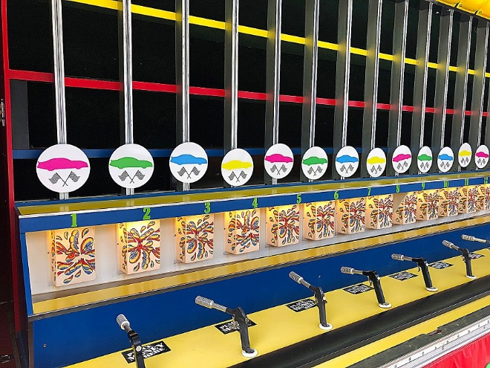
10 min – Design Lab Expectations Horse Race
Kanna to develop an alternative using Kahoot
Action Item was to watch one video (Capstone Introduction & Expectations – Part 2)
What is difference between IED and Capstone?
Who ‘owns’ your project – team, PE, CE, Client?
What is role of team members in Capstone?
What is role of PE?
What is role of CE?
Notes:
Day 2
IED vs CD – Not re-learning IED material – building on what was learned
IED – Becoming an Engineer
CD – Be an Engineer
Owner – Students
Role of Students – Solve an open-ended complex problem by applying good engineering practices
Role of PE – Assist students by day to day operations
Role of CE - Evaluation

Slide 46
Action Item / Meeting Prep Categories
Team Development / Design Process Refresher
  Forming, Storming, Norming, Performing
  Sequence of design artifacts – Needs & Requirements, Concepts, Decision Matrix
T/D
Administrative Tasks
  Onboarding - Legal paperwork, Safety training
  Design Lab Logistics
A
Project Technical Work
  Contribute directly to project progress and deliverables
  ALL project documentation & planning – notes, reports, analysis, Gantt chart
  Background research, design, prototyping, testing
P

Slide 47
15 min – Group Ideation Process
Goal
Learn and Apply the Group Ideation Process to Document Team Skills
Time boxed exercise: It may feel rushed, things may not feel complete. THAT'S OK.
You'll want more time. You can't have it.
Team must move on – the team has deadlines to meet!
Process
For EACH question:
2 min
  Individual silent thought on content
  Write thoughts on Post-It Notes, one per Post-It
2 min
  Place Post-Its onto whiteboard
  Quick discussion of similar, unique, or new answers
Move on to next section of Ideation Poster as a team
Notes:
Tuckman’s stages of team development – learned in IED, practiced and built on in CD

Slide 48
Identifying Team Skills
What classes can you personally call on to help with this project? (2 min + 2 min)
What experiences can you personally call on to help with this project? (2 min + 2 min)
What skills are the team missing BUT are probably needed for project? (2 min + 2 min)

Slide 49
15 min - Team Skill Assessment
template made in Repo,
link on Tasks and Due Dates page
Please Create a Word Document Based on your Team Poster
Shared by 2+ Team Members
Unique Skills
________________
________________
_______________
_______________
Skill Gaps
_______________
_______________
Post the MS Word document to EDN Project Management forum thread by end of today’s meeting!

Slide 50
15 min – Review Project Description
    Re-Read Project Description
    PE is available to answer any fundamental project questions the Team may have
      - Write these questions on the Whiteboard

Slide 51
15 min - Customer Needs & Engineering Requirements Generation
Needs and Requirements workbook.xlsx spreadsheet is located at:
  [new project] Capstone Support Template Documents page https://designlab.eng.rpi.edu/edn/projects/capstone-support-dev/repository/112/entry/template%20documents/Needs%20and%20Requirements%20workbook.xlsx
  [continuing project] Team’s Repository, Engineering Analysis folder
Fill out based on team’s current (uninformed impression) of project
  This is first pass. Don’t worry that answers are not complete or verified by Client. You’ll be updating this often!
Move to class 4
Add ‘lighter’ content/discussion here to prime pump
The Upcoming Exercise Will Help You Generate Ideas!

Slide 52

Developing Needs & Requirements
We Use These Definitions for
IED & the Design Lab
Note – Key IED Course Materials in Capstone Support wiki.

Slide 53
Generating Ideas for Your Needs
The Engineering Team will Play “Spin for Needs” using this link:
https://wheeldecide.com/?c1=Functionality&c2=Performance&c3=Quality&c4=Usability&c5=Accessibility&c6=Reliability&c7=Durability&c8=Availability&c9=Manufacturability&c10=Maintainability&c11=Environmental%20Impact&c12=Wild%20Card&c13=Interfaces
(be sure to copy the entire link to your browser!)
Start with the Needs you Previously Captured as part of your Meeting Prep!
Spin the Wheel
Use the Topic
Write One Related Need on a Post-It
Repeat!

Slide 54
15 min – Group Review of
Needs & Requirements
Read notes in template document for tips
Remove/combine duplicates
Add Requirements based on the Needs
Unsure of a proper metric?
  Quick Google search to put in an educated guess
Fill in holes/gaps after looking at categories
  https://designlab.eng.rpi.edu/edn/projects/capstone-support-dev/wiki/Requirements_Management
  Safety, Reliability, Maintainability, etc…
Take photo of whiteboard and post to Design Forum

Slide 55
Client Meeting 1 – Project Kickoff
Translate information from the Project Description to the first few slides in the deck
Add your questions from today
Complete the slides before next class
REWRITE THIS!!!

Slide 56
10 mins – Communication & Documentation Policies
Electronic Design Notebook - REQUIRED for all collaboration
Webex – Team Chat
WhenIsGood or When2Meet – meeting scheduling
Not Permitted
  Slack, GroupMe, or Discord
  Google Drive
  Google Docs/Sheets/Slides
  Other cloud-based tools for any use (schematics, mind maps, drawings, analysis, etc…) e.g., diagrams.net, etc.
  RPI Box, RPI Onedrive, RPI Sharepoint
  Texting, Instagram, WhatsApp, etc. for ANY project technical content
Webex is good for chat and live meetings, but project documentation should start on and stay in the Electronic Design Notebook (EDN) Forum or Repository.
  Simple/easy solution is to never put it on Webex (or elsewhere) to begin with.

Slide 57
Electronic Design Notebook (EDN)
  Integrated Project Management
  Threaded Communication by topic, rather than a single unorganized stream
  IP protection
  Performance Evaluation - accountability and visibility
  Secure access to team and Client
  Backed up daily !
  The EDN software was chosen as it currently meets the Design Lab’s needs better than the alternatives*.
  * https://designlab.eng.rpi.edu/edn/projects/capstone-support-dev/wiki/Why_Electronic_Design_Notebook_is_the_ONLY_choice

Slide 58

What Should I Document?
Everything
  Research, web links, ALL NOTES *
  Interviews and observations
  Ideas, concepts, sketches, charts, diagrams
  Calculations
  Purchases - components models, vendors, cost
  Analyses – technical and non-technical
  Experiments, debugging, tests
  Hypothesis, procedures, equipment used, steps taken, data, results
  Future work/ideas
Thou shalt document ALL
thy work
* On-site / off-site – ALL meetings & individual work
Although everyone should take notes, there should be a designated note taker for each meeting.

Slide 59
5 min – Wrap-up
Days 3 and 4 include:
  Teams’ initial Client Meeting
  Continuing development of Client Needs
  Beginning translating Client Needs into Engineering Requirements
  Review of prior team’s presentation (if applicable)
Client Needs and Engineering Requirements:
  Are not easy and require practice to do well!
  Guide your project throughout the semester

Slide 60
Wrap-up
Employee Onboarding
Engineering Design Process
As we move from Day 2 to Day 3, the transition from Onboarding to following the Engineering Design Process accelerates
  Off-site teambuilding activity (Onboarding) still to come
  Defining Client Needs has already begun

Slide 61
Action Items / Meeting Prep
(previously called homework, to be completed BEFORE Day 3)
Replace with simple style – see class 1 example
Team Development / Design Process Refresher
Watch Customer Needs video (9 min)
  https://mediasite.mms.rpi.edu/mediasite/Play/87d950eccc2942038b1d06530e9217841d
Watch Engineering Requirements video (11 min)
  https://mediasite.mms.rpi.edu/mediasite/Play/96dceab44ae7447d812f5a216afa97cf1d
Team Standards Agreement due by Day 6
Identify time and register for Team Building Retreat at https://docs.google.com/spreadsheets/d/1YyuAUceBjjqBNjeVwXmJcqnEKxf7gu66obY1jszcvQQ/edit#gid=0
T/D
A
Administrative Tasks
Fill out Client Meeting #1 PPT slides.
Project Technical Work
We invite you to bring project questions to next class.
Identify one Customer Need for your project and translate it into an Engineering Requirement. Post to new thread in EDN Background Info Forum titled “Initial Needs and Requirements”. First member creates the thread, other members reply to add their thoughts.
  Watch “Creating a wiki page.mp4” (3 min)
For ongoing projects, review prior semesters’ final presentation to prepare for Client meeting #1 during Meeting 3 or 4
  PPT should be in last semester’s Repository or Final Deliverables Forum on EDN
  First team member - create new thread in EDN Background Info titled "Questions about project"
  Rest of team - respond to thread with questions you have about project
P

Slide 62
Day 3 & 4 Activities
Over next 2 on-site meetings - All teams will complete the following:
  Client Meeting 1 – Kickoff Meeting (45 mins)
  CE meeting with team (30 mins)
  Client Needs & Requirements - development and review (90 mins)
  Review previous Final Presentation - ongoing projects only (30 mins)
  Benchmarking (25 mins)
  You are STRONGLY ENCOURAGED to download newest version of Playbook prior to EACH on-site meeting.
Repository instructions - https://designlab.eng.rpi.edu/edn/projects/capstone-support-dev/wiki/Subversion
Playbook - https://designlab.eng.rpi.edu/edn/projects/capstone-support-dev/wiki/Capstone_Playbook

Slide 63
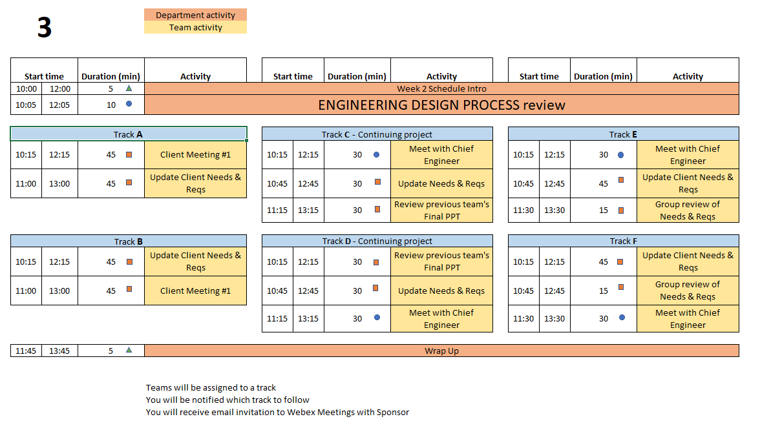
Day 3 Agenda
Notes:
PE Notes
Continuing projects should follow Track C or D
New projects can follow A, B, E or F
Track A or C on Day 3 should follow track A or C on Day 4
Track B, D, or E on Day 3 should follow track B or D on Day 4

Slide 64
Engineering Design Process Progression
Days 1-5
You are here!
Days 3-5
Day 5+6
Day 7
Days 8-10 – Project Planning
This Design Process and terminology was learned previously in IED

Slide 65

30 min – Meet with CE
(Day 3 or 4)
Chief Engineer led discussion of:
  Performance Evaluations – aka Course grading
  Team member expectations
    Group discussions
    Project Documentation on EDN
    Action Items
  CE background and experience
  Project impressions
  Team Standards Agreement
Notes:
Cover these slides in front of class VERY BRIEFLY. They are a reference for the 4 activities which will be done this meeting and next meeting (Day 3 & 4). Students will/can/should open the Playbook and read when they are going through the activities.

Slide 66
45 min – Client Meeting #1
Kickoff Meeting
Meeting Agenda
  Team introductions to Client (name, major, relevant experience/skills)
  Client introduction to team
  Client describes project "in their words“
    History, ultimate and semester goals, deliverables, etc…
  Open Q&A
Document meeting minutes to Project Mgmt Forum on EDN

Slide 67
30 min - Prior Presentation
(if applicable)
Team should review (outside of on-site meeting) the final PPT presentation given by previous engineering team
  Forums->Final Deliverables
  Repository->Reports->Final Reports
PE/CE will quickly walk-through slide deck and discuss:
  Goals
  Accomplishments / Successes
  Challenges
  Next steps
PE/CE will help to clear up confusion and answer any questions current engineering team may have

Slide 68

10 min – Engineering Design Process Horse Race
Action Item was to watch one video (Capstone Introduction & Expectations – Part 2)
What are the steps in Engineering Design Process?
What is a Customer Need?
Example from your current project
What is an Engineering Requirement?
Example from your current project
Notes:
Day 2
IED vs CD – Not re-learning IED material – building on what was learned
IED – Becoming an Engineer
CD – Be an Engineer
Owner – Students
Role of Students – Solve an open-ended complex problem by applying good engineering practices
Role of PE – Assist students by day to day operations
Role of CE - Evaluation

Slide 69
Engineering Design Process Q&A
What is a User Story?
  As a _____ I need to _____ so that _____
What is an Acceptance Criteria?
  Sometime defines the Minimum Viable Product
  The “least” the Client will accept as completion of the job.
Additional tools to define what will be acceptable to Client
Notes:
Day 3

Slide 70
Empathize with your Client
REWRITE THIS
Kanna – do you have materials to share?
Become curious about people you don't know. Empathetic people are people who are curious about those around them. ...
Focus on similarities rather than differences. ...
Put yourself in someone's shoes. ...
Listen, but also share. ...
Connect with social action movements. ...
Get creative with it.
https://www.webmd.com/balance/features/how-to-be-more-empathetic

Slide 71
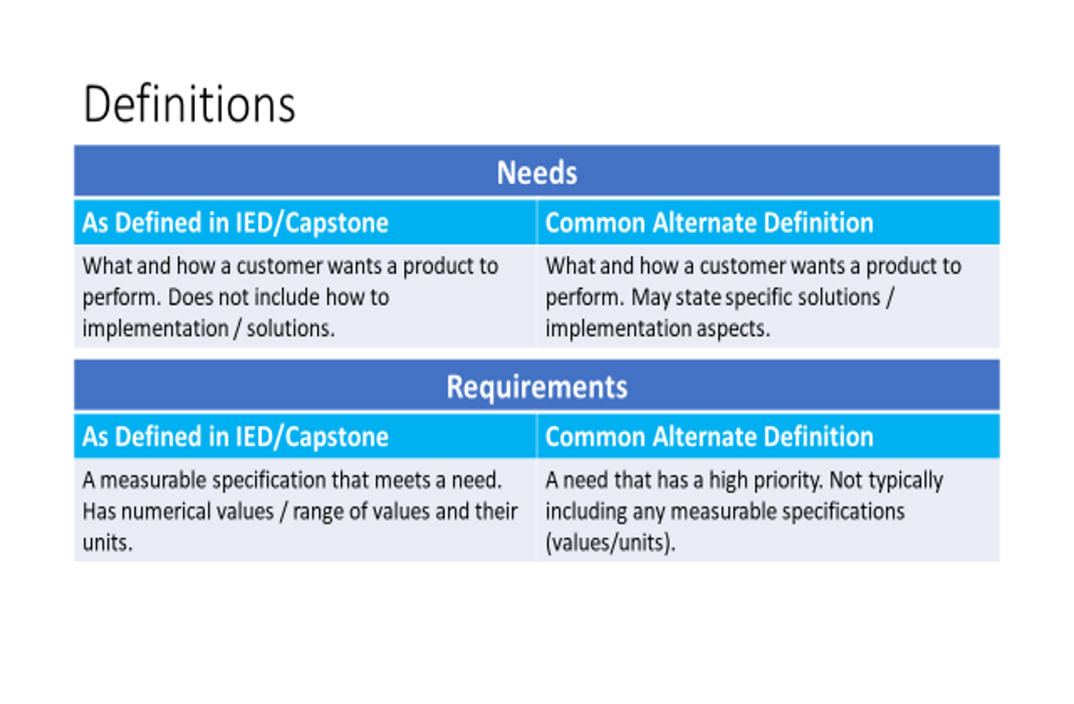
Developing Customer Needs
We Use These Definitions for
IED & the Design Lab
Note – Key IED Course Materials in Capstone Support wiki.

Slide 72
Generating Ideas for Your Needs
The Engineering Team will Play “Spin for Needs” using this link:
https://wheeldecide.com/?c1=Functionality&c2=Performance&c3=Quality&c4=Usability&c5=Accessibility&c6=Reliability&c7=Durability&c8=Availability&c9=Manufacturability&c10=Maintainability&c11=Environmental%20Impact&c12=Wild%20Card&c13=Interfaces
(be sure to copy the entire link to your browser!)
Start with the Needs you Previously Captured as part of your Meeting Prep!
Spin the Wheel
Use the Topic
Write One Related Need on a Post-It
Repeat!

Slide 73
45 min – Update Needs & Requirements
Read notes in template document for tips
Remove/combine duplicates
Unsure of a proper metric?
  Quick Google search to put in an educated guess
Fill in holes/gaps after looking at categories
  https://designlab.eng.rpi.edu/edn/projects/capstone-support-dev/wiki/Requirements_Management

Slide 74
5 min – Wrap-up
Days 3 and 4 include:
  Teams’ initial Client Meeting
  Continuing development of Client Needs
  Begin translating Client Needs into Engineering Requirements
  Review of prior team’s presentation (if applicable)
Client Needs and Engineering Requirements:
  Are not easy and require practice to do well!
  Guide your project throughout the semester

Slide 75
Action Items / Meeting Prep
(what you might call homework, to be completed BEFORE Day 4)
T/D
Team Development / Design Process Refresher
Post Team Standards Agreement to Wiki before Day 6
Administrative Tasks
Choose Client liaison
  This person will be the focal point for emails to/from your Client. They are not the team's "spokesperson" at meetings, conference calls, on/off site meetings, etc.
Watch Intro to EDN video (5 min) for a general understanding of system usage
  https://designlab.eng.rpi.edu/edn/projects/capstone-support-dev/repository/112/raw/training/Intro%20to%20the%20EDN.mp4
Read Meeting Minutes Wiki Page to learn how to take good meeting minutes
  https://designlab.eng.rpi.edu/edn/projects/capstone-support-dev/wiki/Meeting_Minutes
  Post meeting minutes taken during PPT review to Project Management Forum
Follow Subversion instructions to download and install client, then checkout a copy of ONLY your project’s working folder from the Repository. Visit your PE’s office hours for assistance.
  https://designlab.eng.rpi.edu/edn/projects/capstone-support-dev/wiki/Subversion_Clients#section-2
Complete the Online Safety Training in Percipio by Jan 29/26
  https://rpi.percipio.com/
  Rensselaer Manufacturing and Prototyping Laboratories - Safety Orientation-4.0
  Instructions - https://designlab.eng.rpi.edu/edn/projects/capstone-support-dev/repository/112/raw/Course%20Documents/RMPL%20Safety%20Module%20Completion%20Instructions-Percipio%20.pdf
  Post completed safety certificate in a thread in the Project Management Forum
A
P
Project Technical Work
Continue posting Needs and Requirements to Background Info Forum thread

Slide 76
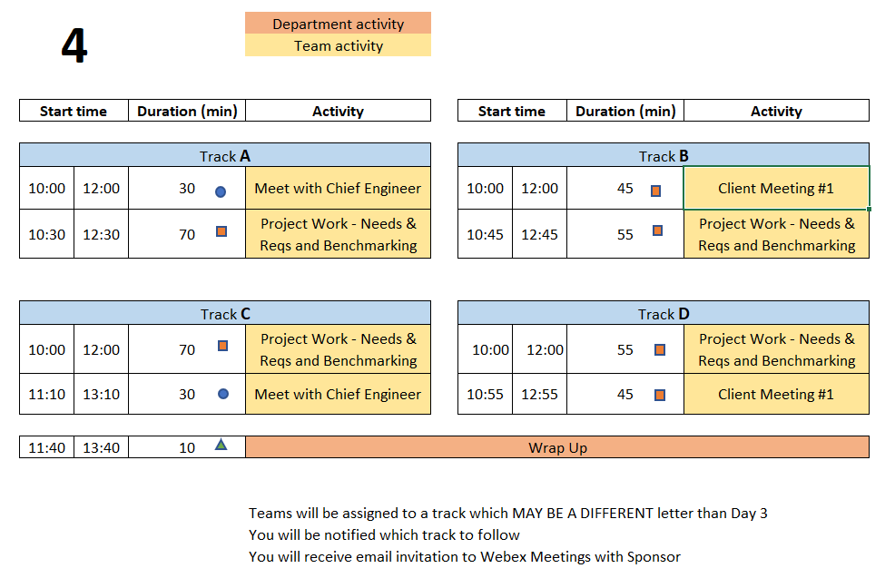
Day 4 Agenda
  You are STRONGLY ENCOURAGED to download newest version of Playbook prior to EACH on-site meeting.
Repository instructions - https://designlab.eng.rpi.edu/edn/projects/capstone-support-dev/wiki/Subversion
Playbook - https://designlab.eng.rpi.edu/edn/projects/capstone-support-dev/wiki/Capstone_Playbook
Notes:
PE Notes (Make clear for new vs. continuing on slide)
Track A or C on Day 3 should follow track A or C on Day 4
Track B, D, or E on Day 3 should follow track B or D on Day 4

Slide 77
Engineering Design Process Progression
Days 1-5
You are here!
Days 3-5
Day 5+6
Day 7
Days 8-10 – Project Planning
This Design Process and terminology was learned previously in IED

Slide 78
45 min – Client Meeting #1
Kickoff Meeting
Meeting Agenda
  Team introductions to Client (name, major, relevant experience/skills)
  Client introduction to team
  Client describes project "in their words“
    History, ultimate and semester goals, deliverables, etc…
  Open Q&A

Slide 79
25 min - Benchmarking
Purpose
  Learn about Competitive Products
    Functions
    Fabrication Methods
    Operation
    Key Technologies
    Maintenance
Avoid Re-inventing the Wheel!
Reference: IED Textbook: Product Design and Development, Ulrich, Eppinger, and Yang
Product Specification
Notes:
Reference: Product Design and Development, Ulrich, Eppinger, and Yang

Slide 80
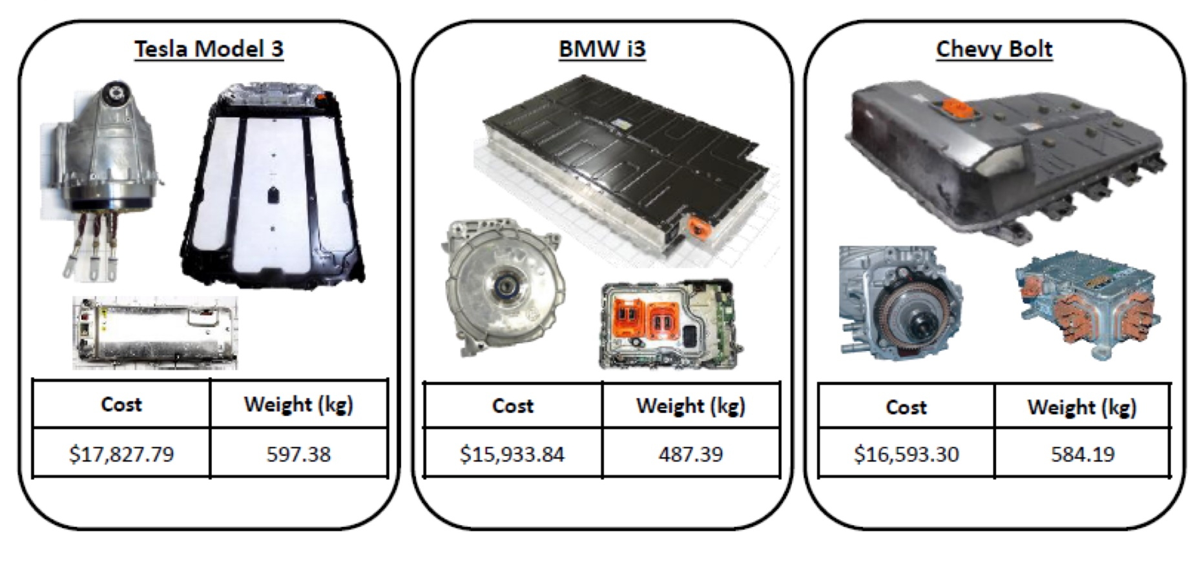
Benchmarking Examples
https://www.lightmetalage.com/news/industry-news/automotive/article-dismantling-and-analysis-of-vehicles-to-develop-optimal-applications/
Powertrain and Battery Pack Systems for the
Tesla Model 3, BMW i3, and Chevy Bolt.

Slide 81
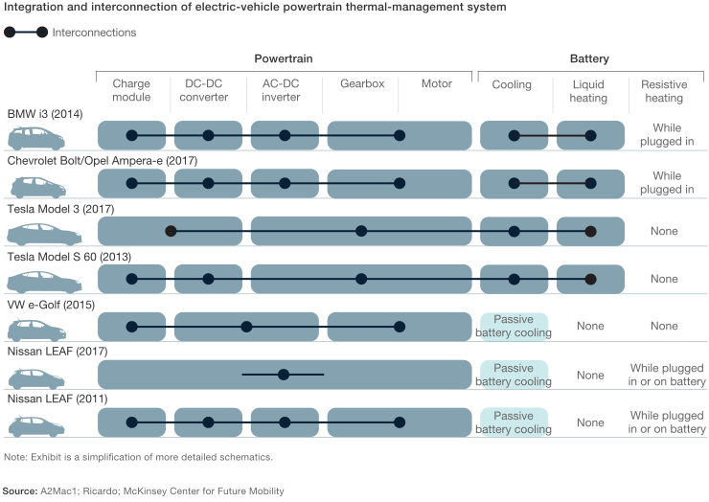
Benchmarking Examples
https://www.mckinsey.com/industries/automotive-and-assembly/our-insights/what-a-teardown-of-the-latest-electric-vehicles-reveals-about-the-future-of-mass-market-evs

Slide 82
Benchmarking - Evaluation
Using the Projects Needs and Requirements
Identify range of values across competitors
Prefer verifiable facts over opinions
Capture values / range of values / units
Assess and prioritize which items are important for your project

Slide 83
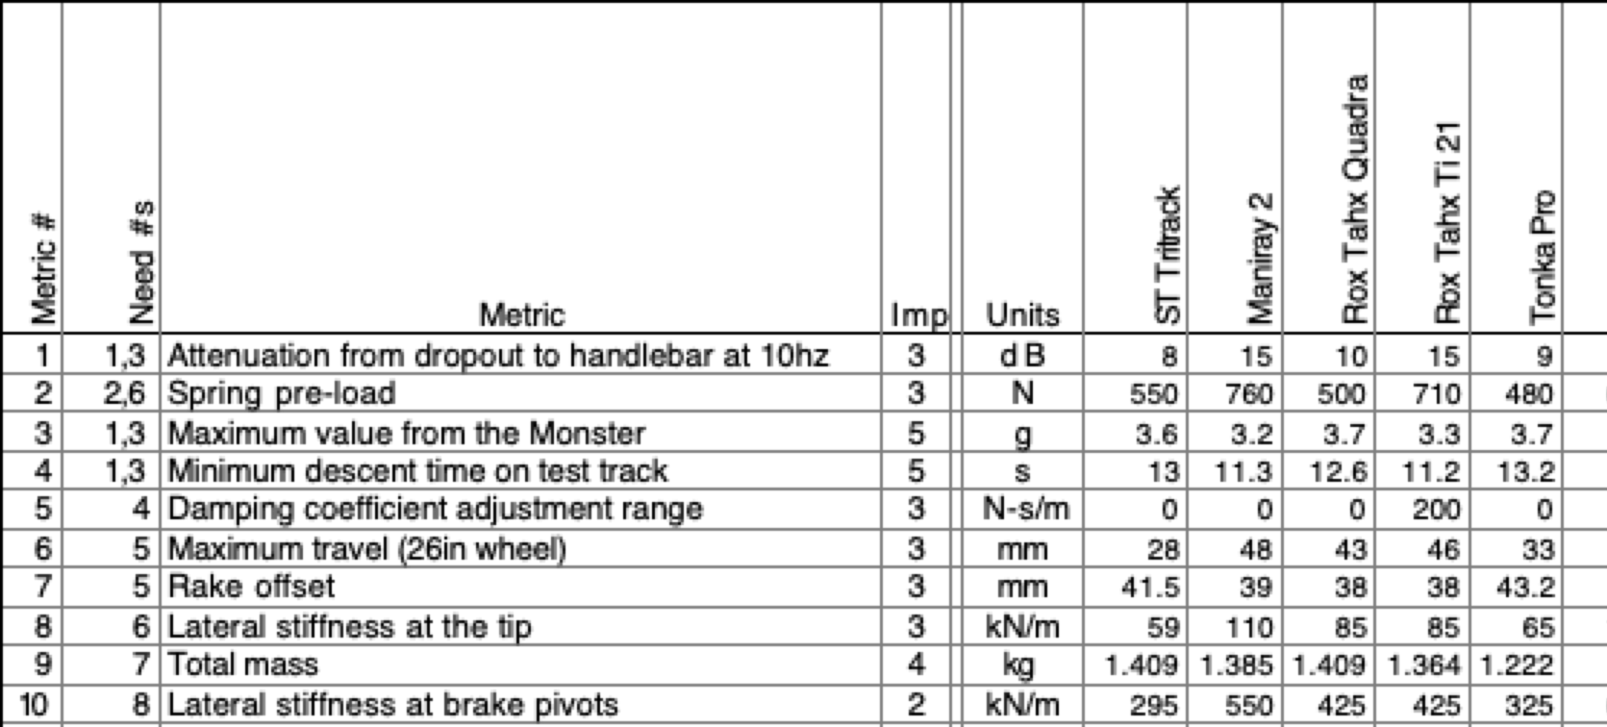
Benchmarking – Evaluation
Competitors
Data on suspension forks
Courtesy of Ulrich and Eppinger Teaching Resource Website for
Product Design and Development

Slide 84

55 min - Project Work
Refine Needs and Requirements Spreadsheet
  Needs
    Ensure all known Customer Needs are documented
  Requirements:
    Associate with appropriate Customer Need(s)
    Identify Measurements and Units (quantitative)
    Ensure that Requirements are detailed and prioritized
    Identify Applicable Engineering Standards
Refine/Develop Follow-Up Questions for Client
  If Team has already had Kickoff Meeting, what new questions have been identified as a result?
    Clearly document, review with PE then email to Client, copy your PE & CE
Background Research/Benchmarking
  Discuss/document work done to date
  Identify/document additional benchmarking needs

Slide 85
Project Work
Someone should take notes of meeting discussion
    NOT as Word document, simply as plain text in Forum post.
  Meeting Minutes instructions and template https://designlab.eng.rpi.edu/edn/projects/capstone-support-dev/wiki/Meeting_Minutes
Post your meeting minutes AT END of the meeting to Forums –> Project Mgmt
  Others can reply to post with any corrections or additional information

Slide 86
Requirements for your Customer Needs
For All Projects
Add measurable requirements for your needs
Continue to generate project questions as you go
For Software Projects
Generate and document User Stories
REWRITE THIS!!!

Slide 87
30 min – Meet with CE
(Day 3 or 4)
Chief Engineer led discussion of:
  Performance Evaluations – aka Course grading
  Team member expectations
    Group discussions
    Project Documentation on EDN
    Action Items
  CE background and experience
  Project impressions
  Team Standards Agreement

Slide 88
10 min – Wrap-up
Day 5 will focus on Concept Generation
  Now that teams have had time to identify the Client Needs and corresponding Engineering Requirements associated with their projects, it is time to identify potential concepts to address them.
  The Concept Generation activity during the Day 5 on-site meeting will utilize the ideation (Post-It Note) process that we have used previously.

Slide 89
Action Items / Meeting Prep
(to be completed BEFORE Day 5)
Need to note that the N&R spreadsheet will be GRADED
T/D
Team Development / Design Process Refresher
Post Team Standards Agreement to Wiki before Day 6 [1/29 or 1/26]
Watch Concept Generation video (9 min) in preparation for Concept Generation on-site exercise
  https://mediasite.mms.rpi.edu/mediasite/Play/d78db44fd9f7424b9d8f4c72857f84371d
Watch video in preparation for Project Planning activity on Day 8
  Deliverables & Activities (3 min)
    https://www.youtube.com/watch?v=L6WYJh1Ygoc
Administrative Tasks
Contact your PE if you are having trouble installing or using subversion
  https://designlab.eng.rpi.edu/edn/projects/capstone-support-dev/wiki/Subversion
Complete the Online Safety Training in Percipio by Day 6 [1/29 or 1/26]
  https://rpi.percipio.com/
  Rensselaer Manufacturing and Prototyping Laboratories - Safety Orientation-4.0
  Instructions - https://designlab.eng.rpi.edu/edn/projects/capstone-support-dev/repository/112/raw/Course%20Documents/RMPL%20Safety%20Module%20Completion%20Instructions-Percipio%20.pdf
  Post completed safety certificate in a thread in the Project Management Forum
Post minutes from Client Meeting to Project Management forum
Post Benchmarking memo to Background Info forum
A
Project Technical Work
Evaluate your current Needs & Requirements workbook against the rubric
  https://designlab.eng.rpi.edu/edn/projects/capstone-support-dev/repository/112/entry/Rubrics/Needs%20and%20Requirements%20rubric.docx
  Each team member shall post their observations/comments in the Needs & Requirements Design Forum Thread
  Update Needs/Reqs Workbook based on feedback and post to Repository
Post proposed project deliverables to Project Mgmt Forum – Deliverables thread
P

Slide 90
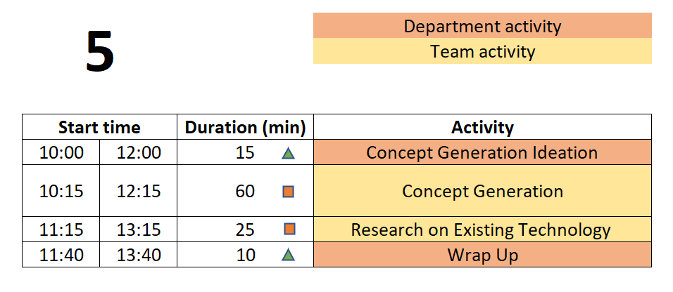
Day 5 Agenda
  You are STRONGLY ENCOURAGED to download newest version of Playbook prior to EACH on-site meeting.
Repository instructions - https://designlab.eng.rpi.edu/edn/projects/capstone-support-dev/wiki/Subversion
Playbook - https://designlab.eng.rpi.edu/edn/projects/capstone-support-dev/wiki/Capstone_Playbook

Slide 91
Engineering Design Process Progression
Days 1-5
You are here!
Days 3-5
Day 5+6
Day 7
Days 8-10 – Project Planning
This Design Process and terminology was learned previously in IED

Slide 92
10 min – Concept Generation Horse Race
Action Item was to watch one video (Capstone Introduction & Expectations – Part 2)
Where do concept ideas come from?
Need more
Example of Internal Search?
Example of External Search?
adssd
Notes:
Day 2
IED vs CD – Not re-learning IED material – building on what was learned
IED – Becoming an Engineer
CD – Be an Engineer
Owner – Students
Role of Students – Solve an open-ended complex problem by applying good engineering practices
Role of PE – Assist students by day to day operations
Role of CE - Evaluation

Slide 93

60 min - Concept Generation
Similar inclusive plan as previous exercises
5 min – Individually silently generate any concept to solve/address customer needs/reqs
  write separately on Post-It Notes
15 min – Place concepts on whiteboard
  Organize list by topic
  Eliminate duplicates
  Add extra ideas you think of right now or are inspired by others ideas
30 min – Group discussion
  Explain further to improve group understanding – if necessary
  Look for missing/unaddressed needs –think of concepts to address them
  Look for lone concepts – think of alternative ideas
Note - CE will jump in to talk for 15 mins of this time block

Slide 94
5 min – Create Forum Threads (EDN)
Concept topics ARE the key discussions and work areas for the team
Create Design Forum threads for each topic
  Use these thread to post explanation, sketches, calculations, etc…
  Reply to teammate’s posts to move idea forwards and advance project
  Includes links to material as appropriate but it is helpful to explain what can be found at the link

Slide 95
25 min – Research on Existing Technology
  Research existing technologies identified to solve similar problems
  Industrial, consumer applications
  Limits of technology/equipment
  Cost, availability, production volume
Needs more work

Slide 96
30 mins - Needs and Requirements
You currently have / have done:
Initial Project Description
List of Questions Based on the Project Description
Team Ideation Poster
PE Discussion on the Project Description
Draft Needs and Requirements Spreadsheet
Project Kickoff Meeting
Move this N&R content to Wiki – next 15 slides
Goal - Enhance the Needs and Requirements Spreadsheet

Slide 97
Making Strong Needs and Requirements
Needs and Requirements are used to guide Concept Generation without suggesting or forcing a particular solution(s).
Needs and Requirements drive the future decision-making process for Concept Selection
Most Needs Will Have Many Requirements
Focus is on your Prototype rather than a “full scale” implementation
Note - Software functions are typically better captured in a different document, e.g. Use Cases and User Scenarios and NOT as part of the Needs and Requirements spreadsheet.
Software Needs Typically Define Functions and Often Do Not Have Associated Measurable Requirements

Slide 98
We Use These Definitions for
IED & the Design Lab
Note – Key IED Course Materials
in the Capstone Support wiki

Slide 99
Examples of Making Needs Stronger for
Designing a Laptop
Weakly Stated Needs | Strongly Stated Needs
The project needs a 12V battery | The device needs to operate without connection to a wall outlet.
The user needs to get a beep when a problem occurs | The user needs to get an alert when a problem occurs.
The system needs an on/off switch. | The system should minimize power usage when its not in use.
It needs to support expected loads AND the frame weight should be minimized. | It needs to support expected loads The frame weight should be minimized.
It needs to be safe. | It must meet appropriate industry safety standards.
It needs to be small | It must fit in a typical backpack.

Slide 100
Examples of Creating Strong Requirements
Need | Requirement
The device needs to operate portably. | Operate for 24 hours. Maximum weight of 5 lbs. for entire laptop
The user needs to get an alert when a problem occurs. | Alerts must be received within 1 minute of a problem
The system should minimize power usage when its not in use | The device can be turned back on after 12 hours In standby mode
The laptop weight should be minimized | Maximum weight of 3 lbs. for frame Maximum weight of 1lb. for electronics Maximum of 1lb. for battery
It needs to support expected loads | Laptop lid must support at least 2 lbs. without breaking.
It must meet appropriate industry safety standards. | Underwriter Labs – UL IEC IP rating – at least 41
It must fit in a typical backpack. | Maximum dimensions 18”x9”x2”
Notes:
Red -

Slide 101
Examples of Creating Strong Requirements
Need | Requirement
The device needs to operate portably. | Operate for 24 hours. Maximum weight of 5 lbs. for entire laptop
The user needs to get an alert when a problem occurs. | Alerts must be received within 1 minute of a problem
The system should minimize power usage when its not in use | The device can be turned back on after 12 hours In standby mode
The laptop weight should be minimized | Maximum weight of 3 lbs. for frame Maximum weight of 1lb. for electronics Maximum of 1lb. for battery
It needs to support expected loads | Laptop lid must support at least 2 lbs. without breaking.
It must meet appropriate industry safety standards. | Underwriter Labs – UL IEC IP rating – at least 41
It must fit in a typical backpack. | Maximum dimensions 18”x9”x2”
Many Needs become multiple Requirements
Some Requirements address multiple Needs
Notes:
Red -

Slide 102
70 mins - Enhance your Project’s Needs & Requirements
Relook at Your Team’s Spreadsheet
Focus only on the Needs and Requirements Columns for Today
Evaluate Your Needs & Requirements Based on the Definitions
Make your Needs Stronger
Ensure your Requirements are Measurable
Leverage the Needs and Requirements Rubric
  https://designlab.eng.rpi.edu/edn/projects/capstone-support-dev/repository/112/entry/Rubrics/Needs%20and%20Requirements%20rubric.docx
Commit the updated file back to your project’s repository by the end of class

Slide 103
Wrap-up - Documentation
Which teams are working on ongoing projects?
  Have you reviewed the work (documentation) of prior teams?
  What did you find?
  What did you not find?
  Have you utilized the EDN’s search feature?
  Did the previous team utilize the wiki page?
  What were you able to find from the prior teams’ Webex, Google Drive, OneDrive, text messages, etc.?

Slide 104
Wrap-up - Documentation
Which teams are working on new projects?
  You have a blank slate – Keep things organized!

Slide 105
Wrap-up - Documentation
Having thorough and well-organized documentation will greatly ease creation of deliverables and graded assignments such as the ETM, System Design Report, DID, Client Update slide decks, and your Final Report!

Slide 106
Action Items / Meeting Prep
(to be completed BEFORE Day 6)
T/D
Team Development / Design Process Refresher
Post Team Standards Agreement to Wiki before Jan 26th [1/29 or 1/26]
Administrative Tasks
Read Project Documentation Wiki page in preparation for Day 6 review
  https://designlab.eng.rpi.edu/edn/projects/capstone-support-dev/wiki/Project_Documentation
Everyone should have their repository checked out by now. See your PE NOW if you are still having difficulty.
Complete the Online Safety Training in Percipio before Friday, 01/26
  https://rpi.percipio.com/
  Rensselaer Manufacturing and Prototyping Laboratories - Safety Orientation-4.0
  Instructions - https://designlab.eng.rpi.edu/edn/projects/capstone-support-dev/repository/112/raw/Course%20Documents/RMPL%20Safety%20Module%20Completion%20Instructions-Percipio%20.pdf
  Post completed safety certificate in a thread in the Project Management Forum
A
Project Technical Work
Post Concept Ideas to Design Forum on EDN
Update Needs & Reqs spreadsheet in Repo as needed
P

Slide 107
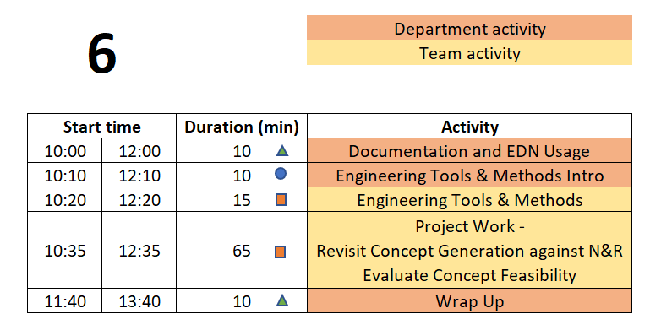
Day 6 Agenda
  You are STRONGLY ENCOURAGED to download newest version of Playbook prior to EACH on-site meeting.
Repository instructions - https://designlab.eng.rpi.edu/edn/projects/capstone-support-dev/wiki/Subversion
Playbook - https://designlab.eng.rpi.edu/edn/projects/capstone-support-dev/wiki/Capstone_Playbook

Slide 108
Engineering Design Process Progression
Days 1-5
You are here!
Days 3-5
Day 5+6
Day 7
Days 8-10 – Project Planning
This Design Process and terminology was learned previously in IED

Slide 109
10 min - N&R Reflective Update
Based on the Concept Generation done during last on-site meeting, and thought/research done off-site, update the Needs & Requirements list in Repository.

Slide 110
10 min – Documentation & EDN Usage Horse Race - round 1
Action Item was to watch one video (Capstone Introduction & Expectations – Part 2)
Why do we document?
What do we document?
How will you document?
How often / when will you document?
Must we wait for things to be complete / final to document?
Notes:
Day 2
IED vs CD – Not re-learning IED material – building on what was learned
IED – Becoming an Engineer
CD – Be an Engineer
Owner – Students
Role of Students – Solve an open-ended complex problem by applying good engineering practices
Role of PE – Assist students by day to day operations
Role of CE - Evaluation

Slide 111
What is Engineering Documentation?
Living record of your work so that:
  Evolution of your product/design is traceable
  Your work (experiment) is reproducible
    Sketches, ideas, discussions
    Test setup, results, failures & successes
  Your work can be understood by others and why you did it that way
  Feedback & help can be offered
  Easy to incorporate into client meeting presentations and the final design report

Slide 112

Why Document?
Extension of your memory
  Who, What, When, Where, Why, How
  So that others can collaborate and continue the work
  Facilitates teamwork
  So that others can review/understand your work
Legal ramifications
  Contractual/legal defense
  Patent application
Efficiently and Effectively move the project forwards
Everyone (now and future) can understand the Who, What, When, Where, Why, and How of the team’s work

Slide 113
Corporate Communication & Documentation
Policies Reminder
Electronic Design Notebook - REQUIRED for all project work & effort
Webex (only) - Team Chat
WhenIsGood or When2Meet - meeting scheduling
Not Permitted
  Slack, GroupMe, or Discord
  Google Drive
  Google Docs/Sheets/Slides
  Other cloud-based tools for any use (schematics, mind maps, drawings, analysis, etc…) e.g., diagrams.net, etc.
  RPI Box, RPI Onedrive, RPI Sharepoint
Webex Teams is good for chat and live meetings, but project documentation should start on and stay in the Electronic Design Notebook (EDN) Forum or Repository.
  Simple/easy solution is to never put it on Webex (or elsewhere) to begin with.

Slide 114
10 min – Documentation & EDN Usage Horse Race - round 2
Action Item was to watch one video (Capstone Introduction & Expectations – Part 2)
Information should be complete before documented?
It is necessary to document negative results?
Teammates share responsibility with PE/CE to offer technical feedback on EDN posts?
Notes:
Day 2
IED vs CD – Not re-learning IED material – building on what was learned
IED – Becoming an Engineer
CD – Be an Engineer
Owner – Students
Role of Students – Solve an open-ended complex problem by applying good engineering practices
Role of PE – Assist students by day to day operations
Role of CE - Evaluation

Slide 115
50 min – Creation of Project Statement and Objectives & Engineering Tools and Methods
  Templates for both documents are on the Capstone Support Wiki
    https://designlab.eng.rpi.edu/edn/projects/capstone-support-dev/wiki/Templates_and_Forms
  Instructions
    https://designlab.eng.rpi.edu/edn/projects/capstone-support-dev/wiki/Project_Statement_and_Objectives
    https://designlab.eng.rpi.edu/edn/projects/capstone-support-dev/wiki/Engineering_Tools_and_Methods_Worksheet
  Your CE & PE are available to answer any questions and review your work
  Finish & save in ‘working\Reports\Final Report + Poster‘ folder in the Repository as Prep for next Meeting
  Files in the Repo can (and should) be revised as often needed. These are drafts and your documents may later change as the engineering team learns more!

Slide 116
Long Term vs. Short Term
FYI
Long Term:
1 – 5+ years in future
Assume there may be multiple projects / semesters / teams working AFTER yours
Assume a successful output from each team
What can the Client do / achieve 1-5+ years from now because your work was successful?
Short Term:
By the end of this semester
Things your Client wants you to achieve early this semester, by mid-semester, and at the end of the semester
Assumes your success
What can your Client do with your work immediately after the semester ends?

Slide 117
10 min – Wrap-up
Day 7 will focus on Concept Selection
  Now that teams have identified concepts it is time to understand how they can fit together into a full solution to the client’s problem.
  The Concept Selection efforts during the Day 7 on-site meeting should utilize the decision matrix process taught in IED. Comparisons and decisions should be based on analysis, metrics, and performance rather than ‘gut feelings’ or personal preferences.

Slide 118
Action Items / Meeting Prep
(to be completed BEFORE Day 7)
Team Development / Design Process Refresher
T/D
Administrative Tasks
This section intentionally left blank
A
Project Technical Work
Continue Updating Needs & Requirements spreadsheet in Repository
Begin filling out slides in Concept Generation and Selection PPT based on team discussions and forum posts
P

Slide 119
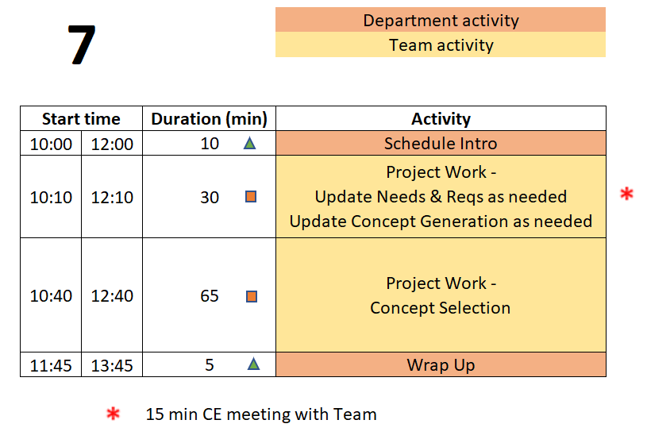
Day 7 Agenda
  You are STRONGLY ENCOURAGED to download newest version of Playbook prior to EACH on-site meeting.
Repository instructions - https://designlab.eng.rpi.edu/edn/projects/capstone-support-dev/wiki/Subversion
Playbook - https://designlab.eng.rpi.edu/edn/projects/capstone-support-dev/wiki/Capstone_Playbook

Slide 120
Engineering Design Process Progression
Days 1-5
You are here!
Days 3-5
Day 5+6
Day 7
Days 8-10 – Project Planning
This Design Process and terminology was learned previously in IED

Slide 121
15 min – CE Time
Meeting will be at team table
This will take place at some point during Concept Selection exercise depending on CE’s schedule

Slide 122
65 min – Concept Selection
May want some content here to help explain specifically how we’d like this done
  Decision matrix
  REAL numbers, not feelings

Slide 123
5 min – Wrap-up
During the Day 8 on-site meeting, teams will develop a project plan to guide their work for the remainder of the semester. To be prepared for this activity, team members must:
  Understand why Project Mgmt. is important
  Understand the difference between Deliverables and Tasks/Activities.
  Come to the meeting with an initial list of tasks required to complete the project.

Slide 124
Action Items / Meeting Prep
(to be completed BEFORE Day 8)
Team Development / Design Process Refresher
Watch video in preparation for Project Planning activity on Day 8
  Intro to Project Mgmt (7 min)
    https://www.youtube.com/watch?v=QwuwzBBThPY
T/D
Administrative Tasks
Create draft of Client Meeting #2 PPT and upload to the Repo BY START OF Day 8
  Template - https://designlab.eng.rpi.edu/edn/projects/capstone-support-dev/wiki/Templates_and_Forms
  Repository location – working/Reports/Client Meetings
A
Project Technical Work
Continue technical work
  Post progress to Design Forum threads of EDN
Each team member brainstorm at least 6 individual tasks which will need to be accomplished to reach the semester objectives
  Post to a SINGLE thread in the Project Mgt. Forum called “Tasks” (first person creates thread, others reply). There should be at least 6 tasks per team member by the start of Day 8 meeting
Finish Concept Generation and Selection PPT – let PE know it can be reviewed
P

Slide 125
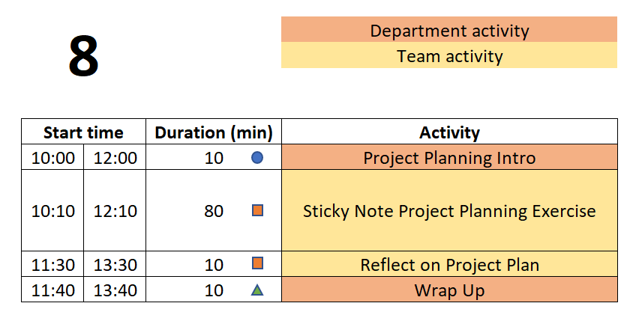
Day 8 Agenda
  You are STRONGLY ENCOURAGED to download newest version of Playbook prior to EACH on-site meeting.
Repository instructions - https://designlab.eng.rpi.edu/edn/projects/capstone-support-dev/wiki/Subversion
Playbook - https://designlab.eng.rpi.edu/edn/projects/capstone-support-dev/wiki/Capstone_Playbook

Slide 126
Engineering Design Process Progression
Days 1-5
You are here!
Days 3-5
Day 5+6
Day 7
Days 8-10 – Project Planning
This Design Process and terminology was learned previously in IED

Slide 127
10 min – Project Planning Horse Race
Action Item was to watch one video (Capstone Introduction & Expectations – Part 2)
What is a milestone?
What is a parallel task?
What is a serial task?
What is the critical path?
Notes:
Day 2
IED vs CD – Not re-learning IED material – building on what was learned
IED – Becoming an Engineer
CD – Be an Engineer
Owner – Students
Role of Students – Solve an open-ended complex problem by applying good engineering practices
Role of PE – Assist students by day to day operations
Role of CE - Evaluation

Slide 128

Defining Meaningful Tasks
80 min - ‘Post-It Note’ Project Planning
One idea per Post-It. Be concise!
Defined to be No More than 1 week long.
Break big things into smaller pieces.
Everyone Needs at Least 1 Task / Week for the
Entire Semester
What will YOU contribute to the project?
Focus on YOUR potential contributions to the project.
(We know these may not yet be defined!)
Focus on the technical work required
For now, leave out project management / overhead tasks,
e.g., report writing, slide making, etc.
DO include documentation needed for technology transfer,
e.g., user manual
Be Technical! Be SMART!

Slide 129
Defining Meaningful Tasks aka “SMART”
Project Planning Tips
Yes, it gets harder to define tasks near the end of the semester. So instead, work backwards from the end!
There may be gaps in time – you will need to fill those in today
Do not just copy a task 3 times because it spans 3 weeks. Instead, you must break it down into 3 well defined smaller tasks.
Don’t allocate slack time at the end of the semester. Project plans do not include tasks called “Just in Case”. Instead estimate the length of tasks to factor in some risk. Not everything works the first time and many thing turn out to be more difficult than first thought.
Group things by functional subsystem rather than by name. This helps reveal possible planning gaps.
Remember your deliverables! Do you have the tasks needed to produce each of them, including things like demos?
Be Technical! Be SMART!

Slide 130
20 min - ‘Post-It Note’ Project Planning
How/when will team generate this list??
10 min – Deliverables
Write each Deliverable from Project Statement and Objectives on a Post-It and
place on the board/calendar at approximate due date.
Draw a box around the note so that it stands out.
10 min – Tasks
(Individually silently) Each team member generate list of TEN tasks which must
be completed to accomplish the deliverables.
Off-site Action Item was to post 6 individual tasks to EDN, so start with those.
Now create at least 4 more each.
Create 1 Post-It for each task
Add your initials to post-it in case there are questions about content

Slide 131
‘Post-It Note’ Project Planning Exercise
10 min – Organize tasks on Whiteboard
Position tasks appropriately along week-by-week calendar
  This can be done before or after getting all items shared.
40 min – Group organization of tasks
Add missing tasks, remove duplicates
Organize by subsystem or milestone
10 min – Re-assign ownership (by color/initial)
Ensure everyone has work throughout semester
Each Team Member Should Leave meeting with their assigned Post-It’s.
Each Team Member then Enters Their Own Tasks as EDN Issues!

Slide 132

10 Min - Reflecting on your New Project Plan
Take a few minutes to pause and reflect on the Project Plan the Engineering Team just created.
Use the prompts on this Wiki page to guide the discussion.
  https://designlab.eng.rpi.edu/edn/projects/capstone-support-dev/wiki/Reflecting_on_your_New_Project_Plan
Focus on Process and Results

Slide 133
10 min – Wrap-up
Activities of Day 9 & 10
  PE/CE Feedback on the Project Plans created during and after Day 8
  PE/CE Feedback on Needs & Requirement list
  Client Meeting #2 Concept Generation and Selection Update
  Developing System Design

Slide 134
Wrap-up
Day 9 & 10 also include 60+ mins for team-directed work.
  Efficient team-directed meetings require an Agenda.
  The Agenda should be SMART - Specific, Measurable, Actionable, Relevant, and Time-Oriented
  Agendas should be posted to your white board before starting the meeting
    Pro Forma Agenda posted on Capstone Support: https://designlab.eng.rpi.edu/edn/projects/capstone-support-dev/wiki/Pro_Forma_Meeting_Agenda

Slide 135
Action Items/ Meeting Prep
(to be completed BEFORE Day 9)
T/D
Team Development / Design Process Refresher
Read Risks Associated with Project Plans Wiki page and revise team plan in EDN Gantt chart as necessary
  https://designlab.eng.rpi.edu/edn/projects/capstone-support-dev/wiki/Risks_Associated_with_Project_Plans
Administrative Tasks
Create agenda for 40 mins of Day 9, team’s plan should NOT be just working on your Client Meeting slides!
Send Client Meeting PPT to Client 24 hrs before meeting
A
Project Technical Work
Add milestones from Project Planning Activity to EDN Gantt Chart as Versions
  Watch video with instructions (4 min) - https://designlab.eng.rpi.edu/edn/projects/capstone-support-dev/repository/112/raw/training/Creating%20Versions%20from%20your%20Statement%20of%20Work.mp4
  Prefix with current semester name/year, e.g. “F23-” to avoid duplication of common deliverable names across semesters.
Add tasks identified on sticky notes into EDN as Issues and associate them with the appropriate version and assignee (owner)
P

Slide 136
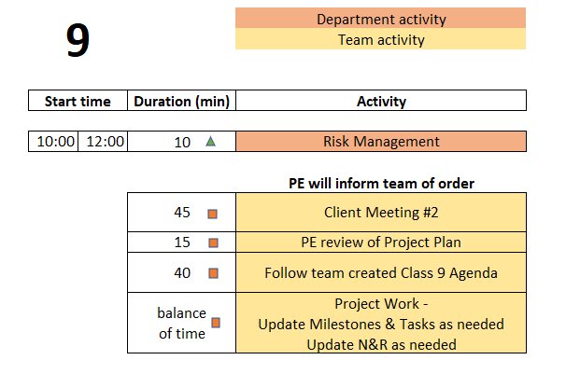
Day 9 Agenda
  You are STRONGLY ENCOURAGED to download newest version of Playbook prior to EACH on-site meeting.
Repository instructions - https://designlab.eng.rpi.edu/edn/projects/capstone-support-dev/wiki/Subversion
Playbook - https://designlab.eng.rpi.edu/edn/projects/capstone-support-dev/wiki/Capstone_Playbook

Slide 137
Engineering Design Process Progression
Days 1-5
You are here!
Days 3-5
Day 5+6
Day 7
Days 8-10 – Project Planning
This Design Process and terminology was learned previously in IED

Slide 138
40 min – Follow Team created Agenda
Designate team member to facilitate this meeting
Designate team member to take and post minutes to EDN
  This should be done for EVERY on-site and off-site meeting.
  Rotate responsibility. To be equitable, ALL team members should have a turn!
Notes:
Day 9

Slide 139
15 min – PE Review Project Plan
Many short individual tasks? Few large group tasks?
Adequate time for:
  Manufacturing?
  Purchasing?
  Testing?
  Iterative development? Second round of any tasks?
Equal division of labor across all team members?
Ability to do some work in parallel rather than series?
  Design test plan BEFORE fabrication is complete
  Create dummy data NOW to test software performance or analysis approach

Slide 140
30 min – PE Review of Client Meeting PPT
Checklist
Are slides numbered?
Are figures labeled?
Have Team members names, PE/CE names & depts, Client name and logo been updated from blank template?
Does agenda match actual contents of PPT?
Do the contents match the rubric and Project Statement & Objectives content?
  Background & Customer Needs
  Technology Assessment
  Engineering Requirements
  Concept Generation

Slide 141
5 Min – Wrap-up
Design Lab created Agendas have ended!
Engineering team should now create Agenda for each on-site (and off-site) meeting
Primary purpose of the remaining on-site meetings is team review and assessment of work already completed, especially with your PE and/or CE.
These 4 hours per week of on-site meeting time may be the only available time for FULL Engineering team to meet. It is therefore recommended to use this time for group discussions, group work, planning, updating Needs and Requirements, making decisions, etc. IF all that is complete / up to date, use the time for individual work.
Use EDN and Repository to document all work moving forwards

Slide 142
Action Items / Meeting Prep
(to be completed BEFORE Day 10)
T/D
Team Development / Design Process Refresher
This section intentionally left blank
Administrative Tasks
Address any feedback received on Client Meeting PPT
Client liaison should email PPT to Client no later than 24 hours prior to call. This person will be the focal point for emails to/from your Client. They are not the team's "spokesperson" at meetings, conference calls, etc.
Prep for upcoming Client Meeting #2, e.g., identify speakers for each slide, prepare your notes, etc.
A
Project Technical Work
Continue technical work
Post progress to Design Forum thread(s)
Team members should now be creating and updating their individual project tasks
Adjust Issues and Project Plan as necessary
  Account for risks identified
  Map to Milestones (versions)
Wordsmith and polish Engineering Standards Worksheet
    Upload to Repository - working/Reports/Design Report + Poster
P

Slide 143
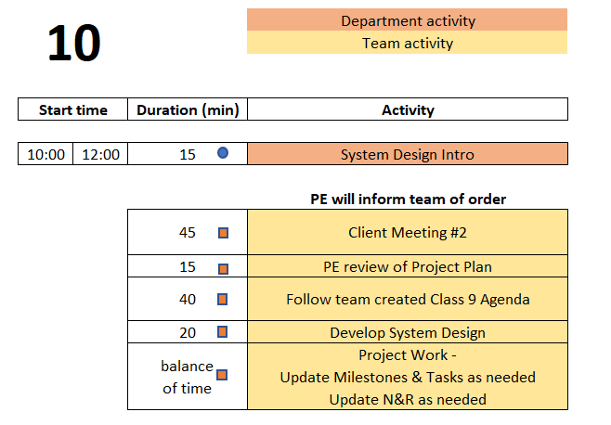
Day 10 Agenda
  You are STRONGLY ENCOURAGED to download newest version of Playbook prior to EACH on-site meeting.
Repository instructions - https://designlab.eng.rpi.edu/edn/projects/capstone-support-dev/wiki/Subversion
Playbook - https://designlab.eng.rpi.edu/edn/projects/capstone-support-dev/wiki/Capstone_Playbook

Slide 144
Engineering Design Process Progression
Days 1-5
You are here!
Days 3-5
Day 5+6
Day 7
Days 8-10 – Project Planning
This Design Process and terminology was learned previously in IED

Slide 145
20 min – System Design
Create Wiki page with this info
Designate team member to facilitate this meeting
Designate team member to take minutes and post them to EDN
  This should be done for EVERY on-site and off-site meeting.
  Rotate responsibility. To be equitable, ALL team members should have a turn!
Complete overall system design
Create System Architecture diagram
Identify subsystem definitions and their owners (assignees)
  One person per subsystem
Notes:
Day 9

Slide 146
System Design Report
From SPREADSHEET : Include updated / improved PSO information, N&R, Concept generation/selection, System Design, Integration and Testing plan.

Slide 147
All Employee Meetings

Slide 148
Board of Directors Review is coming up NEXT WEEK
BDR Introduction
Read Wiki page with instructions
  https://designlab.eng.rpi.edu/edn/projects/capstone-support-dev/wiki/Board_of_Directors_Review
Update Client Meeting #1 slides to address feedback received and BDR rubric posted on EDN
  Rubric posted here - https://designlab.eng.rpi.edu/edn/projects/capstone-support-dev/wiki/Tasks_and_Due_Dates
Notes:
Day 9

Slide 149
Engineering Design Process
POSTER introduction
This Design Process and terminology is taught in IED at RPI
Team is creating a poster to communicate
Overall project (Needs & Requirements)
Progress made (Concepts, System Architecture)
Future steps (Design, Integration, & Test Plan)
Notes:
Day 9

Slide 150
95 min – Poster Creation
Download and Open Poster.pptx from Repository
  https://designlab.eng.rpi.edu/edn/projects/capstone-support-dev/repository/112/entry/template%20documents/Poster.pptx
10 mins – Divide into 3 groups, and work on initial slides. Content can be pulled from Project Statement & Objectives.
  Purpose
  Past Work and/or Project History
  Semester Objectives/Requirements
40 mins – As a full team discuss Technical Approach, Results and Accomplishments to Date
30 mins – Move on to Next Steps and Plan
15 mins – Begin assembly of content onto single slide (pg 8)

Slide 151
Detailed Individual Design Summary
System Architecture Diagram
Subsystem or portion YOU are responsible for
  Related Needs & Reqs (include # from Repo spreadsheet)
  Interfaces to other subsystems (refer to System Architecture)
  Sketch/description of 1-2 leading concepts (list of forum thread links)
Perceived challenges/risks
YOUR next steps/plan
1,000 - 1,500 words
5-10 pages including images
This is an INDIVIDUAL assignment. The document should speak to what YOU personally will contribute to the design and project demonstration.

Slide 152
Revision History
Version | Date | Name | Reason for Changes
4.0 | 7.8.24 | AP, BD, MA | Full review and updating of new course flow
4.1 | 7.23.24 | AP | Director’s letter removed from New Employee Packet
4.2 | 7.25.24 | AP | Updating slides to match agenda and overall on-site plan ‘Design Lab Process Progression’ slide updated Preferred pronouns added to Wiki post
4.3 | 7.31.24 | AP | Some shifting of content, adjustment of section durations Day 1 & 2 team meeting added to Day 1 OOC tasks
4.4 | 8.1.24 | AP, KN | All Agenda slides & Design Process slides updated Notes added to adjust flow, point out content to add on days 2-5
4.5 | 8.9.24 | AP | ‘Design a Vehicle’ N&R activity pulled out into separate training PPT
4.6 | 8.9.24 | AP,MA,BD,KN, JK | So many things, long meeting ironing out bugs and making improvements

Slide 153
Revision History - continued
Version | Date | Name | Reason for Changes

