Slide 1
EDN In-Class Introduction
Basic layout and functionality
  Communication
  Project Planning
  Menu Overview
DRAFT
Work in Progress

Slide 2
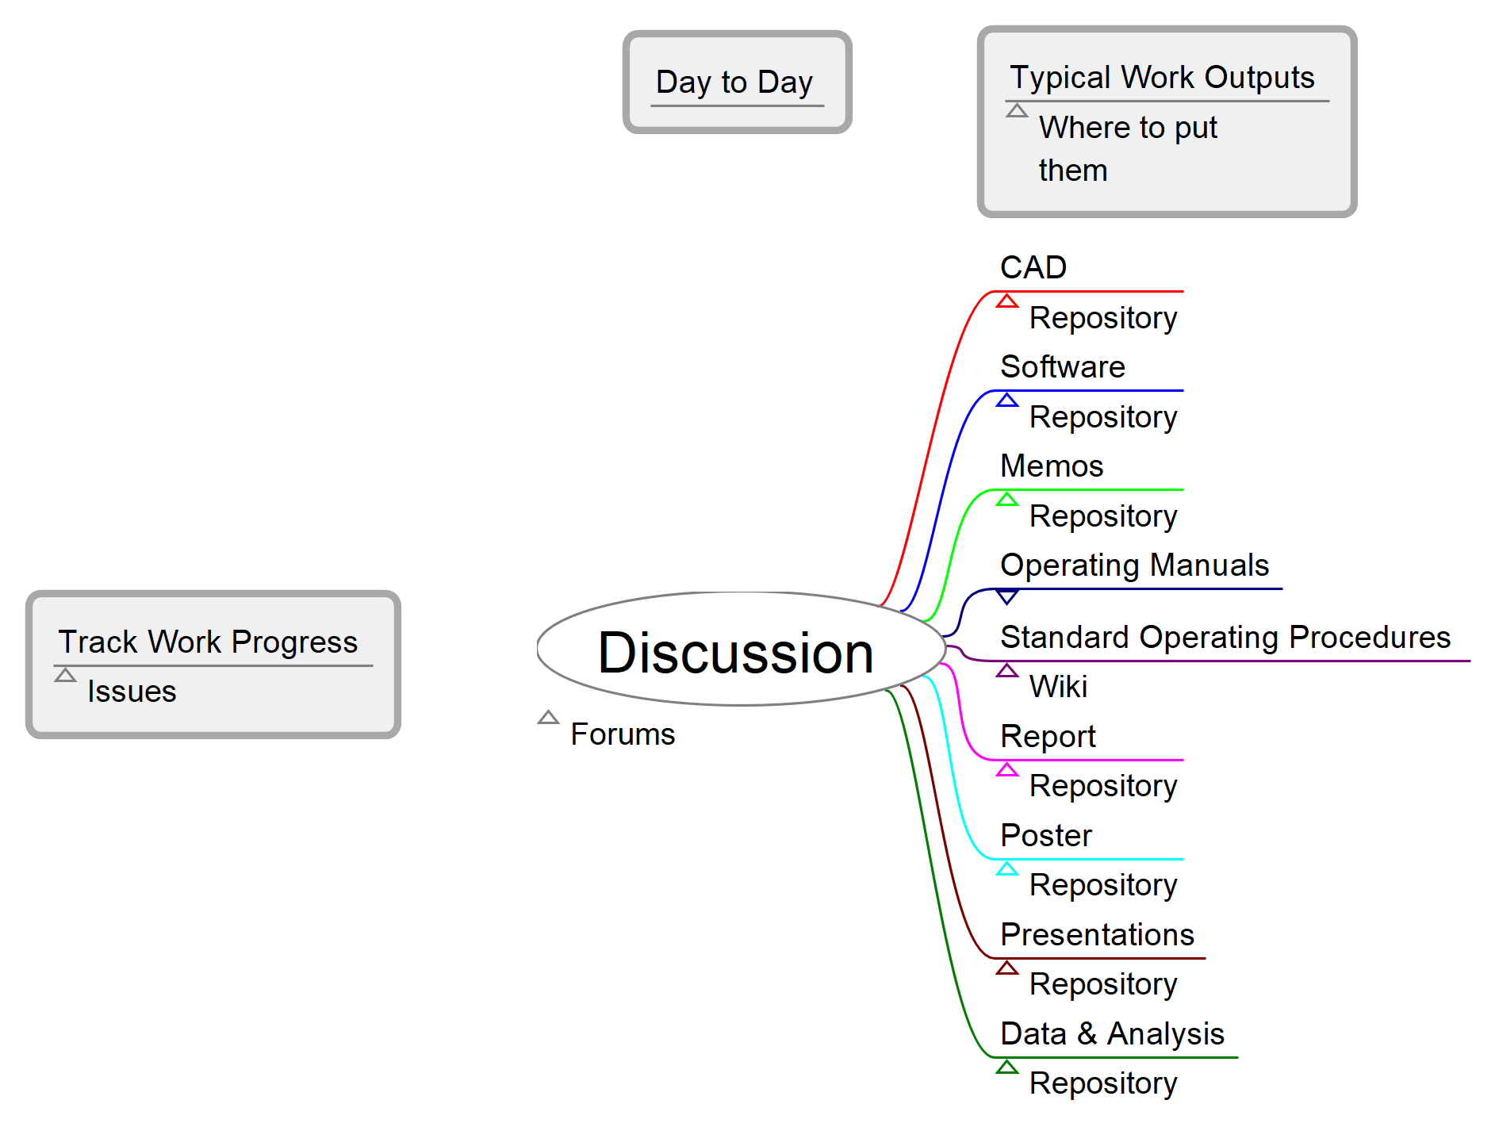
Types of Communication Typically Found in Capstone
Mind Map Created Using Freeplane

Slide 3
EDN Menu Overview
Overview – team members and project description
Activity – recent changes
Roadmap – overview of tasks
Issues – list of tasks
Gantt – graphical view of issue list
News
Wiki
Forums – MOST work posted here
Repository – file storage
Booty Bay – equipment Design Lab loans out
Settings

Slide 4
Posting in Forums - exercise
Create a post – “<Insert name>’s FIRST post!”
Reply - attach file AND describe contents
  Post selfie or image of your choice
  No text in comment box -> doesn’t work
  File larger than 9.77 Mb -> doesn’t work

Slide 5
Gantt Chart - exercise
Create an issue
  Set assignee to “<<me>>”
  Set start date & end date
  Useful description
  Set status to “Assigned”
  Set target version to “Day 1 introduction”

Slide 6
Customizing View - exercise
Sort Issue List
  Group results by Assignee
Filter Gantt Chart
  Create filter – Assignee is <<me>>

Slide 7
Updating Issue - exercise
When you begin working on issue
  Set status to “Working”
  Check Gantt chart to see change
When task is finished
  Set status to “Complete”
  Add notes and link to location of the ARTIFACT which justifies this completion
    File in repository
    Forum thread of discussion and resolution/answer

