Slide 1
Engineering Communication and Documentation
Fall 2019

Slide 2
Outline
WHY
WHAT
WHEN
HOW
Expectations

Slide 3
WHY
Reminder (memo to yourself)
Collaboration
  On-going design reviews
  Fix problems sooner, cheaper, and better
  Delegation and Outsourcing
Risk Management
  Hard disk / computer problems
  Absence

Slide 4
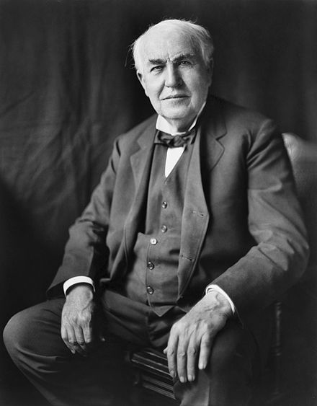
WHAT
Everything!!
  Your design process and solution
  Rejected ideas
  Solutions that did not work
I have not failed. I've just found 10,000 ways that won't work.
(Thomas Edison)
Source: https://en.wikipedia.org/wiki/Thomas_Edison

Slide 5
Show all your work
Design Process
  How and Why engineering decisions are made
Results
Assumptions

Slide 6
WHEN
Homework Assignment
  Finalized work
Engineering Design
  As soon as possible
…
Rough Idea
Review & Feed- back
Preliminary Design
Review & Feed- back
Final Design
Engineering design is an iterative process.

Slide 7

HOW
Forum
  Asynchronous threaded discussions
  Write once
  Update information using Reply
  Easy to document progress (evolution) and technical discussions
Boards

Slide 8
Wiki
  Editable
  Show up to date information
  Table of Contents
  How To
Issues (Tasks)
  Project Management - Tasks, assignments, and status
Repository and Version Control System
  Attend a training session

Slide 9
Attach Files
Photos
  Whiteboard
  Prototyping process
Images
  Graphs
Digitized Paper
  Sketch
  Calculation

Slide 10
Link Information
Wiki Page - [[Wiki page]]
Issue #12 - #12
Repository Revision #34 – r34
Forum Message ID 1234 – message#1234
For more information, see
https://designlab.eng.rpi.edu/edn/help/en/wiki_syntax_detailed_textile.html

Slide 11
Expectations
Fair
Your teammates can report your progress and accomplishments to you sponsor, CE, and PE using EDN only
Good
Your teammates can complete tasks assigned to you EDN only

