Slide 1
Welcome to Capstone Design
Playbook for Day 1 through 10
In-Class Meetings
WARNING
This whole document is a work in process and in massive flux

Slide 2
Link to Agendas
Class 1
Class 2
Class 3
Class 4
Class 5
Class 6
Class 7
Class 8
Class 9
Class 10
#Pro Tip – Current Action Items are listed ONE page before next class’s agenda

Slide 3
Multidisciplinary Capstone Design
ECSE 4900 Electrical & Computer Systems Engineers
ISYE 4270 Industrial Engineers
MANE 4260 Mechanical Engineers
MTLE 4920 Materials Engineers

Slide 4
Class 1 Agenda
TD
Team Development /
Design Process Refresher
Administrative Tasks
Project Work
A
P

Slide 5
5 min - Logistics
The Daily Meeting Agendas are on the Capstone Support Wiki - see link from your PE’s intro email

Slide 6
Design Lab Mission
Develop High Performing Engineers by Mentoring Students in Professional and Engineering Design Practices Through Project Based Learning.

Slide 7
Capstone Design Transition
NO textbook, NO lecture
It is a Team EXPERIENCE
It is a mostly “flipped” experience
Guided/assisted by Project Engineer (PE)
Graded/assisted by Chief Engineer (CE)

Slide 8
Capstone Design: Practice Engineering in Safe Environment
Initial Cover letter and Resume
New Employee Packet from your Project Engineer
Design Lab Support Staff
Project Engineers and Chief Engineers
Students in a Course ➔
Consulting Engineering Team Solving a Client Problem

Slide 9
Design Lab
Engineering Team
New hire

Slide 10
New Employee Onboarding Day 1 Agenda
Class 1 Agenda
TD
Team Development /
Design Process Refresher
Administrative Tasks
Project Work
A
P

Slide 11
Welcome to Your Project Team!
Engineering Team Members
Project Engineer (PE)
Purchasing
Fabrication Support
Chief Engineer (CE)
Client
Notes:
Introduce PE/CE in this slide. Each team has an assigned PE/CE. The project description document has their names.

Slide 12
Your Capstone Expectations
Share your expectations for this Capstone course by answering the questions through Slido.
Join Slido.com with Code #1350435 and passcode: x7ohye
(or) using the QR Code below
https://app.sli.do/event/f77ouqW73dsrUFGwRnjLcp

Slide 13
Design Lab - Core Values
Embrace diverse backgrounds, skills, and perspective
Create an inclusive and equitable team environment
Act with Professionalism and Respect

Slide 14
Participation Expectations
Arrive to meetings on time. Stay until meeting ends.
Be present in all meetings.
Listen, Engage, Participate.
Focus on the Project.
Minimize Distractions
(phone, other tasks)

Slide 15
Work Expectations
Your new position involves:
4 Hours per week of on-site work
5 Hours per week of off-site work
Individual technical work & team meetings
Consistent level of work throughout the semester
Document all progress and results
Read communication from Design Lab staff and teammates
Emails
Webex chat
EDN posts
Please respond in a timely manner!

Slide 16
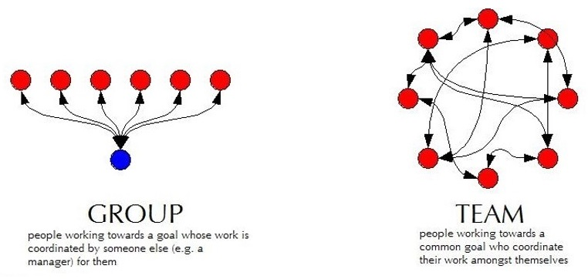
Capstone is More TEAM work than GROUP work
Group Work
Divide and conquer
Low interaction with team
Supervisor managed
Team Work
Collaborative effort
Interactive -peer review
Team member managed

Slide 17
Work Expectations
Q: “What expectations will your boss and peers have at work?”
Let’s start doing this NOW in the Design Lab.
Be Accountable.
To your teammates, to your Chief/Project Engineer, and to the project Client.
Be Professional.
Make your work VISIBLE.
Post/share as you go. Please do not “hide” it from team until its perfect or completely finished.
Use Electronic Design Notebook (EDN)
Notes:
This slide is animated. Shows only the question – PE should ask students and get some responses

Slide 18
Design Lab Communications & Documentation Policies
Written capstone communications are permitted using ONLY Design Lab tools:
The Engineering Design Notebook (EDN)
Native EDN posts
MS Office files, CAD, etc.
Repository via Subversion
Webex
RPI OneDrive – only for development of group deliverables
Use of any other cloud-based service, such as Google Drive/Docs/Sheets/Slides, GroupMe, Discord, Slack, Draw.io, etc. is FORBIDDEN
Although supported by campus, RPI Box is also FORBIDDEN
Scheduling services such as WhenIsGood & When2Meet are acceptable for setting up meetings but must not contain any technical information
This Helps Protect Against Unauthorized Access And
Provides Equal Access To All Team Members

Slide 19
Design Lab Communications & Documentation Policies (2/2)
Generative AI
Properly acknowledge and cite the use of generative AI tools.
You are ultimately responsible for the content you submit.
Do not input any sensitive or confidential information into AI tools.
Helpful Resource
https://info.rpi.edu/comm-d

Slide 20
Use a laptop or tablet for:
Note taking
CAD
Webex
Use paper & pencil for
Sketching
Quick math / calculations
Use your phones for:
Taking photos of whiteboards
Webex
Pro Tips

Slide 21
Accountability Step #1
You all received the New Employee Packet via email:
Project Description - Will guide your work today
Instructions for electronic signatures in Adobe
Recognition Waiver and Release - SIGN & return by end of day
Sponsorship Agreement - SIGN & return by end of day
MANDATORY for all employees to SIGN & return by end of day
More information on Sponsorship Agreement and Confidentiality
https://designlab.eng.rpi.edu/edn/projects/capstone-support-dev/wiki/Confidentiality_Requirements

Slide 22
25 mins - Ice Breaker
Desired Outcomes
Prepare everyone for collaborative engineering team performance by helping create a relaxed environment where everyone can share ideas and participate more fully
Build rapport among the engineering team members

Slide 23
The Process…
Break into pairs within your team – if your team has an odd number of members, one group should include three members
Answer the prompt for the first question using Slido – 1 minute
Pair off and Share Responses with your partner & discuss – 2 minutes
Go around the team and each person introduces their partner – name & skill – 5 minutes total
Review the full word cloud & discuss – 2 minutes
Repeat for second question
Repeat for third question

Slide 24
Ice Breaker JEC 3232 side
SCAN this code
OR
Open slido.com on your smart phone or laptop
Join as a participant with
#3748323

Slide 25
What is something that you are good at doing?
ⓘ Start presenting to display the poll results on this slide.

Slide 26
What is something that you are good at doing? - school related
ⓘ Start presenting to display the poll results on this slide.

Slide 27
How did you get good at the thing you are good at doing?
ⓘ Start presenting to display the poll results on this slide.

Slide 28
Capstone Course - Overview
Work in teams on a one-semester project related to the design of a complex engineering system.
Each student will be responsible for identifying and accomplishing specific work within the project.
Apply the Design Process (taught in IED) to scope the project and design, build, test, and deliver your proposed design solutions
You will be assessed based on your contribution to the project in terms of technical work, communication skills, documentation, project management and teamwork.
Deliverables | Level of Assessment | % of Final Grade
Technical Progress #1 | Individual | 5
Project Statement and Objectives | Team | 5
Technical Memo | Individual | 5
Board of Director Review - PPT Oral presentation | Team | 5
 | Individual | 5
Technical Progress and Project Mgmt. #2 | Individual | 5
Client Meeting #2 | Team | 5
Client Meeting #3 | Team | 5
Technical Progress and Project Mgmt. #3 | Individual | 5
Final Design Report | Team | 25
Final Poster | Team | 5
Technical Progress and Project Mgmt. #4 | Individual | 5
Final Design Review Presentation | Team | 20
 | Total | 100

Slide 29
Capstone Course - Overview
Work in teams on a one-semester project related to the design of a complex engineering system.
Each student will be responsible for identifying and accomplishing specific work within the project.
Apply the Design Process (taught in IED) to scope the project and design, build, test, and deliver your proposed design solutions
Assessed on your contribution to the project in terms of technical work, communication skills, documentation, project management and teamwork.
Deliverables | Level of Assessment | % of Final Grade
Technical Progress #1 | Individual | 5
Project Statement and Objectives | Team | 5
Technical Memo | Individual | 5
Board of Director Review - PPT Oral presentation | Team | 5
 | Individual | 5
Technical Progress and Project Mgmt. #2 | Individual | 5
Client Meeting #2 | Team | 5
Client Meeting #3 | Team | 5
Technical Progress and Project Mgmt. #3 | Individual | 5
Final Design Report | Team | 25
Final Poster | Team | 5
Technical Progress and Project Mgmt. #4 | Individual | 5
Final Design Review Presentation | Team | 20
 | Total | 100

Slide 30
Key Elements
Technical Work
Client Meetings
Project Reviews
Design Documentation

Slide 31
Key Elements
Technical Work
Client Meetings
Project Reviews
Design Documentation

Slide 32
25 min – Staff Introductions & Project Launch
Chief Engineer (CE) & Project Engineer (PE) Introductions
Both individuals will stop by to meet with the team
Project Description Review
If you have not read the document yet, NOW is your chance. You need that information to do the next step effectively!
Begin documenting Questions you have about the project. Share the complied list of questions in the Webex.

Slide 33
15 min - Meet with Project Engineer
Project Engineer meets with each team:
Explain the PE Role
Check on team status / welfare
Team member introductions
Discuss project impressions
PE’s background/experience
When not meeting with your PE or CE, team members generate/discuss questions about project.

Slide 34
10 min - Meet with Chief Engineer
Chief Engineer meets with each team:
Explain the CE role
Check on team status / welfare
Team member introductions
Discuss project impressions
CE’s background/experience
When not meeting with your PE or CE, team members generate/discuss questions about project.

Slide 35
10 min - Team Standards Agreement Intro
According to concepts in organizational behavior, there are five stages of team development (Tuckman’s Model, 1964): forming, storming, norming, performing and adjourning
In high performing teams a Team Standards Agreement is often generated to establish procedures and roles to move the team more quickly into the performing stage
A Team Standards Agreement will be generated off-site by each team before Day 6
The Team Standards Agreement shall be posted to your team’s EDN Wiki page in accordance with the instructions in the following document: https://designlab.eng.rpi.edu/edn/projects/capstone-support-dev/wiki/Team_Standards_Agreement
Completed Agreement should be posted to Wiki by START of Day 6

Slide 36
10 min – Team-Building Retreat
During the second week, there will be an off-site, peer-led, Team-Building Retreat
Retreat Goals:
Build positive foundations of teamwork and communication.
Foster motivation and accountability within teams.
Enhance leadership, working together, and getting to know each other.
Understand the importance of eye contact and active listening.

Slide 37
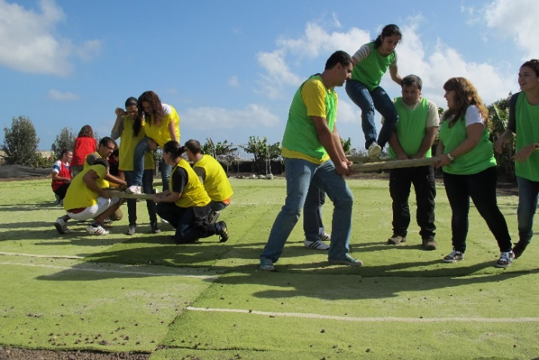
Team-Building Retreat
Location – Meet in the JEC 3222
Schedule - Three options:
Wednesday 9/4 6:00 - 8PM
Saturday 9/7 10:00AM - NOON
Sunday 9/8 10:00AM - NOON
Attendance is expected (and incentivized with a little treat)
Goal is to have entire or majority of team at one session
If entire team can’t make same session, individuals will work with other teams during the event
Notes:
Pic: http://www.entrepreneur-resources.net/theres-no-i-in-team-let-your-company-identity-grow-naturally

Slide 38
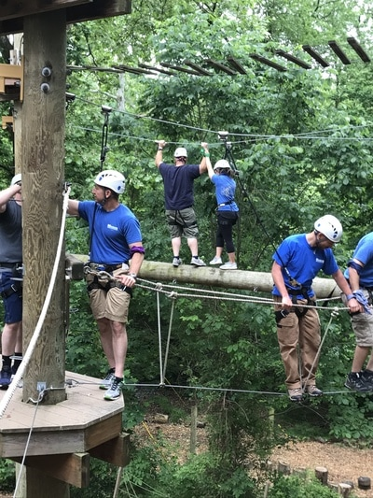
Team-Building Retreat
Action Required!
Determine which session works best for team
Each individual must register by Close of Business (COB) on Tuesday, 9/3/24 at: Capstone S24 LEAP Training Sign Up - Google Sheet
Update link
Notes:
Pic: http://www.msimarinesolutions.com/uploads/3/2/3/0/32309061/img-2216.jpg

Slide 39
5 min – Safety Training Intro
Same material used for IED and other RPI courses
Certification ONLY good for one year, must be valid through END of this semester
Available on Percipio -> under your required training
Notes:
No different from industry

Slide 40
10 min – Wrap-up
Each day of the on-site (class) meetings will end with a wrap-up and discussion of next steps
Team Engineers (YOU) are expected to complete Action Items/Meeting Prep work between on-site meetings to be prepared and make efficient use of meeting time.
Notes:
No different from industry

Slide 41
Wrap-up
On Day 2, teams will
Utilize and build on the work started today and continued off-site.
Discuss and understand project better.
Prepare for Project Kickoff meetings with client to take place during Day 3 or 4 (project-dependent)
Establishing a strong list of questions to have a productive Project Kickoff meeting.

Slide 42
Action Items / Meeting Prep (previously called homework, to be completed BEFORE Meeting 2)
Tasks to be completed BEFORE Meeting 2 @
EDN -> Capstone Support -> Wiki->
Task and Due Dates -> Day 1 Agenda
Note – link is in the PE email you received before classes! And will be echoed in your team’s Webex for convenience!
Notes:
Open the link, show it’s contents, done! Do NOT read it to them!!!

Slide 43
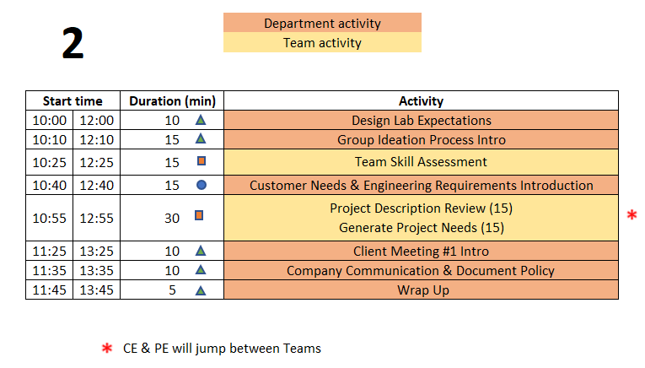
Day 2 Agenda
TD
Team Development /
Design Process Refresher
Administrative Tasks
Project Work
A
P

Slide 44
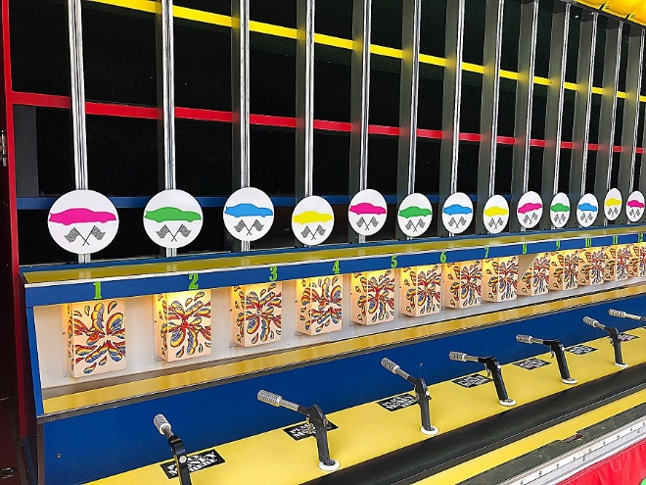
10 min – Design Lab Expectations Horse Race
Kanna – please see next slide
Action Item was to watch one video (Capstone Introduction & Expectations – Part 2)
What are difference between IED and Capstone?
Who ‘owns’ your project – team, PE, CE, Client?
What is role of team members in Capstone?
What is role of PE?
What is role of CE?
Notes:
Day 2
IED vs CD – Not re-learning IED material – building on what was learned
IED – Becoming an Engineer
CD – Be an Engineer
Owner – Students
Role of Students – Solve an open-ended complex problem by applying good engineering practices
Role of PE – Assist students by day to day operations
Role of CE - Evaluation

Slide 45
Kanna – please implement in FREE Kahoot and show the team
What are in common between IED and Capstone?
team based T
work on projects T
You build / make things T
There are quizzes F
Project may carry on after the semester F
Plus two other appropriate questions
Notes:
Day 2
IED vs CD – Not re-learning IED material – building on what was learned
IED – Becoming an Engineer
CD – Be an Engineer
Owner – Students
Role of Students – Solve an open-ended complex problem by applying good engineering practices
Role of PE – Assist students by day to day operations
Role of CE - Evaluation

Slide 46
15 min – Group Ideation Process
Goal
Learn and Apply the Group Ideation Process to Document Team Skills
Process
Time boxed exercise:
It may feel rushed, things may not feel complete. THAT'S OK.
You'll want more time. You can't have it. Team must move on – the team has deadlines to meet!
For EACH question:
2 min
Individual silent thought on content
Write thoughts on Post-It Notes, one per Post-It
2 min
Place Post-Its onto whiteboard
Quick discussion of similar, unique, or new answers
Move on to next section of Ideation Poster as a team
Notes:
Tuckman’s stages of team development – learned in IED, practiced and built on in CD

Slide 47
Identifying Team Skills
What classes can you personally call on to help with this project? (2 min + 2 min)
What experiences can you personally call on to help with this project? (2 min + 2 min)
What skills are the team missing BUT are probably needed for project? (2 min + 2 min)

Slide 48
15 min - Team Skill Assessment
Shared by 2+ Team Members
Unique Skills
________________
________________
_______________
_______________
Skill Gaps
_______________
_______________
Word Template on Day 2 Agenda Wiki
Post the MS Word document to EDN Project Management forum thread by end of today’s meeting!

Slide 49
15 min – Review Project Description
Re-Read Project Description
PE is available to answer any fundamental project questions the Team may have
- Write these questions on the Whiteboard

Slide 50
Engineering Design Process Progression
Days 1-5
You are here!
Days 3-5
Day 5+6
Day 7
Days 8-10 – Project Planning
This Design Process and terminology was learned previously in IED

Slide 51
15 min - Customer Needs & Engineering Requirements Generation
Needs and Requirements workbook.xlsx spreadsheet is located at:
[new project] Capstone Support Template Documents page https://designlab.eng.rpi.edu/edn/projects/capstone-support-dev/repository/112/entry/template%20documents/Needs%20and%20Requirements%20workbook.xlsx
[continuing project] Team’s Repository, Engineering Analysis folder
Fill out based on team’s current (uninformed impression) of project
This is first pass. Don’t worry that answers are not complete or verified by Client. You’ll be updating this often!
The Upcoming Exercise Will Help You Generate Ideas!

Slide 52
Developing Needs & Requirements
We Use These Definitions for
IED & the Design Lab
Note – Key IED Course Materials in Capstone Support wiki.

Slide 53
Generating Ideas for Your Needs
The Engineering Team will Play “Spin for Needs” using this link:
https://wheeldecide.com/?c1=Functionality&c2=Performance&c3=Quality&c4=Usability&c5=Accessibility&c6=Reliability&c7=Durability&c8=Availability&c9=Manufacturability&c10=Maintainability&c11=Environmental%20Impact&c12=Wild%20Card&c13=Interfaces
(be sure to copy the entire link to your browser!)
Start with the Needs you Previously Captured as part of your Meeting Prep!
Spin the Wheel
Use the Topic
Write One Related Need on a Post-It
Repeat!

Slide 54
15 min – Generating Needs & Requirements
Read notes in template document for tips
Remove/combine duplicates
Add Requirements based on the Needs
Unsure of a proper metric?
Quick Google search to put in an educated guess
Fill in holes/gaps after looking at categories
https://designlab.eng.rpi.edu/edn/projects/capstone-support-dev/wiki/Requirements_Management
Safety, Reliability, Maintainability, etc…
Take photo of whiteboard and post to Design Forum

Slide 55
10 mins - Client Meeting 1 Project Kickoff
PPT Template & Instructions
Link on Day 2 Agenda Wiki Page
Translate information from the Project Description to the first few slides in the deck
Add your questions from today
Complete the slides before the meeting!

Slide 56
10 mins – Communication & Documentation Policies
Electronic Design Notebook - REQUIRED for all collaboration
RPI OneDrive – only for development of group deliverables
Webex – Team Chat
WhenIsGood or When2Meet – meeting scheduling
Not Permitted
Slack, GroupMe, or Discord
Google Drive
Google Docs/Sheets/Slides
Other cloud-based tools for any use (schematics, mind maps, drawings, analysis, etc…) e.g., diagrams.net, etc.
RPI Box, RPI Sharepoint
Texting, Instagram, WhatsApp, etc. for ANY project technical content
Webex is good for chat and live meetings, but project documentation should start on and stay in the Electronic Design Notebook (EDN) Forum or Repository.
Simple/easy solution is to never put it on Webex (or elsewhere) to begin with.

Slide 57
Electronic Design Notebook (EDN)
Integrated Project Management
Threaded Communication by topic, rather than a single unorganized stream
IP protection
Performance Evaluation - accountability and visibility
Secure access to team and Client
Backed up daily !
The EDN software was chosen as it currently meets the Design Lab’s needs better than the alternatives*.
* https://designlab.eng.rpi.edu/edn/projects/capstone-support-dev/wiki/Why_Electronic_Design_Notebook_is_the_ONLY_choice

Slide 58
What Should I Document?
Everything
Research, web links, ALL NOTES *
Interviews and observations
Ideas, concepts, sketches, charts, diagrams
Calculations
Purchases - components models, vendors, cost
Analyses – technical and non-technical
Experiments, debugging, tests
Hypothesis, procedures, equipment used, steps taken, data, results
Future work/ideas
Thou shalt document ALL
thy work
* On-site / off-site – ALL meetings & individual work
Although everyone should take notes, there should be a designated note taker for each meeting.

Slide 59
5 min – Wrap-up
Days 3 and 4 include:
Teams’ initial Client Meeting
Continuing development of Client Needs
Beginning translating Client Needs into Engineering Requirements
Review of prior team’s presentation (if applicable)
Client Needs and Engineering Requirements:
Are not easy and require practice to do well!
Guide your project throughout the semester

Slide 60
Wrap-up
Employee Onboarding
Engineering Design Process
As we move from On-site Meeting day 2 to day 3, we will transition from Onboarding to following the Engineering Design Process and accelerating work on the project
Off-site teambuilding activity (Onboarding) still to come
Defining Client Needs has already begun

Slide 61
Action Items / Meeting Prep (previously called homework, to be completed BEFORE Meeting 3)
Tasks to be completed BEFORE Meeting 3 @
EDN -> Capstone Support -> Wiki->
Task and Due Dates -> Day 2 Agenda
Note – link is in the PE email you received before classes! And will be echoed in your team’s Webex for convenience!
Notes:
Open the link, show it’s contents, done! Do NOT read it to them!!!

Slide 62
Day 3 & 4 Activities
Over the next 2 on-site meetings, all teams will complete:
Client Meeting #1 – Kickoff Meeting
CE meeting with team
Client Needs & Requirements - development and review
Review previous Final Presentation - ongoing projects only
Benchmarking

Slide 63
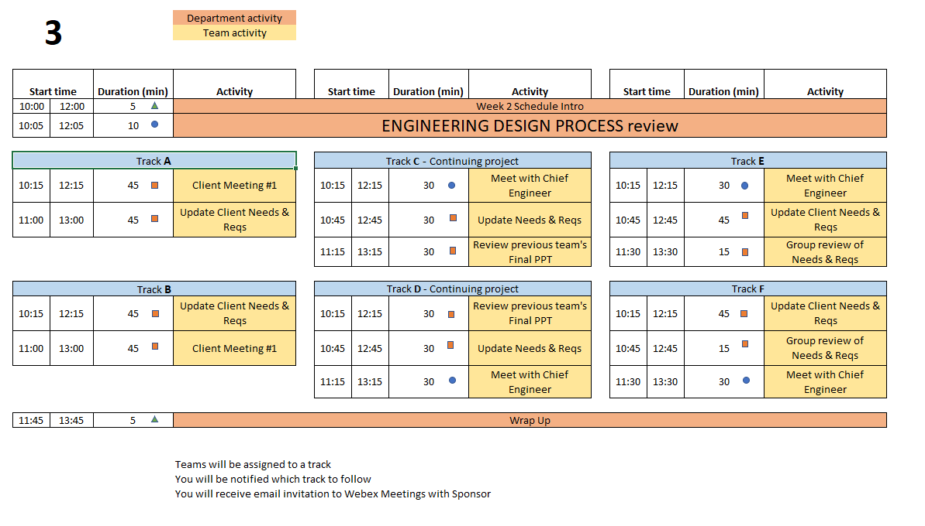
Day 3 Agenda
TD
Team Development /
Design Process Refresher
Administrative Tasks
Project Work
A
P
Notes:
PE Notes
Continuing projects should follow Track C or D
New projects can follow A, B, E or F
Track A or C on Day 3 should follow track A or C on Day 4
Track B, D, or E on Day 3 should follow track B or D on Day 4

Slide 64
Engineering Design Process Progression
Days 1-5
You are here!
Days 3-5
Day 5+6
Day 7
Days 8-10 – Project Planning
This Design Process and terminology was learned previously in IED

Slide 65
30 min – Meet with CE (Day 3 or 4)
Chief Engineer led discussion of:
Performance Evaluations – aka Course grading
Team member expectations
Group discussions
Project Documentation on EDN
Action Items
CE background and experience
Project impressions
Team Standards Agreement
Notes:
Cover these slides in front of class VERY BRIEFLY. They are a reference for the 4 activities which will be done this meeting and next meeting (Day 3 & 4). Students will/can/should open the Playbook and read when they are going through the activities.

Slide 66
45 min – Client Meeting #1 Kickoff Meeting
Meeting Agenda
Team introductions to Client (name, major, relevant experience/skills)
Client introduction to team
Client describes project "in their words“
History, ultimate and semester goals, deliverables, etc…
Open Q&A
Document meeting minutes in
Project Management Forum on EDN

Slide 67
30 min – Review Prior Presentation (if applicable)
Team should review (outside of on-site meeting) the final PPT presentation given by previous engineering team
Forums->Final Deliverables
Repository->Reports->Final Reports
PE/CE will quickly walk-through slide deck and discuss:
Goals
Accomplishments / Successes
Challenges
Next steps
PE/CE will help to clear up confusion and answer any questions current engineering team may have

Slide 68
10 min – Engineering Design Process Horse Race
Action Item was to watch one video (Capstone Introduction & Expectations – Part 2)
What are the steps in Engineering Design Process?
What is a Customer Need?
Example from your current project
What is an Engineering Requirement?
Example from your current project
Notes:
Day 2
IED vs CD – Not re-learning IED material – building on what was learned
IED – Becoming an Engineer
CD – Be an Engineer
Owner – Students
Role of Students – Solve an open-ended complex problem by applying good engineering practices
Role of PE – Assist students by day to day operations
Role of CE - Evaluation

Slide 69
Kanna – please implement in FREE Kahoot and show the team
What are in common between IED and Capstone?
team based T
work on projects T
You build / make things T
There are quizzes F
Project may carry on after the semester F
Plus two other appropriate questions
Notes:
Day 2
IED vs CD – Not re-learning IED material – building on what was learned
IED – Becoming an Engineer
CD – Be an Engineer
Owner – Students
Role of Students – Solve an open-ended complex problem by applying good engineering practices
Role of PE – Assist students by day to day operations
Role of CE - Evaluation

Slide 70
Empathize with your Client
REWRITE THIS
Kanna – do you have materials to share?
Day 4
Become curious about people you don't know. Empathetic people are people who are curious about those around them. ...
Focus on similarities rather than differences. ...
Put yourself in someone's shoes. ...
Listen, but also share. ...
Connect with social action movements. ...
Get creative with it.
https://www.webmd.com/balance/features/how-to-be-more-empathetic

Slide 71
45 min – Update Needs & Requirements
Read notes in template document for tips
Remove/combine duplicates
Unsure of a proper metric?
Quick Google search to put in an educated guess
Fill in holes/gaps after looking at categories
https://designlab.eng.rpi.edu/edn/projects/capstone-support-dev/wiki/Requirements_Management
Capstone Support Wiki -> Knowledge Base -> Requirements Management

Slide 72
5 min – Wrap-up
Days 3 and 4 include:
Teams’ initial Client Meeting
Continuing development of Client Needs
Beginning translating Client Needs into Engineering Requirements
Review of prior team’s presentation (if applicable)
Client Needs and Engineering Requirements:
Are not easy and require practice to do well!
Guide your project throughout the semester

Slide 73
Action Items / Meeting Prep (previously called homework, to be completed BEFORE Meeting 4)
Tasks to be completed BEFORE Meeting 4 @
EDN -> Capstone Support -> Wiki->
Task and Due Dates -> Day 3 Agenda
Note – link is in the PE email you received before classes! And will be echoed in your team’s Webex for convenience!
Notes:
Open the link, show it’s contents, done! Do NOT read it to them!!!

Slide 74
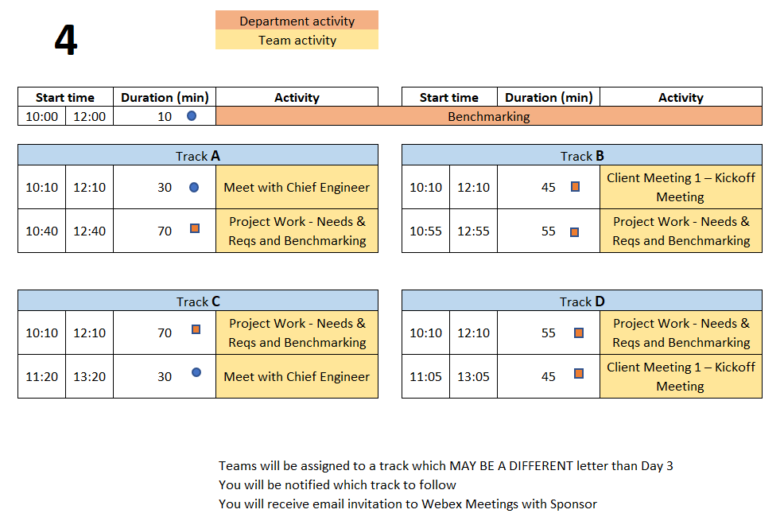
Day 4 Agenda
TD
Team Development /
Design Process Refresher
Administrative Tasks
Project Work
A
P
Notes:
PE Notes (Make clear for new vs. continuing on slide)
Track A or C on Day 3 should follow track A or C on Day 4
Track B, D, or E on Day 3 should follow track B or D on Day 4

Slide 75
Engineering Design Process Progression
Days 1-5
You are here!
Days 3-5
Day 5+6
Day 7
Days 8-10 – Project Planning
This Design Process and terminology was learned previously in IED

Slide 76
10 min - Benchmarking
Purpose
Learn about Competitive Products
Functions
Fabrication Methods
Operation
Key Technologies
Maintenance
Avoid Re-inventing the Wheel!
Reference: IED Textbook:
Product Design and Development, Ulrich, Eppinger, and Yang- Product Specification
Notes:
Reference: Product Design and Development, Ulrich, Eppinger, and Yang

Slide 77
Benchmarking Examples
https://www.lightmetalage.com/news/industry-news/automotive/article-dismantling-and-analysis-of-vehicles-to-develop-optimal-applications/
Powertrain and Battery Pack Systems for the Tesla Model 3, BMW i3, and Chevy Bolt

Slide 78
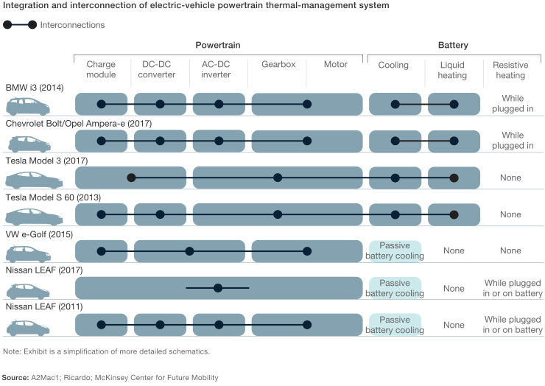
Benchmarking Examples
https://www.mckinsey.com/industries/automotive-and-assembly/our-insights/what-a-teardown-of-the-latest-electric-vehicles-reveals-about-the-future-of-mass-market-evs

Slide 79
Benchmarking - Evaluation
Using the Projects Needs and Requirements
Identify range of values across competitors
Prefer verifiable facts over opinions
Capture values / range of values / units
Assess and prioritize which items are important for your project / client

Slide 80
Benchmarking – Evaluation
Competitors
Note – these are Performance Metrics
NOT Requirements from Your Project
Data on suspension forks
Courtesy of Ulrich and Eppinger Teaching Resource Website for Product Design and Development

Slide 81
45 min – Client Meeting #1 Kickoff Meeting
Meeting Agenda
Team introductions to Client (name, major, relevant experience/skills)
Client introduction to team
Client describes project "in their words“
History, ultimate and semester goals, deliverables, etc…
Open Q&A
Document meeting minutes to
Project Management Forum on EDN

Slide 82
55 min - Project Work
Refine Needs and Requirements Workbook and/or Use Cases & User Stories
Needs
Ensure all currently known Customer Needs are documented. New ones will develop over time!
Requirements:
Associate with appropriate Customer Need(s)
Identify Measurements and Units (quantitative)
Ensure that Requirements are detailed, measurable and prioritized
Identify Applicable Engineering Standards
Use Cases
As a _____ I need to _____ so that _____
User Stories
Determine the Acceptance Criteria / Minimum Viable Product
Continue To Generate Project Questions As You Go!

Slide 83
55 min - Project Work
Refine/Develop Follow-Up Questions for Client
If Team has already had Kickoff Meeting, what new questions have been identified as a result?
Clearly document, review with PE then email to Client, copy your PE & CE
Background Research/Benchmarking
Discuss/document work done to date
Identify/document additional benchmarking needs

Slide 84
Project Work
Someone should take notes of meeting discussion
NOT as Word document, simply as plain text in Forum post.
Meeting Minutes instructions and template https://designlab.eng.rpi.edu/edn/projects/capstone-support-dev/wiki/Meeting_Minutes
Post your meeting minutes AT END of the meeting to Forums –> Project Management
Others can reply to post with any corrections or additional information
Create separate thread for each meeting, e.g., “On-site 9/15”, to help organization and future searching

Slide 85
30 min – Meet with CE (Day 3 or 4)
Chief Engineer led discussion of:
Performance Evaluations – aka Course grading
Team member expectations
Group discussions
Project Documentation on EDN
Action Items
CE background and experience
Project impressions
Team Standards Agreement

Slide 86
10 min – Wrap-up
Day 5 will focus on Concept Generation
Now that teams have had time to identify the Client Needs and corresponding Engineering Requirements associated with their projects, it is time to identify potential concepts to address them.
The Concept Generation activity during the Day 5 on-site meeting will utilize the ideation (Post-It Note) process that we have used previously.

Slide 87
Action Items / Meeting Prep (previously called homework, to be completed BEFORE Meeting 5)
Tasks to be completed BEFORE Meeting 5 @
EDN -> Capstone Support -> Wiki->
Task and Due Dates -> Day 4 Agenda
PE will stop sending out this link.
It is YOUR responsibility to check the list and do the work.
Notes:
Open the link, show it’s contents, done! Do NOT read it to them!!!

Slide 88
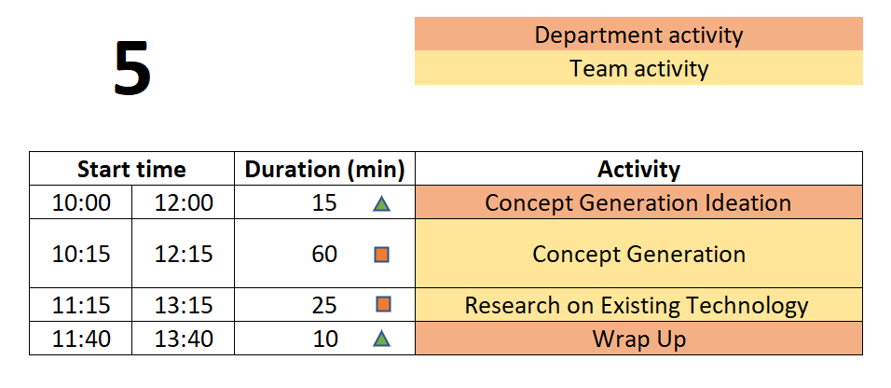
Day 5 Agenda
TD
Team Development /
Design Process Refresher
Administrative Tasks
Project Work
A
P

Slide 89
Engineering Design Process Progression
Days 1-5
You are here!
Days 3-5
Day 5+6
Day 7
Days 8-10 – Project Planning
This Design Process and terminology was learned previously in IED

Slide 90
10 min – Concept Generation Horse Race
This was for Q&A from out of class task
Action Item was to watch one video (Capstone Introduction & Expectations – Part 2)
Where do concept ideas come from?
Need more
Example of Internal Search?
Example of External Search?
Notes:
Day 2
IED vs CD – Not re-learning IED material – building on what was learned
IED – Becoming an Engineer
CD – Be an Engineer
Owner – Students
Role of Students – Solve an open-ended complex problem by applying good engineering practices
Role of PE – Assist students by day to day operations
Role of CE - Evaluation

Slide 91
60 min - Concept Generation
Similar inclusive plan as previous exercises
5 min – Individually silently generate any concept to solve/address customer needs/reqs
write separately on Post-It Notes
15 min – Place concepts on whiteboard
Organize list by topic
Eliminate duplicates
Add extra ideas you think of right now or are inspired by others ideas
30 min – Group discussion
Explain further to improve group understanding – if necessary
Look for missing/unaddressed needs –think of concepts to address them
Look for lone concepts – think of alternative ideas
Note - CE will jump in to talk for 15 mins of this time block

Slide 92
5 min – Create Forum Threads (EDN)
Concept topics ARE the key discussions and work areas for the team
Create Design Forum threads for each topic
Use these thread to post explanation, sketches, calculations, etc…
Reply to teammate’s posts to move idea forwards and advance project
Includes links to material as appropriate but it is helpful to explain what can be found at the link

Slide 93
25 min – Research on Existing Technology
Research existing technologies identified to solve similar problems
Industrial, consumer applications
Limits of technology/equipment
Cost, availability, production volume
Document Your Findings in the Concept Threads
You Will Use Your Findings to Help Select Your Concepts

Slide 94
Wrap-up - Documentation
Which teams are working on ongoing projects?
Have you reviewed the work (documentation) of prior teams?
What did you find?
What did you not find?
Have you utilized the EDN’s search feature?
Did the previous team utilize the wiki page?
What were you able to find from the prior teams’ Webex, Google Drive, OneDrive, text messages, etc.?

Slide 95
Wrap-up - Documentation
Which teams are working on new projects?
You have a blank slate – Keep things organized!

Slide 96
Wrap-up - Documentation
Having thorough and well-organized documentation will greatly ease creation of deliverables and graded assignments such as the ETM, System Design Report, DID, Client Update slide decks, and your Final Report!

Slide 97
Action Items / Meeting Prep (previously called homework, to be completed BEFORE Meeting 6)
Tasks to be completed BEFORE Meeting 6 @
EDN -> Capstone Support -> Wiki->
Task and Due Dates -> Day 5 Agenda
PE will stop sending out this link.
It is YOUR responsibility to check the list and do the work.
Notes:
Open the link, show it’s contents, done! Do NOT read it to them!!!

Slide 98
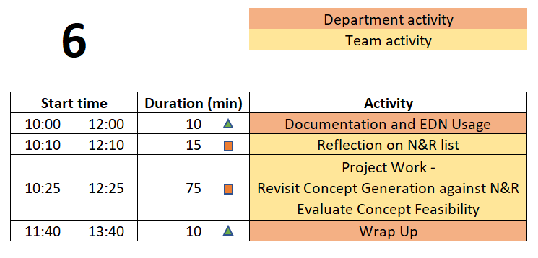
Day 6 Agenda
TD
Team Development /
Design Process Refresher
Administrative Tasks
Project Work
A
P

Slide 99
Engineering Design Process Progression
Days 1-5
You are here!
Days 3-5
Day 5+6
Day 7
Days 8-10 – Project Planning
This Design Process and terminology was learned previously in IED

Slide 100
10 min – Documentation & EDN Usage Horse Race
Action Item was to watch one video (Capstone Introduction & Expectations – Part 2)
Why do we document?
What do we document?
How will you document?
How often / when will you document?
Must we wait for things to be complete / final to document?
Information should be complete before documented?
It is necessary to document negative results?
Teammates share responsibility with PE/CE to offer technical feedback on EDN posts?
Notes:
Day 2
IED vs CD – Not re-learning IED material – building on what was learned
IED – Becoming an Engineer
CD – Be an Engineer
Owner – Students
Role of Students – Solve an open-ended complex problem by applying good engineering practices
Role of PE – Assist students by day to day operations
Role of CE - Evaluation

Slide 101
What is Engineering Documentation?
Living record of your work so that:
Evolution of your product/design is traceable
Your work (experiment) is reproducible
Sketches, ideas, discussions
Test setup, results, failures & successes
Your work can be understood by others and why you did it that way
Feedback & help can be offered
Easy to incorporate into client meeting presentations and the final design report

Slide 102
Why Document?
Extension of your memory
Who, What, When, Where, Why, How
So that others can collaborate and continue the work
Facilitates teamwork
So that others can review/understand your work
Legal ramifications
Contractual/legal defense
Patent application
Efficiently and Effectively move the project forwards
Everyone (now and future) can understand the Who, What, When, Where, Why, and How of the team’s work

Slide 103
Corporate Communication & Documentation Policies Reminder
Electronic Design Notebook - REQUIRED for all project work & effort
RPI OneDrive – only for development of group deliverables
Webex (only) - Team Chat
WhenIsGood or When2Meet - meeting scheduling
Not Permitted
Slack, GroupMe, or Discord
Google Drive
Google Docs/Sheets/Slides
Other cloud-based tools for any use (schematics, mind maps, drawings, analysis, etc…) e.g., diagrams.net, etc.
RPI Box, RPI Sharepoint
Webex Teams is good for chat and live meetings, but project documentation should start on and stay in the Electronic Design Notebook (EDN) Forum or Repository.
Simple/easy solution is to never put it on Webex (or elsewhere) to begin with.

Slide 104
15 min - N&R Reflective Update
Based on the Concept Generation done during last on-site meeting, and thought/research done off-site, update the Needs & Requirements list in Repository.

Slide 105
75 min – Project Work
Revisit Concept Generation
Are the key / Minimum Viable Product Customer Needs addressed by at least 2 concepts?
If not -> generate/research additional concepts
How could concepts be combined into a full system?
Concept Feasibility
Understand feasibility of concepts
Research, calculate, estimate
Document performance and metrics of the technology or idea used elsewhere or in other applications
Can the concepts identified meet the Engineering Requirements?

Slide 106
10 min – Wrap-up
Day 7 will focus on Concept Selection
Now that teams have identified concepts it is time to understand how they can fit together into a full solution for the client’s problem.
Comparisons and decisions should be based on analysis, metrics, and performance rather than ‘gut feelings’ or personal preferences. Avoid comparison matrices with 1’s and 0’s or + and - values.
Several Meaningful Concepts are Required to Perform Concept Selection!
Image from: https://m.media-amazon.com/images/I/41EB53DgtzL._AC_SL1100_.jpg

Slide 107
Action Items / Meeting Prep (previously called homework, to be completed BEFORE Meeting 7)
Tasks to be completed BEFORE Meeting 7 @
EDN -> Capstone Support -> Wiki->
Task and Due Dates -> Day 6 Agenda
PE will stop sending out this link.
It is YOUR responsibility to check the list and do the work.
Notes:
Open the link, show it’s contents, done! Do NOT read it to them!!!

Slide 108
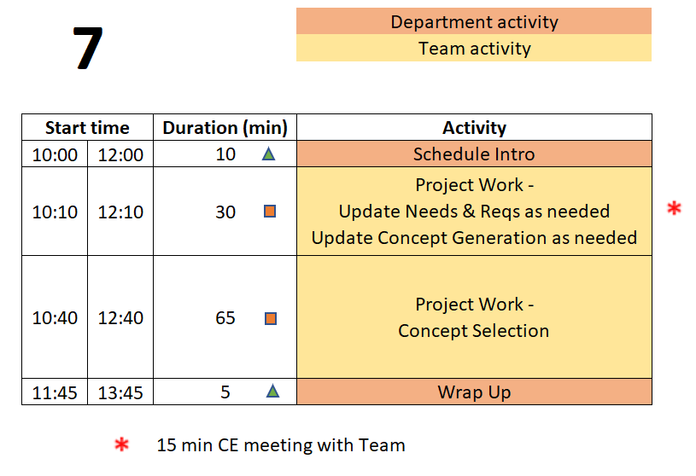
Day 7 Agenda
TD
Team Development /
Design Process Refresher
Administrative Tasks
Project Work
A
P

Slide 109
Engineering Design Process Progression
Days 1-5
You are here!
Days 3-5
Day 5+6
Day 7
Days 8-10 – Project Planning
This Design Process and terminology was learned previously in IED

Slide 110
15 min – CE Time
Meeting will be at team table
This will take place at some point during Concept Selection exercise depending on CE’s schedule

Slide 111
65 min – Concept Selection
May want some content here to help explain specifically how we’d like this done
Decision matrix
REAL numbers
based on your Requirements
values based on facts
not gut feelings
not 1’s/0’s or +’ / -’s

Slide 112
5 min – Wrap-up
During the Day 8 on-site meeting, teams will develop a project plan to guide their work for the remainder of the semester. To be prepared for this activity, team members must:
Understand why Project Management is important
Understand the difference between Deliverables and Tasks/Activities.
Come to the meeting with an initial list of tasks required to complete the project.

Slide 113
Action Items / Meeting Prep (previously called homework, to be completed BEFORE Meeting 8)
Tasks to be completed BEFORE Meeting 8 @
EDN -> Capstone Support -> Wiki->
Task and Due Dates -> Day 7 Agenda
PE will stop sending out this link.
It is YOUR responsibility to check the list and do the work.
Notes:
Open the link, show it’s contents, done! Do NOT read it to them!!!

Slide 114
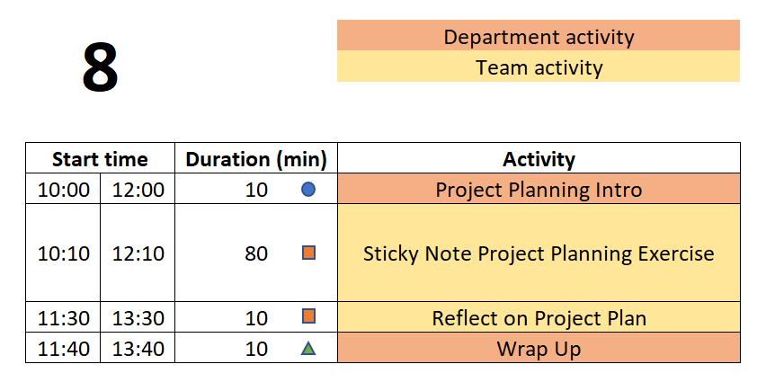
Day 8 Agenda
TD
Team Development /
Design Process Refresher
Administrative Tasks
Project Work
A
P

Slide 115
Engineering Design Process Progression
Days 1-5
You are here!
Days 3-5
Day 5+6
Day 7
Days 8-10 – Project Planning
This Design Process and terminology was learned previously in IED

Slide 116
10 min – Project Planning Horse Race
Action Item was to watch one video (Capstone Introduction & Expectations – Part 2)
What is a milestone?
What is a parallel task?
What is a serial task?
What is the critical path?
Notes:
Day 2
IED vs CD – Not re-learning IED material – building on what was learned
IED – Becoming an Engineer
CD – Be an Engineer
Owner – Students
Role of Students – Solve an open-ended complex problem by applying good engineering practices
Role of PE – Assist students by day to day operations
Role of CE - Evaluation

Slide 117
Defining Meaningful Tasks
80 min - ‘Post-It Note’ Project Planning
One idea per Post-It. Be concise!
Defined to be No More than 1 week long. Break big things into smaller pieces.
Everyone Needs at Least 1 Task per Week for the Entire Semester
What will YOU contribute to the project? Focus on YOUR potential contributions to the project. (We know these may not yet be defined!)
Focus on the technical work required
For now, leave out project management / overhead tasks, e.g., report writing, slide making, etc.
DO include documentation needed for technology transfer, e.g., user manual
Be Technical! Be SMART!

Slide 118
Defining Meaningful Tasks aka “SMART”
Project Planning Tips
Yes, it gets harder to define tasks near the end of the semester. So instead, work backwards from the end!
There may be gaps in time – you will need to fill those in today
Do not just copy a task 3 times because it spans 3 weeks. Instead, you must break it down into 3 well defined smaller tasks.
Don’t allocate slack time at the end of the semester. Project plans do not include tasks called “Just in Case”. Instead estimate the length of tasks to factor in some risk. Not everything works the first time and many thing turn out to be more difficult than first thought.
Group things by functional subsystem rather than by name. This helps reveal possible planning gaps.
Remember your deliverables! Do you have the tasks needed to produce each of them, including things like demos?
Be Technical! Be SMART!

Slide 119
20 min - ‘Post-It Note’ Project Planning
10 min – Deliverables
Write each Deliverable from Client Meeting 2 Slides on a Post-It and place on the board/calendar at approximate due date.
Draw a box around the note so that it stands out.
10 min – Tasks
(Individually silently) Each team member generate list of TEN tasks which must be completed to accomplish the deliverables.
Off-site Action Item was to post 6 individual tasks to EDN, so start with those. Now create at least 4 more each.
Create 1 Post-It for each task
Add your initials to post-it in case there are questions about content

Slide 120
‘Post-It Note’ Project Planning Exercise
10 min – Organize tasks on Whiteboard
Position tasks appropriately along week-by-week calendar
This can be done before or after getting all items shared.
40 min – Group organization of tasks
Add missing tasks, remove duplicates
Organize by subsystem or milestone
10 min – Re-assign ownership (by color/initial)
Ensure everyone has work throughout semester
Each Team Member Should Leave meeting with their assigned Post-It’s.
Each Team Member then Enters Their Own Tasks as EDN Issues!

Slide 121
10 Min - Reflecting on your New Project Plan
Take a few minutes to pause and reflect on the Project Plan the Engineering Team just created.
Use the prompts on this Wiki page to guide the discussion.
https://designlab.eng.rpi.edu/edn/projects/capstone-support-dev/wiki/Reflecting_on_your_New_Project_Plan
Focus on Process and Results

Slide 122
10 min – Wrap-up
Activities of Day 9 & 10
PE/CE Feedback on the Project Plans created during and after Day 8
PE/CE Feedback on Needs & Requirement list
Client Meeting #2 Concept Generation and Selection Update
Developing System Design

Slide 123
Wrap-up
Day 9 & 10 also include 60+ mins for team-directed work.
Efficient team-directed meetings require an Agenda.
The Agenda should be SMART - Specific, Measurable, Actionable, Relevant, and Time-Oriented
Agendas should be posted to your white board before starting the meeting
Pro Forma Agenda posted on Capstone Support: https://designlab.eng.rpi.edu/edn/projects/capstone-support-dev/wiki/Pro_Forma_Meeting_Agenda
Fix link

Slide 124
Action Items / Meeting Prep (previously called homework, to be completed BEFORE Meeting 9)
Tasks to be completed BEFORE Meeting 9 @
EDN -> Capstone Support -> Wiki->
Task and Due Dates -> Day 8 Agenda
PE will stop sending out this link.
It is YOUR responsibility to check the list and do the work.
Notes:
Open the link, show it’s contents, done! Do NOT read it to them!!!

Slide 125
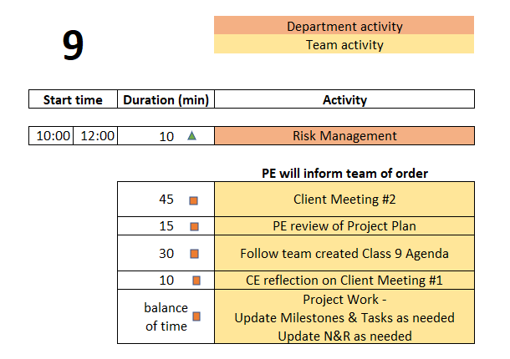
Day 9 Agenda
TD
Team Development /
Design Process Refresher
Administrative Tasks
Project Work
A
P

Slide 126
Engineering Design Process Progression
Days 1-5
You are here!
Days 3-5
Day 5+6
Day 7
Days 8-10 – Project Planning
This Design Process and terminology was learned previously in IED

Slide 127
30 min – Follow Team created Agenda
Designate team member to facilitate this meeting
Designate team member to take and post minutes to EDN
This should be done for EVERY on-site and off-site meeting.
Rotate responsibility. To be equitable, ALL team members should have a turn!
Notes:
Day 9

Slide 128
10 min – CE reflection on Client Meeting #1
Feedback on team’s Client meeting
Review based on rubric
Deliverables
Professionalism and preparedness in meeting
Notes:
Day 9

Slide 129
15 min – PE Review Project Plan
Many short individual tasks? Few large group tasks?
Adequate time for:
Manufacturing?
Purchasing?
Testing?
Iterative development? Second round of any tasks?
Equal division of labor across all team members?
Ability to do some work in parallel rather than series?
Design test plan BEFORE fabrication is complete
Create dummy data NOW to test software performance or analysis approach

Slide 130
Action Items / Meeting Prep (previously called homework, to be completed BEFORE Meeting 10)
Tasks to be completed BEFORE Meeting 10 @
EDN -> Capstone Support -> Wiki ->
Task and Due Dates -> Day 9 Agenda
PE will stop sending out this link.
It is YOUR responsibility to check the list and do the work.
Notes:
Open the link, show it’s contents, done! Do NOT read it to them!!!

Slide 131
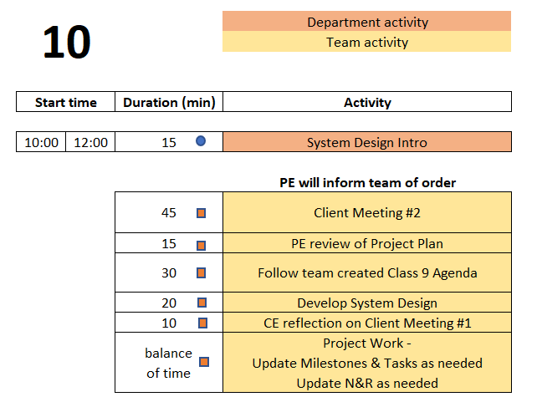
Day 10 Agenda
TD
Team Development /
Design Process Refresher
Administrative Tasks
Project Work
A
P

Slide 132
Engineering Design Process Progression
Days 1-5
You are here!
Days 3-5
Day 5+6
Day 7
Days 8-10 – Project Planning
This Design Process and terminology was learned previously in IED

Slide 133
20 min – System Design
Create Wiki page with this info
Designate team member to facilitate this meeting
Designate team member to take minutes and post them to EDN
This should be done for EVERY on-site and off-site meeting.
Rotate responsibility. To be equitable, ALL team members should have a turn!
Complete overall system design
Create System Architecture diagram
Identify subsystem definitions and their owners (assignees)
One person per subsystem
Notes:
Day 9

Slide 134
System Design Report Intro
From SPREADSHEET : Include updated / improved PSO information, N&R, Concept generation/selection, System Design, Integration and Testing plan.

Slide 135
Detailed Individual Design Report Intro
System Architecture Diagram
Subsystem or portion YOU are responsible for
Related Needs & Reqs (include # from spreadsheet in Repo)
Interfaces to other subsystems (refer to System Architecture)
Sketch/description of 1-2 leading concepts (list of forum thread links)
Perceived challenges/risks
YOUR next steps/plan
1,000 - 1,500 words
10-15 pages including images
This is an INDIVIDUAL assignment. The document should speak to what YOU personally will contribute to the design and project demonstration.

Slide 136
5 Min – Wrap-up
Design Lab created Agendas have ended!
Engineering team should now create Agenda for each on-site (and off-site) meeting
Primary purpose of the remaining on-site meetings is team review and assessment of work already completed, especially with your PE and/or CE.
These 4 hours per week of on-site meeting time may be the only available time for FULL Engineering team to meet. It is therefore recommended to use this time for group discussions, group work, planning, updating Needs and Requirements, making decisions, etc. IF all that is complete / up to date, use the time for individual work.
Use EDN and Repository to document all work moving forwards

Slide 137
All Employee Meetings

Slide 138
Board of Directors Review is coming up NEXT WEEK
BDR Introduction
Read Wiki page with instructions
https://designlab.eng.rpi.edu/edn/projects/capstone-support-dev/wiki/Board_of_Directors_Review
Create poster to show Board
Rubric posted here - https://designlab.eng.rpi.edu/edn/projects/capstone-support-dev/wiki/Tasks_and_Due_Dates
Divide team into 3 groups for review
Practice content to improve your comfort presenting
Notes:
Day 9

Slide 139
Engineering Design Process
POSTER introduction
This Design Process and terminology is taught in IED at RPI
Team is creating a poster to communicate
Overall project (Needs & Requirements)
Progress made (Concepts, System Architecture)
Future steps (Design, Integration, & Test Plan)
Notes:
Day 9

Slide 140
95 min – Poster Creation
Download and Open Poster.pptx from Repository
https://designlab.eng.rpi.edu/edn/projects/capstone-support-dev/repository/112/entry/template%20documents/Poster.pptx
10 mins – Divide into 3 groups, and work on initial slides. Content can be pulled from Project Statement & Objectives.
Purpose
Past Work and/or Project History
Semester Objectives/Requirements
40 mins – As a full team discuss Technical Approach, Results and Accomplishments to Date
30 mins – Move on to Next Steps and Plan
15 mins – Begin assembly of content onto single slide (pg 8)

Slide 141
Revision History
Version | Date | Name | Reason for Changes
4.0 | 7.8.24 | AP, BD, MA | Full review and updating of new course flow
4.1 | 7.23.24 | AP | Director’s letter removed from New Employee Packet
4.2 | 7.25.24 | AP | Updating slides to match agenda and overall on-site plan ‘Design Lab Process Progression’ slide updated Preferred pronouns added to Wiki post
4.3 | 7.31.24 | AP | Some shifting of content, adjustment of section durations Day 1 & 2 team meeting added to Day 1 OOC tasks
4.4 | 8.1.24 | AP, KN | All Agenda slides & Design Process slides updated Notes added to adjust flow, point out content to add on days 2-5
4.5 | 8.9.24 | AP | ‘Design a Vehicle’ N&R activity pulled out into separate training PPT
4.6 | 8.9.24 | AP,MA,BD,KN, JK | So many things, long meeting ironing out bugs and making improvements
4.7 | 8.12 | AP | OneDrive is OK for development of group files
4.8 | 8.15 | AP | Out of Class tasks slides REMOVED. Contents shifted solely to Wiki Agenda slides
4.9 | 8.19 | AP | Slides on Project Questions removed, content shifted to Wiki Updated order of Day 4 activities – benchmarking for whole class @ start
4.10 | 8.20 | AP | Updated Agenda images Day 9/10 team Agenda block reduced to 30 mins Day 9/10 added 10 mins of CE reflection on Client Meeting 1 Removed daily reminders to download Playbook Modified formatting of Out of Class Task reminder slides
4.11 | 8.21 | MA | Formatting – centered titles and better matched their fonts, enlarged some content, fix some bulleting. NO content changes

Slide 142
Revision History - continued
Version | Date | Name | Reason for Changes

