Slide 1
Projects, Evaluators, & Mentors - Section 2
Sponsor | Project | Chief Engineer | Project Engineer | Room | Pod
Corning Incorporated | Crack Growth Measurement | Sandipan Mishra | Mark Anderson | JEC3232 | 1
Design Lab | Window Security for Passive Cooling | Sandipan Mishra | Brad DeBoer | JEC3232 | 3
Vermont Energy Investment Corp. | Predictive Refrigerant Leak Modeling in VRF Systems | Prabhakar Neti | Kannathal Natarajan | JEC3232 | 4
Western Digital | Rover-Based Assistive Device Development - Wheel Chair | Prabhakar Neti | Junichi Kanai | JEC3232 | 6
JEC 3232
JEC 3332
4
3
3
5
2
4
2
5
6
1
1
6

Slide 2
Projects, Evaluators, & Mentors - Section 3
Sponsor | Project | Chief Engineer | Project Engineer | Room | Pod
Design Lab | Design Lab Acoustics | Nima Ahmadi | Aren Paster | JEC3232 | 1
The Boeing Company | Aircraft Robotic Assembly | Nima Ahmadi | Kannathal Natarajan | JEC3232 | 4
Living Buildings | Rammed Earth Formwork Design | Clint Ballinger | Brad DeBoer | JEC3232 | 6
Jefferson Project | Cold-Conditions Sub-Surface Water Quality Sensor Development | Muhsin Celik | Mark Anderson | JEC3332 | 1
NYSDEC | Heat Pump Demonstrator | Muhsin Celik | Junichi Kanai | JEC3332 | 6
JBT Corporation | AGV Mast Lifting | Clint Ballinger | Aren Paster | JEC3232 | 3
JEC 3232
JEC 3332
4
3
3
5
2
4
2
5
6
1
1
6

Slide 3
Projects, Evaluators, & Mentors - Section 4
Sponsor | Project | Chief Engineer | Project Engineer | Room | Pod
Sikorsky | Part Distortion During Machining | Rahmi Ozisik | Brad DeBoer | JEC3232 | 1
Lockheed Martin | Persistent Identification for Manufacturing Processes | Muhsin Celik | Brad DeBoer | JEC3332 | 1
MILL | Swirled Plastic Parts | Rahmi Ozisik | Aren Paster | JEC3232 | 3
Design Lab | Mechatronics Demonstration of 2D Motion | Indika Perera | Junichi Kanai | JEC3232 | 4
The Boeing Company | Enterprise Test Vehicle Design | Indika Perera | Aren Paster | JEC3232 | 6
Plug Power | Autonomous Data Collection | Muhsin Celik | Mark Anderson | JEC3332 | 6
JEC 3232
JEC 3332
4
3
3
5
2
4
2
5
6
1
1
6

Slide 4


Welcome to
Capstone Design
Playbook for Day 1 through 10
In-Class Meetings

Slide 5
Link to Agendas
Class 1
Class 2
Class 3
Class 4
Class 5
Class 6
Class 7
Class 8
Class 9
Class 10
#Pro Tip – Current Action Items are listed ONE page before next class’s agenda

Slide 6

Multidisciplinary Capstone Design
ECSE 4900 Electrical & Computer Systems Engineers
ISYE 4270 Industrial Engineers
MANE 4260 Mechanical Engineers
MTLE 4920 Materials Engineers

Slide 7
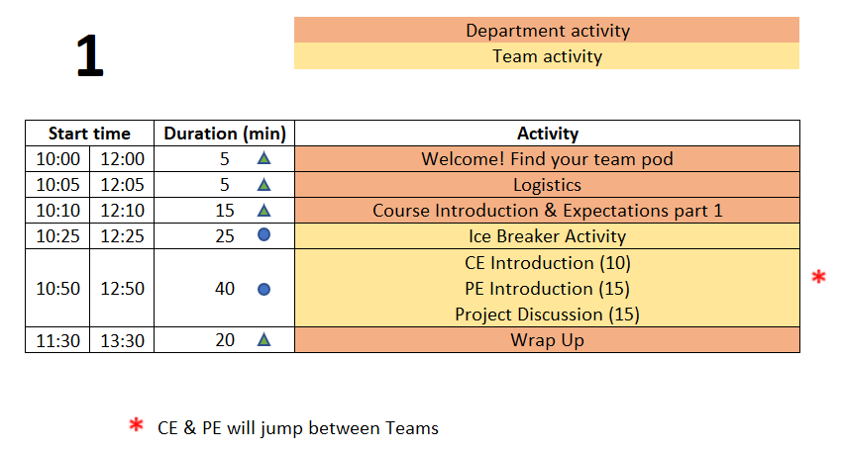
Class 1 Agenda
TD
Team Development /
Design Process Refresher
Administrative Tasks
Project Work
A
P

Slide 8
5 min - Logistics
The Daily Meeting Agendas are on the Capstone Support Wiki - see link from your PE’s intro email

Slide 9
Design Lab Mission
Develop High Performing Engineers by Mentoring Students in Professional and Engineering Design Practices Through Project Based Learning.

Slide 10
Capstone Design Transition
NO textbook, NO lecture
It is a Team EXPERIENCE
It is a mostly “flipped” experience
Guided/assisted by Project Engineer (PE)
Graded/assisted by Chief Engineer (CE)

Slide 11
Capstone Design:
Practice Engineering in Safe Environment
Initial Cover letter and Resume
New Employee Packet from
your Project Engineer
Design Lab Support Staff
Project Engineers and Chief Engineers
Students in a Course ➔
Consulting Engineering Team
Solving a Client Problem

Slide 12

Design Lab
Engineering Team
New hire

Slide 13
New Employee Onboarding
Day 1 Agenda
Class 1 Agenda
TD
Team Development /
Design Process Refresher
Administrative Tasks
Project Work
A
P

Slide 14




Welcome to Your Project Team!
Engineering Team Members
Project Engineer (PE)
Purchasing
Fabrication Support
Chief Engineer (CE)
Client
Notes:
Introduce PE/CE in this slide. Each team has an assigned PE/CE. The project description document has their names.

Slide 15
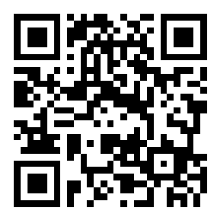
Your Capstone Expectations
Share your expectations for this Capstone course by answering some questions.
Join Slido.com with Code #1350435
(or) using the QR Code below

Slide 16

Design Lab - Core Values
Embrace diverse backgrounds, skills, and perspective
Create an inclusive and equitable team environment
Act with Professionalism and Respect

Slide 17



Participation Expectations
Arrive to meetings on time.
Stay until meeting ends.
Be present in all meetings.
Listen, Engage, Participate.
Focus on the Project.
Minimize Distractions
(phone, other tasks)

Slide 18
Work Expectations
Your new position involves:
  4 Hours per week of on-site work
  5 Hours per week of off-site work
    Individual technical work & team meetings
  Consistent level of work throughout the semester
Document all progress and results
Read communication from Design Lab staff and teammates
  Emails
  Webex chat
  EDN posts
Please respond in a timely manner!

Slide 19
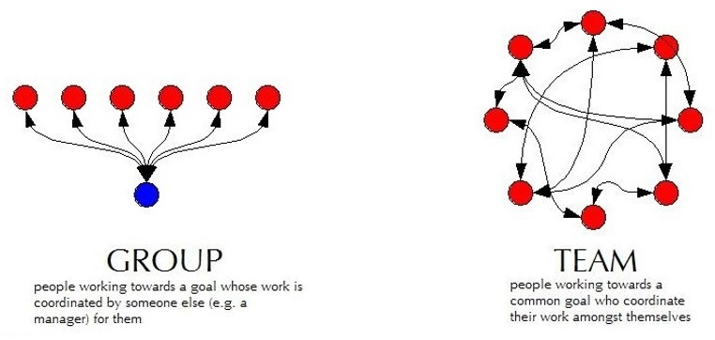
Capstone is More TEAM work than GROUP work
Group Work
  Divide and conquer
  Low interaction with team
  Supervisor managed
Team Work
  Collaborative effort
  Interactive -peer review
  Team member managed

Slide 20
Work Expectations
Q: “What expectations will your boss and peers have of you at work?”
Let’s start doing this NOW in the Design Lab.
  Be Accountable.
    To your teammates, to your Chief/Project Engineer, and to the project Client.
  Be Professional.
  Make your work VISIBLE.
    Post/share as you go. Please do not “hide” it from team until its perfect or completely finished.
    Use Electronic Design Notebook (EDN)
Notes:
This slide is animated. Shows only the question – PE should ask students and get some responses

Slide 21
Design Lab Communications & Documentation Policies (1/2)
Written capstone communications are permitted using ONLY Design Lab tools:
  The Engineering Design Notebook (EDN)
    Native EDN posts
    MS Office files, CAD, etc.
    Repository via Subversion
  Webex
  RPI OneDrive – only for development of group deliverables
Use of any other cloud-based service, such as Google Drive/Docs/Sheets/Slides, GroupMe, Discord, Slack, Draw.io, etc. is FORBIDDEN
Although supported by campus, RPI Box is also FORBIDDEN
Scheduling services such as WhenIsGood & When2Meet are acceptable for setting up meetings but must not contain any technical information
This Helps Protect Against Unauthorized Access And
Provides Equal Access To All Team Members

Slide 22

Design Lab Communications & Documentation Policies (2/2)
Generative AI
  Properly acknowledge and cite the use of generative AI tools.
  You are ultimately responsible for the content you submit.
  Do not input any sensitive or confidential information into AI tools.
Helpful Resource
https://info.rpi.edu/comm-d

Slide 23
Use a laptop or tablet for:
Note taking
CAD
Webex
Use paper & pencil for
Sketching
Quick math / calculations
Use your phones for:
Taking photos of whiteboards, test setups
Webex
Pro Tips

Slide 24
Accountability Step #1
You all received the New Employee Packet via email:
Project Description - Will guide your work today
Instructions for electronic
signatures in Adobe
Recognition Waiver and Release - SIGN & return by end of day
Sponsorship Agreement - SIGN & return by end of day
MANDATORY for all employees to SIGN & return by end of day
More information on Sponsorship Agreement and Confidentiality
EDN -> Capstone Support -> Course Guidelines and Policies -> Confidentiality Requirements

Slide 25
25 mins - Ice Breaker
Desired Outcomes
  Prepare everyone for collaborative engineering team performance by helping create a relaxed environment where everyone can share ideas and participate more fully
  Build rapport among the engineering team members

Slide 26
The Process…
Break into pairs within your team – if your team has an odd number of members, one group should include three members
Answer the prompt for the first question using Slido – 1 minute
Pair off and Share Responses with your partner & discuss – 2 minutes
Go around the team and each person introduces their partner – name & skill – 5 minutes total
Review the full word cloud & discuss – 2 minutes
Repeat for second question
Repeat for third question

Slide 27
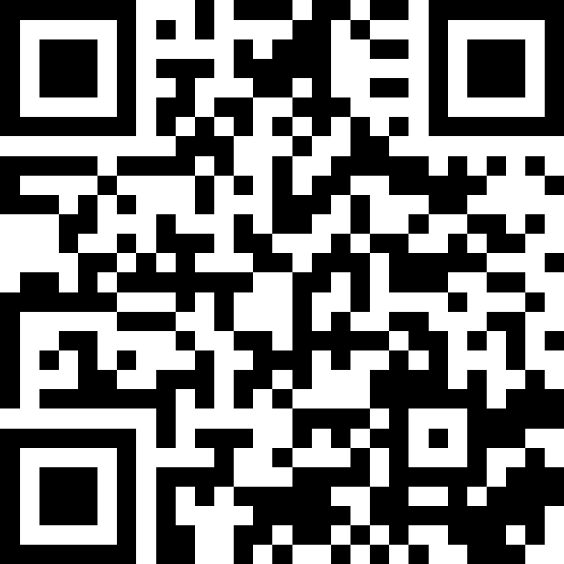
Ice Breaker
JEC 3232 side
SCAN this code
OR
  Open slido.com on your smart phone or laptop
  Join as a participant with
  #1697651

Slide 28
Capstone Course - Overview
Work in teams on a one-semester project related to the design of a complex engineering system.
Each student will be responsible for identifying and accomplishing specific work within the project.
Apply the Design Process (taught in IED) to scope the project and design, build, test, and deliver your proposed design solutions
Assessed on your contribution to the project on technical work, communication skills, project management documentation, and teamwork.
Deliverables | Level of Assessment | % of Final Grade (Team) | % of Final Grade (Individual)
Technical Progress #1 | Individual |  | 6
Benchmarking Memo | Individual |  | 5
N&R Speadsheet | Team | 5
Concept Generation PPT | Team | 5
Board of Directors Review – Oral presentation | Team | 5
 | Individual |  | 2
Tech Progress & Project Mgmt. #2 | Individual |  | 6
System Design Report | Team | 5
Detailed Individual Design Report | Individual |  | 6
Client Meeting #2 | Team | 5
Client Meeting #3 | Team | 5
Tech Progress & Project Mgmt. #3 | Individual |  | 6
Final Design Report +Poster | Team | 15
Tech Progress & Project Mgmt. #4 | Individual |  | 6
Final Design Review Presentation + System Evaluation | Team | 15
 | Individual |  | 3
 | Total | 60 | 40

Slide 29

Key Elements
Technical Work
Client Meetings
Project Reviews
Design Documentation

Slide 30
40 min – Staff Introductions & Project Launch
Chief Engineer (CE) & Project Engineer (PE) Introductions
  Both individuals will stop by to meet with the team
Project Description Review
  If you have not read the document yet, NOW is your chance. You need that information to do the next step effectively!
Discuss project as a t eam.
  Begin documenting Questions you have about the project. Share the complied list of questions in the Webex.

Slide 31
15 min - Meet with Project Engineer
  Project Engineer meets with each team:
    Explain the PE Role
    Check on team status / welfare
    Team member introductions
    Discuss project impressions
    PE’s background/experience
    When not meeting with your PE or CE, team members generate/discuss questions about project.

Slide 32
10 min - Meet with Chief Engineer
  Chief Engineer meets with each team:
    Explain the CE role
    Check on team status / welfare
    Team member introductions
    Discuss project impressions
    CE’s background/experience
    When not meeting with your PE or CE, team members generate/discuss questions about project.

Slide 33
20 min – Wrap Up
Team Standards Agreement Intro
According to concepts in organizational behavior, there are five stages of team development (Tuckman’s Model, 1964): forming, storming, norming, performing and adjourning
In high performing teams a Team Standards Agreement is often generated to establish procedures and roles to move the team more quickly into the performing stage
A Team Standards Agreement will be generated off-site by each team before Day 6
  The Team Standards Agreement shall be posted to your team’s EDN Wiki page in accordance with the instructions on Wiki
  EDN -> Capstone Support -> Wiki-> Task and Due Dates -> Team Standards Agreement
Completed Team Standard Agreement should be posted to Wiki by START of Day 6

Slide 34
Wrap Up – Team-Building Retreat
During the second week, there will be an off-site, peer-led, Team-Building Retreat
Retreat Goals:
  Build positive foundations of teamwork and communication.
  Foster motivation and accountability within teams.
  Enhance leadership, working together, and getting to know each other.
  Understand the importance of eye contact and active listening.

Slide 35

Team-Building Retreat
Location - Design Lab, JEC 3232
Schedule - Three options:
  Wednesday 9/4 6:00 – 8pm
  Saturday 9/7 10:00am - NOON
  Sunday 9/8 10:00am - NOON
Attendance is expected (and incentivized with a little treat)
  Goal is to have entire or majority of team at one session
  If entire team can’t make same session, individuals will work with other teams during the event
Notes:
Pic: http://www.entrepreneur-resources.net/theres-no-i-in-team-let-your-company-identity-grow-naturally

Slide 36

Team-Building Retreat
Action Required!
  Determine which session works best for team
  Each individual must register by Close of Business (COB) on Tuesday, 9/3/24
  Fall 2024 Capstone LEAP Training Sign Up Sheet
Notes:
Pic: http://www.msimarinesolutions.com/uploads/3/2/3/0/32309061/img-2216.jpg

Slide 37
Wrap Up – Safety Training Intro
Same material used for IED and other RPI courses & labs
Certification ONLY good for one year, must be valid through END of this semester
Available on Percipio -> under your required training
Notes:
No different from industry

Slide 38
Wrap-up
Each day of the on-site (class) meetings will end with a wrap-up and discussion of next steps
Team Engineers (YOU) are expected to complete Action Items/Meeting Prep work between on-site meetings to be prepared and make efficient use of meeting time.
Notes:
No different from industry

Slide 39
Wrap-up – Looking forwards
On Day 2, teams will
  Utilize and build on the work started today and continued off-site.
  Discuss and understand project better.
  Prepare for Project Kickoff meetings with client to take place during Day 3 or 4 (project-dependent)
    Establishing a strong list of questions to have a productive Project Kickoff meeting.

Slide 40
Action Items / Meeting Prep
(previously called homework, to be completed BEFORE Meeting 2)
Tasks to be completed BEFORE Meeting 2 @
EDN -> Capstone Support -> Wiki->
Task and Due Dates -> Day 1 Agenda
Note – link is in the PE email you received before classes! And will be echoed in your team’s Webex for convenience!
Notes:
Open the link, show it’s contents, done! Do NOT read it to them!!!

Slide 41
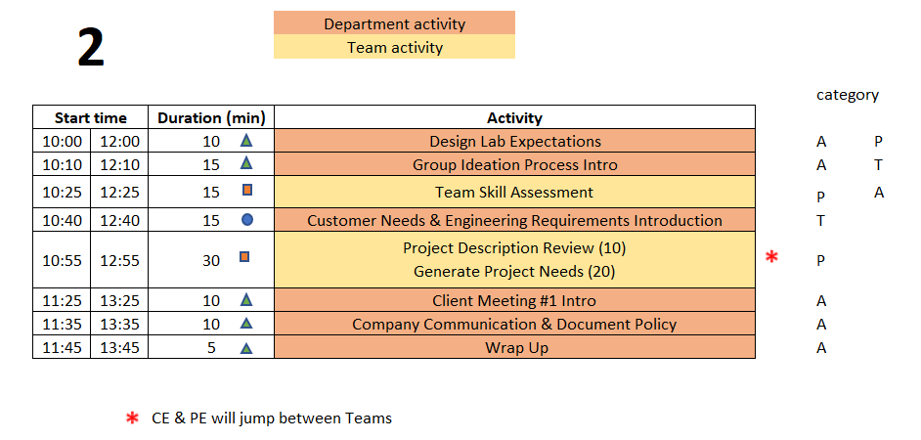
Day 2 Agenda
TD
Team Development /
Design Process Refresher
Administrative Tasks
Project Work
A
P

Slide 42

10 min – Design Lab Expectations
Action Item from Day 1
Watch video on Capstone Introduction & Expectations – Part 2
Knowledge Check – Through Kahoot
Instructions
Each team design a name for Kahoot login
One member in each team login to Kahoot using the given GAME PIN
For every question, the team discuss among themselves and give the correct answer
Students get one minute to answer each question
There are 4 questions
Notes:
Day 2
IED vs CD – Not re-learning IED material – building on what was learned
IED – Becoming an Engineer
CD – Be an Engineer
Owner – Students
Role of Students – Solve an open-ended complex problem by applying good engineering practices
Role of PE – Assist students by day to day operations
Role of CE - Evaluation

Slide 43
15 min – Group Ideation Process
Goal
Learn and Apply the Group Ideation Process to Document Team Skills
Process
Time boxed exercise:
It may feel rushed, things may not feel complete. THAT'S OK.
You'll want more time. You can't have it.
Team must move on – the team has deadlines to meet!
For EACH question:
2 min
  Individual silent thought on content
  Write thoughts on Post-It Notes, one per Post-It
2 min
  Place Post-Its onto whiteboard
  Quick discussion of similar, unique, or new answers
Move on to next section of Ideation as a team
Notes:
Tuckman’s stages of team development – learned in IED, practiced and built on in CD

Slide 44

Identifying Team Skills
What classes can you personally call on to help with this project? (2 min + 2 min)
What experiences can you personally call on to help with this project? (2 min + 2 min)
What skills are the team missing BUT are probably needed for project? (2 min + 2 min)

Slide 45
15 min - Team Skill Assessment
Shared by 2+ Team Members
Unique Skills
________________
________________
_______________
_______________
Skill Gaps
_______________
_______________
Word Template on Day 2 Agenda Wiki
Post the MS Word document to EDN Project Management forum thread by end of today’s meeting!

Slide 46

Engineering Design Process Progression
Days 1-5
You are here!
Days 3-5
Day 5+6
Day 7
Days 8-10 – Project Planning
This Design Process and terminology was learned previously in IED

Slide 47
15 min – Design Process Step 1 !
Solve the Problem Your Customer Has!
  Seek to Understand What the Customer Needs
Two Primary Set of Tools Based on Project Type
  Hardware Projects
    Needs and Requirements (covered in IED)
  Software Projects
    Use Cases
    User Stories
Projects with Both May Use All these Tools!

Slide 48
Documenting and Describing the Client problem
If Needed, Divide Your Team Into Two Groups
  Hardware
  Software
Each Group Leverage The Appropriate Tools
  Develop The Appropriate Information

Slide 49
Customer Needs & Engineering Requirements Introduction
Needs and Requirements workbook.xlsx spreadsheet is located at:
  [new project] Capstone Support Template Documents page
  [continuing project] Team’s Repository, Engineering Analysis folder
Fill out based on team’s current (uninformed impression) of project
  This is first pass. Don’t worry that answers are not complete or verified by Client. You’ll be updating this often!
The Upcoming Exercise Will Help You Generate Ideas!

Slide 50

Developing Needs & Requirements
We Use These Definitions for
IED & the Design Lab
Note – Key IED Course Materials in Capstone Support wiki.

Slide 51
Generating Ideas for Your Needs
The Engineering Team will Play “Spin for Needs” using the link on Day 2 Agenda
EDN Capstone Support wiki -> Capstone Daily Agendas -> Day 2 Agenda
Start with the Needs you Previously Captured as part of your Meeting Prep!
Spin the Wheel
Use the Topic
Write One Related Need on a Post-It
Repeat!

Slide 52
Generation of
Use Cases and User Stories
Use Cases and User Stories document are located at:
  [new project] Capstone Support Template Documents page
  [continuing project] Team’s Repository, Engineering Analysis folder
Fill out based on team’s current (uninformed impression) of project
  This is first pass. Don’t worry that answers are not complete or verified by Client. You’ll be updating this often!
The Upcoming Exercise Will Help You Generate Ideas!

Slide 53
User Stories
A user story is a short description of something that your customer will do when they come to your website or use your application/software, focused on the value or result they get from doing this thing. They are written from the point of view of a person using your website or application, and written in the language that your customers would use.
A user story is usually written using the format:
As an [actor] I want [action] so that [achievement].
As a Flickr member, I want to set different privacy levels on my photos, so I can control who sees which of my photos.
From: https://www.boost.co.nz/blog/2012/01/use-cases-or-user-stories 8/28/2024

Slide 54
Use Cases
A use case is a description of a set of interactions between a system and one or more actors (where ‘actor’ can be people, or other systems: for example, both online shoppers and PayPal can be actors). They are usually created as documents, and generally include this kind of information:
  use case title
  rationale/description/goal
  actor/user
  preconditions (the things that must have already happened in the system)
  standard path or main success scenario (what will usually happen, described as a series of steps)
  alternate paths or extensions (variations on the above/edge cases)
  post conditions (what the system will have done by the end of the steps).
From: https://www.boost.co.nz/blog/2012/01/use-cases-or-user-stories 8/28/2024

Slide 55
Developing Use Cases and User Stories
The process can be similar for both
Until you have direct client feedback, role play yourselves in the client’s role
Identify things you would want or need to help you be successful in your job
As with Needs and Requirements, one would expect a relatively large number of User Stories or Use Cases. There is no specific target number!
The goal is to fully define the required functionality.

Slide 56
10 min – Review Project Description
    Re-Read Project Description
    PE is available to answer any fundamental project questions the Team may have
      - Write these questions on the Whiteboard

Slide 57
20 min – Generating
Needs & Requirements /
User Stories and Use Cases
Read notes in template documents for tips
Remove/combine duplicates
Hardware Projects
  Add Requirements based on the Needs
  Unsure of a proper metric? Quick Google search to put in an educated guess
Software Projects
  Can iterate between stories and cases. Cases may identify new stories and vice versa!
Fill in holes/gaps after looking at categories
  Safety, Reliability, Maintainability, etc…
Take photo of whiteboard and post to Design Forum

Slide 58
10 mins - Client Meeting 1
Project Kickoff
PPT Template & Instructions
  Link on Day 2 Agenda Wiki Page
Translate information from the Project Description to the first few slides in the deck
Add your questions from today
Complete the slides before the meeting!

Slide 59
10 mins – Communication & Documentation Policies
Electronic Design Notebook - REQUIRED for all collaboration
RPI OneDrive – only for development of group deliverables
Webex – Team Chat
WhenIsGood or When2Meet – meeting scheduling
Not Permitted
  Slack, GroupMe, or Discord
  Google Drive
  Google Docs/Sheets/Slides
  Other cloud-based tools for any use (schematics, mind maps, drawings, analysis, etc…) e.g., diagrams.net, etc.
  RPI Box, RPI Sharepoint
  Texting, Instagram, WhatsApp, etc. for ANY project technical content
Webex is good for chat and live meetings, but project documentation should start on and stay in the Electronic Design Notebook (EDN) Forum or Repository.
  Simple/easy solution is to never put it on Webex (or elsewhere) to begin with.

Slide 60
Electronic Design Notebook (EDN)
  Integrated Project Management
  Threaded Communication by topic, rather than a single unorganized stream
  IP protection
  Performance Evaluation - accountability and visibility
  Secure access to team and Client
  Backed up daily !
  The EDN software was chosen as it currently meets the Design Lab’s needs better than the alternatives*.
  * https://designlab.eng.rpi.edu/edn/projects/capstone-support-dev/wiki/Why_Electronic_Design_Notebook_is_the_ONLY_choice

Slide 61

What Should I Document?
Everything
  Research, web links, ALL NOTES *
  Interviews and observations
  Ideas, concepts, sketches, charts, diagrams
  Calculations
  Purchases - components models, vendors, cost
  Analyses – technical and non-technical
  Experiments, debugging, tests
  Hypothesis, procedures, equipment used, steps taken, data, results
  Future work/ideas
  Feedback on your teammates’ work
Thou shalt document ALL
thy work
* On-site / off-site – ALL meeting discussion/decisions & individual work
Although everyone should take notes, there should be a designated note taker for each meeting.

Slide 62
5 min - Wrap-up
Employee Onboarding
Engineering Design Process
As we move from On-site Meeting day 2 to day 3, we will transition from Onboarding to following the Engineering Design Process and accelerating work on the project
  Off-site teambuilding activity (Onboarding) still to come
  Defining Client Needs has already begun

Slide 63
Day 3 & 4 Activities
Over the next 2 on-site meetings, all teams will complete:
  Client Meeting #1 – Kickoff Meeting
  CE meeting with team
  Client Needs & Requirements - development and review
  Review previous Final Presentation - ongoing projects only
  Benchmarking
Client Needs and Engineering Requirements:
  Are not easy and require practice to do well!
  Guide your project throughout the semester

Slide 64
Action Items / Meeting Prep
(previously called homework, to be completed BEFORE Meeting 3)
Tasks to be completed BEFORE Meeting 3 @
EDN -> Capstone Support -> Wiki->
Task and Due Dates -> Day 2 Agenda
Note – link is in the PE email you received before classes! And will be echoed in your team’s Webex for convenience!
Notes:
Open the link, show it’s contents, done! Do NOT read it to them!!!

Slide 65
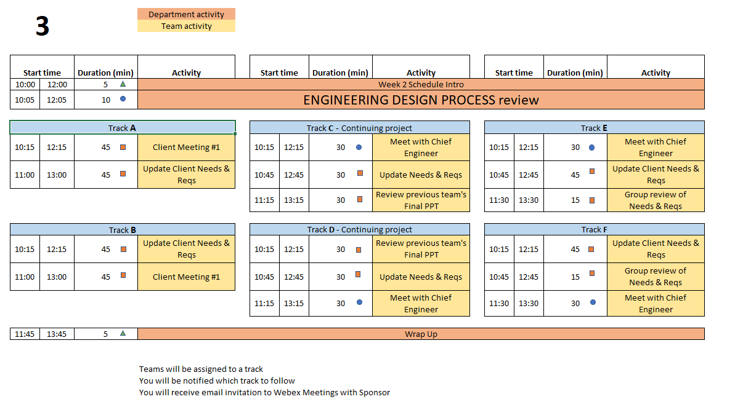
Day 3 Agenda
TD
Team Development /
Design Process Refresher
Administrative Tasks
Project Work
A
P
Notes:
PE Notes
Continuing projects should follow Track C or D
New projects can follow A, B, E or F
Track A or C on Day 3 should follow track A or C on Day 4
Track B, D, or E on Day 3 should follow track B or D on Day 4

Slide 66
Engineering Design Process Progression
Days 1-5
You are here!
Days 3-5
Day 5+6
Day 7
Days 8-10 – Project Planning
This Design Process and terminology was learned previously in IED

Slide 67

30 min – Meet with CE
(Day 3 or 4)
Chief Engineer led discussion of:
  Performance Evaluations – aka Course grading
  Team member expectations
    Group discussions
    Project Documentation on EDN
    Action Items
  CE background and experience
  Project impressions
  Team Standards Agreement
Notes:
Cover these slides in front of class VERY BRIEFLY. They are a reference for the 4 activities which will be done this meeting and next meeting (Day 3 & 4). Students will/can/should open the Playbook and read when they are going through the activities.

Slide 68
45 min – Client Meeting #1
Kickoff Meeting
Meeting Agenda
  Team introductions to Client (name, major, relevant experience/skills)
  Client introduction to team
  Client describes project "in their words“
    History, ultimate and semester goals, deliverables, etc…
  Open Q&A
Document meeting minutes in
Project Management Forum on EDN

Slide 69
30 min – Review Prior Presentation
(if applicable)
Team should review (outside of on-site meeting) the final PPT presentation given by previous engineering team
  Forums->Final Deliverables
  Repository->Reports->Final Reports
PE/CE will quickly walk-through slide deck and discuss:
  Goals
  Accomplishments / Successes
  Challenges
  Next steps
PE/CE will help to clear up confusion and answer any questions current engineering team may have

Slide 70
10 min – Design Lab Expectations
Action Item from Day 2
Customer Needs video and Engineering Requirements video
Knowledge Check – Through Kahoot
Instructions
Each team design a name for Kahoot login
One member in each team login to Kahoot using the given GAME PIN
For every question, the team discuss among themselves and give the correct answer
Students get one minute to answer each question
There are 4 questions

Slide 71
Benchmarking Memo
Individual Assignment
Post to Repository working/Background Info folder by START of Class 5
Instructions and rubric on Wiki
EDN -> Capstone Support -> Wiki-> Task and Due Dates

Slide 72
Empathize with your Client
Become curious about people you don't know. Empathetic people are people who are curious about those around them. ...
Focus on similarities rather than differences. ...
Put yourself in someone's shoes. ...
Listen, but also share. ...
Connect with social action movements. ...
Get creative with it.
https://www.webmd.com/balance/features/how-to-be-more-empathetic

Slide 73
45 min – Update Needs & Requirements
Read notes in template document for tips
Remove/combine duplicates
Unsure of a proper metric?
  Quick Google search to put in an educated guess
Fill in holes/gaps after looking at categories
  https://designlab.eng.rpi.edu/edn/projects/capstone-support-dev/wiki/Requirements_Management
  Capstone Support Wiki -> Knowledge Base -> Requirements Management

Slide 74
5 min – Wrap-up
Days 3 and 4 include:
  Teams’ initial Client Meeting
  Continuing development of Client Needs
  Beginning translating Client Needs into Engineering Requirements
  Review of prior team’s presentation (if applicable)
Client Needs and Engineering Requirements:
  Are not easy and require practice to do well!
  Guide your project throughout the semester

Slide 75
Action Items / Meeting Prep
(previously called homework, to be completed BEFORE Meeting 4)
Tasks to be completed BEFORE Meeting 4 @
EDN -> Capstone Support -> Wiki->
Task and Due Dates -> Day 3 Agenda
Note – link is in the PE email you received before classes! And will be echoed in your team’s Webex for convenience!
Notes:
Open the link, show it’s contents, done! Do NOT read it to them!!!

Slide 76
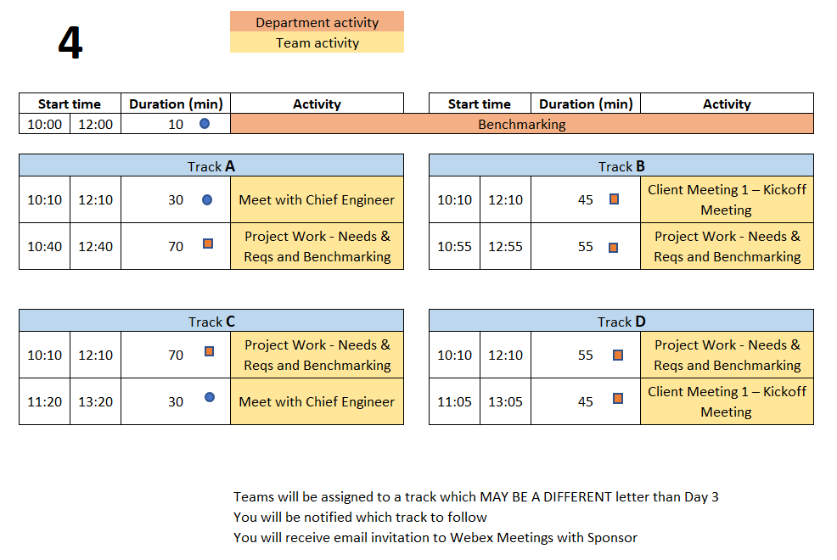
Day 4 Agenda
TD
Team Development /
Design Process Refresher
Administrative Tasks
Project Work
A
P
Notes:
PE Notes (Make clear for new vs. continuing on slide)
Track A or C on Day 3 should follow track A or C on Day 4
Track B, D, or E on Day 3 should follow track B or D on Day 4

Slide 77
Engineering Design Process Progression
Days 1-5
You are here!
Days 3-5
Day 5+6
Day 7
Days 8-10 – Project Planning
This Design Process and terminology was learned previously in IED

Slide 78
10 min - Benchmarking
Purpose
  Learn about Competitive Products
    Functions
    Fabrication Methods
    Operation
    Key Technologies
    Maintenance
Avoid Re-inventing the Wheel!
Reference: IED Textbook:
Product Design and Development, Ulrich, Eppinger, and Yang- Product Specification
Notes:
Reference: Product Design and Development, Ulrich, Eppinger, and Yang

Slide 79
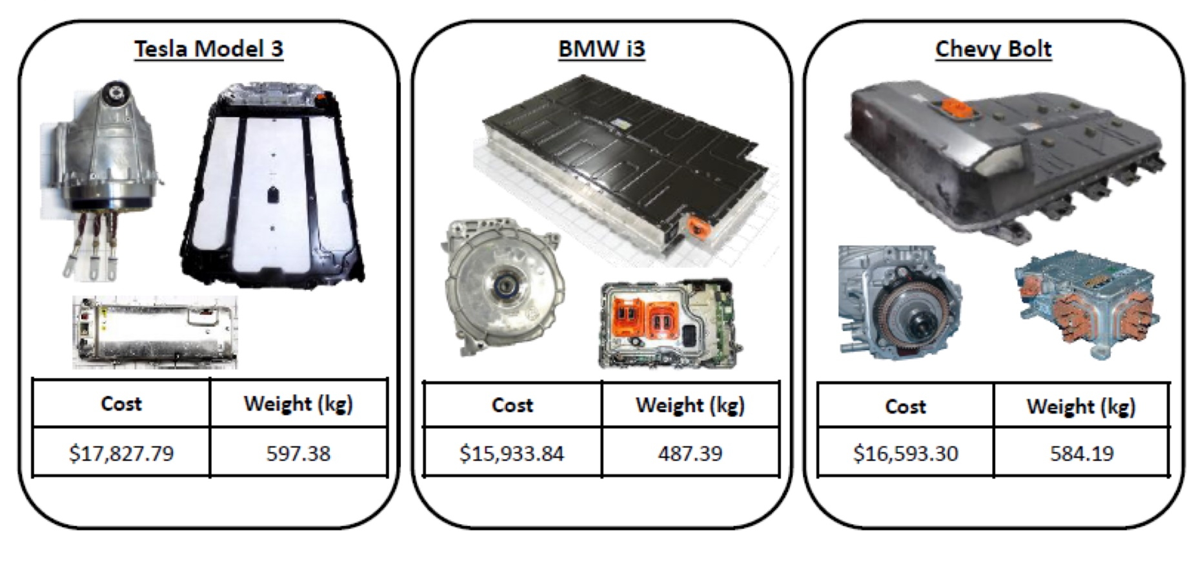
Benchmarking Examples
https://www.lightmetalage.com/news/industry-news/automotive/article-dismantling-and-analysis-of-vehicles-to-develop-optimal-applications/
Powertrain and Battery Pack Systems for the
Tesla Model 3, BMW i3, and Chevy Bolt

Slide 80
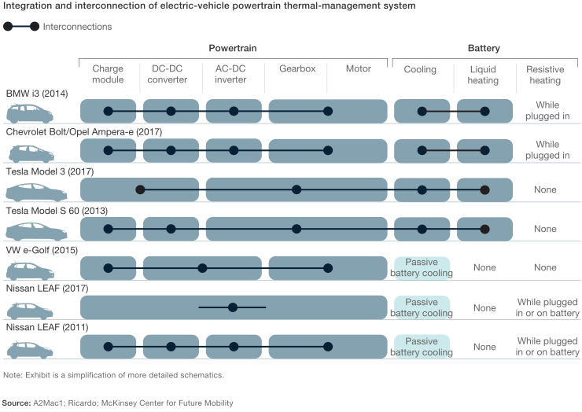
Benchmarking Examples
https://www.mckinsey.com/industries/automotive-and-assembly/our-insights/what-a-teardown-of-the-latest-electric-vehicles-reveals-about-the-future-of-mass-market-evs

Slide 81
Benchmarking - Evaluation
Using the Projects Needs and Requirements
Identify range of values across competitors
Prefer verifiable facts over opinions
Capture values / range of values / units
Assess and prioritize which items are important for your project / client

Slide 82
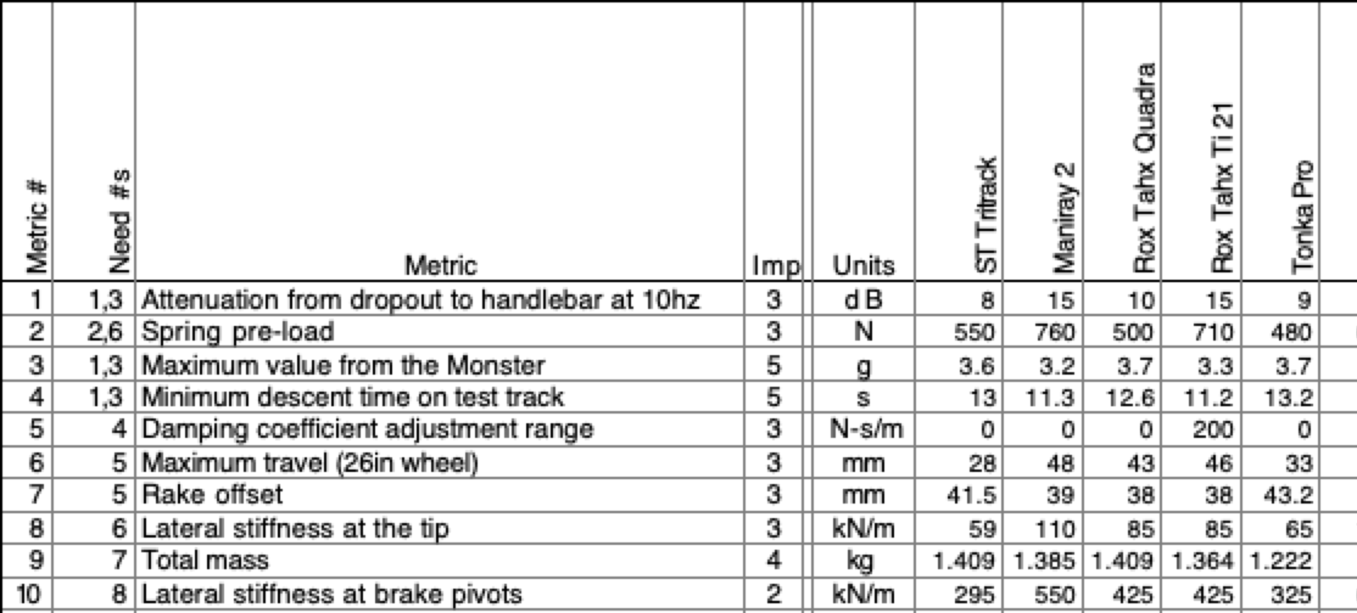
Benchmarking – Evaluation
Competitors
Note – these are Performance Metrics
NOT Requirements from Your Project
Data on suspension forks
Courtesy of Ulrich and Eppinger Teaching Resource Website for
Product Design and Development

Slide 83
45 min – Client Meeting #1
Kickoff Meeting
Meeting Agenda
  Team introductions to Client (name, major, relevant experience/skills)
  Client introduction to team
  Client describes project "in their words“
    History, ultimate and semester goals, deliverables, etc…
  Open Q&A
Document meeting minutes to
Project Management Forum on EDN

Slide 84

55 min - Project Work
Refine Needs and Requirements Workbook and/or
Use Cases & User Stories
  Needs
    Ensure all currently known Customer Needs are documented. New ones will develop over time!
  Requirements:
    Associate with appropriate Customer Need(s)
    Identify Measurements and Units (quantitative)
    Ensure that Requirements are detailed, measurable and prioritized
    Identify Applicable Engineering Standards
  Use Cases
    As a _____ I need to _____ so that _____
  User Stories
  Determine the Acceptance Criteria / Minimum Viable Product
Continue To Generate Project Questions As You Go!

Slide 85
55 min - Project Work
Refine/Develop Follow-Up Questions for Client
  If Team has already had Kickoff Meeting, what new questions have been identified as a result?
    Clearly document, review with PE then email to Client, copy your PE & CE
Background Research/Benchmarking
  Discuss/document work done to date
  Identify/document additional benchmarking needs

Slide 86
Project Work
Someone should take notes of meeting discussion
    NOT as Word document, simply as plain text in Forum post.
  Meeting Minutes instructions and template https://designlab.eng.rpi.edu/edn/projects/capstone-support-dev/wiki/Meeting_Minutes
Post your meeting minutes AT END of the meeting to Forums –> Project Management
  Others can reply to post with any corrections or additional information
  Create separate thread for each meeting, e.g., “On-site 9/15”, to help organization and future searching

Slide 87
30 min – Meet with CE
(Day 3 or 4)
Chief Engineer led discussion of:
  Performance Evaluations – aka Course grading
  Team member expectations
    Group discussions
    Project Documentation on EDN
    Action Items
  CE background and experience
  Project impressions
  Team Standards Agreement

Slide 88
10 min – Wrap-up
Day 5 will focus on Concept Generation
  Now that teams have had time to identify the Client Needs and corresponding Engineering Requirements associated with their projects, it is time to identify potential concepts to address them.
  The Concept Generation activity during the Day 5 on-site meeting will utilize the ideation (Post-It Note) process that we have used previously.

Slide 89
Action Items / Meeting Prep
(previously called homework, to be completed BEFORE Meeting 5)
Tasks to be completed BEFORE Meeting 5 @
EDN -> Capstone Support -> Wiki->
Task and Due Dates -> Day 4 Agenda
PE will stop sending out this link.
It is YOUR responsibility to check the list and do the work.
Notes:
Open the link, show it’s contents, done! Do NOT read it to them!!!

Slide 90
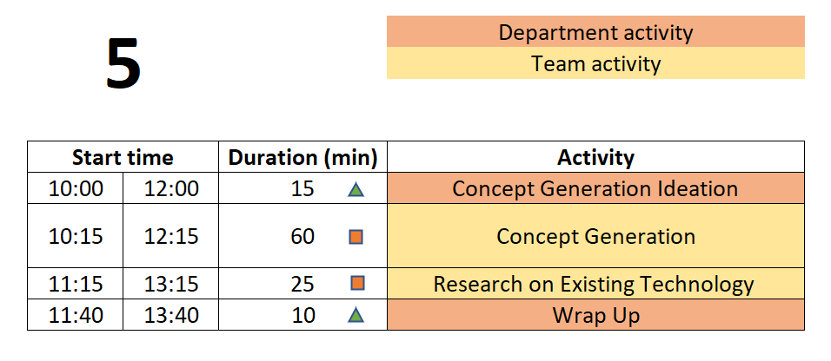
Day 5 Agenda
TD
Team Development /
Design Process Refresher
Administrative Tasks
Project Work
A
P

Slide 91
Engineering Design Process Progression
Days 1-5
You are here!
Days 3-5
Day 5+6
Day 7
Days 8-10 – Project Planning
This Design Process and terminology was learned previously in IED

Slide 92
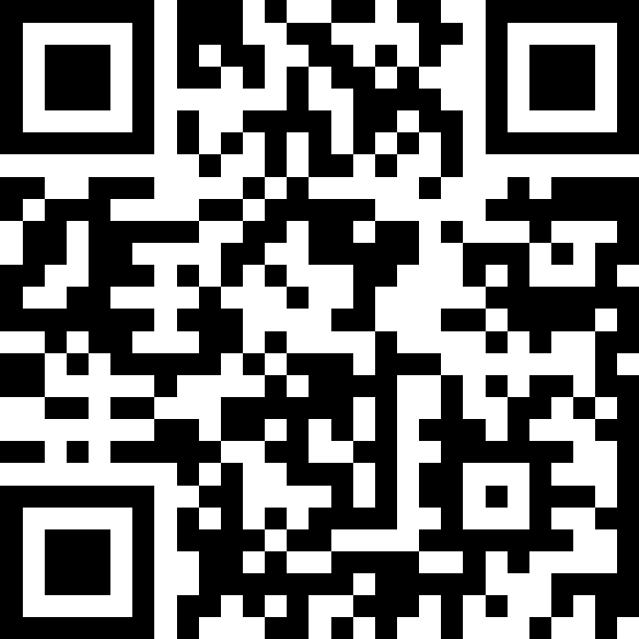
10 mins - Concept Generation
Join Slido.com with Code #3964230
(or) using the QR Code below

Slide 93

60 min - Concept Generation
Similar inclusive plan as previous exercises
5 min – Individually silently generate any concept to solve/address customer needs/reqs
  write separately on Post-It Notes
15 min – Place concepts on whiteboard
  Organize list by topic
  Eliminate duplicates
  Add extra ideas you think of right now or are inspired by others ideas
30 min – Group discussion
  Explain further to improve group understanding – if necessary
  Look for missing/unaddressed needs –think of concepts to address them
  Look for lone concepts – think of alternative ideas
Note - CE will jump in to talk for 15 mins of this time block

Slide 94
5 min – Create Forum Threads (EDN)
Concept topics ARE the key discussions and work areas for the team
Create Design Forum threads for each topic
  Use these thread to post explanation, sketches, calculations, etc…
  Reply to teammate’s posts to move idea forwards and advance project
  Includes links to material as appropriate but it is helpful to explain what can be found at the link

Slide 95
25 min – Research on Existing Technology
  Research existing technologies identified to solve similar problems
  Industrial, consumer applications
  Limits of technology/equipment
  Cost, availability, production volume
Document Your Findings in the Concept Threads
You Will Use Your Findings to Help Select Your Concepts

Slide 96
Wrap-up - Documentation
Which teams are working on ongoing projects?
  Have you reviewed the work (documentation) of prior teams?
  What did you find?
  What did you not find?
  Have you utilized the EDN’s search feature?
  Did the previous team utilize the wiki page?
  What were you able to find from the prior teams’ Webex, Google Drive, OneDrive, text messages, etc.?

Slide 97
Wrap-up - Documentation
Which teams are working on new projects?
  You have a blank slate – Keep things organized!

Slide 98
Wrap-up - Documentation
Having thorough and well-organized documentation will greatly ease creation of deliverables and graded assignments such as the ETM, System Design Report, DID, Client Update slide decks, and your Final Report!

Slide 99
Action Items / Meeting Prep
(previously called homework, to be completed BEFORE Meeting 6)
Tasks to be completed BEFORE Meeting 6 @
EDN -> Capstone Support -> Wiki->
Task and Due Dates -> Day 5 Agenda
PE will stop sending out this link.
It is YOUR responsibility to check the list and do the work.
Notes:
Open the link, show it’s contents, done! Do NOT read it to them!!!

Slide 100
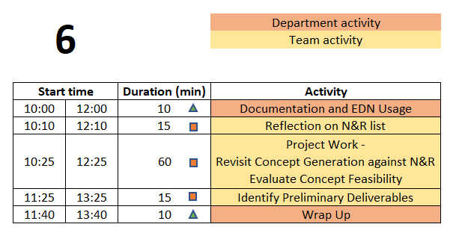
Day 6 Agenda
TD
Team Development /
Design Process Refresher
Administrative Tasks
Project Work
A
P

Slide 101
Engineering Design Process Progression
Days 1-5
You are here!
Days 3-5
Day 5+6
Day 7
Days 8-10 – Project Planning
This Design Process and terminology was learned previously in IED

Slide 102
10 min – Project Documentation & EDN Usage
Action Item from Day 5
Read Project Documentation Wiki page
Knowledge Check – Through Kahoot
Instructions
Each team design a name for Kahoot login
One member in each team login to Kahoot using the given GAME PIN
For every question, the team discuss among themselves and give the correct answer
Students get one minute to answer each question
There are 4 questions

Slide 103
What is Engineering Documentation?
Living record of your work so that:
  Evolution of your product/design is traceable
  Your work (experiment) is reproducible
    Sketches, ideas, discussions
    Test setup, results, failures & successes
  Your work can be understood by others and why you did it that way
  Feedback & help can be offered
  Easy to incorporate into client meeting presentations and the final design report

Slide 104

Why Document?
Extension of your memory
  Who, What, When, Where, Why, How
  So that others can collaborate and continue the work
  Facilitates teamwork
  So that others can review/understand your work
Legal ramifications
  Contractual/legal defense
  Patent application
Efficiently and Effectively move the project forwards
Everyone (now and future) can understand the Who, What, When, Where, Why, and How of the team’s work

Slide 105
Corporate Communication & Documentation
Policies Reminder
Electronic Design Notebook - REQUIRED for all project work & effort
RPI OneDrive – only for development of group deliverables
Webex (only) - Team Chat
WhenIsGood or When2Meet - meeting scheduling
Not Permitted
  Slack, GroupMe, or Discord
  Google Drive
  Google Docs/Sheets/Slides
  Other cloud-based tools for any use (schematics, mind maps, drawings, analysis, etc…) e.g., diagrams.net, etc.
  RPI Box, RPI Sharepoint
Webex Teams is good for chat and live meetings, but project documentation should start on and stay in the Electronic Design Notebook (EDN) Forum or Repository.
  Simple/easy solution is to never put it on Webex (or elsewhere) to begin with.

Slide 106
15 min - N&R Reflective Update
Based on the Concept Generation done during last on-site meeting, and thought/research done off-site, update the Needs & Requirements list in Repository.

Slide 107
60 min – Project Work
Revisit Concept Generation
Are the key / Minimum Viable Product Customer Needs addressed by at least 2 concepts?
  If not -> generate/research additional concepts
How could concepts be combined into a full system?
Concept Feasibility
Understand feasibility of concepts
  Research, calculate, estimate
  Document performance and metrics of the technology or idea used elsewhere or in other applications
  Can the concepts identified meet the Engineering Requirements?

Slide 108
15 min – Identify Preliminary Deliverables
Needs & Requirements
Client Meeting #1 Objectives
Selected Concepts
Proposed Deliverables
Post your deliverables to the Project Management forum

Slide 109


10 min – Wrap-up
Day 7 will focus on Concept Selection
  Now that teams have identified concepts it is time to understand how they can fit together into a full solution for the client’s problem.
  Comparisons and decisions should be based on analysis, metrics, and performance rather than ‘gut feelings’ or personal preferences. Avoid comparison matrices with 1’s and 0’s or + and - values.
  Several Meaningful Concepts are Required to Perform Concept Selection!
Image from: https://m.media-amazon.com/images/I/41EB53DgtzL._AC_SL1100_.jpg

Slide 110
Action Items / Meeting Prep
(previously called homework, to be completed BEFORE Meeting 7)
Tasks to be completed BEFORE Meeting 7 @
EDN -> Capstone Support -> Wiki->
Task and Due Dates -> Day 6 Agenda
PE will stop sending out this link.
It is YOUR responsibility to check the list and do the work.
Notes:
Open the link, show it’s contents, done! Do NOT read it to them!!!

Slide 111
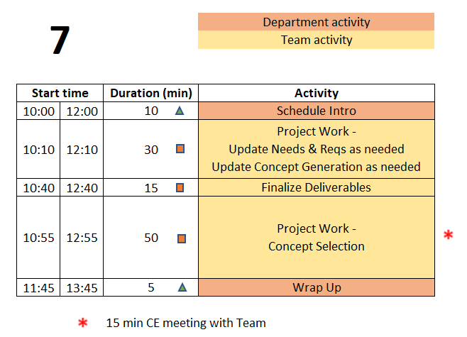
Day 7 Agenda
TD
Team Development /
Design Process Refresher
Administrative Tasks
Project Work
A
P

Slide 112
Safety Training was DUE by last class
Talk to PE if you are having difficulties and have not completed yet
Complete training TODAY

Slide 113
Engineering Design Process Progression
Days 1-5
You are here!
Days 3-5
Day 5+6
Day 7
Days 8-10 – Project Planning
This Design Process and terminology was learned previously in IED

Slide 114
15 min – CE Time
Meeting will be at team table
This will take place at some point during Concept Selection exercise depending on CE’s schedule

Slide 115
65 min – Concept Selection
Use engineering and research to justify a choice of which concepts to pursue and develop further
Good reasons
  Decision matrix
  REAL numbers
    based on your Requirements
    values based on facts
Poor reasons
    gut feelings, instinct
    1’s/0’s or +’ / -’s pulled out of thin air
    ‘shiny’ marketing claims on sales website or youtube video

Slide 116
15 min – Finalize Project Deliverables
Needs & Requirements
Client Meeting #1 Objectives
Selected Concepts
Proposed Deliverables
Solid list of deliverables will jumpstart project planning exercise on Day 8

Slide 117
5 min – Wrap-up
During the Day 8 on-site meeting, teams will develop a project plan to guide their work for the remainder of the semester. To be prepared for this activity, team members must:
  Understand why Project Management is important
  Understand the difference between Deliverables and Tasks/Activities.
  Come to the meeting with an initial list of tasks required to complete the project.

Slide 118
Action Items / Meeting Prep
(previously called homework, to be completed BEFORE Meeting 8)
Tasks to be completed BEFORE Meeting 8 @
EDN -> Capstone Support -> Wiki->
Task and Due Dates -> Day 7 Agenda
PE will stop sending out this link.
It is YOUR responsibility to check the list and do the work.
Notes:
Open the link, show it’s contents, done! Do NOT read it to them!!!

Slide 119
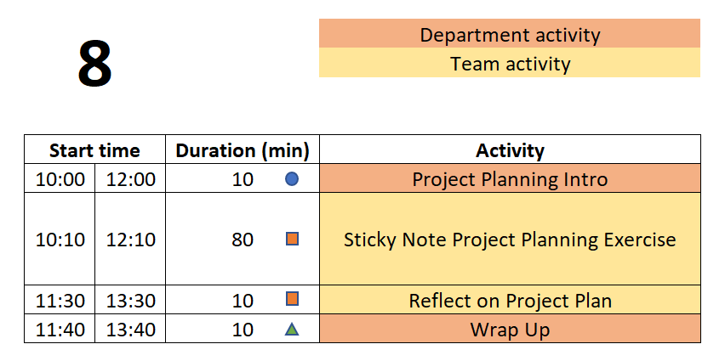
Day 8 Agenda
TD
Team Development /
Design Process Refresher
Administrative Tasks
Project Work
A
P

Slide 120
Engineering Design Process Progression
Days 1-5
You are here!
Days 3-5
Day 5+6
Day 7
Days 8-10 – Project Planning
This Design Process and terminology was learned previously in IED

Slide 121

Project Planning
Knowledge Check: Understanding of project planning
Join Slido.com with Code # 2760 893
(or) using the QR Code below

Slide 122

Defining Meaningful Tasks
80 min - ‘Post-It Note’ Project Planning
One idea per Post-It. Be concise!
Defined to be No More than 1 week long.
Break big things into smaller pieces.
Everyone Needs at Least 1 Task per Week for the
Entire Semester
What will YOU contribute to the project?
Focus on YOUR potential contributions to the project.
(We know these may not yet be defined!)
Focus on the technical work required
For now, leave out project management / overhead tasks,
e.g., report writing, slide making, etc.
DO include documentation needed for technology transfer,
e.g., user manual
Be Technical! Be SMART!

Slide 123
Defining Meaningful Tasks aka “SMART”
Project Planning Tips
Yes, it gets harder to define tasks near the end of the semester. So instead, work backwards from the end!
There may be gaps in time – you will need to fill those in today
Do not just copy a task 3 times because it spans 3 weeks. Instead, you must break it down into 3 well defined smaller tasks.
Don’t allocate slack time at the end of the semester. Project plans do not include tasks called “Just in Case”. Instead estimate the length of tasks to factor in some risk. Not everything works the first time and many thing turn out to be more difficult than first thought.
Group things by functional subsystem rather than by name. This helps reveal possible planning gaps.
Remember your deliverables! Do you have the tasks needed to produce each of them, including things like demos?
Be Technical! Be SMART!

Slide 124
20 min - ‘Post-It Note’ Project Planning
10 min – Deliverables
Write each Deliverable from Client Meeting 2 Slides on a Post-It and
place on the board/calendar at approximate due date.
Draw a box around the note so that it stands out.
10 min – Tasks
(Individually silently) Each team member generate list of TEN tasks which must
be completed to accomplish the deliverables.
Off-site Action Item was to post 6 individual tasks to EDN, so start with those.
Now create at least 4 more each.
Create 1 Post-It for each task
Add your initials to post-it in case there are questions about content

Slide 125
‘Post-It Note’ Project Planning Exercise
10 min – Organize tasks on Whiteboard
Position tasks appropriately along week-by-week calendar
  This can be done before or after getting all items shared.
40 min – Group organization of tasks
Add missing tasks, remove duplicates
Organize by subsystem or milestone
10 min – Re-assign ownership (by color/initial)
Ensure everyone has work throughout semester
Each Team Member Should Leave meeting with their assigned Post-It’s.
Each Team Member then Enters Their Own Tasks as EDN Issues!

Slide 126

10 Min - Reflecting on your New Project Plan
Take a few minutes to pause and reflect on the Project Plan the Engineering Team just created.
Use the prompts on this Wiki page to guide the discussion.
  EDN -> Capstone Support -> Wiki-> Reflecting on your New Project Plan
Focus on Process and Results

Slide 127
10 min – Wrap-up
Activities of Day 9 & 10
PE/CE Feedback on the Project Plans created during and after Day 8
PE/CE Feedback on Needs & Requirement list
Client Meeting #2 Concept Generation and Selection Update
Developing System Design

Slide 128
Wrap-up
Day 9 & 10 also include 60+ mins for team-directed work.
Efficient team-directed meetings require an Agenda.
The Agenda should be SMART - Specific, Measurable, Actionable, Relevant, and Time-Oriented
Agendas should be posted to your white board before starting the meeting
    Pro Forma Agenda posted on Capstone Support:
    EDN -> Capstone Support -> Wiki-> Pro_Forma_Meeting_Agenda

Slide 129
Action Items / Meeting Prep
(previously called homework, to be completed BEFORE Meeting 9)
Tasks to be completed BEFORE Meeting 9 @
EDN -> Capstone Support -> Wiki->
Task and Due Dates -> Day 8 Agenda
PE will stop sending out this link.
It is YOUR responsibility to check the list and do the work.
Notes:
Open the link, show it’s contents, done! Do NOT read it to them!!!

Slide 130
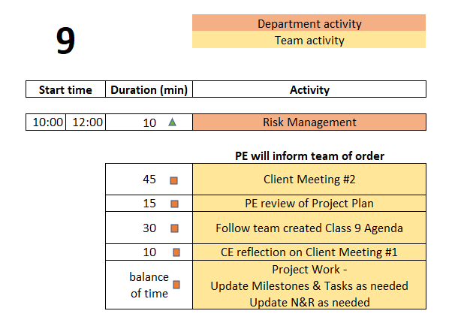
Day 9 Agenda
TD
Team Development /
Design Process Refresher
Administrative Tasks
Project Work
A
P

Slide 131
Engineering Design Process Progression
Days 1-5
You are here!
Days 3-5
Day 5+6
Day 7
Days 8-10 – Project Planning
This Design Process and terminology was learned previously in IED

Slide 132
30 min – Follow Team created Agenda
Designate team member to facilitate this meeting
Designate team member to take and post minutes to EDN
  This should be done for EVERY on-site and off-site meeting.
  Rotate responsibility. To be equitable, ALL team members should have a turn!
Notes:
Day 9

Slide 133
10 min – CE reflection on Client Meeting #1
Feedback on team’s Client meeting
  Review based on rubric
  Deliverables
  Professionalism and preparedness in meeting
Notes:
Day 9

Slide 134
15 min – PE Review Project Plan
Many short individual tasks? Few large group tasks?
Adequate time for:
  Manufacturing?
  Purchasing?
  Testing?
  Iterative development? Second round of any tasks?
Equal division of labor across all team members?
Ability to do some work in parallel rather than series?
  Design test plan BEFORE fabrication is complete
  Create dummy data NOW to test software performance or analysis approach

Slide 135
Action Items / Meeting Prep
(previously called homework, to be completed BEFORE Meeting 10)
Tasks to be completed BEFORE Meeting 10 @
EDN -> Capstone Support -> Wiki ->
Task and Due Dates -> Day 9 Agenda
PE will stop sending out this link.
It is YOUR responsibility to check the list and do the work.
Notes:
Open the link, show it’s contents, done! Do NOT read it to them!!!

Slide 136
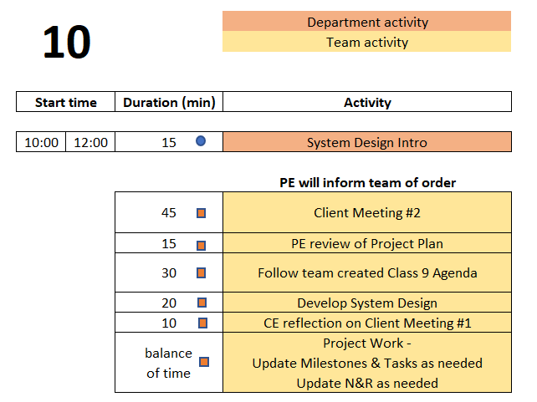
Day 10 Agenda
TD
Team Development /
Design Process Refresher
Administrative Tasks
Project Work
A
P

Slide 137
Engineering Design Process Progression
Days 1-5
You are here!
Days 3-5
Day 5+6
Day 7
Days 8-10 – Project Planning
This Design Process and terminology was learned previously in IED

Slide 138
15 Min - System Design Intro
Needs & Requirements Established
Concept Generation Provided road Range of Alternative Solutions
Concept Selection Identified A Small Number of Concepts that
  Meet all the High Priority Needs OR
  Those For a Minimum Viable Product (MVP)
Subsystems For the Chosen Concept(s) Are Preliminarily Identified
But How Do These All Go Together!

Slide 139
Communication Of Your High Level System Design
System Architecture Diagrams, aka, Block Diagrams
Show Major Overall System Elements / Functions
Show Interfaces / Interconnections Between Elements
Where Appropriate, Show Data Flow Between Elements
Can Be Used to Show Before and After Situations
  Indicate What Is Removed, What is Added, What is Changed
Can Show Organization of Elements
Examples Found by Searching for “block diagram for ________”
Apply to All Fields of Engineering!

Slide 140
Sample System Architecture Diagram - IOT
Server
PC
Laptop
Network
Wired or Wifi
Wifi only
Pi
Esp32
Sensor
Sensor
Arduino
Arduino
Arduino
Sensor
Sensor
Sensor
Sensor
Sensor
Sensor
IoT Generic System Architecture
From the Capstone Support Wiki - Internet of Things page

Slide 141
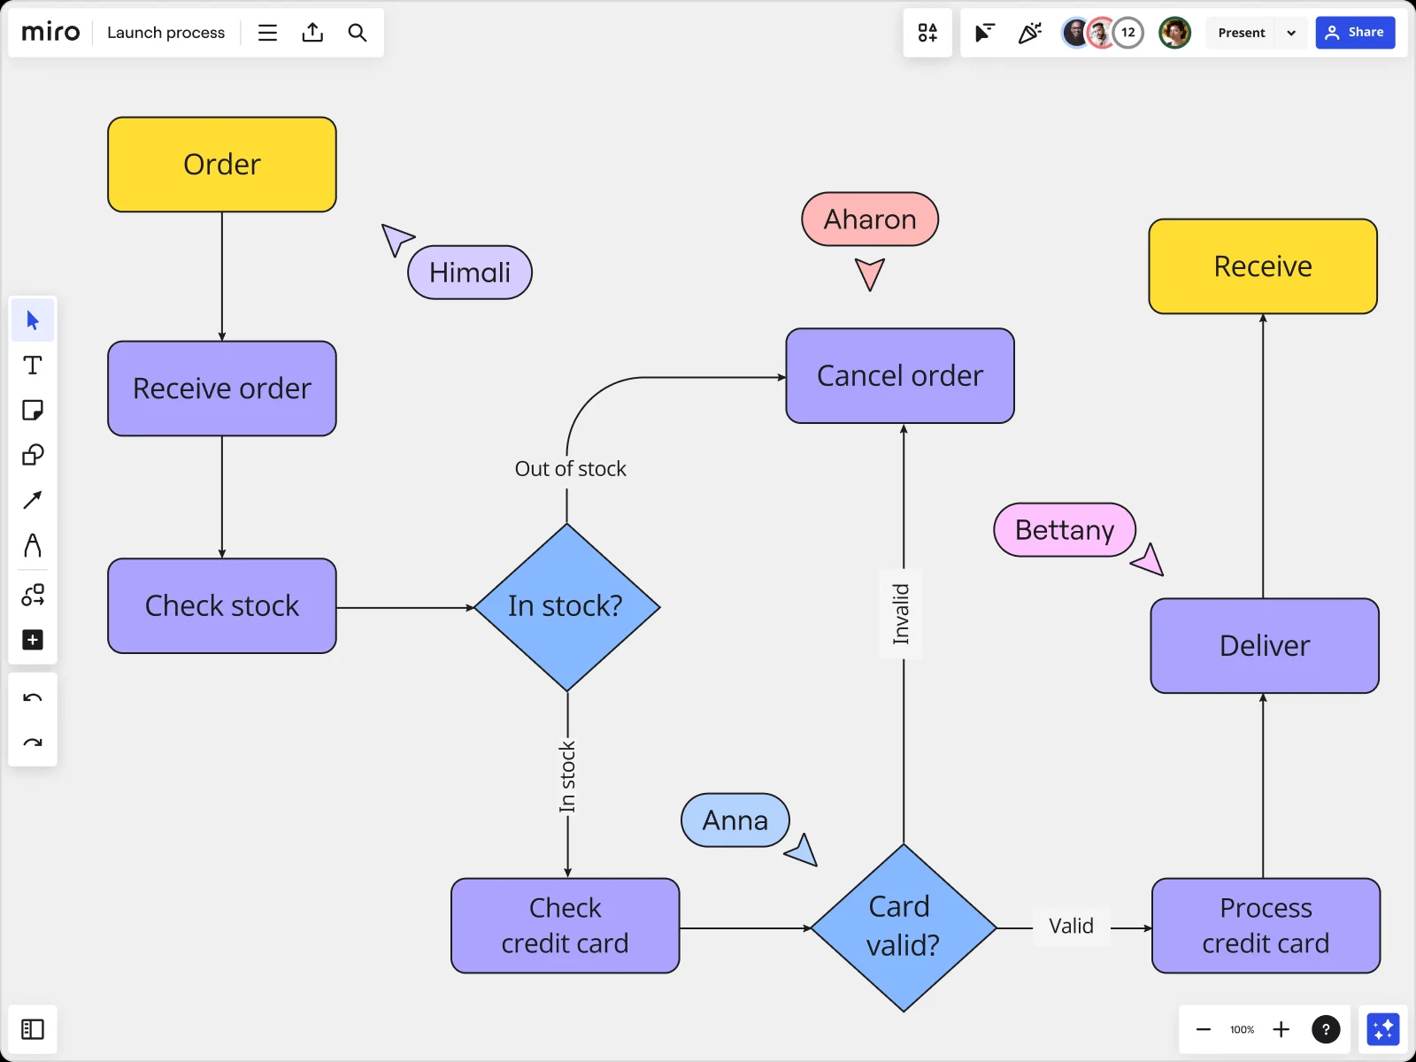
Sample System Architecture Diagram - Process
https://miro.com/diagramming/what-is-a-block-diagram/

Slide 142
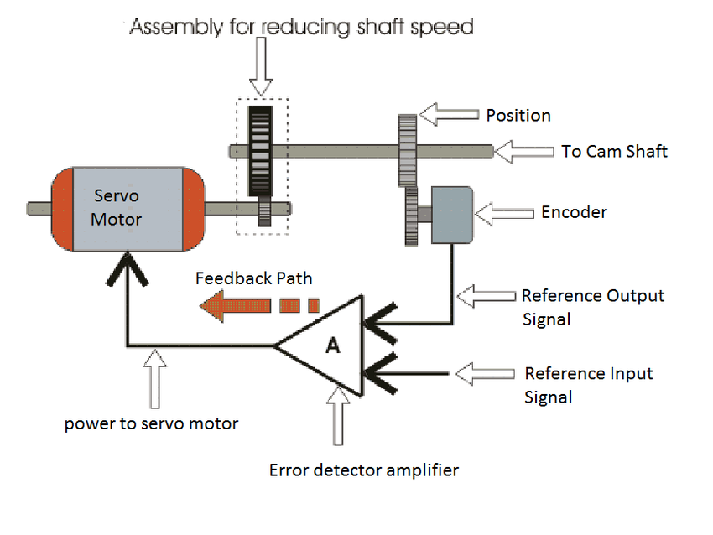
Sample System Architecture Diagram - Mechanical
https://www.researchgate.net/figure/Mechanical-Block-Diagram_fig3_282866893

Slide 143
System Architecture Diagrams
Label All Items in the Diagram
Provide Explanation Of How It Addresses Project’s Needs
Provide Brief Explanation Of Operation

Slide 144
5 Min – Wrap-up
Design Lab created Agendas have ended!
Engineering team should now create Agenda for each on-site (and off-site) meeting
Primary purpose of the remaining on-site meetings is team review and assessment of work already completed, especially with your PE and/or CE.
These 4 hours per week of on-site meeting time may be the only available time for FULL Engineering team to meet. It is therefore recommended to use this time for group discussions, group work, planning, updating Needs and Requirements, making decisions, etc. IF all that is complete / up to date, use the time for individual work.
Use EDN and Repository to document all work moving forwards

Slide 145
Day 13 Agenda
Upcoming Graded deliverables
System Design Report
Team assignment
5% of final grade
Detailed Individual Design Report
Individual assignment
6% of final grade
Submit both to Repo /working/Reports

Slide 146
20 min – System Design
Designate team member to facilitate this meeting
Designate team member to take minutes and post them to EDN
  This should be done for EVERY on-site and off-site meeting.
  Rotate responsibility. To be equitable, ALL team members should have a turn!
Complete overall system design
Create System Architecture diagram
Identify subsystem definitions and their owners (assignees)
  One person per subsystem
Notes:
Day 9

Slide 147
System Design Report Intro
Contents of document:
Updated / improved project description information
Key Needs & Requirements
Concept generation/selection
System Design
Integration and Testing plan

Slide 148
Detailed Individual Design Report Intro
System Architecture Diagram
Subsystem or portion YOU are responsible for
  Related Needs & Reqs (include # from spreadsheet in Repo)
  Interfaces to other subsystems (refer to System Architecture)
  Sketch/description of 1-2 leading concepts (list of forum thread links)
Perceived challenges/risks
YOUR next steps/plan
1,000 - 1,500 words
10-15 pages including images
This is an INDIVIDUAL assignment. The document should speak to what YOU personally will contribute to the design and project demonstration.

Slide 149
All Employee Meetings

Slide 150
Board of Directors Review is coming up NEXT WEEK
BDR Introduction
Read Wiki page with instructions
  https://designlab.eng.rpi.edu/edn/projects/capstone-support-dev/wiki/Board_of_Directors_Review
Create poster to show Board
  Rubric posted here - https://designlab.eng.rpi.edu/edn/projects/capstone-support-dev/wiki/Tasks_and_Due_Dates
Divide team into 3 groups for review
Practice content to improve your comfort presenting
Notes:
Day 9

Slide 151
Engineering Design Process
POSTER introduction
This Design Process and terminology is taught in IED at RPI
Team is creating a poster to communicate
Overall project (Needs & Requirements)
Progress made (Concepts, System Architecture)
Future steps (Design, Integration, & Test Plan)
Notes:
Day 9

Slide 152
95 min – Poster Creation
Download and Open Poster.pptx from Repository
  https://designlab.eng.rpi.edu/edn/projects/capstone-support-dev/repository/112/entry/template%20documents/Poster.pptx
10 mins – Divide into 3 groups, and work on initial slides. Content can be pulled from Project Statement & Objectives.
  Purpose
  Past Work and/or Project History
  Semester Objectives/Requirements
40 mins – As a full team discuss Technical Approach, Results and Accomplishments to Date
30 mins – Move on to Next Steps and Plan
15 mins – Begin assembly of content onto single slide (pg 8)

Slide 153
Revision History
Version | Date | Name | Reason for Changes
4.0 | 7.8.24 | AP, BD, MA | Full review and updating of new course flow
4.1 | 7.23.24 | AP | Director’s letter removed from New Employee Packet
4.2 | 7.25.24 | AP | Updating slides to match agenda and overall on-site plan ‘Design Lab Process Progression’ slide updated Preferred pronouns added to Wiki post
4.3 | 7.31.24 | AP | Some shifting of content, adjustment of section durations Day 1 & 2 team meeting added to Day 1 OOC tasks
4.4 | 8.1.24 | AP, KN | All Agenda slides & Design Process slides updated Notes added to adjust flow, point out content to add on days 2-5
4.5 | 8.9.24 | AP | ‘Design a Vehicle’ N&R activity pulled out into separate training PPT
4.6 | 8.9.24 | AP,MA,BD,KN, JK | So many things, long meeting ironing out bugs and making improvements
4.7 | 8.12 | AP | OneDrive is OK for development of group files
4.8 | 8.15 | AP | Out of Class tasks slides REMOVED. Contents shifted solely to Wiki Agenda slides
4.9 | 8.19 | AP | Slides on Project Questions removed, content shifted to Wiki Updated order of Day 4 activities – benchmarking for whole class @ start
4.10 | 8.20 | AP | Updated Agenda images Day 9/10 team Agenda block reduced to 30 mins Day 9/10 added 10 mins of CE reflection on Client Meeting 1 Removed daily reminders to download Playbook Modified formatting of Out of Class Task reminder slides
4.11 | 8.21 | MA | Formatting – centered titles and better matched their fonts, enlarged some content, fix some bulleting. NO content changes

Slide 154
Revision History - continued
Version | Date | Name | Reason for Changes
4.12 | 8.22 | MA, KN, AP | Slido content updated Added time during day 6 + 7 to ideate and finalize project deliverables
4.13 | 8.26 | BD | Corrected info for Ice Breaker (room typo, etc.)
4.14 | 8.26 | AP | Fixed formatting of some links
4.15 | 8.30 | AP | Agenda shifted day 1 to allow for team project discussion time, shorten wrap up time
4.16 | 9.3 | BD | Meeting 2 - Animated prompts on “Identifying Team Skills” slide, moved “Review Project Description” slide to after N&R/User Stories slides
4.17 | 9.5 | AP | Added slide to introduce Benchmarking Memo
4.18 | 9.6 | AP | Few small formatting and flow cleanup to Day 2
4.19 | 9.12 | AP | Updated Slido link and slides for Day 5 Concept Generation
4.20 | 9.16 | AP | Swap Kahoot for Horse Race on Day 6
4.21 | 9.19 | AP | Added stern reminder for safety training on Day 7 System Design Report and DID discussion shifted to Day 13

