Slide 1
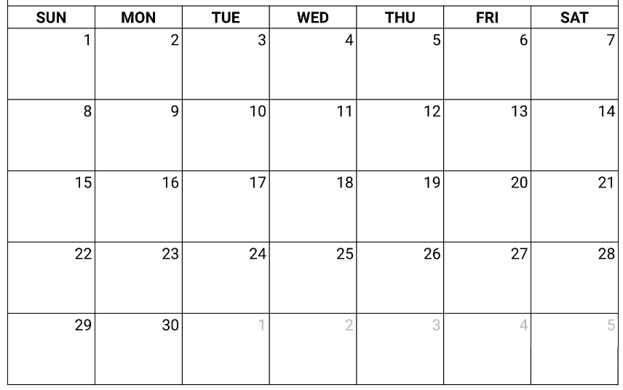
Capstone On-Site Meeting Schedule ex: 9/16 is Day 6 for sections 1+2
2 3 2
SEPTEMBER 2024
Section 1+2 – orange
Section 3+4 – blue
OCTOBER 2024
4 3 5 4
6 5 7 6
8 7 9 8
10 9 10

Slide 2
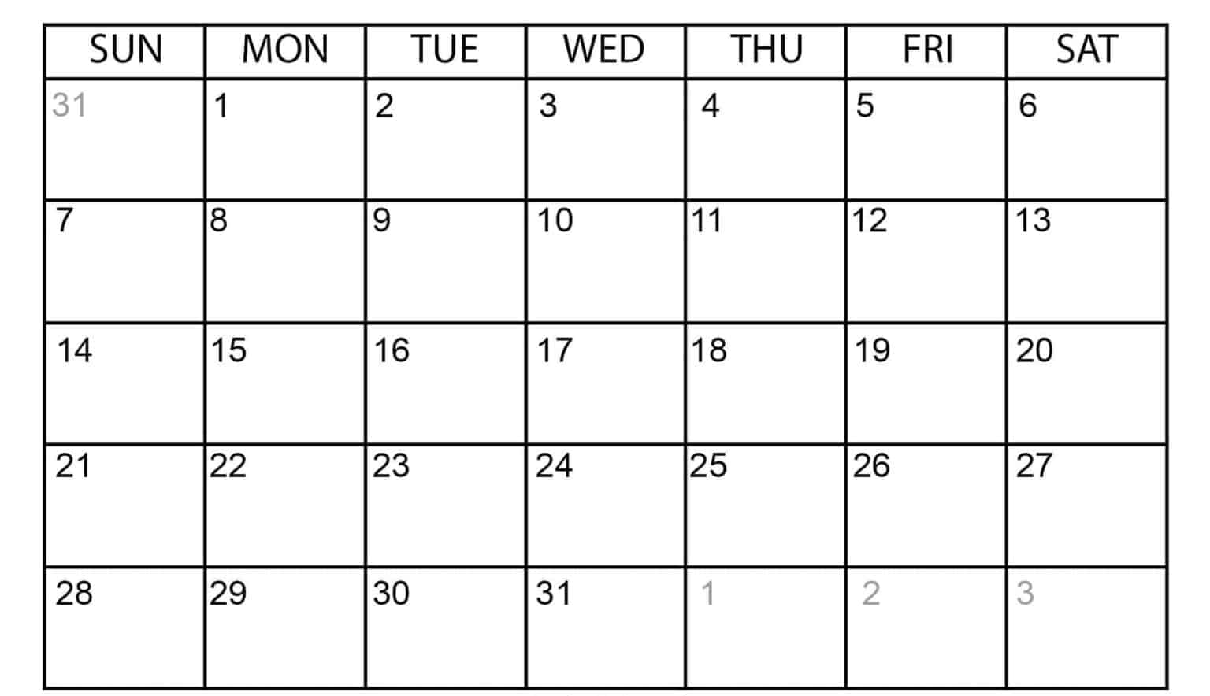
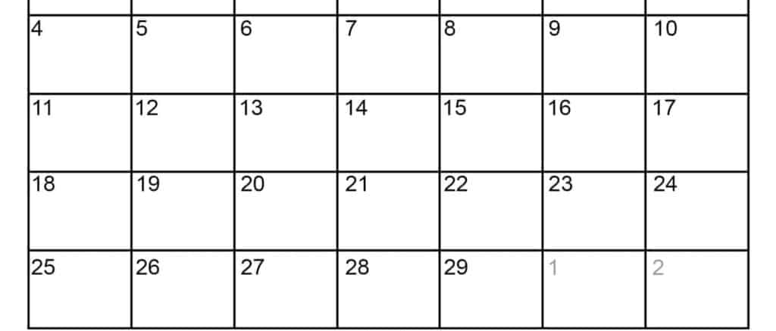
Capstone On-Site Meeting Schedule ex: 1/16 is Day 3 for sections 3+4
JANUARY 2024
Section 1+2 – orange
Section 3+4 – blue
FEBUARY 2024
1
1
2
1
2
2
3
3
4
MLK
4
5
5
6
6
7
7
8
8
9
9
President
Day
BDR
BDR

