Slide 1
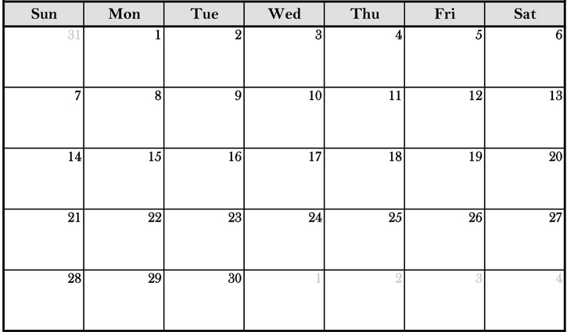
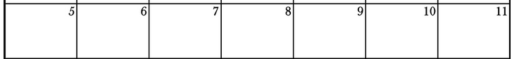
Capstone On-Site Meeting Schedule ex: 9/16 is Day 6 for sections 1+2
2 2 3
4 3 5 4
SEPTEMBER 2025
Section 1+2 – orange
Section 3+4 – blue
OCTOBER 2025
6 5 7 6
8 7 9 8
10 9 11 10
11

Slide 2
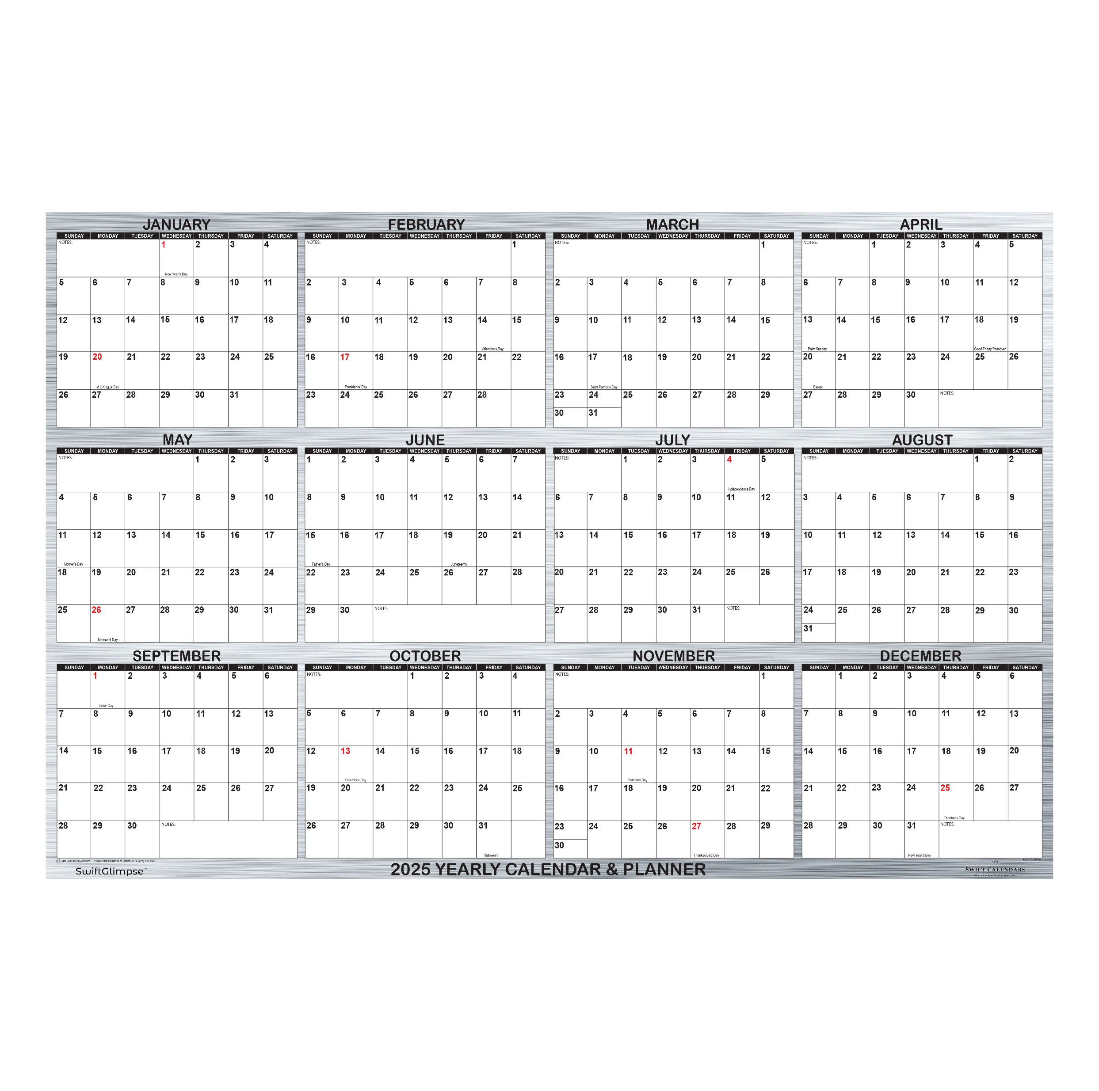
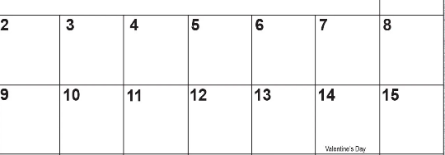
Capstone On-Site Meeting Schedule ex: 1/16 is Day 4 for sections 1+2
JANUARY 2026
Section 1+2 – orange
Section 3+4 – blue
FEBRUARY 2026
1
1
2
2
3
3
4
4
5
6
5
MLK
6
7
7
8
8
9
9
10
10
BDR
BDR

