Slide 1
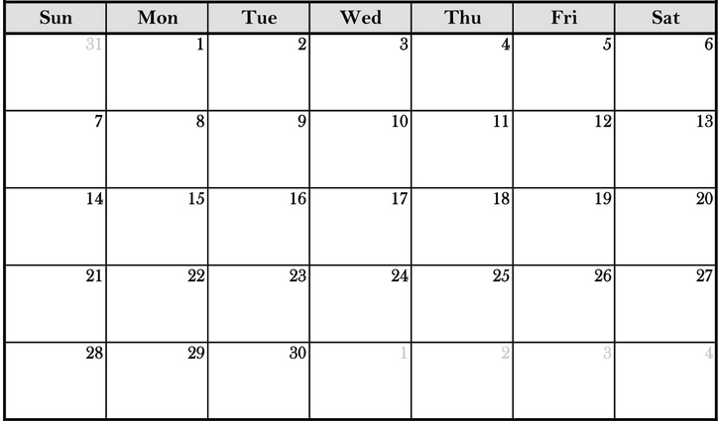
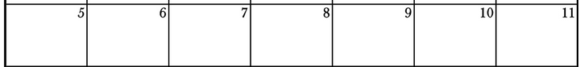
Capstone On-Site Meeting Schedule ex: 9/15 is Day 5 for sections 1+2
2 2 2.5
3 3 4 4
SEPTEMBER 2025
Section 1+2 – orange
Section 3+4 – blue
OCTOBER 2025
5 5 6 6
7 7 8 8
9 9 10 10
11 11
Notes:
Fall 2025

Slide 2
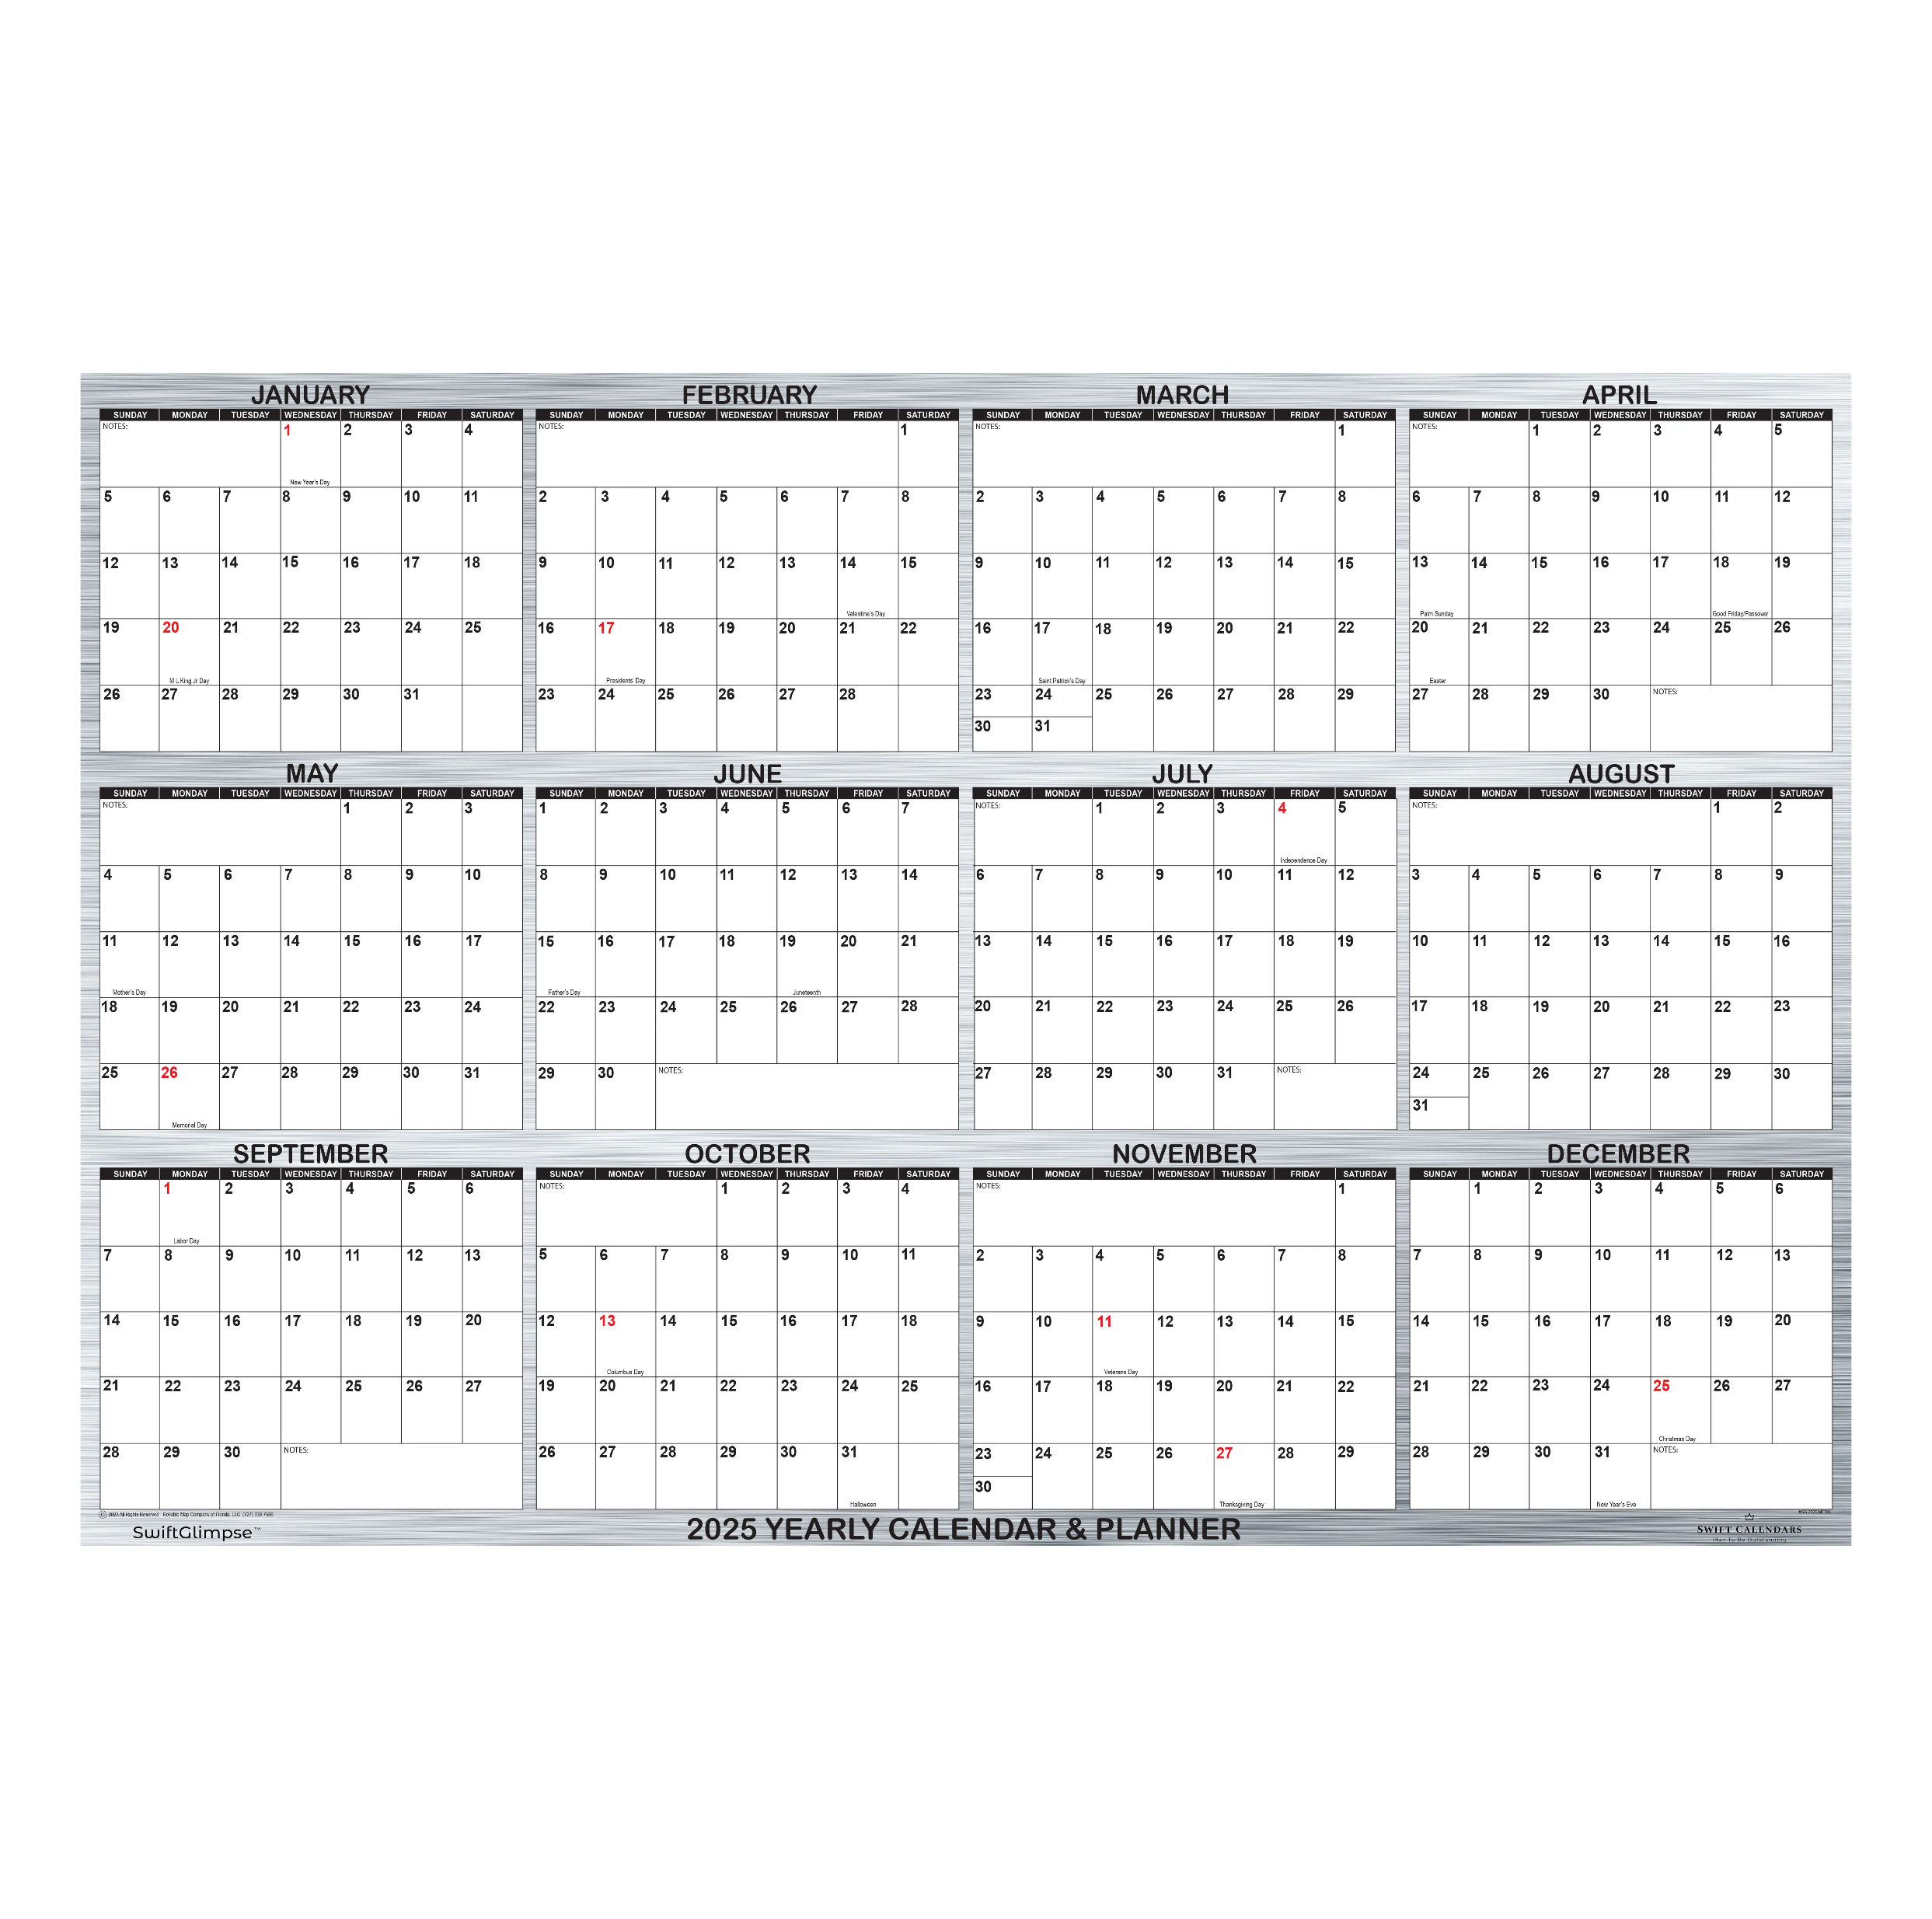
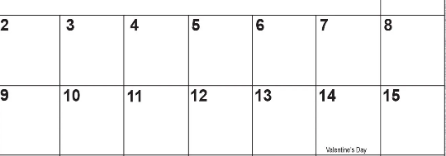
Capstone On-Site Meeting Schedule ex: 1/16 is Day 4 for sections 1+2
JANUARY 2026
Section 1+2 – orange
Section 3+4 – blue
FEBRUARY 2026
1
1
2
2
3
3
4
4
5
6
5
MLK
6
7
7
8
8
9
9
10
10
BDR
BDR

