Slide 1
Projects, Evaluators, & Mentors - Section 1
Sponsor | Project | Chief Engineer | Project Engineer | Room | Pod
Eaton | Analysis of FMVA Gasket Aging | Asish Ghosh | Brad DeBoer | JEC3232 | 5
MSE | Welding Theory Lab | Asish Ghosh | Mark Anderson | JEC3232 | 2
Eaton | Facility-Wide Non-Contact Voltage Sensing and Display System | Koushik Kar | Kanna Natarajan | JEC3232 | 4
Eaton | PIR Data Object Classification | Koushik Kar | Mark Anderson | JEC3232 | 3
JEC 3232
JEC 3332
4
3
3
5
2
4
2
5
6
1
1
6

Slide 2
Projects, Evaluators, & Mentors - Section 2
Sponsor | Project | Chief Engineer | Project Engineer | Room | Pod
Eaton | Flame Path Design for Fixtures and Enclosures in Harsh and Hazardous Environments | Asish Ghosh | Brad DeBoer | JEC3232 | 5
Boeing | Multi-Robot Flexible Part Handling System | Paul Chow | Kanna Natarajan | JEC3332 | 3
Bill Lake Modular Homes | Trim Area Improvements | Asish Ghosh | Aren Paster | JEC3232 | 2
Latham Group | Battery Powered Pool Cover | Paul Chow | Mark Anderson | JEC3332 | 5
Sodexo | Reusable To-Go Box Dispensing System for Dining Halls | Sarah Felix | Aren Paster | JEC3232 | 3
Eaton | Distribution Center Layout Optimization | Junichi Kanai | Kanna Natarajan | JEC3332 | 2
Center for Smart Convergent Manufacturing Systems | Sewn Part Inverting Mechanism | Sarah Felix | Brad DeBoer | JEC3232 | 4
JEC 3232
JEC 3332
4
3
3
5
2
4
2
5
6
1
1
6

Slide 3
Projects, Evaluators, & Mentors - Section 3
Sponsor | Project | Chief Engineer | Project Engineer | Room | Pod
Center for Disability Services | Off-Road Wheelchair | Clint Ballinger | Aren Paster | JEC3232 | 2
Rensselaer ARC | Slow Feeding Device | Kim Oakes | Brad DeBoer | JEC3232 | 5
RPI Registrar Office | Course Conflicts Identification Tool | Rostyslav Korolov | Junichi Kanai | JEC3332 | 2
GlobalFoundries | Furnace Defects Root Cause Analysis | Kim Oakes | Kanna Natarajan | JEC3332 | 5
Monaghan Medical | Automated Piston-Spring Assembly | Clint Ballinger | Aren Paster | JEC3232 | 3
JEC 3232
JEC 3332
4
3
3
5
2
4
2
5
6
1
1
6

Slide 4
Projects, Evaluators, & Mentors - Section 4
Sponsor | Project | Chief Engineer | Project Engineer | Room | Pod
Sikorsky | Additive Manufacturing Improvements | Chaitania Ullal | Brad DeBoer | JEC3232 | 4
Corning | CorningGPT Meeting Efficiency Tool (CoMET) | Junichi Kanai | Mark Anderson | JEC3332 | 4
MSE | Sand Casting Lab | Chaitania Ullal | Aren Paster | JEC3232 | 2
Eaton | Intelligent Bluetooth based of End of Line Test and Configurator | Prabhakr Neti | Mark Anderson | JEC3332 | 5
GlobalFoundries | CMP Arc Scratch Defect Visualization | Prabhakr Neti | Kanna Natarajan | JEC3332 | 2
Western Digital | Rover-Based Assistive Device Development - Wheel Chair | Junichi Kanai | Kanna Natarajan | JEC3332 | 3
NYSID | Single-Ream Paper Unwrapper System | Clint Ballinger | Aren Paster | JEC3232 | 3
Bevin Bells | Compressed Gas Cylinder Welding Improvements | Clint Ballinger | Brad DeBoer | JEC3232 | 5
JEC 3232
JEC 3332
4
3
3
5
2
4
2
5
6
1
1
6

Slide 5


Welcome to
Capstone Design
Playbook for Days 1 through 10
In-Class Meetings

Slide 6
Link to Agendas
Class 1
Class 2
Class 3
Class 4
Class 5
Class 6
Class 7
Class 8
Class 9
Class 10
#Pro Tip – Current Action Items are listed ONE page before next class’s agenda

Slide 7

Multidisciplinary Capstone Design
ECSE 4900 Electrical & Computer Systems Engineers
ISYE 4270 Industrial Engineers
MANE 4260 Mechanical Engineers
MTLE 4920 Materials Engineers

Slide 8
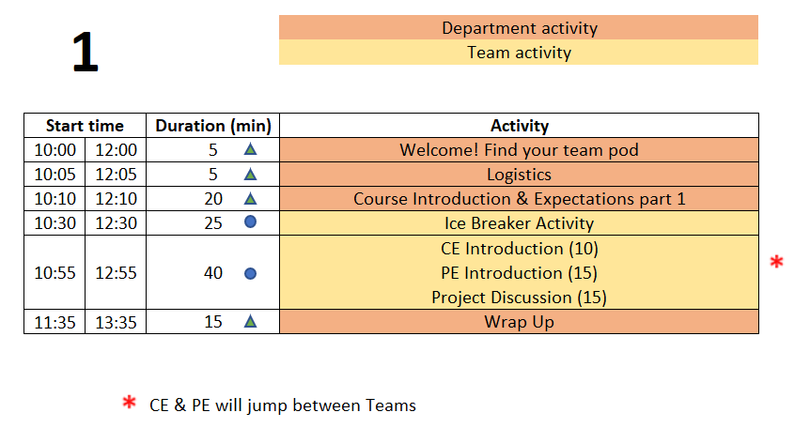
Class 1 Agenda
TD
Team Development /
Design Process Refresher
Administrative Tasks
Project Work
A
P

Slide 9
5 min - Logistics
The Daily Meeting Agendas are on the Capstone Support Wiki - see link from your PE’s intro email

Slide 10
Design Lab Mission
Develop High Performing Engineers by Mentoring Students in Professional and Engineering Design Practices Through Project Based Learning.

Slide 11
Capstone Design Transition
NO textbook, NO lecture
It is a Team EXPERIENCE
It is a mostly “flipped” experience
Guided/assisted by Project Engineer (PE)
Graded/assisted by Chief Engineer (CE)

Slide 12
Capstone Design:
Practice Engineering in Safe Environment
Initial Cover letter and Resume
New Employee Packet from
your Project Engineer
Design Lab Support Staff
Project Engineers and Chief Engineers
Students in a Course ➔
Consulting Engineering Team
Solving a Client Problem

Slide 13

Design Lab
Engineering Team
New hire

Slide 14
New Employee Onboarding
Day 1 Agenda
Class 1 Agenda
TD
Team Development /
Design Process Refresher
Administrative Tasks
Project Work
A
P

Slide 15

Welcome to Design Lab !!!
Core Values
Embrace diverse backgrounds, skills, and perspective
Create an inclusive and equitable team environment
Act with Professionalism and Respect

Slide 16




Welcome to Your Project Team!
Engineering Team Members
Project Engineer (PE)
Purchasing
Fabrication Support
Chief Engineer (CE)
Client
Notes:
Introduce PE/CE in this slide. Each team has an assigned PE/CE. The project description document has their names.

Slide 17
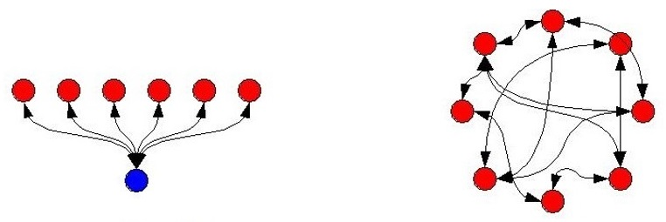
Capstone is more TEAM work than GROUP work
Group Work
  Divide and conquer
  Low interaction with team
  Supervisor managed
Team Work
  Collaborative effort
  Interactive -peer review
  Team member managed
GROUP
People working towards a goal whose work is coordinated by someone else, e.g., a manager, for them
TEAM
People working towards a common goal who coordinate their work amongst themselves

Slide 18
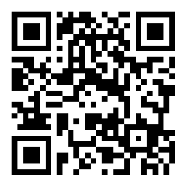
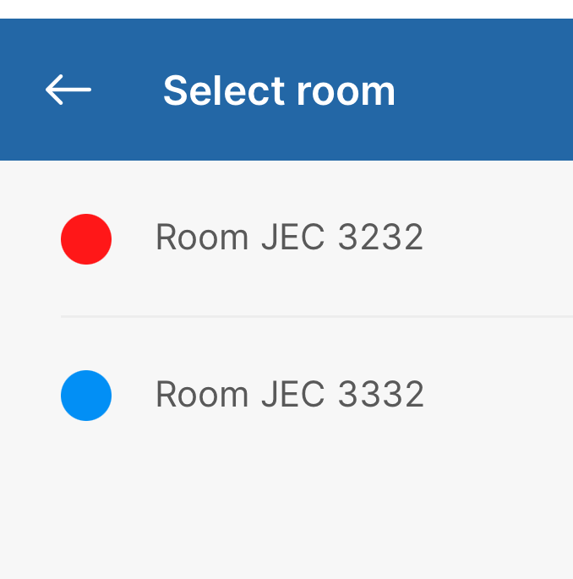
Your Capstone Expectations - Slido
Share your expectations for this Capstone course by answering some questions.
Join Slido.com with Code #1350435
(or) using the QR Code below
Select the room you are in:
Notes:
Instructors: Select the correct room before presenting.
1.1 Expectations Slido

Slide 19
Work Expectations
Q: “What expectations will your boss and peers have of you at work (@Internships/co-op)?”
Let’s start doing this NOW in the Design Lab.
Notes:
This slide is animated. Shows only the question – PE should ask students and get some responses

Slide 20



Participation Expectations
Arrive to meetings on time.
Stay until meeting ends.
Be present in all meetings.
Listen, Engage, Participate.
Focus on the Project.
Minimize Distractions
(phone, other tasks)

Slide 21
Work Expectations
Your new position involves:
  4 Hours per week of on-site work
  5 Hours per week of off-site work
    Individual technical work & team meetings
  Consistent level of work throughout the semester
Document all progress and results
Read communication from Design Lab staff and teammates
  Emails
  Webex chat
  EDN posts
Please respond in a timely manner!

Slide 22
Work Expectations
  Be Accountable.
    To your teammates, to your Chief/Project Engineer, and to the project Client.
  Be Professional.
  Make your work VISIBLE.
    Post/share as you go. Please do not “hide” it from team until its perfect or completely finished.
    Use Electronic Design Notebook (EDN)
Notes:
This slide is animated. Shows only the question – PE should ask students and get some responses

Slide 23
Accountability Step #1
You all received the New Employee Packet via email:
Project Description - Will guide your work today
Instructions for electronic signatures in Adobe
Capstone Participation Agreement - SIGN & return by end of day
MANDATORY for all employees to SIGN & return by end of day
More information on Capstone Participation Agreement
EDN -> Capstone Support -> Course Guidelines and Policies -> Confidentiality Requirements

Slide 24
Design Lab Communications & Documentation Policies (1/2)
Written capstone communications are permitted using ONLY Design Lab tools:
  The Engineering Design Notebook (EDN)
    Native EDN posts
    MS Office files, CAD, etc.
    Repository via Subversion
  Webex
  RPI OneDrive – only for development of group deliverables
Use of any other cloud-based service, such as
Google Drive/Docs/Sheets/Slides/Colab, Jupyter Notebooks in the Cloud, GroupMe, Discord, Slack, Github, Draw.io (cloud), etc. is FORBIDDEN
Although supported by campus, RPI Box is also FORBIDDEN
Scheduling services such as WhenIsGood & When2Meet are acceptable for setting up meetings but must not contain any technical information
This Helps Protect Against Unauthorized Access And
Provides Equal Access To All Team Members

Slide 25

Design Lab Communications & Documentation Policies (2/2)
Generative AI
  Properly acknowledge and cite the use of generative AI tools.
  You are ultimately responsible for the content you submit.
  Do not input any sensitive or confidential information into AI tools.
Helpful Resource
https://info.rpi.edu/comm-d

Slide 26
Documentation Tools
Use a laptop or tablet for:
Note taking
CAD
Webex
Use paper & pencil for:
Sketching
Quick math & calculations
Use your phones for:
Taking photos of whiteboards, test setups
Webex
Software Tools:
Draw.io(desktop version) – for flowchart
Siemens NX – for CAD
KiCAD – for Circuit schematic
Pro Tips
Capstone is a Communications Intensive Course

Slide 27
25 mins - Ice Breaker
Desired Outcomes
  Prepare everyone for collaborative engineering team performance by helping create a relaxed environment where everyone can share ideas and participate more fully
  Build rapport among the engineering team members

Slide 28
Ice Breaker - The Process…
Answer the prompt for the first question using Slido – 1 minute
Pair off (Teams with an odd number of team members will have one group of three) and share your response(s) with your partner & discuss – 2 minutes
Go around the table and each person introduces their partner to the team – name & skill – 5 minutes total
Reveal the full word cloud & discuss as class – 2 minutes
Repeat steps 1-4 for second question
Answer third question using Slido – 1 minute
Reveal word cloud and discuss – 2 minutes

Slide 29
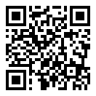
Ice Breaker
JEC 3232 side
Skillz Ice Breaker - Slido
Join Slido.com with Code #5292937
(or) using the QR Code below
Select the room you are in:
Notes:
Instructors: Select the correct room before presenting.
1.2 Skillz Ice Breaker Slido

Slide 30
Capstone Course - Overview
Work in teams on a one-semester project related to the design of a complex engineering system.
Each student will be responsible for identifying and accomplishing specific work within the project.
Apply the Design Process (taught in IED) to scope the project and design, build, test, and deliver your proposed design solutions
Assessed on your contribution to the project on technical work, communication skills, project management documentation, and teamwork.
Deliverables | Level of Assessment | % of Final Grade (Team) | % of Final Grade (Individual)
Benchmarking Memo | Individual |  | 5
Technical Progress #1 | Individual |  | 5
Concept Generation PPT | Team | 5
Client Meeting #2 | Team | 5
Technical Progress and Project Mgmt. #2 | Individual |  | 5
System Design Report | Team | 10
Appendix Detailed Individual Design | Individual |  | 5
Preliminary Peer Evaluation | Bonus |  | 1
Client Meeting #3 | Team | 5
Engineering Definition | Team | 5
Technical Progress and Project Mgmt. #3 | Individual |  | 5
Individual Technical Demo | Individual |  | 5
Final Poster | Team | 5
Final Design Report | Team | 15
Appendix - Individual Ethical and Professional Consideration | Individual |  | 2
Technical Progress and Project Mgmt. #4 | Individual |  | 5
Final Design Review Presentation | Team | 10
 | Individual |  | 3
Final Peer Evaluation | Bonus |  | 1
 | Total | 60 | 42
Check syllabus posted on Capstone Support Wiki for latest grading details

Slide 31

Key Elements
Technical Work
Client Meetings
Project Reviews
Design Documentation

Slide 32
40 min – Staff Introductions & Project Launch
Chief Engineer (CE) & Project Engineer (PE) Introductions
  Both individuals will stop by to meet with the team.
Project Description Review
  If you have not read the document yet, NOW is your chance. You need that information to do the next step effectively!
Discuss project as a team
  Begin documenting Questions you have about the project. Share the compiled list of questions in the Webex.

Slide 33
15 min - Meet with Project Engineer
  Project Engineer meets with each team:
    Explain the PE Role
    Check on team status / welfare
    Team member introductions
    Discuss project impressions
    PE’s background/experience
    When not meeting with your PE or CE, team members should discuss project and generate questions.

Slide 34
10 min - Meet with Chief Engineer
  Chief Engineer meets with each team:
    Explain the CE role
    Check on team status / welfare
    Team member introductions
    Discuss project impressions
    CE’s background/experience
    When not meeting with your PE or CE, team members should discuss project and generate questions.

Slide 35
15 min – Wrap Up
Team Standards Agreement Intro
According to concepts in organizational behavior, there are five stages of team development (Tuckman’s Model, 1964): forming, storming, norming, performing and adjourning.
In high performing teams a Team Standards Agreement is often generated to establish procedures and roles to move the team more quickly into the performing stage.
A Team Standards Agreement will be generated off-site by each team before Day 6.
  The Team Standards Agreement shall be posted to your team’s EDN Wiki page in accordance with the instructions on Wiki.
  EDN -> Capstone Support -> Wiki-> Task and Due Dates -> Team Standards Agreement
Completed Team Standard Agreement should be posted to Wiki before Day 6

Slide 36
Wrap Up – Team-Building Retreat
During the second week, there will be an off-site, peer-led, Team-Building Retreat.
Retreat Goals:
  Build positive foundations of teamwork and communication.
  Foster motivation and accountability within teams.
  Enhance leadership, working together, and getting to know each other.
  Understand the importance of eye contact and active listening.

Slide 37
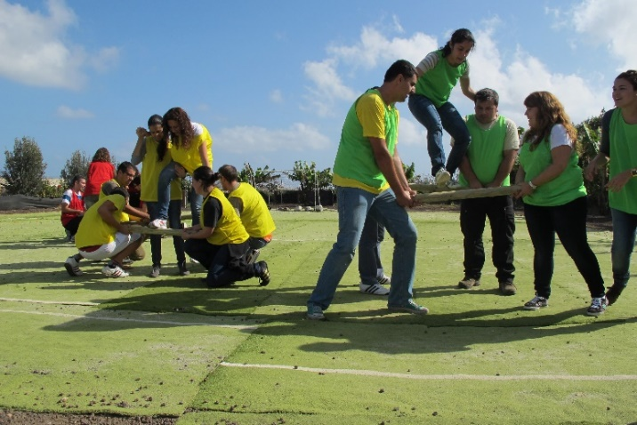
Team-Building Retreat
Location - Design Lab, JEC 3232
Schedule - Three options
  Tuesday 1/20 6:00 – 8pm
  Wednesday 1/21 6:00 – 8pm
  Thursday 1/22 6:00 – 8pm
Attendance is expected (and incentivized with a little treat)
  Goal is to have entire or majority of team at one session
  If entire team can’t make same session, individuals will work with other teams during the event
Notes:
Pic: http://www.entrepreneur-resources.net/theres-no-i-in-team-let-your-company-identity-grow-naturally

Slide 38
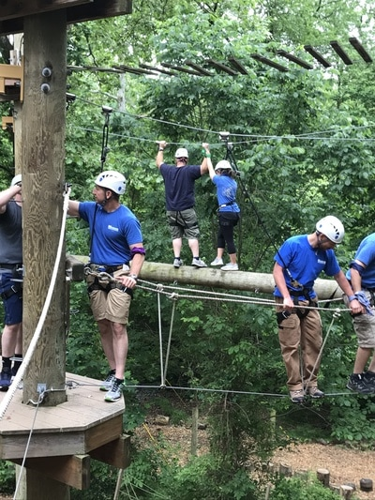
Team-Building Retreat
Action Required!
  Determine which session works best for team
  Each individual must register by Close of Business (COB) on Friday, 1/16/26
  Capstone S26 Team Building Sign Ups – Google Sheets
Notes:
Pic: http://www.msimarinesolutions.com/uploads/3/2/3/0/32309061/img-2216.jpg

Slide 39
Wrap Up – Safety Training Intro
Same material used for IED and other RPI courses & labs
Certification ONLY good for one year, must be valid through END of this semester
Available on Percipio -> under your required training
Complete by Class 6
Rensselaer Manufacturing and Prototyping Laboratories-Safety Orientation https://rpi.percipio.com/
Notes:
No different from industry

Slide 40
Wrap-up
Each day of the on-site (class) meetings will end with a wrap-up and discussion of next steps.
Team Engineers (YOU) are expected to complete Action Items/Meeting Prep work between on-site meetings to be prepared and make efficient use of meeting time.
  Team may need meetings between classes to complete GROUP activities.
  #pro tip Do individual work alone. Prioritize limited time the entire team is available for group discussions.
Notes:
No different from industry

Slide 41
Wrap-up – Looking forwards
On Day 2, teams will
  Utilize and build on the work started today and continued off-site.
  Discuss and understand project better.
  Prepare for Client Meeting #1 with client to take place during Day 3 or 4 (project-dependent)
    Establishing a strong list of questions to have a productive Project Kickoff meeting.

Slide 42
Action Items / Meeting Prep
(previously called homework, to be completed BEFORE Meeting 2)
Tasks to be completed BEFORE Meeting 2 @
EDN -> Capstone Support -> Wiki->
Task and Due Dates -> Day 1 Agenda
Note – link is in the PE email you received before classes! And will be echoed in your team’s Webex for convenience!
Notes:
Open the link, show it’s contents, done! Do NOT read it to them!!!

Slide 43
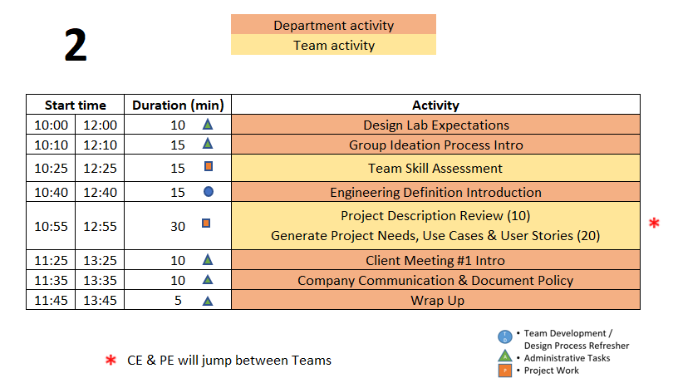
Day 2 Agenda

Slide 44
Accountability
Raise your hand if you have completed these Action Items:
Registered for EDN access
Watched the Capstone Introduction & Expectations video
Read the project description
Identify time and registered for Team Building Retreat
If you don’t complete the Action Items after each meeting
  What are the implications to your team’s progress on the project?
  To your grade in this course?

Slide 45

10 min – Design Lab Expectations
Action Item from Day 1
Watch video on Capstone Introduction & Expectations – Part 2
Knowledge Check – Through Kahoot
Instructions
Each team design a name for Kahoot login
One member in each team login to Kahoot using the given GAME PIN
For every question, the team discuss among themselves and give the correct answer
Teams get one minute to answer each question
There are 4 questions
Notes:
Show the Kahoot for the respective rooms:
For Room 3232 - Day 2 - Capstone Course Expectations 3232
For Room 3332 - Day 2 - Capstone Course Expectations 3332
Day 2
IED vs CD – Not re-learning IED material – building on what was learned
IED – Becoming an Engineer
CD – Be an Engineer
Owner – Students
Role of Students – Solve an open-ended complex problem by applying good engineering practices
Role of PE – Assist students by day to day operations
Role of CE - Evaluation

Slide 46
15 min – Group Ideation Process
Goal
Learn and Apply the Group Ideation Process to Document Team Skills
Process
Time boxed exercise:
It may feel rushed, things may not feel complete. THAT'S OK.
You'll want more time. You can't have it.
Team must move on – the team has deadlines to meet!
For EACH question:
2 min
  Individual silent thought on content
  Write thoughts on Post-It Notes - one thought per Post-It
2 min
  Place Post-Its onto whiteboard
  Quick discussion of similar, unique, or new answers
Move on to next section of Ideation as a team
Notes:
Tuckman’s stages of team development – learned in IED, practiced and built on in CD

Slide 47

Identifying Team Skills
What classes can you personally call on to help with this project? (2 min + 2 min)
What experiences can you personally call on to help with this project? (2 min + 2 min)
What skills are the team missing BUT are probably needed for project? (2 min + 2 min)

Slide 48
15 min - Team Skill Assessment
Shared by 2+ Team Members
Unique Skills
________________
________________
_______________
_______________
Skill Gaps
_______________
_______________
Word Template on Day 2 Agenda Wiki
Post the MS Word document to EDN Project Management forum thread by end of today’s meeting!

Slide 49
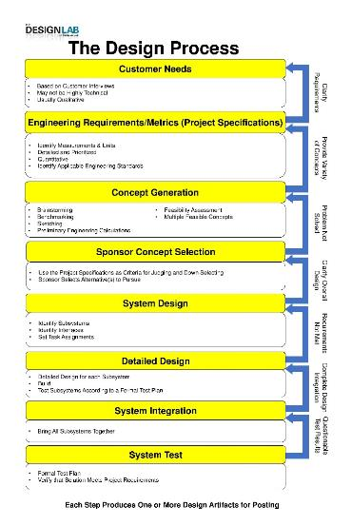
Engineering Design Process Progression
Days 1-5
You are here!
Days 3-5
Day 5+6
Day 7
Days 8-10 – Project Planning
This Design Process and terminology were learned previously in IED

Slide 50
Engineering Design Process Progression
Work here creates the Engineering Definition of the Client’s Problem

Slide 51
15 min – Design Process Step 1
Seek to Understand the Problem the Client Has
Three Primary Tools to capture the Engineering Definition of the Problem (covered in IED)
  Needs and Requirements
  Use Cases
  User Stories
Team may use any or all of these tools to fully describe the problem.

Slide 52
Customer Needs & Engineering Requirements Introduction
Needs and Requirements workbook.xlsx spreadsheet is located at:
  [new project] Capstone Support Template Documents page
  [continuing project] Team’s Repository, Engineering Analysis folder
Fill out based on team’s current (uninformed first impressions) of project
  This is first pass. Don’t worry that answers are not complete or verified by Client. You’ll be updating this often!

Slide 53
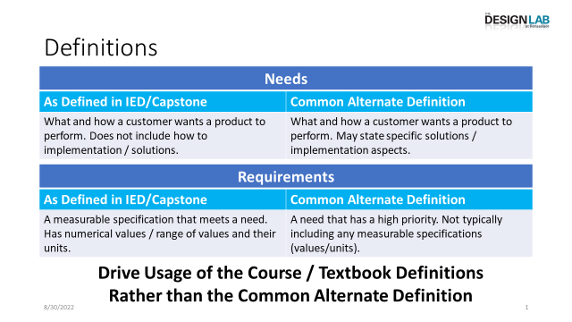
Developing Needs & Requirements
We Use These Definitions for
IED & the Design Lab
Note – Key IED Course Materials in Capstone Support wiki.

Slide 54
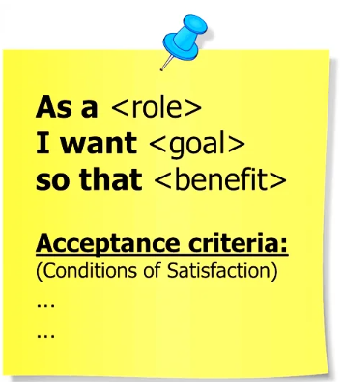
User Story
A user story is a short description of what a customer does with your product/application, written from their perspective and in their own language, focusing on the value or outcome they get.
Format: As a <type of user>, I want <a goal> so that <reason>.
Example 1: E-commerce Platform
As a shopper,
I want to filter products by price range
so that I can quickly find items within my budget.
Example 2: Real-time Data Monitoring
As a engineer,
I want to view real-time data from the sensors on a dashboard
so that I can monitor and react quickly to issues.

Slide 55
Use Case
A use case outlines interactions between a system and its actors (people or other systems). They are documented and usually include key information about these interactions.
Title: Name of the use case
Primary User: Who is using the system
Goal: What the primary user wants to achieve
Preconditions: What must be true before the use case starts
Main Success Scenario (Flow): Step-by-step of what happens
Extensions / Alternate flows: What happens if something goes wrong
Format:

Slide 56
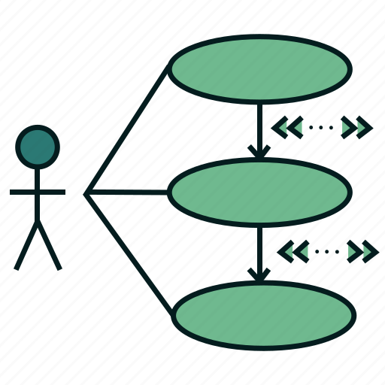
Use Case Example
Example 1: Monitor Real-time Production Data
Primary User: Process Engineer
Goal: To view real-time metrics of each manufacturing stage
Preconditions: Software can acquire data from the sensors / data sources.
Main Success Scenario:
  Engineer logs into the system
  System fetches current data from the sensors / data sources
  Engineer sees a dashboard of live performance metrics and graphs
  Data is updated every 10 seconds
Extensions: If a data source is offline, system shows a warning.
More examples in EDN @ https://designlab.eng.rpi.edu/edn/projects/capstone-support-dev/wiki/User_Stories_and_Use_Cases

Slide 57
The Upcoming Exercise Will Help the team Generate the Engineering Definition of the Client’s problem!

Slide 58
10 min – Review Project Description
    Re-Read Project Description.
    PE & CE are available to answer any fundamental project questions the Team may have.
      - Write these questions on the Whiteboard.

Slide 59
20 min – Generating Engineering Definition of the Problem: Needs & Requirements,
User Stories and Use Cases
Read notes in template documents for tips
Remove/combine duplicate thoughts
Add Requirements based on the Needs
  Unsure of a proper metric? Use a quick Google search to put in an educated guess.
Iterate between User Stories and Use Cases. Cases may identify new Stories and vice versa!
Fill in holes/gaps after looking at categories
  Safety, Reliability, Maintainability, etc…
Edit on OneDrive, When Done –
Post to EDN Design Forum thread

Slide 60
Generating Needs
The Engineering Team will Play “Spin for Needs” using the link on Day 2 Agenda
EDN Capstone Support wiki -> Capstone Daily Agendas -> Day 2 Agenda
Start with the Needs you Previously Captured as part of your Meeting Prep!
Spin the Wheel
Use the Topic
Write One Related Need on a Post-It
Repeat!

Slide 61
10 mins - Client Meeting 1
Project Kickoff
PPT Template & Instructions
  Link on Day 2 Agenda Wiki Page
  ONE person transfer file from Capstone Support EDN to team’s OneDrive for collaborative creation
Translate information from the Project Description to the first few slides in the deck
Add your questions from today
Complete these slides AND send to your PE
Every team member should plan to speak during every client meeting
Notes:
PE – alert each team what the due date is for slide submission

Slide 62
10 mins – Communication & Documentation Policies
Electronic Design Notebook - REQUIRED for all collaboration
RPI OneDrive – only for development of group deliverables
Webex – Team Chat
WhenIsGood or When2Meet – meeting scheduling
Not Permitted to avoid project data exposure
  Slack, GroupMe, or Discord
  Google Drive
  Google Docs/Sheets/Slides
  Google Colab
  Jupyter Notebooks in the cloud
  Github
  Other cloud-based tools for any use (schematics, mind maps, drawings, analysis, etc…) e.g., diagrams.net, etc.
  RPI Box, RPI Sharepoint
  Texting, Instagram, WhatsApp, etc. for ANY project technical content
Webex is good for chat and live meetings, but project documentation should start on and stay in the Electronic Design Notebook (EDN) Forum or Repository.
  Simple/easy solution is to never put it on Webex (or elsewhere) to begin with.

Slide 63
Electronic Design Notebook (EDN)
  Integrated Project Management
  Threaded Communication by topic, rather than a single unorganized stream
  IP protection
  Performance Evaluation - accountability and visibility
  Secure access to team and Client
  Backed up daily !
  The EDN software was chosen as it currently meets the Design Lab’s needs better than the alternatives*.
  * https://designlab.eng.rpi.edu/edn/projects/capstone-support-dev/wiki/Why_Electronic_Design_Notebook_is_the_ONLY_choice

Slide 64

What Should I Document?
Everything
  Research, web links, ALL NOTES *
  Interviews and observations
  Ideas, concepts, sketches, charts, diagrams
  Calculations
  Purchases - components models, vendors, cost
  Analyses – technical and non-technical
  Experiments, debugging, tests
  Hypothesis, procedures, equipment used, steps taken, data, results
  Future work/ideas
  Feedback on your teammates’ work
Thou shalt document ALL
thy work
* On-site / off-site – ALL meeting discussion/decisions & individual work
Although everyone should take notes, there should be a designated note taker for each meeting.

Slide 65


Participation + Documentation Expectation
At least 4 technical posts per week per team member to EDN Forums
Technical post | Non technical (but necessary) post
FBD of expected forces on structure | Meeting notes
Concept sketch
Question to add to user survey | Changing status of EDN Issues on Gantt chart
Explanation of changes to code or CAD | Spell checking the client meeting PPT slides
Data collected during testing/experimentation | Scheduling time to do testing
Technical reply to a teammate’s post on any of above | Voting yes/no on suggested approach
Goal is collaborative work amongst all team members to ensure steady project progress

Slide 66
Participation + Documentation Encouragement
Every Monday morning, a report will be generated of EDN usage. PE and CE will review to identify low performing team members.
If you are unsure what to post, we invite you to ask a teammate, your PE or CE.
Please DO NOT GAME the system.
Please DO USE the system.
Capstone is a Communications Intensive Course
Notes:
Bring up EDN and show ‘Activity tab’ for a team to show how easy it is to check/view posts

Slide 67
What Makes a Good Forum Post?
Good forum posts typically meet a few criteria:
  They contain technical information related to your project.
  They are specific.
  They are timely, i.e., the posts were created as or immediately after the work that they pertain to was done.
Helpful Hints:
  Good forum posts do not need to be lengthy!
  Replies to posts within a thread count as technical posts (so long as they meet the criteria for good posts)!
PE will now show a few examples of good posts
Notes:
Examples: CFD Info - Bogus - The Design Lab at Rensselaer - Electronic Design Notebook,

Slide 68
5 min - Wrap-up
Employee Onboarding
Engineering Design Process
As we move from On-site Meeting Day 2 to Day 3, we will transition from Onboarding to following the Engineering Design Process and accelerating work on the project
  Off-site teambuilding activity (Onboarding) still to come
  Generating the Engineering Definition has already begun

Slide 69
Day 3 & 4 Activities
Over the next 2 on-site meetings, all teams will complete:
  Client Meeting #1 – Kickoff Meeting
  CE meeting with team
  Engineering Definition- development and review
  Review previous Final Presentation - ongoing projects only
  Benchmarking
Needs & Requirements, Use Cases, and User Stories:
  Are not easy and require practice to do well!
  Guide your project throughout the semester

Slide 70
Action Items / Meeting Prep
(previously called homework, to be completed BEFORE Meeting 3)
Tasks to be completed BEFORE Meeting 3 @
EDN -> Capstone Support -> Wiki->
Task and Due Dates -> Day 2 Agenda
Note – link is in the PE email you received before classes! And will be echoed in your team’s Webex for convenience!
Notes:
Open the link, show it’s contents, done! Do NOT read it to them!!!

Slide 71
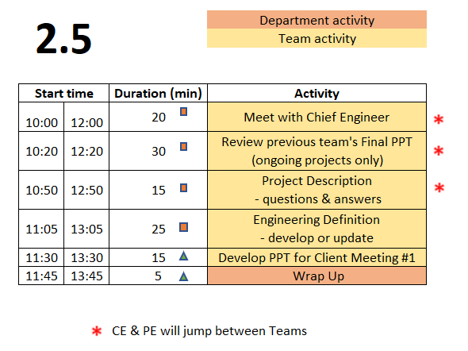
Day 2.5 Agenda
TD
Team Development /
Design Process Refresher
Administrative Tasks
Project Work
A
P
This day ONLY applies for sections 1 & 2

Slide 72

20 min – Meet with CE
(Day 2.5)
Chief Engineer led discussion of:
  Performance Evaluations – aka Course grading
  Team member expectations
    Group discussions
    Project Documentation on EDN
    Action Items
  CE background and experience
  Project impressions
  Team Standards Agreement
  Things that are good topics for posts
Notes:
Cover these slides in front of class VERY BRIEFLY. They are a reference for the 4 activities which will be done this meeting and next meeting (Day 3 & 4). Students will/can/should open the Playbook and read when they are going through the activities.

Slide 73
30 min – Review Prior Presentation
(if applicable)
Team should review (outside of on-site meeting) the final PPT presentation given by previous engineering team
  Forums->Final Deliverables
  Repository->Reports->Final Reports
PE & CE will quickly walk-through slide deck and discuss:
  Goals
  Accomplishments / Successes
  Challenges
  Next steps
PE & CE will help to clear up confusion and answer any questions current engineering team may have

Slide 74
25 min – Update Engineering Definition
Read notes in template documents for tips
Remove/combine duplicates
Unsure of a proper metric?
  Quick Google search to put in an educated guess
Fill in holes/gaps after looking at categories
  https://designlab.eng.rpi.edu/edn/projects/capstone-support-dev/wiki/Requirements_Management
  Capstone Support Wiki -> Knowledge Base -> Requirements Management

Slide 75
15 min – Project Description Q&A
Generate list of questions based on Project Description
Discuss list with PE & CE when available
(this class or next)

Slide 76
15 min – Develop PPT for Client Meeting #1
Prepare Client Meeting #1 PPT slides using the given template and instructions.
  PPT Template - Templates_and_Forms
  Instructions - Client Meeting 1
Create a thread in the EDN Project Management forum called Client Meeting 1.
When your slides are ready for review, post the slides to that thread. You'll also use the thread for your meeting minutes.
Send a link to that forum thread to your PE so that they can review your slides.

Slide 77
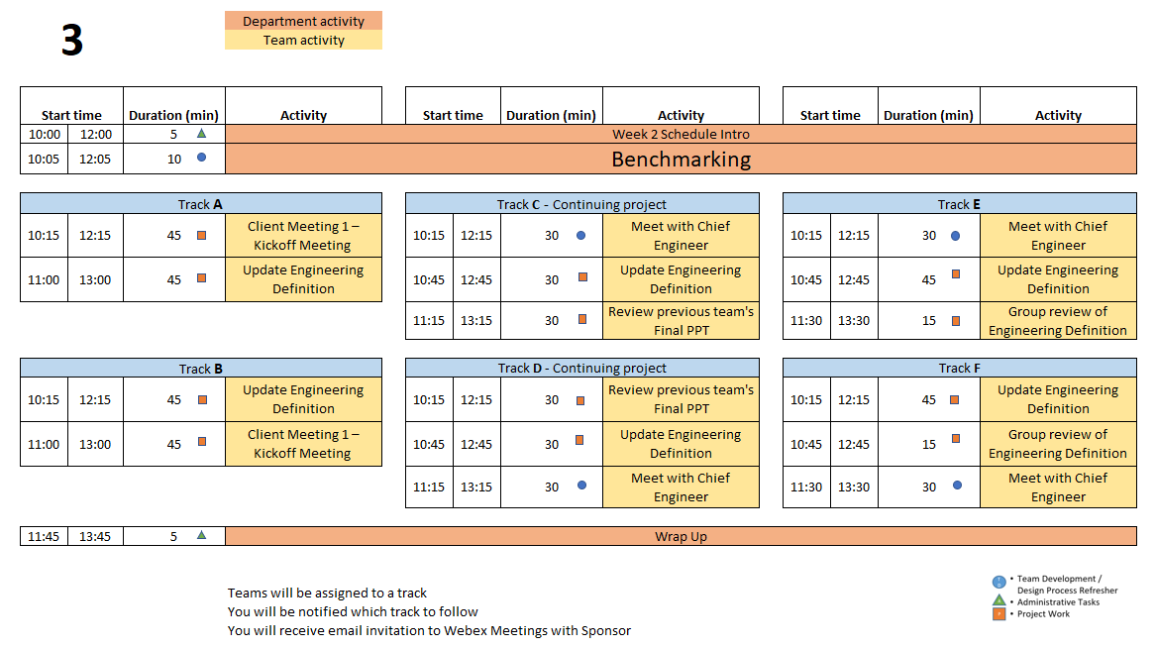
Day 3 Agenda
Notes:
PE Notes
Continuing projects should follow Track C or D
New projects can follow A, B, E or F
Track A or C on Day 3 should follow track A or C on Day 4
Track B, D, or E on Day 3 should follow track B or D on Day 4

Slide 78
Accountability
Raise your hand if you have completed these Action Items:
Watch Customer Needs video (9 min)
Watch Engineering Requirements video (11 min)
Choose team liaison
Read Meeting Minutes Wiki page
Install Subversion client & checkout project’s working folder
If you don’t complete the Action Items after each meeting
  What are the implications to your team’s progress on the project?
  To your grade in this course?

Slide 79
Late Policy
Deliverables
  Due by 11:59pm on date listed on Task and Due Dates
  10% deduction per business day
  50% deduction after 5 business days
Out of class tasks
  Due BEFORE the next class to help advance team collaboration
  Assessed within Technical Progress and Project Management reviews with CE
EDN -> Capstone Support -> Wiki-> Course
Guidelines and Policies -> Late Policy

Slide 80
Engineering Design Process Progression
Days 1-5
You are here!
Days 3-5
Day 5+6
Day 7
Days 8-10 – Project Planning
This Design Process and terminology were learned previously in IED

Slide 81
30 min – Meet with CE
(Day 3 or 4)
Chief Engineer led discussion of:
  Performance Evaluations – aka Course grading
  Team member expectations
    Group discussions
    Project Documentation on EDN
    Action Items
  CE background and experience
  Project impressions
  Team Standards Agreement
  Things that are good topics for posts
Notes:
Cover these slides in front of class VERY BRIEFLY. They are a reference for the 4 activities which will be done this meeting and next meeting (Day 3 & 4). Students will/can/should open the Playbook and read when they are going through the activities.

Slide 82
45 min – Client Meeting #1
Kickoff Meeting
Meeting Agenda
  Team introductions to Client (name, major, relevant experience/skills)
  Client introduction to team
  Client describes project "in their words“
    History, ultimate and semester goals, deliverables, etc…
  Open Q&A
Document meeting minutes in
Project Management Forum on EDN

Slide 83
30 min – Review Prior Presentation
(if applicable)
Team should review (outside of on-site meeting) the final PPT presentation given by previous engineering team
  Forums->Final Deliverables
  Repository->Reports->Final Reports
PE and CE will quickly walk-through slide deck and discuss:
  Goals
  Accomplishments / Successes
  Challenges
  Next steps
PE and CE will help to clear up confusion and answer any questions current engineering team may have

Slide 84
10 min - Benchmarking
Purpose
  Learn about Competitive Products
    Functions
    Fabrication Methods
    Operation
    Key Technologies
    Maintenance
Avoid Re-inventing the Wheel!
Reference: IED Textbook:
Product Design and Development, Ulrich, Eppinger, and Yang- Product Specification
Notes:
Reference: Product Design and Development, Ulrich, Eppinger, and Yang

Slide 85
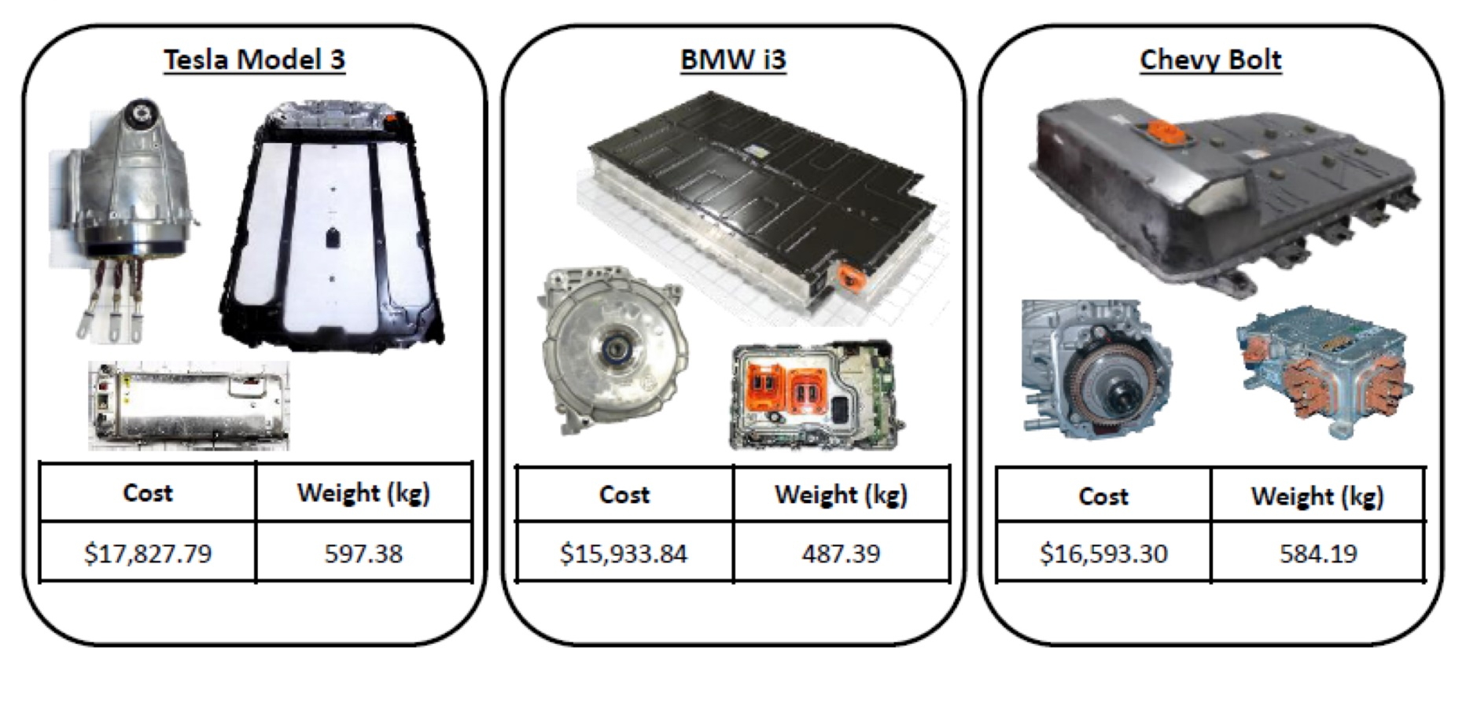
Benchmarking Examples
https://www.lightmetalage.com/news/industry-news/automotive/article-dismantling-and-analysis-of-vehicles-to-develop-optimal-applications/
Powertrain and Battery Pack Systems for the
Tesla Model 3, BMW i3, and Chevy Bolt

Slide 86
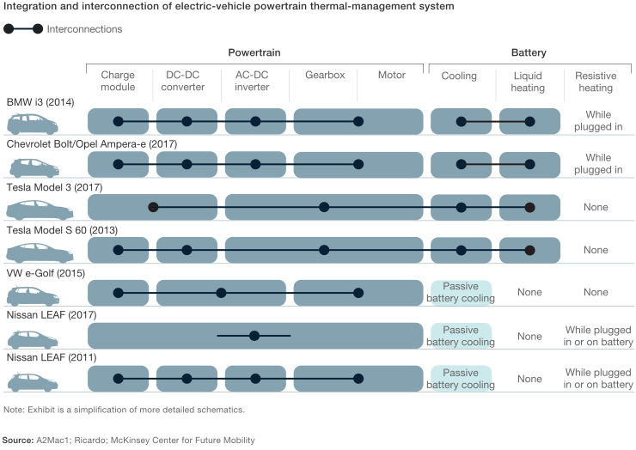
Benchmarking Examples
https://www.mckinsey.com/industries/automotive-and-assembly/our-insights/what-a-teardown-of-the-latest-electric-vehicles-reveals-about-the-future-of-mass-market-evs

Slide 87
Benchmarking - Evaluation
Using the Project’s Engineering Definition
Identify range of values across competitors
Prefer verifiable facts over opinions
Capture values / range of values / units
Assess and prioritize which items are important for your project / client
Post the information to the EDN!

Slide 88
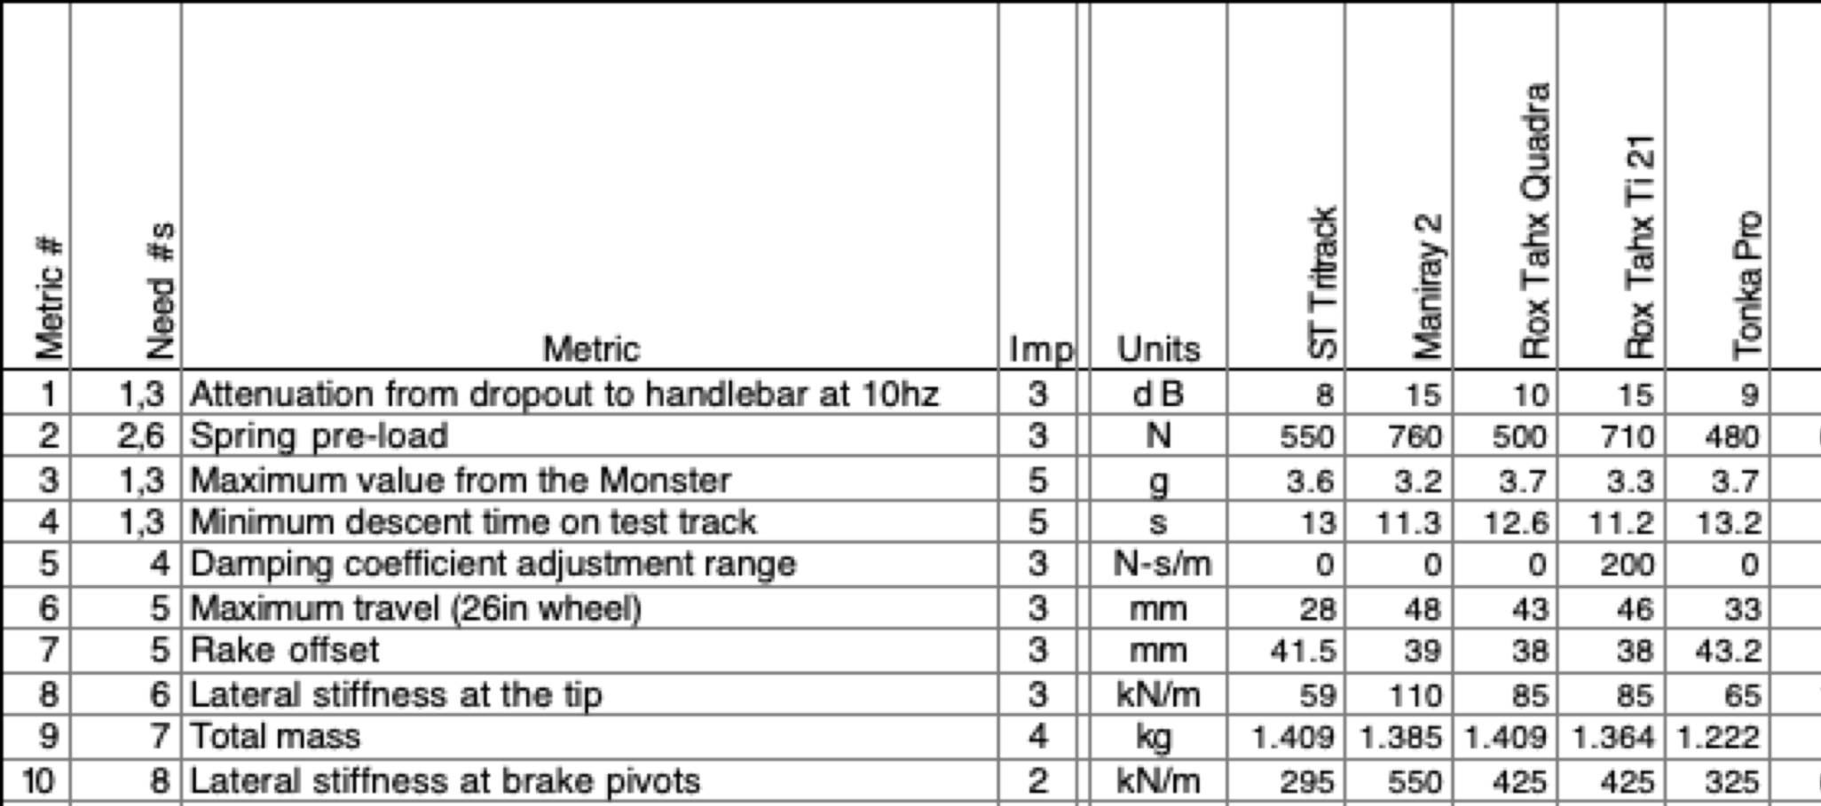
Benchmarking – Evaluation
Competitors
Note – these are Performance Metrics
NOT Requirements from Your Project
Data on suspension forks
Courtesy of Ulrich and Eppinger Teaching Resource Website for
Product Design and Development

Slide 89
Benchmarking Memo
Individual Assignment
Post to Repository working/Background Info folder by 11:59pm of Due Date
Instructions and rubric on Wiki
EDN -> Capstone Support -> Wiki-> Task and Due Dates

Slide 90
45 min – Update Engineering Definition
Read notes in template documents for tips
Remove/combine duplicates
Unsure of a proper metric?
  Quick Google search to put in an educated guess
Fill in holes/gaps after looking at categories
  https://designlab.eng.rpi.edu/edn/projects/capstone-support-dev/wiki/Requirements_Management
  Capstone Support Wiki -> Knowledge Base -> Requirements Management

Slide 91
5 min – Wrap-up
Days 3 and 4 include:
  Teams’ initial Client Meeting
  Continuing to understand the Client’s problem
  Begin developing the Engineering Definition
  Review of prior team’s presentation (if applicable)
  Many things that should be turned into tech posts!
    If you are unsure what to post, we invite you to ask a teammate, your PE or CE
Needs & Requirements, Use Cases, and User Stories :
  Are not easy and require practice to do well!
  Guide your project throughout the semester

Slide 92
Action Items / Meeting Prep
(previously called homework, to be completed BEFORE Meeting 4)
Tasks to be completed BEFORE Meeting 4 @
EDN -> Capstone Support -> Wiki->
Task and Due Dates -> Day 3 Agenda
Note – link is in the PE email you received before classes! And will be echoed in your team’s Webex for convenience!
Notes:
Open the link, show it’s contents, done! Do NOT read it to them!!!

Slide 93
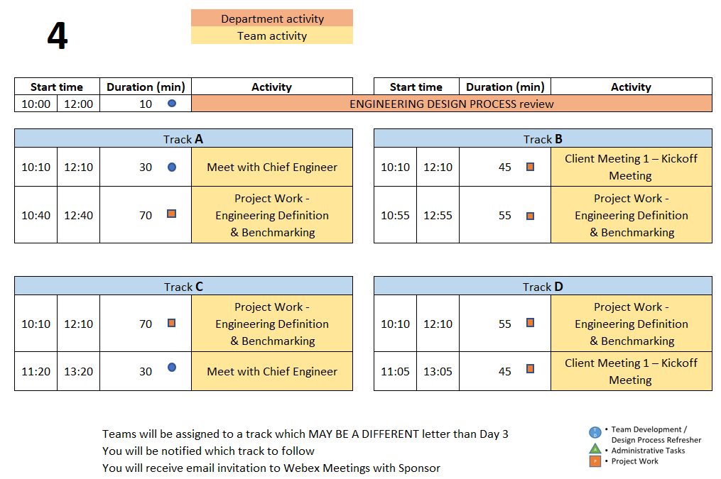
Day 4 Agenda
Notes:
PE Notes (Make clear for new vs. continuing on slide)
Track A or C on Day 3 should follow track A or C on Day 4
Track B, D, or E on Day 3 should follow track B or D on Day 4

Slide 94
Engineering Design Process Progression
Days 1-5
You are here!
Days 3-5
Day 5+6
Day 7
Days 8-10 – Project Planning
This Design Process and terminology were learned previously in IED

Slide 95
10 min – Engineering Definition Review
Action Item from Day 2
Customer Needs video and Engineering Requirements video
Knowledge Check – Through Kahoot
Instructions
Each team design a name for Kahoot login
One member in each team login to Kahoot using the given GAME PIN
For every question, the team discusses among themselves and give the correct answer
Teams get one minute to answer each question
There are 4 questions

Slide 96
Empathize with your Client
Become curious about people you don't know. Empathetic people are people who are curious about those around them. ...
Focus on similarities rather than differences. ...
Put yourself in someone's shoes. ...
Listen, but also share. ...
Connect with social action movements. ...
Get creative with it.
https://www.webmd.com/balance/features/how-to-be-more-empathetic

Slide 97
45 min – Client Meeting #1
Kickoff Meeting
Meeting Agenda
  Team introductions to Client (name, major, relevant experience/skills)
  Client introduction to team
  Client describes project "in their words“
    History, ultimate and semester goals, deliverables, etc…
  Open Q&A
Document meeting minutes to
Project Management Forum on EDN

Slide 98

55 min - Project Work
Refine Engineering Definition documentation
  Needs
    Ensure all currently known Customer Needs are documented. New ones will develop over time!
  Requirements:
    Associate with appropriate Customer Need(s)
    Identify Measurements and Units (quantitative)
    Ensure that Requirements are detailed, measurable and prioritized
    Identify Applicable Engineering Standards
  Use Cases
    As a _____ I need to _____ so that _____
  User Stories
  Determine the Acceptance Criteria / Minimum Viable Product
Continue To Generate Project Questions As You Go!

Slide 99
55 min - Project Work
Refine/Develop Follow-Up Questions for Client
  If Team has already had Kickoff Meeting, what new questions have been identified as a result?
    Clearly document, review with PE then email to Client, copy your PE & CE
Background Research/Benchmarking
  Discuss/document work done to date
  Identify/document additional benchmarking needs
Document Today’s Work with EDN Forum Posts

Slide 100
Project Work
Someone should take notes of meeting discussion
    NOT as Word document, simply as plain text in Forum post.
  Meeting Minutes instructions and template https://designlab.eng.rpi.edu/edn/projects/capstone-support-dev/wiki/Meeting_Minutes
Post your work as you go, during the meeting.
  If you are unsure what to post - we invite you to ask a teammate, your PE or CE
Post your meeting minutes AT END of the meeting to Forums –> Project Management
  Others can reply to post with any corrections or additional information
  Create separate thread for each meeting, e.g., “On-site 9/15”, to help organization and future searching

Slide 101
30 min – Meet with CE
(Day 3 or 4)
Chief Engineer led discussion of:
  Performance Evaluations – aka Course grading
  Team member expectations
    Group discussions
    Project Documentation on EDN
    Action Items
  CE background and experience
  Project impressions
  Team Standards Agreement
  Topics for technical posts

Slide 102
5 min – Wrap-up
Day 5 will focus on Concept Generation
  Now that teams have had time to identify the Needs & Requirements, Use Cases, and User Stories, it is time to identify potential concepts to address them.
  The Concept Generation activity during the Day 5 on-site meeting will utilize the ideation (Post-It Note) process that we have used previously.
Post your work as you go, during the meeting.
If you are unsure what to post, we invite you to ask a teammate, your PE or CE

Slide 103
Action Items / Meeting Prep
(previously called homework, to be completed BEFORE Meeting 5)
Tasks to be completed BEFORE Meeting 5 @
EDN -> Capstone Support -> Wiki->
Task and Due Dates -> Day 4 Agenda
PE will stop sending out this link.
It is YOUR responsibility to check the list and do the work.
Notes:
Open the link, show it’s contents, done! Do NOT read it to them!!!

Slide 104
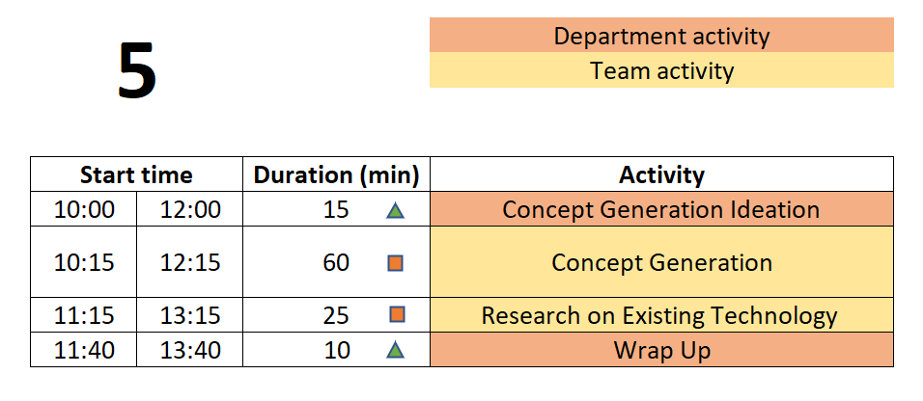
Day 5 Agenda
TD
Team Development /
Design Process Refresher
Administrative Tasks
Project Work
A
P

Slide 105
Engineering Design Process Progression
Days 1-5
You are here!
Days 3-5
Day 5+6
Day 7
Days 8-10 – Project Planning
This Design Process and terminology were learned previously in IED

Slide 106
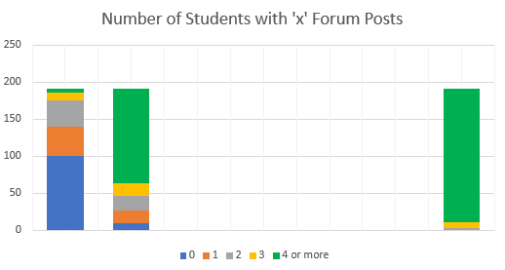
Documentation Participation
EDN Forum posts by Mon 9/15 @ 8am
9/8 9/15 TARGET
Goal is 100% of students at 4+ posts per week

Slide 107
We invite you to Ask for help
Capstone Design (and any new job / position) can be overwhelming at first.
  It is OK to be unsure or confused
  It is OK to ask for clarification or help
  It is not OK and not professional to do nothing and hope someone gives you exact specific instructions.
  Ask a teammate, your PE, or your CE for assistance and direction.
  Advocate for yourself.

Slide 108
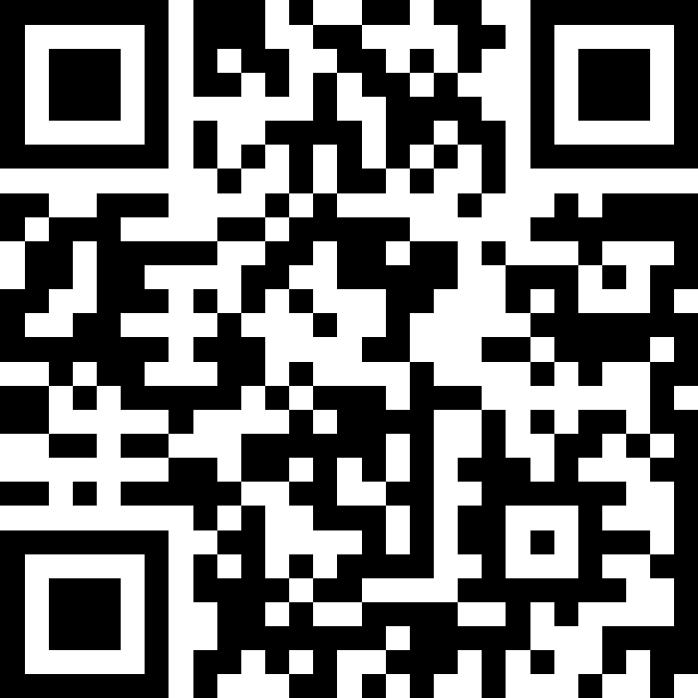
15 mins - Concept Generation
Join Slido.com with Code #3964230
(or) using the QR Code below

Slide 109

60 min - Concept Generation
Similar inclusive plan as previous exercises
5 min – Individually silently generate any concept to solve/address customer Needs & Requirements , Use Cases, & User Stories
  write separately on Post-It Notes
15 min – Place concepts on whiteboard
  Organize list by topic
  Eliminate duplicates
  Add extra ideas you think of right now or are inspired by other’s ideas
30 min – Group discussion
  Explain further to improve group understanding – if necessary
  Look for missing/unaddressed needs –think of concepts to address them
  Look for lone concepts – think of alternative ideas
Note - CE will jump in to talk for 15 mins of this time block

Slide 110
5 min – Create Forum Threads (EDN)
Concept topics ARE the key discussions and work areas for the team
Create Design Forum threads for each topic
  Use these thread to post explanation, sketches, calculations, etc…
  Reply to teammate’s posts to move idea forwards and advance project
  Includes links to material as appropriate but it is helpful to explain what can be found at the link

Slide 111
25 min – Research on Existing Technology
  Research existing technologies identified to solve similar problems
  Industrial, consumer applications
  Limits of technology/equipment
  Cost, availability, production volume
Document Your Findings in the Concept Threads
You Will Use Your Findings to Help Select Your Concepts

Slide 112
10 min - Wrap-up
Documentation
Which teams are working on ongoing projects?
  Have you reviewed the work (documentation) of prior teams?
  What did you find?
  What did you not find?
  Have you utilized the EDN’s search feature?
  Did the previous team utilize the wiki page?
  What were you able to find from the prior team’s Webex, Google Drive, OneDrive, text messages, etc.?

Slide 113
Wrap-up - Documentation
Which teams are working on new projects?
  You have a blank slate – Keep things organized!

Slide 114
Wrap-up - Documentation
Having thorough and well-organized documentation will greatly ease creation of deliverables and graded assignments such as the Needs and Requirements Spreadsheet, Use Cases, User Stories, System Design Report, Client Update slide decks, and your Final Report!
Capstone is a Communications Intensive Course!
There Will Be Lots of Writing and Speaking!

Slide 115
Action Items / Meeting Prep
(previously called homework, to be completed BEFORE Meeting 6)
Tasks to be completed BEFORE Meeting 6 @
EDN -> Capstone Support -> Wiki->
Task and Due Dates -> Day 5 Agenda
PE will stop sending out this link.
It is YOUR responsibility to check the list and do the work.
Notes:
Open the link, show it’s contents, done! Do NOT read it to them!!!

Slide 116
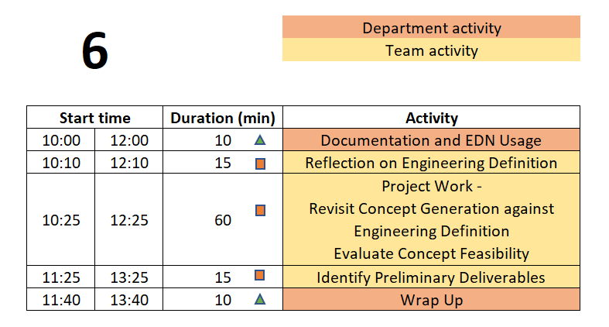
Day 6 Agenda
TD
Team Development /
Design Process Refresher
Administrative Tasks
Project Work
A
P

Slide 117
Engineering Design Process Progression
Days 1-5
You are here!
Days 3-5
Day 5+6
Day 7
Days 8-10 – Project Planning
This Design Process and terminology were learned previously in IED

Slide 118
10 min – Project Documentation & EDN Usage
Action Item from Day 5
Read Project Documentation Wiki page
Knowledge Check – Through Kahoot
Instructions
Each team design a name for Kahoot login
One member in each team login to Kahoot using the given GAME PIN
For every question, the team discusses among themselves and give the correct answer
Teams get one minute to answer each question
There are 4 questions

Slide 119
What is Engineering Documentation?
Living record of your work so that:
  Evolution of your product/design is traceable
  Your work (experiment) is reproducible
    Sketches, ideas, discussions
    Test setup, results, failures & successes
  Your work can be understood by others and why you did it that way
  Feedback & help can be offered
  Easy to incorporate into client meeting presentations and design reports

Slide 120

Why Document?
Extension of your memory
  Who, What, When, Where, Why, How
  So that others can collaborate and continue the work
  Facilitates teamwork
  So that others can review/understand your work
Legal ramifications
  Contractual/legal defense
  Patent application
Efficiently and Effectively move the project forwards
Everyone (now and future) can understand the
Who, What, When, Where, Why, and How of the team’s work

Slide 121
Examples of Things to Document
Updates to your Needs & Requirements, Use Cases, User Stories
Clarifications to the project’s goals
Ideas on possible solutions
Technical feedback on a teammate’s post(s)
Review and technical of files placed in the repo
  Comments from a code review
  Comments from a CAD review
Questions to ask your client
Things you tried that worked
Things you tried that did not work – and why you think that happened
Explanation of calculations

Slide 122
Corporate Communication & Documentation Policies Reminder
Electronic Design Notebook - REQUIRED for all project work & effort
RPI OneDrive – only for development of group deliverables
Webex (only) - Team Chat
WhenIsGood or When2Meet - meeting scheduling
Not Permitted
  Slack, GroupMe, or Discord
  Google Drive
  Google Docs/Sheets/Slides
  Google Colab
  Jupyter Notebooks in the Cloud
  Other cloud-based tools for any use (schematics, mind maps, drawings, analysis, etc…) e.g., diagrams.net, etc.
  RPI Box, RPI Sharepoint
Webex Teams is good for chat and live meetings, but project documentation should start on and stay in the Electronic Design Notebook (EDN) Forum or Repository.
  Simple/easy solution is to never put it on Webex (or elsewhere) to begin with.

Slide 123
Documentation Participation
EDN Forum posts by Mon 9/15 @ 8am
9/8 9/15 TARGET
Goal is 100% of students at 4+ posts per week

Slide 124
15 min – Reflection on Engineering Definition
Based on the Concept Generation done during last on-site meeting, and thought/research done off-site
Update the Needs & Requirements list, Use Cases, and User Stories documents in the EDN Repository.

Slide 125
60 min – Project Work
Revisit Concept Generation
Are the key Customer Needs, Use Cases and User Stories addressed by at least 2 concepts?
  If not -> generate/research additional concepts
How could concepts be combined into a full system?
Concept Feasibility
Understand feasibility of concepts
  Research, calculate, estimate
  Document performance and metrics of the technology or idea used elsewhere or in other applications
  Can the concepts identified meet the Engineering Requirements?
Post Your Findings
What might work and why
What might fail and why
Clarifications for the Minimum Viable Product (MVP)
Calculations

Slide 126
15 min – Identify Preliminary Deliverables
Needs & Requirements, Use Cases, User Stories
Client Meeting #1 Objectives
Selected Concepts
Proposed Deliverables
Post your deliverables to the Project Management forum

Slide 127


10 min – Wrap-up
Day 7 will focus on Concept Selection
  Now that teams have identified concepts it is time to understand how they can fit together into a full solution for the client’s problem.
  Comparisons and decisions should be based on analysis, metrics, and performance rather than ‘gut feelings’ or personal preferences. Avoid comparison matrices with 1’s and 0’s or + and - values.
  Several Meaningful Concepts are Required to Perform Concept Selection!
Image from: https://m.media-amazon.com/images/I/41EB53DgtzL._AC_SL1100_.jpg

Slide 128
Action Items / Meeting Prep
(previously called homework, to be completed BEFORE Meeting 7)
Tasks to be completed BEFORE Meeting 7 @
EDN -> Capstone Support -> Wiki->
Task and Due Dates -> Day 6 Agenda
PE will stop sending out this link.
It is YOUR responsibility to check the list and do the work.
Notes:
Open the link, show it’s contents, done! Do NOT read it to them!!!

Slide 129
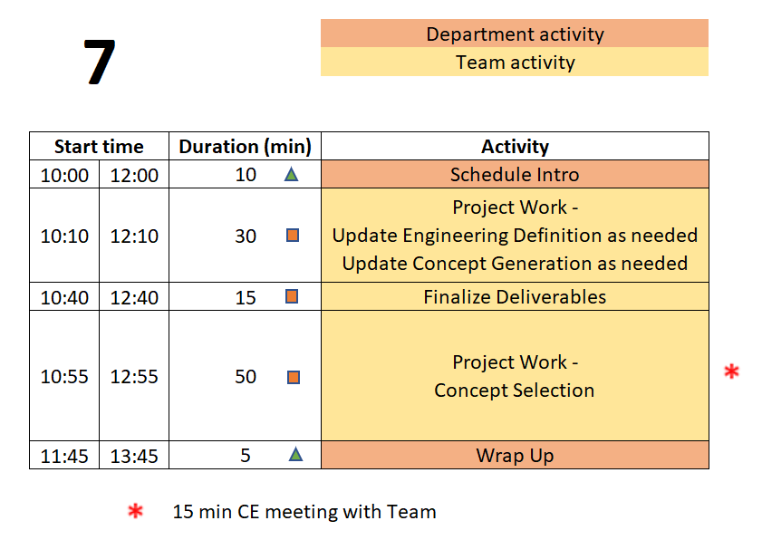
Day 7 Agenda
TD
Team Development /
Design Process Refresher
Administrative Tasks
Project Work
A
P

Slide 130
Safety Training was DUE by last class
Talk to PE if you are having difficulties and have not completed yet
Complete training TODAY

Slide 131
Engineering Design Process Progression
Days 1-5
You are here!
Days 3-5
Day 5+6
Day 7
Days 8-10 – Project Planning
This Design Process and terminology were learned previously in IED

Slide 132
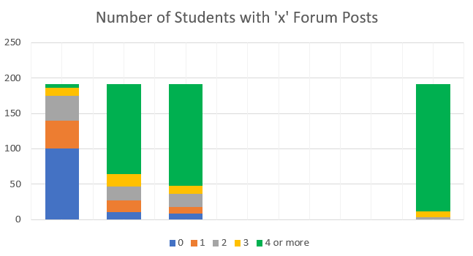
Documentation Participation
EDN Forum posts by Mon 9/15 @ 8am
9/8 9/15 TARGET
Goal is 100% of students at 4+ posts per week

Slide 133
30 Min - Update Previous Work
Review & Update
Needs & Requirements / Use Cases / User Stories
Concept Generation
Technical Posts of New Ideas / Information
Finalize This To Allow:
Selecting Concepts
To Define Deliverables
To Support Project Planning

Slide 134
15 min – CE Time
Meeting will be at team table
This will take place at some point during Concept Selection exercise depending on CE’s schedule

Slide 135
50 min – Concept Selection
Use engineering and research to justify a choice of concept(s) to pursue and develop further
Good reasons
  Decision matrix
  REAL numbers
    based on the project’s Engineering Definition
    values based on facts
Poor reasons
  gut feelings, instinct
  1’s/0’s or +’ / -’s pulled out of thin air
  ‘shiny’ marketing claims from sales website or YouTube video
Post your notes to EDN

Slide 136
15 min – Finalize Project Deliverables
Needs & Requirements, Use Cases, User Stories
Client Meeting #1 Objectives
Selected Concepts
Proposed Deliverables
Solid list of deliverables will jumpstart project planning exercise on Day 8

Slide 137
5 min – Wrap-up
During the Day 8 on-site meeting, teams will develop a project plan to guide their work for the remainder of the semester. To be prepared for this activity, team members must:
  Understand why Project Management is important.
  Understand the difference between Deliverables and Tasks/Activities.
  Come to the meeting with an initial list of tasks required to complete the project.

Slide 138
Action Items / Meeting Prep
(previously called homework, to be completed BEFORE Meeting 8)
Tasks to be completed BEFORE Meeting 8 @
EDN -> Capstone Support -> Wiki->
Task and Due Dates -> Day 7 Agenda
PE will stop sending out this link.
It is YOUR responsibility to check the list and do the work.
Notes:
Open the link, show it’s contents, done! Do NOT read it to them!!!

Slide 139
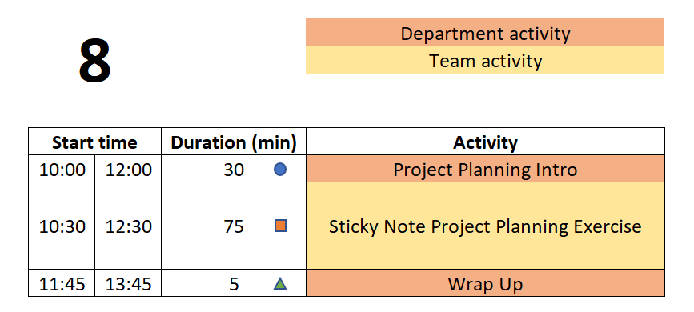
Day 8 Agenda
TD
Team Development /
Design Process Refresher
Administrative Tasks
Project Work
A
P

Slide 140
Engineering Design Process Progression
Days 1-5
You are here!
Days 3-5
Day 5+6
Day 7
Days 8-10 – Project Planning
This Design Process and terminology were learned previously in IED

Slide 141
Documentation Participation
EDN Forum posts by Mon 9/15 @ 8am
9/8 9/15 TARGET
Goal is 100% of students at 4+ posts per week

Slide 142
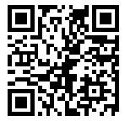
30 min - Project Planning Introduction
Knowledge Check: Understanding of project planning
Join Slido.com with Code # 2760 893
(or) using the QR Code below

Slide 143
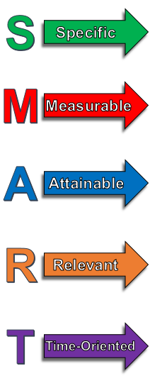
75 min - ‘Sticky Note’ Project Planning
One idea per Post-It. Be concise!
Defined to be No More than 1 week long.
Break big things into smaller pieces.
Everyone Needs at Least 1 Task per Week for the
Entire Semester.
What will YOU contribute to the project?
Focus on YOUR potential contributions to the project.
(We know these may not yet be defined!)
Focus on the technical work required.
For now, leave out project management / overhead tasks,
e.g., report writing, slide making, etc.
DO include documentation needed for technology transfer, e.g., user manual.
Be Technical! Be SMART!

Slide 144
Project Planning Tips
Yes, it gets harder to define tasks near the end of the semester. So instead, work backwards from the end!
There may be gaps in time – you will need to fill those in today
Do not just copy a task 3 times because it spans 3 weeks. Instead, you must break it down into 3 well defined smaller tasks.
Don’t allocate slack time at the end of the semester. Project plans do not include tasks called “Just in Case”. Instead estimate the length of tasks to factor in some risk. Not everything works the first time and many thing turn out to be more difficult than first thought.
Group things by functional subsystem rather than by name. This helps reveal possible planning gaps.
Remember your deliverables! Do you have the tasks needed to produce each of them, including things like demos?
Be Technical! Be SMART!

Slide 145
‘Sticky Note’ Project Planning – phase 1
10 min – Deliverables
Write each Deliverable from Client Meeting 2 Slides on a Post-It and
place on the board/calendar at approximate due date.
Draw a box around the note so that it stands out.
10 min – Tasks
(Individually silently) Each team member generate list of TEN tasks which must be completed to accomplish the deliverables.
Off-site Action Item was to post 6 individual tasks to EDN, so start with those.
Now create at least 4 more tasks.
Create 1 Post-It for each task.

Slide 146
‘Sticky Note’ Project Planning – phase 2
10 min – Organize tasks on Whiteboard
Position tasks appropriately along week-by-week calendar
  This can be done before or after getting all items shared
35 min – Group organization of tasks
Add missing tasks, remove duplicates
Organize by subsystem or milestone
Add your initials to Post-Its of tasks you will be responsible for
10 min – Re-assign ownership (by initial)
Ensure everyone has work throughout semester
Each Team Member Should Leave meeting with their assigned Post-It’s.
Each Team Member then Enters Their Own Tasks as EDN Issues!

Slide 147
5 min – Wrap-up
Activities of Day 9 & 10
PE/CE Feedback on the Project Plans created during and after Day 8
PE/CE Feedback on Engineering Definition
Client Meeting #2 Concept Generation and Selection Update
Developing System Design

Slide 148
Wrap-up
Day 9 & 10 also include 60+ mins for team-directed work.
Efficient team-directed meetings require an Agenda.
The Agenda should be SMART - Specific, Measurable, Attainable, Relevant, and Time-Oriented.
Agendas should be posted to your white board before starting the meeting.
    Pro Forma Agenda posted on Capstone Support:
    EDN -> Capstone Support -> Wiki-> Pro Forma Meeting Agenda

Slide 149
Action Items / Meeting Prep
(previously called homework, to be completed BEFORE Meeting 9)
Tasks to be completed BEFORE Meeting 9 @
EDN -> Capstone Support -> Wiki->
Task and Due Dates -> Day 8 Agenda
PE will stop sending out this link.
It is YOUR responsibility to check the list and do the work.
Notes:
Open the link, show it’s contents, done! Do NOT read it to them!!!

Slide 150
Day 9 Agenda
First 10 mins Risk Management
Duration | Activity
45 | Client Meeting #2
15 | PE Review of Project Plan
30 | Follow team created Class 9 agenda
10 | CE Reflection on Client Meeting #2
Balance of Time | Project Work – Update Milestones & Tasks as needed Update Engineering Definition as needed
*
May be Day 10 for some teams

Slide 151
Engineering Design Process Progression
Days 1-5
You are here!
Days 3-5
Day 5+6
Day 7
Days 8-10 – Project Planning
This Design Process and terminology were learned previously in IED

Slide 152
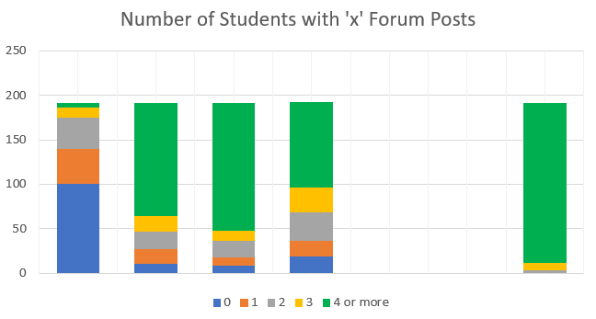
Documentation Participation
EDN Forum posts by Mon 9/15 @ 8am
9/8 9/15 9/22 9/29 TARGET
Goal is 100% of students at 4+ posts per week

Slide 153
30 min – Follow Team created Agenda
Designate team member to facilitate this meeting.
Designate team member to take and post minutes to EDN.
  This should be done for EVERY on-site and off-site meeting.
  Rotate responsibility. To be equitable, ALL team members should have a turn!
Each team member to take notes on their own work and post in and out of the meeting.
Notes:
Day 9

Slide 154
10 min – CE reflection on Client Meeting #2
Feedback on team’s Client meeting
  Project Overview
  Design Concepts
  Technical progress
  Project Status
  Communication
  Professionalism and preparedness in meeting
Notes:
Day 9

Slide 155
15 min – PE Review Project Plan
Many short individual tasks?
Are the tasks SMART? How can they be improved?
Adequate time for:
  Manufacturing?
  Purchasing?
  Testing?
  Iterative development? Second round of any tasks?
Equal division of labor across all team members?
Ability to do some work in parallel rather than series?
  Design test plan BEFORE fabrication is complete
  Create dummy data NOW to test software performance or analysis approach

Slide 156
Action Items / Meeting Prep
(previously called homework, to be completed BEFORE Meeting 10)
Tasks to be completed BEFORE Meeting 10 @
EDN -> Capstone Support -> Wiki ->
Task and Due Dates -> Day 9 Agenda
PE will stop sending out this link.
It is YOUR responsibility to check the list and do the work.
Notes:
Open the link, show it’s contents, done! Do NOT read it to them!!!

Slide 157
Day 10 Agenda
First 10 mins System Design Intro
Duration | Activity
45 | Client Meeting #2
15 | PE Review of Project Plan
20 | Follow team created Class 10 agenda
10 | CE Reflection on Client Meeting #2
20 | Develop System Design
Balance of Time | Project Work – Update Milestones & Tasks as needed Update Engineering Definition as needed
*
May be Day 9 for some teams
Last 10 mins Wrap Up

Slide 158
Engineering Design Process Progression
Days 1-5
You are here!
Days 3-5
Day 5+6
Day 7
Days 8-10 – Project Planning
This Design Process and terminology were learned previously in IED

Slide 159
15 Min - System Design Intro
Needs & Requirements, Use Cases, & User Stories are Established
Concept Generation Provided Broad Range of Alternative Solutions
Concept Selection Identified A Small Number of Concepts that
  Meet all the High Priority Needs OR
  Establish a Minimum Viable Product (MVP)
Subsystems For the Chosen Concept(s) Are Preliminarily Identified
But How Do These All Go Together!

Slide 160
Communication Of Your High-Level System Design
System Architecture Diagrams, aka Block Diagrams
Show Major Overall System Elements / Functions
Show Interfaces / Interconnections Between Elements
Where Appropriate, Show Data Flow Between Elements
Can Be Used to Show Before and After Situations
  Indicate What Is Removed, What is Added, What is Changed
Can Show Organization of Elements
Examples Found by Searching for “block diagram for ________”
Apply to All Fields of Engineering!

Slide 161
Sample System Architecture Diagram IOT
Server
PC
Laptop
Network
Wired or Wifi
Wifi only
Pi
Esp32
Sensor
Sensor
Arduino
Arduino
Arduino
Sensor
Sensor
Sensor
Sensor
Sensor
Sensor
IoT Generic System Architecture
From the Capstone Support Wiki - Internet of Things page

Slide 162
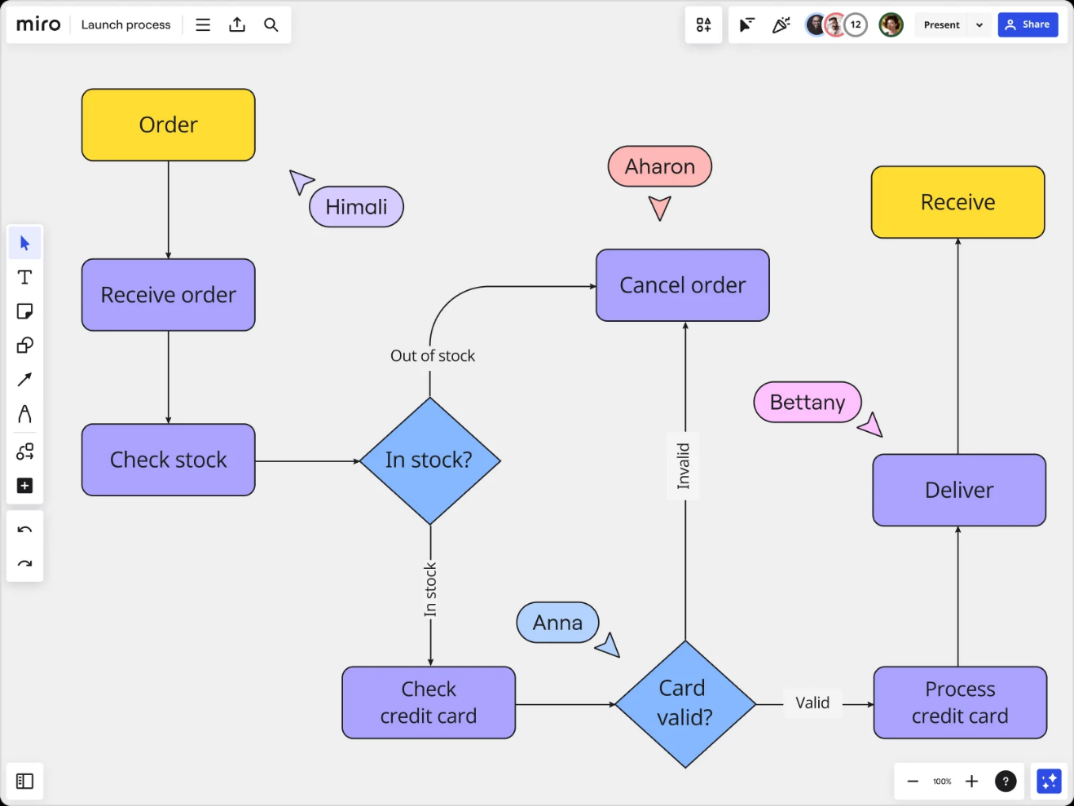
Sample System Architecture Diagram Process
https://miro.com/diagramming/what-is-a-block-diagram/

Slide 163
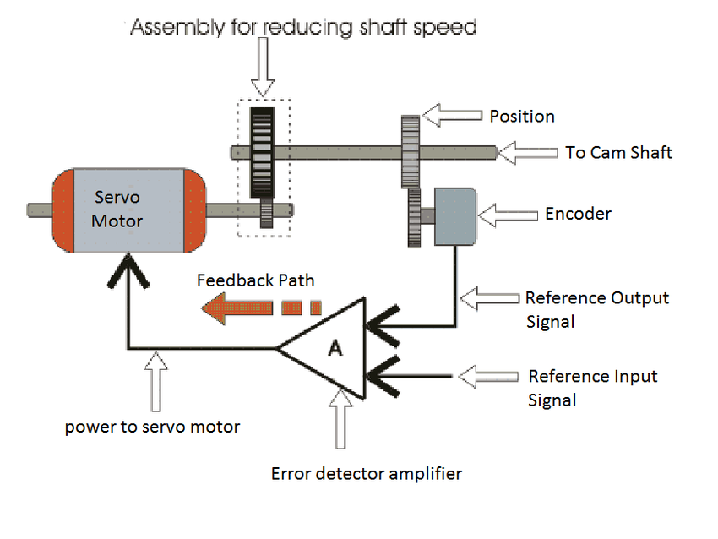
Sample System Architecture Diagram Mechanical
https://www.researchgate.net/figure/Mechanical-Block-Diagram_fig3_282866893

Slide 164
System Architecture Diagrams
Label All Items in the Diagram
Provide Explanation Of How It Addresses the Engineering Definition of Problem
Provide Brief Explanation Of Operation

Slide 165
20 min – Develop System Design
Create/complete overall system design
Create/complete System Architecture diagram
Identify subsystem definitions and their owners (assignees)
  One person per subsystem
  Subsystems can be used as Categories in the EDN Gantt chart
Notes:
Day 9

Slide 166
5 Min – Wrap-up
Design Lab created Agendas have ended!
Engineering team should now create Agenda for each on-site (and off-site) meeting
Primary purpose of the remaining on-site meetings is team review and assessment of work already completed, especially with your PE and CE.
These 4 hours per week of on-site meeting time may be the only available time for the FULL Engineering team to meet. It is therefore recommended to use this time for group discussions, group work, planning, updating Engineering Definition, making decisions, etc. AFTER all that is complete / up to date, use the on-site time for individual work.
Use EDN and Repository to document all work moving forwards

Slide 167
Capstone is a
Communications Intensive Course
This includes:
  Forum posts
  Documents placed in the repository
  Wiki pages created / revised
Just Document the Work You Do Each Week!

Slide 168
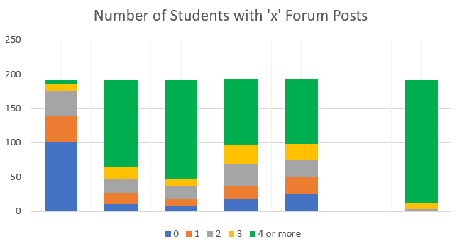
Documentation Participation – week 5
EDN Forum posts by Mon 10/6 @ 9am
9/8 9/15 9/22 9/29 10/6 TARGET
Goal is 100% of students at 4+ posts per week

Slide 169
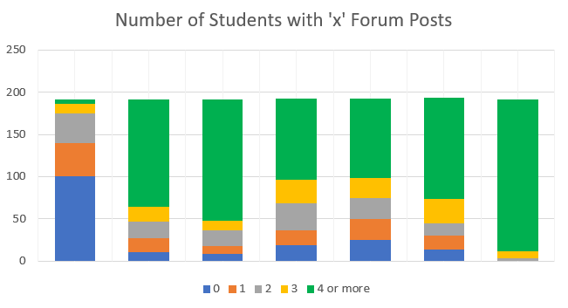
Documentation Participation – week 6
EDN Forum posts by Mon 10/6 @ 9am
9/8 9/15 9/22 9/29 10/6 10/13 TARGET
Goal is 100% of students at 4+ posts per week

Slide 170
All Employee Meetings

Slide 171
Upcoming Graded deliverables
2/21
System Design Report
Team assignment
10% of final grade
Detailed Individual Design Appendix
Individual assignment
5% of final grade
Submit both to Repo /working/Reports

Slide 172
System Design Report Intro
Contents of document:
Updated / improved project description information
Key Needs & Requirements
Concept generation/selection
System Design
Integration and Testing plan

Slide 173
Appendix - Detailed Individual Design
Subsystem or project portion YOU are responsible for
Related Needs & Requirements, Use Cases, User Stories (include # from lists in Repo)
Interfaces to other subsystems (refer to System Architecture)
Sketch/description of 1-2 leading concepts (list of forum thread links)
Perceived challenges/risks
YOUR next steps/plan
10-15 pages including images
This is an INDIVIDUAL assignment. The appendix should speak to what YOU personally will contribute to the design and project demonstration.

Slide 174
Engineering Design Process
POSTER introduction
This Design Process and terminology is taught in IED at RPI
Team is creating a poster to communicate
Overall project (Needs & Requirements)
Progress made (Concepts, System Architecture)
Future steps (Design, Integration, & Test Plan)
Notes:
Day 9

Slide 175
95 min – Poster Creation
Download and Open Poster.pptx from Repository
  https://designlab.eng.rpi.edu/edn/projects/capstone-support-dev/repository/112/entry/template%20documents/Poster.pptx
10 mins – Divide into 3 groups, and work on initial slides. Content can be pulled from Project Statement & Objectives.
  Purpose
  Past Work and/or Project History
  Semester Objectives/Engineering Definition
40 mins – As a full team discuss Technical Approach, Results and Accomplishments to Date
30 mins – Move on to Next Steps and Plan
15 mins – Begin assembly of content onto single slide (pg 8)

Slide 176
Revision History - continued
Version | Date | Name | Reason for Changes
8.0 | 1/7 | KN | Reordered Class 1 slides, updated slido numbers and software tools
8.1 | 1/7 | AP | Updated dates and links for Team Building Retreat
8.2 | 1/12 | AP | Hide slides for Day 2.5 Delete additional slides on Use Cases Removed “less than 4 posts/week = EWS” rule

Slide 177
Revision History - continued
Version | Date | Name | Reason for Changes

